Slide 1
Supplementary Data Table 1.
Clinical features of healthy control targeted in this study and remaining subjects in the normal healthy cohort
 | HC in this study | remaining HC | p value
Participants No. | 151 | 65
Age (years) | 65.5 (9.6) | 62.6 (10.3) | N.S.
Gender (M:F) | 87:64 | 35:31 | < 0.001
Education (years) | 13.1 (2.6) | 15.2 (1.8) | < 0.001
MMSE | 29.1 (1.0) | 29.2 (0.9) | N.S.
ACE-R total score | 95.1 (3.3) | 95.7 (3.9) | N.S.
ACE-R subscore
Orientation/attention | 17.8 (0.4) | 17.8 (0.4) | N.S.
Memory | 23.3 (2.4) | 24.0(2.2) | 0.016
Fluency | 13.3 (1.3) | 13.4 (1.1) | N.S.
Language | 25.0 (1.1) | 25.1 (1.2) | N.S.
Visuospatial abilities | 15.5 (0.7) | 15.4 (1.2) | N.S.
Data were shown as mean ± standard deviation (SD). Clinical backgrounds except gender and cognitive examinations were compared using Mann-Whitney test. Gender was compared by chi-square test. The statistical significance threshold was set at p < 0.05.
ALSFRS-R: Revised Amyotrophic Lateral Sclerosis Functional Rating Scale, MMSE: Mini-Mental State Examination, ACE-R: Addenbrooke’s Cognitive Examination-Revised, ALS: amyotrophic lateral sclerosis, HC: healthy control

Slide 2
Supplementary Data Table 2. Spearman's rank correlation coefficient of background factors
 |  | age at examination | age at onset | sex | education | duration | ALSFRS-R | disease type
age at examination | ρ | 1 | 0.981** | 0.097 | -0.171 | -0.08 | -0.19 | -0.209*
 | p value |  | < 0.001 | 0.271 | 0.05 | 0.37 | 0.07 | 0.018
age at onset | ρ | 0.981** | 1 | 0.115 | -0.188* | -0.216* | -0.181 | -0.196*
 | p value | < 0.001 |  | 0.191 | 0.031 | 0.015 | 0.084 | 0.027
sex | ρ | 0.097 | 0.115 | 1 | -0.167 | -0.01 | 0.027 | 0.115
 | p value | 0.271 | 0.191 |  | 0.056 | 0.913 | 0.801 | 0.196
education | ρ | -0.171 | -0.188* | -0.167 | 1 | 0.132 | -0.034 | -0.054
 | p value | 0.05 | 0.031 | 0.056 |  | 0.139 | 0.746 | 0.544
duration | ρ | -0.08 | -0.216* | -0.01 | 0.132 | 1 | -0.059 | 0.062
 | p value | 0.37 | 0.015 | 0.913 | 0.139 |  | 0.579 | 0.491
ALSFRS-R | ρ | -0.19 | -0.181 | 0.027 | -0.034 | -0.059 | 1 | -0.072
 | p value | 0.07 | 0.084 | 0.801 | 0.746 | 0.579 |  | 0.499
disease type | ρ | -0.209* | -0.196* | 0.115 | -0.054 | 0.062 | -0.072 | 1
 | p value | 0.018 | 0.027 | 0.196 | 0.544 | 0.491 | 0.499
Spearman's rank correlation coefficient was performed to reveal the correlation of the clinical backgrounds.
ρ: Spearman's rank correlation coefficient, *: p-value < 0.05, **: p-value < 0.001
Notes:
This slide showed Correlation coefficient of background factors using Spearman.
Spearman's rank correlation coefficient indicated the onset age and the age at examination have a very high correlation.
So we speculate age at onset is likely to be associated with decline of ACE-R scores in ALS.

Slide 3
Supplementary Data Table 3. Multiple regression analysis for the total ACE-R score
Multiple regression analysis including age at examination
Multiple regression analysis including age at onset
 | Standardized beta | t value | p value
Age at examination | -.429 | -4.517 | <0.001
Gender | .008 | .092 | 0.927
Education | .202 | 2.223 | 0.029
Disease duration | .004 | .049 | 0.961
ALSFRS-R | .283 | 3.106 | 0.003
Type | .068 | .734 | 0.465
 | Standardized beta | t value | p value
Age at onset | -.442 | -4.510 | <0.001
Gender | .008 | .089 | 0.929
Education | .201 | 2.219 | 0.029
Disease duration | -.071 | -.770 | 0.443
ALSFRS-R | .282 | 3.097 | 0.003
Type | .067 | .729 | 0.468
Multiple regression analysis was performed to assess the influence of demographic variables including gender, educational level, age, ALSFRS-R, duration, and disease type on total score of ACE-R. The statistical significance threshold was set at p < 0.05.
ALSFRS-R: Revised Amyotrophic Lateral Sclerosis Functional Rating Scale, ACE-R: Addenbrooke’s Cognitive Examination-Revised

Slide 4
Supplementary Data Table 4. Clinical Features among four groups
ALS | Youngest group | Younger middle group | Older middle group | Oldest group | p value
No. | 32 | 34 | 33 | 32 | -
Age at examination (y) | 50.9 | 62.8 | 68.7 | 76.8 | <0.001
Age at onset (y) | 48.8 | 60.8 | 66.7 | 75.5 | <0.001
Gender | 21:11 | 25:9 | 24:9 | 17:15 | N.S.
Education | 12.7 | 13.3† | 12.6 | 11.4 | 0.037
Disease duration (y) | 2.2 | 2.7 | 2.0 | 1.3 | N.S.
ALSFRS-R | 41.7 | 41.5 | 39.9 | 39.8 | N.S.
Phenotype (upper : lower : bulbar : others) | 14:14:3:0 | 15:12:5:1 | 16:8:6:2 | 10:6:16:0 | 0.002
ACE-R total score | 93.7 */‡ | 92.0‡ | 88.1 | 82.6 | <0.001
ACE-R sub-core
Orientation/attention | 17.8† | 17.7† | 17.3 | 16.8 | <0.001
Memory | 22.6‡ | 22.2‡ | 19.8 | 17.5 | <0.001
Fluency | 13.3*/‡ | 12.3 | 12.1 | 11.3 | <0.001
Language | 24.9‡ | 24.5† | 23.9 | 22.7 | <0.001
Visuospatial | 15.1 | 15.4 | 14.9 | 14.4 | N.S.
HC | Youngest group | Younger middle group | Older middle group | Oldest group | p value
No. | 32 | 37 | 48 | 32 | -
Age at examination (y) | 52.3 | 63.8 | 69.3 | 76.3 | <0.001
Gender | 24:8 | 21:16 | 21:27 | 21:13 | 0.046
Education (y) | 13.1 | 13.5 | 12.9 | 12.4 | N.S.
ACE-R total score | 96.8‡ | 96.0‡ | 94.9 | 92.9 | <0.001
ACE-R sub-core
Orientation/attention | 17.9 | 17.8 | 17.8 | 17.8 | N.S.
Memory | 24.5‡ | 23.9† | 23.3 | 21.9 | <0.001
Fluency | 13.7 | 13.6 | 13.2 | 13.0 | N.S.
Language | 25.0 | 25.0 | 25.2 | 24.8 | N.S.
Visuospatial | 15.6 | 15.7 | 15.5 | 15.5 | N.S.
Clinical backgrounds and cognitive examinations were compared using Kruskal-Wallis tests followed by post hoc tests. Gender and Phenotype were compared by chi-square test. Youngest group : age at examination;-59.3(y), Younger middle group : age at examination;59.3-66.3(y), Older middle group : age at examination;66.3-72.4(y), Oldest group : age at examination;72.4(y) -
Significant difference from group 4 was shown as †:p<0.05 and ‡:p<0.001. Significant difference from group3 was shown as *:p<0.005

Slide 5
Supplementary Data Table 5.
ACE-R Scores except for Fluency in ALS and Healthy Control
 | HC | ALS | p value
ACE-R Scores except for Fluency | 81.7 (2.8) | 76.9 (7.3) | <0.001
 |  | youngest group (age at examination:-59.31) |  |  |  | younger middle group (age at examination:59.31-66.31) |  |  |  | older middle group (age at examination:66.31-72.36) |  |  |  | oldest group (age at examination:72.36-)
 |  | HC | ALS | p value |  | HC | ALS | p value |  | HC | ALS | p value |  | HC | ALS | p value
ACE-R Scores except for Fluency |  | 83.1 (2.0) | 80.4 (5.6) | 0.05 |  | 82.4 (2.7) | 79.7 (5.9) | n.s. |  | 81.8 (2.5) | 76.0 (6.4) | <0.001 |  | 79.9 (3.2) | 71.4 (7.9) | <0.001

Slide 6
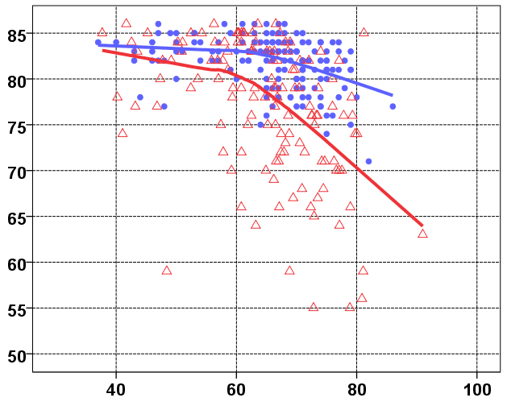
Supplementary Data Figure 1.
ACE-R Scores except for Fluency
score
age at examination(y)

