Slide 2
Gaussian Mixture Models for Robust Unsupervised Scanning-Electron Microscopy Image Segmentation of North Sea Chalk
¹
J.S. Dramsch¹*, F. Amour¹, M. Lüthje¹
¹Technical University of Denmark

Slide 3
Outline
Scanning Electron Microscopy
Neural Networks
Histogram Thresholds
Gaussian Mixture Models
Coffee & Hubris

Slide 4
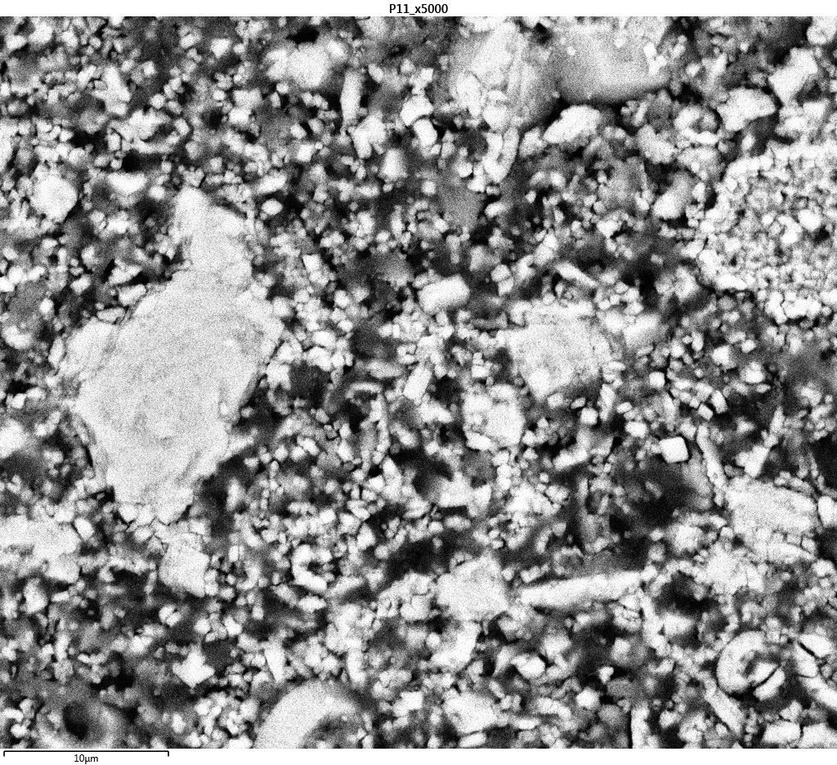
Scanning Electron Microscopy
Micrometer Scale Images
North Sea Chalk
Measure
Area
Perimeter
Orientation
By Hand
With a Ruler

Slide 5
Why am I here?

Slide 6
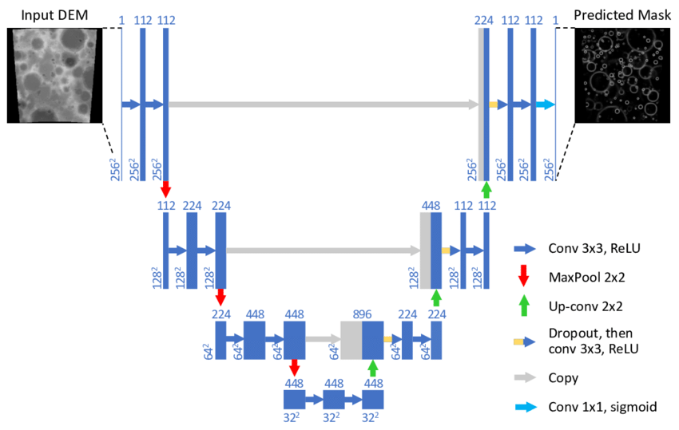
What has been done.
Ronneberger 2015

Slide 7
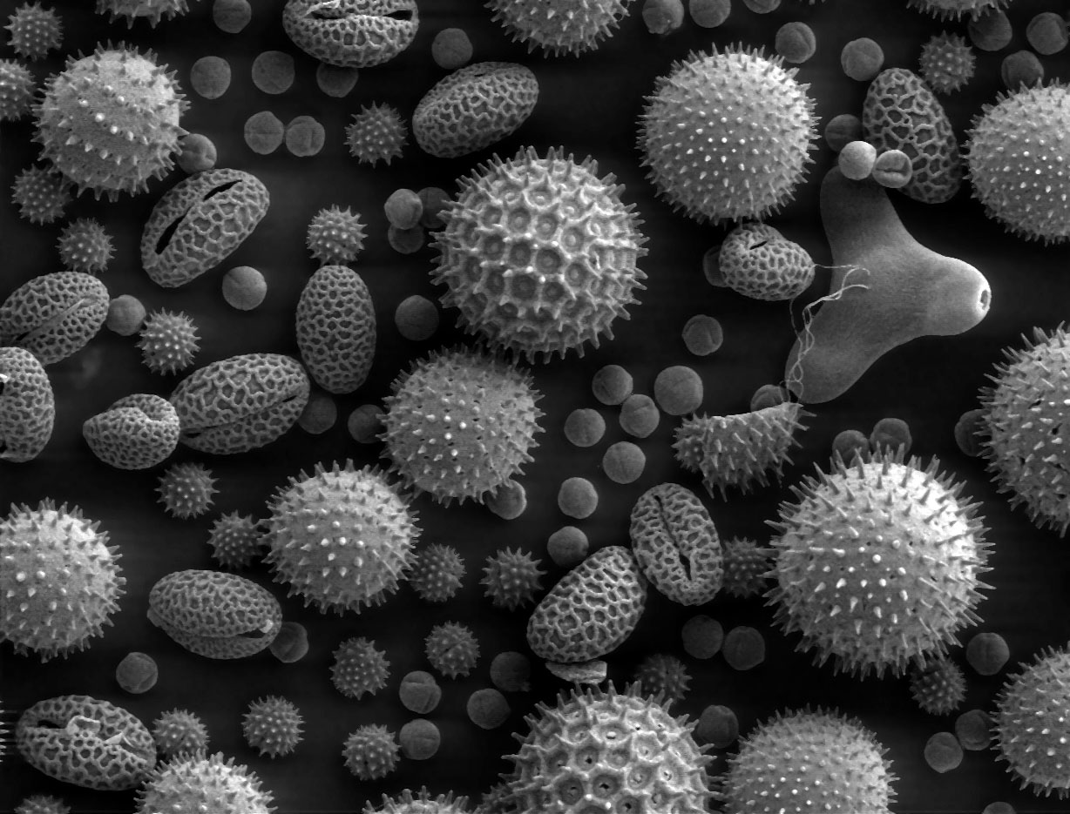
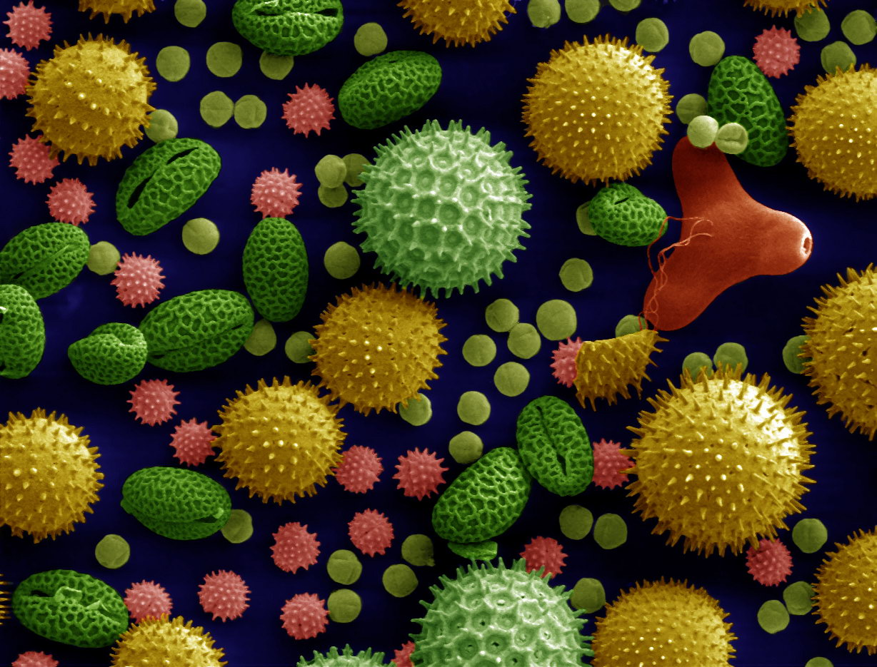
What has been done.
NN

Slide 8
Why am I here?
The Neural Network is gone
The Postdoc is gone
There is no documentation to reproduce
The training data was external
Postdoc Syndrome

Slide 9
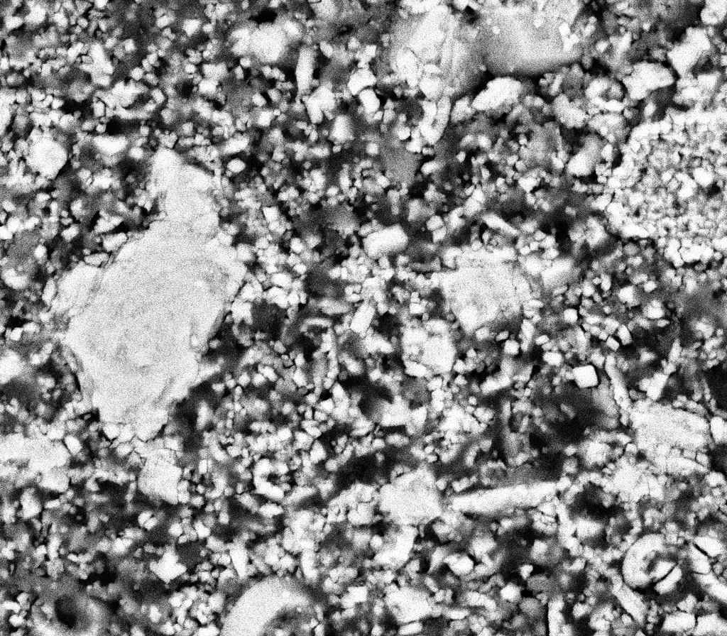
SEM of North Sea Chalk

Slide 10
Histogram with Otsu Threshold

Slide 11
Gaussian Mixture Model

Slide 12
Histogram with Otsu Threshold

Slide 13
Gaussian Mixture Model

Slide 14
How does it actually work?

Slide 15
Expectation Maximization
CC-BY Chire

Slide 16
Mixture of Gaussians
CC-BY Muehlenberg

Slide 17
Decision Boundaries

Slide 18
Histogram

Slide 19
Mixture of Gaussians

Slide 20
Segmentation with GMM

Slide 21
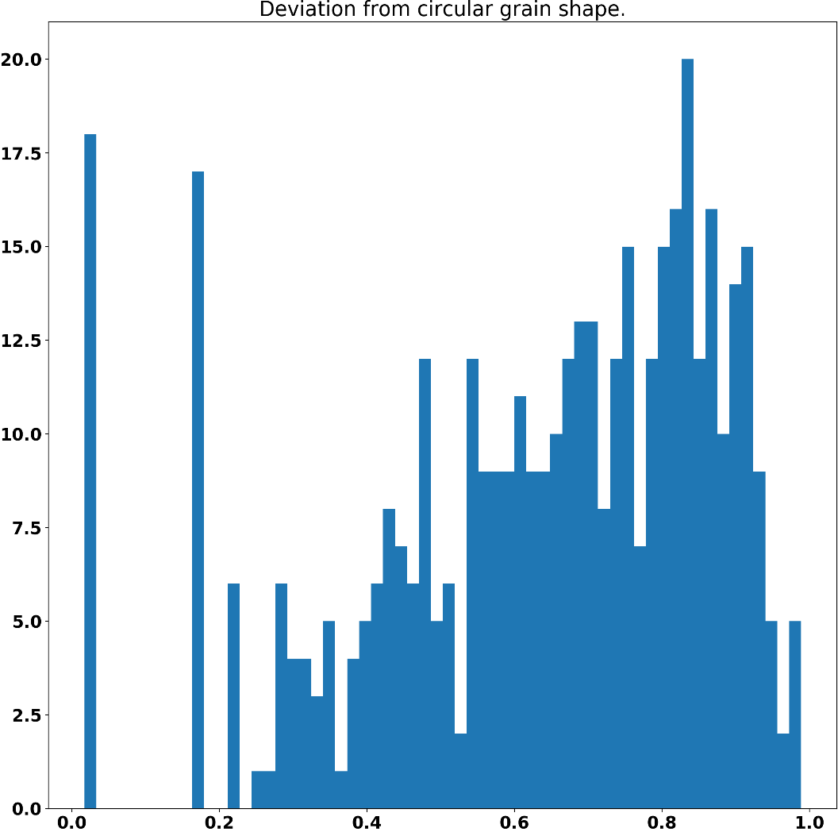
Scikit Image for Region Calculation

Slide 22
Conclusions
GMM is
Fast, cheap and noise robust
Accurate
Automatable
Unsupervised
Morphological Filtering cleans up Segmentation
Calculate Grain Properties easily

Slide 23
Main Tools

