Slide 1
Introduction
Arika Virapongse Principal, Middle Path EcoSolutions
Webinar series coordinator, ESIP
av@middlepatheco.com
Building Societal Capacity: The Educational Value of Earth System Science data, information, and applications
December 4, 2018 | Webinar #6
www.esipfed.org
@ESIPfed | #ESIPfed
ESIP is supported by
and 110+ member organizations

Slide 2
Socioeconomic Value of Data Webinar Series
Series is available on the ESIP YouTube Channel and Figshare
Jun. 5
Does it Matter? The Socioeconomic Value of Earth Science Data, Information and Applications
Aug 7
The Information Pathway for Earth Science Data: Moving Between Supplier and User
Sep. 4
Measuring and assessing socioeconomic value
Oct. 2
The “pipeline” of Earth science data to climate resilience and its value for real-world decision making
Nov. 15
Managing disasters through improved data-driven decision-making
Dec. 4
Building Societal Capacity: The Educational Value of Earth System Science data, information, and applications
Notes:
ESIP You Tube: https://www.youtube.com/channel/UCfQZ-8G7ptfbvbhii3T30OA?reload=9
ESIP figshare: https://esip.figshare.com/

Slide 3
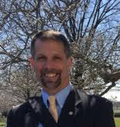
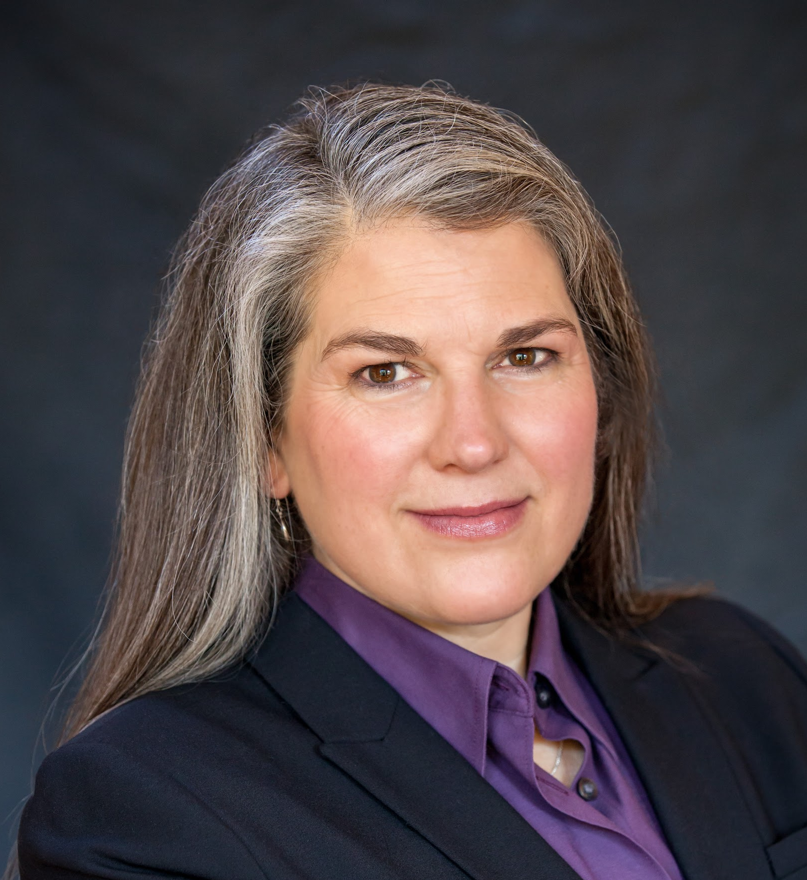
Presentations
Frank Niepold
Climate Program Office,
NOAA
Presentation: Introduction of CLEAN
Sean Fox
Science Education Resource Center (SERC),
Carleton College
Presentation: Web Architecture
Katie Boyd
Cooperative Institute for Research in Environmental Sciences (CIRES)
Presentation: Web Analytics
Cheryl Manning
Earth Science Teacher and Science Education Consultant
Presentation: Value of CLEAN for Educators
Patrick Chandler
University of Colorado
Presentation: ESIP CLEAN Fellow Perspective

Slide 4
CLEAN
Building Societal Capacity for
Climate Change Since 2008
Frank Niepold, Katie Boyd & Anne Gold

Slide 5
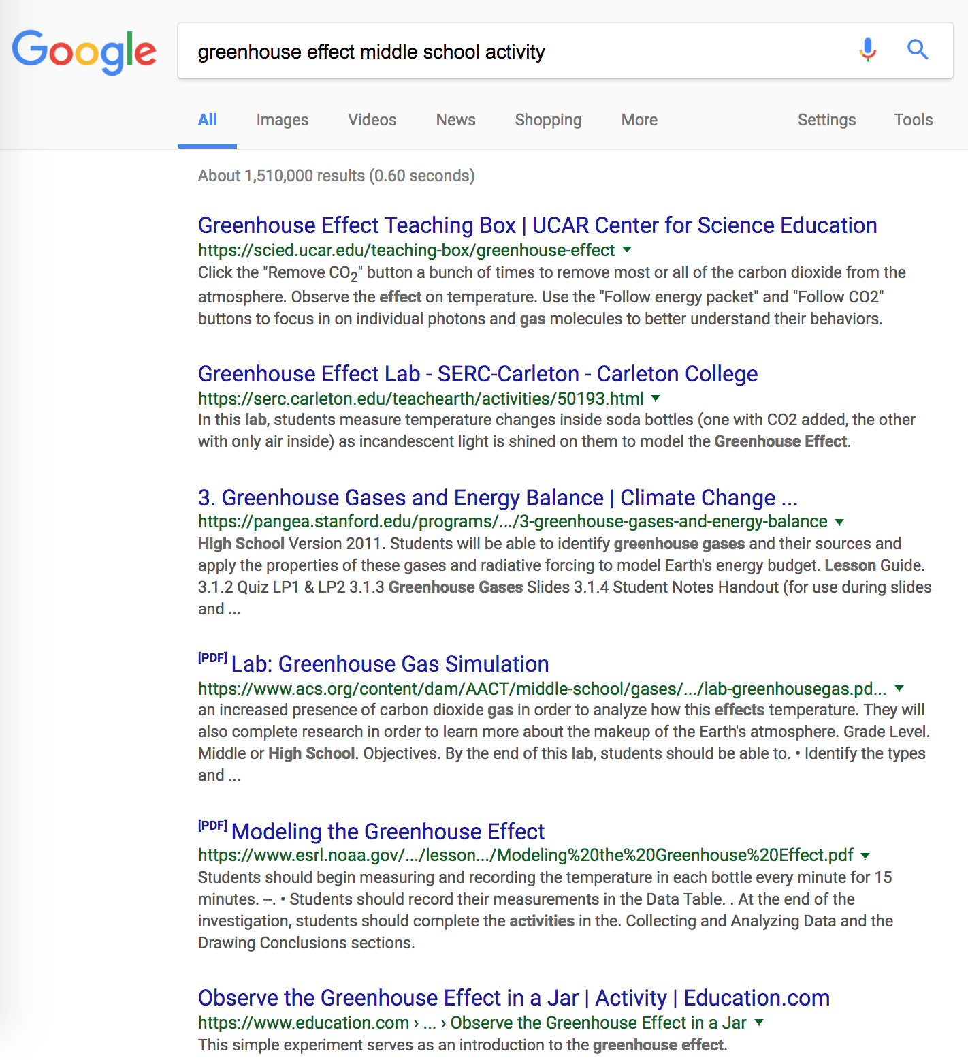
cleanet.org
Notes:
Why would we need a collection? Everyone has google and can find a million resources fast – but who has time to go through that?

Slide 6
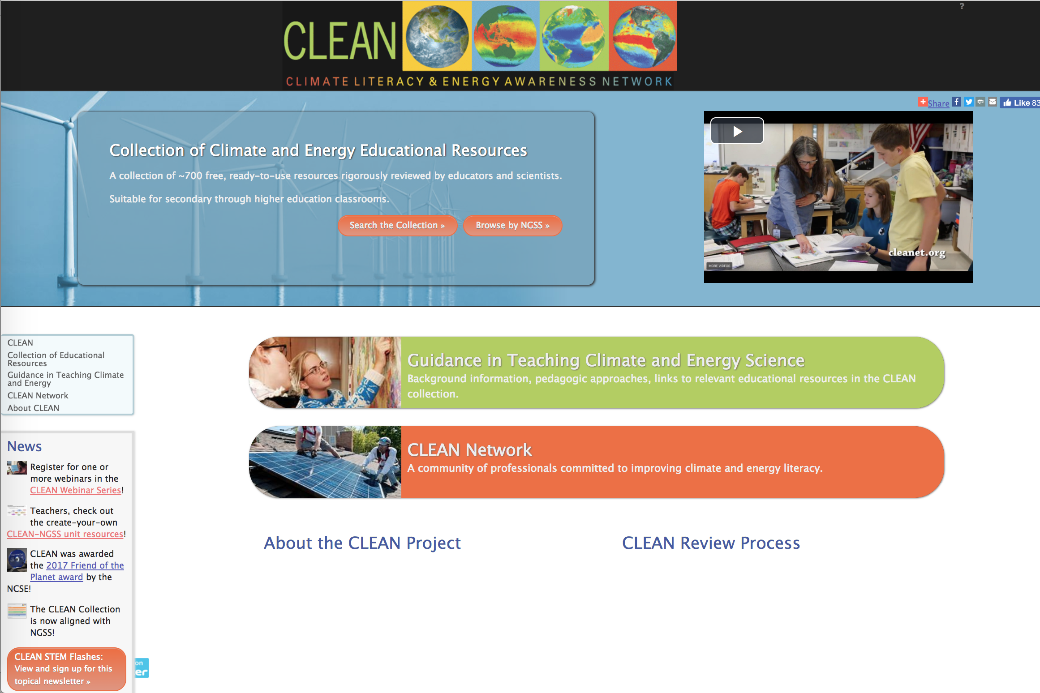
CLEAN Portal
CLEAN Collection
Guidance for Teaching Climate
and Energy
CLEAN Network
http://cleanet.org
https://www.climate.gov/teaching
cleanet.org
Notes:
3 pillars of CLEAN – background is guidance. Mention climate.gov site – official government site for teaching about climate & energy.
The CLEAN Collection contains 700+ vetted educational resources including activities, lab demonstrations, visualizations, videos for grades 6-16. Resources are organized by the climate and energy literacy principles, and are aligned with the Next Generation Science Standards.
Guidance for Teaching Climate Literacy and Energy Science Provides pedagogical support for teaching climate and energy topics using the collection. The ESIs are examples of how to combine resources in the collection to create engaging climate and energy investigations.
The CLEAN Network a professionally diverse community of climate and energy literacy stakeholders. The CLEAN Network home page provides access to the email list archive, information about upcoming weekly teleconferences and presentations and recordings of past teleconferences, information targeted for Educators and Resources Developers, as well as link to partner sites. Anyone is welcome to join the CLEAN network

Slide 7
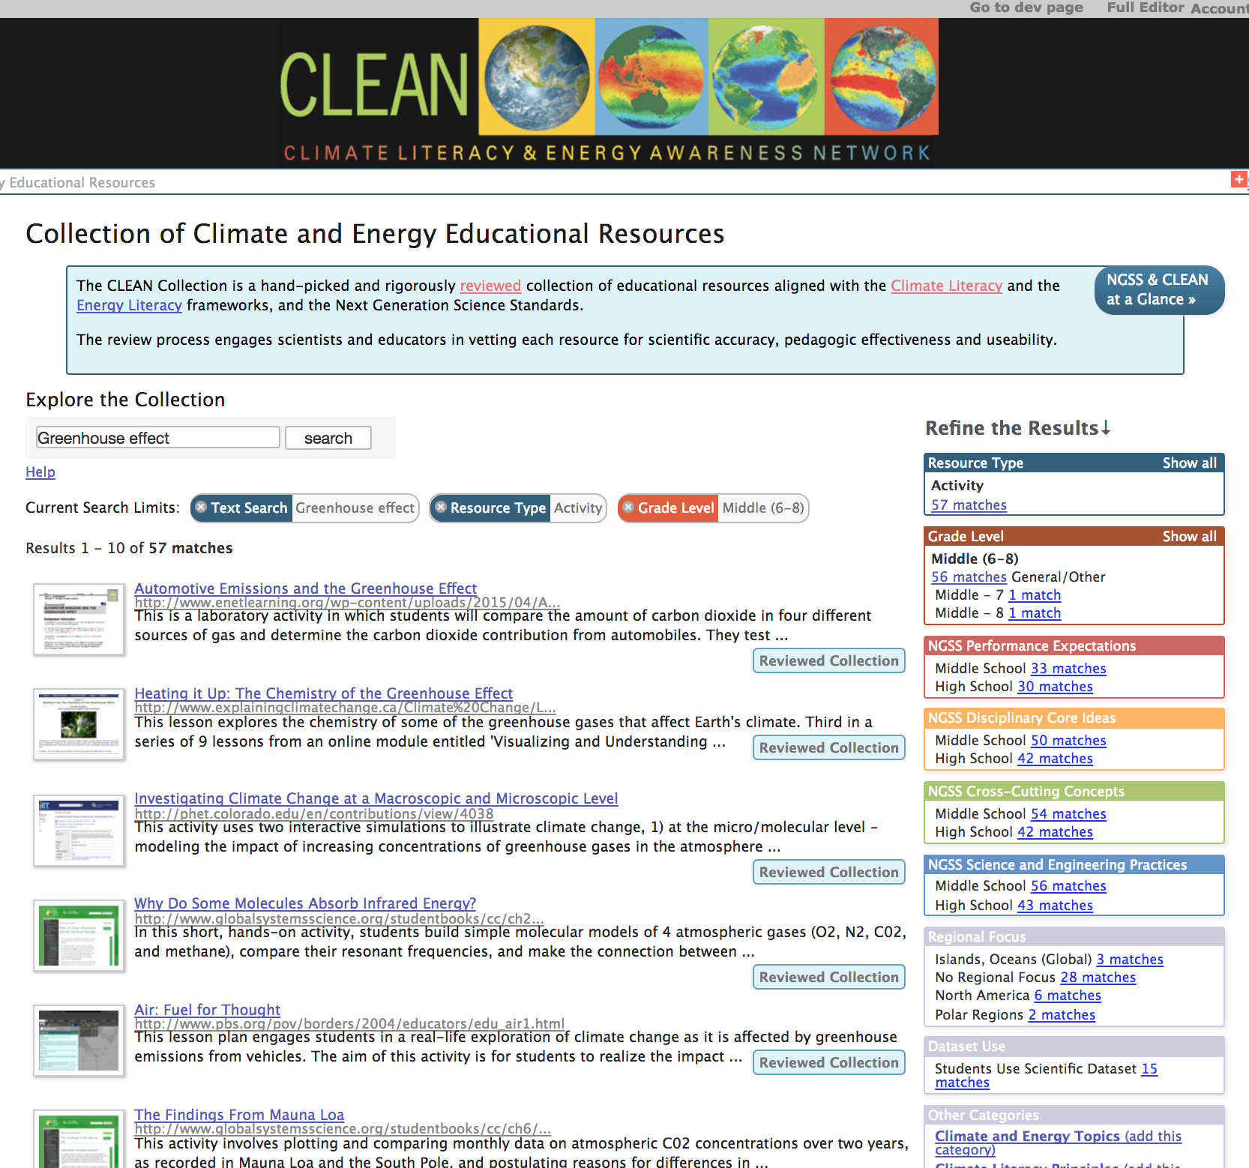
cleanet.org

Slide 8
CLEAN Collection
700+ online, free resources
Activities, videos, visualizations
Classroom ready
Community & Expert scientist reviewed, Curated
Aligned with NGSS, Literacy Frameworks
Grades 6-16
Pointer collection – resources developed by others
cleanet.org
Notes:
Teachers help to vet this – not just scientists/academics

Slide 9
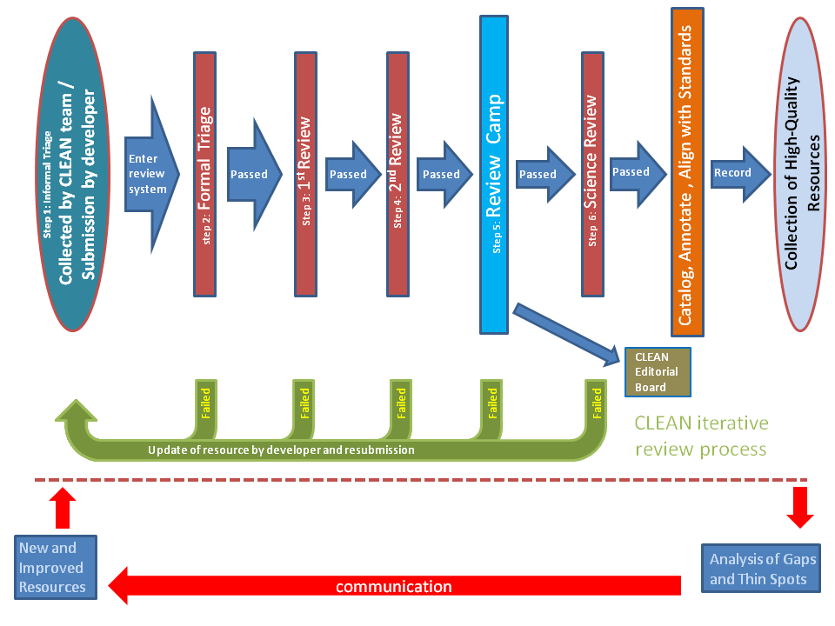
cleanet.org
Notes:
Busy but let me tell you what this shows – vetting, panel with 4 people, alignment, etc. At least 6 people have looked at this (don’t have to talk about each step - summarize)

Slide 10
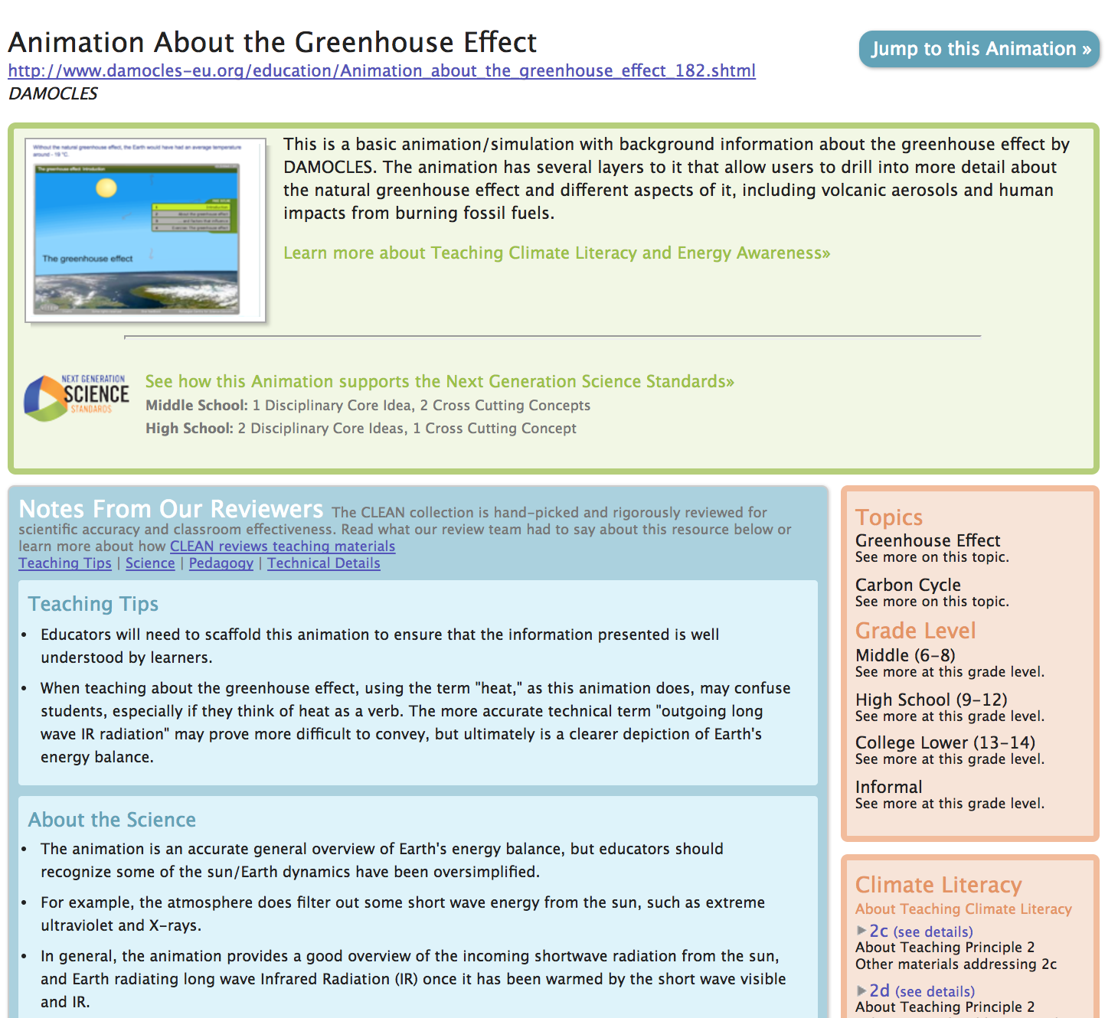
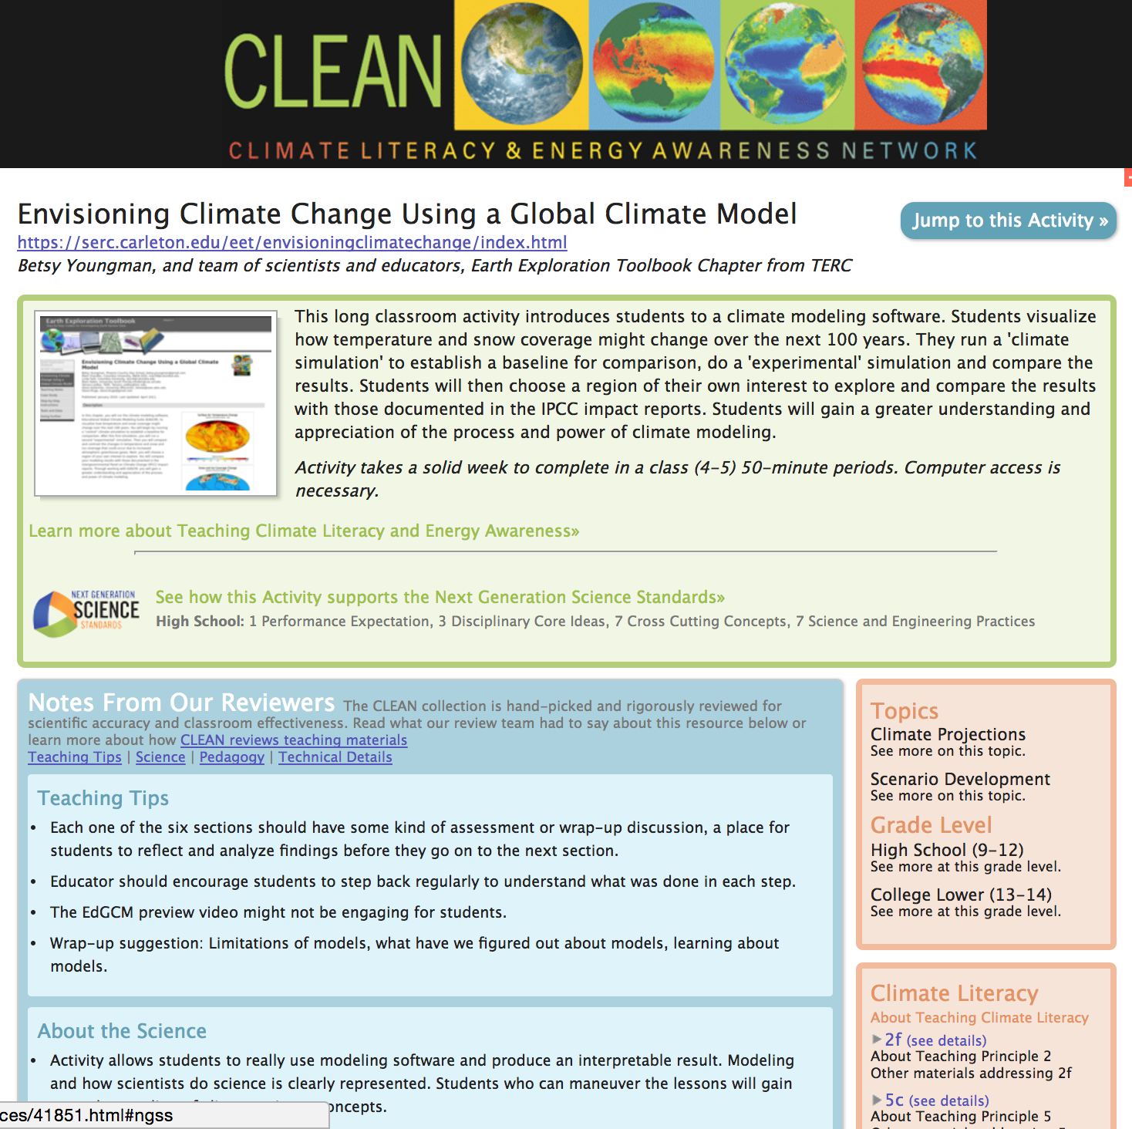
cleanet.org
cleanet.org
Notes:
It’s a pointer collection – summary allows you to scan and get a glimpse of what it is – then more info if you want to use it from reviewers

Slide 11
Search the Collection
Resource Type
Grade Level
Next Generation Science Standards (NGSS)
Regional Focus / Dataset Use
Climate & Energy Topics / Principles, etc.
cleanet.org
Notes:
Search in multiple ways – open search vs. tags. (open search looks for text anywhere on page – filters are tagged by humans). Dataset use might be especially useful

Slide 12
CLEAN Portal
Guidance for Teaching Climate
and Energy
CLEAN Network
http://cleanet.org
https://www.climate.gov/teaching
cleanet.org
Notes:
Guidance for Teaching Climate and Energy Provides pedagogical support for teaching climate and energy topics using the collection. The ESIs are examples of how to combine resources in the collection to create engaging climate and energy investigations.

Slide 13
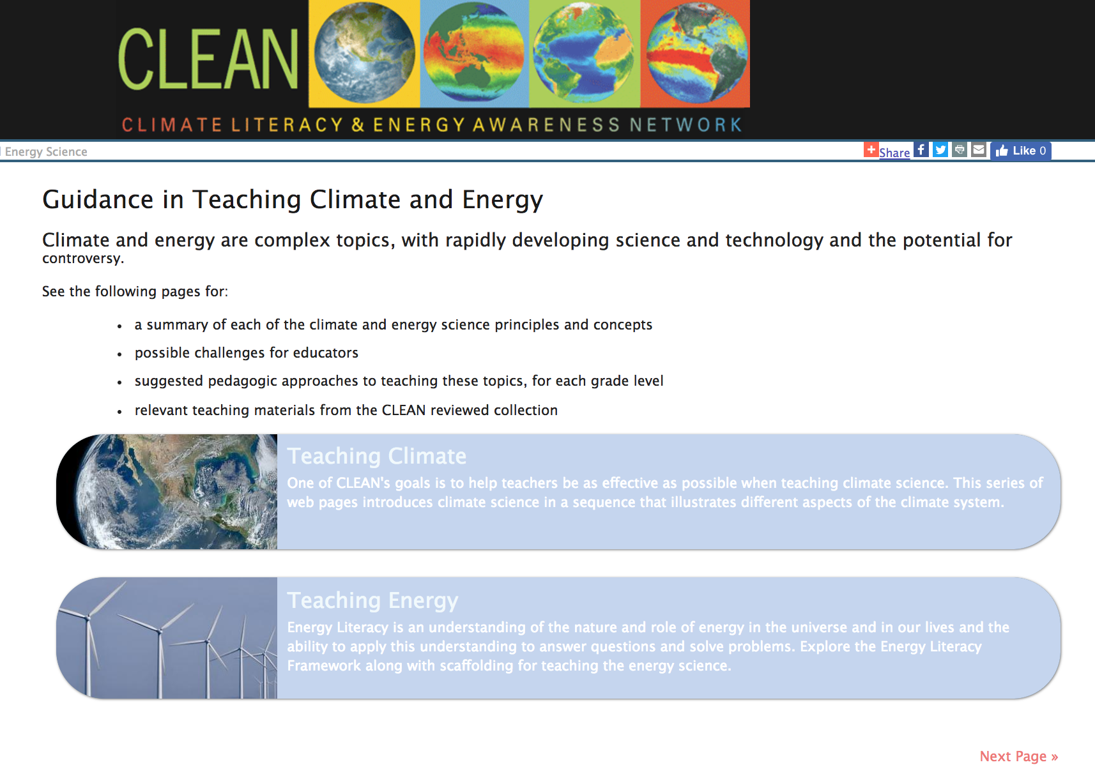
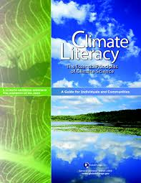
cleanet.org
Notes:
Principles = big ideas! Summarizes common challenges or known misconceptions, suggests strategies for teaching and resources from the collection

Slide 14
CLEAN Portal
CLEAN Network
http://cleanet.org
https://www.climate.gov/teaching
cleanet.org
Notes:
The CLEAN Network a professionally diverse community of climate and energy literacy stakeholders. The CLEAN Network home page provides access to the email list archive, information about upcoming weekly teleconferences and presentations and recordings of past teleconferences, information targeted for Educators and Resources Developers, as well as link to partner sites. Anyone is welcome to join the CLEAN network.

Slide 15
cleanet.org
Notes:
Listserve – active but can sign up as a digest. Responsive and friendly group that can help with challenges to teaching or resources
Recorded teleconferences – have had teachers present

Slide 16
Web Architecture Sean Fox
Making Earth Science Data and Tools Useful in Education

Slide 17
What needs to happen for Earth Science data and tools to be of utility to educators and have an impact on education?
What implications does this have for ‘web architecture’?
CLEAN as an example

Slide 18
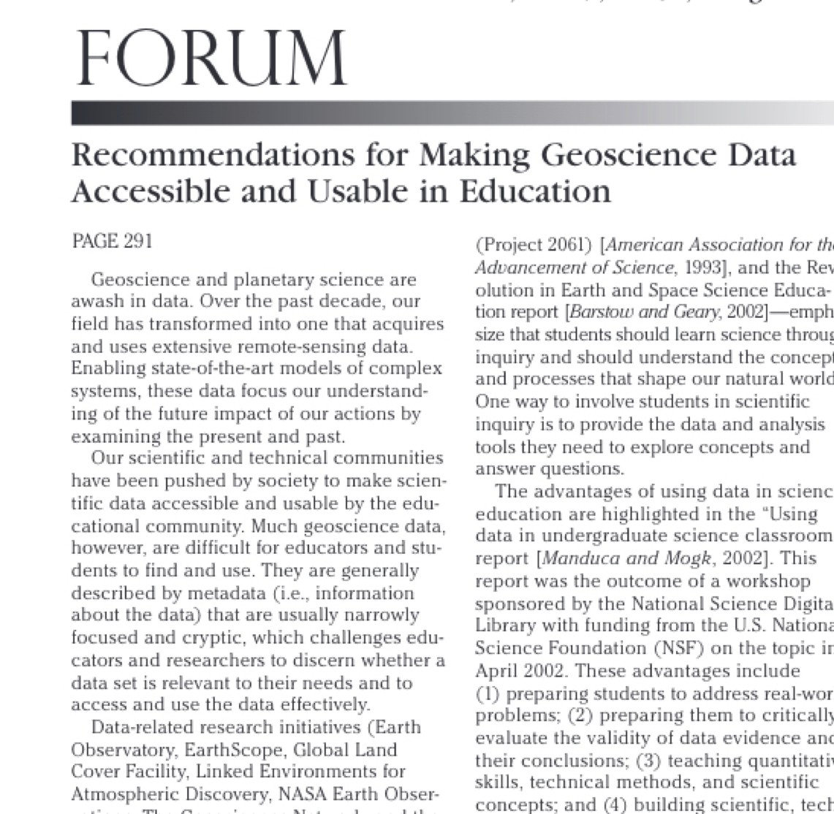
EOS, Vol. 89, No. 32, 5 August 2008
From the Data Access Working Group
Curriculum developers can find and use appropriate data easily.
The level of knowledge for use is clear.
Information is provided on the relevance of data to societal, educational, or scientific problems.
The data site points to examples of educational use of data.
Data are archived for reliable, long-term access.
The interface to, and the organization of, the data is user-friendly.
Descriptive information (e.g., metadata) is audience-appropriate.
Curriculum developers can ascertain data quality and its impact on their conclusions.
Information is provided about overall data collection, quality, reduction, and limitations. Data sites include sources of error and limitations of the collection process as well as inaccuracies and uncertainties from models and from particular choices of representations.
Information about the accuracy of individual data sets, points, and analyses is provided.
Data are provided in ways that facilitate their manipulation through a variety of tools, including:
Providing the data in common formats that are accessible via desktop tools (spreadsheets, geographic information systems, image analysis programs);
Providing tools that are integrated into, or downloadable from, the site; and
Exposing the data via protocols to make them accessible through third-party tools. These tools should be easily acquired, easy to use, and reliable.
The data site supports, through these tools, data manipulation to answer questions by:
Using data contained within the site or combined with data from other sites;
Generating appropriate visualizations; and
Comparing students’ own data to the data on the site.
see also https://serc.carleton.edu/17321

Slide 19
The 2013 EarthCube Education End-User Workshop produced a 12 page report including specific recommendations for “ EarthCube technology/cyberinfrastructure”. Some interesting excerpts:
“In general, participants did not favor a dedicated education portal for undergraduate users, feeling that working in such an environment does not build adult competencies and that such secondary portals tend to be less well maintained than those used by professionals. Rather, most of the participants would favor a novice view of EarthCube’s interface, in which less commonly-used options and tools would be hidden until the learner developed a need for them.”
“Participants want learners to be able to combine and compare historical/archival data about a phenomenon with forecasts/predictions about the future. Tools could include data visualizations that put both on the same display, and analytical tools to quantify the similarities and differences. “
http://nagt.org/69379

Slide 20
Making earth science data and tools useful to education is non-trivial. Simply making them available via web interfaces or APIs as you would to support use by scientists is necessary but not sufficient.
Use is usually mediated by a curriculum developer or faculty member with specific relevant science and pedagogic expertise who bridges the gap.
Successful educational use happens when the tools and architecture (and coordination of people) attends explicitly to this bridging layer.
Examples:
UNAVCO (https://serc.carleton.edu/getsi),
GeoPrisms (https://serc.carleton.edu/margins)
CLEAN project provides some examples of how this bridging can be supported.

Slide 21
CLEAN’s role is to bridge between curriculum developers and educators

Slide 22
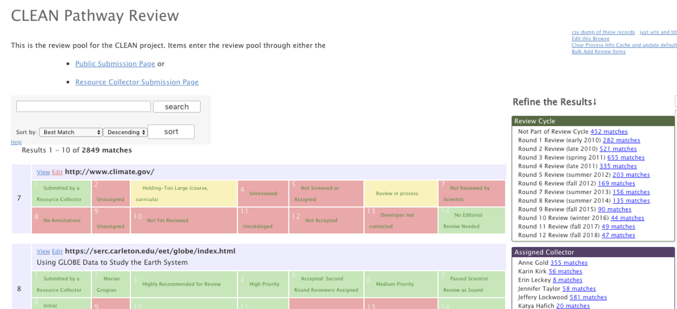
Web Architecture supports a Review Process

Slide 23
Web Architecture supports discovery based on education-relevant dimensions

Slide 24
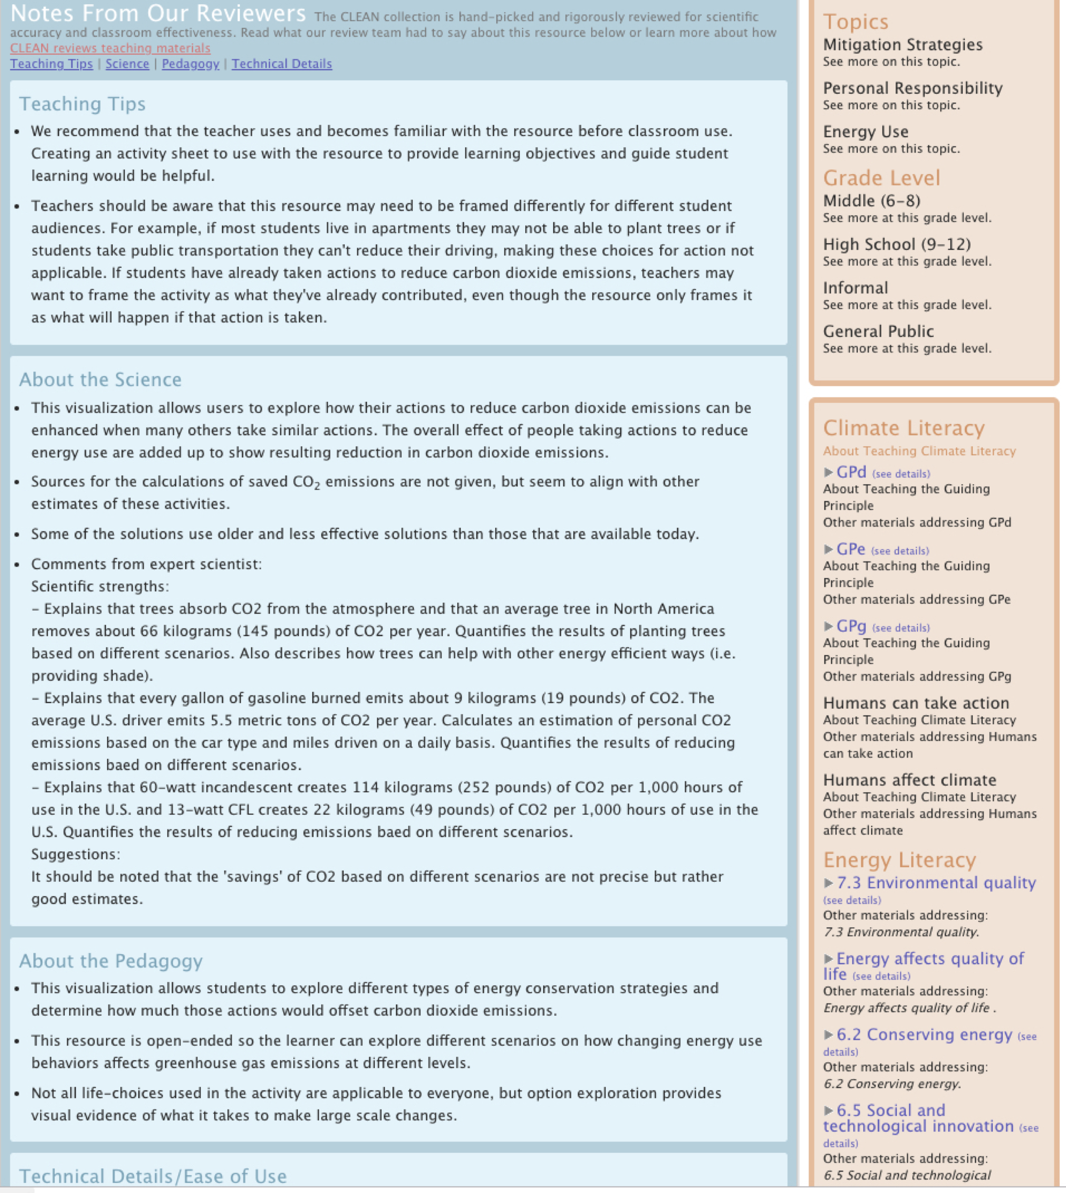
Web Architecture supports collection and sharing of guidance from reviewers

Slide 25
CLEAN Web Analytics - Using Data for Marketing
Katie Boyd
ESIP Webinar #6
December 4, 2018

Slide 26
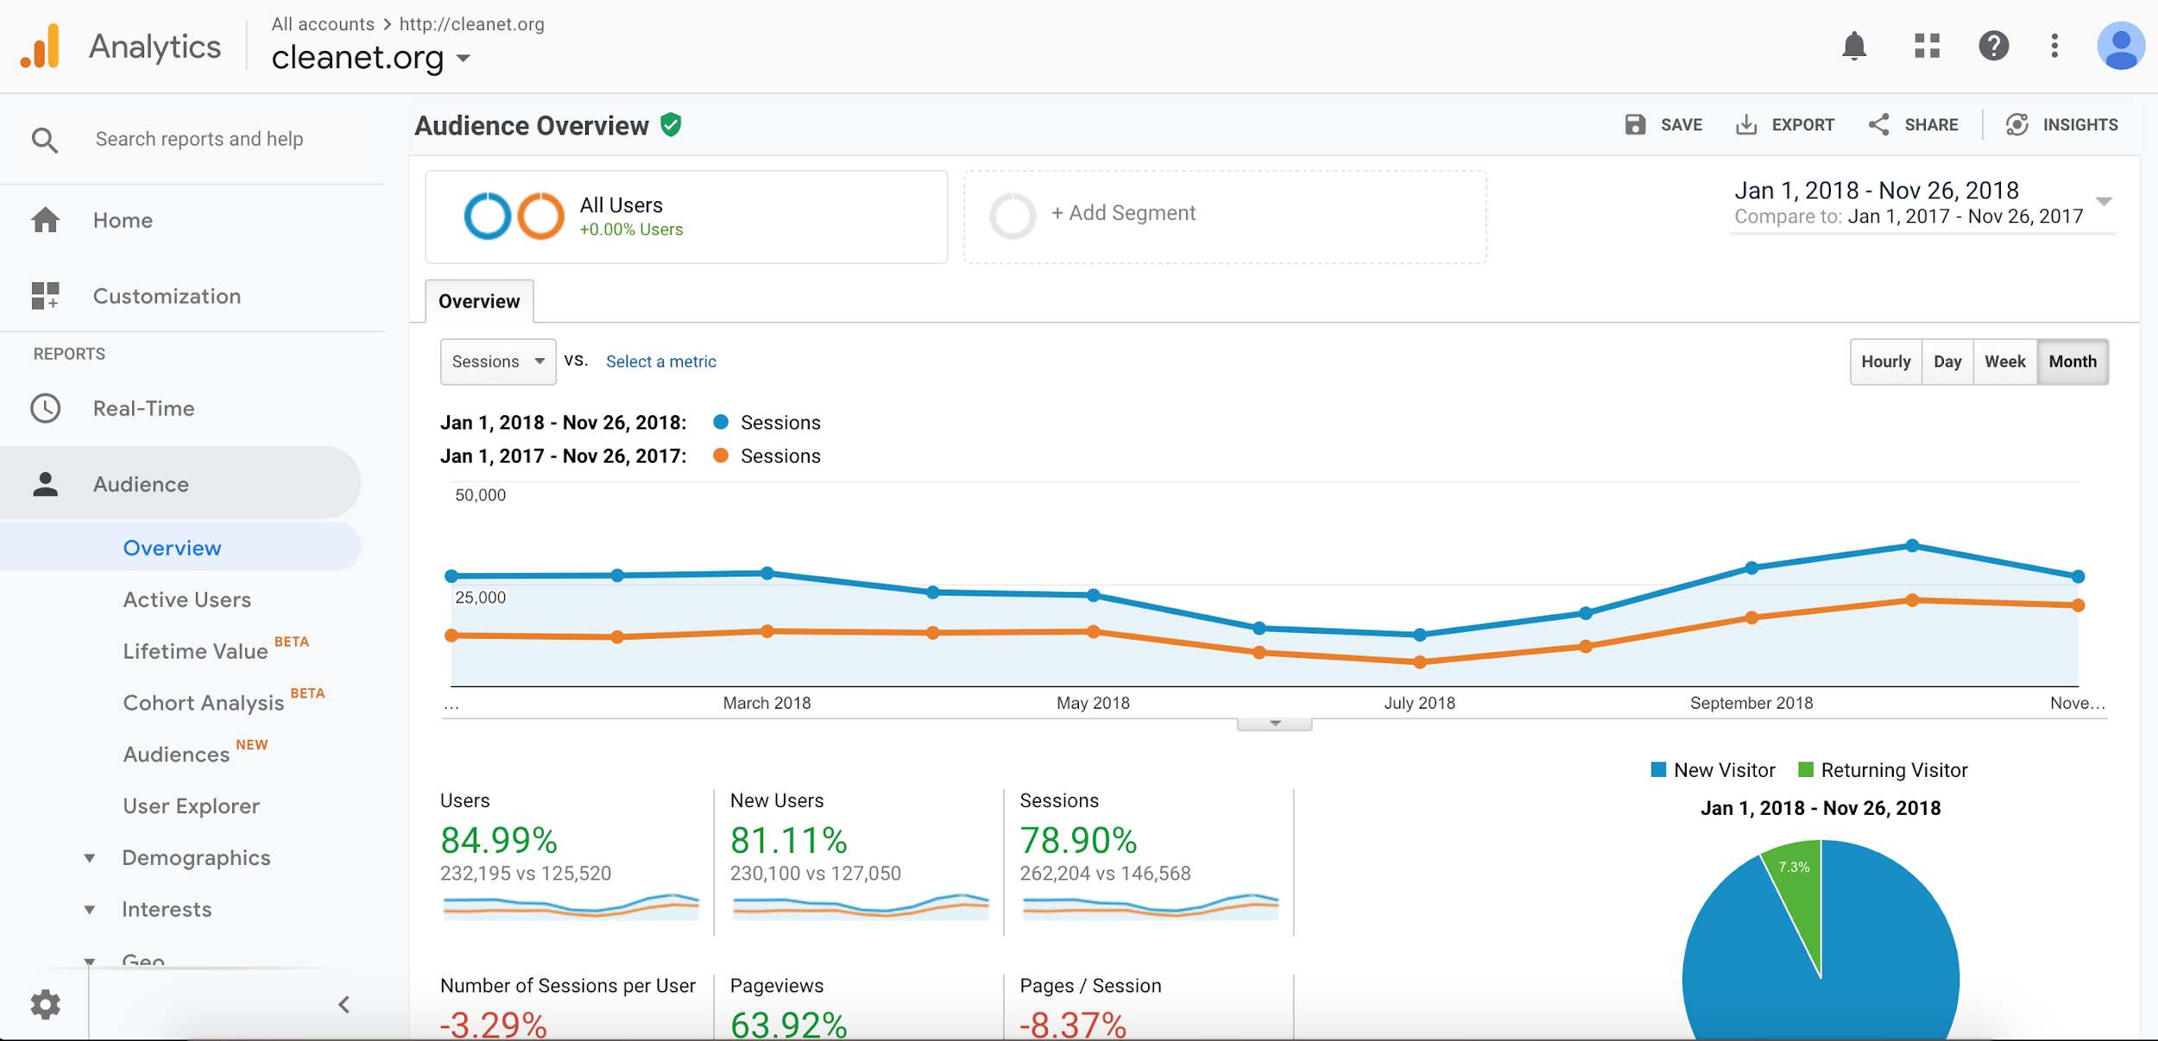
Using Data to Market CLEAN
CLEAN uses Google Web and Social Media Analytics to measure how successful our marketing efforts are.

Slide 27
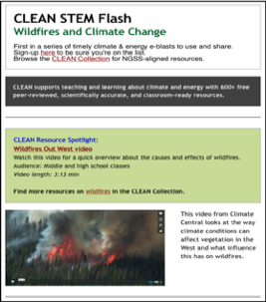
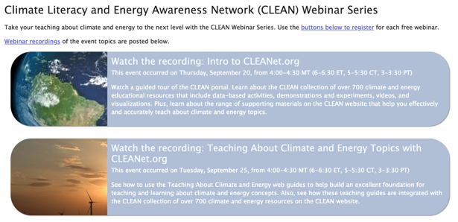
CLEAN Marketing Efforts
Social Media Engagement
STEM Flash Newsletter
Professional Development Webinars
Work with developers
Syndication with sites like PBS Learning & NSTA
CLEAN “Selected By” logo
CLEAN widget on websites
Presentations at professional conferences
Targeted outreach to states (media kits)

Slide 28
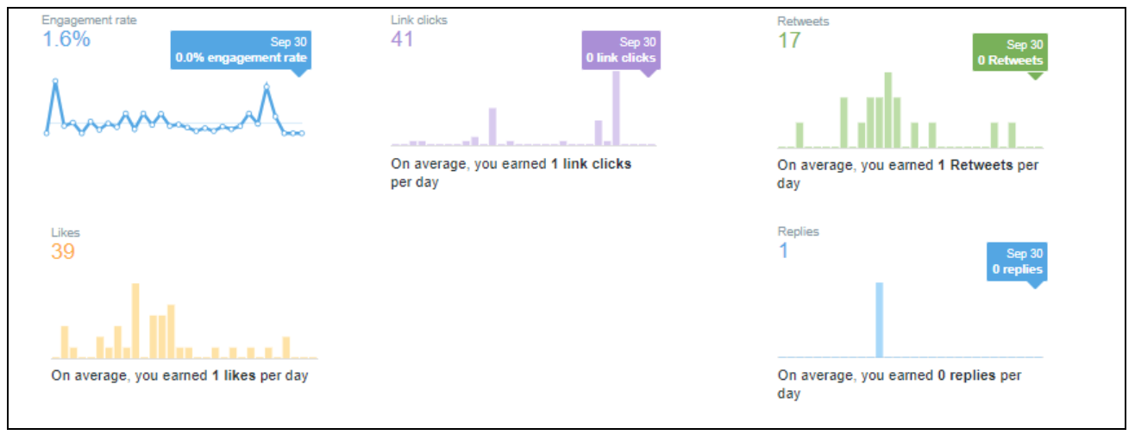
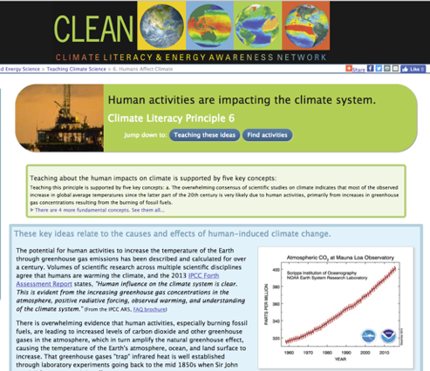
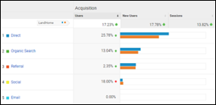
Web Analytics
Google Analytics
Track users, sessions, pageviews
Social Media
Track followers, impressions, etc.
Track pageviews
Track individual page popularity
Track referrals
Direct link vs. natural search
Referrals from social media
Referrals from other sources such as climate.gov, NBC news article, etc.
Track locations
Comparing NGSS states with those looking at our NGSS resources
Tracking presentations on CLEAN
Pop-up Survey

Slide 29
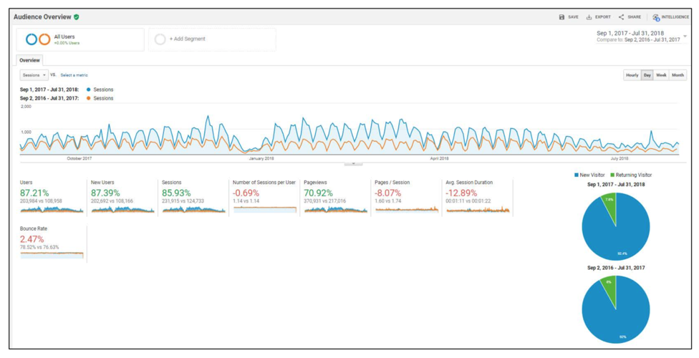
CLEAN Marketing Efforts Are Successful
For 2018 users, new users, and pageviews are all up about 70% compared to 2017
September 2018 had 79,000 pageviews
Monthly average number of sessions increased from about 32,000 in 2017 to 46,000 in 2018

Slide 30
Using CLEAN’s Data-focused resources in the Classroom
Cheryl L. B. Manning
Science Teacher and Science Education Consultant
clbmanning@mac.com
@clbmanning

Slide 31
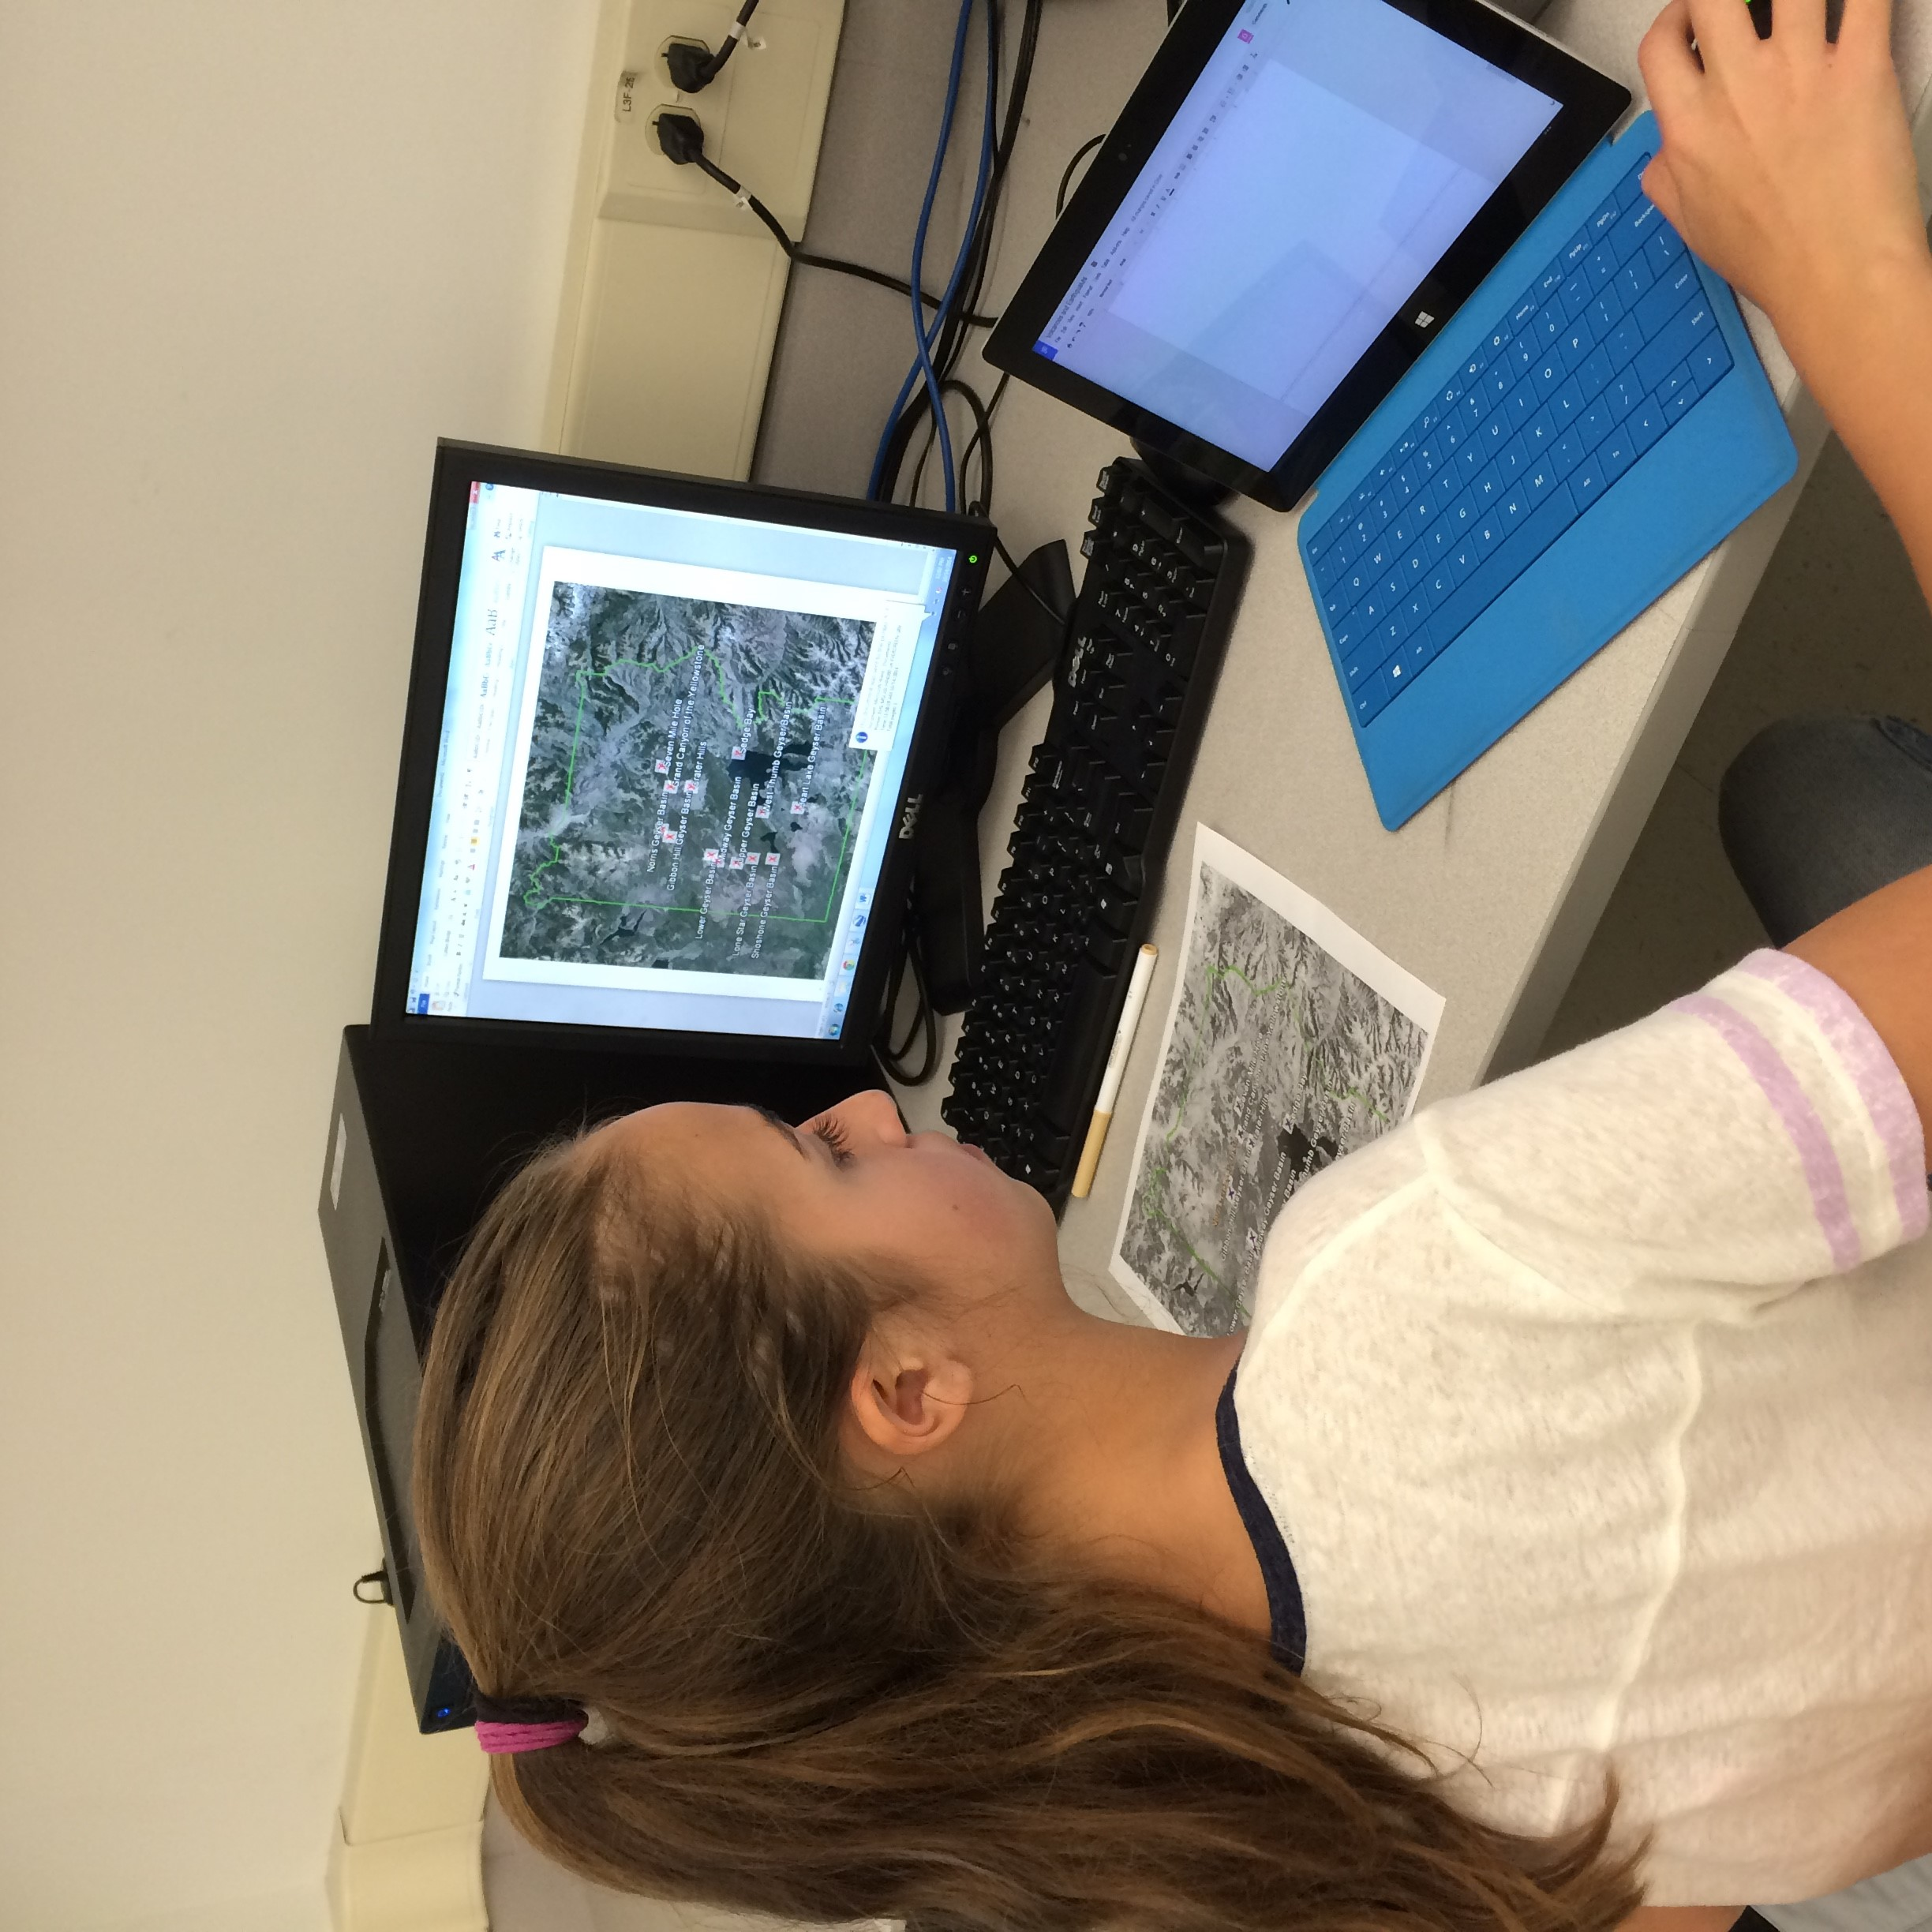
CLEAN Data Sets Support Good Instruction
Nationwide, teachers are engaging students with real data. Why?
Skill Development
Sense of Place
Understanding the role of data in modeling and decision making
Earth Science Data is used in AP Computer Science courses
Earth Science data is relevant, interesting and challenges students’ thinking
Complex and messy
Emphasizes space, time, and cause-effect
CLEAN Collection of resources contain many different opportunities to integrate data into instruction in different ways

Slide 32
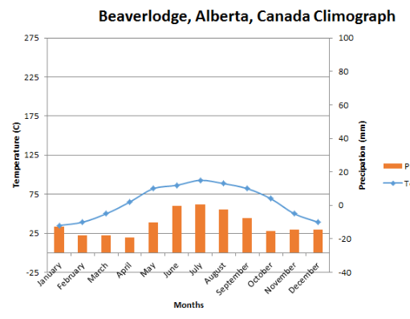
The Frameworks and Next Generation Science Standards – Science and Engineering Practices
All students should interact with data in many different ways
Skills develop from kindergarten through high school
Students in
Grades K-2 record information and use pictures and drawings to represent observations, find patterns and relationships, and make comparisons
Grades 3-5 make data tables, graphical displays, and find relationships between data sets
Grades 6-8 increase the sophistication of their graphical displays of data; identify relationships as linear or nonlinear, temporal or spatial, cause/effect vs correlation; identify data limitations, apply simple statistics and make interpretations
Grades 9-12 use technology and tools to manage, statistically analyze, evaluate and interpret data sets; use data to support claims, evaluate models, and characterize systems

Slide 33
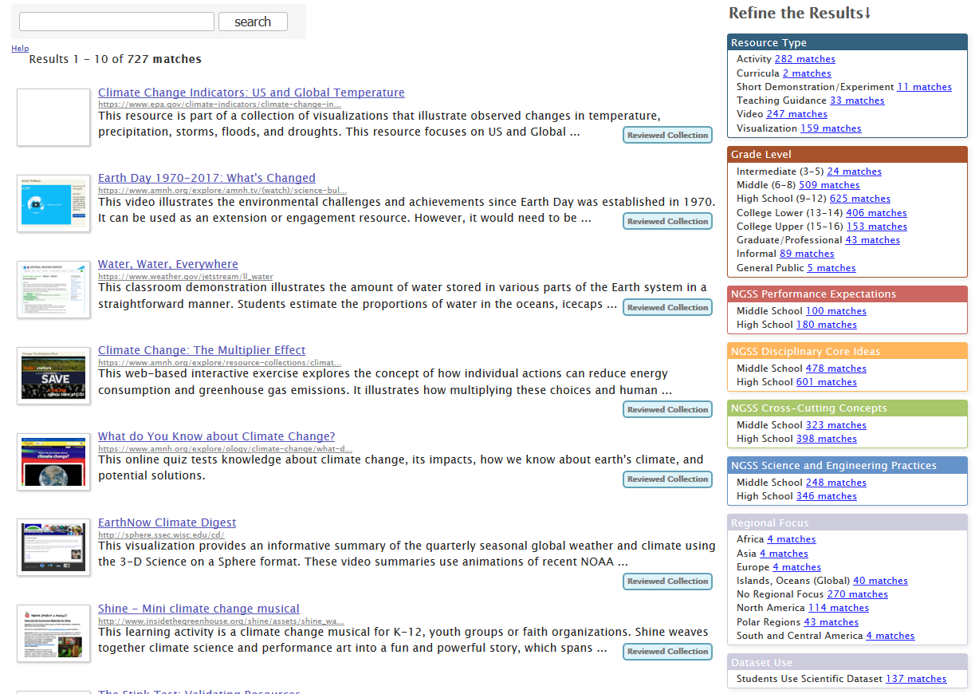
Use the “Refine the Results” tool to identify those resources that rely on students using data.
Depending on learning objectives, teachers can choose one of the data-focused options from the NGSS Science and Engineering Practices for “Analyzing and Interpreting Data” or “Using Mathematical and Computational Thinking”.
Or, select the Dataset Use refinement

Slide 34
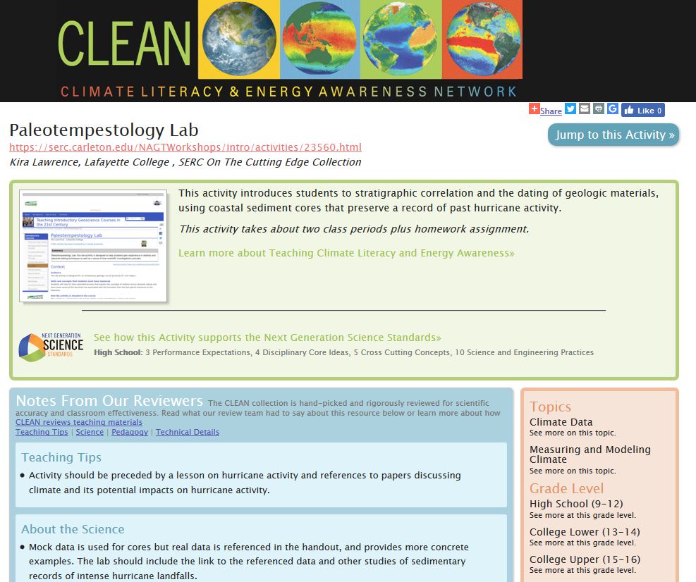
Data-rich Example: Paleotempestology Lab By Kira Lawrence, Lafayette College
Stratigraphic correlation and radiometric dating of materials
Assess frequency and intensity of past hurricane intensity
Spatial and temporal data
Students interact with data in spreadsheet and graphing program
Manipulate data using formula and macros
Create graphical displays
Conduct statistical analyses
Interpret and make predictions

Slide 35
Other CLEAN Data-rich Resources
Resources that use GeoMapApp
Lessons and instructional units in Earth Exploration Toolbook
Understanding current events with live data sets – Some Examples of data sets from the CLEAN collection
State-level data: California’s www.cal-adapt.org/data/
Droughts in the US
www.drought.gov/drought/data-maps-tools
droughtmonitor.unl.edu/
Globally, at www.nnvl.noaa.gov/view/globaldata.html

Slide 36
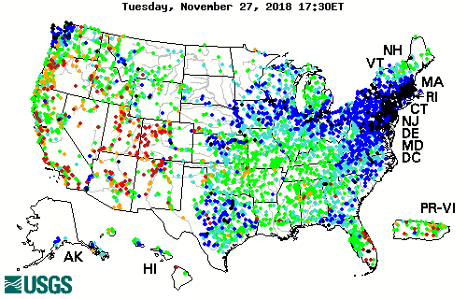
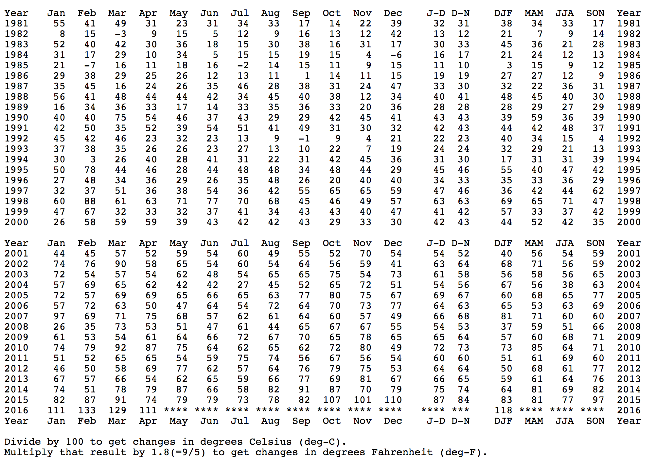
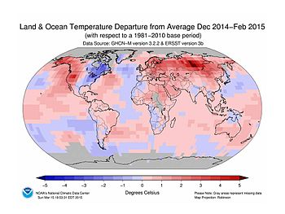
What teachers need in a data set
Context -- it is helpful to know the story behind the data
Essential findings so that they can guide students in the right direction
Data that is not overly processed
Variety of data sets for students to investigate freely

Slide 37
CLEAN and ESIP from a community fellow’s perspective Patrick Chandler Patrick.chandler@Colorado.edu

Slide 38
2018 ESIP Community Fellows

Slide 39
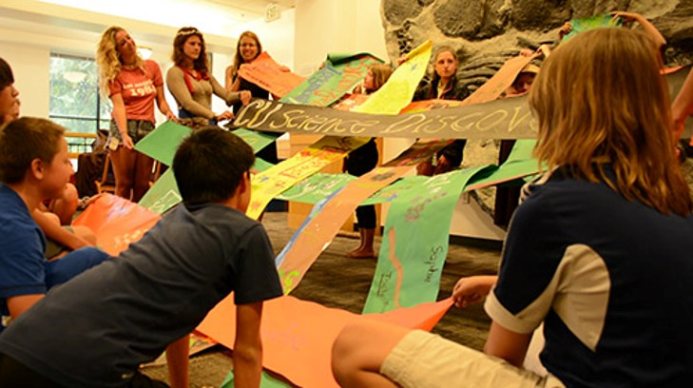
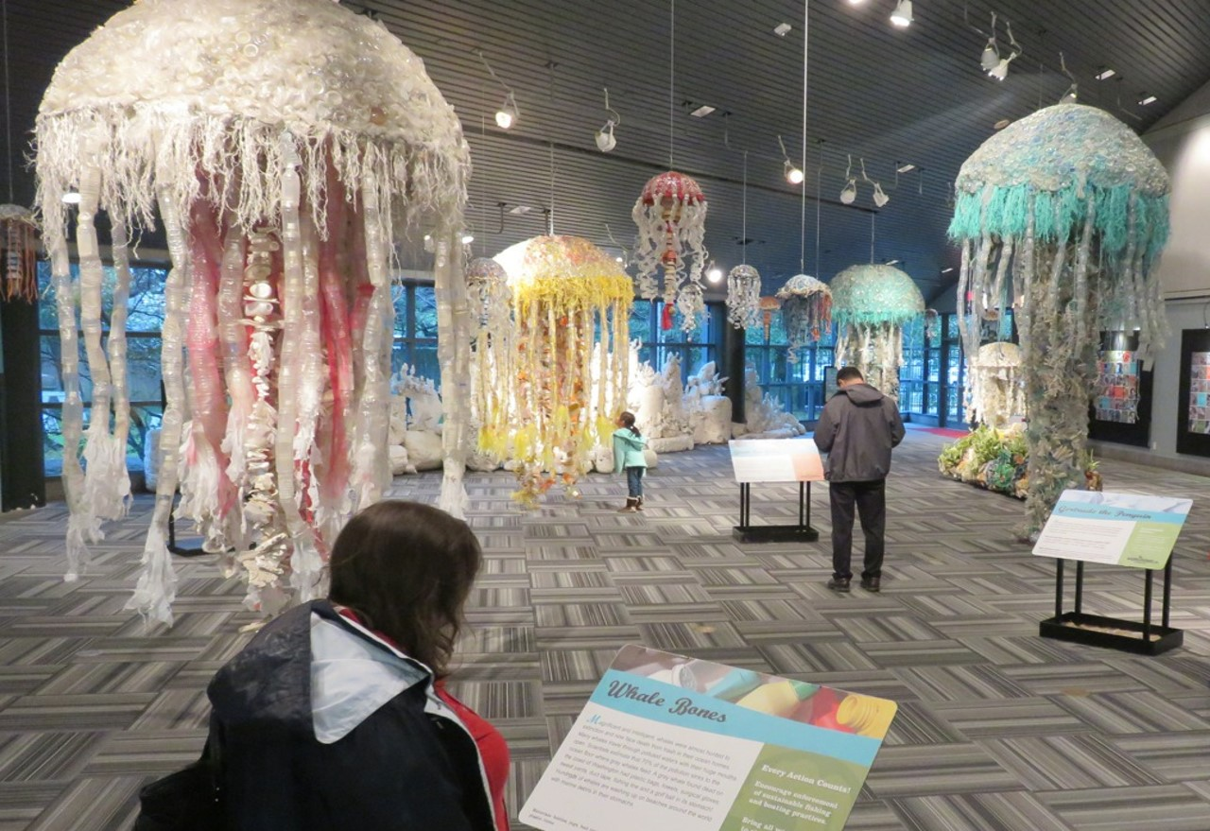
Finding new methods
To communicate research and data

Slide 40
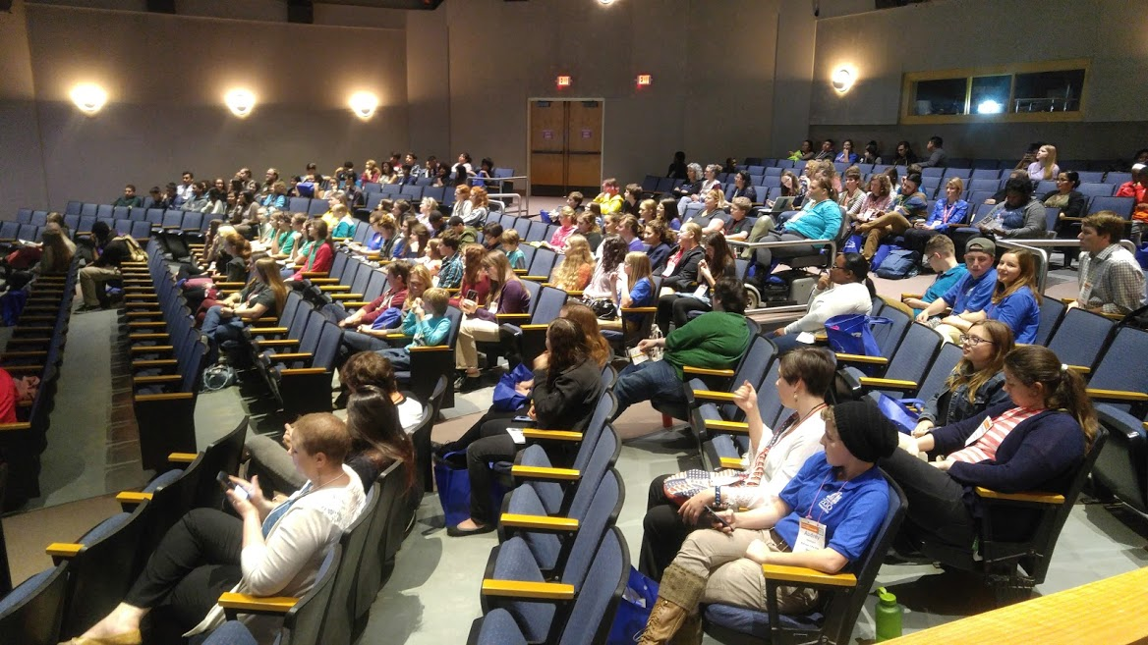
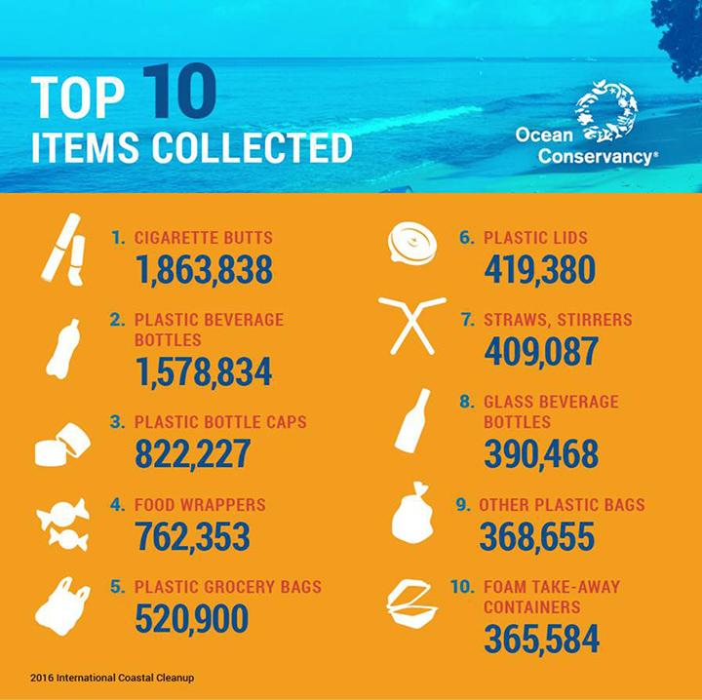
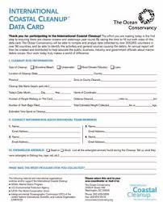
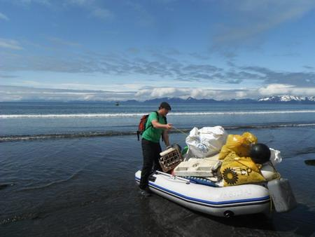
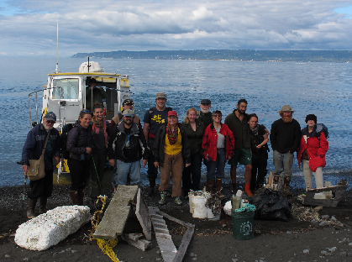

Slide 41
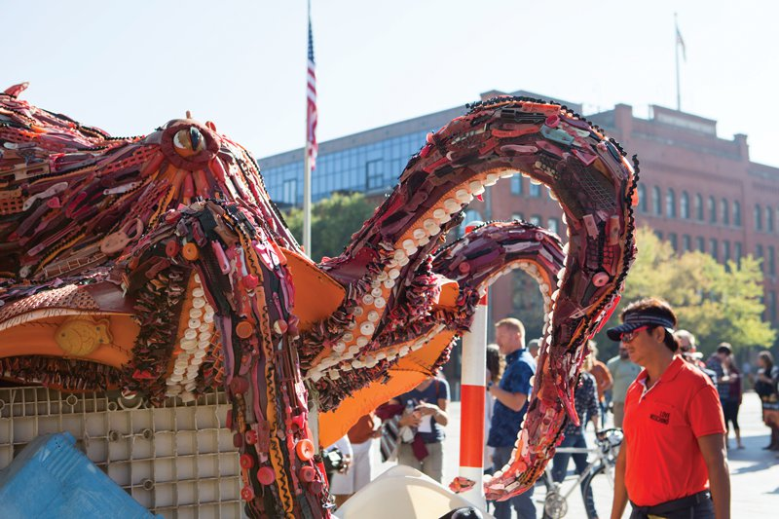
How can we make science and data accessible to educators and the general public?

Slide 42
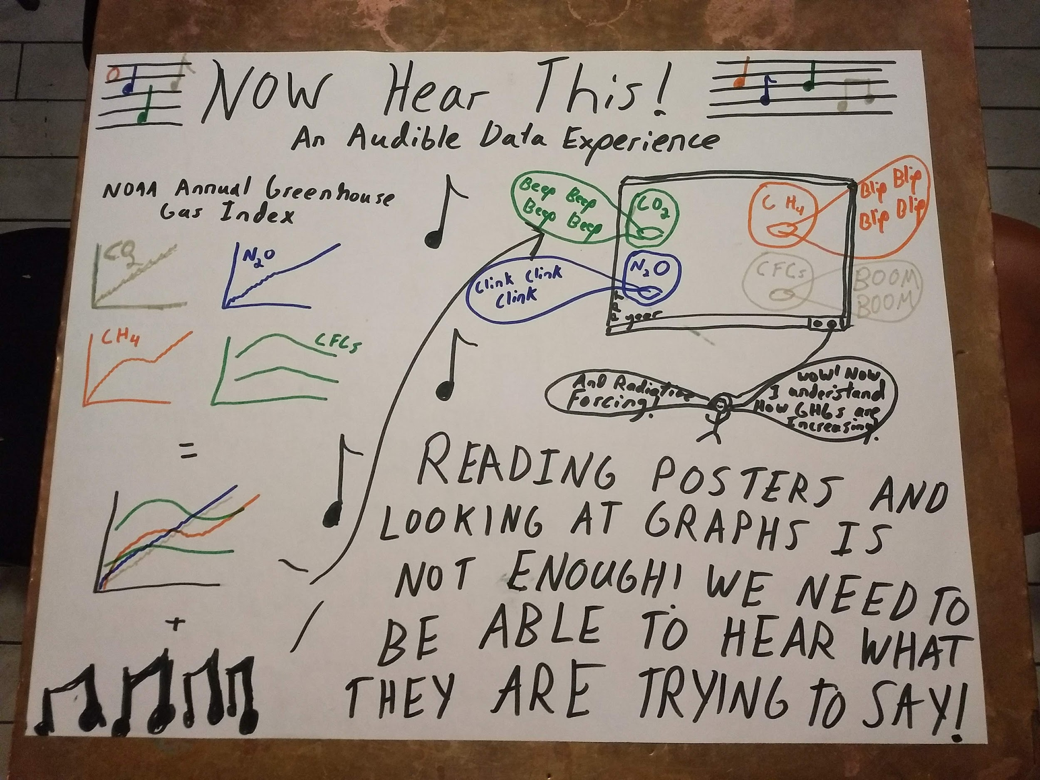

Slide 43
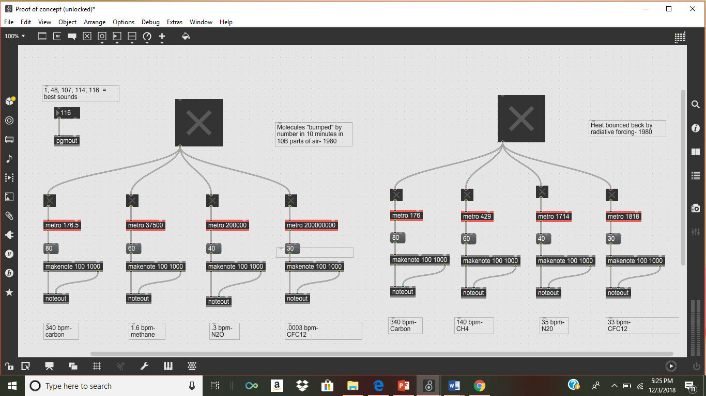

Slide 44
ESIP and CLEAN together = Increased Science Literacy and Action
ESIP provides the what and CLEAN can help define the how. ESIP has multiple groups of practitioners that create meaning from data, but their products are not often accessible to educators or the public. CLEAN can help to bring ESIP’s products and ideas to these groups so that the meaning of the data spurs them to take action.
As a student fellow, I hope to act as a liaison between the two groups to help make connections that enable new audiences to be reached and tools to be created.

Slide 45
Weekly CLEAN Teleconference:
Each Tuesday at 1:00pm Eastern Time (12pm Central, 11am Mountain, 10am Pacific) CLEAN Network members meet on a teleconference call to update each other about their climate literacy projects, upcoming events, and funding opportunities and share information about best practices, key teaching/learning resources, and the development of collaborative activities. Often these teleconferences include special presentations by members and guests.

Slide 46
Presenting for the CLEAN Network
Why do a CLEAN presentation? Doing a webinar for CLEAN is good for the visibility of your work and
also serves the CLEAN Network which is a grassroots organization highlighting science communication
for educators.
How many people are on the CLEAN listserv and about how many people will be on the call? We
have 660+ people on the listserv. The CLEAN facebook page has 2.200+ followers. The talk will be advertised on both. On a typical call, we have 10-30 people who attend the live presentation. However,
calls are recorded and many folks from the network watch them later.
Who will the audience most likely be? Timing of the calls is difficult for classroom educators to attend
live, but quite a few listen to the recordings. Most folks on the call are on the government side of climate communication- NOAA, etc., or Education Directors for organizations teaching about climate.

Slide 47
CLEAN Priorities
Increasing integration of the CLEAN Collection, support guides and network programs for the millions of educators
Supporting and growing the CLEAN Collection and Network (ESIP scientists & fellows)
Identifying and promoting effective climate change education, community engagement, and workforce development
Developing new partnerships and strategies for sustaining and increasing funding

Slide 48
cleanet.org
Notes:
Listserve – active but can sign up as a digest. Responsive and friendly group that can help with challenges to teaching or resources
Recorded teleconferences – have had teachers present

Slide 49
Final Remarks
Arika Virapongse Principal, Middle Path EcoSolutions
Webinar series coordinator, ESIP
av@middlepatheco.com
Building Societal Capacity: The Educational Value of Earth System Science data, information, and applications
December 4, 2018 | Webinar #6
www.esipfed.org
@ESIPfed | #ESIPfed
ESIP is supported by
and 110+ member organizations

Slide 50
Ways to stay involved
Join CLEAN
Join the CLEAN Network email list: https://cleanet.org/clean/community/index.html
Meetings (telecons) are on Tuesdays at 10am PT/11am MT/12pm CT/1pm ET (ESIP calendar)
Contact Katie or Patrick if you want to present
Meeting notes: https://cleanet.org/clean/community/cln/telecon_schedule.html
ESIP:
Join the Monday Update
Find active collaboration areas
ESIP Winter Meeting in Bethesda, MD in January 15-17, 2019
GeoValue:
Join the GeoValue community! http://www.geovalue.org/
Kruse, J., J. Crompvoets, and F. Pearlman, editors (2017) GEOValue: The Socioeconomic Value of Geospatial Information. CRC Press/Taylor and Francis, Boca Raton, FL, USA.
Notes:
ESIP Monday update: http://esipfed.org/category/monday-updates
ESIP Collaboration areas: http://www.esipfed.org/get-involved/collaborate
Next ESIP meeting: http://www.esipfed.org/meetings/upcoming-meetings

Slide 51
Thank you!
For more information about the webinar and series, contact:
Arika Virapongse: av@middlepatheco.com

