Slide 1
Scholarly Communication
COMM 132: Science Communication, Prof. Pezzoli
Allegra Swift | Scholarly Communications Librarian
@UCSDScholCom | CONDUIT https://knit.ucsd.edu/scholcomm/ scholcomm@ucsd.edu | lib.ucsd.edu/schol-comm
Notes:
Prof. Keith Pezzoli
11/27, 12:30-1:50pm in Center Hall 217B. slide notes
30 mins : UCSD is doing to promote/enable good scholarly communication , shaping scholarly/professional identity and positioning the UG as author and creator of information.
about your role as a scholarly communication librarian, what role the univ plays in enabling scholarly communication --how, why, for whose benefit?. And whatever else you may want to share (e.g., tips on how to do scholarly communication well). The class has 35 undergraduate Communication majors in it.

Slide 2
Defining scholarly communication
Scholarly communication at the library
Digital citizenship, scholarly identity, and the communication connection
Notes:
1st thing is to make sure we have an understanding of what scholarly communication is and how it differs from research or science communication
What my role is in the library
Scholarly communication is a huge area, and though i will cover a lot of things, i’m not going to cover all the things. I’m focusing this presentation on you, the undergraduate as a scholar
So if there is one thing i want you to come away with is that you have agency, by understanding how you as a content creator have impact, you’ll use your power for good and not evil

Slide 3
Scholarly communication is an ongoing process that involves the creation, evaluation, dissemination and preservation of knowledge related to teaching, research and scholarship.
https://scholarlycommunication.uottawa.ca/
Notes:
https://scholarlycommunication.uottawa.ca/

Slide 4
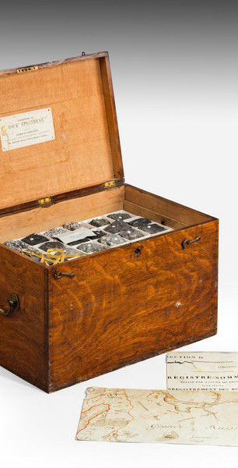
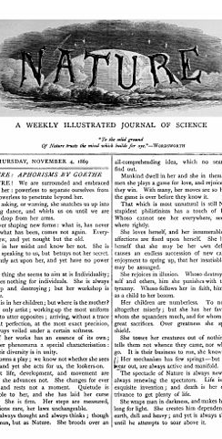
Scholarly communication
back in the day
Image credits:
Specimin box: http://www.onlinegalleries.com/art-and-antiques/detail/collection-of-geological-specimens-in-an-oak-box/271659
Nature article: Public Domain, https://commons.wikimedia.org/w/index.php?curid=601236
Notes:
Nature founded in 1869, 48 journals under the brand Scholarly Communication is usually understood to be about the way academics publish their research, and the way researchers get access to it. https://sparcopen.org/open-access/ . Now journals cost in the thousands, paid for by libraries to provide access to researchers and student. , costs keep rising - crisis
For our purposes, we’re defining it more broadly. New technologies have radically changed how scholars get access to information, analyze it, transform it into knowledge, share insights, influence policy, and contribute to broader understandings and uses of the issues they study.
We encourage participants in the Institute to think about scholarly communication as involving all of these processes, and including creators, contributors, collaborators, and audiences beyond the academy.
https://trianglesci.org/faq/what-do-you-mean-by-scholarly-communications/

Slide 5
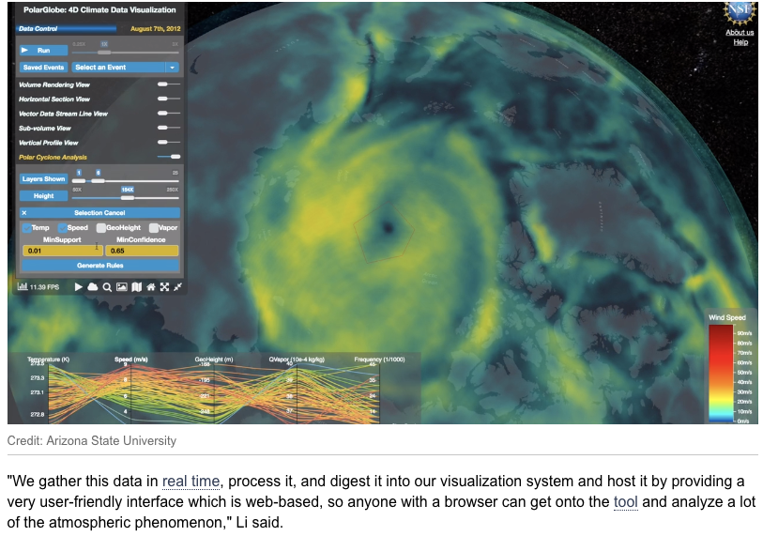
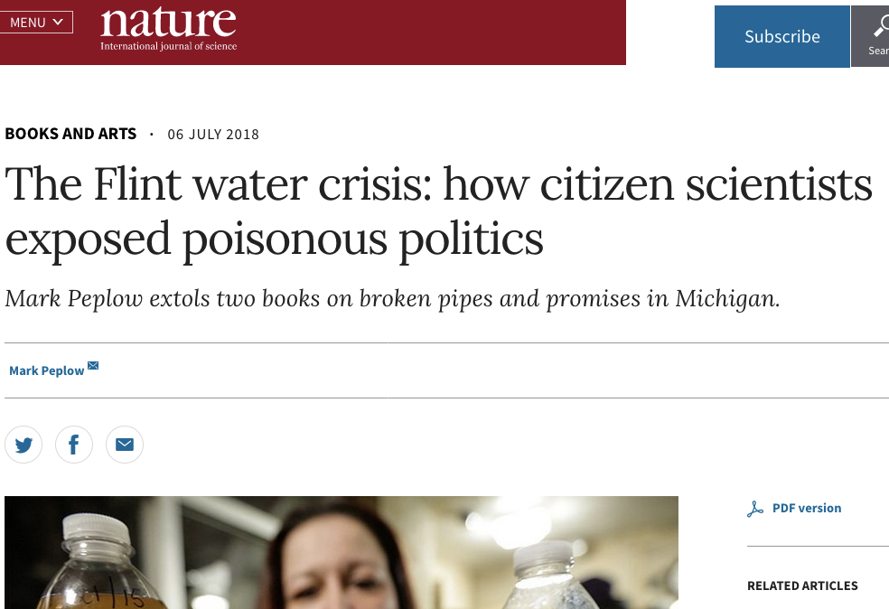
Scholarly communication today
https://www.nature.com/articles/d41586-018-05651- 7
https://phys.org/news/2018-10-professor-climate-visualization-tool-reveal.html
Notes:
Left - data, right - nature article
Despite that broader definition, our current system for communicating research is crippled by a centuries old model that hasn’t been updated to take advantage of 21st century technology:
The internet was invented to share research, journal articles faster and more widely
Scholarly communication has become more complicated but the dissemination or publishing has not kept up
https://sparcopen.org/open-access/
https://www.scmp.com/tech/apps-social/article/2174875/jane-wong-explains-why-she-uncovers-hidden-app-features-tech-giants?fbclid=IwAR03xRm2VLNJeoS12seHNlm9xVwwQ0mlDCMXMXiIcT7vi4jsTXhWM1x0gsc
Internet = possibilities
Back to the definition
Despite the possibilities - why? Perceptions of prestige and $

Slide 7
70%
Notes:
Around 70% is behind a subscription paywal
Only those institutions with subscriptions
When you graduate, your access to library resources ends,

Slide 8
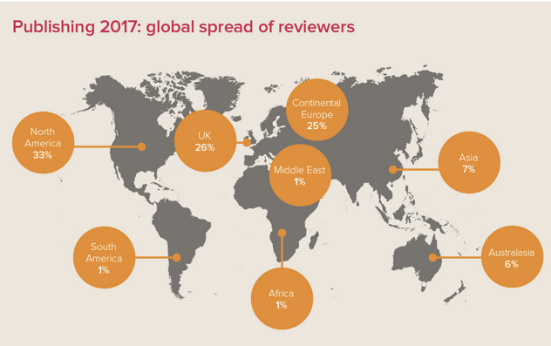
Who can access? Who gets to publish? What is published?
Notes:
In addition to not having access, the global south - those countries not north america or western europe
Despite the Possibilities of the internet but we are still confined to a box
Social justice - information privilege - accessing information that others can not
How do you get access to research and scholarship?
Who are scholars? National and international scientists from the global south are less likely
Citizen science - not just for science

Slide 9
Scholarly Communication at UC San Diego
The Library's Scholarly Communication Services supports researchers and scholars at UC San Diego from all backgrounds, disciplines, and at all career stages in matters relating to scholarly communications.
Notes:
This is where i come in - my job is to facilitate access and visibility to scholarship and research

Slide 10
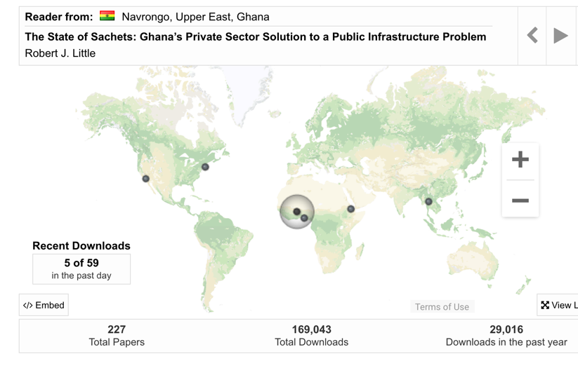
https://scholarship.claremont.edu/eap_ea_theses/
Importance of access & more democratic views of content
Notes:
https://scholarship.claremont.edu/eap_ea_theses/
Take ownership, be aware and intentional with how you use other people’s works and how you share your own
Your work is important to share, use your power for good not evil

Slide 11
Scholarly Communications at the Library
Copyright & author rights
Research impact & scholarly identity
Funder & UC public access policies
Publishing opportunities & UCSD journal editor resources
[open educational resources/open textbooks]
https://ucsd.libguides.com/ScholComm
Notes:
Individual consults, workshops, presentations like this one today
Use copyrighted works or retain copyright to your works
Demonstrate impact and manage your online scholarly reputation
Meet requirements and ensure the widest reach of your works
Be aware of new publishing opportunities as an author or journal editor
3d journal, OA new mode, visiting scholaror from Asia and female

Slide 12
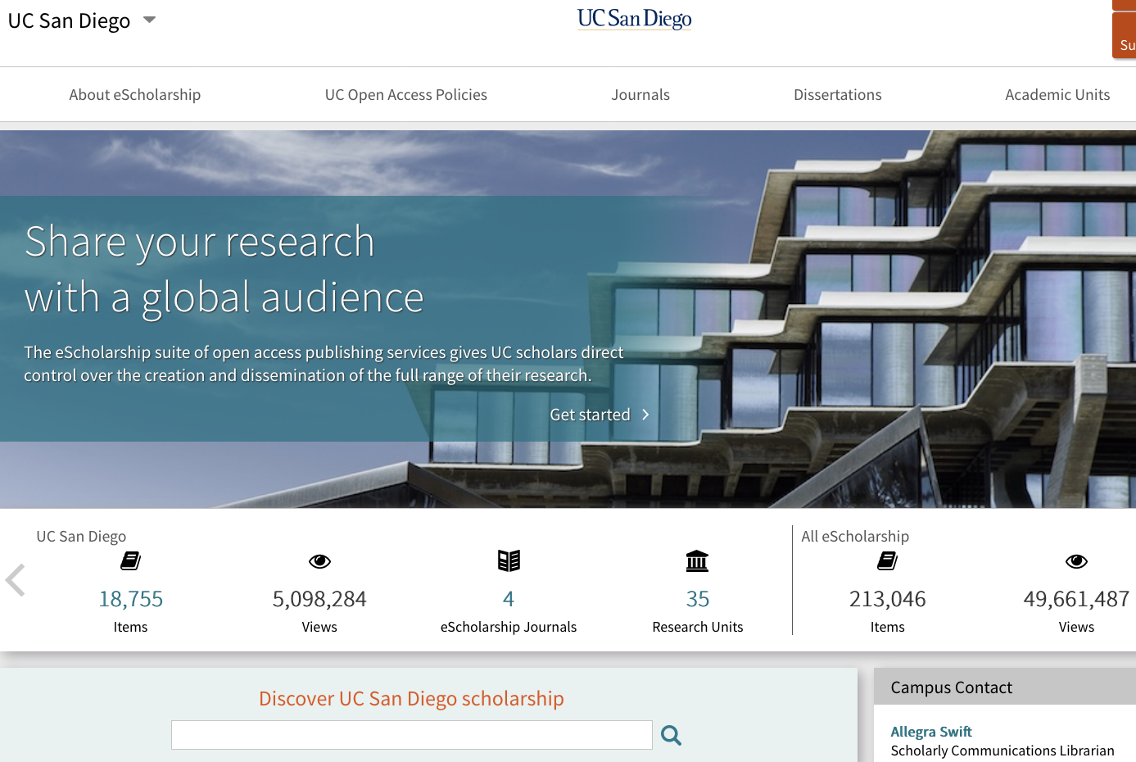
https://escholarship.org/uc/ucsd
Notes:
Built a repository to provide UC scholarship in OA, can also publish oa journals here
Expand what is published - data, oer, syllabus
https://escholarship.org/uc/ucsd
Bending the curve - climate science

Slide 13
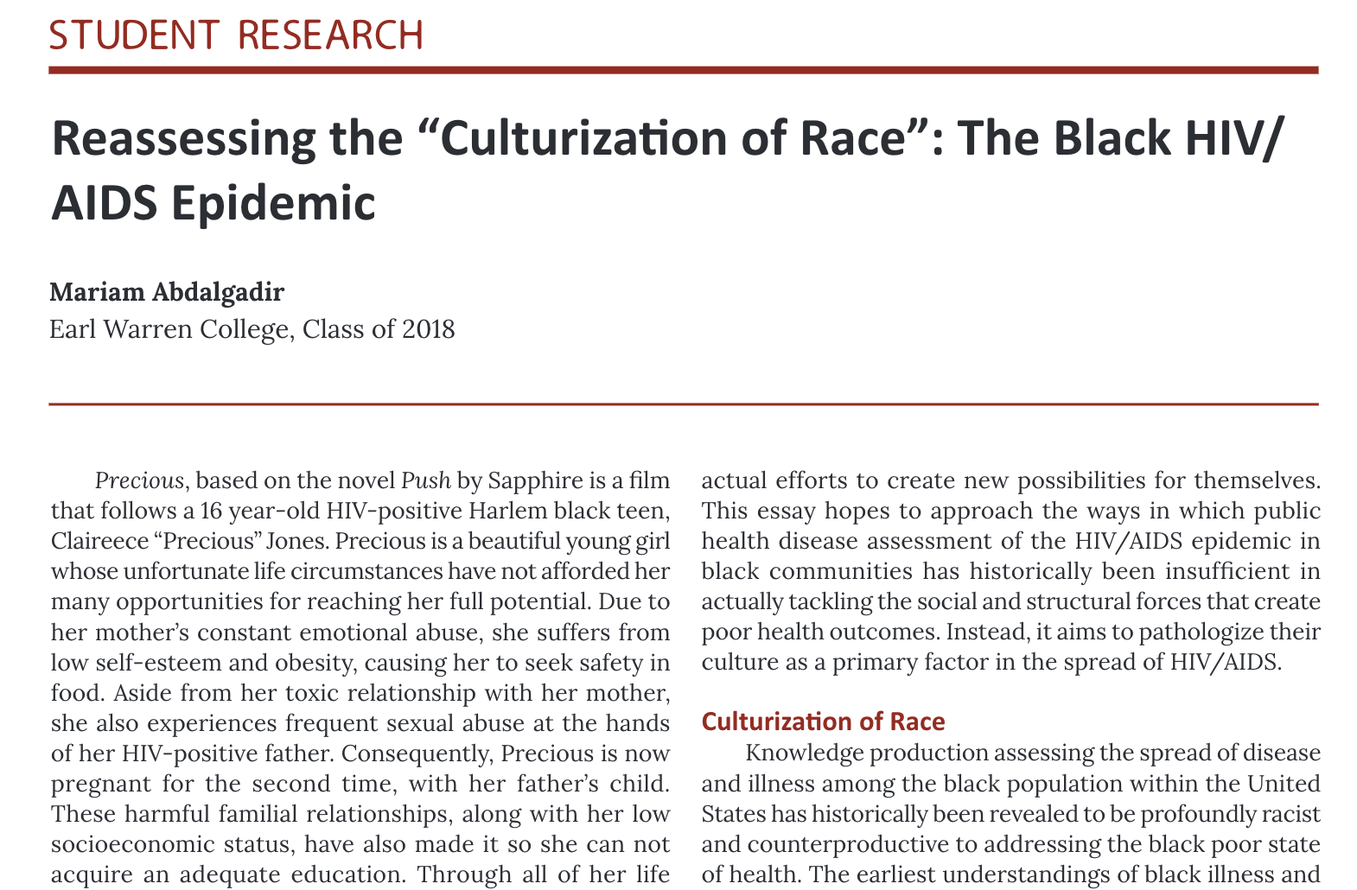
Publishing options
Abdalgadir, M. (2018). Reassessing the “Culturization of Race”: The Black HIV/ AIDS Epidemic. The Equilibrium, 4(1). Retrieved from https://escholarship.org/uc/item/0sg9261n
Notes:
Publisher discount

Slide 14
https://digital.sandiego.edu/symposium/2017/2017/15/

Slide 15
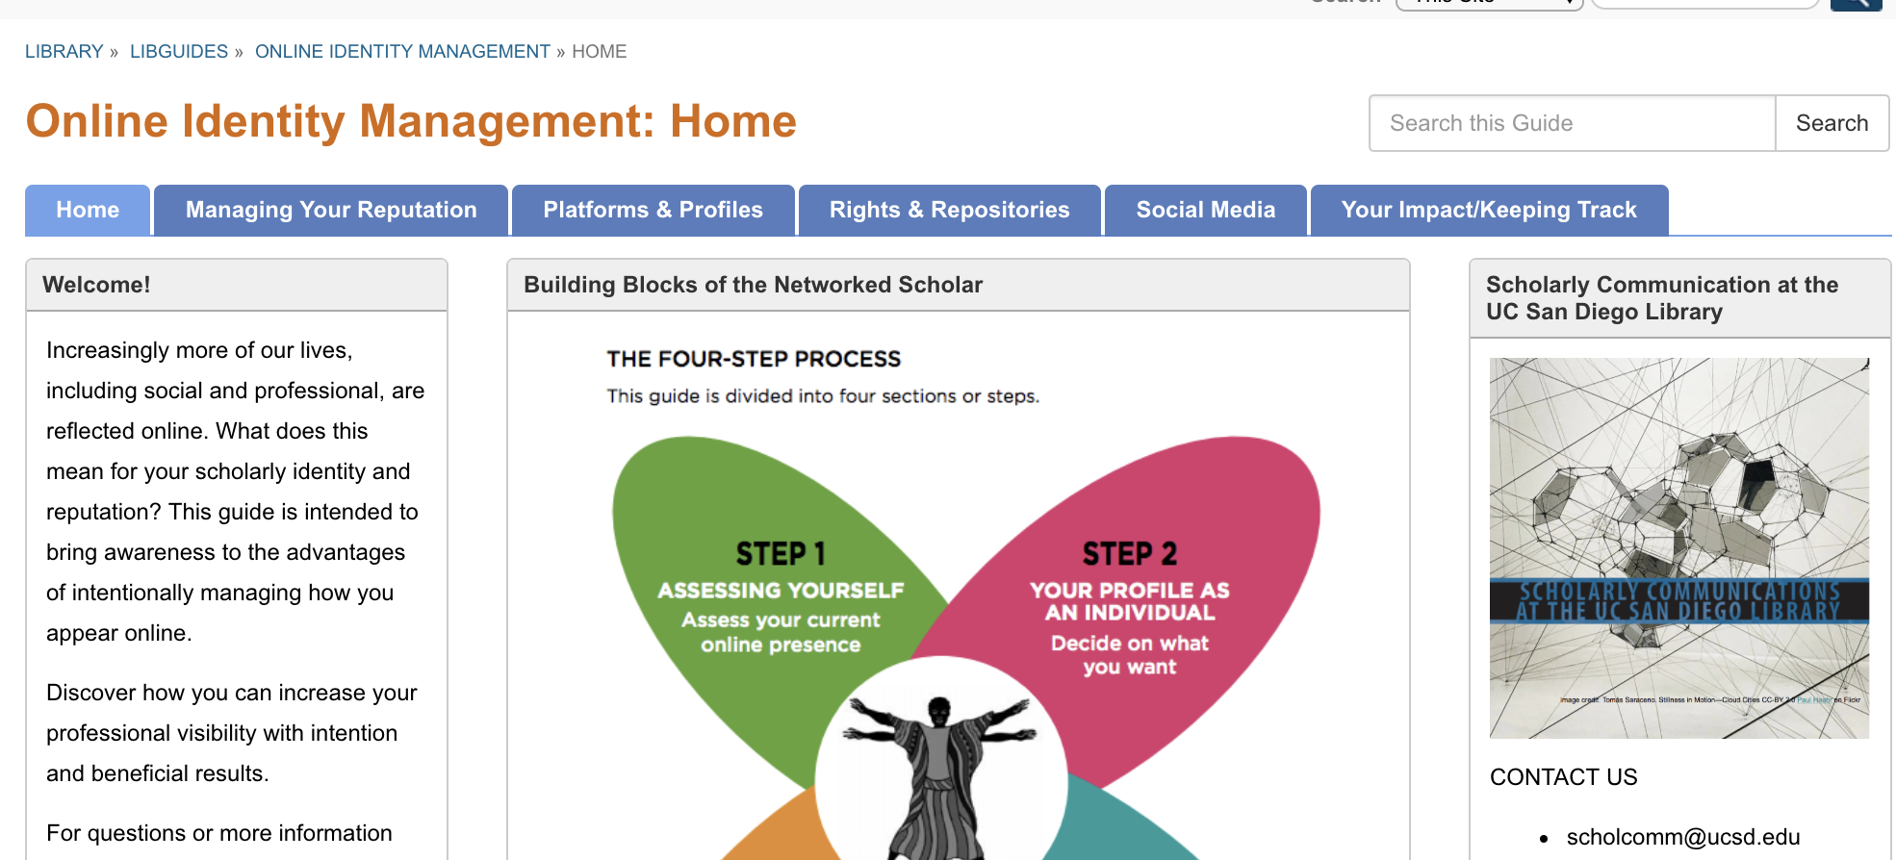
http://ucsd.libguides.com/OnlineIdentity/home
Notes:
While you are putting all of the scholarship online, there are some things to consider.
They should be things to consider even in your dialy online life
Intetional and thoughtful
Digitlal citizenship

Slide 16
Questions?
Allegra Swift | Scholarly Communications Librarian
scholcomm@ucsd.edu
@UCSDScholCom | CONDUIT https://knit.ucsd.edu/scholcomm/ scholcomm@ucsd.edu | lib.ucsd.edu/schol-comm
Notes:
Prof. Keith Pezzoli
11/27/2018, 12:30-1:50pm in Center Hall 217B.
30 mins : UCSD is doing to promote/enable good scholarly communication , shaping scholarly/professional identity and positioning the UG as author and creator of information.
about your role as a scholarly communication librarian, what role the univ plays in enabling scholarly communication --how, why, for whose benefit?. And whatever else you may want to share (e.g., tips on how to do scholarly communication well). The class has 35 undergraduate Communication majors in it.

