Slide 1
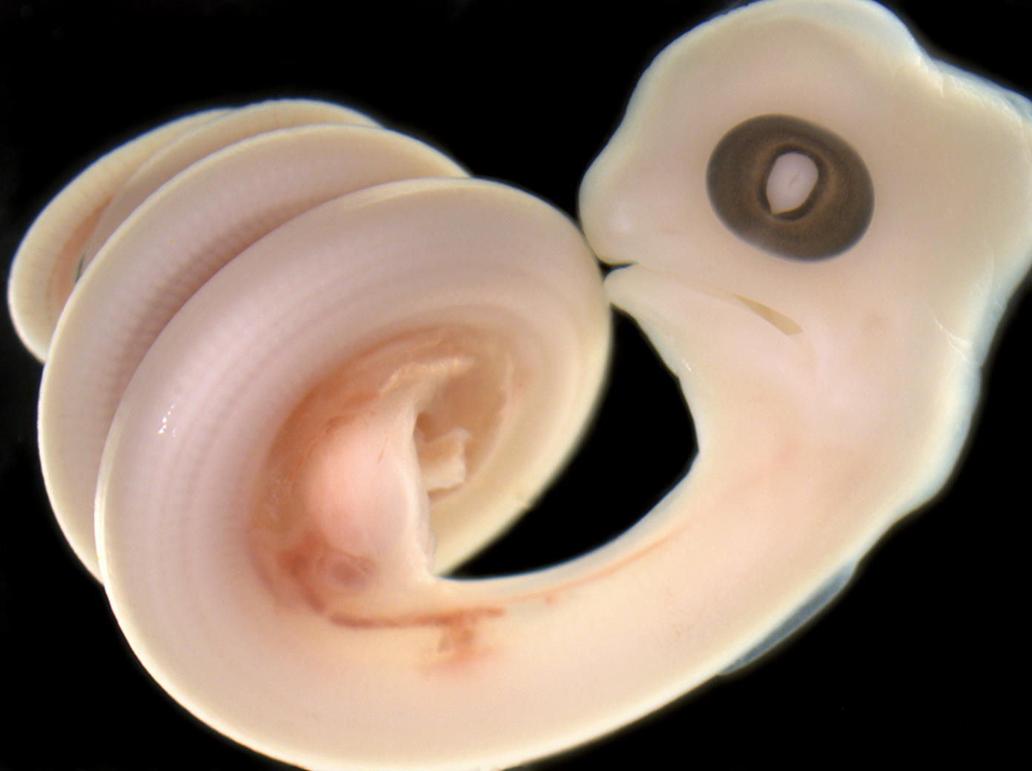
Dehydration during egg production alters egg composition and yolk immune function
George Brusch IV¹, Benoit Heulin², and Dale DeNardo¹
¹Arizona State University, USA ²University of Rennes, FR
Background
Parent-offspring conflicts occur when resources for allocation are limited. Water is a fundamental resource that has received limited consideration as a potential currency of these conflicts.
Past studies examining clutch size and mass suggest that, when water is limited, reproductive females are compromised in favor of developing embryos¹.
We tested the hypothesis that the mother-offspring conflict over limited water resources leads to finer scale morphological and physiological impacts on the eggs in Children’s pythons (Antaresia childreni).
We predicted that water deprivation during gravidity alters female investment into her eggs, impacting egg water content and shell development.
Additionally, we predicted that the yolk in these dehydrated eggs would have enhanced immune performance metrics, as has been documented in dehydrated adults² and late-stage embryos³.
Dehydrated eggs have higher water loss rates
*
As a result of thinner shells
CC
F
Dehydrated females produce lighter eggs that are also dehydrated (less water content and higher yolk osmolality)
Water
No water
*
Maternal treatment | Calcareous crust (µm) | Fibrous layer (µm)* | Total thickness (µm)*
Water | 6.8 ± 0.2 | 94.8 ± 3.3 | 101.6 ± 3.6
No water | 6.5 ± 0.7 | 85.2 ± 2.8 | 91.8 ± 3.5
*
Dehydrated eggs have greater antimicrobial capabilities
*
*
*
Conclusions
Our results provide the first evidence of a water-based mother-offspring intergenerational trade-off in an oviparous vertebrate.
The impacts are not entirely negative, as dehydrated eggs have higher antimicrobial capabilities and thinner shells which might lead to elevated rates of rehydration, but this would also lead to greater water loss should substrate be dry.
Our study emphasizes the importance of including effects that are more cryptic when exploring consequences of mother-offspring conflicts.
Overall, by examining an array of egg traits, we demonstrated that dehydration of gravid females impacts the eggs, not just the females as previously reported.
References
1. Dupoué et al.(2015) Biol J Linnean Soc
2. Brusch et al. (2017) Physiol Biochem Zool
3. Brusch & DeNardo (2019) Dev Comp Immunol
Acknowledgements
We thank Dr. O. Lourdais and members of the DeNardo lab. Funding provided by the GPSA JumpStart grant, Peabody Family Memorial Award, and the NSF GRFP (#1311230).

