Slide 1

Why Open Science
Slow, wasteful, locked away
Ruled by commercial interests
Questionable research practices
Closed science means people suffer
Reproducibility, Access, Serials, Evaluation crises
Science is not working as it should be
@OpenScienceMOOC

Slide 2
Why Open Science now?
@OpenScienceMOOC
Things are getting worse (in many respects)
Growth of Open is too slow from the ‘bottom up’
We have to act now, as a community

Slide 3
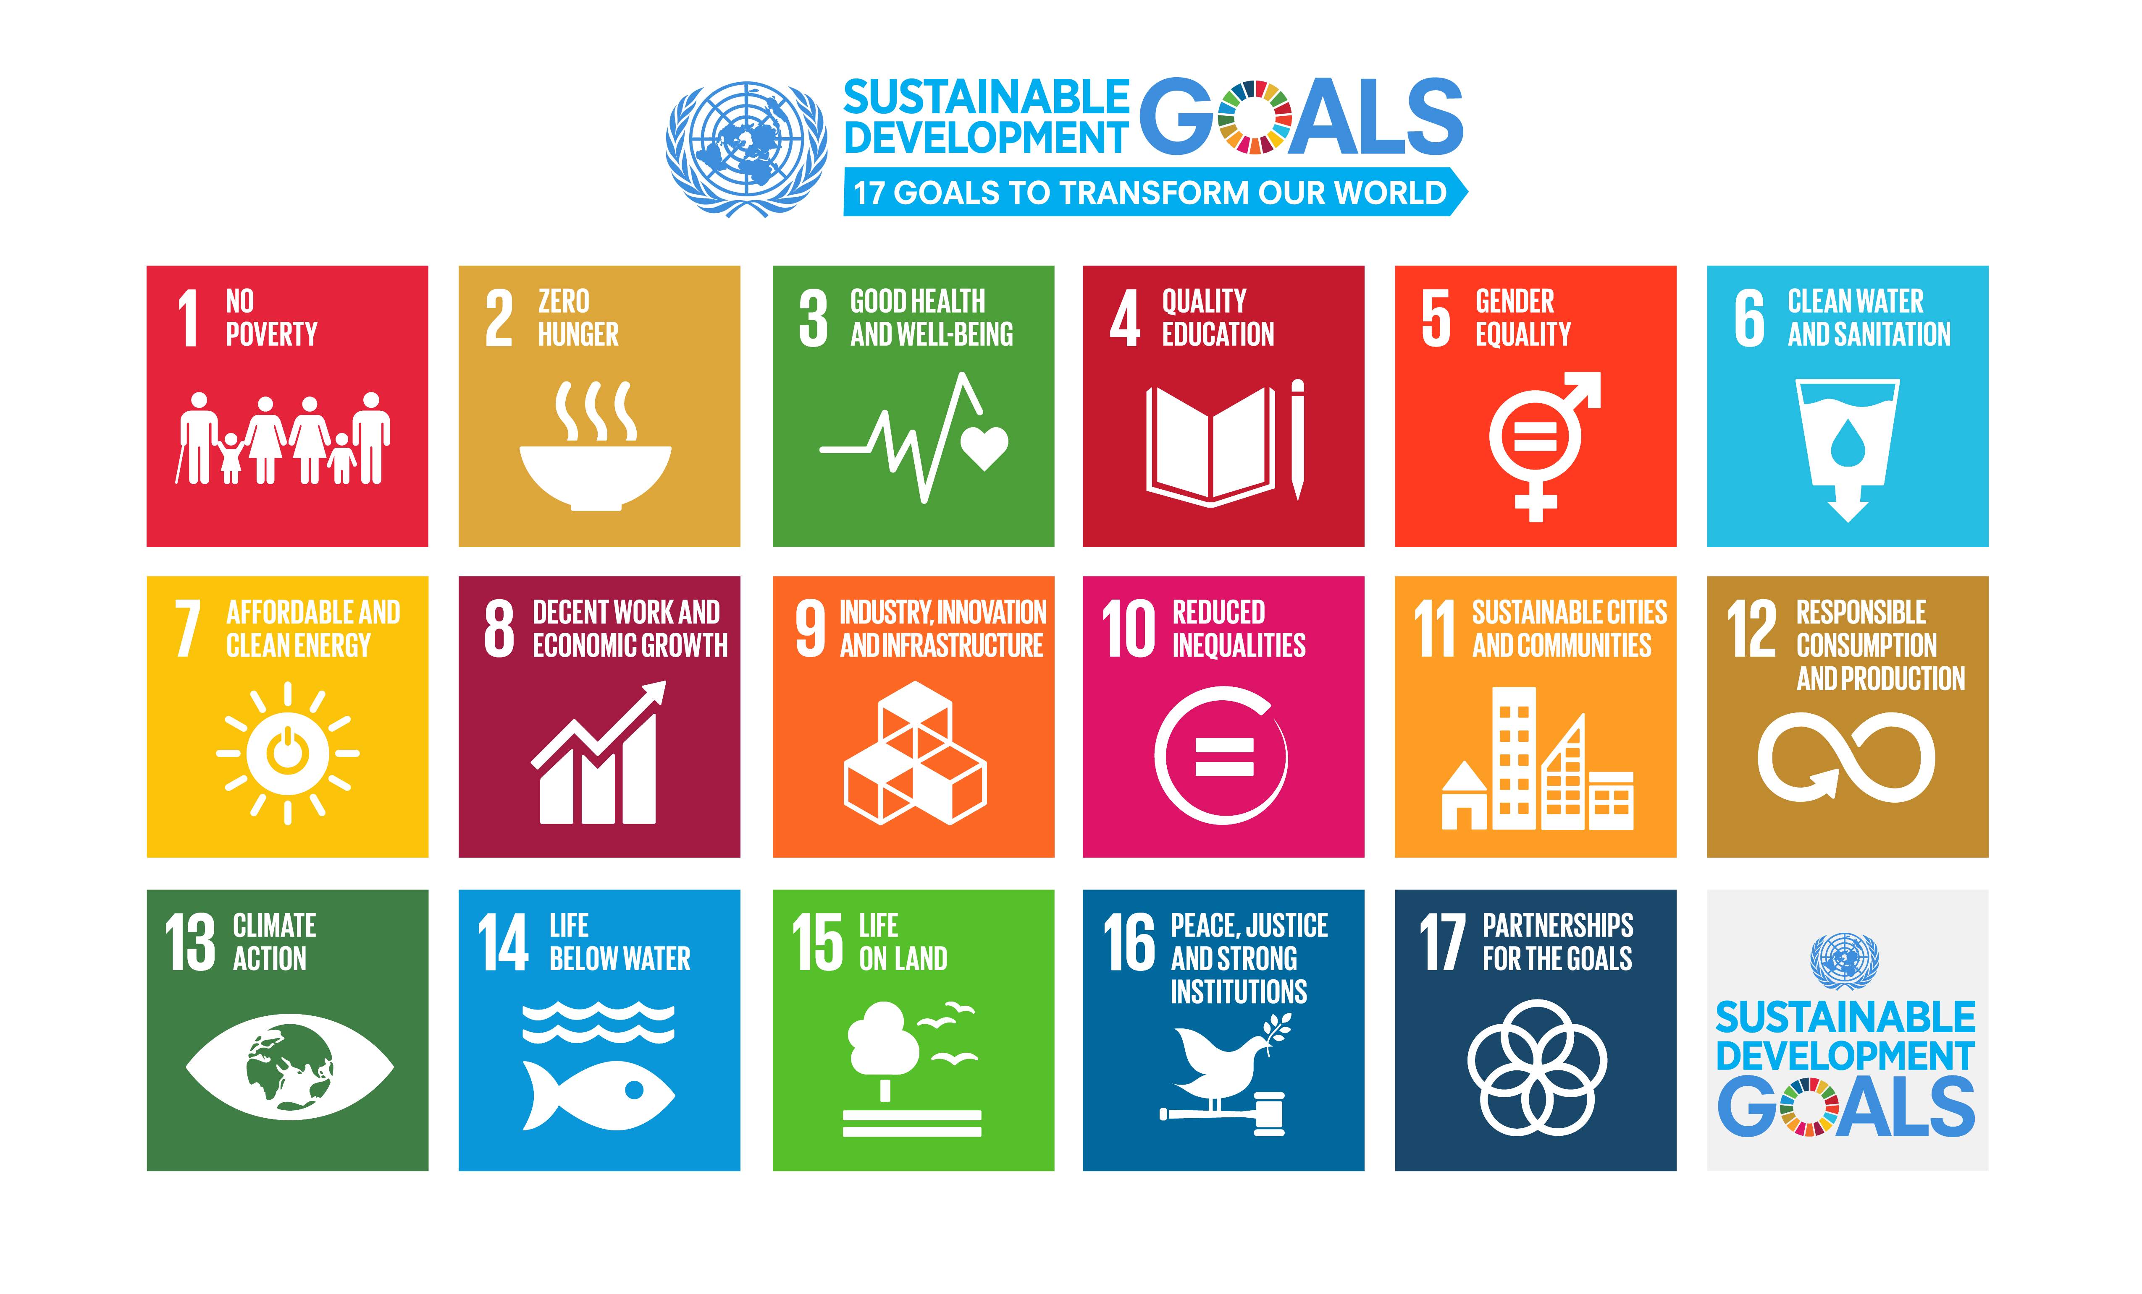
We need science if we are going to help quickly and sustainably solve these
http://www.who.int/mediacentre/events/meetings/2015/un-sustainable-development-summit/en

Slide 4
Who is leading the change?
Organisations still stuck in a pre-digital mindset whose primary product was developed in the 17th Century.
We DO NOT share the same values and principles.
But as individuals we are powerless to face these tasks alone.
Elsevier?
Springer Nature?
We can do better.
@OpenScienceMOOC

Slide 5
Our vision of the future
To help make ‘Open’ the default setting for all global research.
We want to help create a welcoming and supporting community, with good tools, teachers, and role-models, and built upon a solid values-based foundation of freedom and equitable access to research.
@OpenScienceMOOC

Slide 6
The way we do research has changed for good
We now have new expectations
Transparency
Not secrecy
Collaborative
Not solo
Continuous
Not discretised
@OpenScienceMOOC

Slide 7
We should be training ourselves
Sustained community engagement across disciplines
Rethinking our mindset
Changing the incentive system
New skills for inside/outside of academia
@OpenScienceMOOC

Slide 8
Our communication strategy
Messaging
For students:
These skills will get you a job both inside and outside of academia.
These skills will save you time during your research.
These skills will make your output of better quality.
These skills make peer review of your papers more efficient.
Also specific messages tailored for lab/institutional heads, policymakers, and librarians
https://github.com/OpenScienceMOOC/Main/blob/master/communication_strategy.md
@OpenScienceMOOC

Slide 9

How do we get to where we want?
Imagine a future defined by the values of Open Science:
        Freely available public good
        Rigorous and reproducible
        Open to ALL
        Isn’t that just GOOD science?
@OpenScienceMOOC

Slide 10
The best researchers have already reinvented themselves into Openness
We need everyone to be collaborating together if we are going to help solve the challenges humanity faces.
Previous slide: Melanie Imming, & Jon Tennant. (2018, June 8). Sticker open science: just science done right.
Zenodo. http://doi.org/10.5281/zenodo.128557

Slide 11
How do we fit in?
Community
Common values
Collaboration not competition
@OpenScienceMOOC

Slide 12
Introducing the Open Science MOOC
A peer-to-peer value-based community that works towards better science for society
@OpenScienceMOOC

Slide 13
What do researchers care about?
Saving time and effort
Problem solving
Advancing research
We give them the knowledge and skills to do this
@OpenScienceMOOC

Slide 14
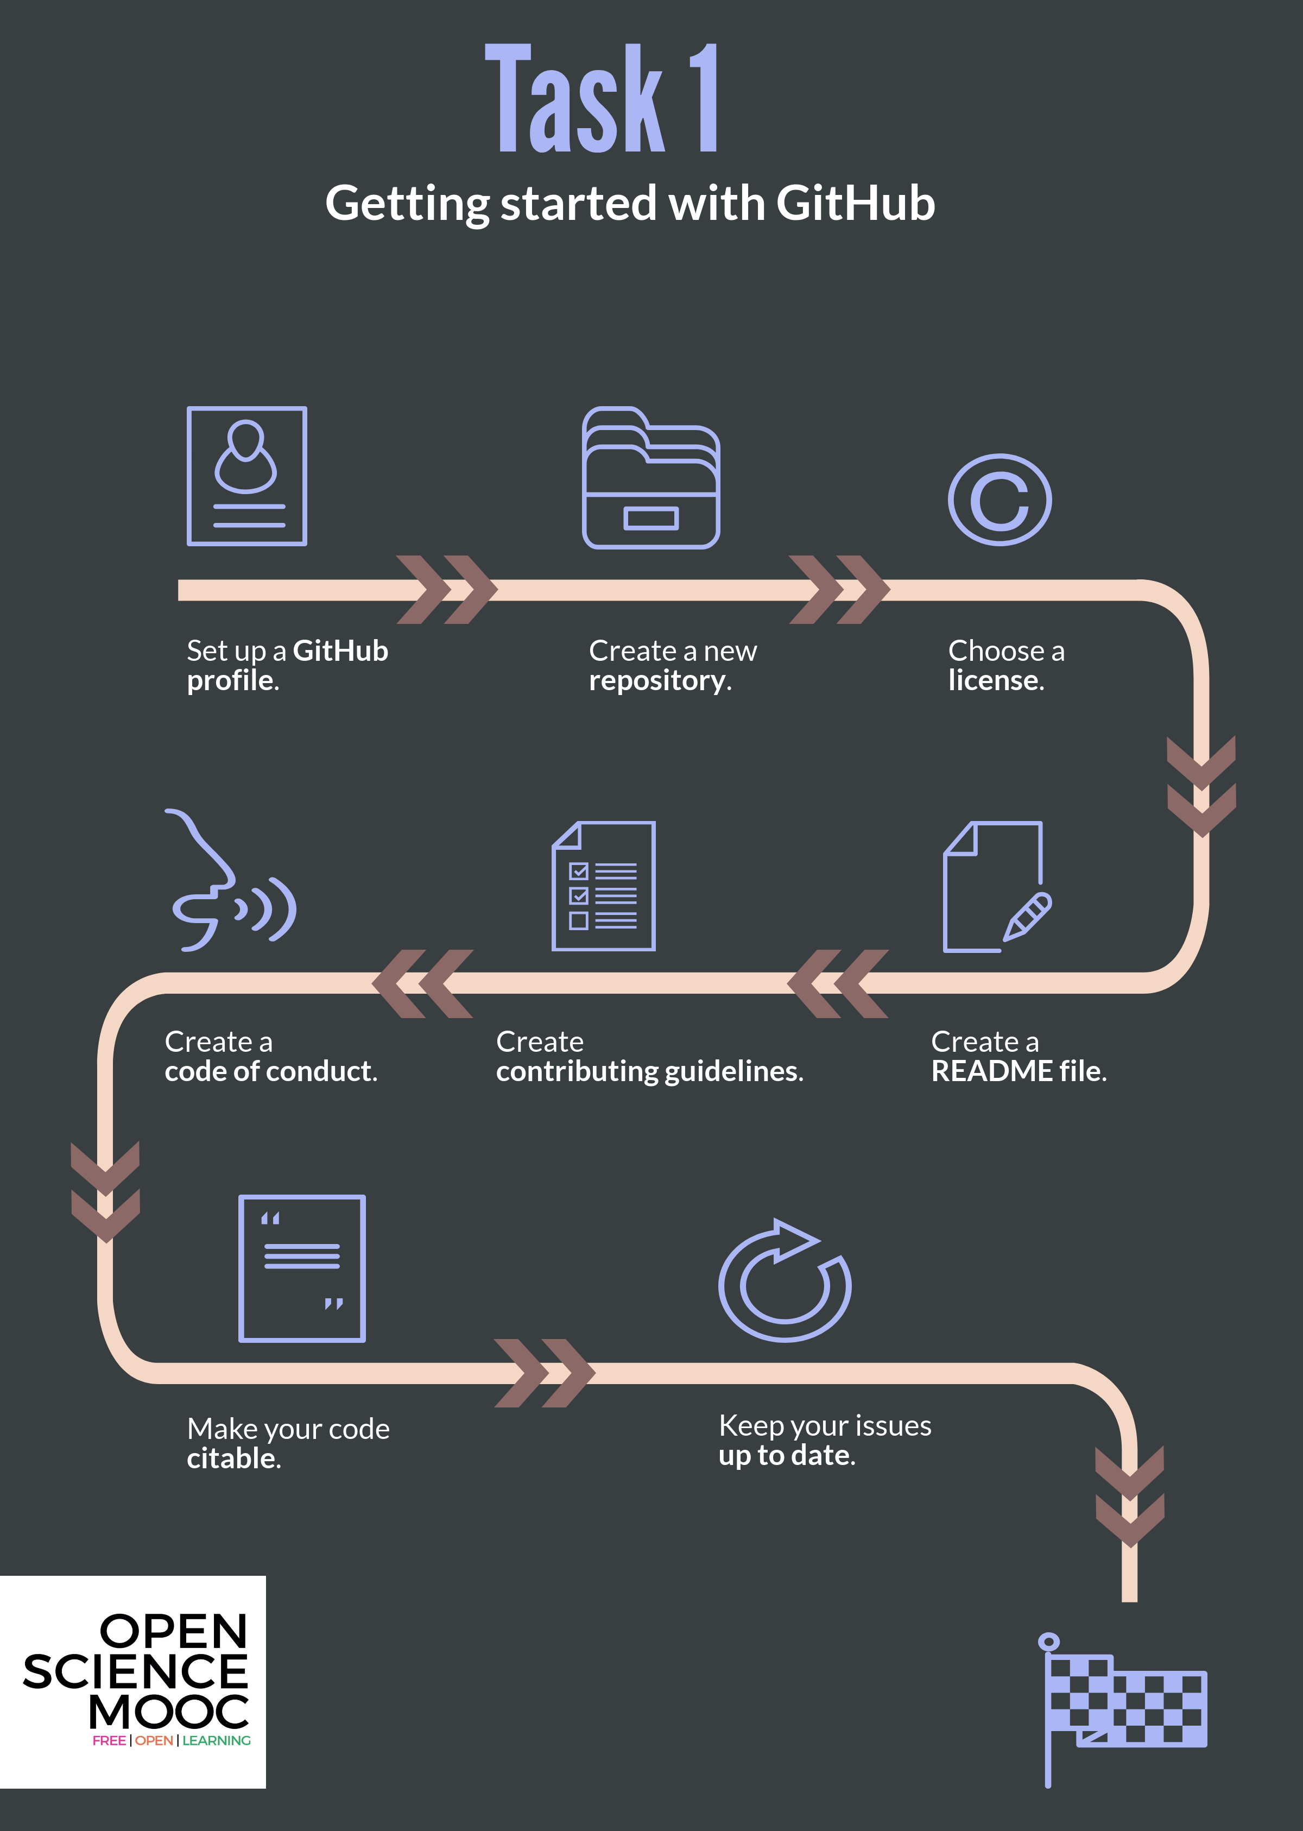
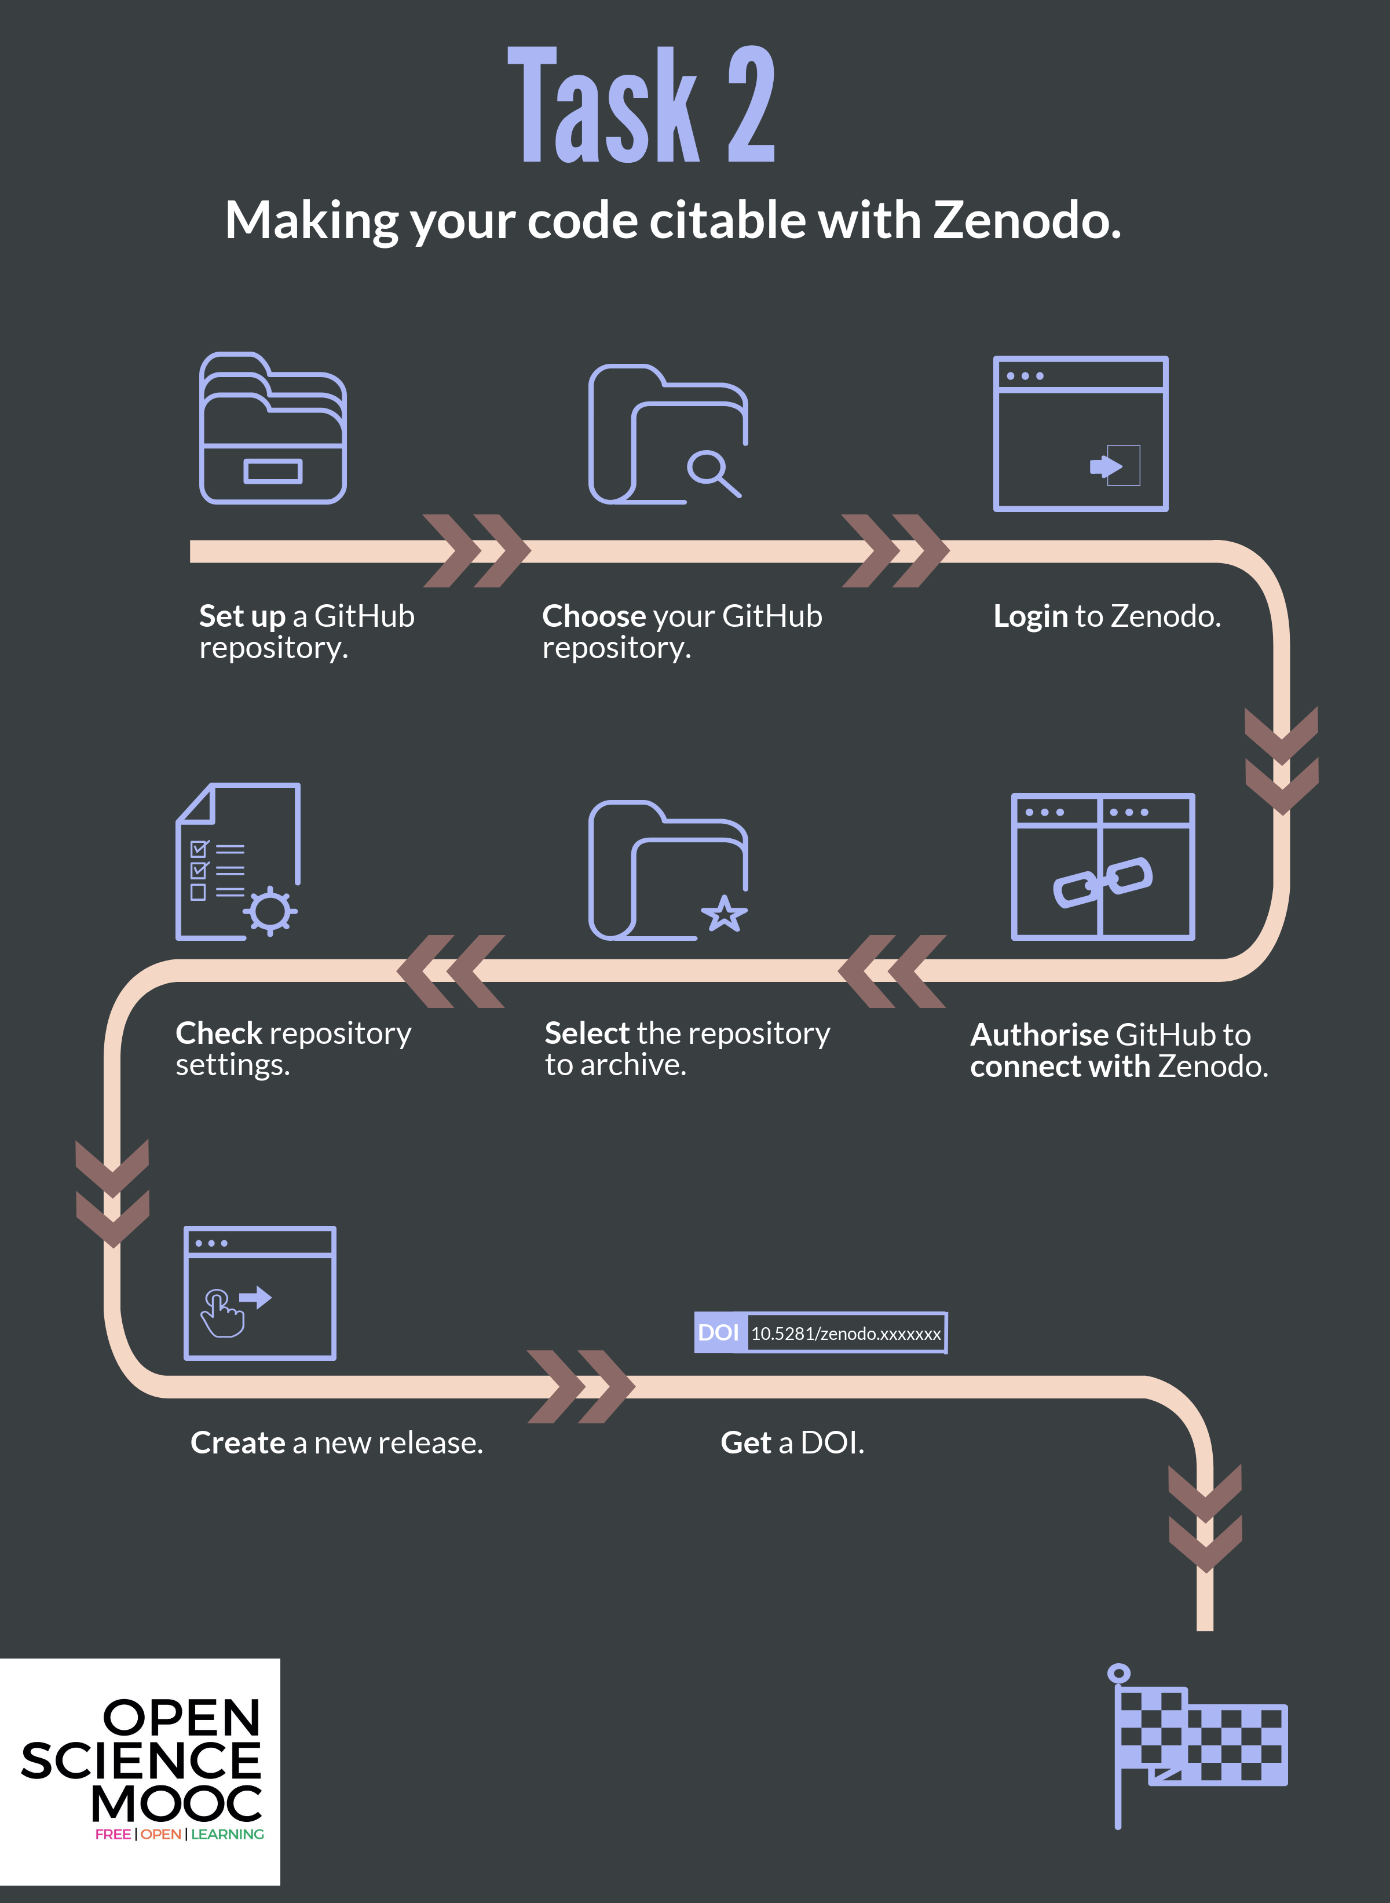

Slide 15
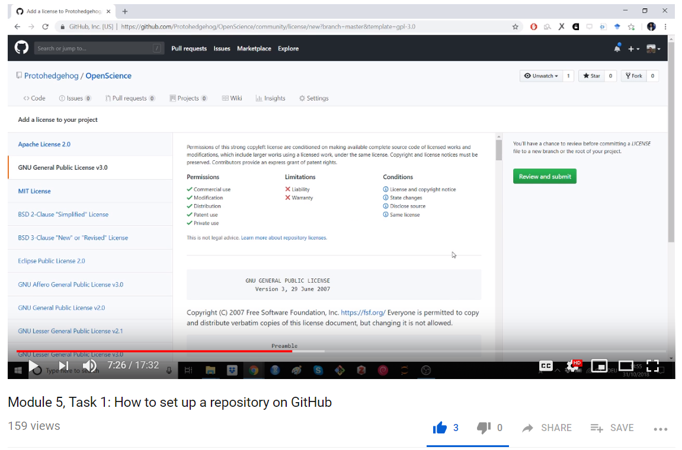
https://www.youtube.com/watch?v=AnftV9HBPSc&t=1s
@OpenScienceMOOC

Slide 16
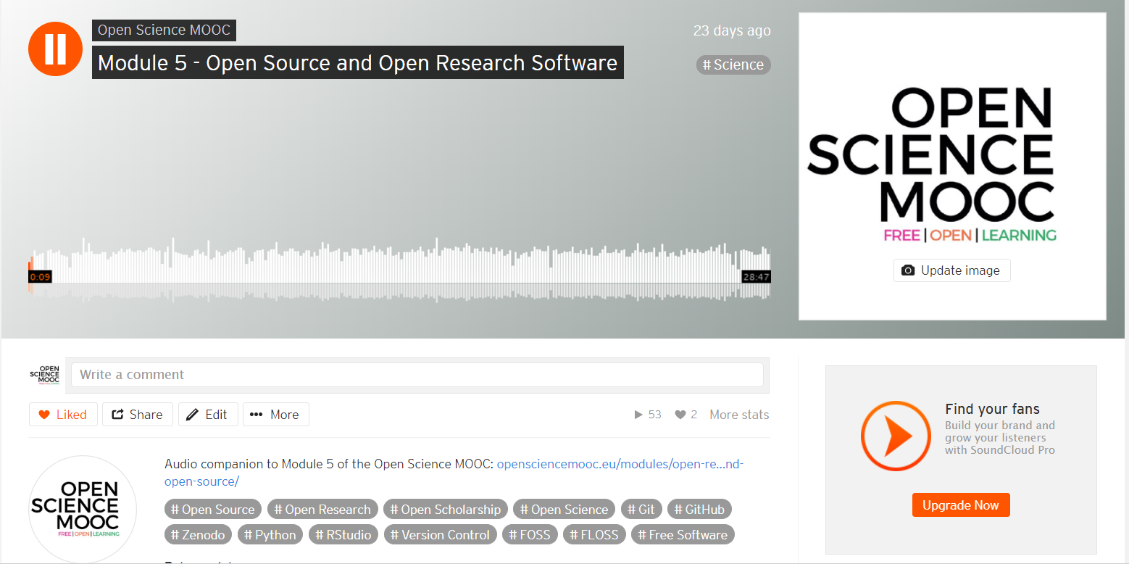
https://soundcloud.com/open-science-mooc/module-5-open-source-and-open-research-software
@OpenScienceMOOC

Slide 17
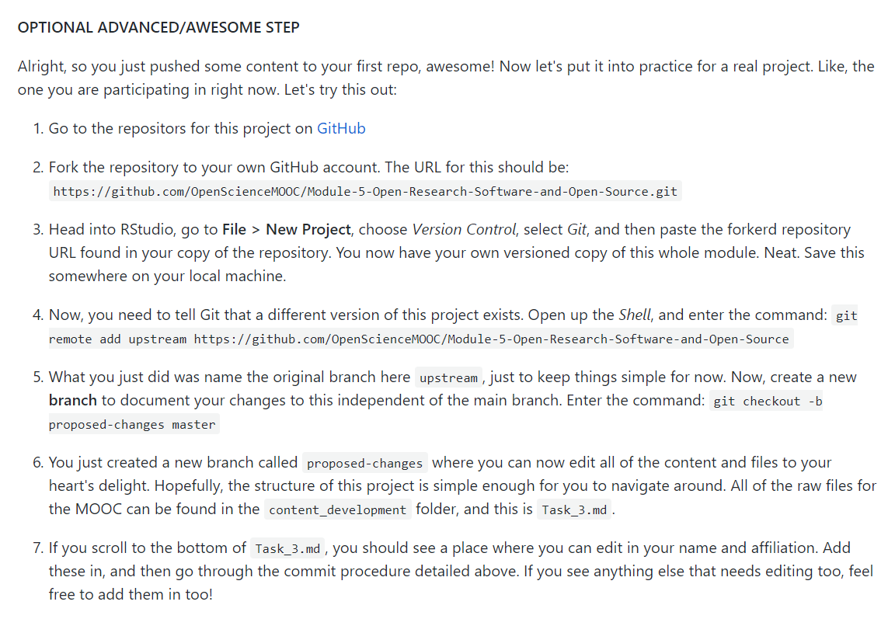
A fully interactive learning style
This allows learners to actually edit the MOOC content for this module. Nice.
Learning is based on participation and collaboration.
@OpenScienceMOOC

Slide 18
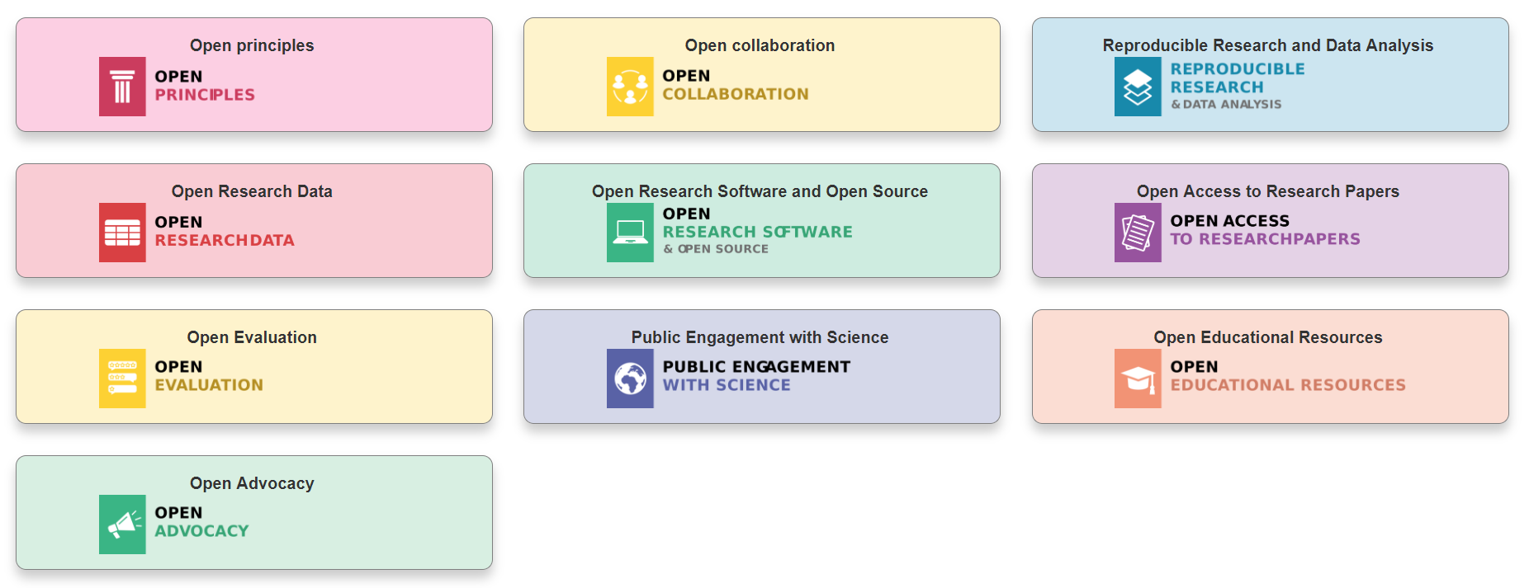
Modular learning
@OpenScienceMOOC
Designed by: Mike Morrison

Slide 19
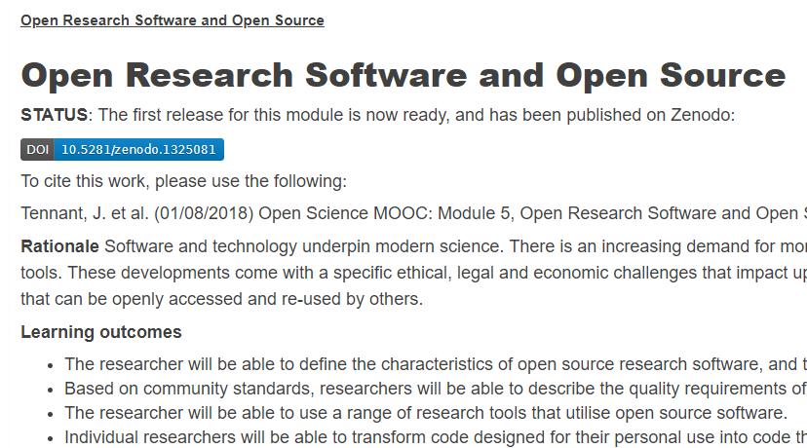
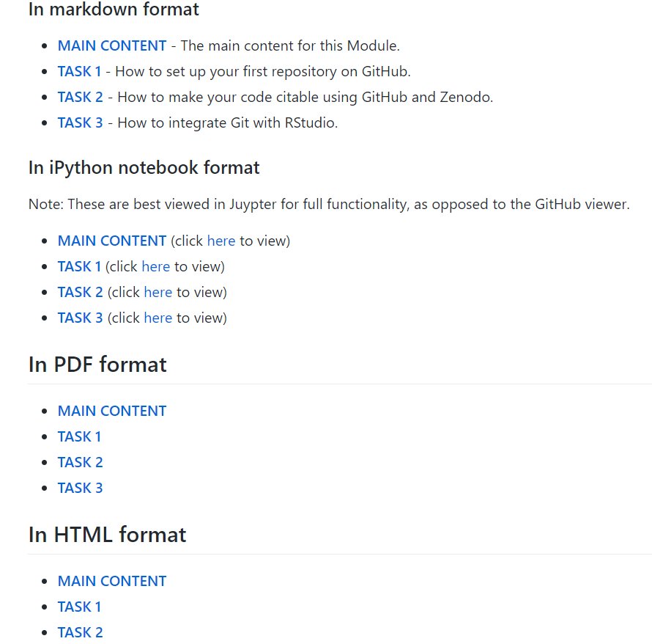

Open for re-use
@OpenScienceMOOC

Slide 20
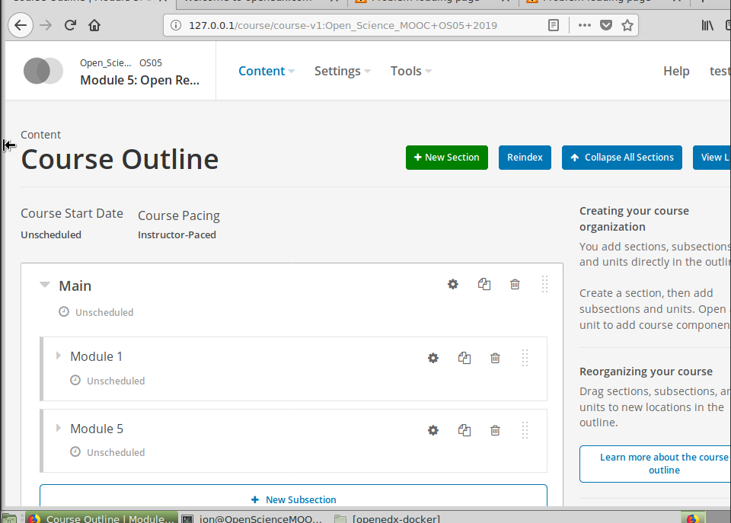
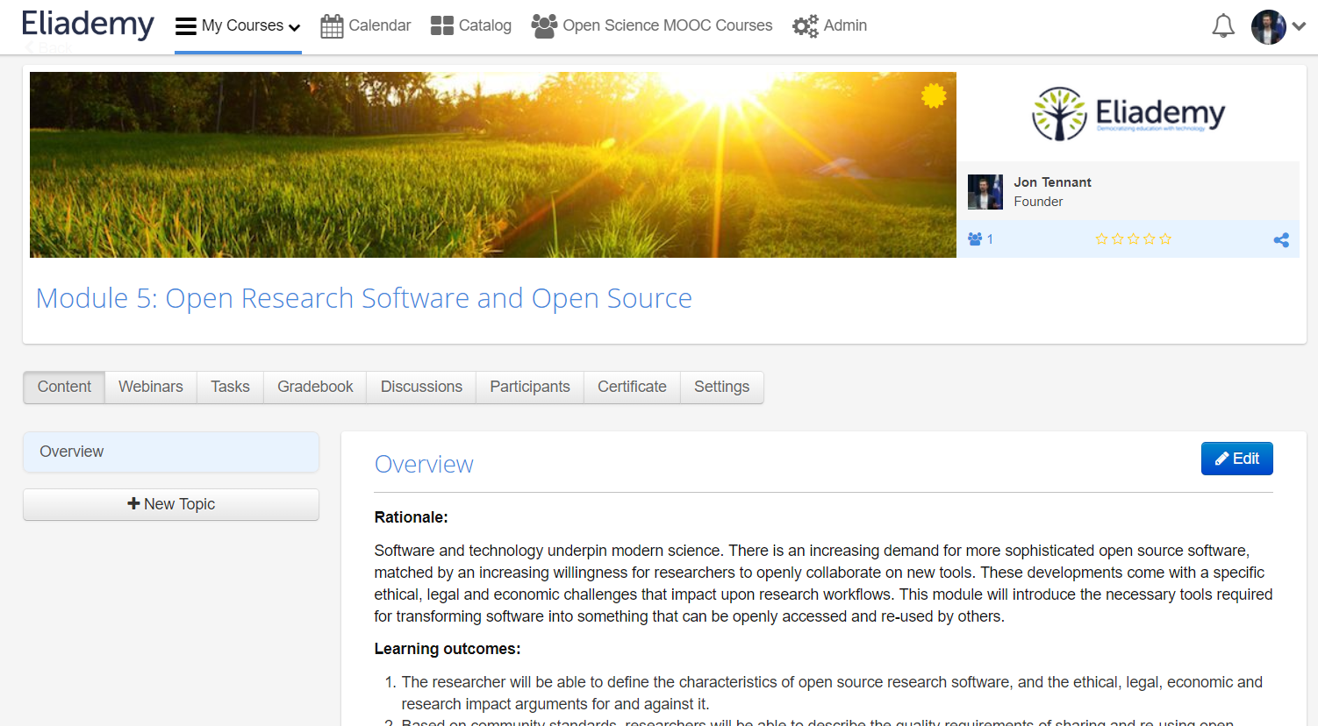
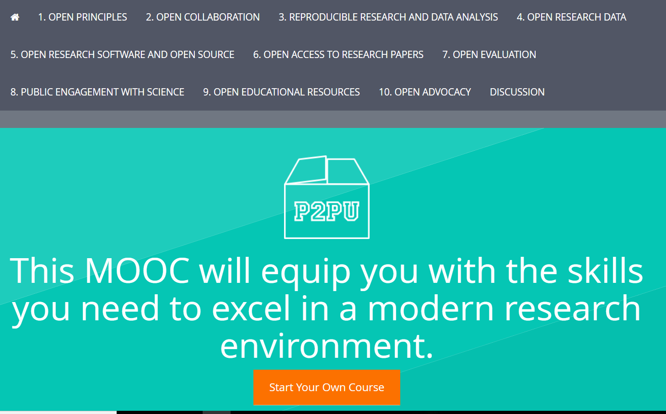
What about the MOOC provider?
https://eliademy.com/app/a/courses/02d7338a7e
https://opensciencemooc.github.io/course-in-a-box/
@OpenScienceMOOC

Slide 21
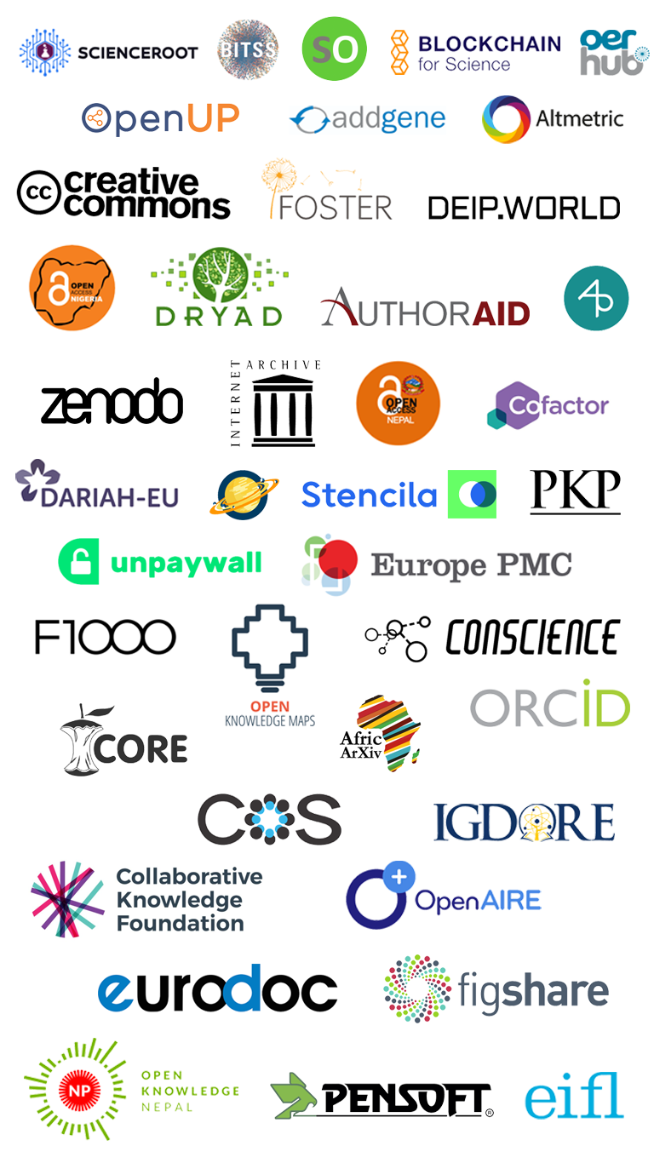
We are not alone

Slide 22
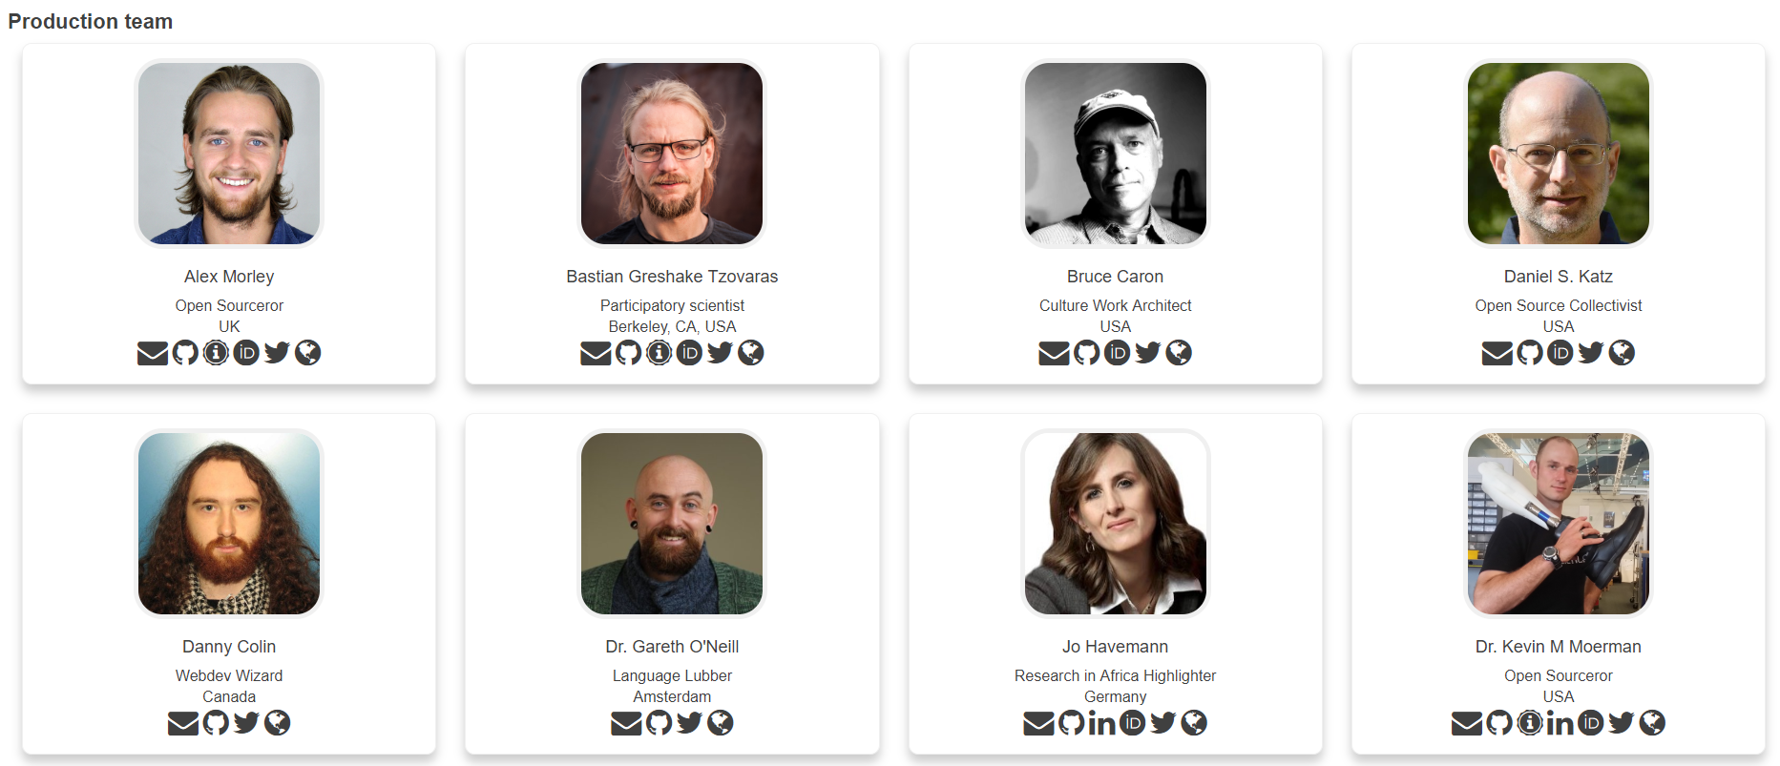
Some of our Production Team

Slide 23
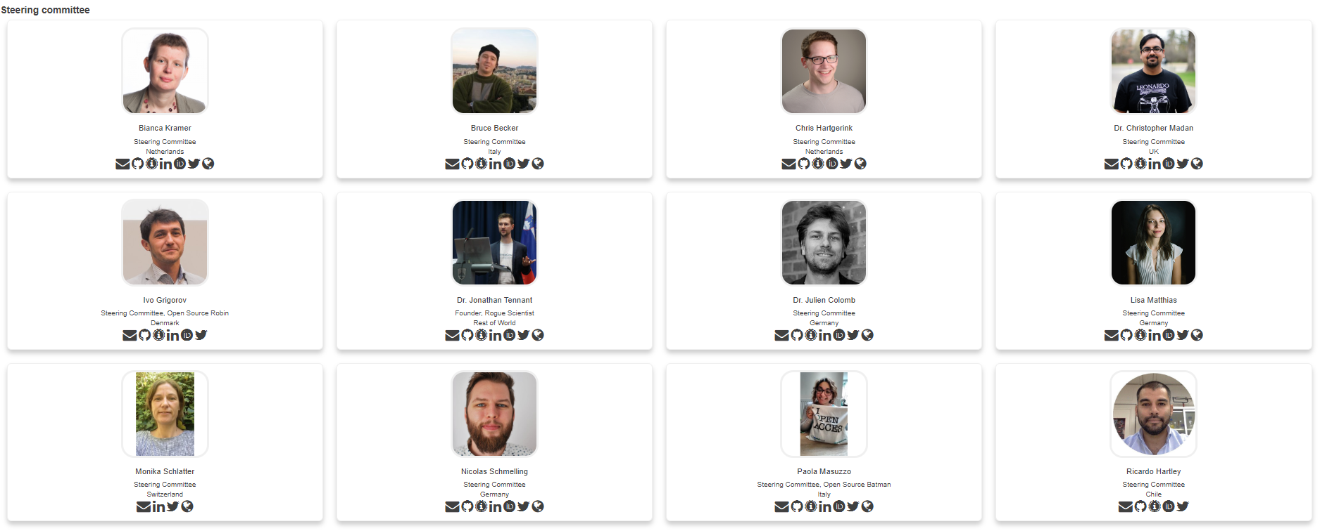
We are guided by passion

Slide 24
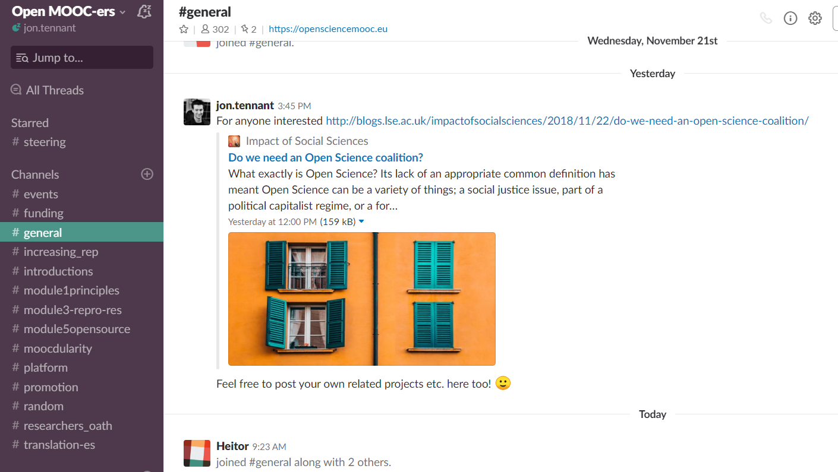
@OpenScienceMOOC
https://openmooc-ers-slackin.herokuapp.com/

Slide 25
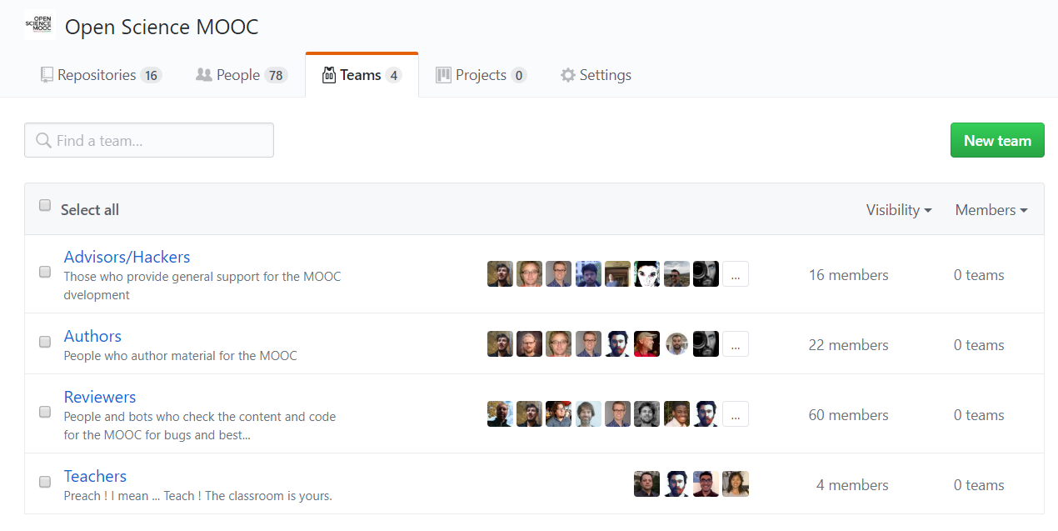
https://open-science-mooc-invite.herokuapp.com/
@OpenScienceMOOC

Slide 26
Skeptical? You should be.
@OpenScienceMOOC
But it’s not as new as you think.
Science was founded on openness.
We closed it down.
It’s time to open it up again.

Slide 27
Status
@OpenScienceMOOC
In development
300 Slack community members
4000 Twitter followers
45 strategic partnerships
Agile development so people are already using content
Iterative feedback is our design

Slide 28
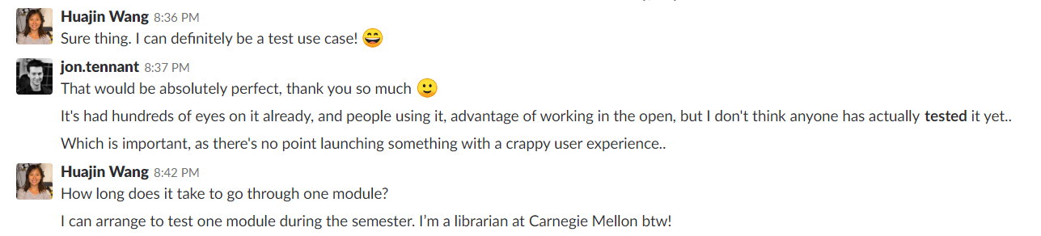
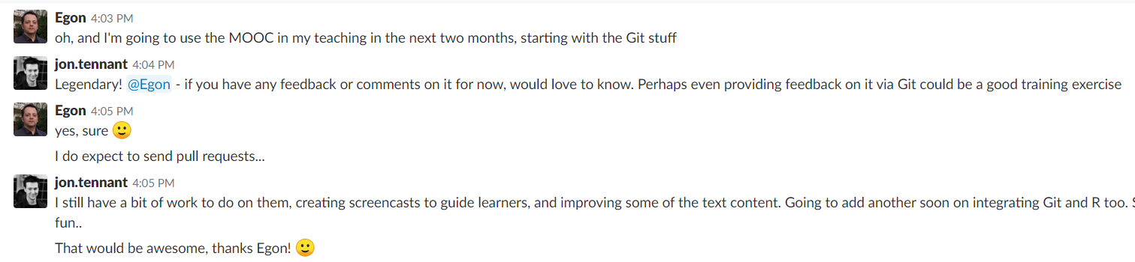
Already making ripples
Carnegie Mellon and Maastricht University
And we haven’t even started promotion yet…
@OpenScienceMOOC

Slide 29
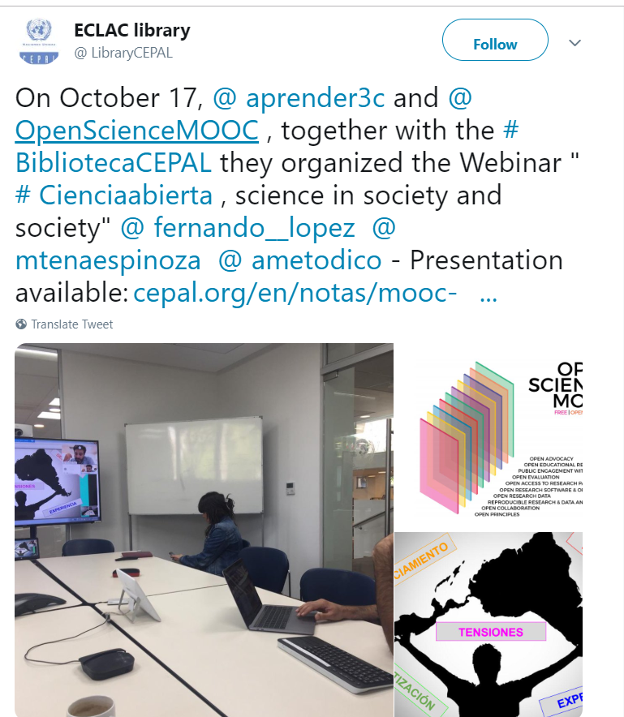
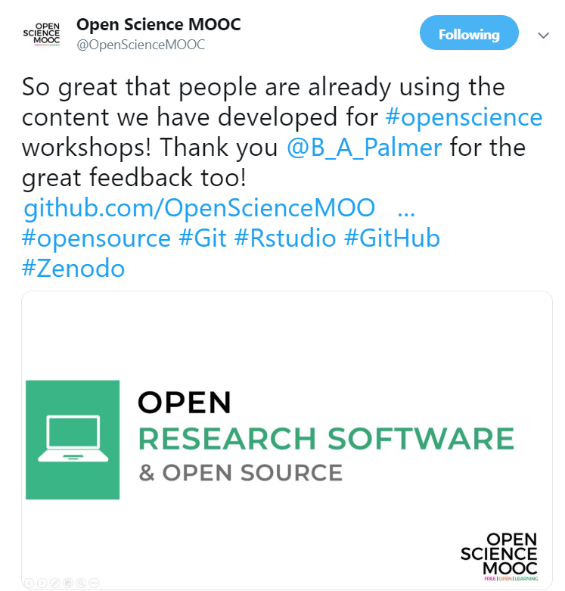
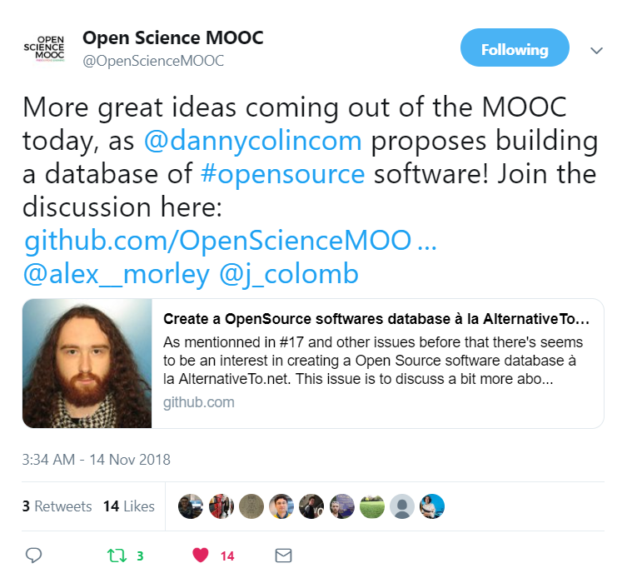
https://twitter.com/BibliotecaCEPAL/status/1064939900817088512
https://twitter.com/OpenScienceMOOC/status/1059823755680202752
https://twitter.com/OpenScienceMOOC/status/1062549416450523137

Slide 30
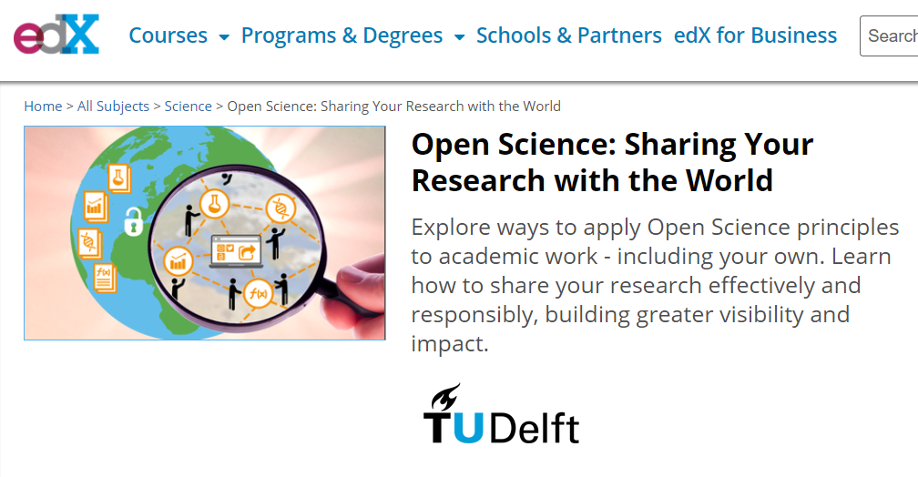
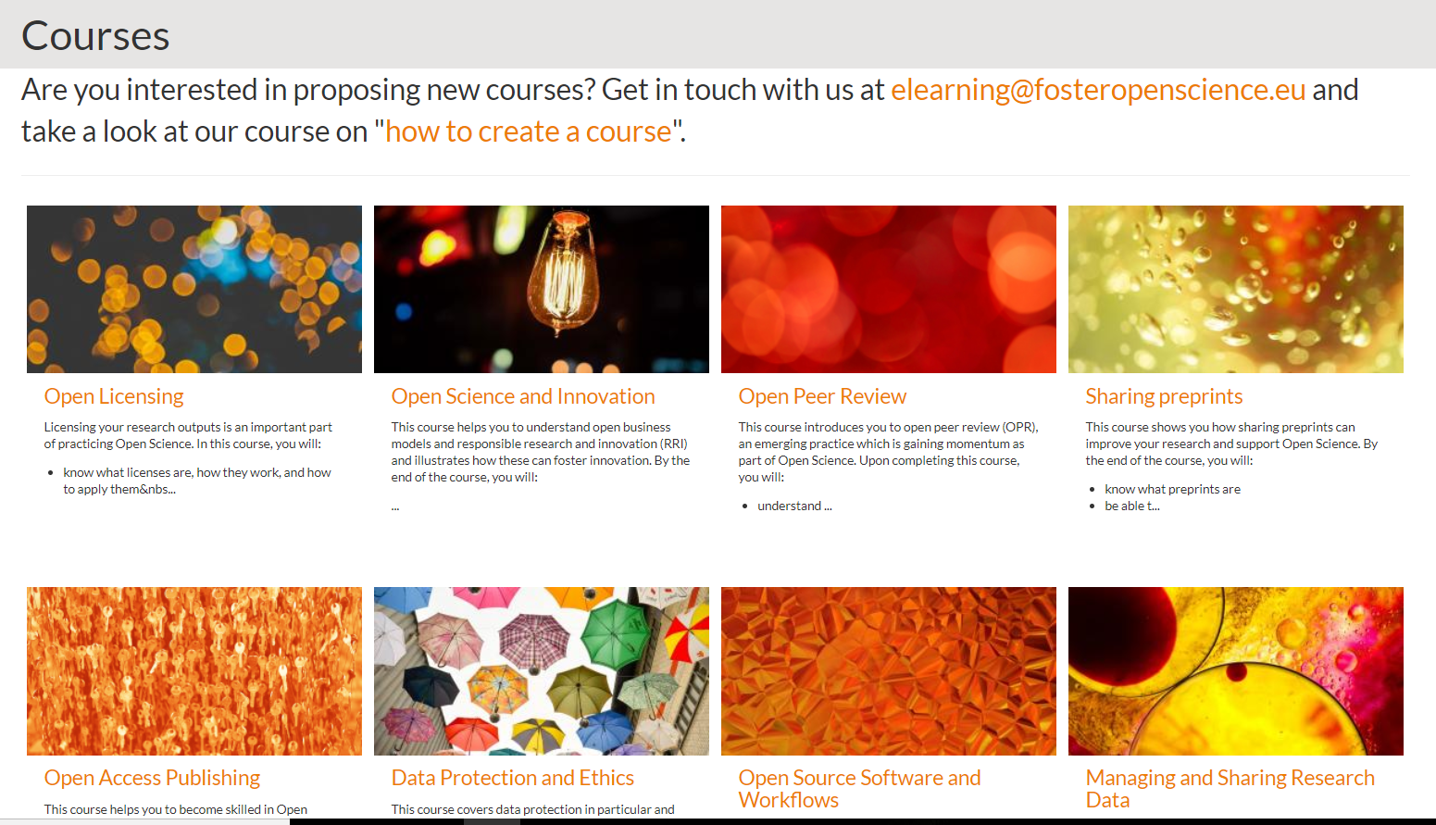
Others working in this space
https://www.edx.org/course/open-science-sharing-your-research-with-the-world
https://www.fosteropenscience.eu/courses
https://open-science-training-handbook.gitbook.io/book
@OpenScienceMOOC

Slide 31
How do you want to shape your identity as a scientist?
Researchers can be world-changing heroes
We will give them the power to achieve that
@OpenScienceMOOC

Slide 32
Help science work for society again
People not profits!
Students, teachers, journalists, bloggers, startups, entrepreneurs, policymakers, citizen scientists, NGOs, charities, health practitioners.
We are here for you.
@OpenScienceMOOC

Slide 33
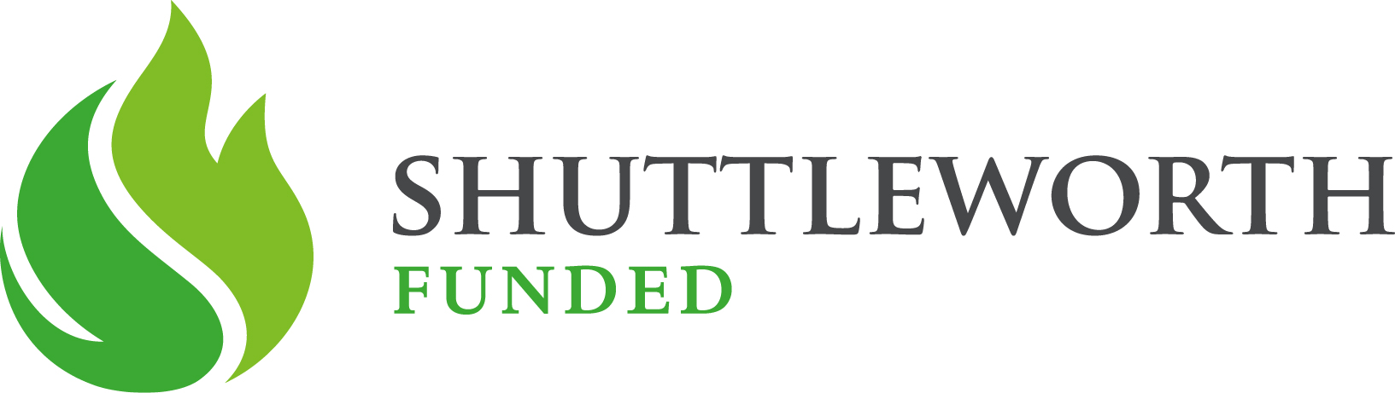
Thanks!
GitHub: https://github.com/OpenScienceMOOC
Website: https://opensciencemooc.eu
Twitter: @OpenScienceMOOC
Email: info@opensciencemooc.eu

