Slide 1
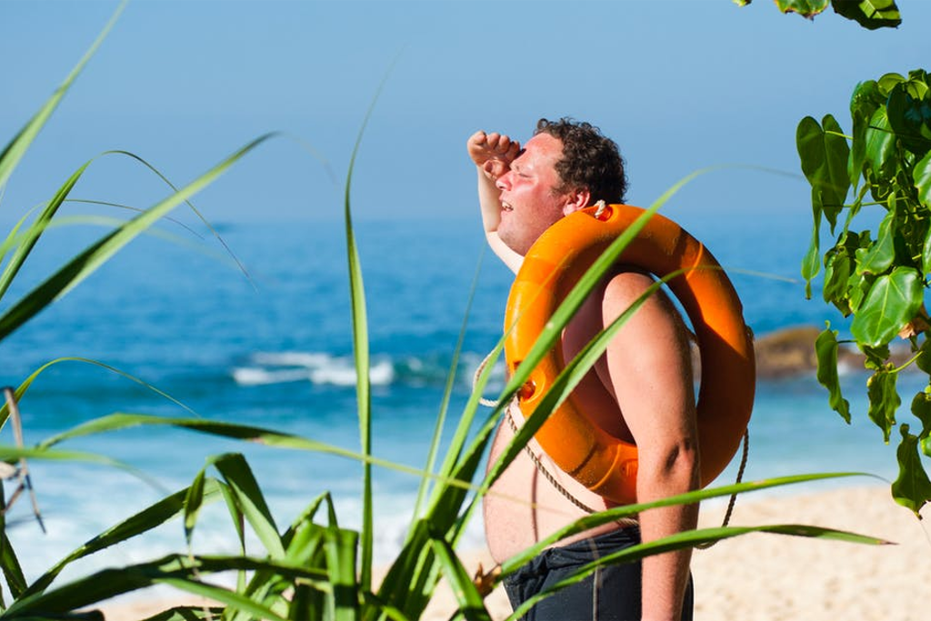



The Road to Nhill: Sharing Responsibility for Bushfire Prevention
Communicating about heatwaves: Research findings and implications for practice
Dr Scott Hanson-Easey
Dr Alana Hansen
Dr Susan Williams
Prof. Peng Bi

Slide 2
5 Goals for today
Provide pragmatic evidence for translation into heatwave communication practice
Highlight what ‘competition’ your current messaging is up against in the social world, and what other barriers to communication may be active.
Provide evidence for so-called ‘message fatigue’, and what role might be playing in heatwave communication
Provide some ideas for ‘engaging’ with different kinds of community logics
Learn from each others’ experiences

Slide 3
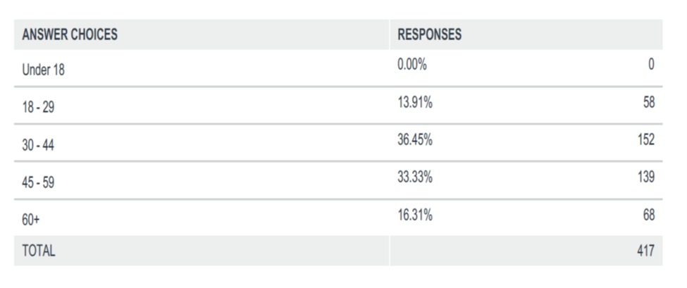
What we did

Slide 4
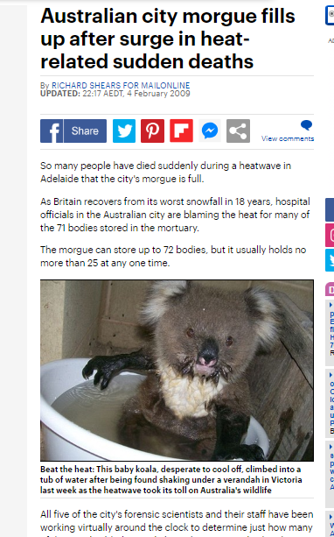
Why do this research?

Slide 5
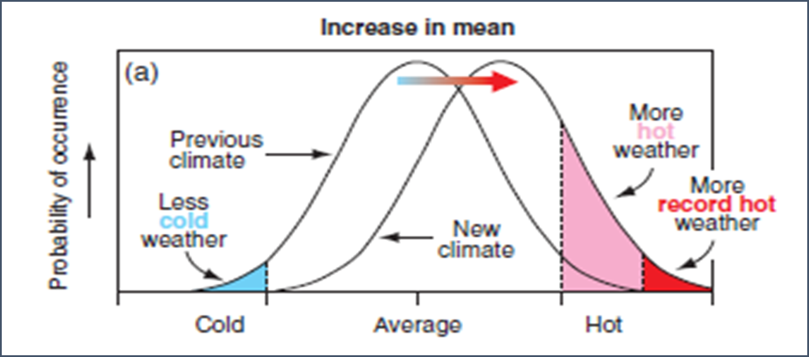
Climate change: unknown territory

Slide 6
Risk communication
Widen the range of available choices people can make to mitigate their risk to hazards
Raise risk awareness to enhance preparedness planning
An exchange of views between between communities facing threats and experts.

Slide 7
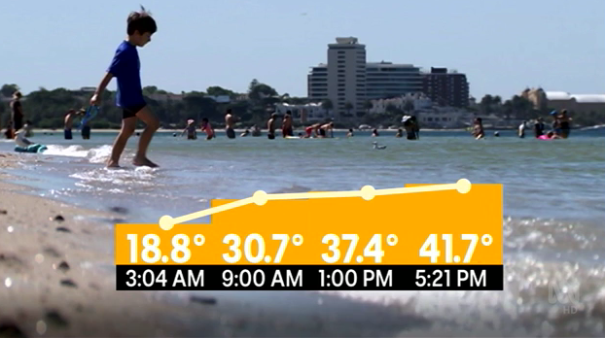
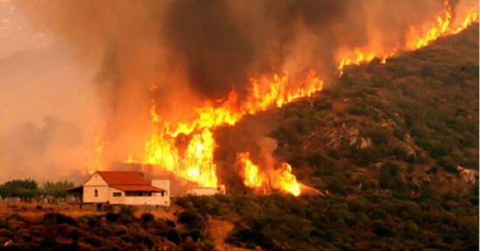
The ‘problem child’ of natural hazards communication

Slide 8
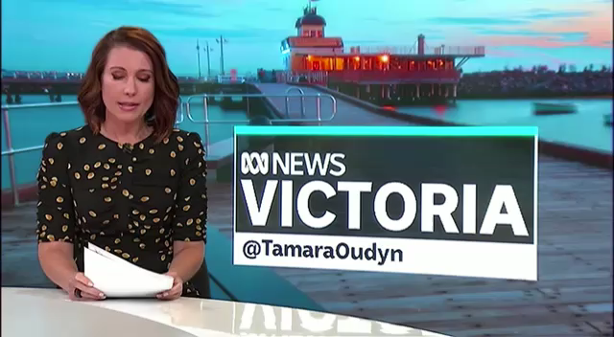
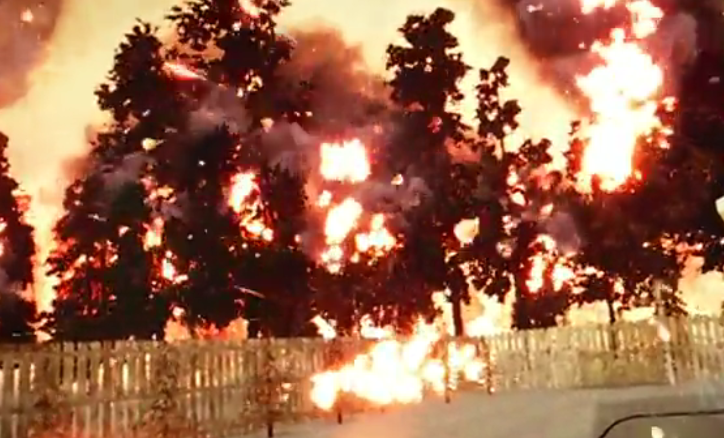
REPRESENTING Natural HAZARDS RISK

Slide 9
I remember years ago, wasn’t it in Queensland or somewhere, there were big bushfires and we saw a huge amount of people dying, we never had that kind of mass tragedy because of the heatwaves. Male participant, Playford.

Slide 10
‘There is nothing as practical as a good theory’ (Kurt Lewin)
Social Amplification of Risk Framework (SARF) (Kasperson et al.)
Extended Parallel Process Model (EPPM) (Witte)
Psychometric Risk Perception (Slovic)
Social Marketing
Cultural Theory of Risk (Beck)
Discursive Psychology (Augoustinos)
Mental Models Approach
Social Representations Theory (Moscovici)

Slide 11
Social amplification of risk framework (SARF)

Slide 12
Social marketing
Recognise the importance of audience segmentation
Message and behavioural competition
Promotion

Slide 13
Competing messages: A social marketing approach

Slide 14

Practice experts from the field
John Nairn (State Manager. Bureau or Meteorology)
Jon Carr (Communications Manager, SA State Emergency Service)
Rebekah Huppatz (Senior Communications Advisor, SA Health) & Lauren Barker
Nick Banks, Community Resilience, Australian Red Cross

Slide 15
Research aims
1. How do people perceive risk and vulnerability from heatwaves
2. Analyze TV News’ role in ‘constructing’ and reflecting public understanding of heatwaves and their health risk.
3. Examine if, and in what way, so-called ‘message fatigue’ is affecting heatwave messaging and protective behaviours
4. Proffer some potential messages/audience segmentation ideas for consideration.

Slide 16
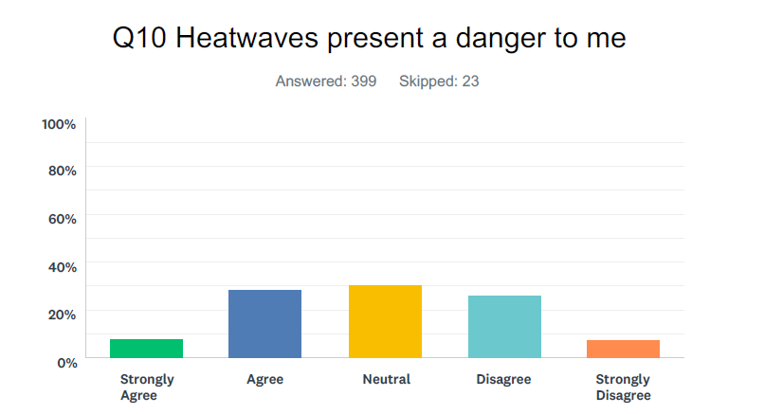
1. Heatwave Risk and vulnerability perception

Slide 17
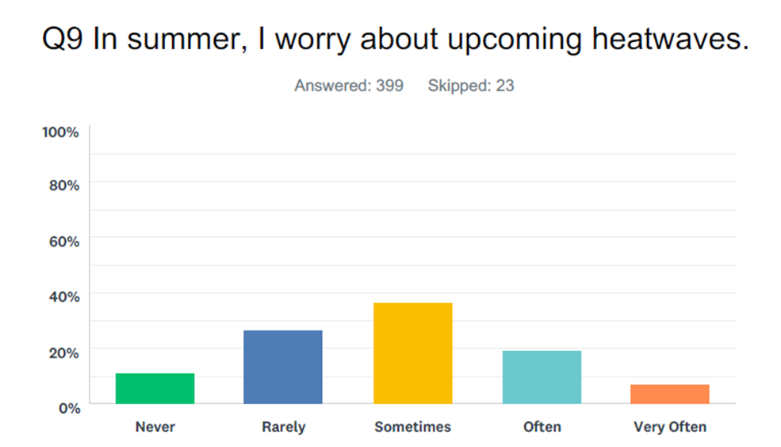

worry

Slide 18
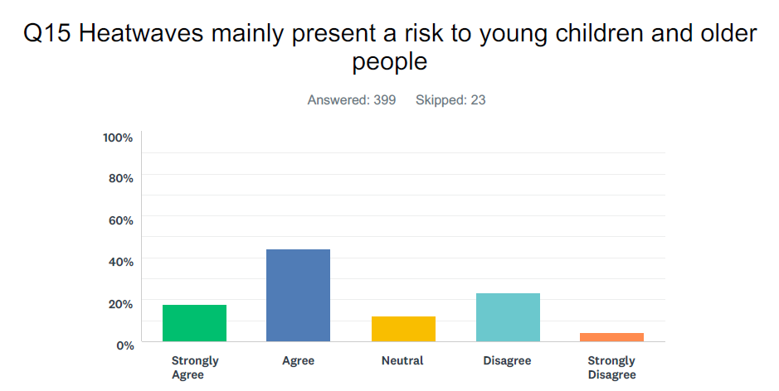

It’s not me, it’s you!

Slide 20
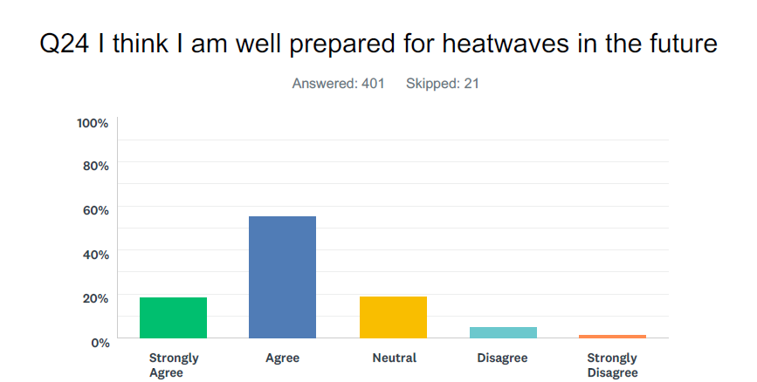
Prepared for the worst? Sure am

Slide 21
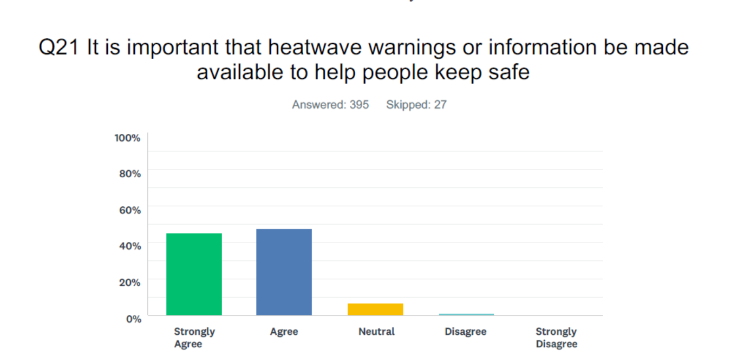

Vulnerability and risk perception: Does it affect thinking on the relevance of heatwave communication?

Slide 22
Most people (over 95%) in the qualitative study rated bushfires as far more concerning than heatwaves.

Slide 23
‘just A given’
Scott: Would you say you worry about the potential for heatwaves during summer?
P: No, it’s just a given. It’s part of life really. I don’t worry about it, no. I prepare for it and I obviously keep an eye on the weather to see when they’re coming so that I can be as prepared as possible, but apart from that it’s not something I particularly worry about. Thankfully my elderly family members are all pretty comfortable, they’ve got their air conditioning and whatnot, so I don’t worry about anybody in my family so much.
(F,38, Adelaide)

Slide 24
Perception of Vulnerability: A function of context?
Scott: How did you cope with heatwaves when you were homeless?
P: Not well. Because of my safety concerns I would lock the doors and have the windows up and one of the other reasons I’d have the windows up, the mosquitoes would be coming in through the window if you left the car windows open, so I wouldn’t sleep, you’d just lay there and you’re just in a bath of perspiration. I had an old mattress that I found, like a foam caravan mattress, which was in average condition and I lay on that and between the mattress and the roof of the car there was only just enough room. You couldn’t even sit up, there was that much space between the car and the roof, I couldn’t lay down in the back seats. The heat was oppressive.
Scott: Where did you park?
P: Usually down by the seafront to get a bit of a sea breeze, but some nights it was still very, very hot down there when there’s no air, there’s no wind, and the extreme temperatures. So I just lay there and every now and then I’d have to get out of the car and just shut the door. Like I was saying, I’d keep the windows closed and the roof vent thing closed because the mosquitoes would be coming in….
Scott: From your recollection did you used to worry a lot about the heat? It sounds like you did when you were homeless. (Dumb question, Scott!)
P: Absolutely, yeah, because if I passed out in the car no-one would know. I would just be there, there’d be no-one around to help. I was concerned, yep. Mainly because you’re homeless, if you go into unconsciousness nobody knows. It’s not like you’ve got neighbours here where they all look out for each other or maybe you live with a family or something. …There was times when I felt really faint, but I managed to get through it. It makes you feel uneasy just thinking about it, but I want to talk about it, but it makes me feel really uneasy. You go through that – you sort of re-live that feeling. (m, 70s, Adelaide)

Slide 25
I Don’t know what they whinge about!
Scott: Have you experienced a heatwave?
P: Yeah all the time, yeah, I love it. It don’t bother me. We’ve had several, they’re not every year. People complain about 40 degrees but it happens once or twice in our summer months and then that’s it, so I don’t know what they whinge about.
Scott You enjoy the heat?
P: I certainly do, I thrive on it.
Scott: What do you do that’s kinda different in the heat, if anything?
P: I think I have more energy. I must admit when it gets hot, I get hot, but I feel, I was telling my friend today who come to help me out I feel more motivated, I feel I want to do more, it gives me more energy, more motivation.
Scott : Do you do anything different to cope in the heat?
A: Not really. I drink more, probably drink more fluids, that’s about it. I don’t really use my air conditioner much because I enjoy the heat.
(F, 74, Adelaide)

Slide 26
Summary thus far
A majority of respondents do not perceive themselves at risk from heatwaves; yet, heatwaves messages are important to help ‘people’ (others) to keep safe.
Messages are often interpreted as a reminder to change behaviour, and check on the elderly (and very young).
Most participants felt they held the capacity to cope with heatwaves into the future.

Slide 27

DISCUSSION QUESTIONS
Overall, the findings suggest that most people do not feel personally threated by, or vulnerable to, heatwaves. This reasonable, yet: In an uncertain climatic future, where heatwaves will most likely become more dangerous to more people, does our messaging need to start to address this?
How can we segment messages to compete with different logics and beliefs around heatwaves? Is this tenable with current health promotion budgets?

Slide 28
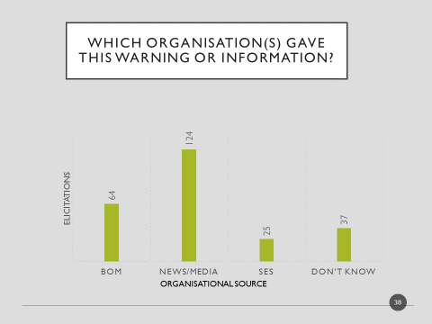
2. Heatwaves in the news: modelling and reflecting normative behaviour

Slide 29
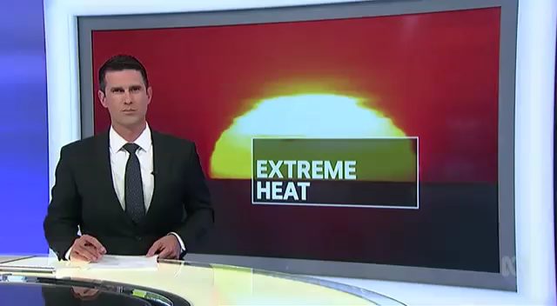
Heatwaves in the news: modelling and reflecting behaviour
Notes:
PLAY

Slide 30
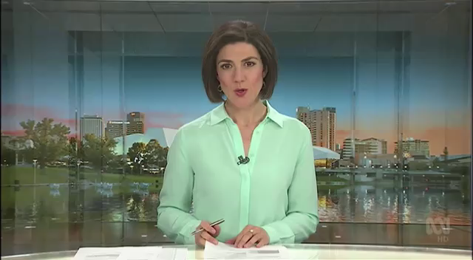
ABC, Adelaide, 2018

Slide 31
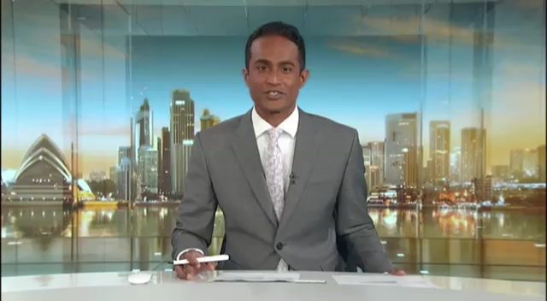
ABC Sydney, 2018

Slide 32
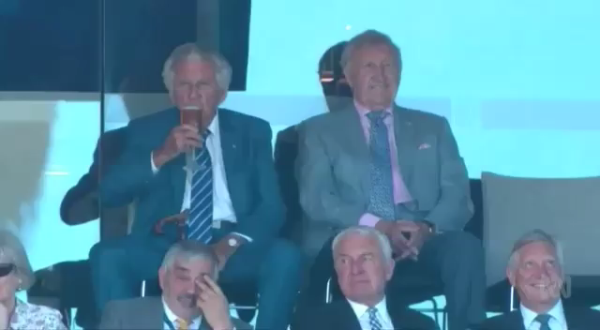
ABC Sydney, 2018

Slide 33
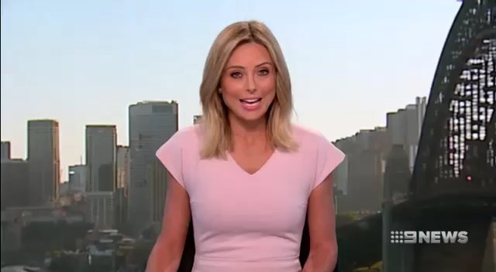
NINE, Sydney, 2018

Slide 34
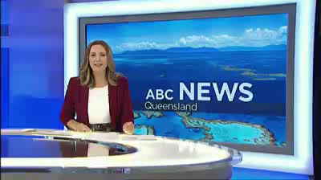
ABC Brisbane, 2017

Slide 35
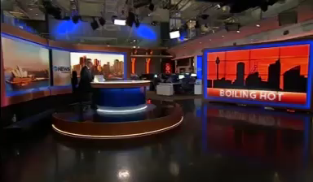
modelling and reflecting cultural norms
(Channel 10, Sydney. 10 February 2017)

Slide 36

The struggle with meaning (and heatwave hair)

Slide 37
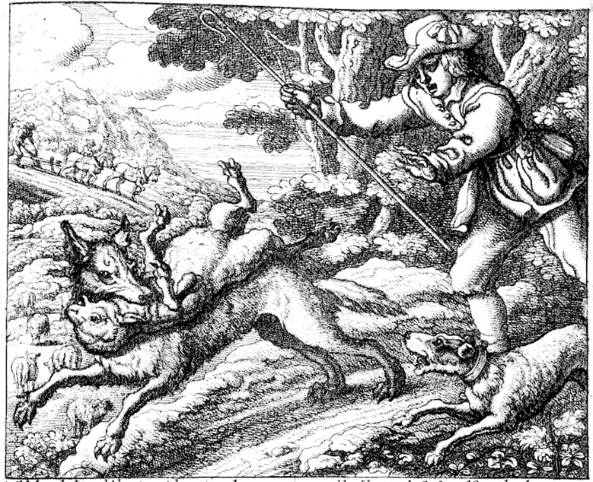
3. Message fatigue?
‘Of the herd boy and the farmers’. Francis Barlow, 1687, DE PASTORIS PUERO ET AGRICOLIS, 1687 (The boy who cried ‘wolf’)

Slide 38
What is message fatigue?
Heatwave communication may be particularly prone to perceptions of overexposure and redundancy; although, to our knowledge, no research has attempted to find evidence for this, or explore potential effects on heatwave messaging.
‘an aversive motivational state of being exhausted and bored by overexposure to similar, redundant messages over an extended period of time’ (So, Kim & Cohen, 2017).

Slide 39
We asked?
1) Do you feel like you have heard enough about how important it is to stay safe in heatwaves?
2) In summer, are there too many messages about heatwaves?
3) Do heatwave heatwaves messages provide you with new information?
4) Do you think that information about what to do in heatwaves is ‘common sense’?
5) Are heatwave messages repetitive?
6) Are you tired hearing about what you should or shouldn’t do in heatwaves?
7) Are heatwave messages tedious?
8) Do you wish you knew more about how to prepare for heatwaves?

Slide 40
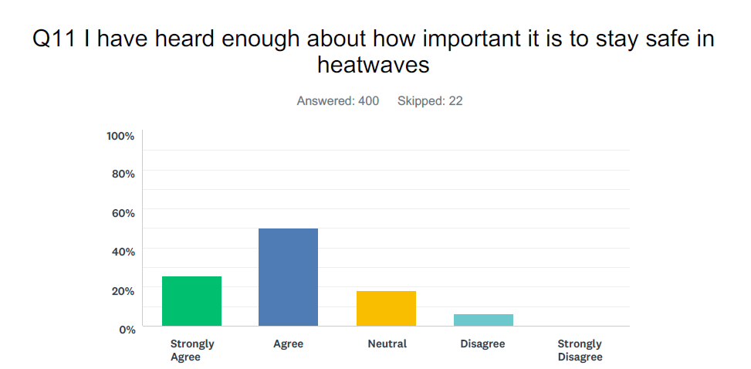
REDUNDANCY (I know enough)

Slide 41
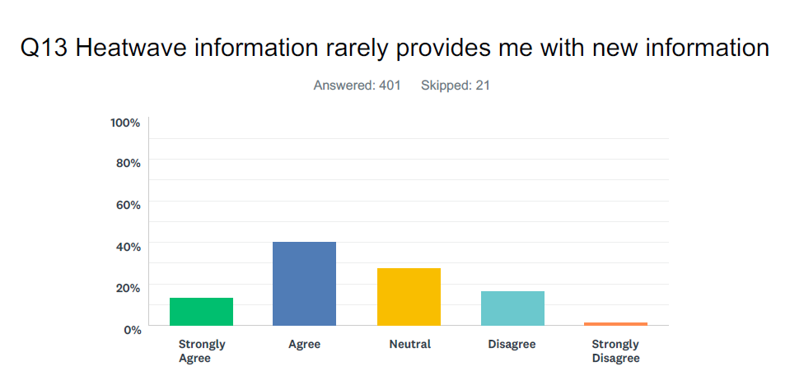
REDUNDANCY

Slide 42
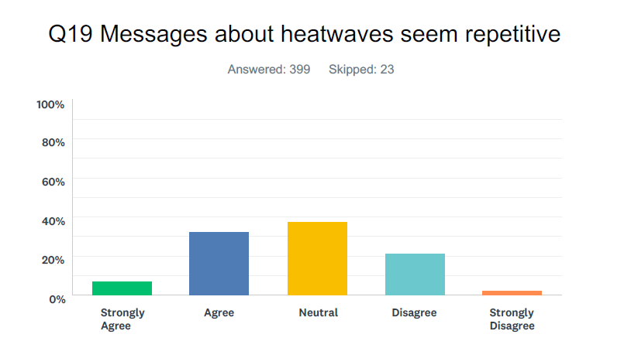
Repetition

Slide 43
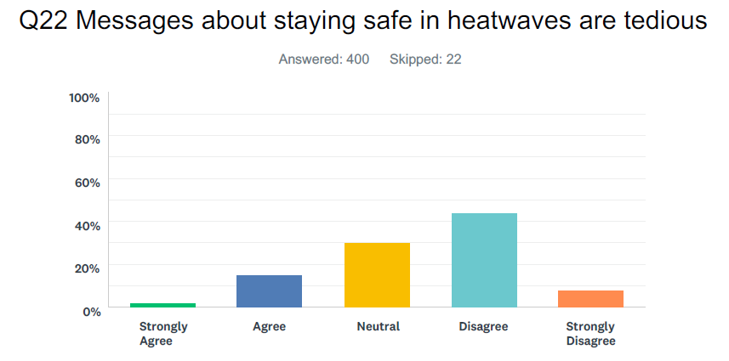
Tedium

Slide 44
Common sense

Slide 45
But Wait!

Slide 46
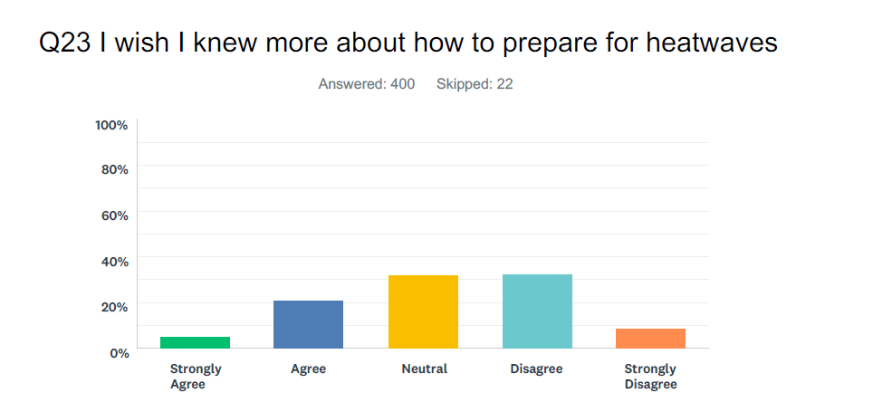

Slide 47
COMMON, OR NOT SO COMMON, SENSE
Scott: Do you think the kind of information that’s communicated about heatwaves is common sense or not?
P: Yeah, but people are idiots. I think they need to be really, really more into the heat protection messages and stuff. If they tell you there’s a heatwave coming, like I know it’s on the weather channel or the news or whatever, but however it comes out I think they should try to explain more what that actually means, “If there’s a heatwave, remember to take these precautions”, or “If you’re working outside do this and that” and whatever because…don’t really get it sometimes.
(F, 31, Mount Gambier)

Slide 48
Fatigue as scepticism (in the media)
P1: Yeah that’s the thing, they (the media) make it seem like the ‘Bold and the Beautiful’ sort of drama.
P2: And they do seem to clutch at “We don’t have any good filler for this week’s show so let’s just expand on it, and the last heatwave we had that was significant” and they’ll bring in two or three people that are so-called experts that might have had something to do with a heatwave or they might have been weather men 20 years ago in a different State.
P1: Or they’re outside...
P2: Yeah, you get someone standing outside going, “Oh gee it’s hot”. They do put in too much filler and it takes the emphasis away, like [X] was saying, there needs to be that emphasis and we need to understand the importance of what can be a big issue, but the way they do report it seems to sensationalise it too much and we become desensitised to what other specifics we need to be careful of I guess. You get that then with your friends going, “Blah, blah, blah” about the weather and you’re like “I’ve heard it on the news all day, shut up”.

Slide 49
The mentality of people these days!
P: Yeah, you hear it all the time news, they say there’s a heatwave at 35 degrees. 35 degrees is not a heatwave, I don’t care what anyone says.
P2: That’s right, 43, 45 is.
P1: No, even that, I can remember when …in the mid-80s average 58 degrees for eight days (P3: yeah, bugger that), topped out at 61 and that was in the shade. Everyone worked a full 10 hour day, no-one stopped.
P2: Same when I was out at Tarcoola as an apprentice, 56 in the shade, I think it was 66 on the railway line.
P1: The reason why we think it’s a heatwave now is we’re conditioned to think it and no‑one gets in a car – if a car hasn’t got air conditioning no-one will get in it. If it’s 25 degrees it’s nice but if it’s 24 degrees it’s cold and 26 it’s hot. That’s the mentality of people today.
P3: I drive a car with no air conditioning.
P1: I don’t turn the air conditioner on in the house. I turn my heater on but I don’t turn my air conditioner on in the summertime. I go out to the station at ? 47, 49 degrees and I’m out in the sun all day and love it. We were born to that. I drove trucks, probably started in late early 60s, all around the north of Australia. We had nothing, and it’s only nowadays people think it’s hot when it’s not hot.
P2: When I was working in the railways you were working along the railway freight wagons, you were underneath, it might be 42 or something up there but the radiated heat down below is pelting down on you. You just did your job.
A: We always figured it was hot when you couldn’t pick up any tools you were working with.
Port Augusta (blokes, 60/70s)

Slide 50
Triggering

Slide 51
Knowledge triggering
Scott: Do you think the importance of heatwaves is overdone in the media or to messaging or underdone? Do you think there could be more importance placed on it or do you think it’s at saturation point?
P: No I don’t think it’s at saturation point. I think people will always need reminding about things that are obvious and timely advice also is useful because it has to be like, “Oh, hang on a minute, that’s happening now, okay”, because people forget, people are too busy so, yeah, as it’s happening is very good.
Scott: Messages now, we’ve just hit spring, do you think might be wasted in terms of getting people prepared?
P: In this changing weather we’re starting to go, “Oh is it spring, is it winter?” You know how we get the warnings of the fire, clean up your surrounding houses in advance of summer, that sort of thing might just kick in with, “Okay, so what’s your plan for a heatwave in your house?” it might just be useful, not so much of it, but just for people to think about, “Have you got your relatives’ details handy? What would you do? How would you help your relative out?” I don’t know whether that would get to a lot of people or whether they’d think about it much but I think that might be worth a thought. (F, 43, Adelaide)

Slide 52
Summary thus far
For the most part most respondents perceived messages as holding redundant information (already known). (Potentially because messages do not provide segmentation?)
We are less confident that ‘message fatigue’ is operating in relation to heatwave communication, as messages are not deemed tedious, are not uniformly seen as irrelevant or repetitive.
Importantly, when we conducted a Chi Square test (not shown), most respondents who indicated that they had all the information they needed, still agreed that messages were important to ‘keep people safe’.
Messages appear to trigger behaviours in many people.
There may be scope for providing new information to the community, but this may need to be carefully designed to overcome perceived redundancy

Slide 53
DISCUSSION QUESTIONS
What implications does this have for your communication practice?
Can new messages be designed to overcome perceived redundancy? Is there a budget for this?
How can we scaffold onto ‘triggering’ messages to promote new knowledge, and possibly change behaviour in a changing climate?

Slide 54
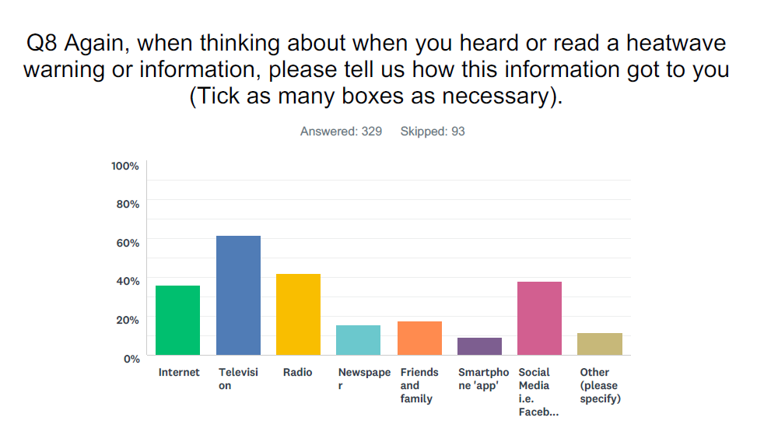
3. Heatwave messaging and channels

Slide 55
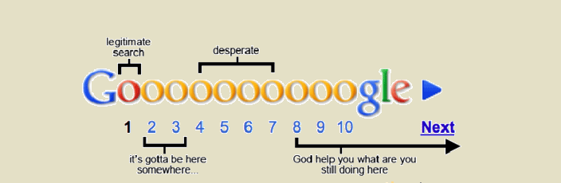
Where would you go to find more information about heatwaves and what to do?
Just Google it!
Scott: Where would you go if you wanted to find out more information about heatwaves?
P1: Google. I’d go online. Social media.
Scott: You’d just Google ‘heatwave’?
P1: Yeah. It’s quick, it’s easy. I’d prefer to do that than call somebody or try and research the information some other way.
P2: I suppose that’s tricky isn’t it because then you’ve got to target which sites you pick out of that list, which ones look like a legitimate site, which ones are a forum of people whinging and moaning about electricity out in heatwaves?
https://www.google.com.au/

Slide 56
Social media
P1: Coming from someone who doesn’t really watch TV, but likes their social media, the only things I really see are on Facebook - the CFS when they’re talking about bushfires and stuff, but other than that I don’t really get much communication about it.
P2: Yeah, you don’t really look at newsfeeds and such, do you?
P1: They pop up, but unless I’m looking for the information it doesn’t get presented in anything.
P2: So you’ve got to go looking for the weather to know what’s going to be happening?
P1: Yeah, which I do but looking at news coming towards me I guess it doesn’t really happen unless it’s communication about a bushfire somewhere in South Australia or something like that.
(F, 21, Onkaparinga)

Slide 57
Scott: Do you feel like you get enough information from them [Gov agencies])?
P: I think there’s fairly adequate – generally you get something about “Make sure that your kids have water and check on your elderly relatives or friends, people who are elderly” but I’m not sure that there’s enough as to “Okay, if they’re refusing to put the air conditioning on because they want to save electricity, what do you do then?” It’s okay to have a warning but then what?
Scott: So there should be other sorts of messages or other sorts of things happen after the warning to help people?
P: Maybe, just augmenting exactly – all sorts of ways because I don’t think that people really learn about it, like within families. It seems that there’s a lot of stuff that’s been lost in the last even 40 years that we grew up going, “Okay, yep, this is how we deal with this situation” because you see it, you talked about it with your parents, they say “Yep, everybody inside, stay out of the sun” that sort of thing….like we’ve all got air conditioning, so in a blackout what do you do, because it gets hot, or even after five days the air conditioning no longer is of any value because it doesn’t work effectively anymore, so you’ve just got to like it or lump it.
(F, 45, Adelaide)

Slide 59
Message segmentation ideas
The ‘old school’ heatwave ‘survivor’ (‘pack of sooks’’)
The media sceptic (information is needed, but not sensationalised)
The knowledgeable, but ‘triggerable’ (reminds me to bring in the chickens)
The ‘carer’ (I need to go look after the olds)
New arrivals and unconditioned
The ‘prepared’ and (over)confident
Working through and exposure to the heat (‘another day, another dollar, mate’)
I know the risks, but am resource poor (no aircon)

Slide 60
Take home messages
Heatwave, as a perceived risk, is comparatively low (especially when compared to bushfire etc.)
Messages are mostly disseminated through media channels that can ‘normalise’ risk perception, hampering EM and health messages.
Some evidence for ‘Message Fatigue’ was observed, but chiefly in terms of ‘redundancy’; although this may not preclude people from listening to new information or ‘(re)framings’ of messages
‘Repetition’ of messages may not be problematic per se, as messages are deployed comparatively rarely (in summer) and deemed ‘important’.
Messages cannot be ‘all things to all people’: message segmentation needs strategic thinking and audience research before making decisions about who to target.
In a changing climate, new heat-health information may need to be disseminated, especially as the Australian population ages.
For people living with limited socioeconomic resources, and in poor quality housing, messaging will need to be tailored to their needs, along with policies that alleviate their vulnerability.

