Slide 1
Introduction
Arika Virapongse Principal, Middle Path EcoSolutions
av@middlepatheco.com
ESIP’s webinar series:
The socioeconomic value of Earth Science data, information, and applications
November 15, 2018 | Webinar #5
www.esipfed.org
@ESIPfed | #ESIPfed
ESIP is supported by
and 110+ member organizations

Slide 2
Socioeconomic Value of Data Webinar Series
Recordings available on the ESIP YouTube Channel
Presentations can be downloaded from ESIP’s Figshare.
Jun. 5
Does it Matter? The Socioeconomic Value of Earth Science Data, Information and Applications
Aug 7
The Information Pathway for Earth Science Data: Moving Between Supplier and User
Sep. 4
Measuring and assessing socioeconomic value
Oct. 2
The “pipeline” of Earth science data to climate resilience and its value for real-world decision making
Nov. 15
Managing disasters through improved data-driven decision-making
Dec. 4
Building Societal Capacity: The Educational Value of Earth System Science data, information, and applications
Notes:
ESIP You Tube: https://www.youtube.com/channel/UCfQZ-8G7ptfbvbhii3T30OA?reload=9
Jun 5 webinar: https://docs.google.com/document/d/1BhyX-sj7FGvjI9NS2Qg_OaVxE3z1QFYcjfG-iA2mlK0/edit?usp=sharing
Aug 7 webinar: https://docs.google.com/document/d/1t8_jQvy-4vHCNSK1G2YCX5fNW1PlbslrOro3qWI6KEU/edit?usp=sharing
Sep 4 webinar: https://docs.google.com/document/d/1BByYfb-kek0tSzGyrpcdl3IHoH2MsGXm8fg5FoX6_1w/edit?usp=sharing
Oct 2 webinar: https://docs.google.com/document/d/149aeIIe06vJ4_Eh4ISEH2fnJa2AgJHzNr6lam47iQDc/edit?usp=sharing
Nov 15 webinar: https://docs.google.com/document/d/1T3FyoldmkE9v4y1236MI2cD2_6yCjwlNtMxnU4SPzK8/edit?usp=sharing

Slide 3
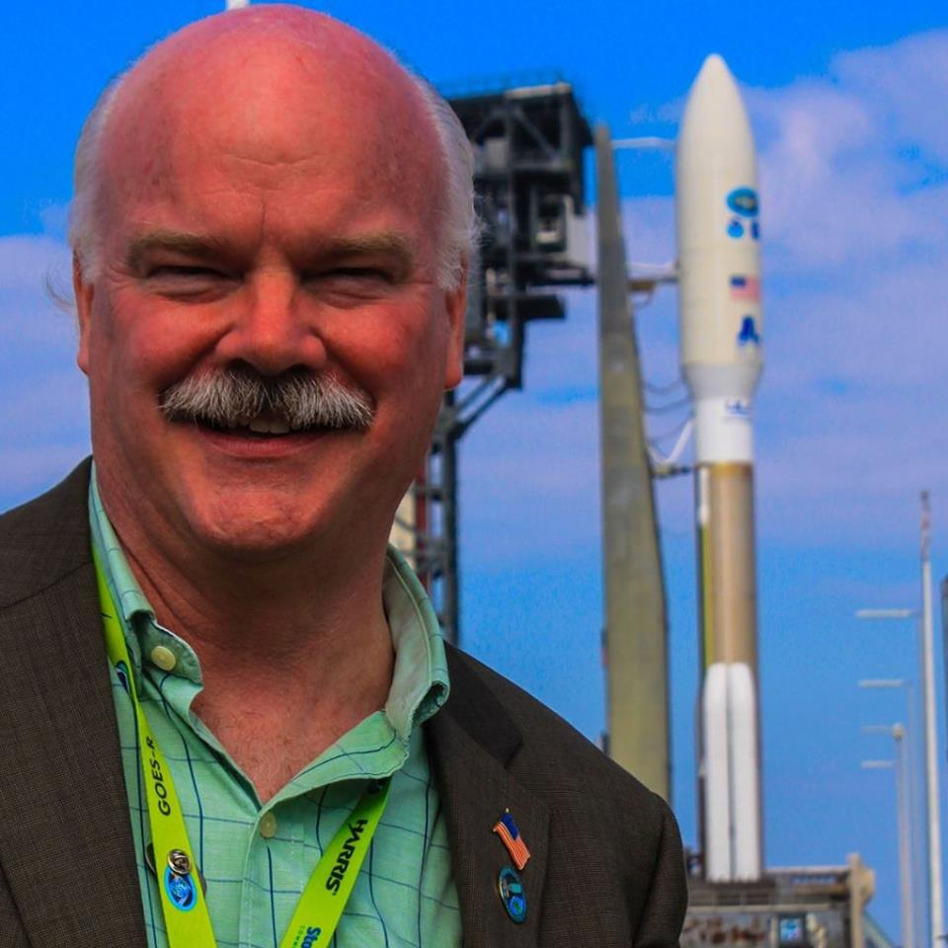
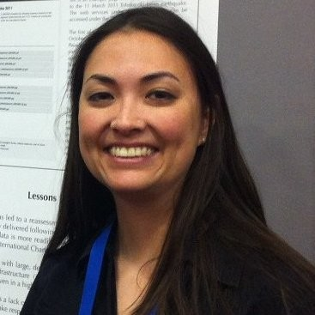
Managing disasters through improved data-driven decision-making (3DM)
November 15, 2018 | 12:0pm ET | Webinar #5
Karen Moe
NASA Emeritus
Moderator
Webinar Coordinates:
Date: Nov 15, 2018
Time: 12:30 PM - 1:30 PM ET
Location: GoToMeeting: https://global.gotomeeting.com/join/813398909
Presenters:
Tom Moran
All Hazards
Consortium
Dave Jones
StormCenter Communications
Kari Hicks
Duke Energy
Maggi Glasscoe
NASA JPL

Slide 4
Managing Disasters Through Improved Data-Driven Decision-Making (3DM) A Unified Approach to Readiness, Responsiveness and Resilience
Tom Moran
Executive Director
All Hazards Consortium

Slide 5
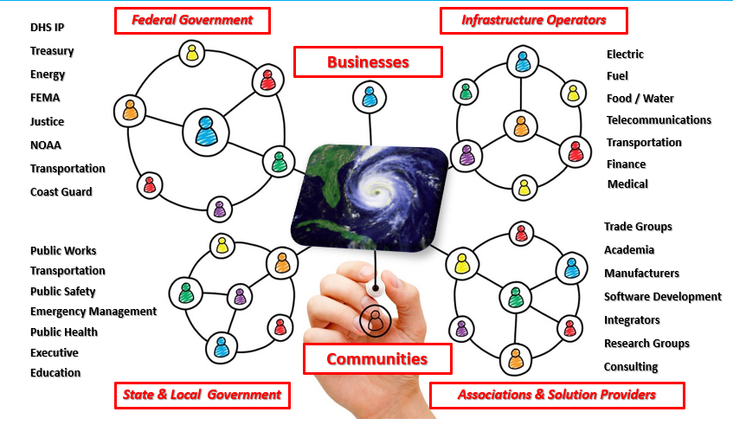
Who is All Hazards Consortium (AHC)?

Slide 6
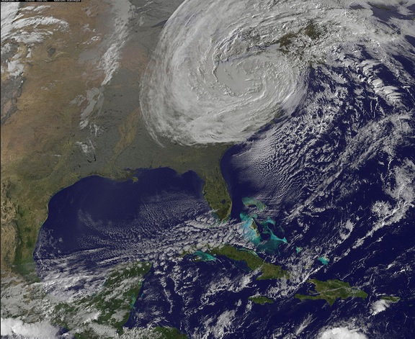
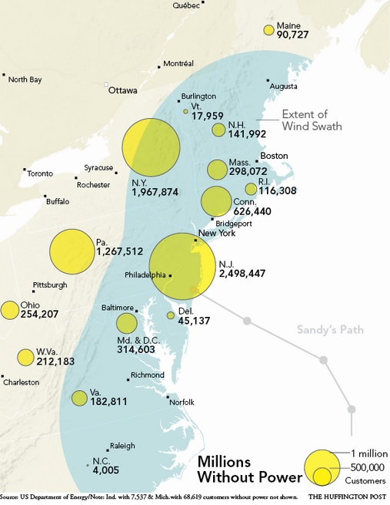
Use Case - SANDY
Historic power outages
Electric sector mutual assistance process moves 70,000+resources
Coordination needed w/40 states to avoid delays
No mechanism to share sensitive information from private sector with states
Multi-State Fleet Response Working Group formed Jan 2013

Slide 7
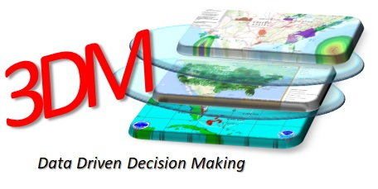
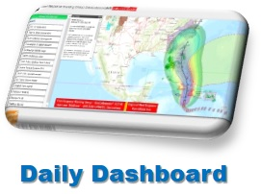
ESIP – AHC Partnership
FRWG standardizes on GeoCollaborate®
ESIP partnership formed
Testbed Pilot creates “Daily Disaster Dashboard” and feedback loop on data sets from private sector
ESIP/NASA & FRWG develop ORL (Operational Readiness level) Standard
Create 3DM (Data Driven Decision making) Initiative

Slide 8
The Future…. Trusted, Reliable Data Driven Decision Making Network

Slide 9
Managing Disasters Through Improved Data-Driven Decision-Making (3DM) A Unified Approach to Readiness, Responsiveness and Resilience
Dave Jones
StormCenter
Communications, Inc.
& GeoCollaborate®

Slide 10
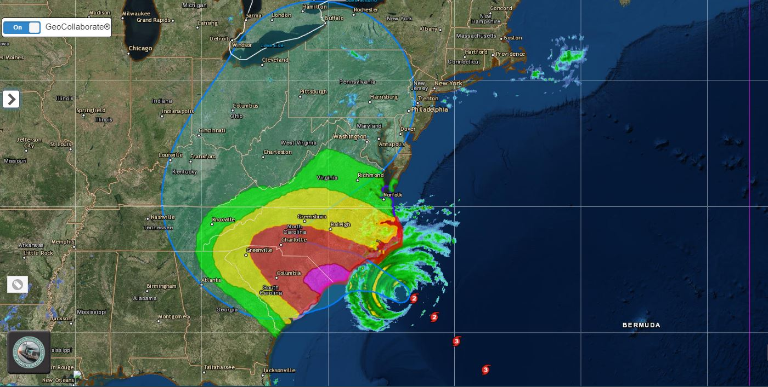
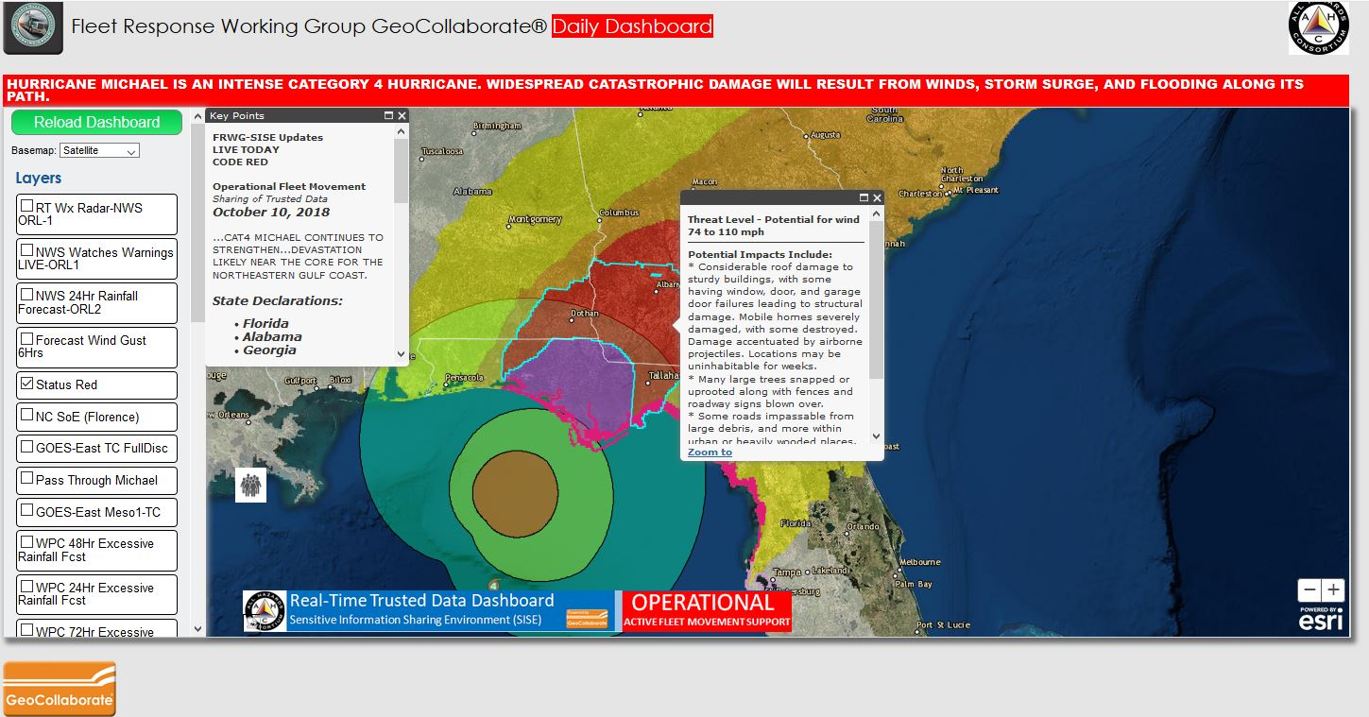
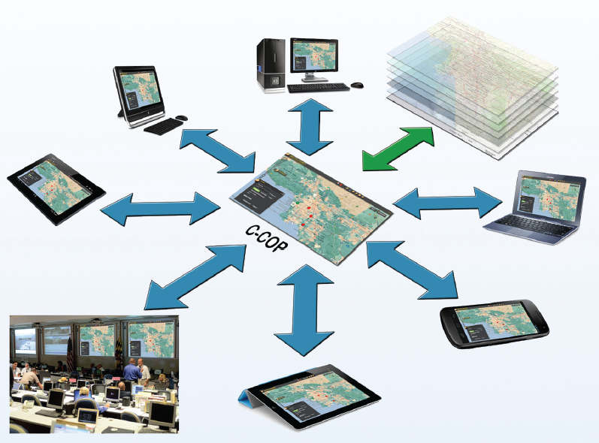
What is GeoCollaborate® ?
Collaborative, Data-Sharing Environment
LEADER
FOLLOWER
COLLABORATIVE
DASHBOARD
Many People. One Map.

Slide 11
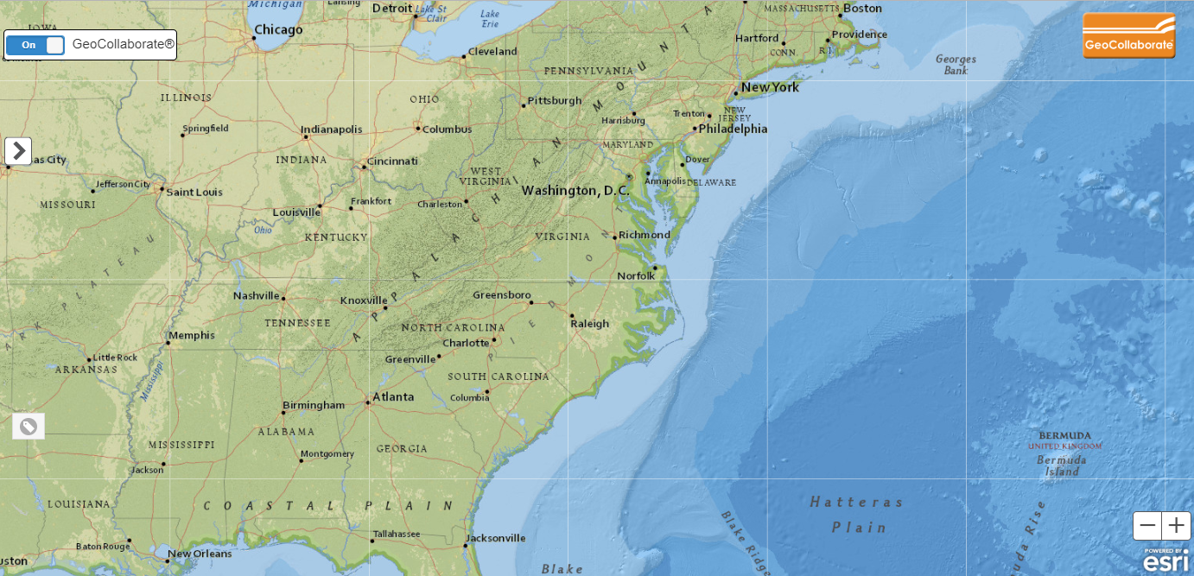
Trusted
Data CLOUD
State to Private Sector Data Sharing
PENNSYLVANIA
GIANT
GIANT
ACME
ACME
BRIEFINGS
STATUS
KEY POINTS
DASHBOARD
OIL CO
HERSHEY
TRANS
OIL CO
WALMART
GARDEN CTR
TIRE CTR
Many People. One Map.
Notes:
Add CLOUD after PA then to other systems

Slide 12
Trusted
Data Sources
State to Private Sector Data Sharing
PENNSYLVANIA
GIANT
GIANT
ACME
BRIEFINGS
STATUS
KEY POINTS
DASHBOARD
OIL CO
PEN
HERSHEY
TRANS
WALMART
GARDEN CTR
TIRE CTR
Many People. One Map.
Notes:
Add CLOUD after PA then to other systems

Slide 13
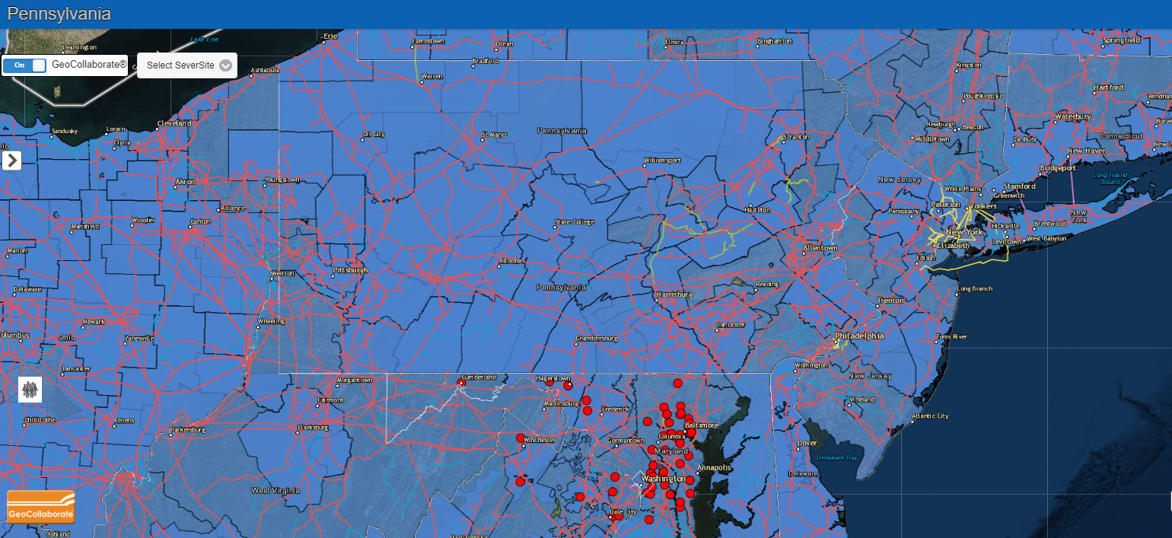
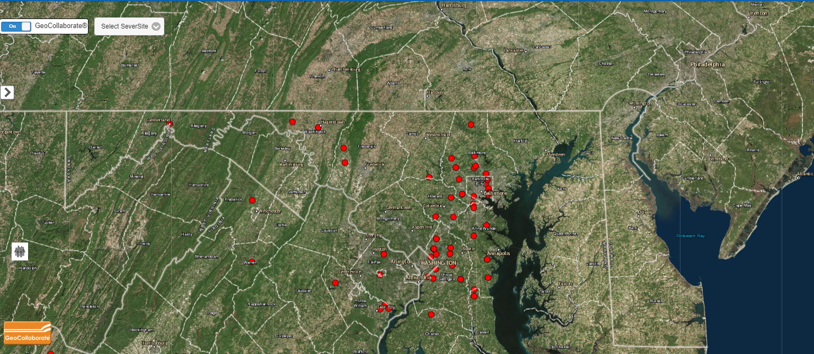
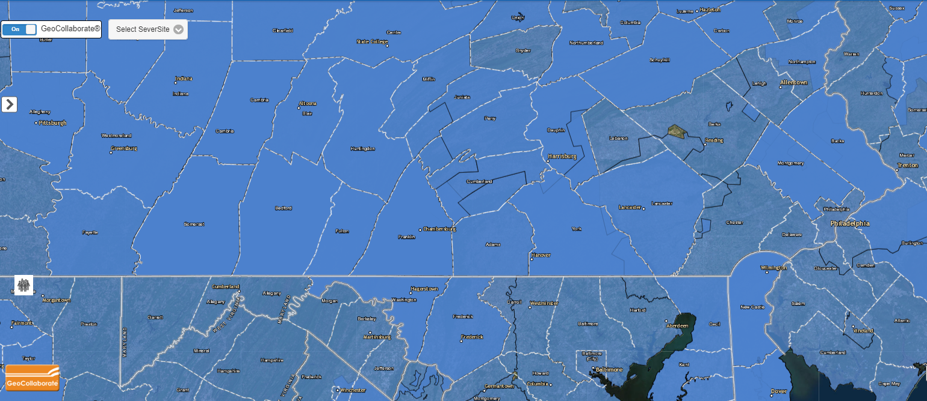
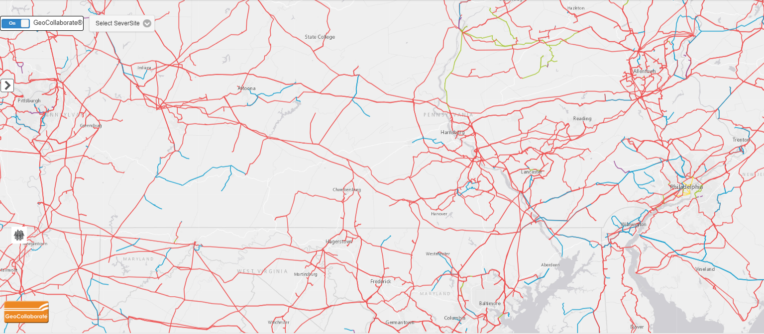
Private Sector Data Sharing (requires individual license & Data Sharing Agreement)
PENNSYLVANIA
GIANT
C&S
FUEL CLOSED
OIL CO
TRUSTED
CLOUD
SERVICE
HPS, LLC
PROPERTY
MGMT
UTILITY
GARDEN CTR
TIRE CTR
TRANS-DIST LINES
Many People. One Map.

Slide 14
Private Sector to State Data Sharing (requires individual license)
THREE DISTINCT SOURCES – EACH DATASET CONTROLLED BY PRIVATE SECTOR PARTNER
Many People. One Map.

Slide 15
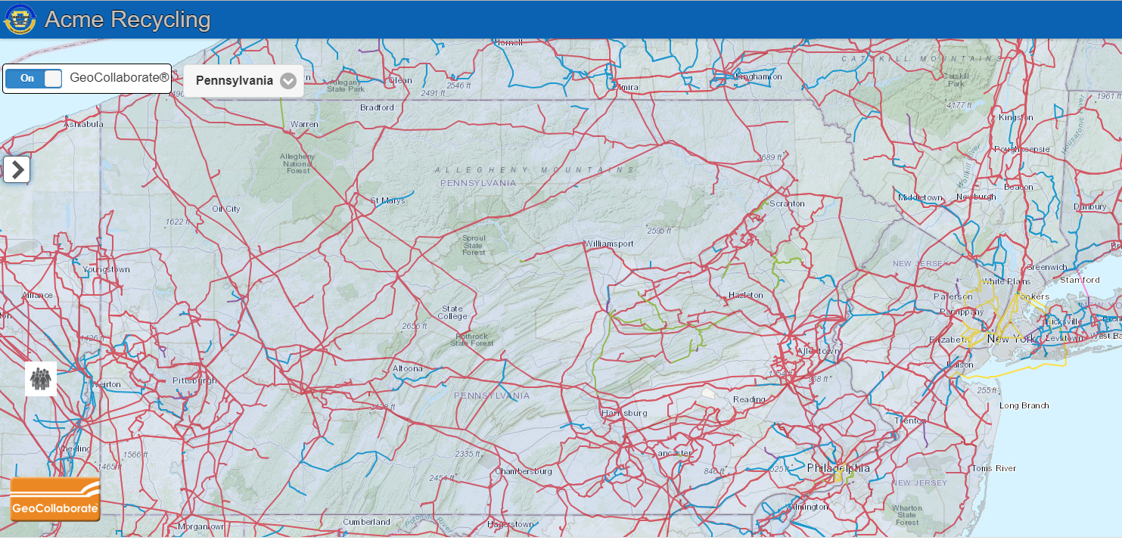
Private Sector to State Data Sharing
ACME Recycling Instance
Pulling IN Pennsylvania Staged Data
Add internal data – without sharing
Only FOLLOWERS (Acme Recycling) see combined info
Many People. One Map.

Slide 16
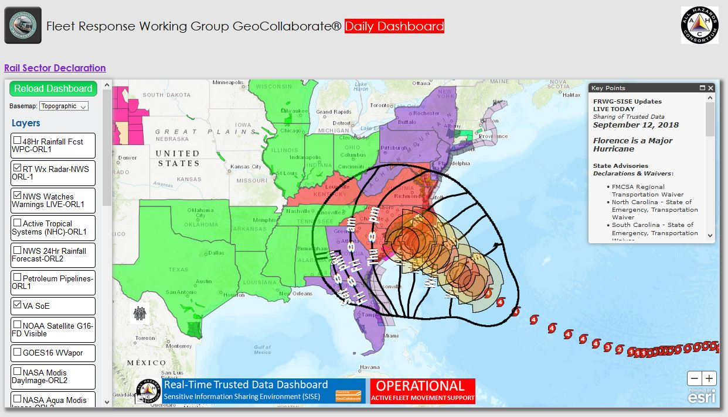
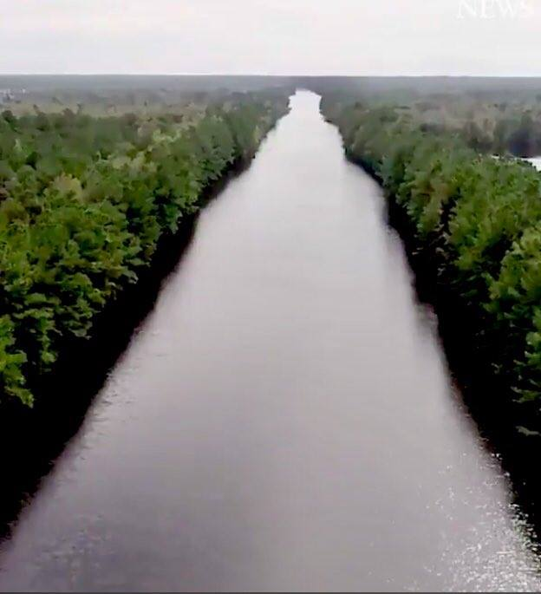
Operational Dashboard Example
September 18, 2018 GOES16-ABI+NOAA-20 VIIRS+SoumiNPP VIIRS FLOOD Product
Flood Detect Pixels
September 17, 2018
I-40 ender, CO North Carolina
I-40
Rt. 40 Between Raleigh and Wilmington | NORTH CAROLINA
Data accessed via RealEarth by GeoCollaborate® and shared with NWS NWC Director, Water Prediction Operations Division

Slide 17
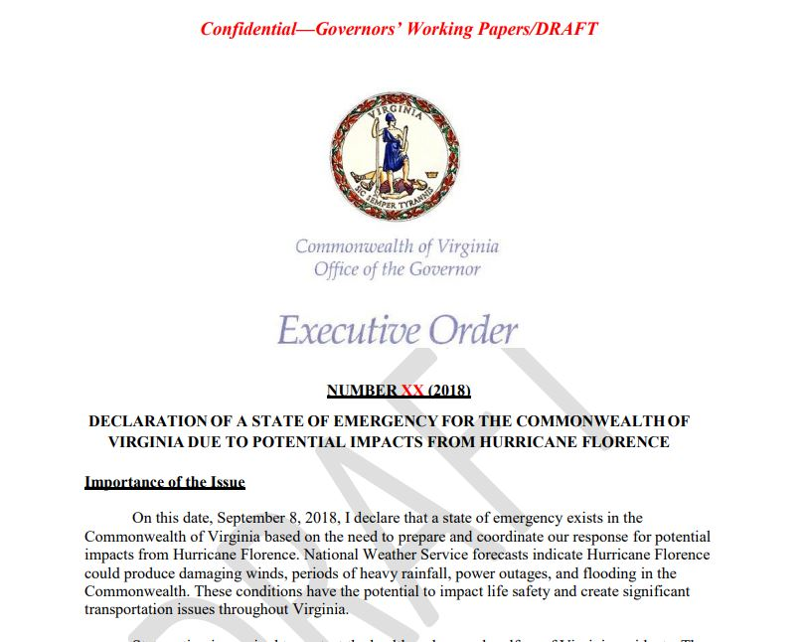
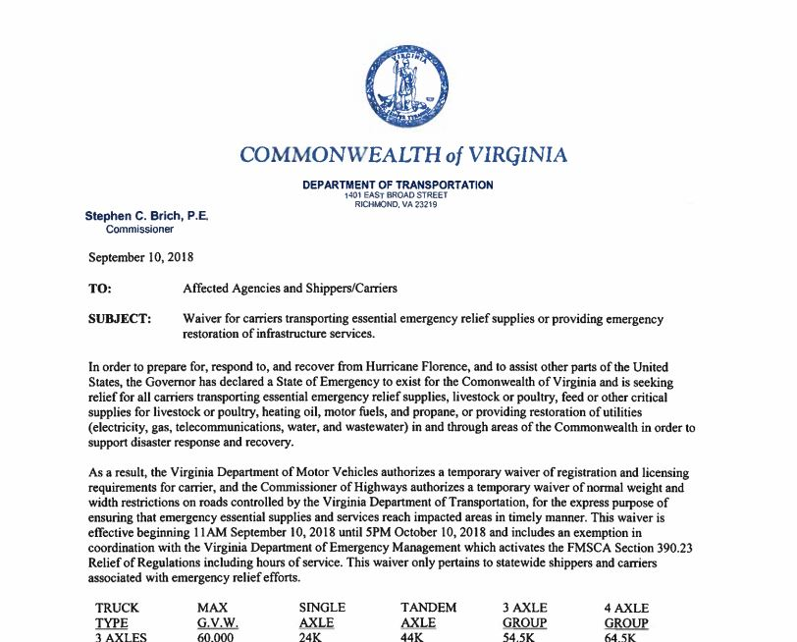

Slide 18
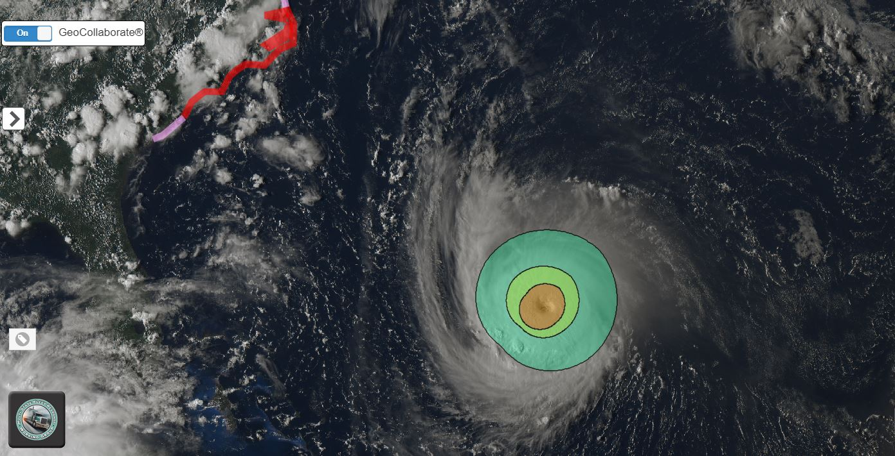
GOES-16 20180911.0510pmET
This is a GOES-East True Color visible satellite image. The sun is providing the light and as the sun sets, it gets darker across the world and we see the ‘terminator’ (shadow line).
GeoCollaborate® enables me to overlay the latest wind field determined by the Hurricane Hunters flying through the storm.
Thunderstorms
Not associated with Florence
34kts+
50kts+
Strongest
75-140mph
Gusts to 165mph
HURRICANE FLORENCE
GeoCollaborate® Update 5:00pm September 11, 2018
CAT4 Winds: 140MPH | GOES-16 TC channel & 5pm Initial Wind Field
5pm - Wind Field Expanding

Slide 19
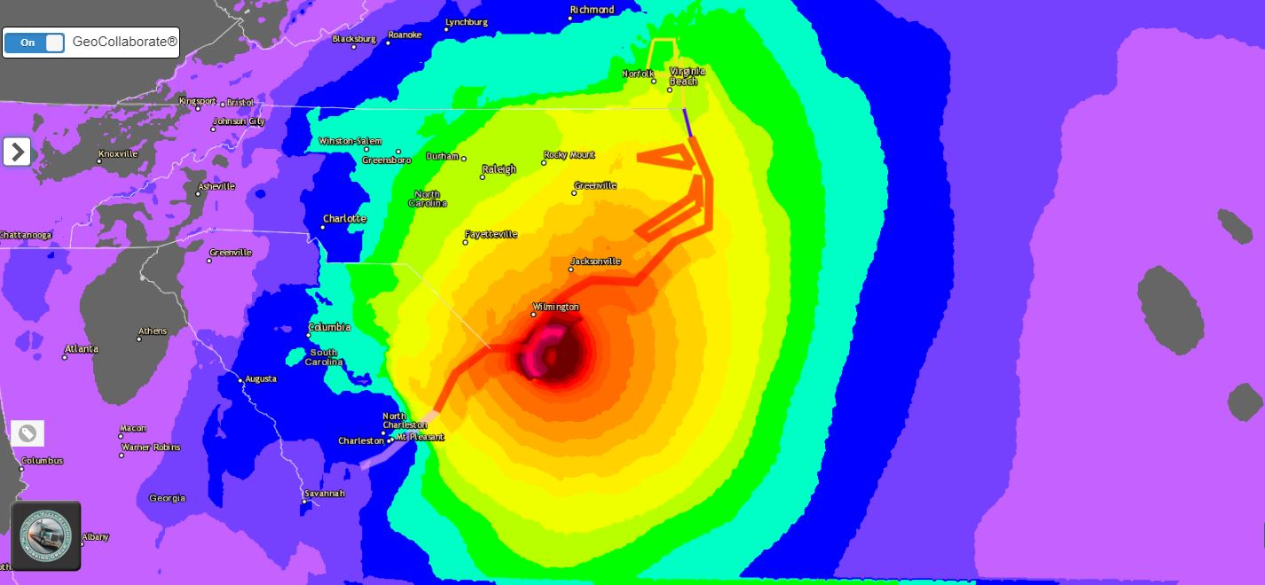
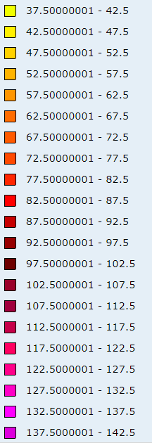
Wind Gust Forecast for Friday 2pm ET
67-72knots = 77-83MPH
117 - 122knots = 134-140MPH
HURRICANE FLORENCE – WIND GUST FORECAST (DATA FROM NOAA NOWCOAST)
Valid: 2:00pm ET September 14, 2018

Slide 20
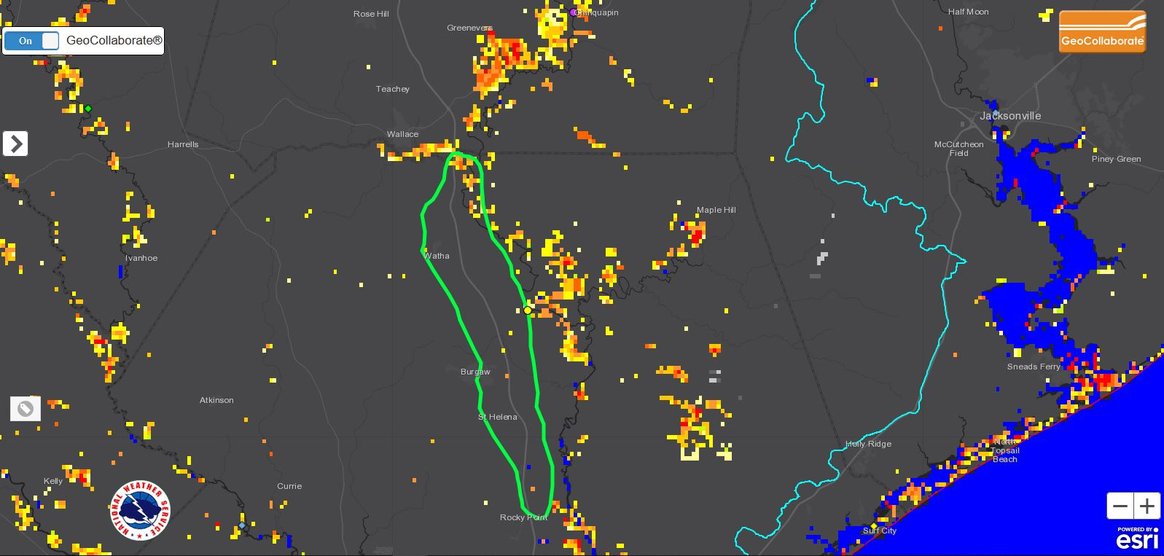
September 18, 2018 GOES16-ABI+NOAA-20 VIIRS+SoumiNPP FLOOD Product
Flood Detect Pixels
September 17, 2018
I-40 ender, CO North Carolina
I-40
Rt. 40 Between Raleigh and Wilmington | NORTH CAROLINA

Slide 21
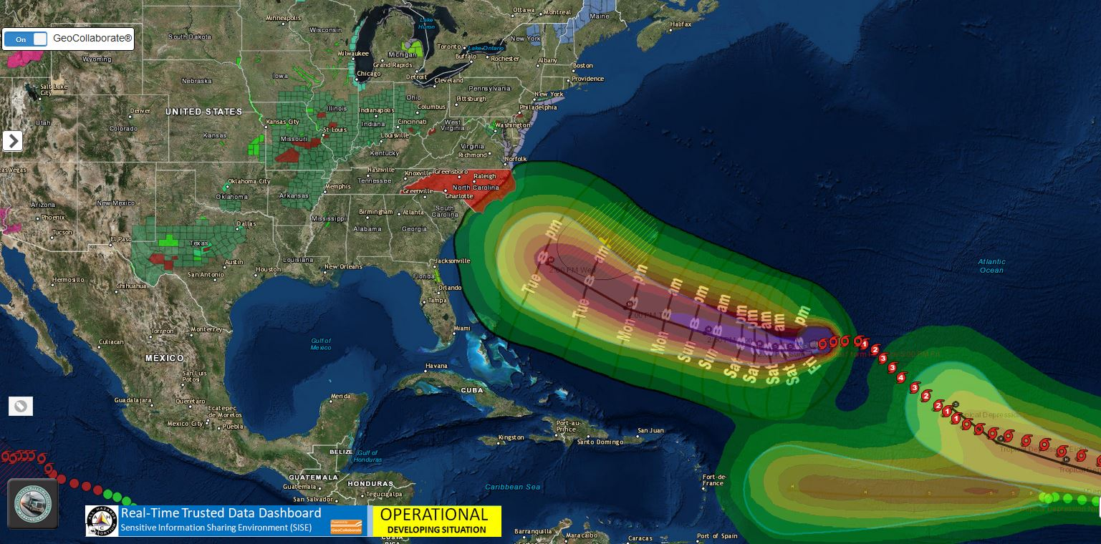
Excellent Move by State of North Carolina!
Declared State of Emergency SEPTEMBER 7, 2018
735 AM EDT Fri Sep 14 2018 ...CENTER OF THE EYE OF HURRICANE FLORENCE FINALLY MAKES LANDFALL NEAR WRIGHTSVILLE BEACH NORTH CAROLINA...

Slide 22
Managing Disasters Through Improved Data-Driven Decision-Making (3DM) A Unified Approach to Readiness, Responsiveness and Resilience
Kari Hicks
Senior GIS Analyst
Duke Energy

Slide 23
Operationalizing ORLs during Hurricane FLorence
Kari Hicks
Sr. Data Analyst

Slide 24
Overview
Background: What was our goal?
What did operationalized ORLs look like?
Successes/Lessons Learned

Slide 25
Background
GIS Analyst Storm Team
Working to prepare for storms over past 1.5 years
Data automation, map automation, leveraging ESRI Portal, establishing best practices
ORLs
Model has been worked on and refined over the past year
ORL committee with the SISE Working Group decided to test the model during a real storm event
ORLs implemented within Duke’s ecosystem back in June, following a Storm Summit in Charlotte, NC

Slide 27
Process
What is the process for adding a new dataset to a production application in storm mode?
Find dataset, preferably a REST Service
Assess the source of the dataset. Is it trusted and reliable?
If no or unsure, we don’t add it. Instead, we add it to a TEST web map to look at later.
Add the service as a Portal Item.
Naming convention: [ORL_LEVEL]:[DATA_SOURCE]_[DESCRIPTION]
Tag within Portal with ORL Level, use case, and ICS Section
Add full description of the dataset within Portal
Share to our Storm Group within Portal
Add Portal Item to web map
Ensure that the service is working as expected
Set any necessary zoom level restrictions
Check labels, symbology, etc.
Add REST Service endpoints to AlertSite Dashboard for monitoring
One person on the hook for monitoring
If a service is causing issues, we take it down
Utilize splash pages in web app to communicate to users that new data has been added (or if something has been changed)

Slide 28
Regional IC
Planning
Logistics
Operations
Finance/Admin
Situational Awareness
GIS!
Routing, Flooding, Basecamps/Staging
Outages/Grid Monitoring

Slide 29
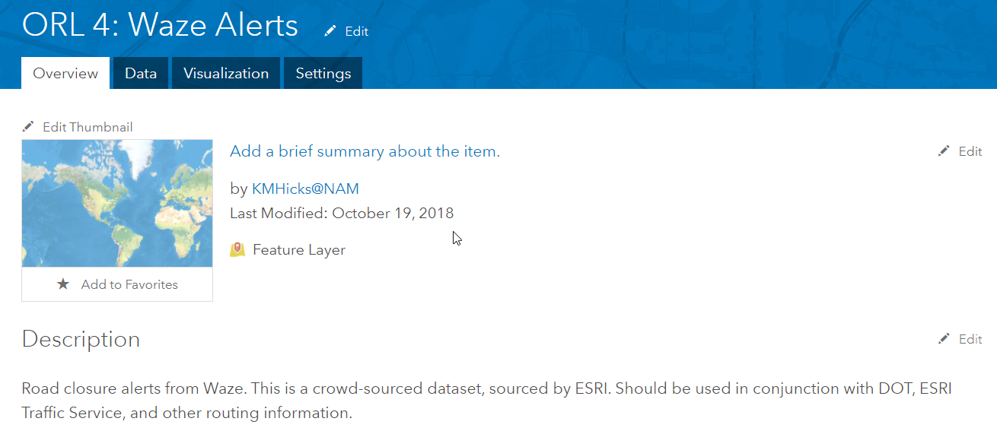

Slide 30
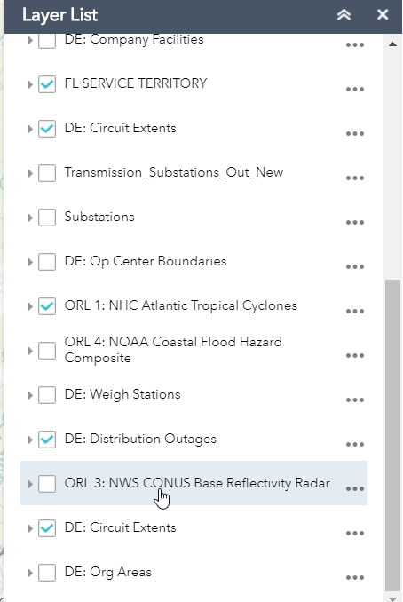
Operations
Planning
Logistics

Slide 31
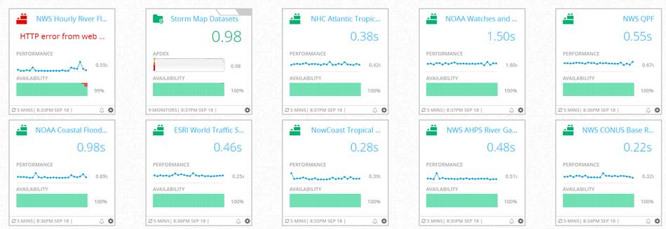
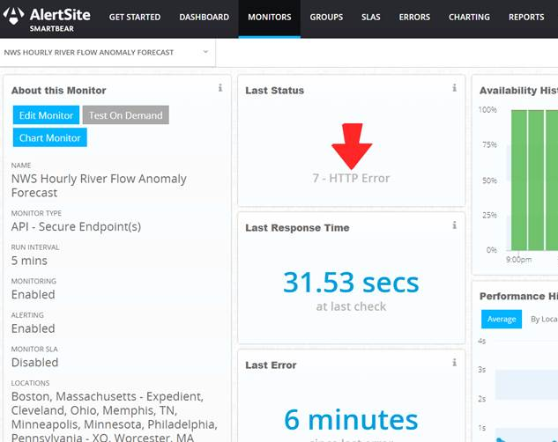
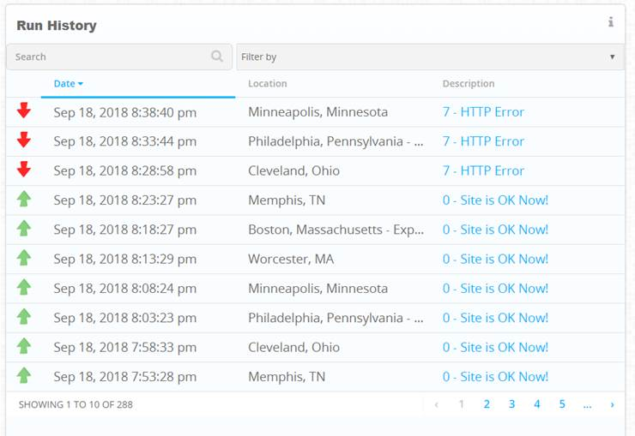

Slide 32
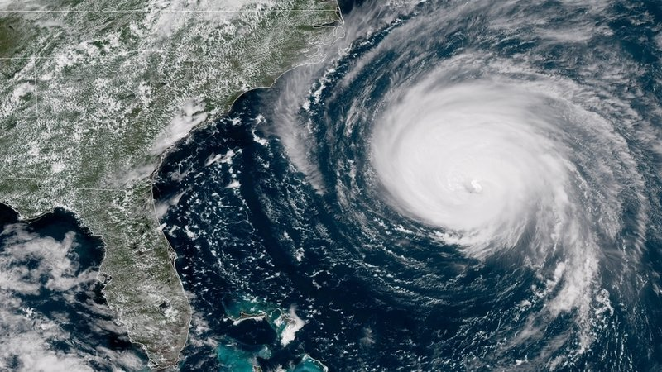
Successes
We found it incredibly helpful on the GIS side of things
ORL model fit well into our existing processes – Is this dataset appropriate for the use case?
We found that filling out the form before adding a dataset made us more thoughtful and less knee-jerk about simply tossing data out there. We are trying to communicate better with our users.
Example: VIIRS flood data
Even though it passed many of the requirements to be ranked on the scale, we felt that it would be too confusing a dataset to add last minute

Slide 33
Lessons Learned
Communication continues to be a challenge
We are working on a platform that incorporates the ORL definitions into the user interface
Need to communicate more with users during blue sky mode on what the model means and why it’s important.
There are some tweaks that definitely need to be made to the ORL Model.
Example: incorporating REST Service monitoring metrics.

Slide 35
Managing Disasters Through Improved Data-Driven Decision-Making A Unified Approach to Readiness, Responsiveness and Resilience
Maggi Glasscoe
NASA Jet Propulsion Lab

Slide 36
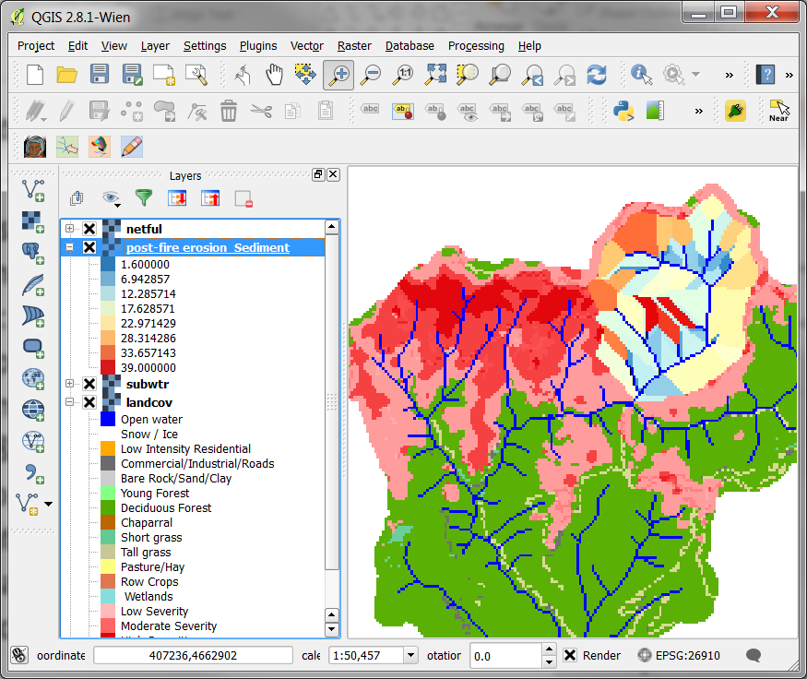
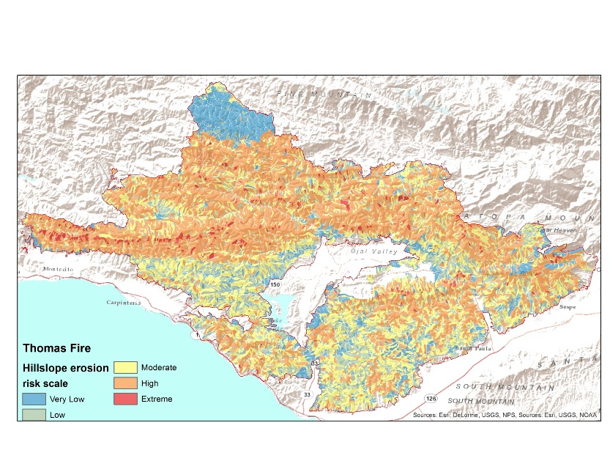
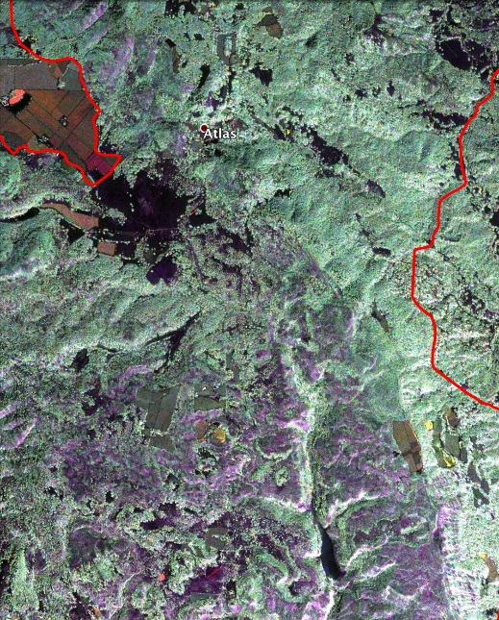
NASA Support of 2017 CA Wildfires: Lessons Learned
NASA Applied Sciences Program:
Disasters and Wildland Fire Program Elements
Presented by Maggi Glasscoe Jet Propulsion Laboratory, California Institute of Technology
© 2018. California Institute of Technology. Government sponsorship acknowledged.
ESIP Webinar 11/15/18
Managing disasters through improved data-driven decision-making

Slide 37
NASA Applied Science: Disasters
The Disasters Applications area promotes the use of Earth observations to improve prediction of, preparation for, response to, and recovery from natural and technological disasters. Disaster applications and applied research on natural hazards support emergency preparedness leaders in developing mitigation approaches, such as early warning systems, and providing information and maps to disaster response and recovery teams.
https://disasters.nasa.gov
https://maps.disasters.nasa.gov
The Program targets a spectrum of disasters, including floods, earthquakes, volcanoes, and landslides as well as combined hazards and cascading impacts.
The Program has Coordinators at NASA HQ and across NASA Centers to enable generation and delivery of data and products to end-users during disaster event activations.
Since NASA is not an operational agency, the Disasters Program activates during an event upon an end-user request
Products are shared directly to the end-user, posted to the Disasters website, and through the Disasters Geoportal.

Slide 38
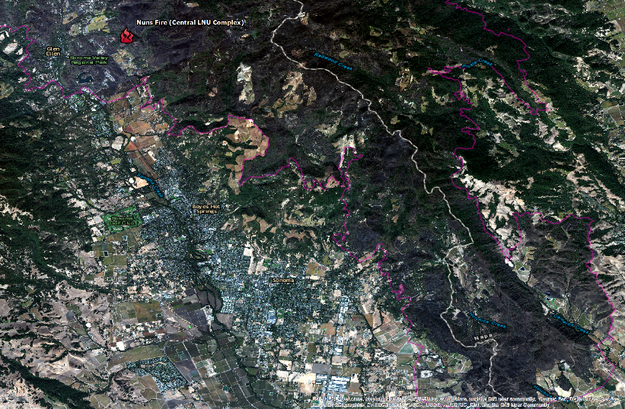
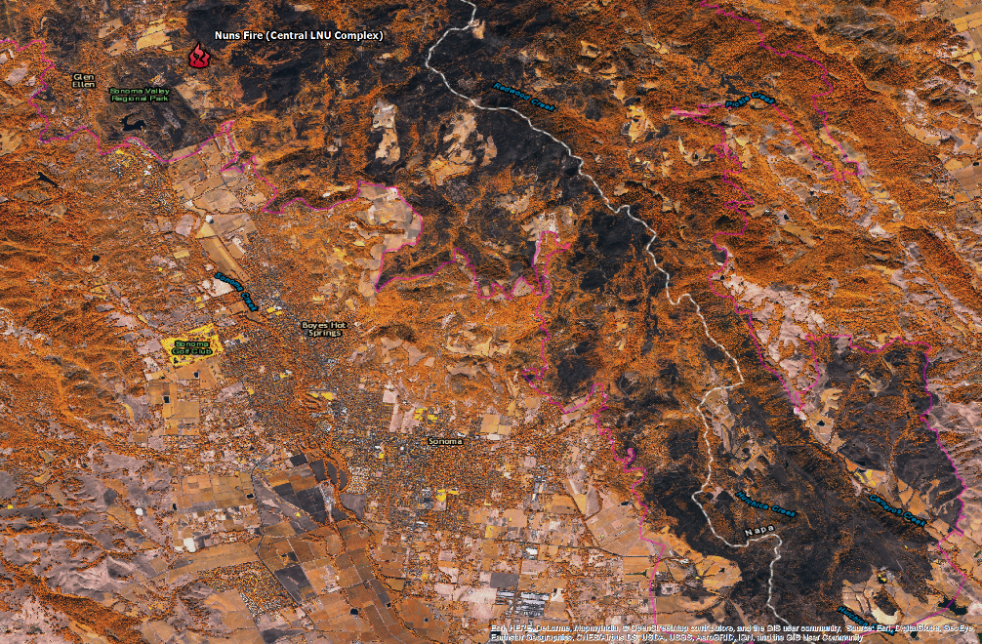
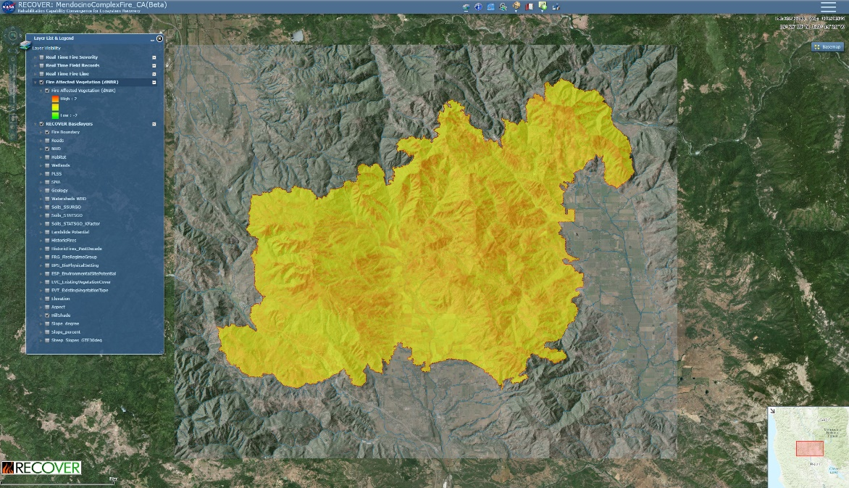
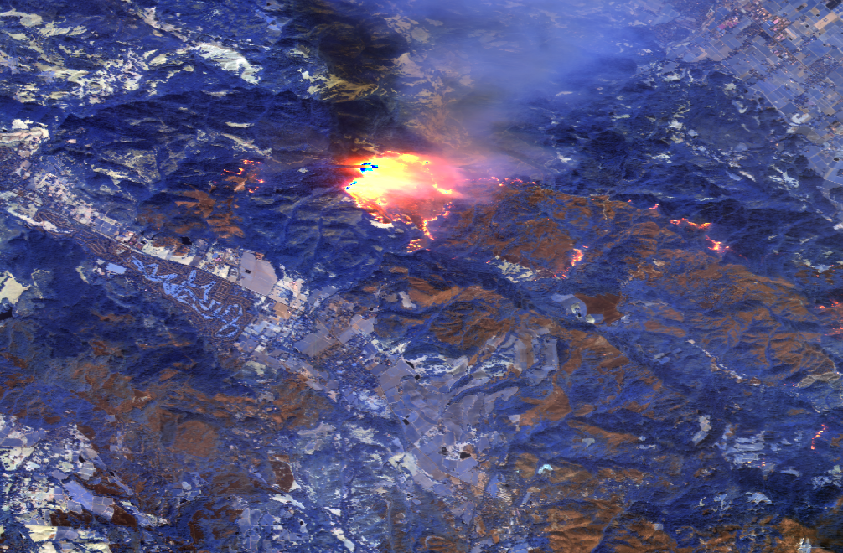
California Fires, October 2017
True Color RGB
Vegetation RGB
Digital Globe Worldview imagery RGB processed at NASA Marshall from HDDS downloaded imagery
The NASA RECOVER DSS rapidly assembled dozens of GIS layers and earth observation imagery to provide fire fighters and managers with actionable information to respond to California’s wildfires (http://giscenter.isu.edu/research/Techpg/nasa_RECOVER/). The DSS for the Mendocino complex of fires was available in 5 minutes with fire severity imagery (shown on the figure below) added shortly after.
SW-IR 641 RGB

Slide 39
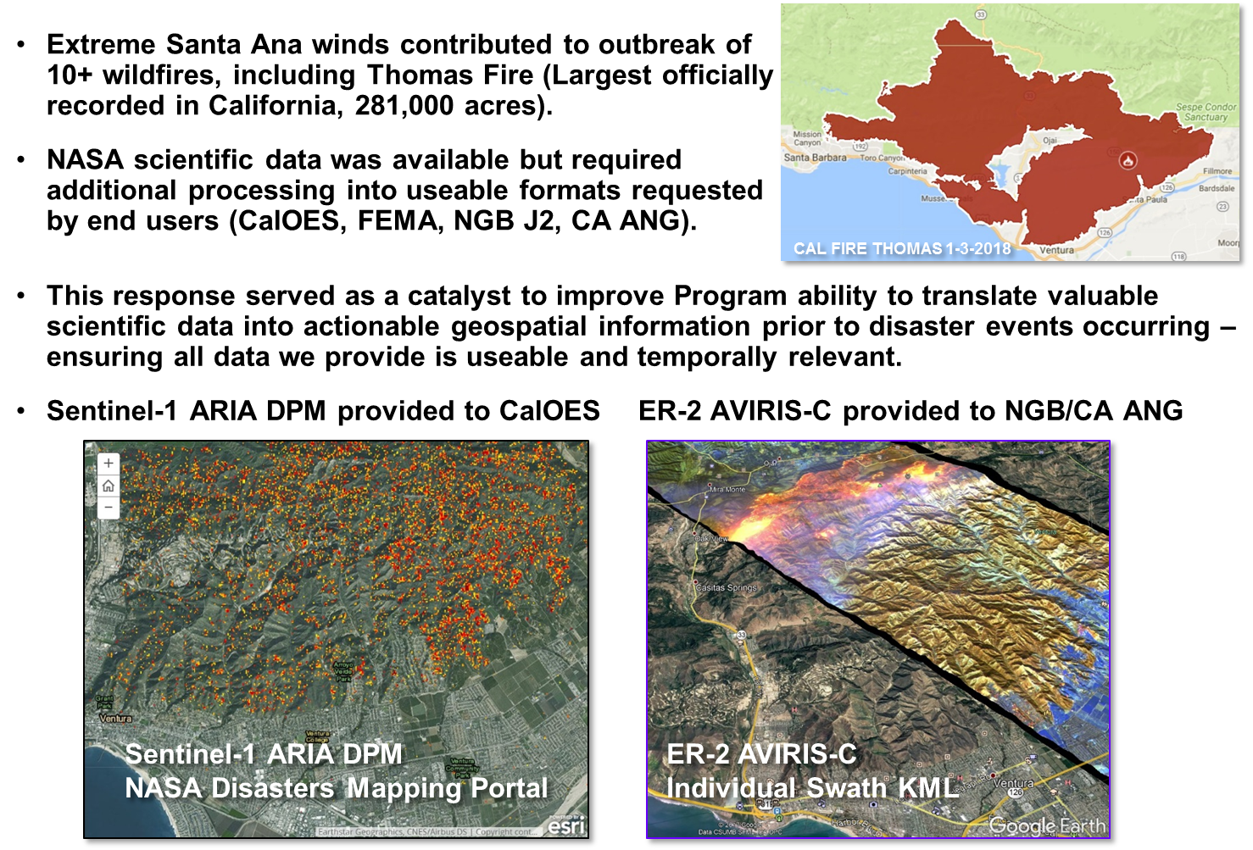
California Fires, December 2017

Slide 40
NASA Airborne Science Data
https://airbornescience.nasa.gov/
UAVSAR aboard NASA G-III aircraft imaged Napa County, California on October 16 to observe areas affected by several wildfires that started on October 8 and burned thousands of buildings as well as vineyards and forests.

Slide 41
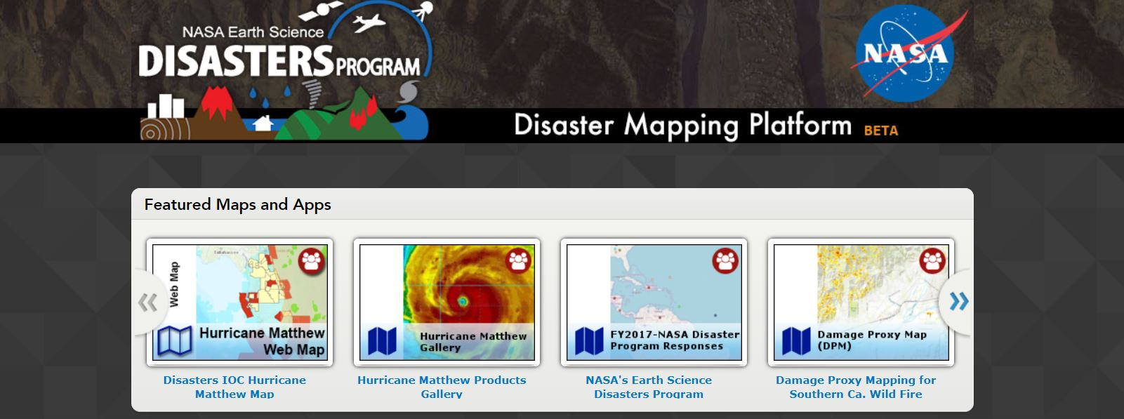
Geospatial Enablement & Data Delivery
The Disasters Program is developing the Disaster Mapping Platform in order to provide action-driven geospatial content and capabilities supporting integration, analytics and collaboration across the disaster management landscape.
https://maps.disasters.nasa.gov

Slide 42
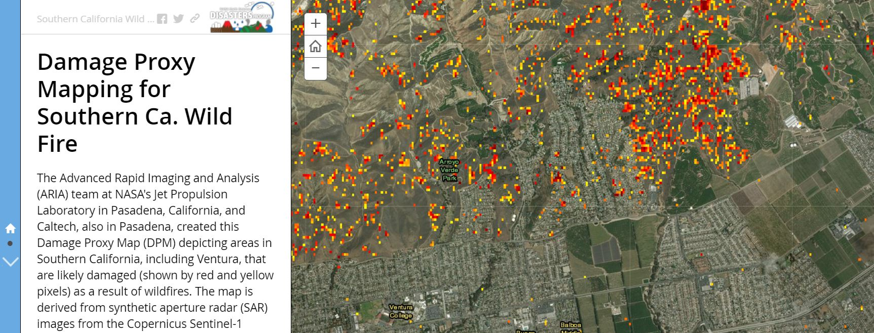
Geospatial Enablement & Data Delivery
The Disaster Mapping Platform bridges the gap between the NASA Science Communities’ generated products and the disaster community that could benefit from the data.

Slide 43
Lessons Learned
End users are still confused about what products are actually available – modeling, remote sensing (satellite vs. airborne) and how to get these products and ingest them into their systems
Work needs to be done to consolidate information and make end-users aware of these, as well as make them more readily available to them in standardized format.
Understand High Resolution Data Availability vs Needs
Pan sharpened true color imagery (sub meter resolution) with minimal latency generally wanted by all end users following disasters – is this something that is NASA/Disasters Program specific, or are we aiding end users to find/use this data? What are NASA capabilities vs. commercial or other providers?
Need for standardized formats and data delivery
Need for training and engagement

Slide 44
Acknowledgments
Dave Borges (NASA Langley Research Center)
Lori Schultz (NASA Marshall Space Flight Center)
Vince Ambrosia (NASA Ames Research Center)
Randy Albertson (NASA Armstrong Flight Research Center)
NASA Disasters and Wildland Fire Program Elements

Slide 45
Further Information
https://appliedsciences.nasa.gov/programs/disasters-program
https://appliedsciences.nasa.gov/programs/wildfires-program
https://disasters.nasa.gov
NASA Earth Science
Applied Sciences Program
NASA Headquarters
Washington, DC
1.202.358.7200

Slide 46
Final Remarks
Arika Virapongse Principal, Middle Path EcoSolutions
av@middlepatheco.com
ESIP’s webinar series:
The socioeconomic value of Earth Science data, information, and applications
November 15, 2018 | Webinar #5
www.esipfed.org
@ESIPfed | #ESIPfed
ESIP is supported by
and 110+ member organizations

Slide 47
Ways to stay involved
ESIP:
Join the Monday Update
Find active collaboration areas
ESIP Winter Meeting in Bethesda, MD in January, 2019
Join Disaster Lifecycle calls:
Meetings (telecons) are on the first Thursday of each month ESIP calendar
To join the cluster, contact Karen Moe karen.moe@nasa.gov
GeoValue:
Join the GeoValue community! http://www.geovalue.org/
Kruse, J., J. Crompvoets, and F. Pearlman, editors (2017) GEOValue: The Socioeconomic Value of Geospatial Information. CRC Press/Taylor and Francis, Boca Raton, FL, USA.
Notes:
Sign in sheet: goo.gl/YWoaXZ
ESIP Monday update: http://esipfed.org/category/monday-updates
ESIP Collaboration areas: http://www.esipfed.org/get-involved/collaborate
Next ESIP meeting: http://www.esipfed.org/meetings/upcoming-meetings
Agriculture & Climate Cluster telecons: http://esipfed.org/get-involved/telecon-calendar
Agriculture & Climate Cluster telecon notes: goo.gl/9w5rua

Slide 48
Thank you!
For more information about the webinar and series, contact:
Arika Virapongse: av@middlepatheco.com

