Slide 1
Where has the soil gone?
Soil erosion modelling case-study in agricultural landscapes of South Australia
Amelie Jeanneau¹, Bertram Ostendorf¹, Tim Herrmann² ¹Spatial Sciences Group, School of Biological Sciences ²Department for Environment and Water
Notes:
Thanks Suzan for the introduction.
My name is Amelie Jeanneau I am currently working within the Spatial Sciences Group of the University of Adelaide
I am here today to give you an overview of my research project on soil erosion modelling in agricultural landscapes of South Australia

Slide 2
2002
2015
280 days of cover
340 days of cover
Reduced erosion risk!!
Notes:
Recent improvements in land management practices have resulted in an increase of protective cover from 280 days in 2002 to 340 in 2015
These progresses have therefore significantly reduced soil erosion risk over the years.

Slide 3
2050?
Soil losses
?
?
Direct impact on land productivity
Notes:
But we can’t reliably predict yet how changes in land management and climate conditions will affect future soil losses.
For instance, with more variable weather conditions, soil losses will probably be more important which will have a direct impact on land productivity

Slide 4
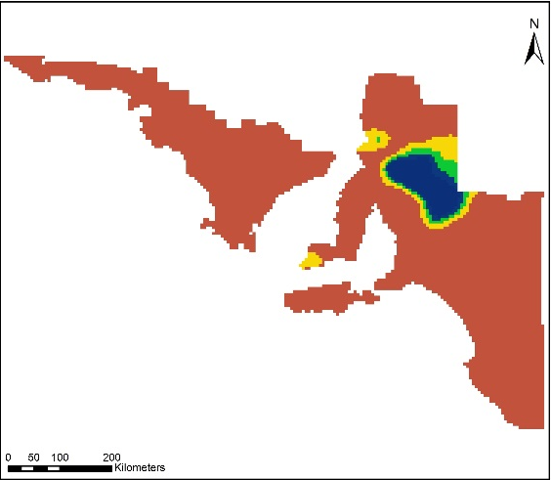
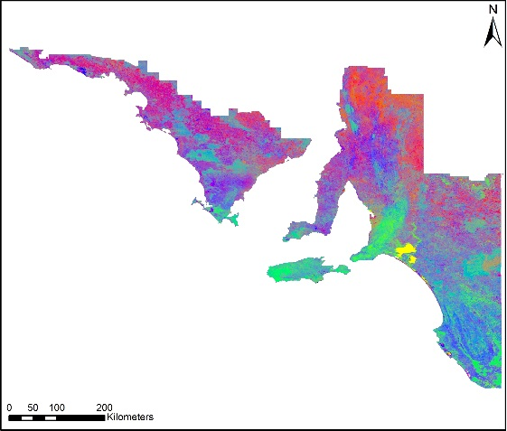
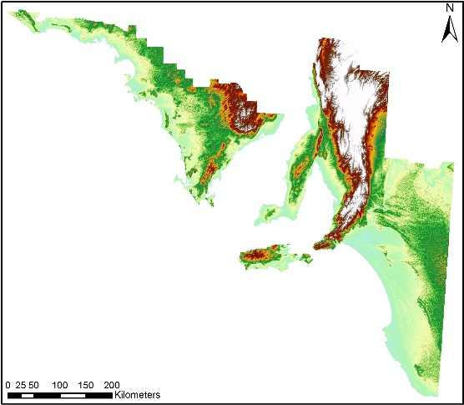
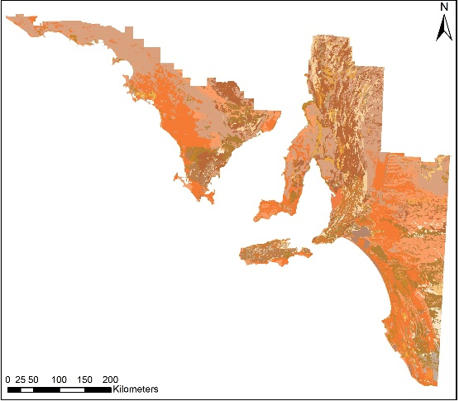
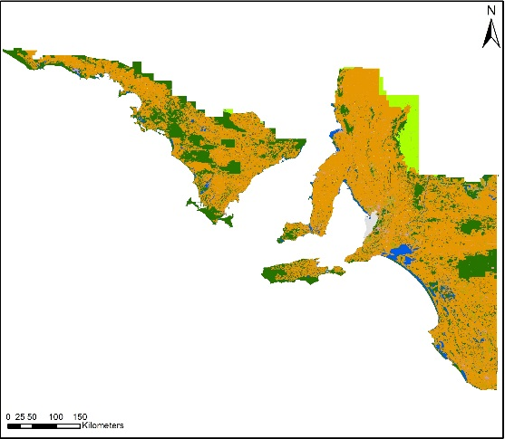
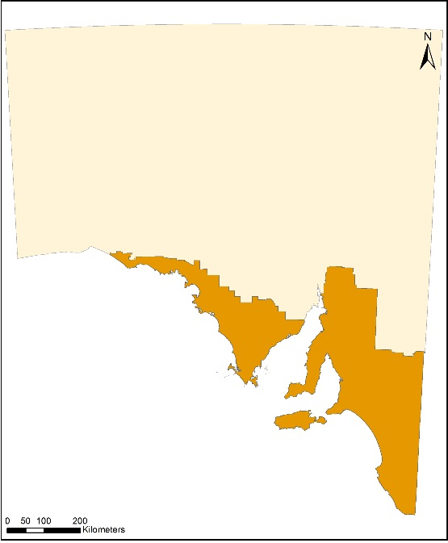
Modelling Approach
Notes:
What we propose here, is to combine the latest remote sensing products to model soil erosion by wind and water in agricultural regions of South Australia.
We are using GIS to combine remotely sensed data such as:
weather satellite information, fractional vegetation cover and topography
With other datasets like soil characteristics from digital soil mapping and land use data.

Slide 5
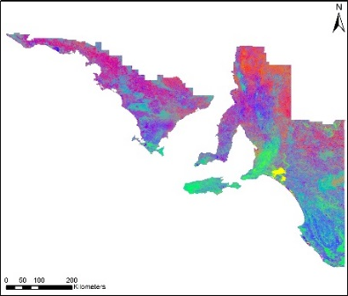
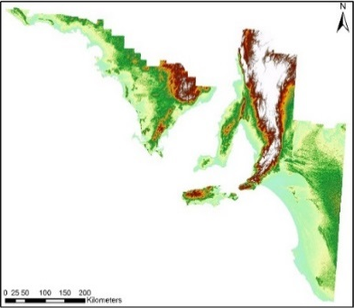
Modelling Approach
Provide daily/monthly/annual outputs
From km² to ha scale
Data fusion
Digital soil mapping
Topography maps
Possibility to improve resolution to 90 or 30m
Notes:
Due to advances in spatial technologies, we have now developed models with a better spatial and temporal resolution than those used in past decades.
Indeed we can:
Provide soil losses at daily/monthly and annual time-frames
And navigate through our modelled results from a square km to a hectare scale
Additionally, with image fusion techniques and the current resolution of digital soil mapping and radar topography map we could improve our spatial resolution even further.

Slide 6
Objectives
Soil loss forecasts
Characterise current soil loss
Isolate years/months with extreme weather conditions
Provide erosion forecasts
Notes:
So to understand how changes in land management and climate conditions will affect future soil losses, we will:
Define current soil losses > Isolate years with extreme weather conditions and use them as surrogate > to propose erosion forecasts in accordance with current Global Climate Models

Slide 7
Objectives
Soil loss forecasts
Characterise current soil loss
Isolate years/months with extreme weather conditions
Provide erosion forecasts
Relative magnitude of wind/water erosion
Identify regions currently vulnerable to erosion
Examine changes in erosion patterns with future climate conditions
Notes:
We will also identify regions which are currently prone to wind or water erosion > and see whether these erosion patterns will change in the future to potentially highlight new erosion hotspots

Slide 8
Objectives
Soil loss forecasts
Characterise current soil loss
Isolate years/months with extreme weather conditions
Provide erosion forecasts
Relative magnitude of wind/water erosion
Identify regions currently vulnerable to erosion
Examine changes in erosion patterns with future climate conditions
Vulnerability of fire-affected soils
Notes:
Finally, as extreme fire weather risks will increase in the future, we want to scrutinize the impact of bushfires on soil erosion on cropped lands.

Slide 9
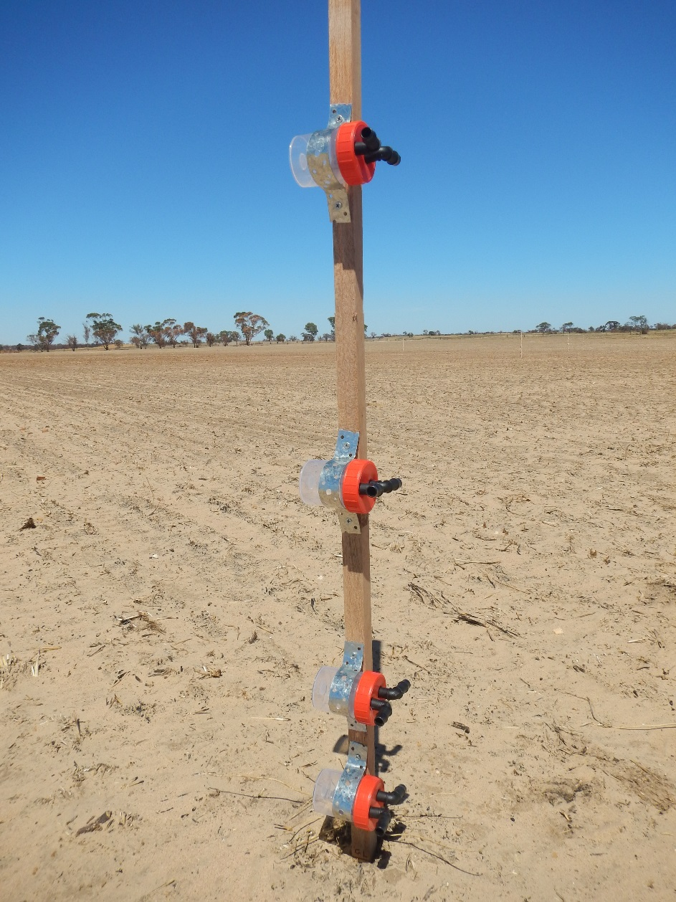
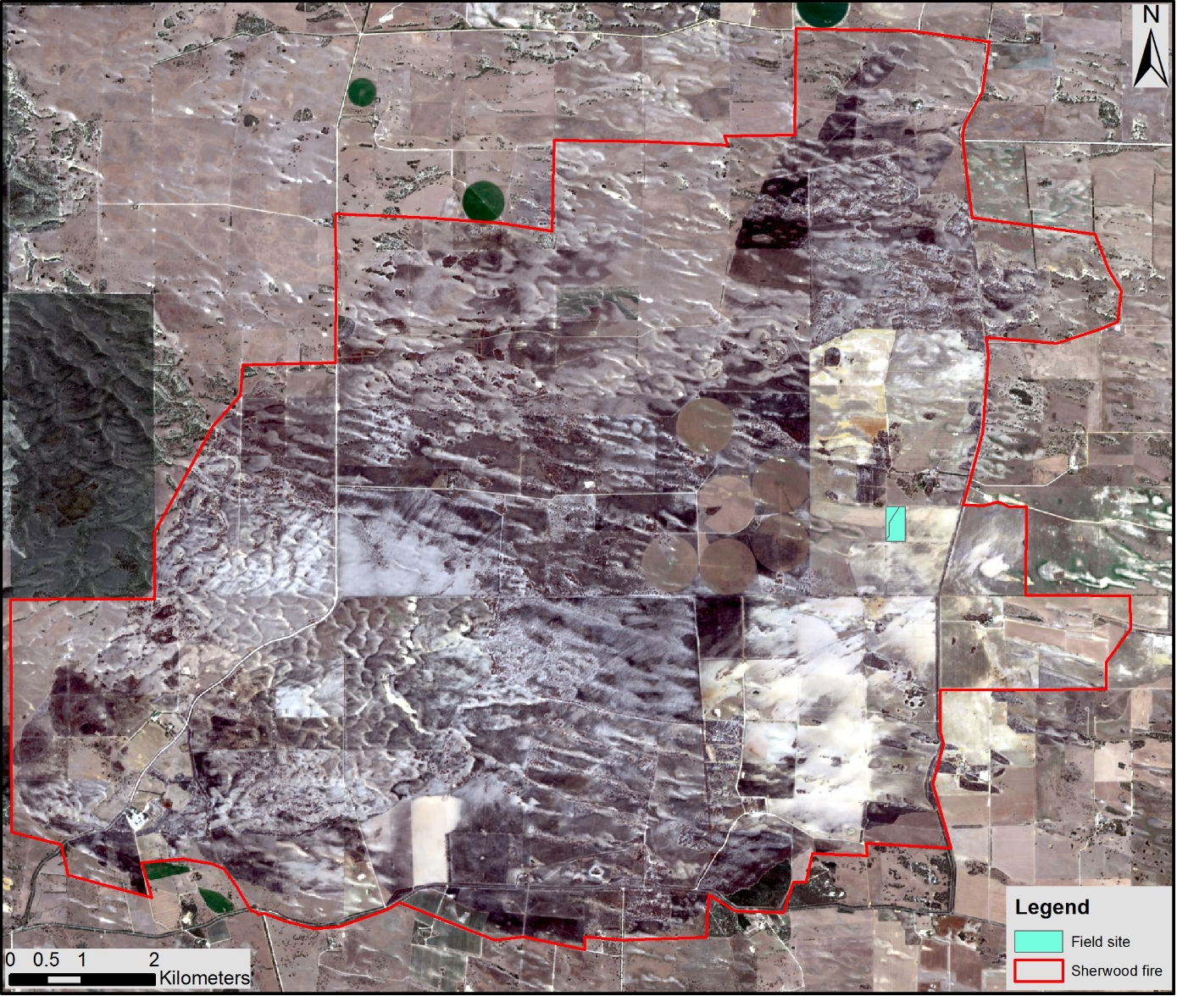
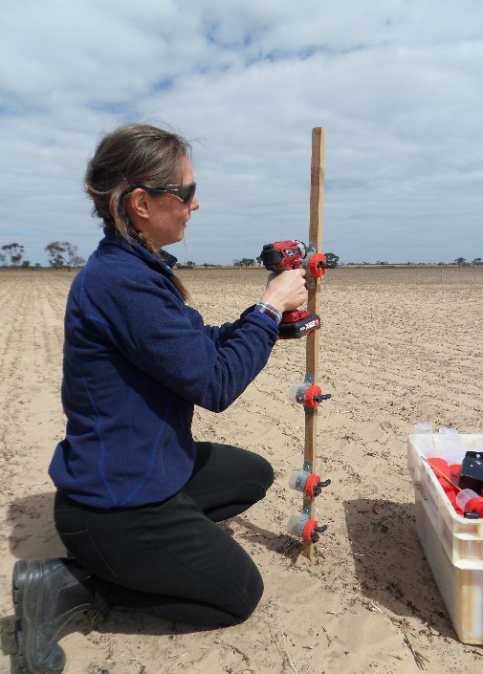
Erosion post-fire in cropping regions
Notes:
Our monitoring set-up follows a protocol developed by the US Department of Agriculture in 2015, and collects sediments over 1ha plots with sampling mast like the one presented on the picture here.
These dust traps are sampling horizontal sediment mass flux and collecting bottles are changed every 3weeks.
These sediment measurements will enable:
The detection of spatial variability in sediment mass flux within the plots
And the evaluation of spatio-temporal patterns of sediment transport within sites.
This method generates the minimum data required to calibrate and validate wind erosion models.
Additionally it is intended to evaluate the transport variance following established cost-effective protocols for measuring spatial variability in soil redistribution.

Slide 10
Significance
Input data readily available
High resolution models
Time and space
Automated scripts
Able to predict:
Future vulnerable regions
Current and potential future soil losses
Notes:
To conclude, this project employs readily available inputs, produces high resolution modelled outputs and can be frequently updated through the use of automated scripts.
From our results, we will therefore be able to identify future regions at risk of soil erosion and predict current and future soil losses.
The tool that we are developing could then be used for decision making regarding erosion mitigation.

Slide 11
Bertram Ostendorf
Cameron Grant
Spatial Sciences Group
Applied Ecology and Conservation
Tim Herrmann
Trevor Hobbs
Craig Liddicoat
Giles Forward
Amelie Jeanneau amelie.jeanneau@adelaide.edu.au
Spatial Sciences Group
School of Biological Sciences
Notes:
I would like to thank my supervisors and all the project members who have been involved and helped me shape this project
If you have specific questions or if you want to know more about the project please come find me at the closing ceremony later.
Thank you all for your attention

Slide 13
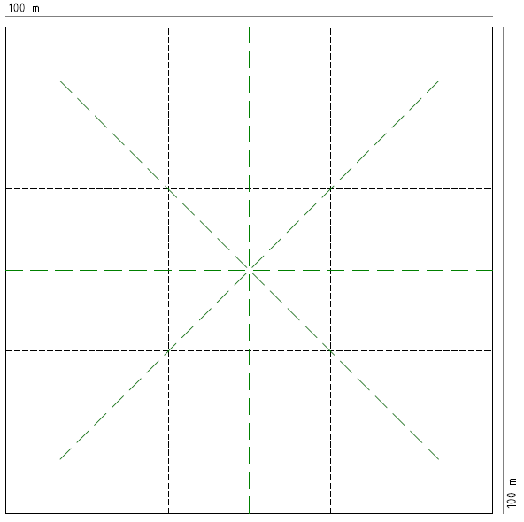
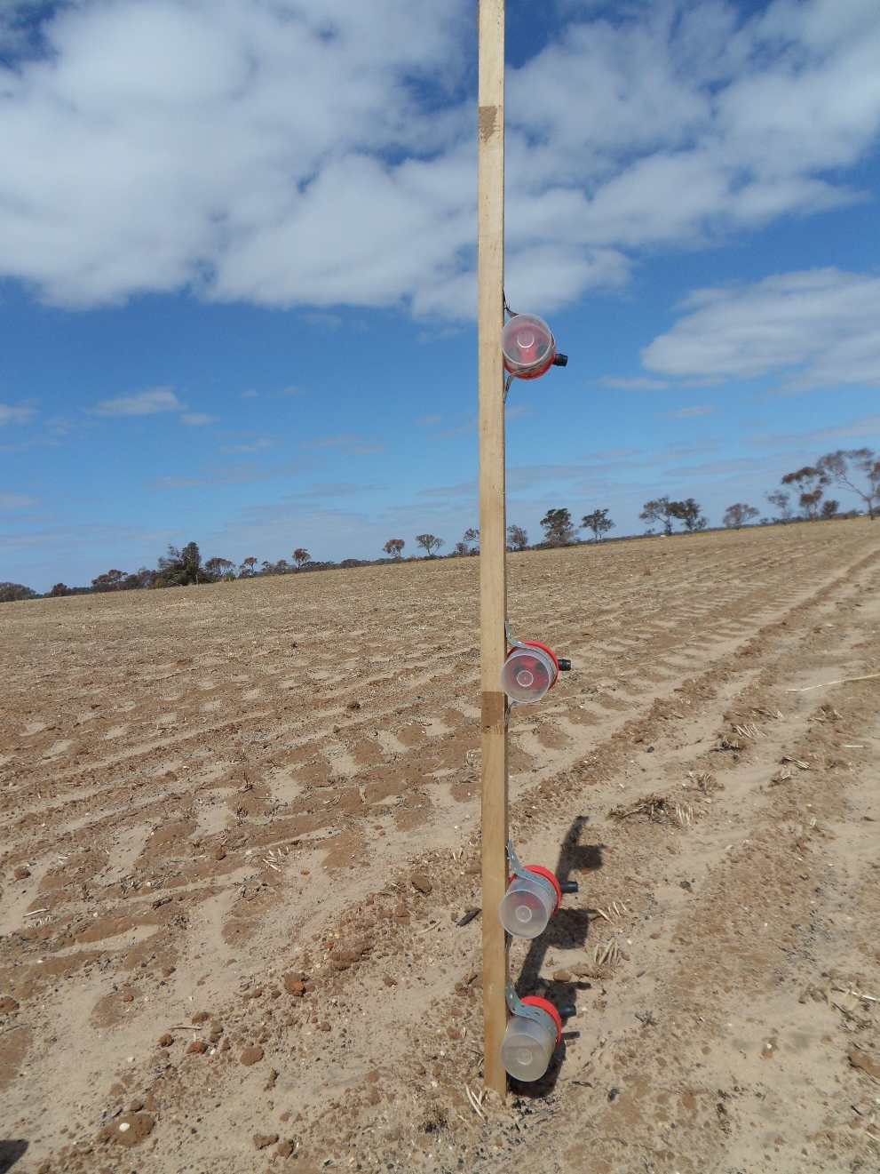
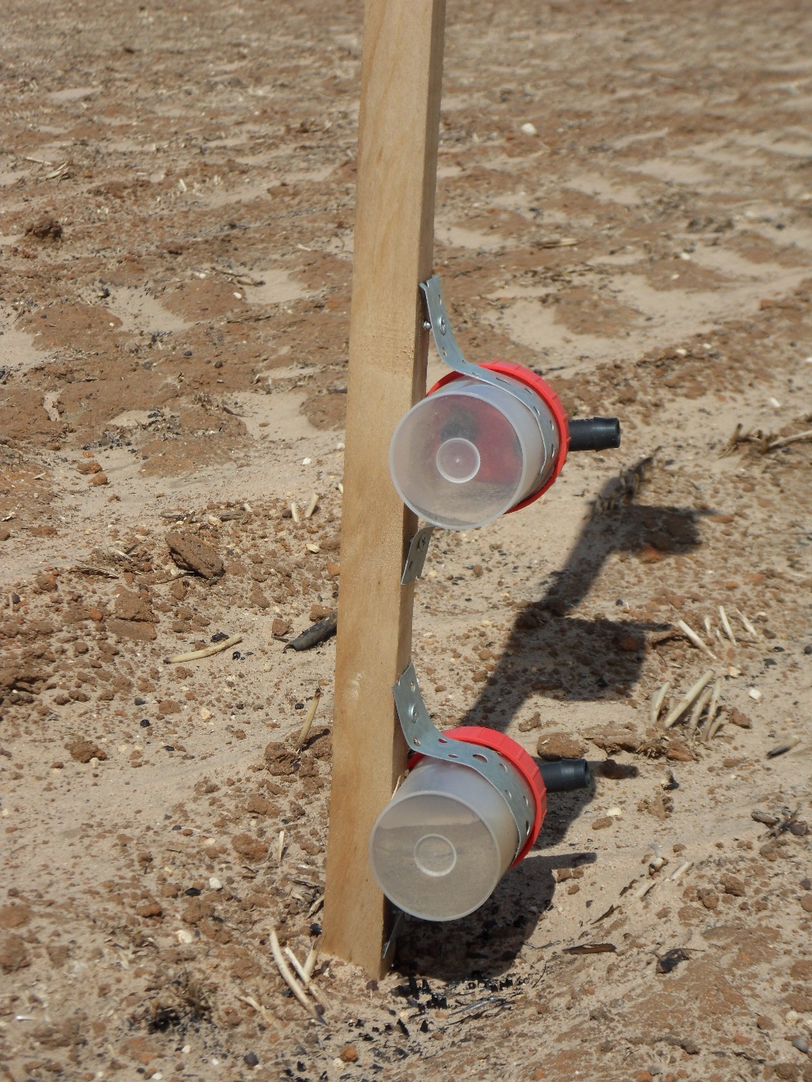
M
M
M
M
M
M
M
M
M
M
M
M
M
M
M
M
M
M
M
M
M
M
M
M
M
M
M
M
Dust sampling masts (27)
Vegetation transects

