Slide 1
The New ORCID US Community Blooms: Working Together for Positive Change
November 7, 2018
Sheila Rabun, ORCID US Community Specialist
https://orcid.org/0000-0002-1196-6279
Jill Grogg, Licensing Program Strategist
https://orcid.org/0000-0001-5136-4507

Slide 2
What is ORCID?
https://orcid.org/0000-0002-1196-6279
0000-0002-1196-6279
ORCID = Open Researcher & Contributor Identifier
Name disambiguation: Unique identifier for individuals
FREE to Register: http://orcid.org/register

Slide 3
LYRASIS & ORCID

Slide 4
ORCID US Community

Slide 5
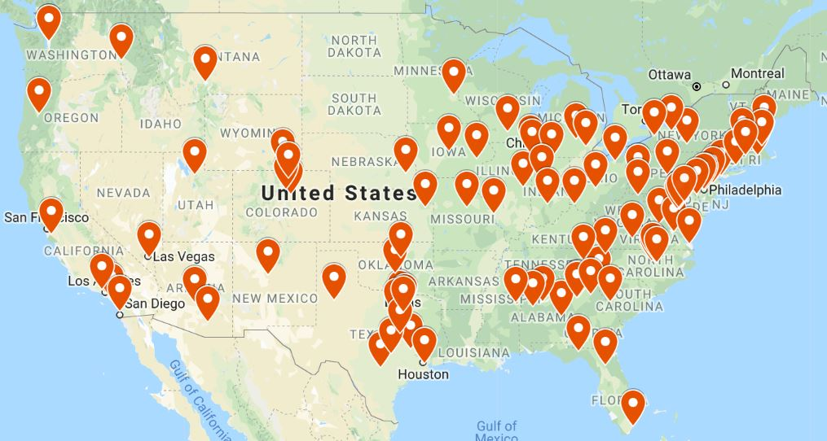
ORCID US Community Map
107+ institutional members
~300,000 ORCID iDs (public data, as of Oct. 1)

Slide 6
ORCID US Community Goals
Build a community of practice around ORCID in the US
Enable institutions to work together, share best practices, advice, etc. for ORCID adoption
Ease the pathway to ORCID adoption
Ensure that member institutions know how to get the most value from ORCID membership

Slide 7
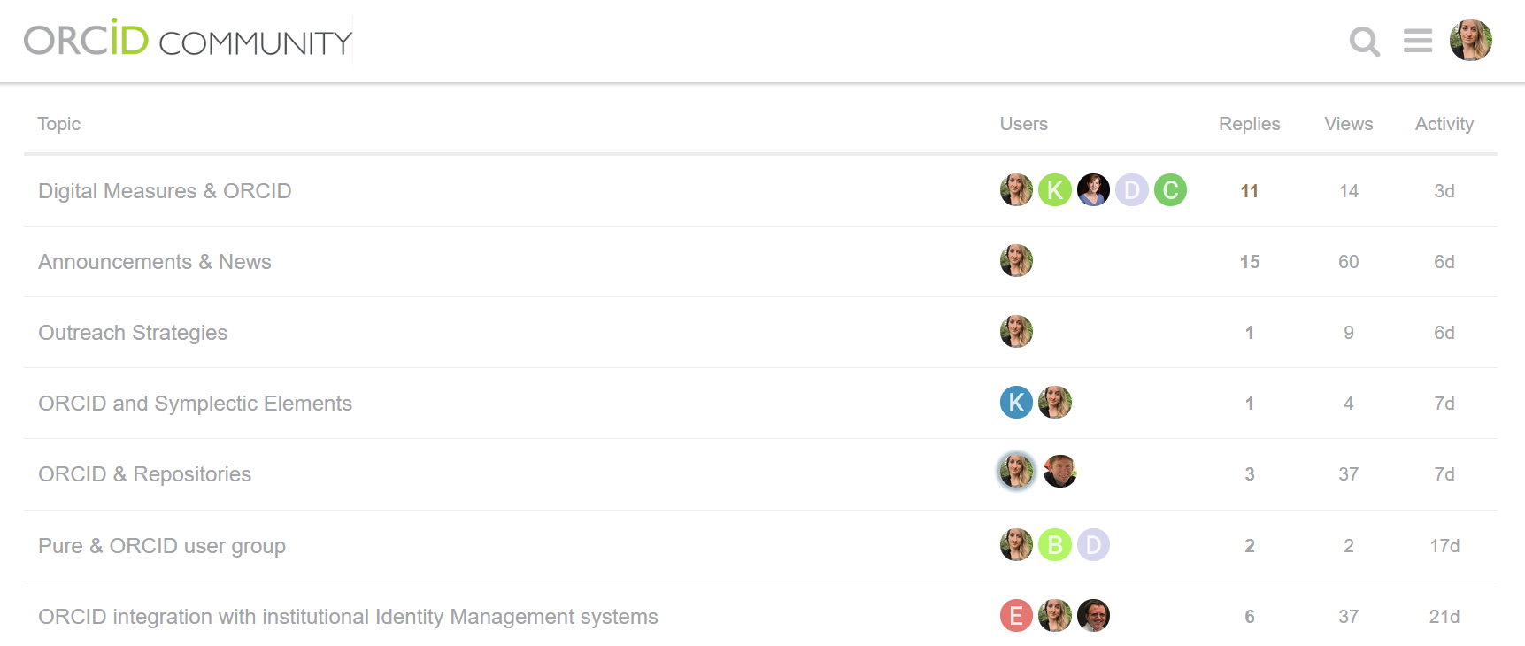
ORCID US Community Discussion Forum
Members-Only Discussion Forum: Utilize the collective wisdom of the community

Slide 8
ORCID US Community Website
ORCID US website: http://orcid-us.org

Slide 9
ORCID US Community Exemplars
https://www.lyrasis.org/Leadership/Pages/ORCID-US-Exemplars.aspx

Slide 10
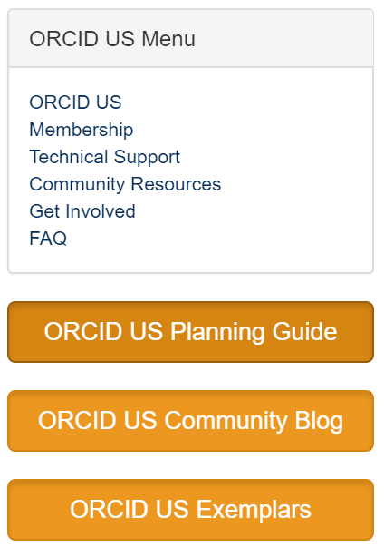
ORCID US Community Resources
Coming Soon:
Quarterly Newsletter
Member Stories Blog
Software integration demos and documentation
Quarterly community calls

Slide 11
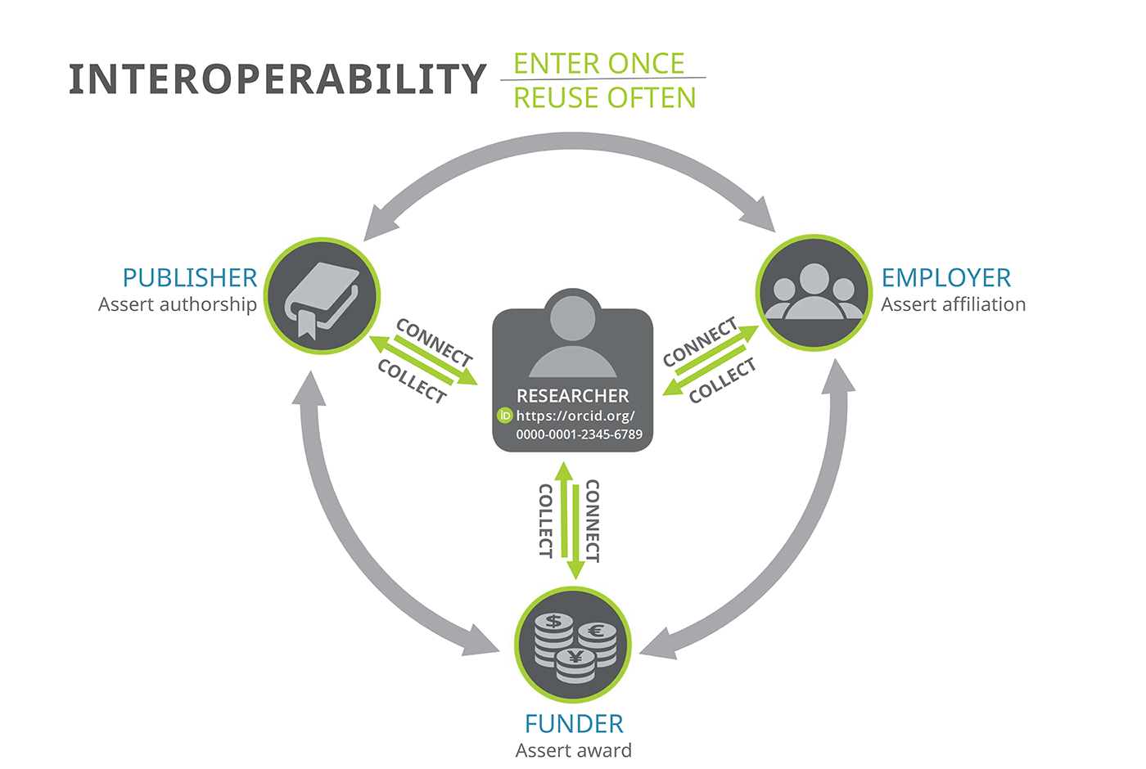
ORCID Ecosystem & Interoperability
Employment & Education Affiliations
Names(s) & Biographical Information
Research Published, Presentations, etc.
Peer Review Activity
Grant Funding Received
Image source: ORCID

Slide 12
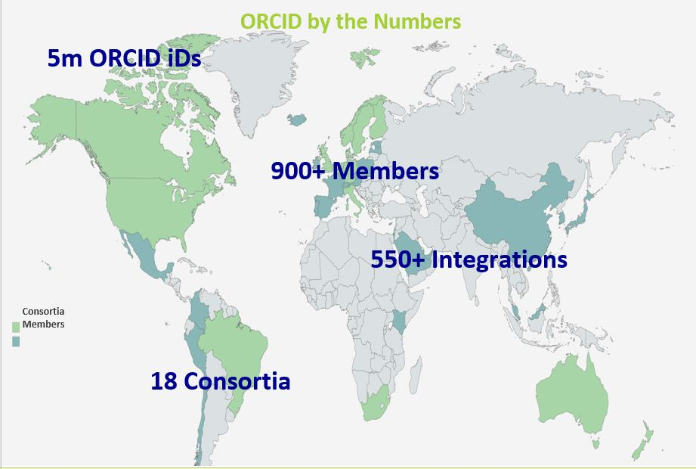
ORCID Globally
Image source: ORCID

Slide 13
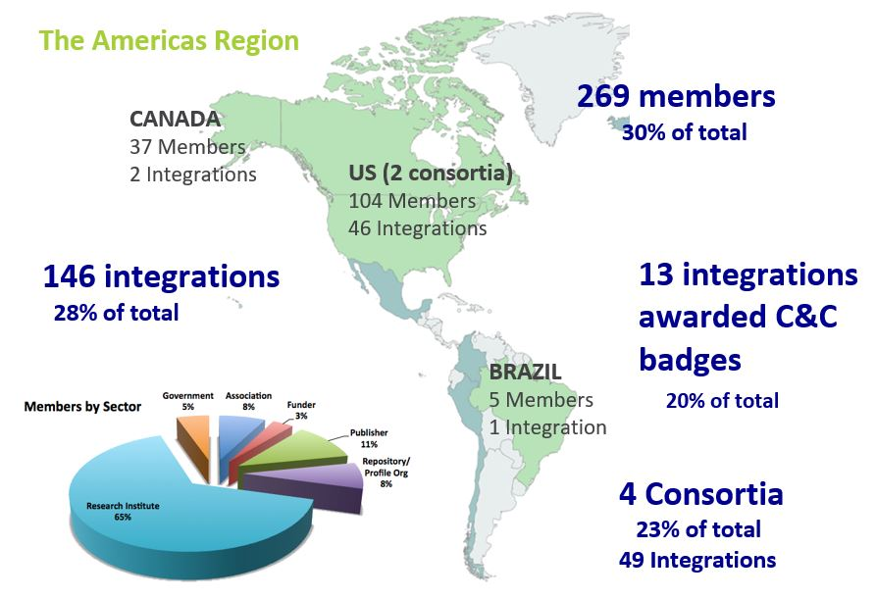
ORCID Americas Region
Image source: ORCID

Slide 14
ORCID US Community Map
107+ institutional members
~300,000 ORCID iDs (public data, as of Oct. 1)

Slide 15
ORCID Benefits for Research Institutions
Mitigate confusion caused by name ambiguity
Assess & track individual contributions & measure institutional impact
Assert trustworthy & accurate affiliations
Save time & reduce administrative burden

Slide 16
ORCID Benefits for Research Institutions
Mitigate confusion caused by name ambiguity

Slide 17
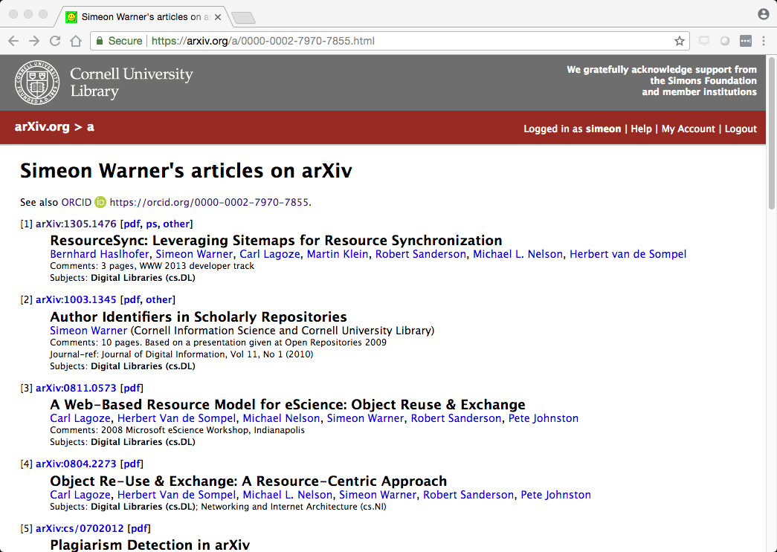
Mitigate confusion caused by name ambiguity
Image source: Simeon Warner, Cornell University

Slide 18
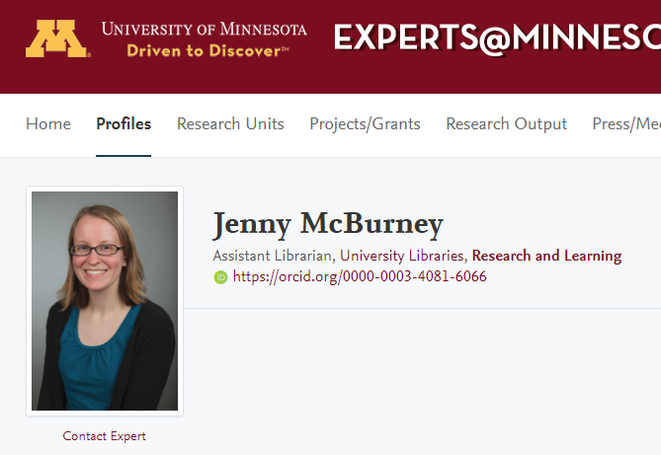
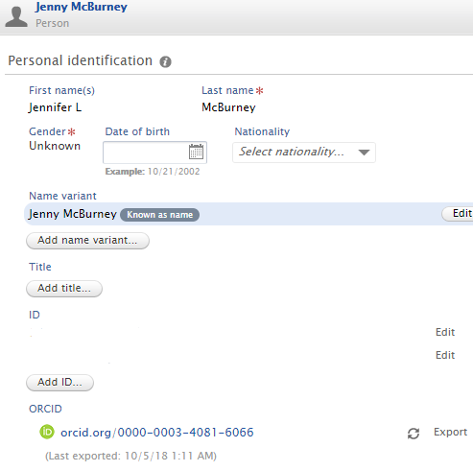
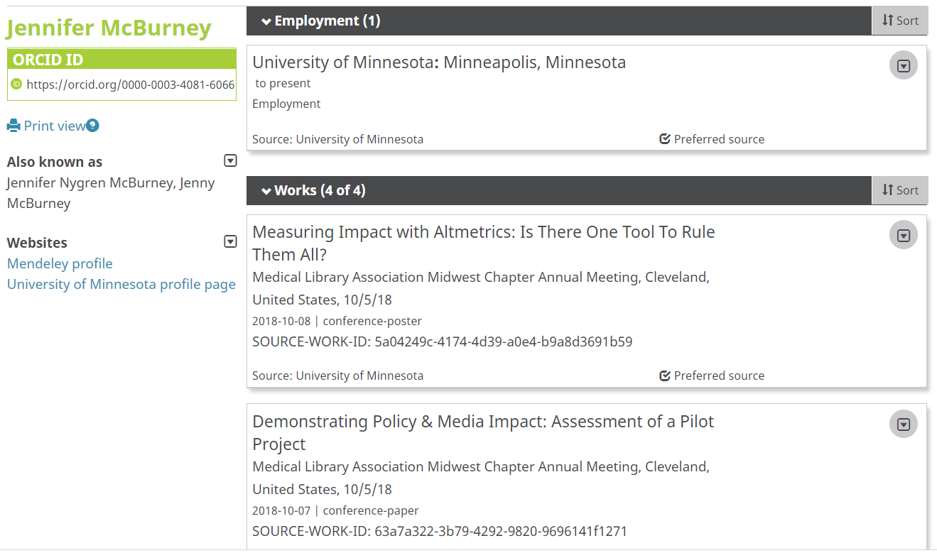
Mitigate confusion caused by name ambiguity
Images: University of Minnesota

Slide 19
ORCID Benefits for Research Institutions
Assess & track individual contributions & measure institutional impact

Slide 20
Assess contributions & measure impact
ORCID + CRIS vendor integrations
And more...
More info: http://members.orcid.org/api/orcid-enabled-systems

Slide 21
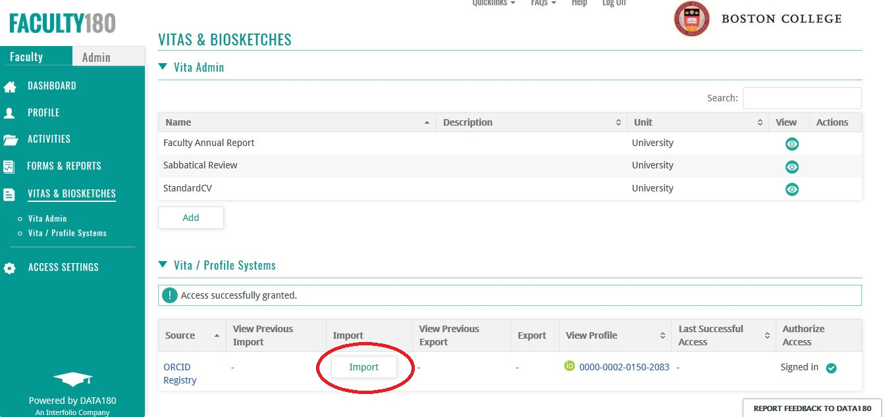
Assess contributions & measure impact
Image source: John O’Connor, Boston College

Slide 22
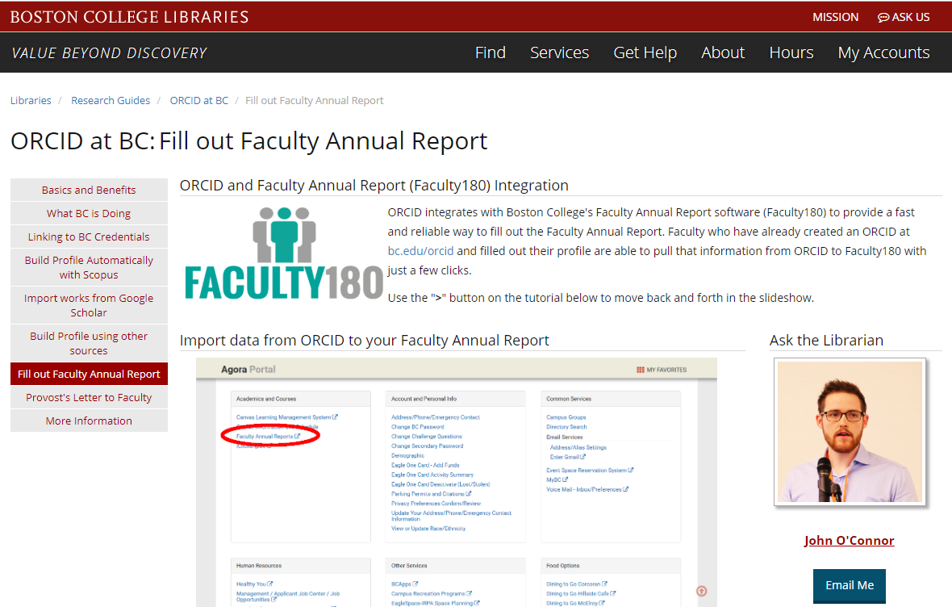
Training for Faculty
Image credit: https://libguides.bc.edu/orcid/facultyreport

Slide 23
Assess contributions & measure impact
Get an ORCID iD!
Click the button below to get an ORCID iD and Connect to XYZ Institutional System.
Create a new ORCID iD
Already have an ORCID iD? Connect your existing ORCID iD

Slide 24
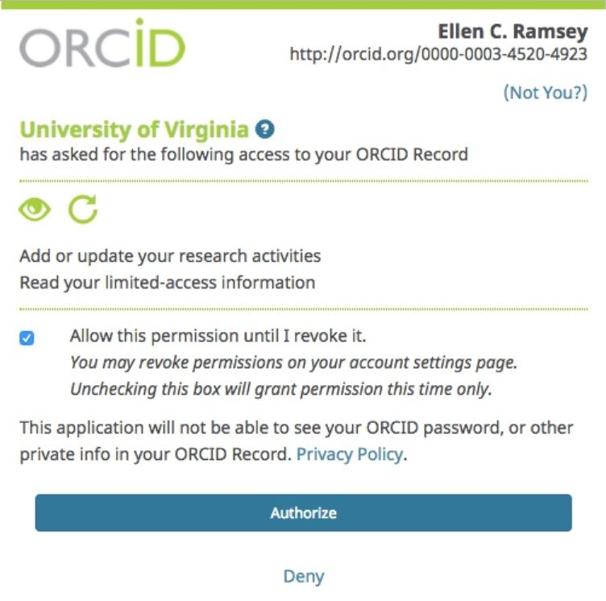
Assess contributions & measure impact
Individual’s Name
http://orcid.org/0000-0000-0000-0000
XYZ Institution Name

Slide 25
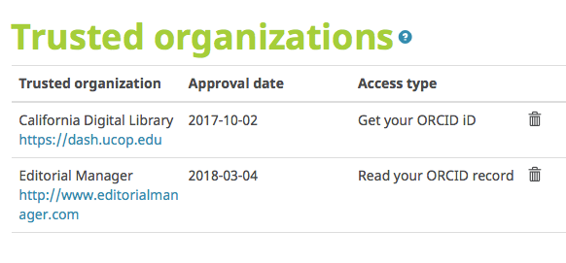
Assess contributions & measure impact

Slide 26
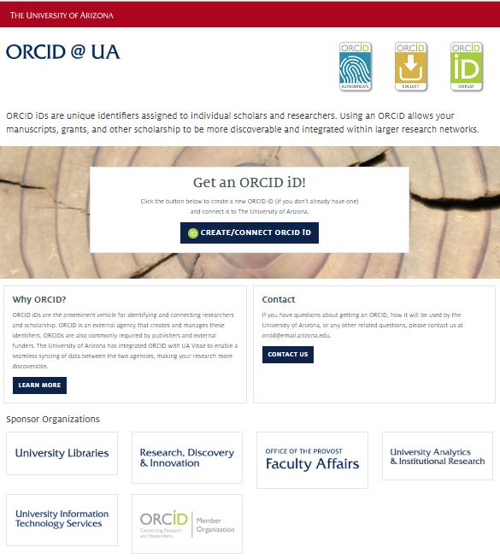
Create & Connect
https://orcid.arizona.edu/

Slide 27
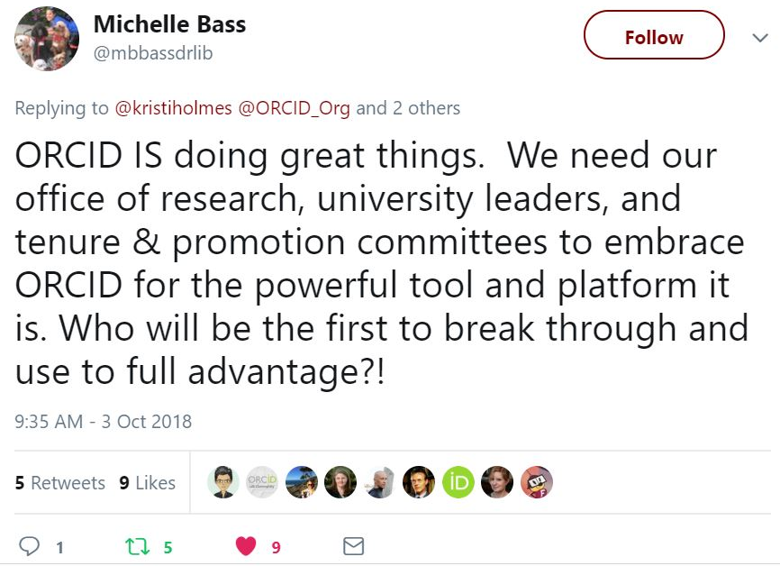
Assess contributions & measure impact
https://twitter.com/mbbassdrlib/status/1047525597021274112

Slide 28
Assess contributions & measure impact
Image source: Melroy Almeida, Australian Access Federation
https://public.tableau.com/profile/melroy#!/

Slide 29
Assess contributions & measure impact
Image source: Melroy Almeida, Australian Access Federation
https://public.tableau.com/profile/melroy#!/

Slide 30
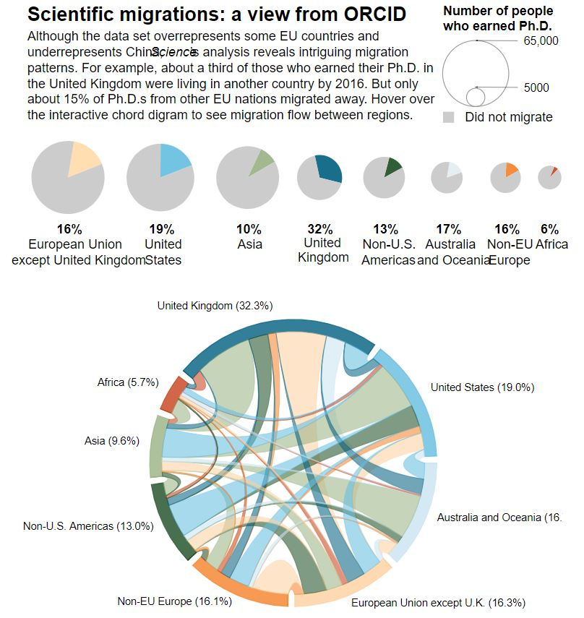
Assess contributions & measure impact
https://www.sciencemag.org/news/2017/05/vast-set-public-cvs-reveals-world-s-most-migratory-scientists

Slide 31
ORCID Benefits for Research Institutions
Assert trustworthy & accurate affiliations

Slide 32
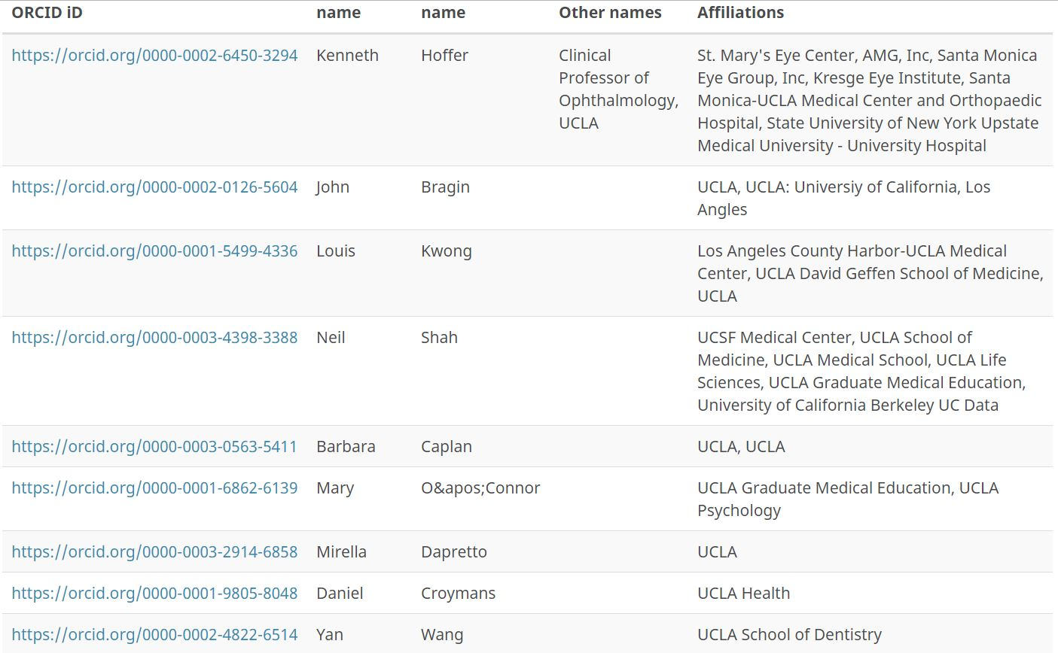
Assert trustworthy & accurate affiliations

Slide 33
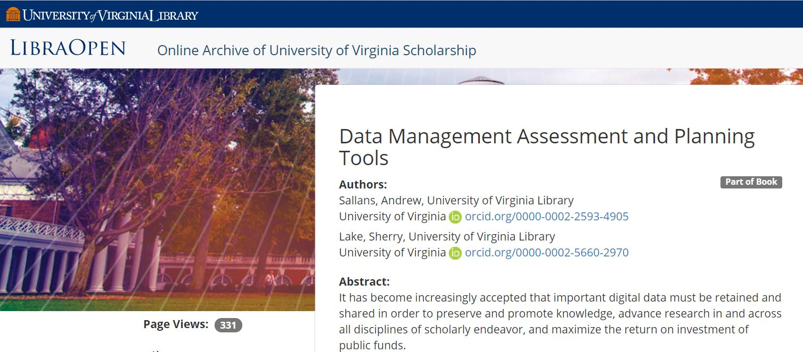
Assert trustworthy & accurate affiliations
Image credit: University of Virginia Libraries

Slide 34
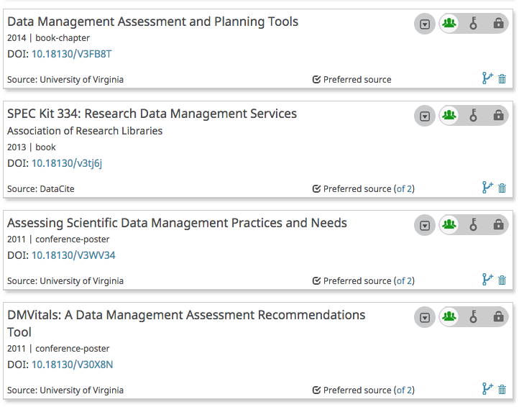
Assert trustworthy & accurate affiliations
Image credit: Sherry Lake, University of Virginia

Slide 35
ORCID Benefits for Research Institutions
Save time & reduce administrative burden

Slide 36
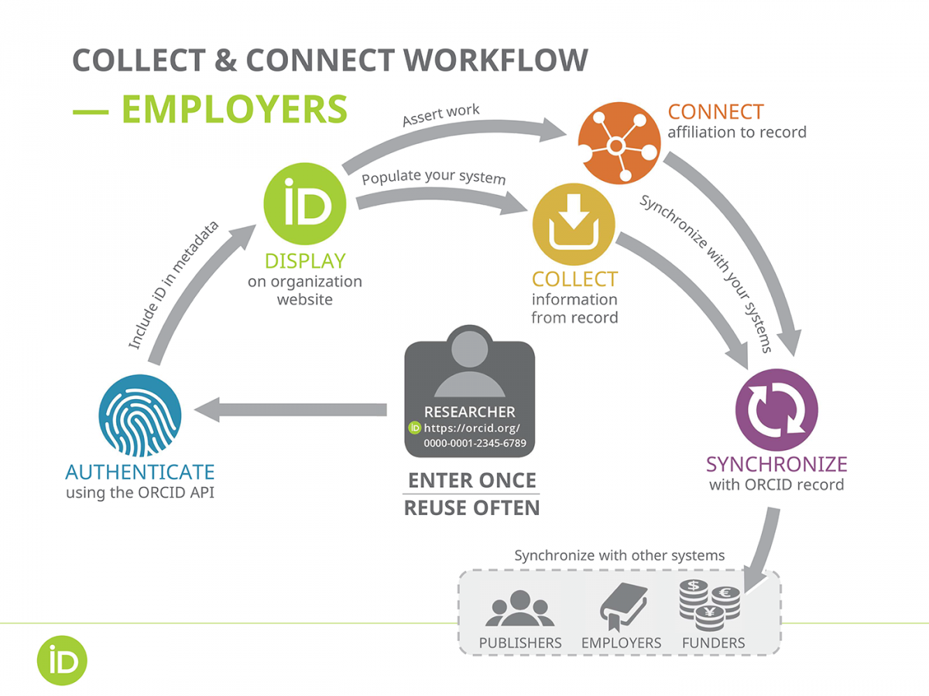
Save time & reduce administrative burden
2
3,4
1
5
Automated Transfer of Data:
Enter Once
Re-use Often
https://orcid.org/content/best-practices-research-organizations

Slide 37
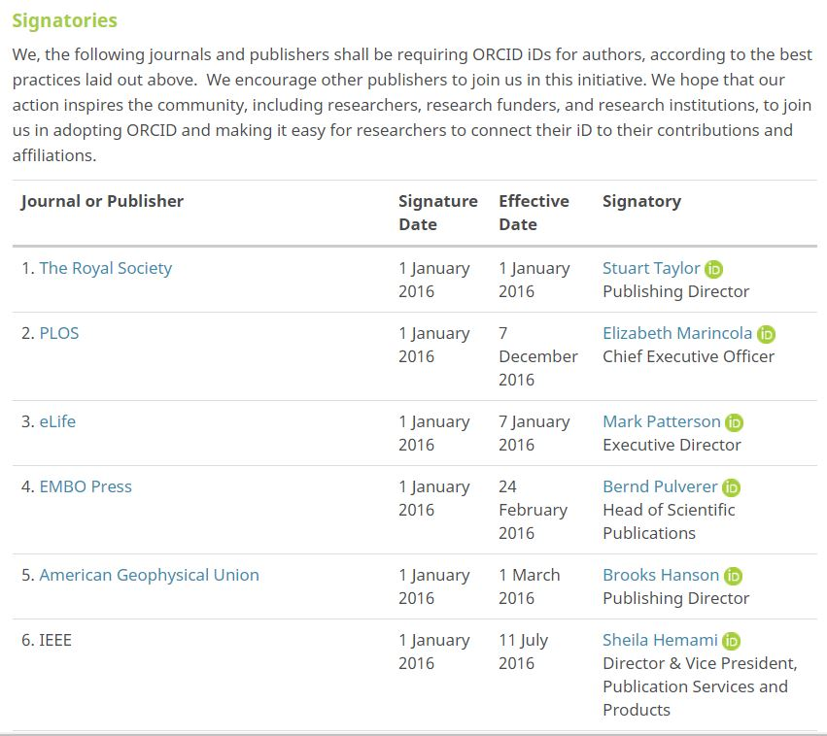
Save time & reduce administrative burden
https://orcid.org/content/requiring-orcid-publication-workflows-open-letter

Slide 38
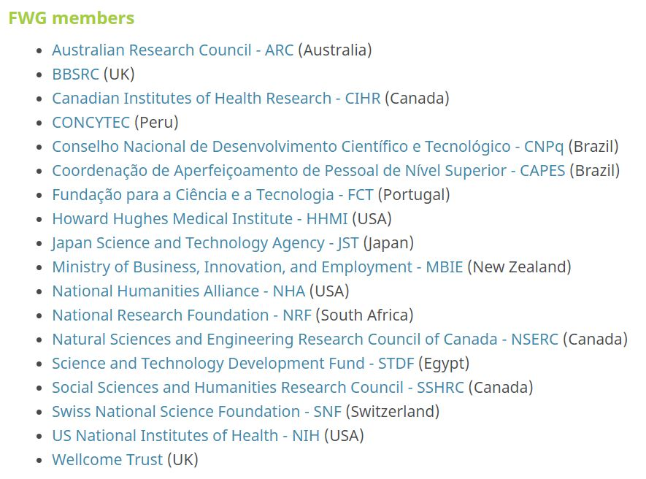
Save time & reduce administrative burden
ORCID Funder Working Group members:
https://orcid.org/about/community/working-group/funders

Slide 39
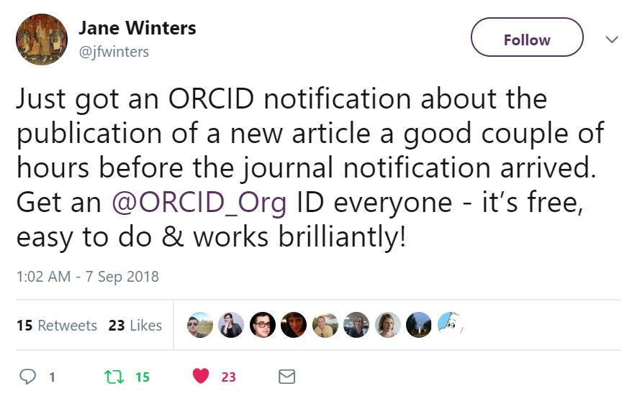
ORCID Benefits for Individuals
What does ORCID help individuals to do?
Distinguish themselves from others​
Ensure trustworthy record of contributions & affiliations
Save time & reduce administrative burden​
https://twitter.com/jfwinters/status/1037974383090966528

Slide 40
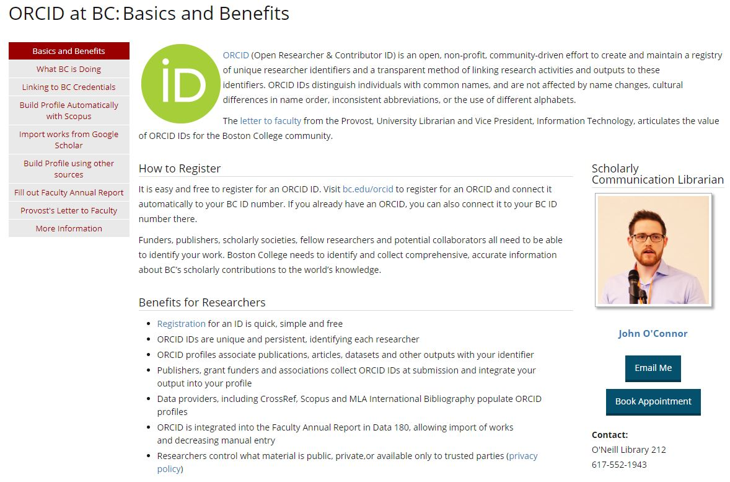
ORCID Documentation
https://libguides.bc.edu/orcid

Slide 41
Outreach & Education
https://members.orcid.org/outreach-resources
https://libraries.ou.edu/impactchallenge

Slide 42
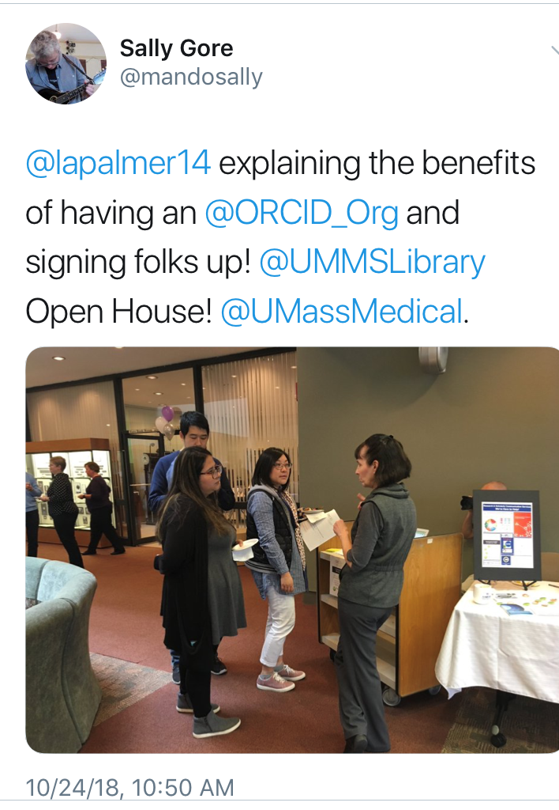
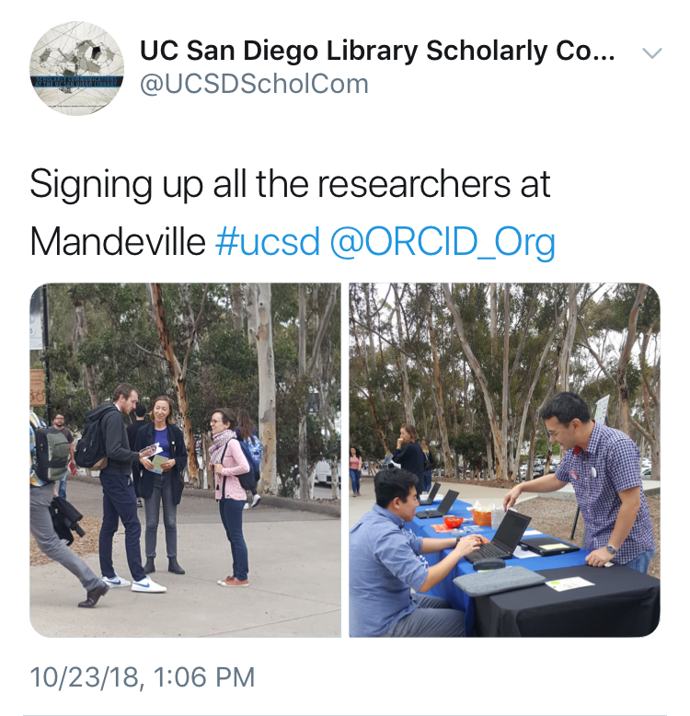
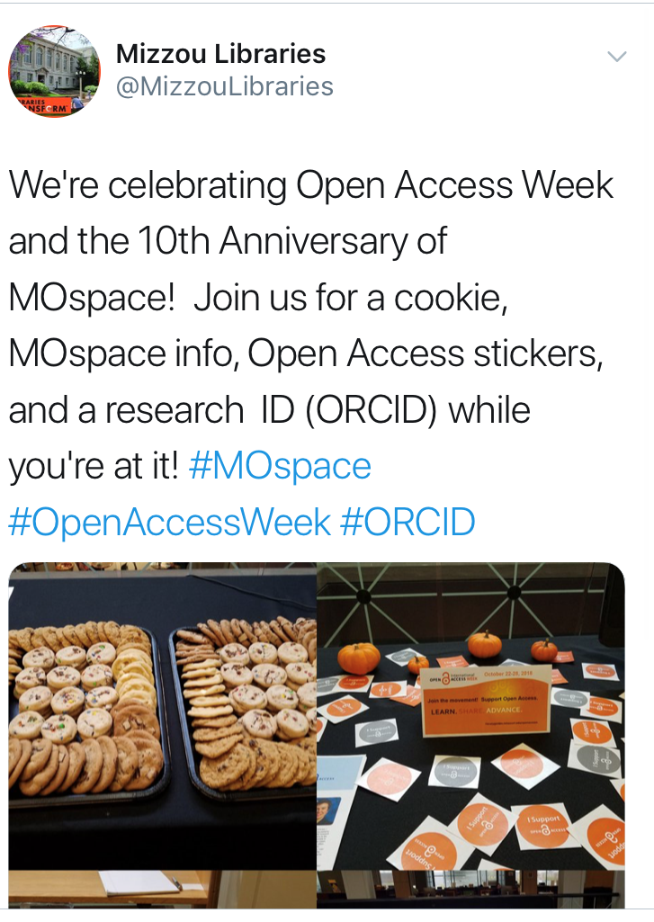
Outreach & Education
Open Access Week ORCID Events:
University of Massachusetts Amherst
University of California San Diego
University of Missouri

Slide 43
ORCID US Community Planning Guide

Slide 44
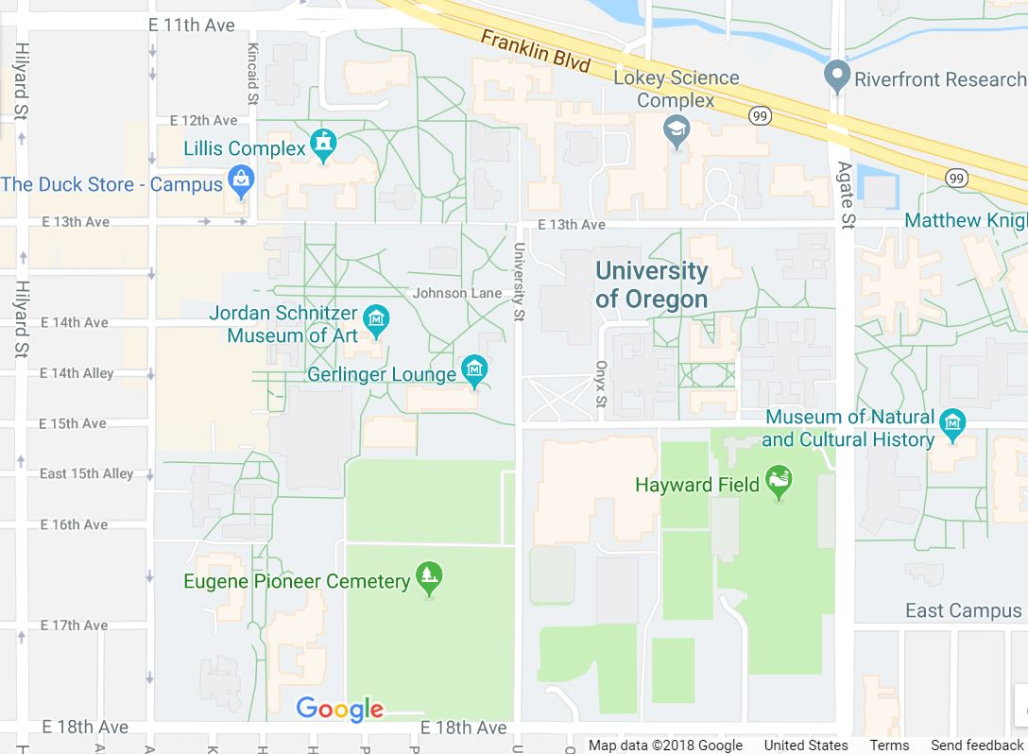
Stakeholder Support
Central IT
Research Office
Human Resources
Academic Units
Graduate School
Provost
Library/Libraries
Grants Office
Form a cross-institutional ORCID group to fully leverage ORCID benefits

Slide 45
Planning with Stakeholders
Example: Florida State University ORCID Implementation Committee
Office of Faculty Development & Advancement
Office of Research
University Libraries
Office of Institutional Research
National Magnet Lab
Graduate School
College of Medicine
What do you want to do with ORCID?
Read information from ORCID records?
Write information to ORCID records?
What kind of information are you interested in?

Slide 46
Common Systems
Institutional ID and Profile Systems
Current Research Information Systems (CRIS)
Grant Management
Human Resources
Institutional Repositories
Publishing Platforms
Peer Review
Data Management Platform
https://members.orcid.org/api/workflow

Slide 47
ORCID Outreach Resources
https://members.orcid.org/outreach-resources

Slide 48
Become a Member

Slide 49
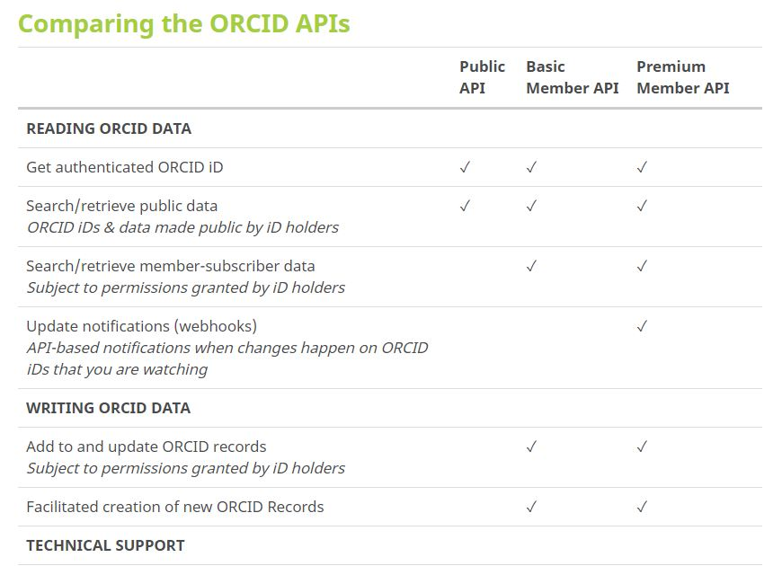
Become a Member

Slide 50
ORCID US Membership Benefits
Discounted membership fee for joining as part of a large group ($4,300/ calendar year)
Dedicated Technical & Community Support
5 API credentials for ORCID integration with 5 systems
Monthly Member Newsletter
Monthly statistics report

Slide 51
ORCID US Community Resources
Communication Channels:
Website https://orcid-us.org
Listserv (open to all) http://lyralists.lyrasis.org/mailman/listinfo/orcid-us
Twitter @USconsortium
Members Discussion Forum

Slide 52
Questions? Discuss...
Web orcid-us.org
Email orcidus@lyrasis.org
Follow on Twitter @USconsortium
Thank you!

