Slide 1
DIMENSIONS TRAINING University of Tennessee at Knoxville October 30, 2018

Slide 2
Agenda
What is Dimensions? Brief overview of contents Orientation to Dimensions Filters are your friends
Search types: full data, title & abstract, abstract search Exports and favorites
Walk-through of some common queries with small exercises
Please log in and follow along! app.dimensions.ai
Q&A

Slide 3
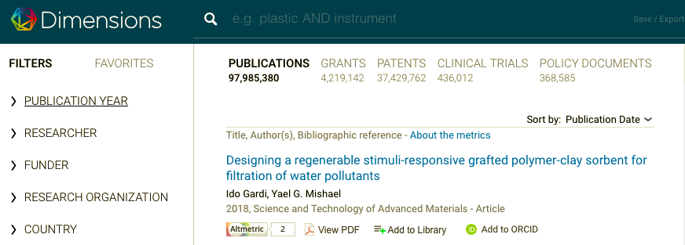
WHAT IS DIMENSIONS?
A linked, categorized and disambiguated database of:
Publications
Awarded Grants
Patents
Clinical Trials
Policy Documents

Slide 4
PUBLICATION DATA currently
PUBLICATIONS
JOURNALS / BOOKS
PRE-PRINT / OA
Pipeline 2018/19
Journal articles, pre-prints, conference proceedings and books/book chapters
Over 97 million records based on metadata
Metadata and citations derived from multiple available databases
OA tagging
Most recent addition: SSRN

Slide 5
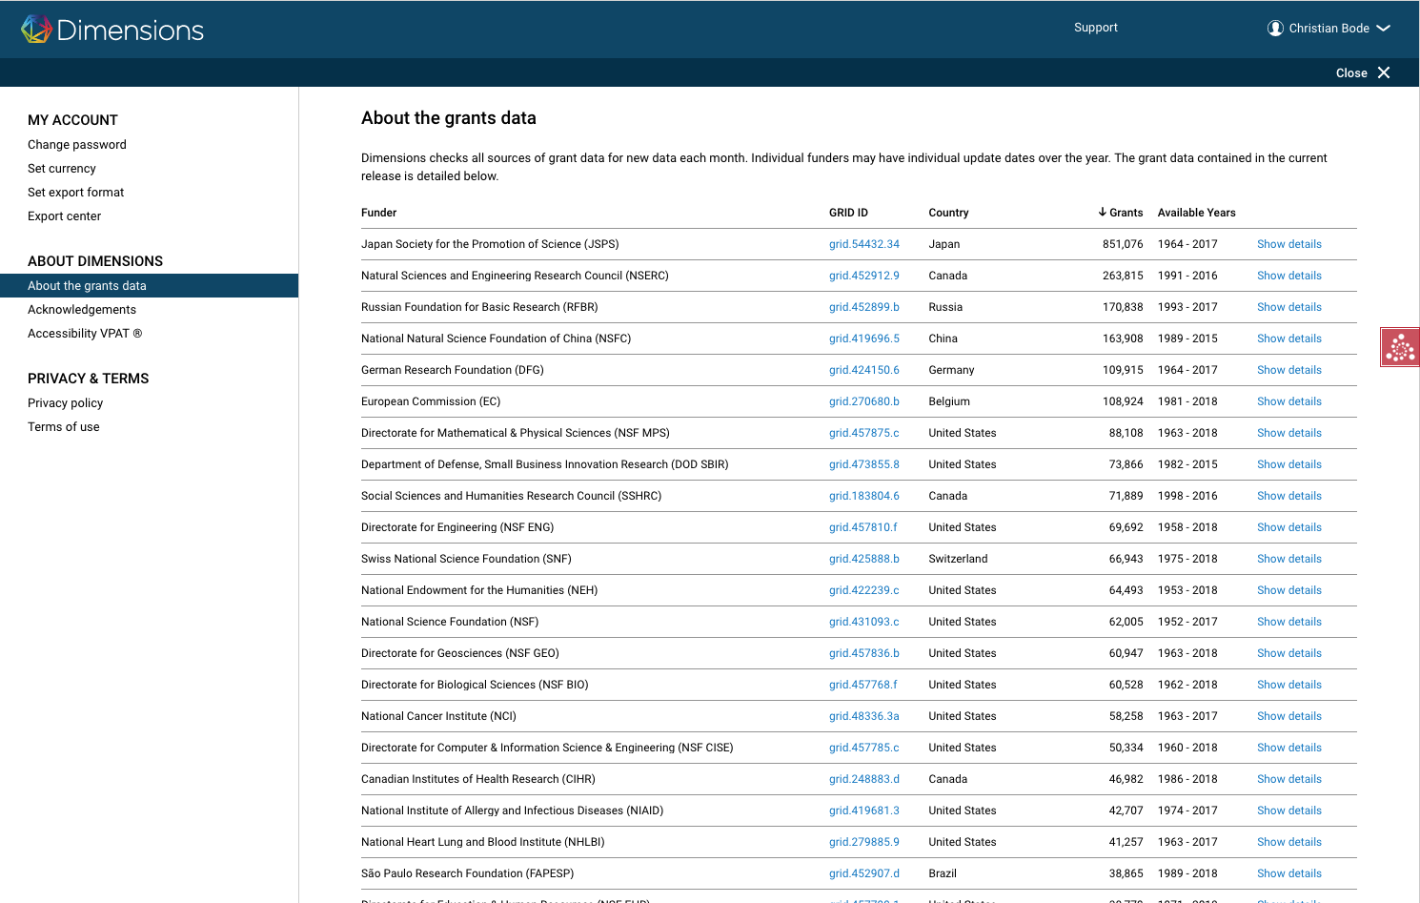
GRANTS DATA currently
🏆
GRANTS
Project funding
4.1M grants, from ~250 funders globally
$1.3 trillion of funding
Sourcing
Direct relationships with funders
Data available via APIs
Data available via websites which we crawl

Slide 6
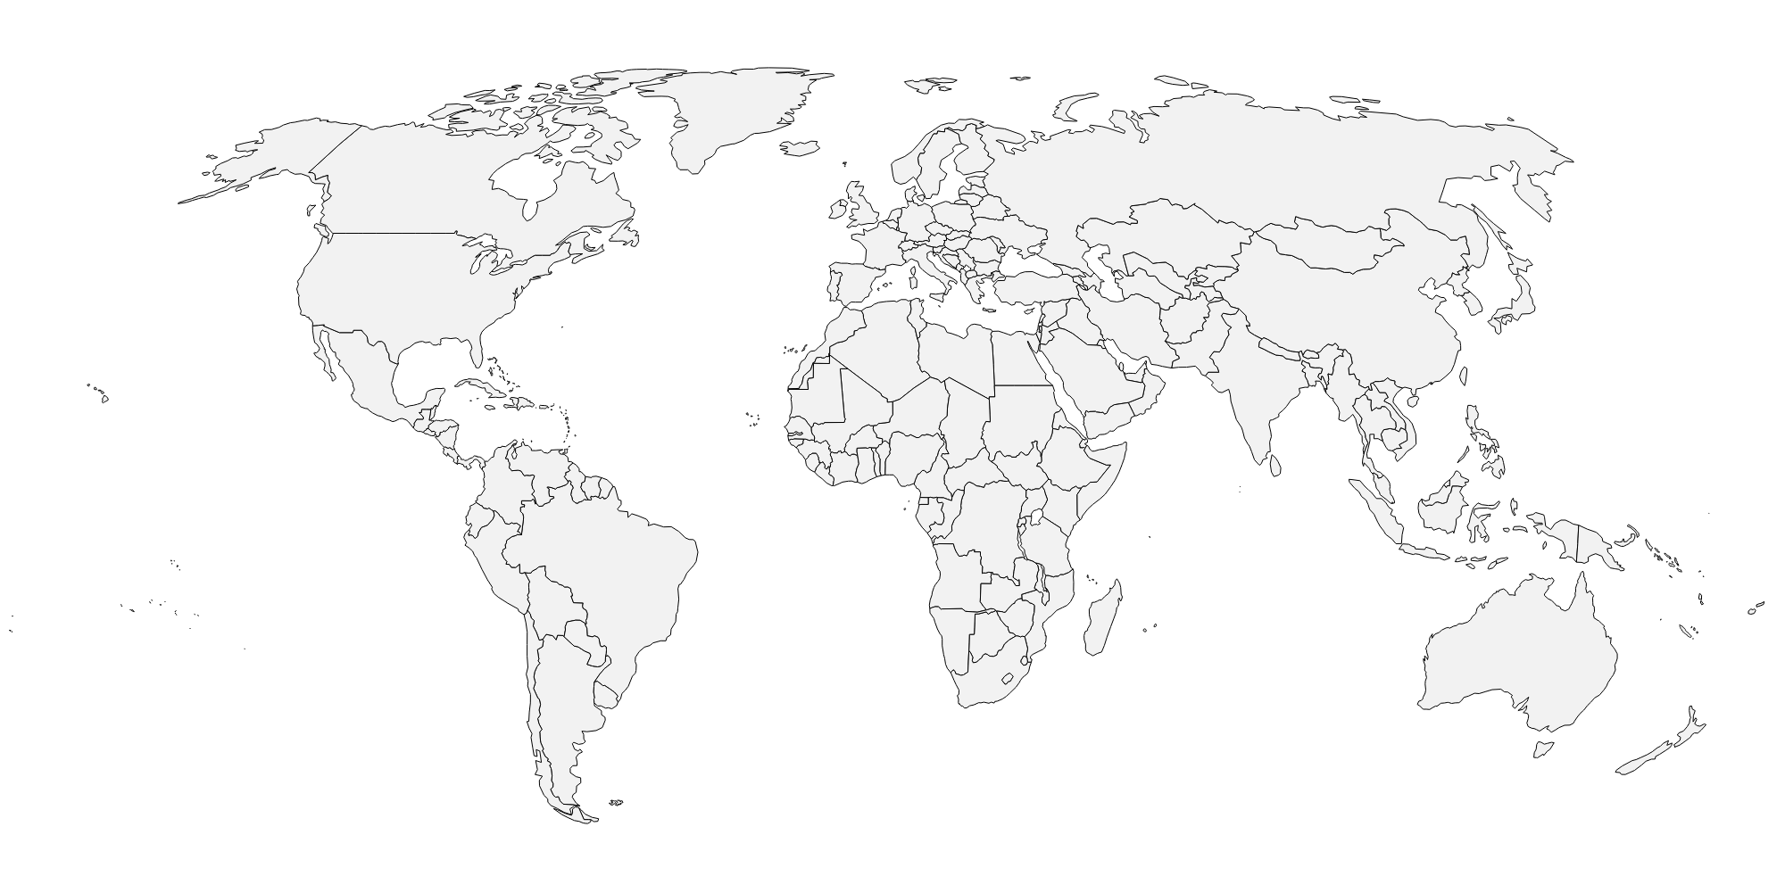
PATENT DATA currently
PATENTS
US
EP
WIPO
DE
CA
IN
AU
GB
FR
Hong Kong
Russia
China will be the next to be added.

Slide 7
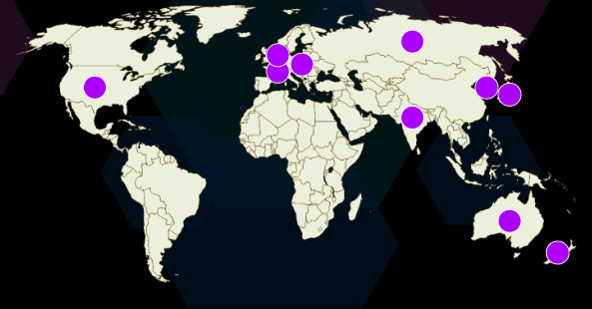
CLINICAL TRIAL DATA currently
CLINICAL TRIALS
ClinicalTrials.gov
EU-CTR
UMIN-CTR
ISRCTN
ANZCTR
CHICTR
NTR
GCTR
CTRI
CRIS
… and more are coming

Slide 8
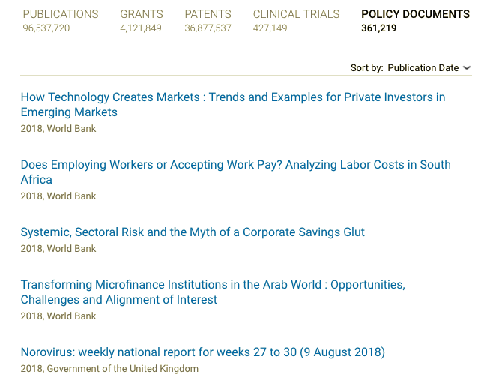
POLICY DOCUMENTS currently
📂
POLICY DOCUMENTS
Over 360,000 policy document records, linked to publication records Including but not limited to:
World Health Organization
World Bank
Food & Agriculture Organization of the UN
National Academies Press
Centers for Disease Control & Prevention
Publications Office of the European Union
Government of the United Kingdom
National Bureau of Economic Research
Economic Policy Institute

Slide 9
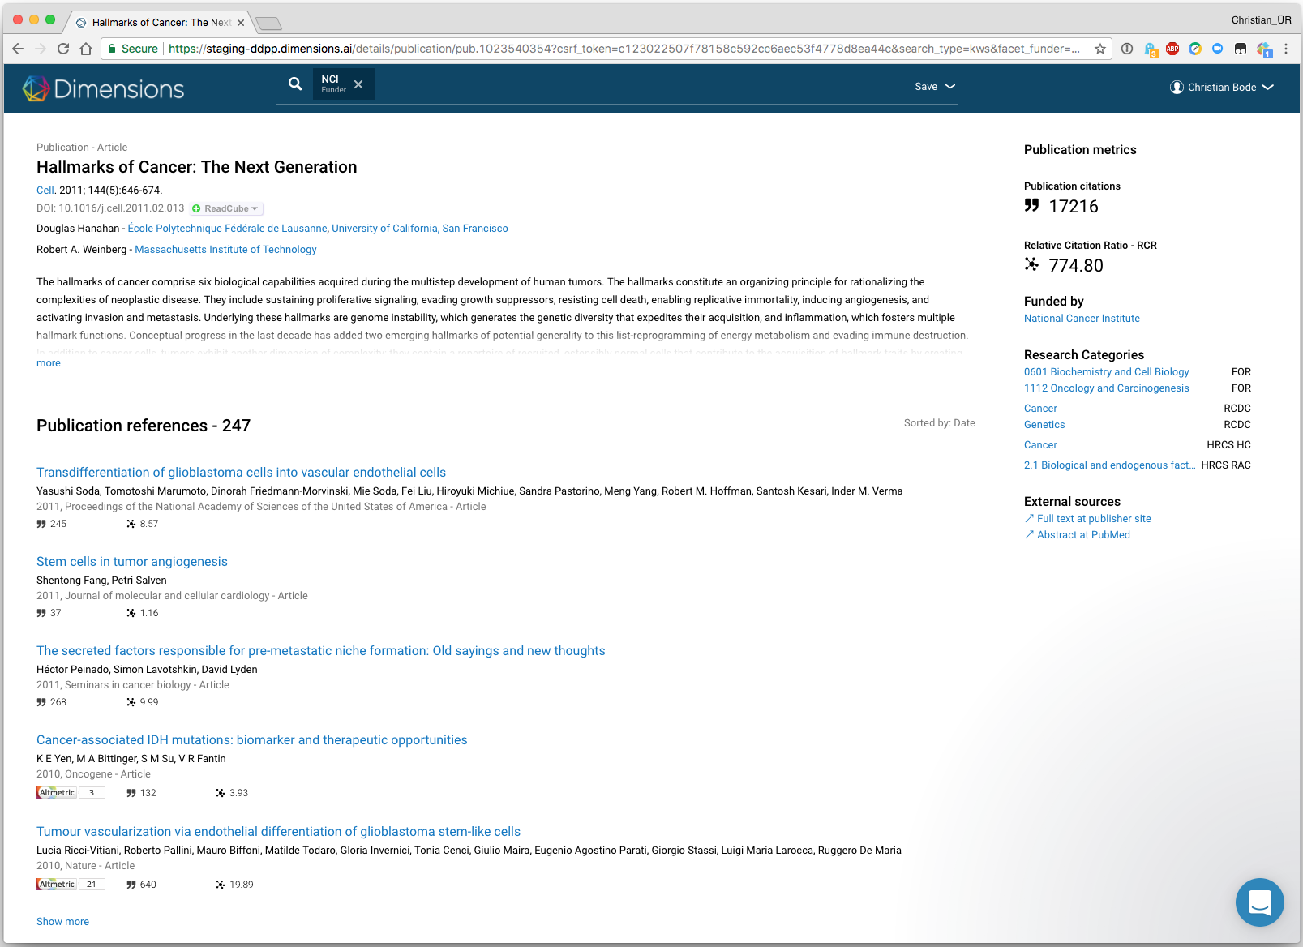
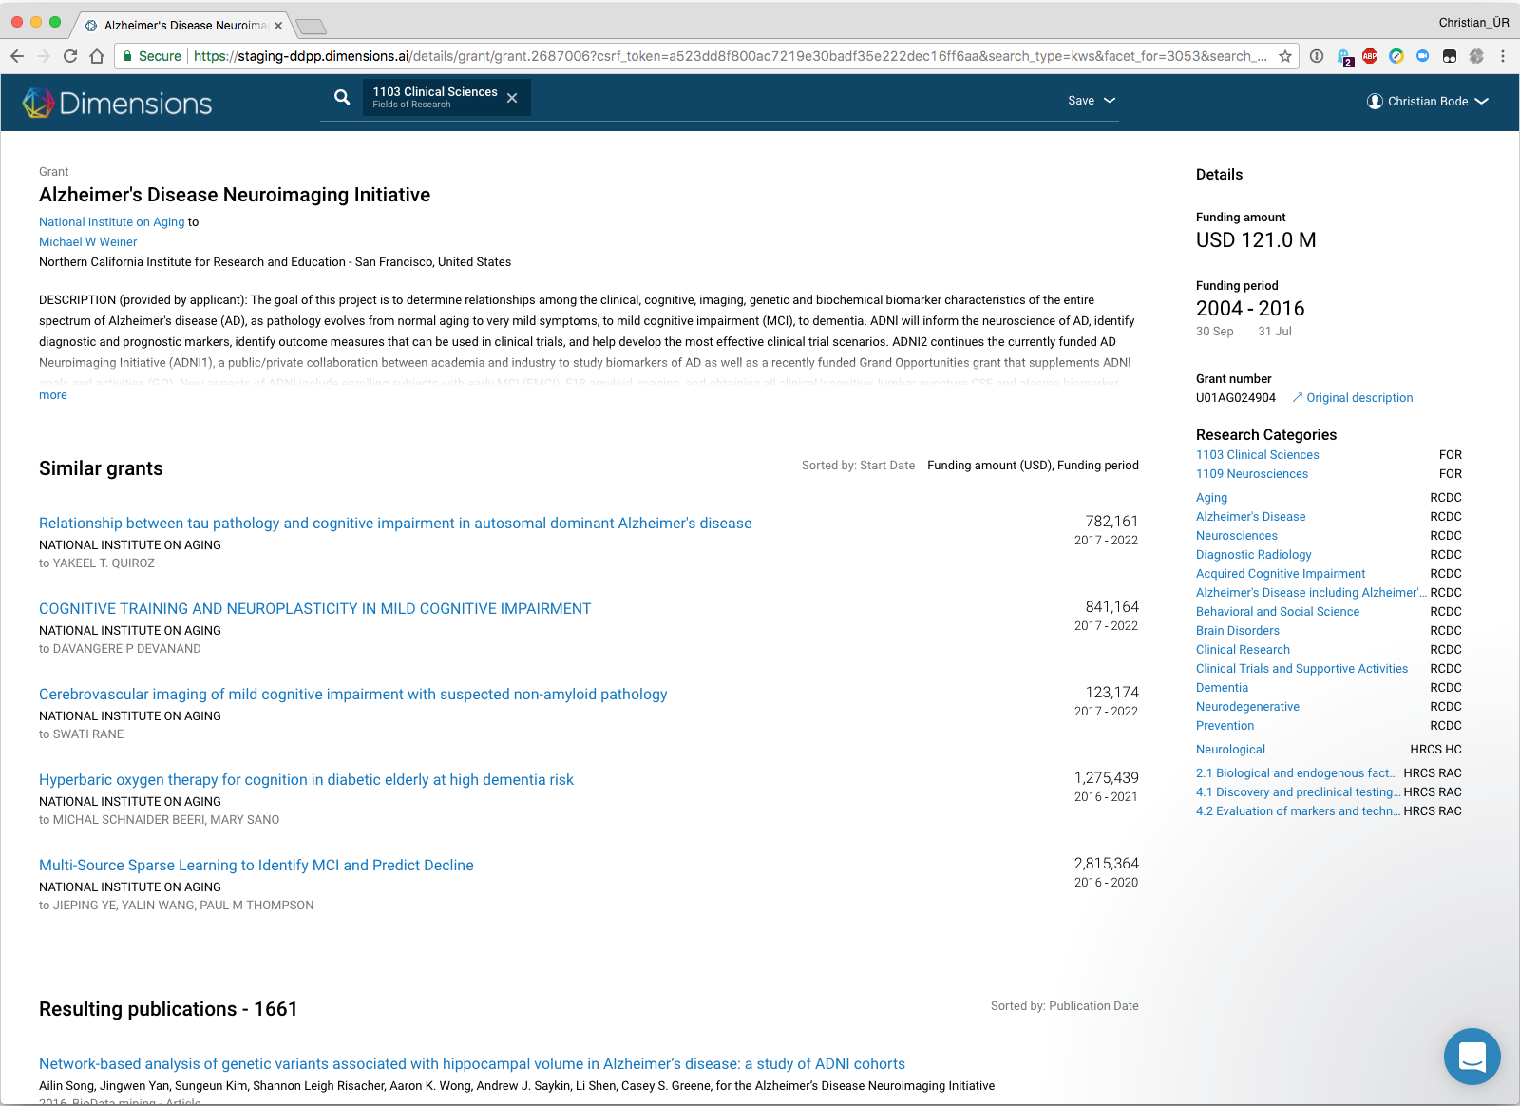
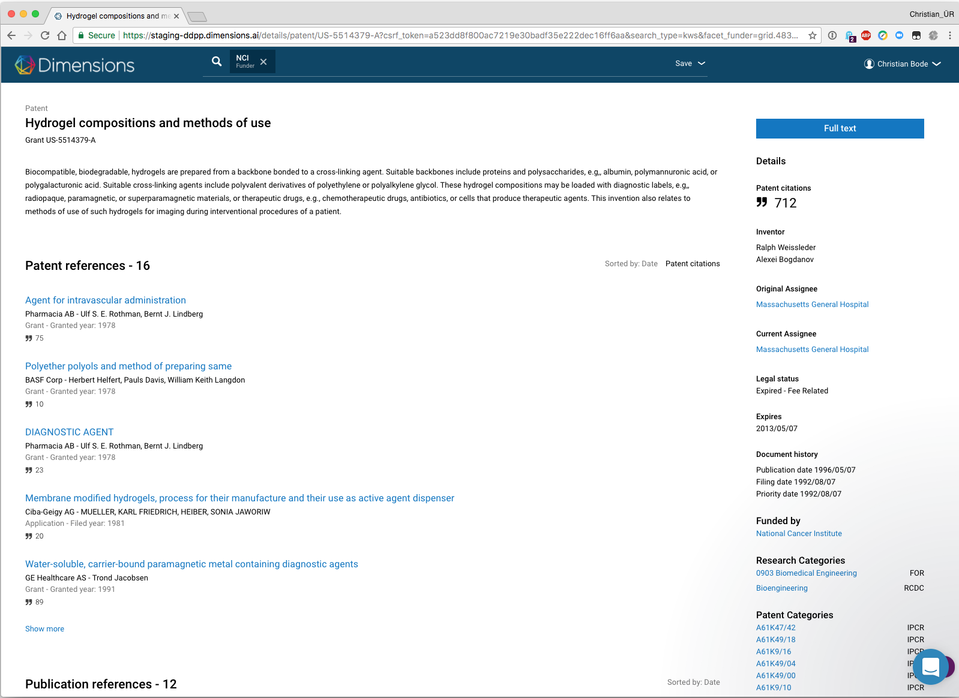
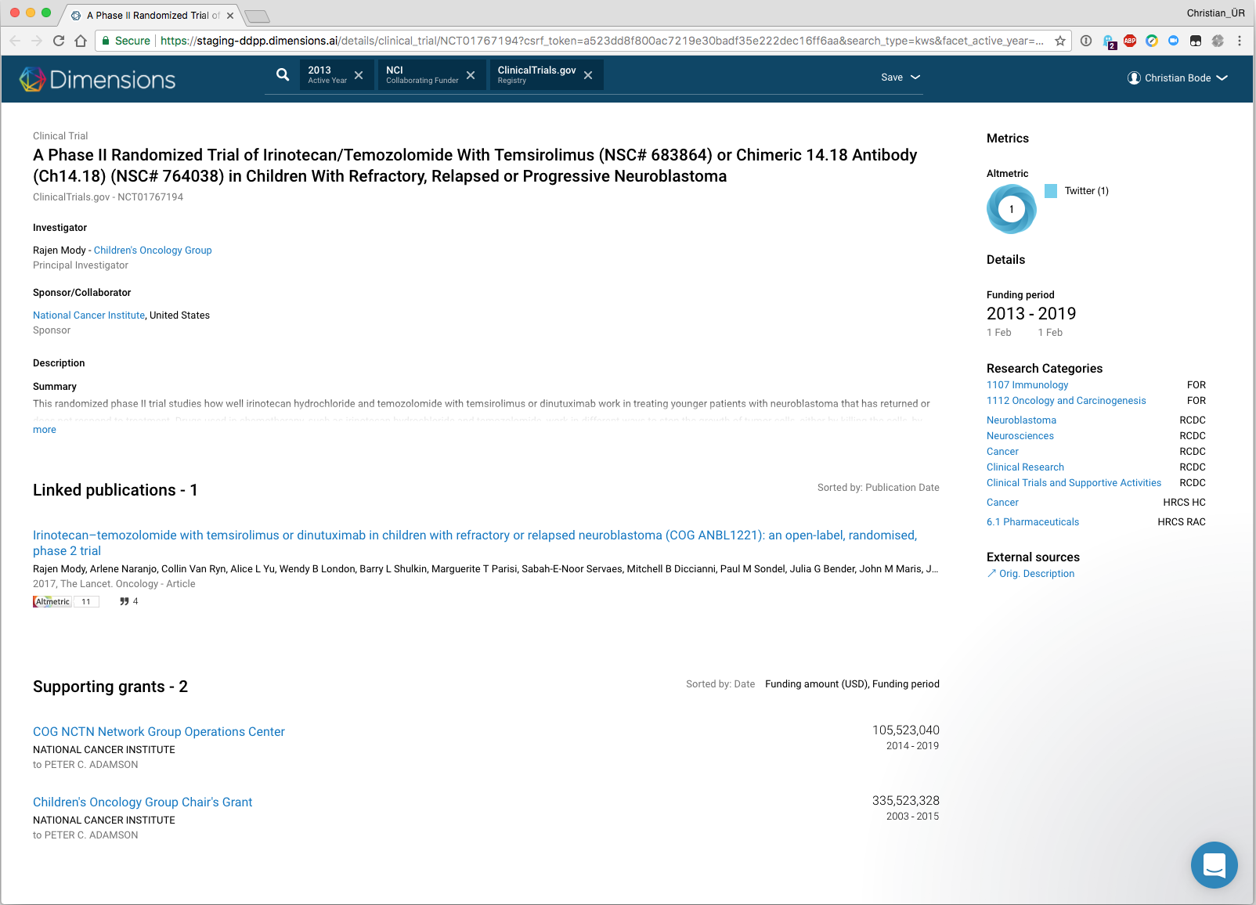
Links between the different content sources
Publication
Grant
Resulting publications
Resulting patents
Resulting clinical trials
Publication references
Publication citations
Supporting grants
Patent citations
Linked clinical trials
Policy Documents
Patent
Clinical trial
Patent references
Publication references
Supporting grants
Patent citations
Linked publications
Supporting grants

Slide 10
How do we capture a broader picture of research?
Research
Data sets
Tweets Blogs
Clinical Trials
Policy docs
Grants
Conferences
Publications
Citations
Patents
Pre-publication
Post publication
1-5 years from grant to publication
immediate
2-3 years
years
years
decades
Notes:
Links between traditional A&I content types are quickly overviewed:
→ it is only the link between publications and citations.
The set of linkages in new Dimensions is much richer:
→ These many links between content types are useful in two ways:
- They allow discovery across content
- (you can for example go from a found grant to the publication that came from the project)
- They provide an interesting base for deeper-going analyses
The most often repeated request from new users is for more linkages, and that is of course something we work toward continuously.

Slide 11
O R I E N T A T I O N Create an account Save searches and favorites, link to ORCID Filters Function similar to fields in an advanced search, applicable to content type Three ways to search Full data, title and abstract, and abstract search Compare feature Remove any organizational or funder filters from your search bar before proceeding

Slide 12
COMMON QUERIES

Slide 13
P U B L I C A T I O N S
Who is the most prolific researcher in Materials Engineering in the past 5 years?
Who is the most prolific researcher at University of Tennessee at Knoxville in Materials Engineering in the past 5 years?
What was the most cited paper by a researcher at University of Tennessee at Knoxville in Materials Engineering in the past 5 years? Which had the top Altmetric score?
Who is the top funder of publications published in the past 5 years in Materials Engineering at University of Tennessee at Knoxville?
Notes:
Show publication details page on Q3

Slide 14
Which researcher has received the most funding in Materials Engineering?
G R A N T S
Which funder has awarded the most total funding in Materials Engineering?
Which funder has awarded the most funding in Materials Engineering to University of Tennessee at Knoxville?
How do University of Tennessee at Knoxville and University of Oslo compare with respect to grants active in the next 5 years in Materials Engineering?
How many grants in Materials Engineering were awarded to University of Tennessee at Knoxville that are active in 2019?

Slide 15
P A T E N T S
Which funders have supported the most patents in Oncology and Carcinogenesis?
Which organization owns the most active patents in Oncology and Carcinogenesis?
How many active patents have been awarded to University of Tennessee at Knoxville in Oncology and Carcinogenesis?
How many active patents in Immunology were awarded to organizations in Japan? Who are the top funders of these patents?

Slide 16
C L I N I C A L T R I A L S
How many clinical trials will be active over the next five years that are sponsored/co-sponsored by University of Tennessee at Knoxville?
How many of these trials are related to the condition of obesity?
How many Phase 4 clinical trials concerning hypertension will be active in 2019?

Slide 17
T E C H N I C A L S U P P O R T
Search for answers in our Support Library
If you can’t find an answer to your question, please submit a support ticket. We try our best to respond within 24 hours.

Slide 18
THANK YOU Heidi Becker Email h.becker@digital-science.com Twitter @heidibeckerdata @DSDimensions

Slide 19
ADDITIONAL INFO

Slide 20
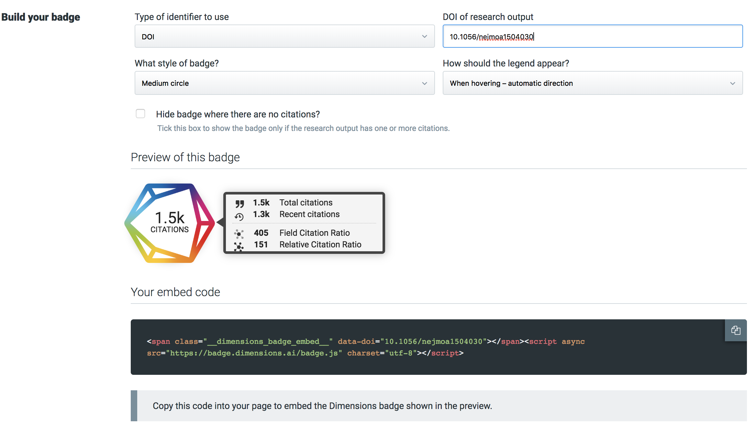
Dimensions Badges and open Metrics API
Dimensions is making publication and citation data available - also via badges and as an open metrics API
Start using it today at badges.dimensions.ai

Slide 21
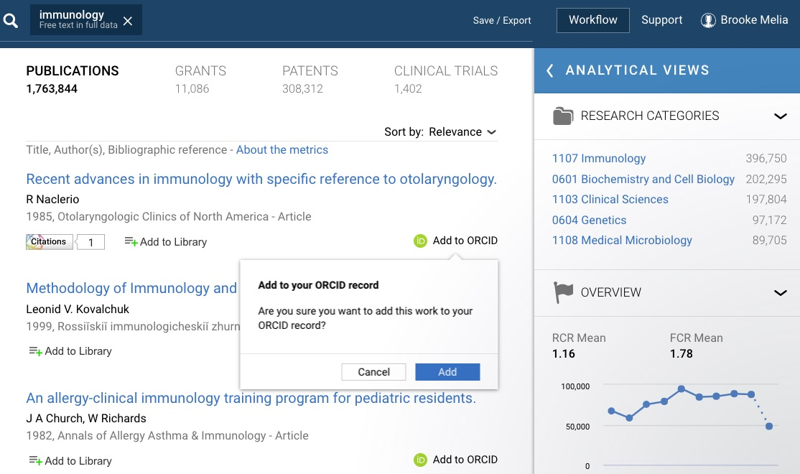
Dimensions & ORCID
Researchers can connect their ORCID record to Dimensions to help claim and showcase their published research with a simple, efficient process.
Add publication information to your ORCID profile directly from Dimensions with a single click
When available, publically available information is used to enrich research profiles
ORCID records are also used to improve author disambiguation

Slide 22
The Dimensions API
Powerful API - designed to allow flexible use of the enriched data
Use without constraints for internal purposes
Use data outside of the web-app; e.g. in admin systems or analytical software
Querying language made and documented specifically for new Dimensions

Slide 23
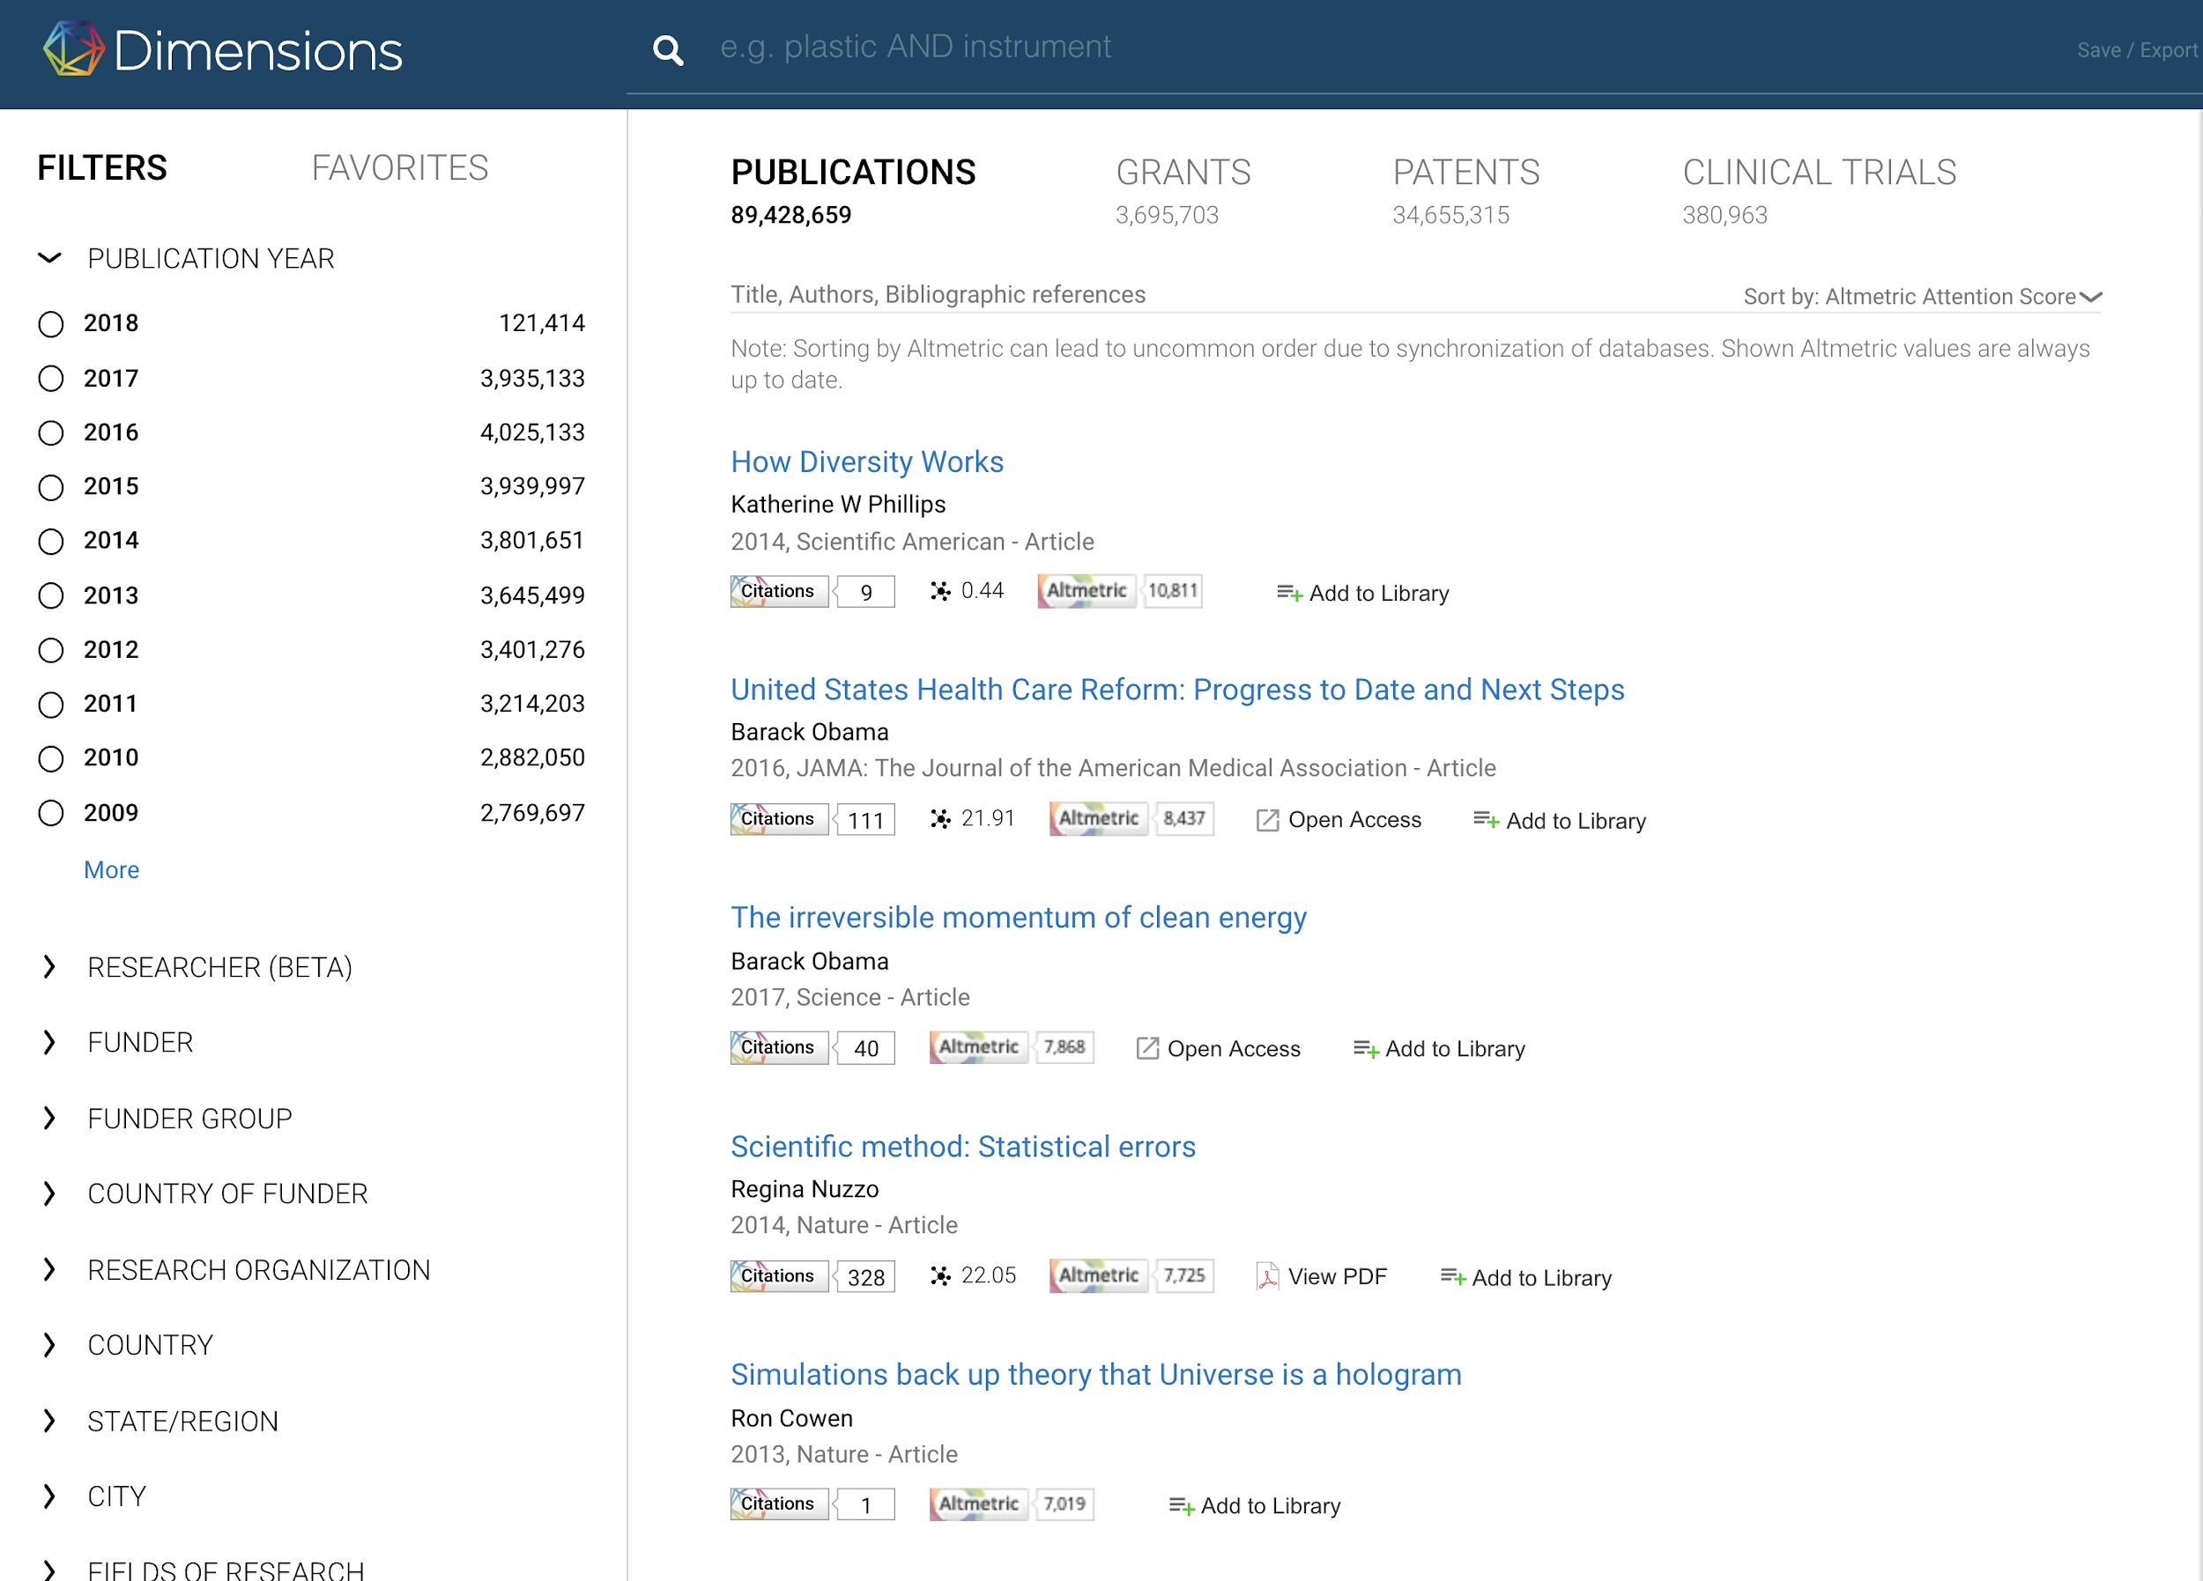
Anywhere Access
An add-on module to Dimensions, the Anywhere Access module offers instant single-click access to:
Open Access articles
Articles subscribed to with publishers
Anywhere Access works with the organization’s own subscription holdings via EZProxy integration and SSO authentication.
Notes:
Dimensions comes with an add-on option for instant single-click access to article full-text:
Open Access articles
articles subscribed to by the organisation
It is helpful for researchers that want to discover relevant research articles
It is helpful for libraries that want to assess collections and subscriptions
It works with the organization’s subscription holdings via EZProxy integration and SSO authentication.
Note that it is yet only in beta; it still only works with full collections, for example, and it does not work with aggregators.
We are happy to provide more information about release plans, limitations, and implementation requirements, if relevant. Please let us know.
- - - - - - - -
LIMITATIONS AND TECH INFO IF NEEDED:
Subscription holdings must be exported in a specific format
Only direct publisher subscription holdings are supported
Physical holdings or holdings via aggregators may not be in exports
The library is responsible for updating holdings in the Anywhere Access dashboard
EZProxy integration is required for Anywhere Access
OCLC EZProxy v6.3.5 or higher is required and a 1-line addition to the EZproxy configuration file
Additional access solutions will be available in v1.1 for libraries not running EZProxy
Single Sign-on (SSO) is required - one of these: Shibboleth, SAML, CAS, OAuth, or LDAP
Also see this internal document: https://docs.google.com/document/d/1IqAEJ4ehHIpxS7B2b2FmY9rZ9drMvihg-ejY622TVkM/edit?usp=sharing

Slide 24
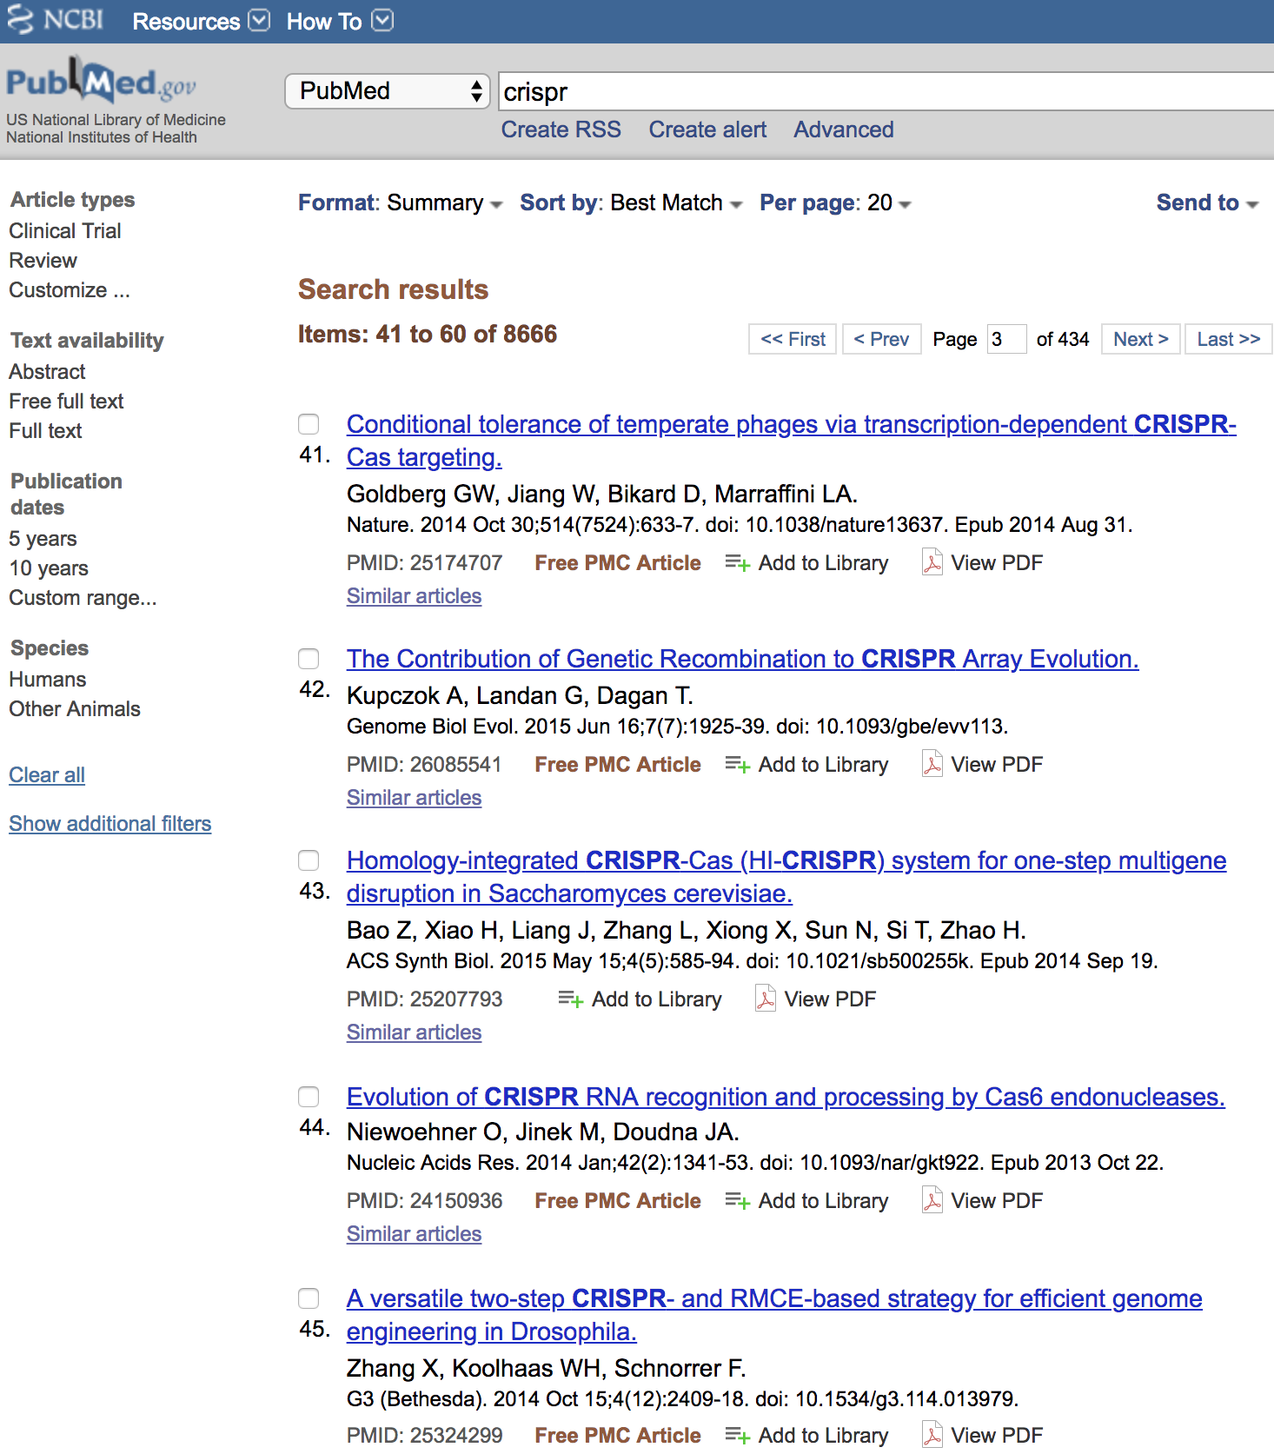
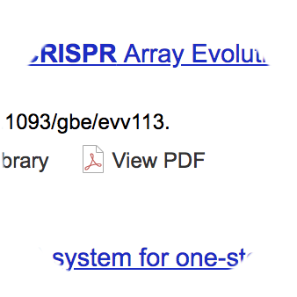
Anywhere Access as a Library Solution
Library software that connects patrons to subscribed content efficiently
1-click access to full text - simplest way to access subscribed content
Integrated with library holdings, link resolvers, ILL
COUNTER compliant - downloads from publisher platform.
Clear indication of access; Ensure no dead ends
On/off campus - authenticated with SSO
Integrated document delivery option (instant)
Cloud solution with two deployment options:
Platform add-in (e.g. Dimensions, Primo)
Browser Extension (works across web)

