Slide 1
Information Resources

Slide 2
Learning Topics
Google/Internet source vs Library Search/Databases
Scholarly/Academic sources of information
Evaluating Scholarly/Academic Information sources
Primary and Secondary Source of Information
Notes:
Researching on the internet wisely

Slide 3
The internet vs the Library
The Internet is an easy and quick source of in formation.
Unregulated
No filtering process
Full of questionable content
Free content
Requires careful evaluation
Academic and scholarly resources from the library
High-quality paid content
From established publishers
Regulated and quality controlled materials

Slide 4
Scholarly/Academic Sources of Information

Slide 5
Scholarly Sources of Information
Text and Reference Books :
Search library catalogue and locate books on library shelves

Slide 6
Scholarly Sources of Information
Reference material : Library Online resources
Material providing students with quick background information.
e.g. Dictionaries, Encyclopaedias

Slide 7
Scholarly Sources of Information
E-Books:
Library online resources

Slide 8
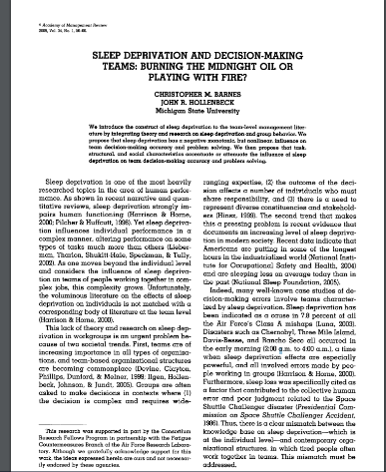
Scholarly Sources of Information
Journal articles :
Library online resources
Journal articles are short papers on specific topics. They are published in journals (also called periodicals) which appear regularly. Most commonly used source to find up-to-date research in your subject.

Slide 9
Scholarly Sources of Information
Conference proceedings :
Library online resources
Collection of papers based on presentations delivered during a conference. Often looks like a journal article

Slide 10
Scholarly Sources of Information
Reports :
Library online resources
Reports are produced by government departments, research entities, charitable foundations etc. on specific topics or issues.

Slide 11
Scholarly Sources of Information
Theses :
Library online resources, University Repositories, On shelves
Theses are major sources of primary research output. Some of the most current and original research every year is produced by postgraduate researchers at universities.

Slide 12
Scholarly Sources of Information
Standards
A standard is an agreed way of doing something. It could be about making a product, managing a process, delivering a service or supplying materials.

Slide 13
Scholarly Sources of Information
Patents:
Library online resources, Patent websites
Legal documents giving owner exclusive rights to profit from an invention, protecting it from exploitation by others.

Slide 14
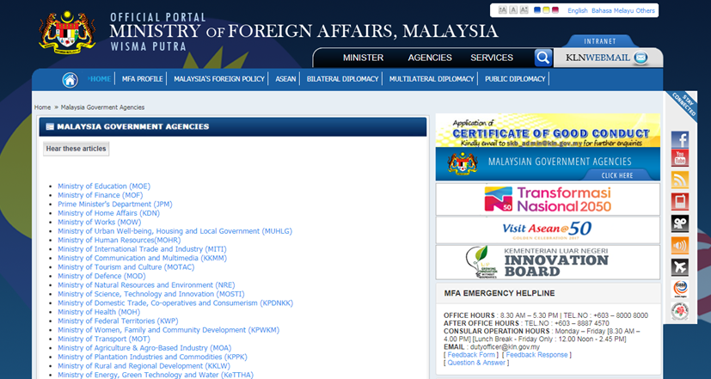
Credible Web Resources

Slide 15
Primary and Secondary Sources
of Information

Slide 16
Primary and Secondary Sources of Information
Primary Sources | Secondary Sources
Original documents / sources. Written or produced by people who have direct connection with the output. | Documents / sources that synthesise, summarise or interpret primary sources. Generally, they are written after the event
Original research articles Newspaper reports, by reporters who witnessed an event Speeches Interviews Survey data Photographs, video, or audio of events | Review articles (summaries of research articles) Textbooks Magazine articles Biographies Histories Encyclopaedias Documentaries

Slide 17
Evaluating Information

Slide 18
Evaluating Scholarly / Academic Information sources
Peer Reviewed: Is the information source reviewed by other experts in the author’s field of study.
Expert Author: Is the author an expert on the subject matter with author’s academic degree and affiliate institution listed.
Reputable publishers: Does the information come from a university press, an academic press, or a peer-reviewed press. ( Journals, Conference papers)
Robust Bibliography: Does it contain a bibliography or references list of many sources.
High-Quality Content: Is the material clearly organized, relevant, well written and free of grammatical and spelling errors
Domain (for freely accessed websites): what is the nature of the organisation: .gov, .edu, .org, .mil
.com = commercial ( need to evaluate carefully)

Slide 19
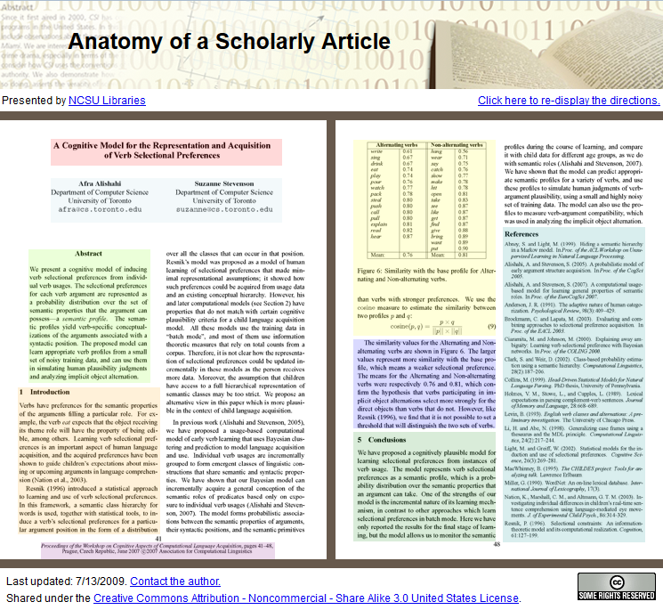
Sample article : Scholarly / Academic Information source
Click here
Orphanides, A. (2009, July 7). Anatomy of a Scholarly Article . Retrieved from http://www.lib.ncsu.edu/tutorials/scholarly-articles/

Slide 20
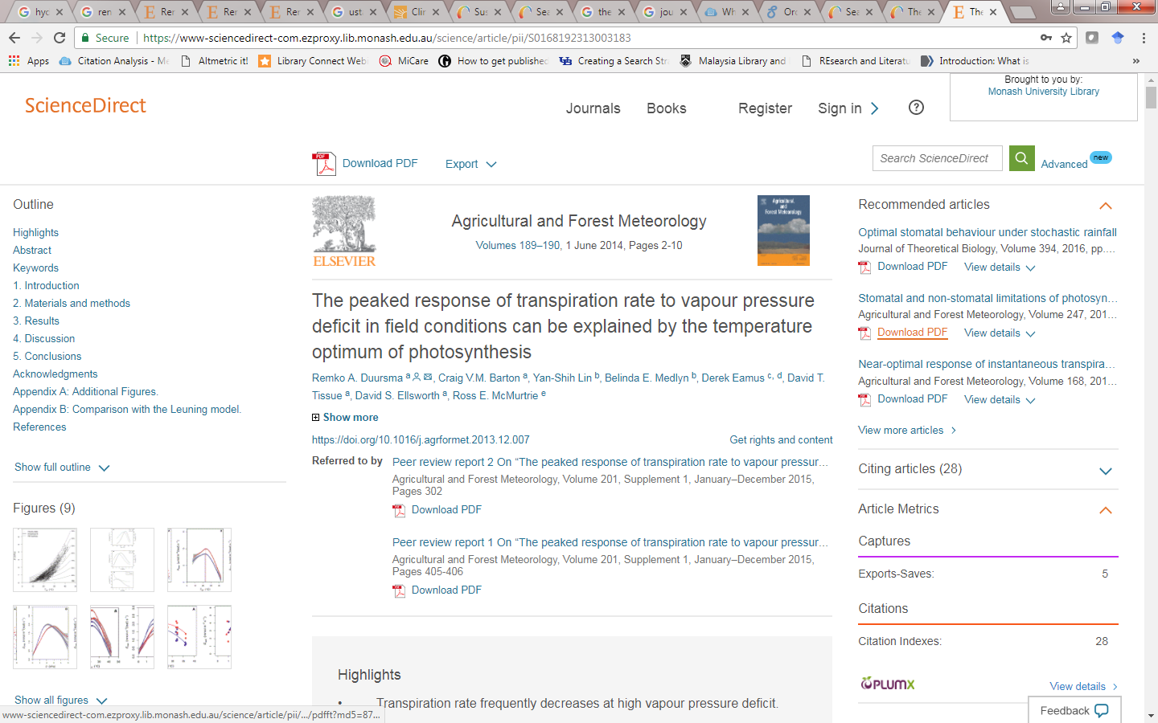
Sample article : Scholarly / Academic Information source

Slide 21
Task 1
Which of the following websites is the most scholarly?
Research offers mixed messages on the impact of social media on adolescent emotional health
Social media and adolescent body image: What to know
Cutting adolescents’ use of social media will not solve their problems
The Social Media Disorder Scale

Slide 22
THANK YOU

