Slide 1
DIGITAL FUTURE.
WE ARE ALREADY THERE, BUT KEEP LIVING IN THE PAST.
LISA MATTHIAS – FREIE UNIVERSITÄT BERLIN – @l_matthia

Slide 2
How many of you have ever hit a paywall when trying to access a research article?

Slide 3
The Access Problem
MOST
ONLY AROUND 28%
Scholarly research remains inaccessible to most people on this planet.
Of scholarly literature is Open Access.
Piwowar H, Priem J, Larivière V, Alperin JP, Matthias L, Norlander B, Farley A, West J, Haustein S. (2018) The state of OA: a large-scale analysis of the prevalence and impact of Open Access articles. PeerJ 6:e4375 https://doi.org/10.7717/peerj.4375

Slide 4
The Serials Problem
https://publications.parliament.uk/pa/cm201314/cmselect/cmbis/99/9905.htm

Slide 5
BRIAN NOSEK
UNIVERSITY OF VIRGINIA, CENTER FOR OPEN SCIENCE
“Academic publishing is the perfect business model to make a lot of money. You have the producer and consumer as the same person: the researcher. And the researcher has no idea how much anything costs.”

Slide 6
Adapted from https://alexholcombe.files.wordpress.com/2015/05/publisherprofitsincludingplos2015edition1.png

Slide 7
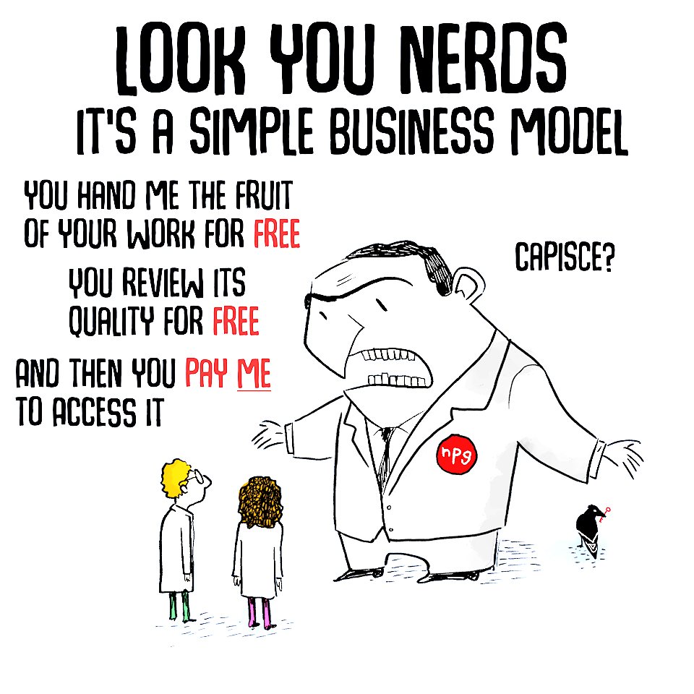
BRIAN NOSEK
UNIVERSITY OF VIRGINIA, CENTER FOR OPEN SCIENCE
“Academic publishing is the perfect business model to make a lot of money. You have the producer and consumer as the same person: the researcher. And the researcher has no idea how much anything costs.”
Adapted from https://twitter.com/pedromics/status/940348247264153600

Slide 8
The Reproducibility Problem

Slide 9
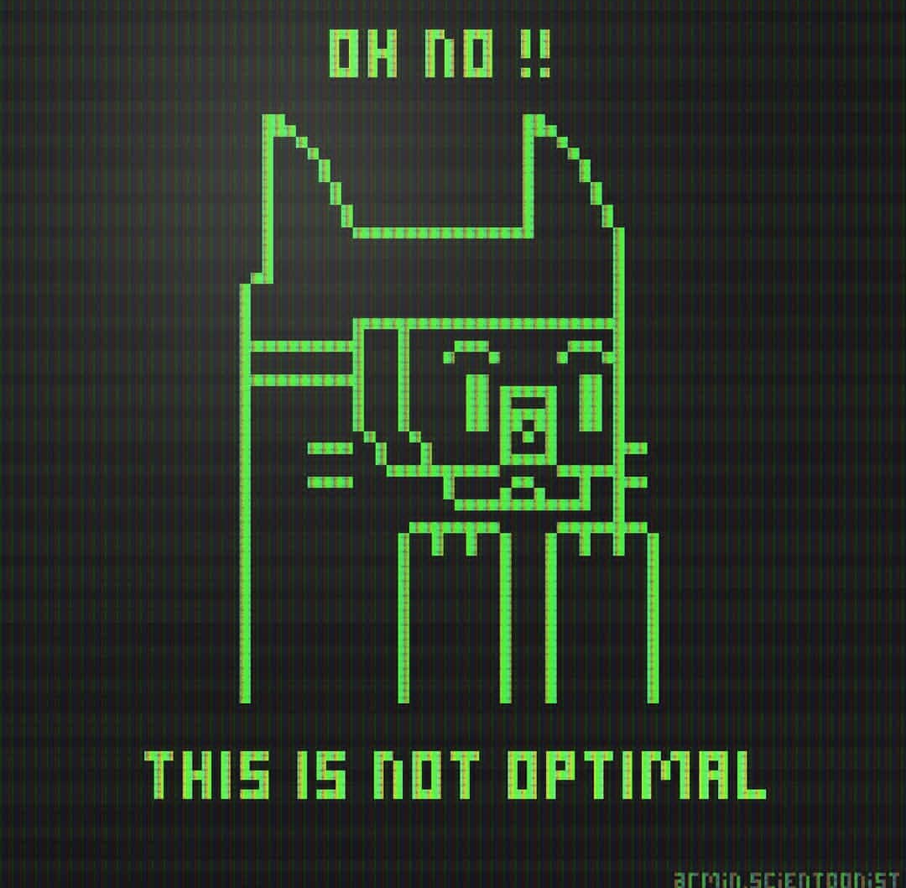
But the good news is we can change it, and it is going to help our careers.
Image by Armin Mortazavi (http://arminmortazavi.com)

Slide 10
GET PUBLISHED
And build our academic profile.
Early-career researchers
FINISH THAT DISSERTATION
…
What do we want?
FIND A PERMANENT JOB
Within or outside of academia.

Slide 12
Open Access
GOLD OPEN ACCESS
Publishing your scholarly work in an OA journal or as an OA monograph.
GREEN OPEN ACCESS
Providing OA to a version of a work published in a closed-access journal or with a closed-access publisher.

Slide 13
Gold Open Access: Common Concerns
PAYING TO PUBLISH
AUTHOR RIGHTS
AVAILABILITY
Majority of OA journals does not charge APCs.
Author rights still protected, granting greater reuse right to readers.
Considerable differences regarding the availability of OA journals.
QUALITY
ROYALTIES
OA articles and monographs subject to the same editorial & peer review standards as closed-access counterparts.
OA does not influence print sales. Consult publisher.

Slide 14
Publish where you want,
Open Access is still possible.
YAY!

Slide 15
WHERE
Institutional or disciplinary repositories, sometimes author’s personal website.
Green Open Access: Common Practices
WHEN & WHAT
Check the publisher’s self-archiving policies to know when & which version you are allowed to deposit.

Slide 16
What about these?
RESEARCHGATE
ACADEMIA.EDU
SSRN
Sued by Elsevier.
Received several takedown notices from Elsevier.
Bought by Elsevier.

Slide 17
What about these?
SUPPORTS EXPORT & HARVESTING
No
No
Yes
LONG-TERM PRESERVATION
No
No
Yes
BUSINESS MODEL
Commercial
Commercial
Non-profit
FULFILLS FUNDER OA POLICIES
No
No
Yes
Adapted from: https://openreflections.wordpress.com/2017/05/09/academia-edu-and-self-branding

Slide 18
Benefits of Open Access
Fast communication
Maximize visibility
Facilitate collaboration
Increase efficiency

Slide 19
The OA Citation Advantage
Tennant JP, Waldner F, Jacques DC et al. (2016) The academic, economic and societal impacts of Open Access: an evidence-based review [version 3; referees: 4 approved, 1 approved with reservations]. F1000Research 5:632. https://doi.org/10.12688/f1000research.8460.3

Slide 20
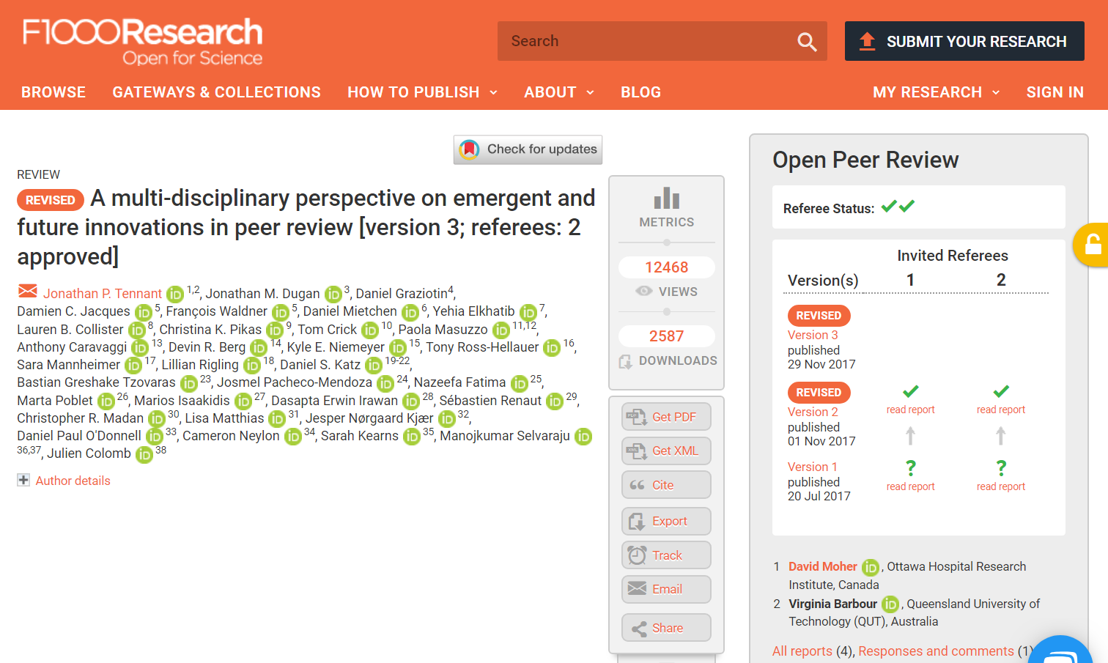
Tennant JP, Dugan JM, Graziotin D et al. (2017) A multi-disciplinary perspective on emergent and future innovations in peer review [version 3; referees: 2 approved]. F1000Research, 6:1151 https://doi.org/10.12688/f1000research.12037.3

Slide 21
Submitted August 9, 2017
Piwowar H, Priem J, Larivière V, Alperin JP, Matthias L, Norlander B, Farley A, West J, Haustein S. (2018) The state of OA: a large-scale analysis of the prevalence and impact of Open Access articles. PeerJ 6:e4375 https://doi.org/10.7717/peerj.4375

Slide 22
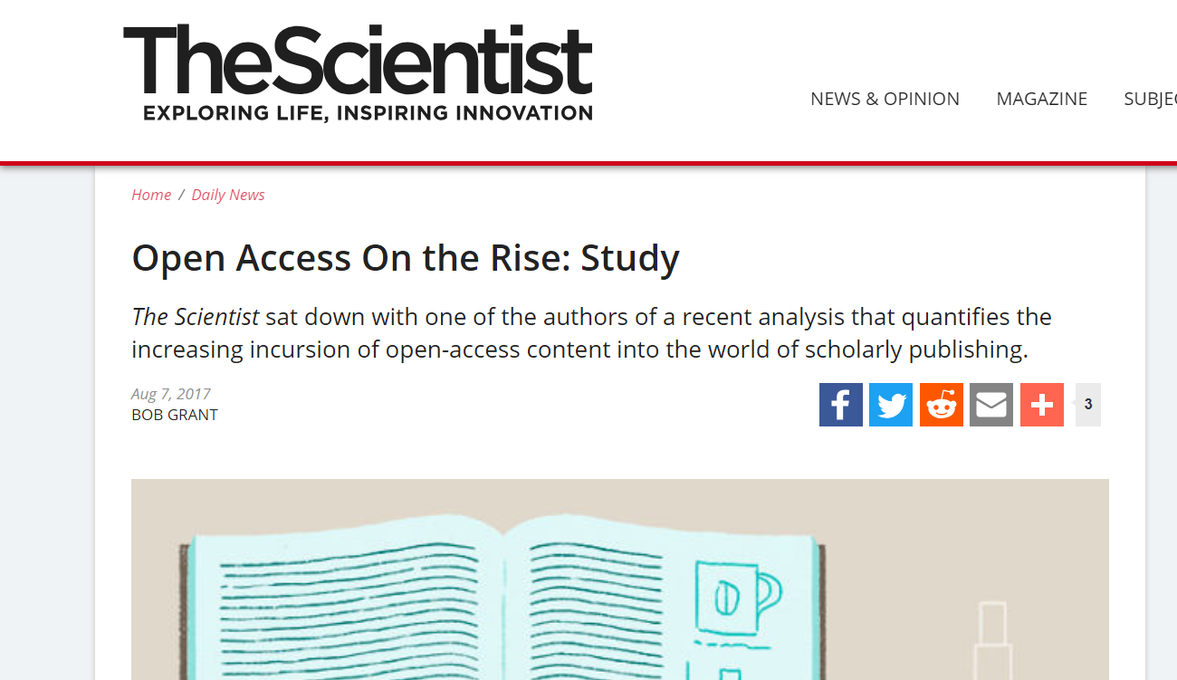
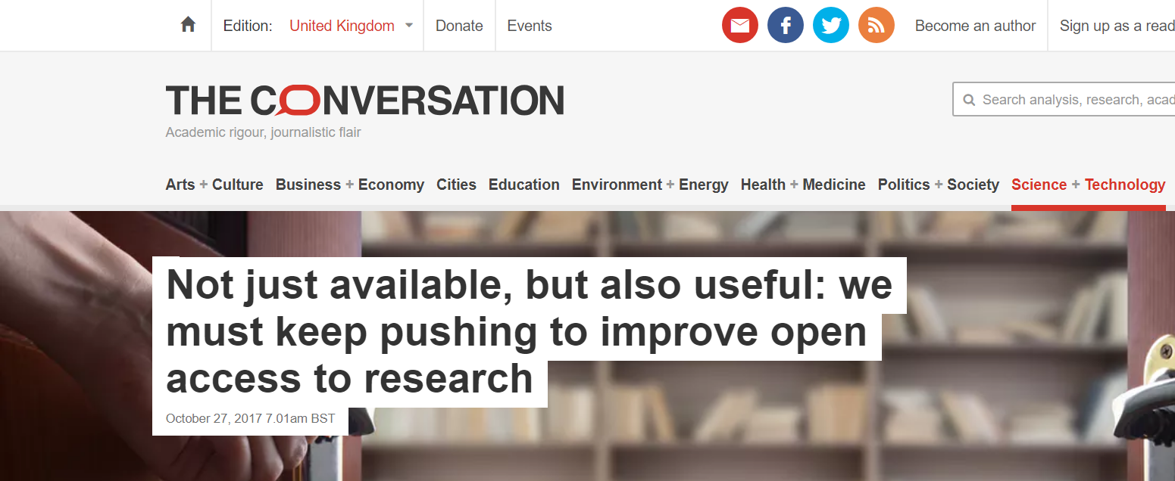
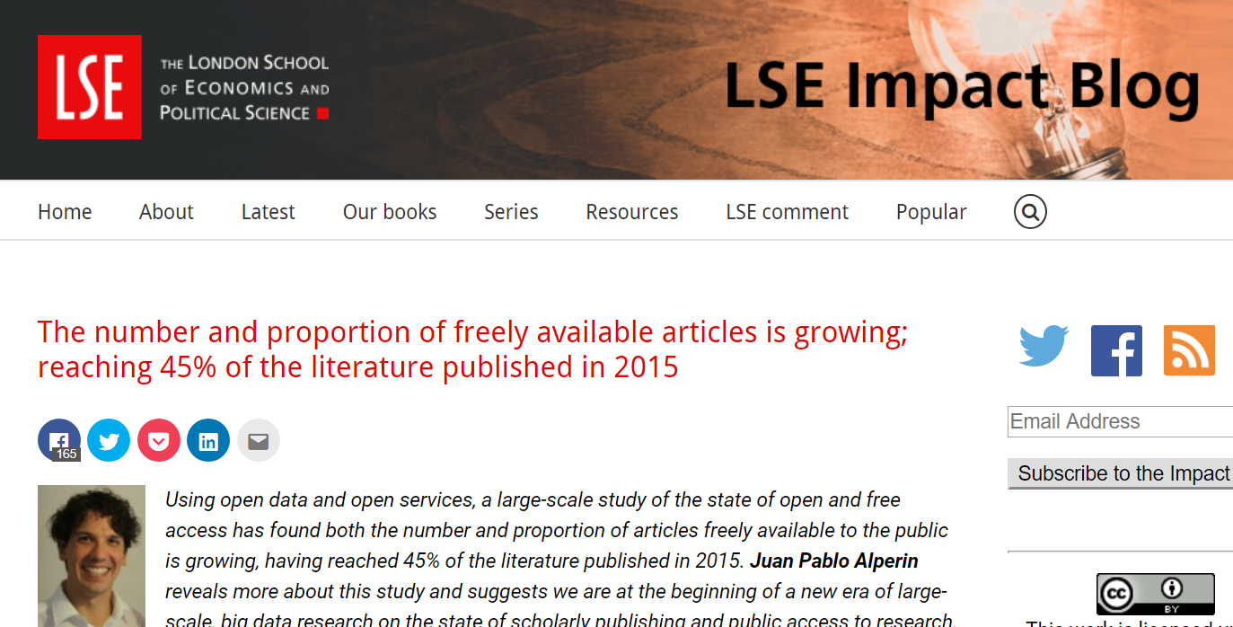

Slide 23
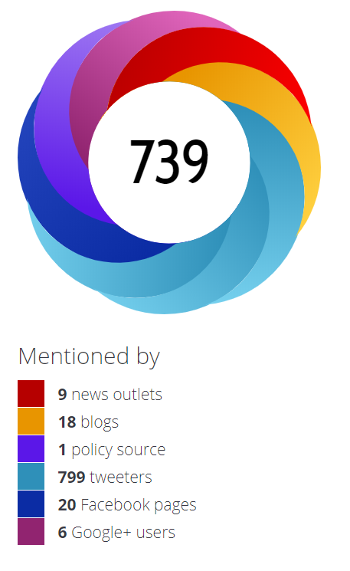
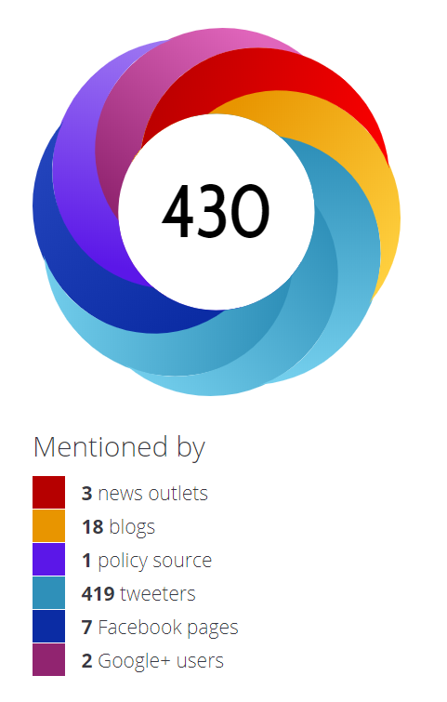
PREPRINT
JOURNAL ARTICLE
30 Citations
28 Citations
https://www.altmetric.com/details/23358582
https://www.altmetric.com/details/33152539

Slide 24
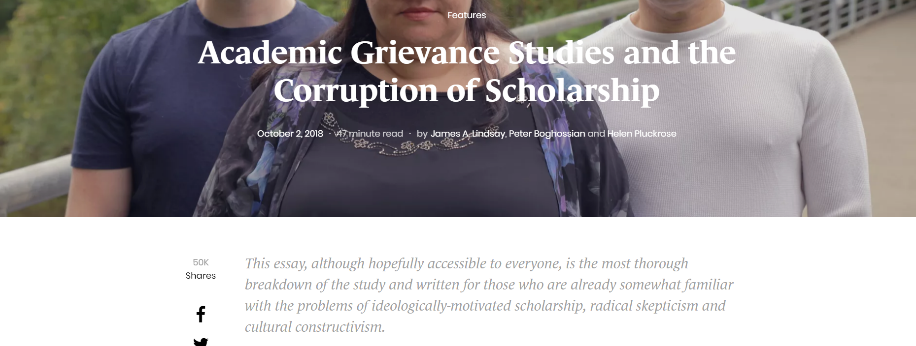
https://areomagazine.com/2018/10/02/academic-grievance-studies-and-the-corruption-of-scholarship

Slide 25
Reproducibility
DEFINITION
Reproducibility refers to the ability to reach the same conclusions/results using the same approach and the same data.
GUIDING PRINCIPLES
Transparency, openness, sharing.

Slide 26
Ensuring reproducible results.
01
DOCUMENTATION
02
OPEN DATA
03
OPEN CODE
Document EVERY.SINGLE.DETAIL
Provide access to underlying data.
Share your annotated code.
04
ANALYTIC TRANSPARENCY
05
PRODUCTION TRANSPARENCY
Provide sufficient details about data analysis (code, detailed methods, supplementary material).
Provide information in which context data were collected/generated and which procedures were used.
See https://doi.org/10.1177/0002764218784991 for more information on sharing qualitative data, and https://www.princeton.edu/~amoravcs/library/transparency.pdf on transparency.

Slide 27
IMHO, the methodology cannot be explained in too much detail.
What?
Why?
What was the result?
What?
Why?
See https://doi.org/10.7910/DVN/VY4TJE

Slide 28
Your primary collaborator is yourself 6 months from now, and your past self doesn’t answer emails.
- Rachel Ainsworth

Slide 29
Benefits of reproducibility
Easier reuse of material for future projects
Easier to write papers
Helps referees to review
Builds your reputation

Slide 30
Anonymous Reviewer (2018) Peer Review #1 of "The state of OA: a large-scale analysis of the prevalence and impact of Open Access articles (v0.1)”. PeerJ https://doi.org/10.7287.peerj.4375v0.1/reviews/1

Slide 31
Other benefits…

