Slide 1
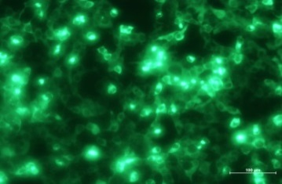
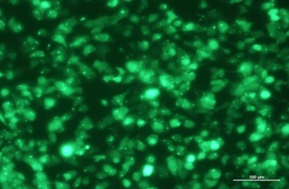
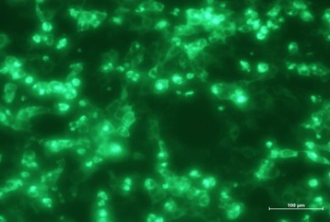
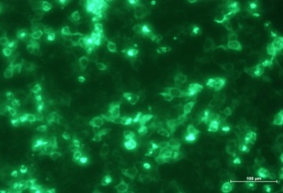
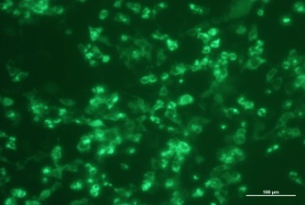
Fig. Fluorescent identify of recombinant plasmids
GFP-NSP1
GFP-NSP2
GFP-NSP3
GFP-NSP4
GFP-NSP5
GFP-NSP6
GFP-NSP7
GFP-NSP8
GFP-NSP9
GFP-NSP10
GFP-NSP11
GFP-NSP12
GFP-NSP13
GFP-NSP14
GFP-NSP15
GFP-NSP16
GFP-ORF3
GFP-M
GFP-N
GFP-E
GFP-S1
GFP-S2
GFP
Notes:
Fluorescent identify result showed that all these recombinant plasmids were correctly constructed. The bright green fluorescence was observed from these recombinant plasmids-transfected cells, although the expression efficiency of each recombinant plasmid is different due to individual gene specificity.

