Slide 1
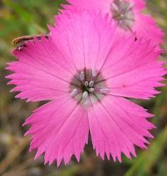
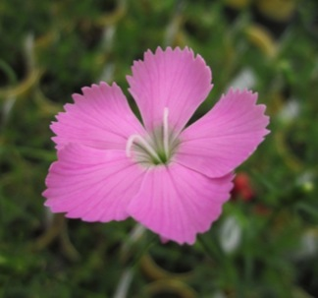
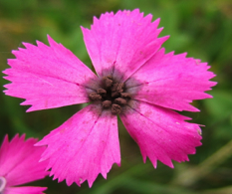
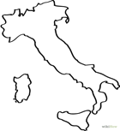
Study system: Dianthus pavonius, the alpine carnation
Hermaphrodite
Female
Diseased
Endemic to the Maritime Alps
Photo near UP site

Slide 2
Phenology: Female plants flower earlier than hermaphrodites
Decline in the frequency of flowering females over three weeks
Fig 2c.

Slide 3
Female flowers are open for a shorter time period
closed
open
Example of floral closure:
Flowers with dark paint were hand-pollinated the previous day.
The open female flower was not
Figure 3a

Slide 4
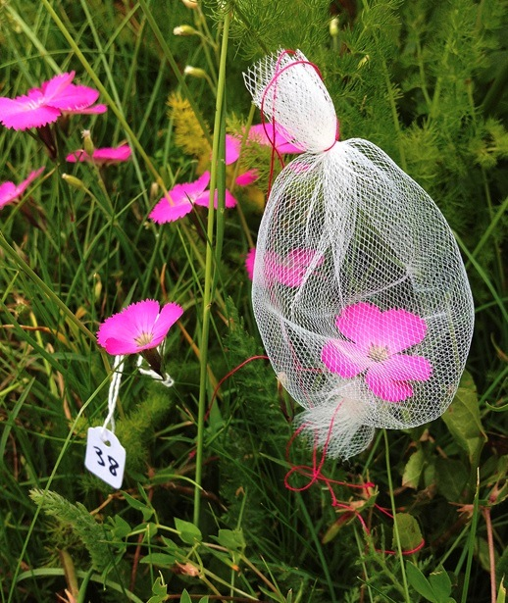
Pollination accounts for the difference in floral longevity
Fig 3b

Slide 5
Female flowers have fewer spores
Fig 3c

Slide 6
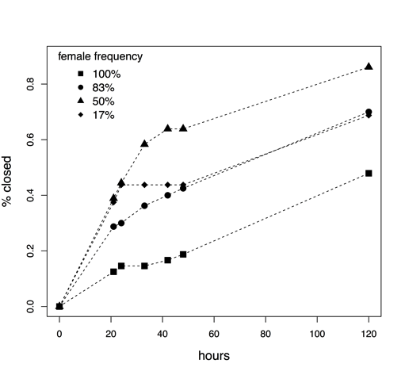
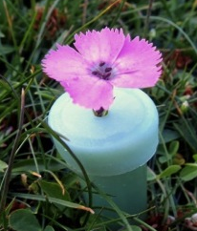

Females close faster when rare
80% Female
Fig 4
50% Female
20% Female
A diseased flower and a healthy female flower in floral tubes

Slide 7
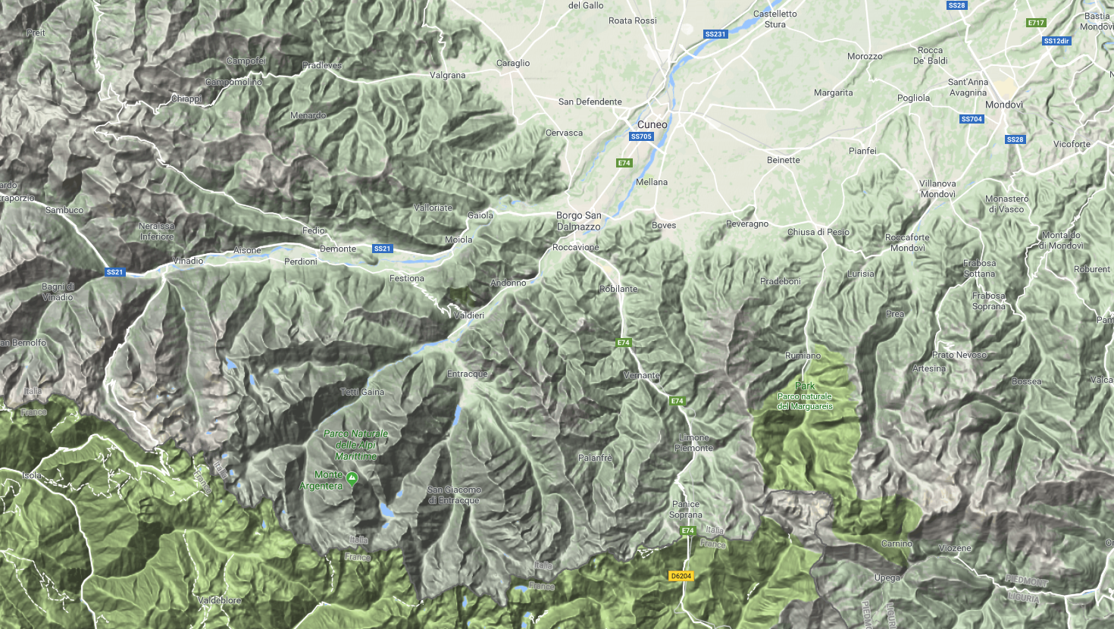
Diseased populations have more female-biased sex ratios
Fig 5
Garelli
2mi
Sampled 13 transects in martime alps

Slide 8
Sexes do not difference in fertility
Inflorescence number
Seed production
Fig 6

Slide 9
Significant Inbreeding depression
Fig 6e
self
outcross

