Slide 1
Deep Learning Seismic Facies on State-of-the-Art CNN Architectures
Jesper Soeren Dramsch*, Mikael Luethje Technical University of Denmark

Slide 2
Outline
Deep Learning
Transfer Learning
Fine Tuning
Imagenet
F3 Seismic Data
Conclusions

Slide 3
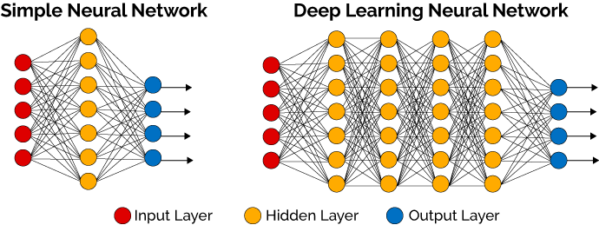
Deep Learning

Slide 4
Transfer Learning
Dataset 1
Dataset 2
Network X
Network X

Slide 5
Fine-Tuning
Dataset 1
Dataset 2
Network X
Network X*
Network X

Slide 6
Why Transfer Learning?
Less Training with Larger Network
Cheaper
Nuance from other larger Dataset
Rapid Iteration of Ideas
Stable Training

Slide 7
Original Training Data

Slide 8
Our Training Data
MalenoV from Conoco
Dutch F3 Dataset form dgb
Nine Classes

Slide 9
95,735 Parameters at 8+ hours

Slide 12
Overfit

Slide 15
Accuracy and Loss

Slide 16
15,242,605 Parameters at < 3 hour

Slide 17
Accuracy and Loss VGG

Slide 18
Inline

Slide 19
VGG Inline

Slide 20
Waldeland CNN

Slide 21
Crossline

Slide 22
VGG Crossline

Slide 23
Waldeland CNN

Slide 24
Accuracy and Loss Resnet

Slide 25
Why would I not recommend this?
Prediction very slow
Full network run for one sample
Improvements in ”semantic segmentation”

Slide 26
Kaggle TGS Salt Challenge

Slide 27
U-Net for Segmentation

Slide 28
U-Net for Segmentation
Encoder
Decoder
Low Dimensional
Representation

Slide 29
Replace Encoder
VGG Encoder
Encoder
Decoder
Low Dimensional
Representation

Slide 30
Finetune Encoder
VGG Encoder
Encoder
Finetune Resnet Encoder
Decoder
Low Dimensional
Representation

Slide 31
Conclusions
Transfer Learning Works for Seismic
Deep Network preferrable
Deep Networks may overfit
Regularization
Early Stopping
Better approaches, but findings relevant to those

Slide 32
Thank You
https://github.com/JesperDramsch/segam18

