Slide 1
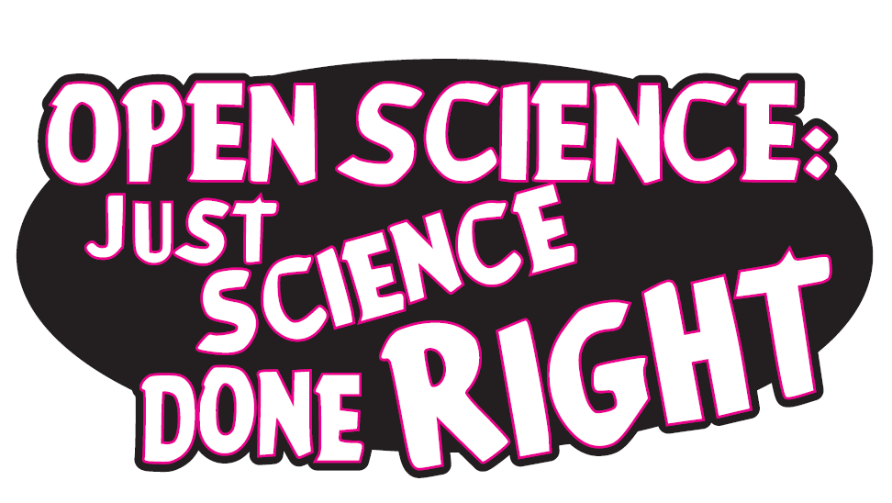
Dr. Jon Tennant
@protohedgehog
Blockchain for Science Con 2018 5-6 November, Berlin, Germany
https://orcid.org/0000-0001-7794-0218

Slide 2
A global scientific ‘crisis’
https://paywallthemovie.com/
There are four major ‘crises’:
Access – Most research still paywalled to most people
Reproducibility – Much research fails basic reproducibility tests
Serials – The ridiculous price increases of journals
Evaluation – The metric that shall not be named
Previous slide: Melanie Imming, & Jon Tennant. (2018, June 8). Sticker open science: just science done right.
Zenodo. http://doi.org/10.5281/zenodo.128557
@protohedgehog

Slide 3
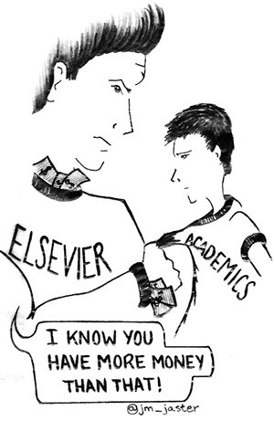
Why Open Science?
Science is not working as well as it could be
Slow and wasteful
Ruled by commercial interests
Copyright is broken
The four crises
Illusion of academic freedom
Questionable research practices
Closed science means people suffer
@protohedgehog

Slide 4
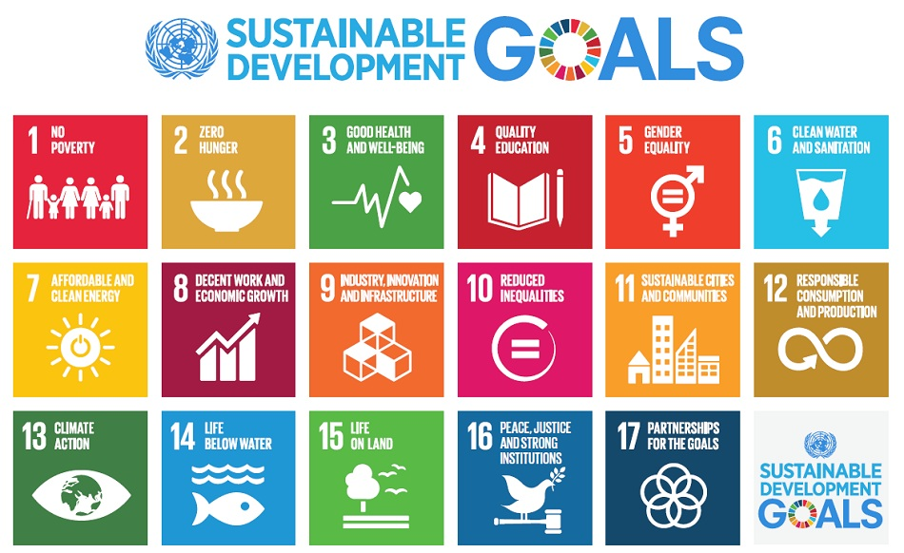
Do you believe that science can help us solve these problems?
http://www.who.int/mediacentre/events/meetings/2015/un-sustainable-development-summit/en
@protohedgehog

Slide 5
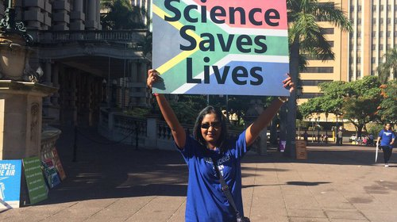
YES!
But then you also must acknowledge that by preventing access to research, we are acting against meeting these goals.
And this is what the present scholarly publishing industry is doing. In exchange for our money.
It’s not a bug. It‘s a feature.
@protohedgehog

Slide 6
For researchers, getting published is like going to a restaurant, bringing all of your own ingredients, cooking the meal yourself, and then being charged $40 for a waiter to bring it out on a plate for you.
You are the provider, the product, and the consumer.
@protohedgehog

Slide 7
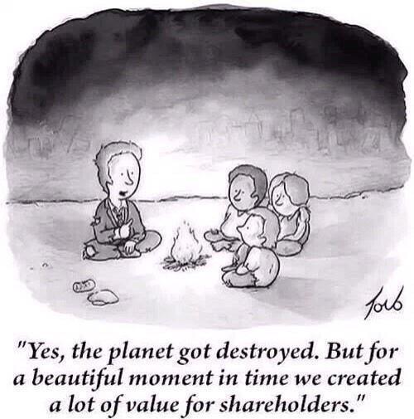
Why Open Science now?
Things are getting worse
Lower public trust in science
Co-option of Open Science
Commercial interests strengthening
Ownership of scholarly infrastructure
We have to act now, as a global community and take control of [Open] Science.
@protohedgehog

Slide 8
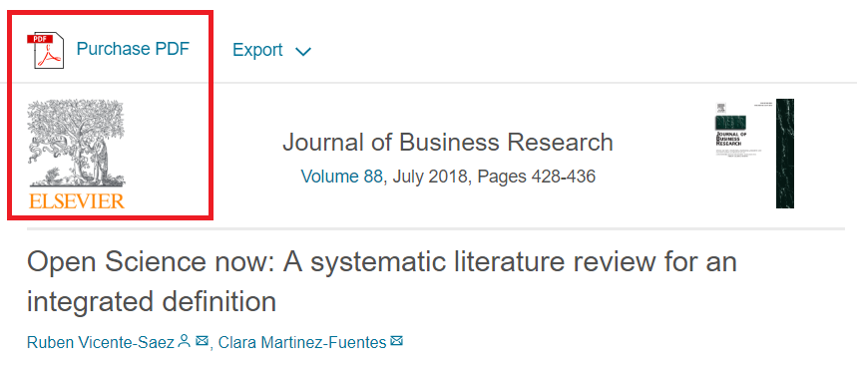
I feel like often we talk about “Open Science” as a different entity to [good] “science”.
“Open Science is transparent and accessible knowledge that is shared and developed through collaborative networks.”
“Open science describes the practice of carrying out scientific research in a completely transparent manner, and making the results of that research available to everyone. Isn’t that just ‘science’?”
THIS IS VERY BAD
THIS IS VERY GOOD
https://genomebiology.biomedcentral.com/articles/10.1186/s13059-015-0669-2
https://www.sciencedirect.com/science/article/abs/pii/S0148296317305441
@protohedgehog

Slide 9
What’s the fuss?
Because OS has become a poorly-defined process- based concept
Divorced from any human, value-based element
Treated as distinct from ‘good’ science
This makes it very easy AGAIN for commercial interests to co-opt (which they are)
Or to be used as a political slogan to gain brownie points (which it also is)
@protohedgehog

Slide 10
Freedom
Fairness
Justice
Truth
Liberty
FAIR principles
TOP guidelines
Principles of Open Scholarship, by Tony Ross-Hellauer (Source, CC BY).

Slide 11
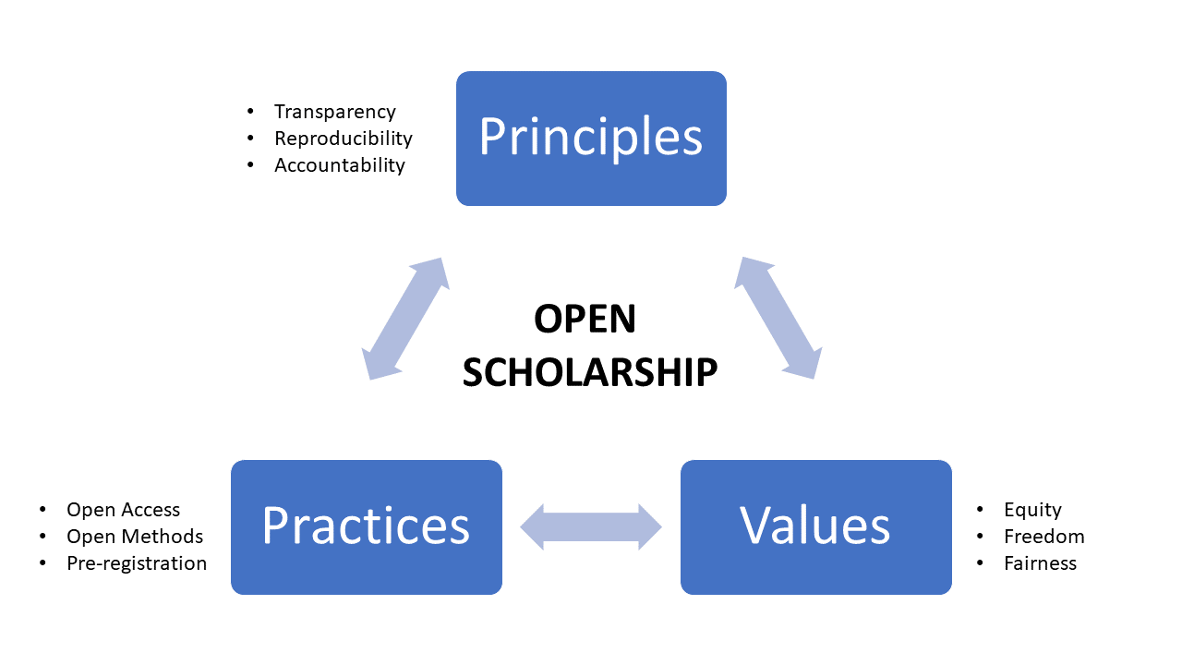
@protohedgehog

Slide 12
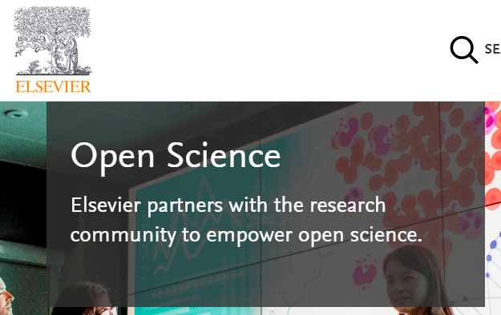
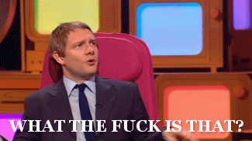
Mega-publishers are corrupting Open Science
Organisations stuck in a pre-digital mindset with a key product developed in the 17th Century.
Basically the reason why the Open Science ‘movement’ began.
Business models based on exclusion, exploitation of privilege, discrimination, extortion..
Who pay lip service to Open Science, while simultaneously subverting it to meet their own intentions.
We DO NOT share the same values and principles.
@protohedgehog

Slide 13
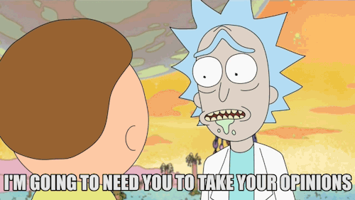
Recent events have been a bit odd…
Now with 1096 supporting signatures!!
Elsevier and the Lisbon Council get miffed and respond..
http://fossilsandshit.com/response-to-president-paul-hofheinz-of-the-lisbon-council-regarding-elsevier-and-the-open-science-monitor/
@protohedgehog

Slide 14
Cough
Dated 28th August
https://zenodo.org/record/1405079#.W5dYdej7RPY
@protohedgehog

Slide 15
They responded! And exactly as expected.
But they failed to adequately address the explicit role of Elsevier, the inherent COIs, the incredible data biases
But now at least there is an ‘advisory group’ overseeing the whole process
#WIN
Their response is being annotated here for a counter-reply:
https://docdrop.org/pdf/Annex-to-letter-to-Jon-Tennant-1--BbPfR.pdf/?
https://zenodo.org/record/1443395?#.W724P2j7RPY
@protohedgehog

Slide 16
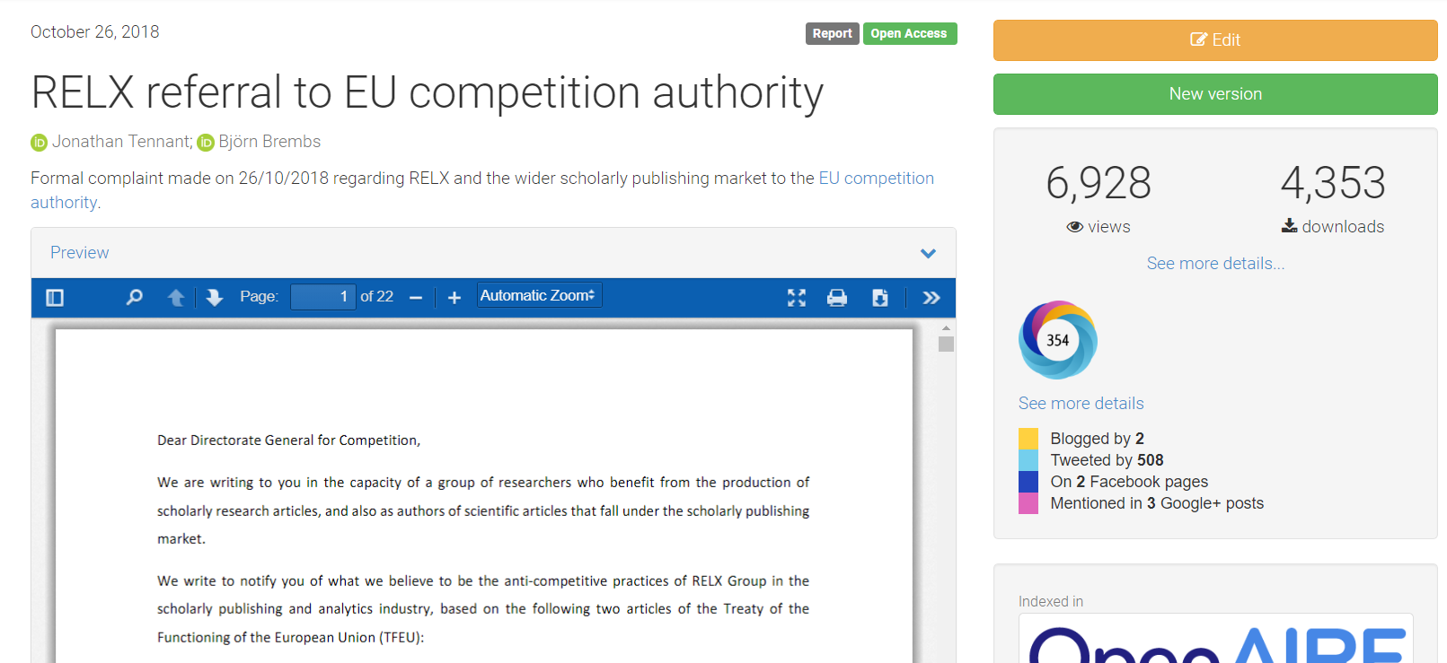
And while they were busy dealing with that..
https://zenodo.org/record/1472045#.W98HkZP0lPY

Slide 17
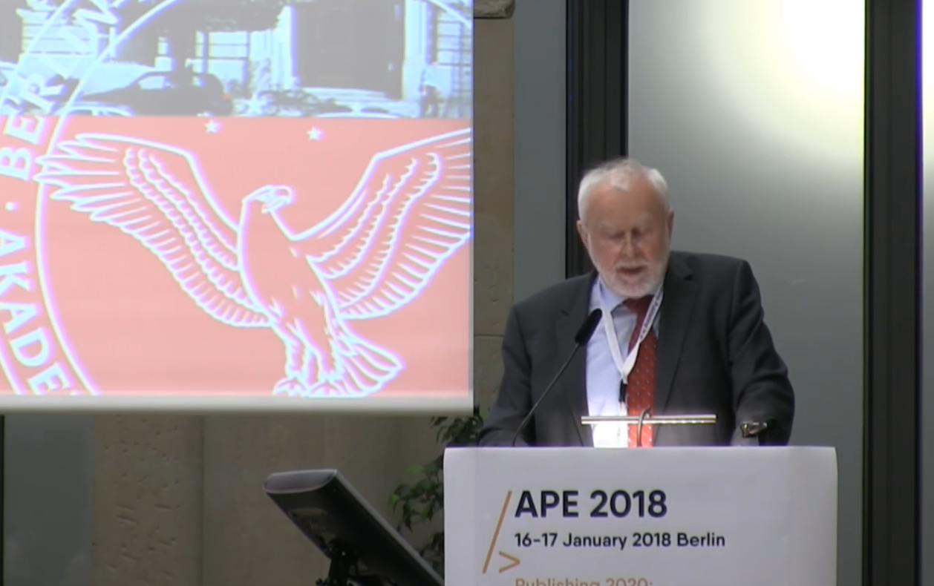
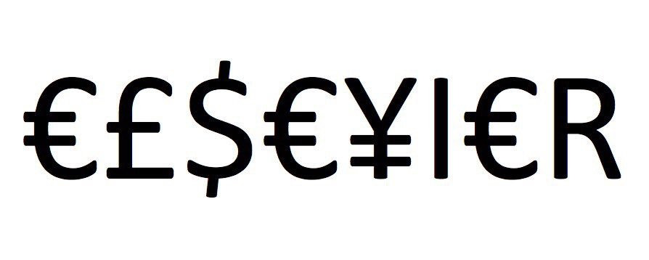
Germany versus Elsevier
“One big publisher stated: if your country stops subscribing to our journals, science in your country will be set back significantly. I responded […] it is interesting to hear such a threat from a producer of envelopes who does not have any idea of the contents.”
Martin Grötschel, President of the Berlin-Brandenburg Academy of Sciences and Humanities
#HERO
#villain
@protohedgehog

Slide 18
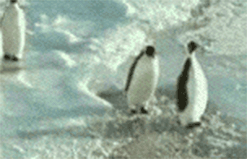
Have you ever met an average academic?
50% of academics are stupider than the average academic.
A system defined by cultural inertia.
Publish or perish mentality is still strong.
Generally terrified of new technologies.
What happened to doing good science? What are the incentives for that?
We are all penguins.
@protohedgehog

Slide 19
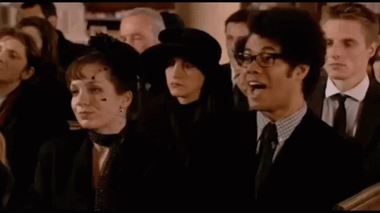
But academics are also generally terrible at making predictions...
“Open Access will never catch on.”
“Preprints will never be a thing.”
“Sharing our data won’t ever be mandatory.”
“Open peer review is fake news.”
“It doesn’t matter if research isn’t reproducible.”
“Open Science is just a fad.”
“Blockchain will never be needed for science”?
I wonder if they ever get tired being wrong all the time…
Time for you all to prove them wrong!
@protohedgehog

Slide 20
Principles in open science
Drivers
Barriers
Reduce publication bias.
Increase replicability.
Increase reliability of scientific record.
Make publicly funded research publicly accessible.
Make research more efficient.
Increase public trust.
Foster collaboration.
Sustainable research.
Fear of scooping or ideas being stolen.
Fear of not being credited for ideas.
Fear of errors and public humiliation.
Fear of risk to reputation.
Fear of reduced scientific quality.
Fear of information overload.
Fear of career compromise.
Fear of backlash from senior figures.
Fear of being different.
@protohedgehog

Slide 21
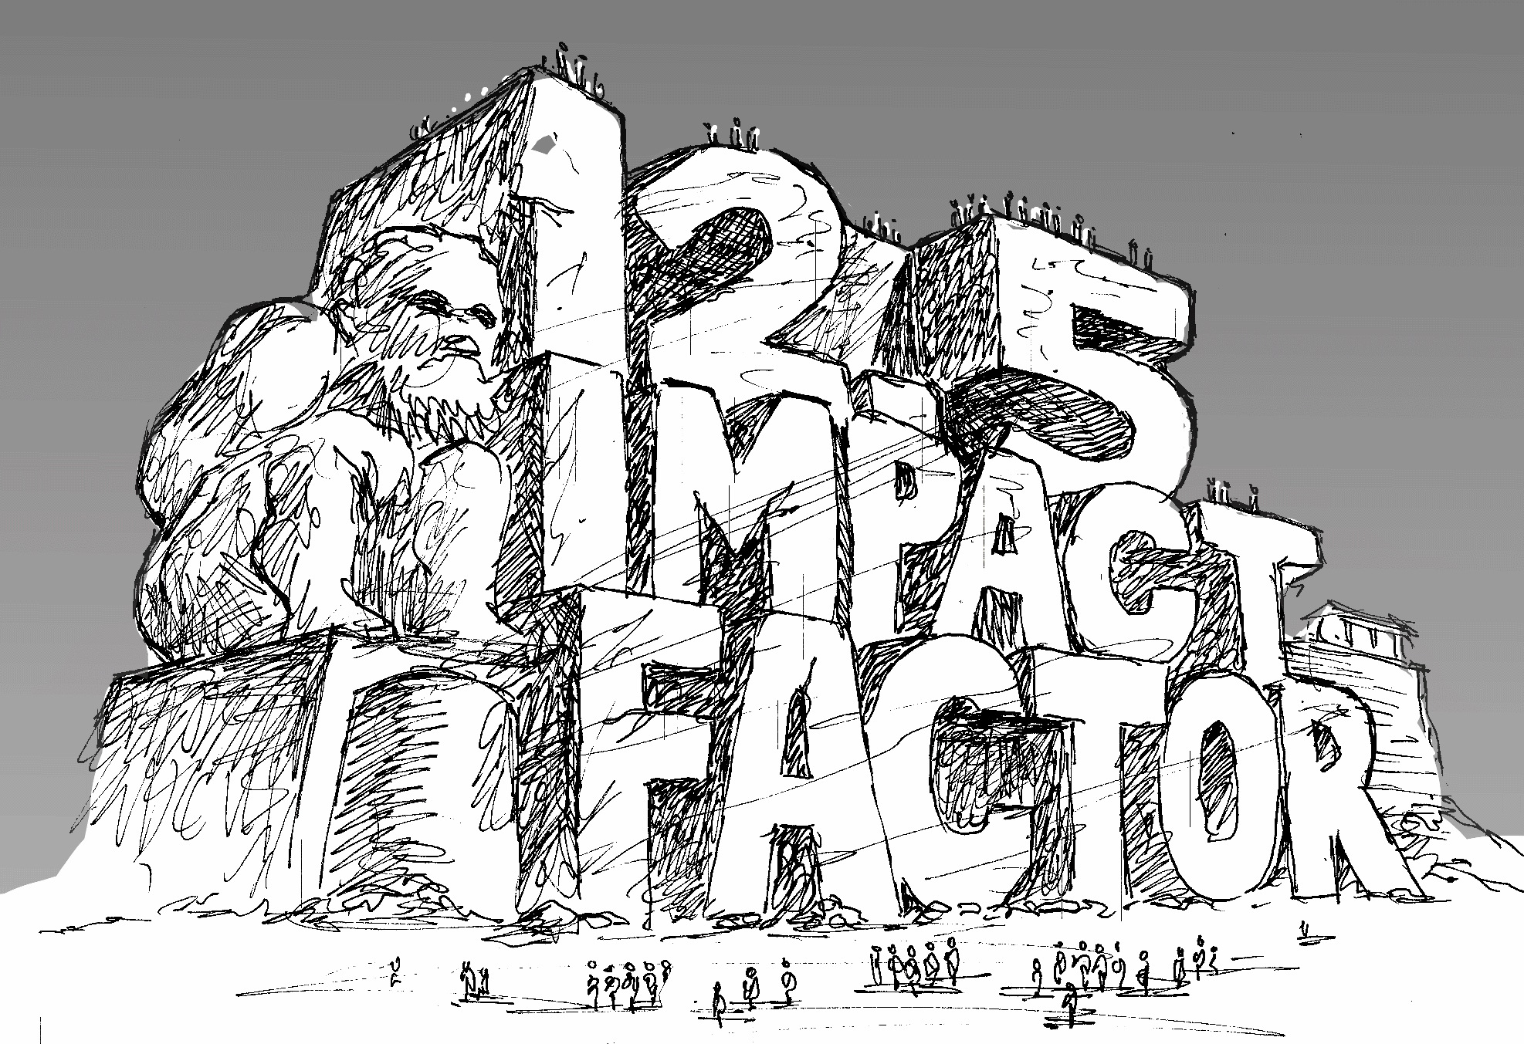
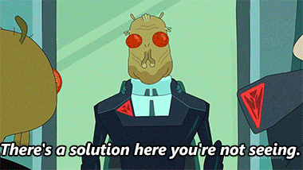
http://whyopenresearch.org/impactfactor
@protohedgehog

Slide 22
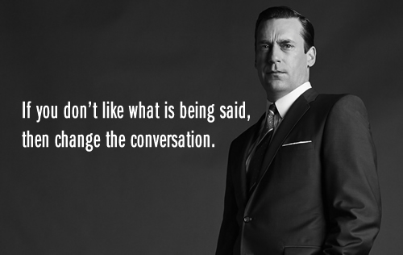
AN OPEN SCIENCE EDUCATION CRISIS
Can we break the cycle through training?
@protohedgehog

Slide 23
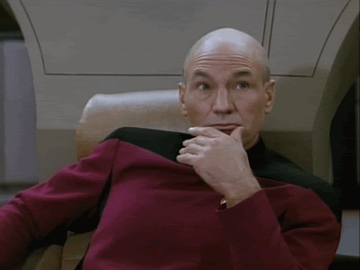
Attitudes versus practice
“60.8% of researchers do not self-archive their work even when it is free and in keeping with journal policy.”
“In a field where OA seems of practical and ethical importance for the sharing of knowledge promoting health equity, it is surprising that researchers do not make their papers available when they are legally able to do so without any cost.”
https://health-policy-systems.biomedcentral.com/articles/10.1186/s12961-017-0235-3
@protohedgehog

Slide 24
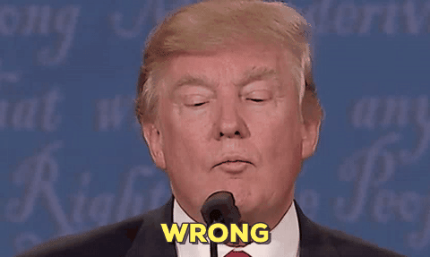
“Open Access is too expensive.”
Common view about high costs is due to a combination of monopolisation and political broadsiding and sabotage by commercial publishers.
@protohedgehog

Slide 25
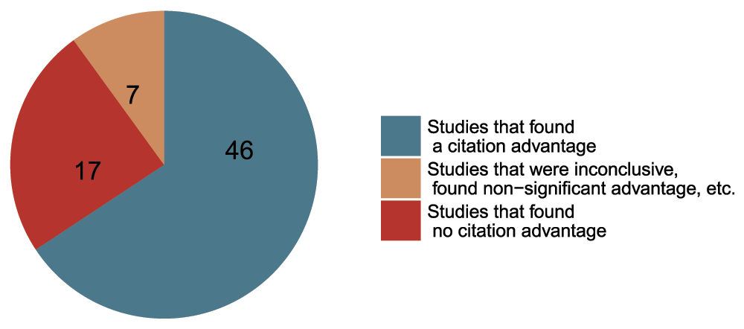
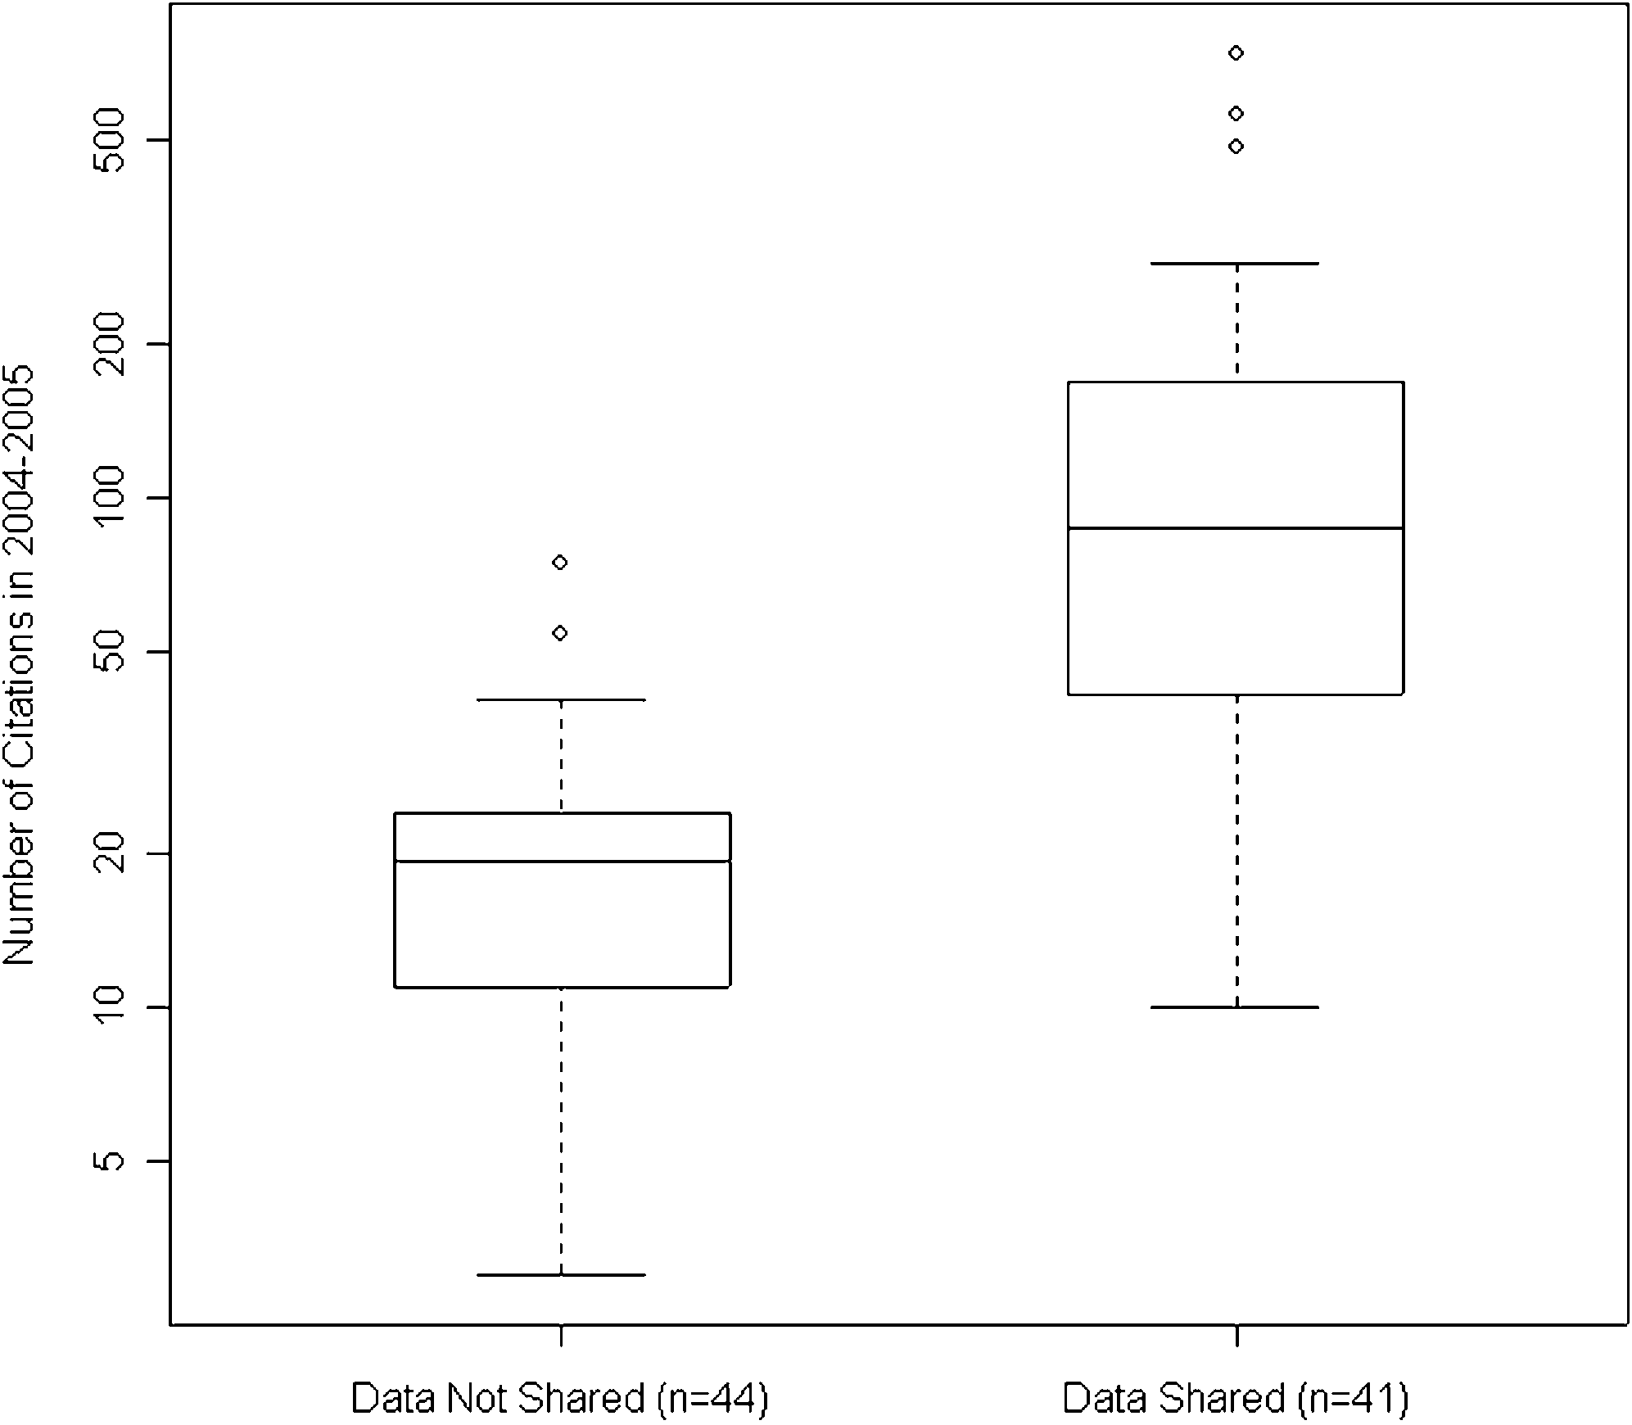
Openness is good for your work and career
Rapid communication
Greater exposure
More citations, faster
http://whyopenresearch.org
https://peerj.com/articles/175
Data from The Open Access Citation Advantage Service, SPARC Europe, accessed March 2016.
http://f1000research.com/articles/5-632/v3
@protohedgehog

Slide 26
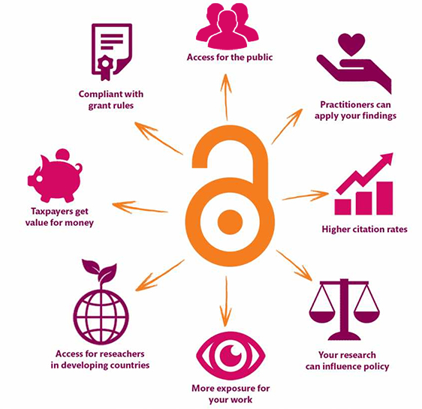
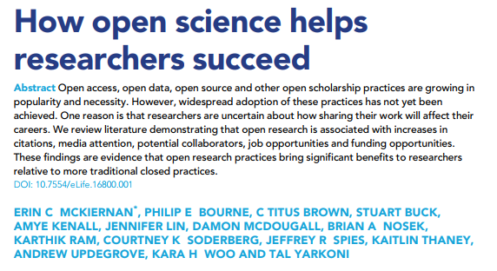
Openess is better for EVERYONE
We should be in a position where we are able to influence our academic system, not be stifled by the current actors in it.
https://elifesciences.org/articles/16800
@protohedgehog
https://kib.ki.se/en/publish-analyse/open-access

Slide 27
What can we all achieve if we stand together?
We need to stand together as a unified global community to make sure that we are acting in the best interests of the public, not corporate gains.
#PeopleNotProfits
https://letsallstandtogether.wordpress.com/
@protohedgehog

Slide 28
What do we need to change cultures?
Education, training, support.
Empowerment and leadership for the next generation.
Shifting power dynamics to reduce bias and abuse.
Building a global community based on sharing and collaboration.
Massive-scale engagement to re-align Open Science with current incentive structures.
@protohedgehog

Slide 29
Our vision of the future
To help make ‘Open’ the default setting for all global research.
We want to help create a welcoming and supporting community, with good tools, teachers, and role-models, and built upon a solid values-based foundation of freedom and equitable access to research.
@protohedgehog

Slide 30
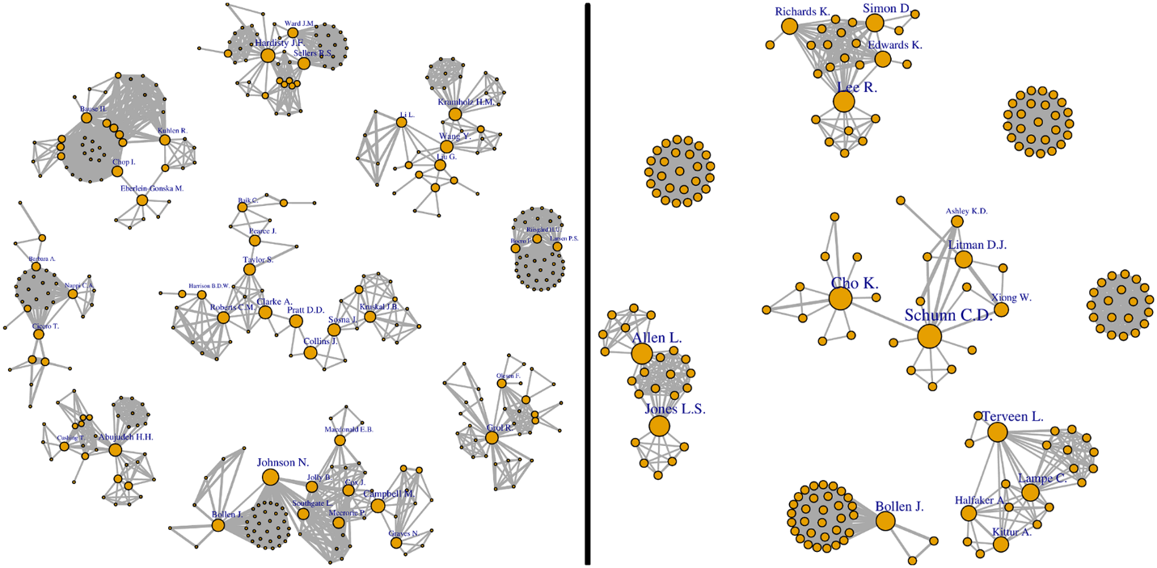
Welcome to the networked 21st century
Everywhere we are using networks to evaluate information on the Web. Why not in science? Use the power of professional networks to evaluate scientific results.
http://journals.plos.org/plosone/article?id=10.1371/journal.pone.0193148
@protohedgehog

Slide 31
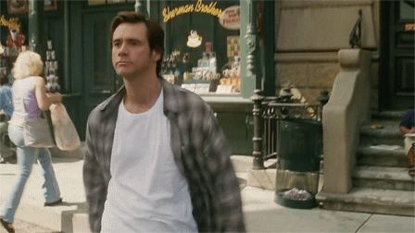
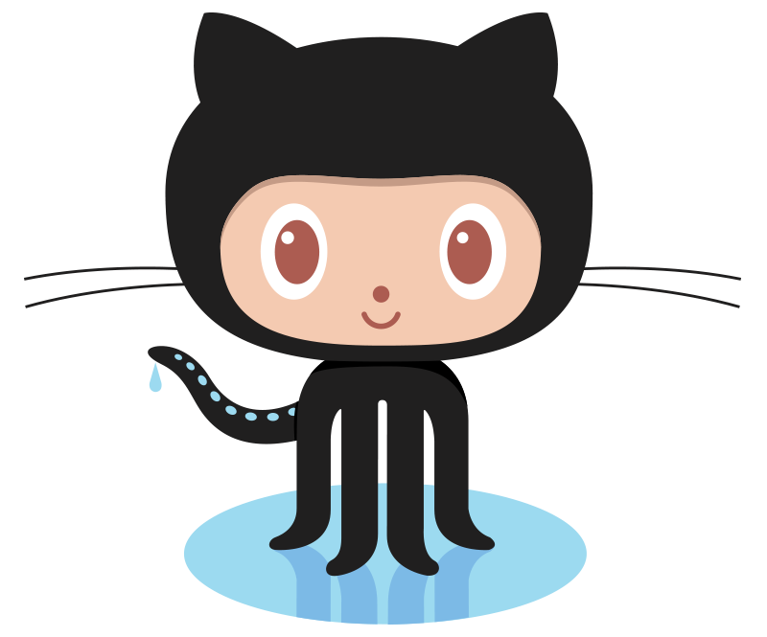
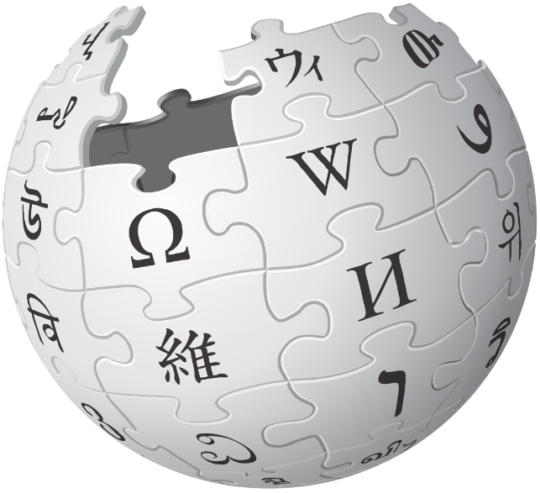
We have the tools to blow things wide open
Low cost
Creditable
Collaborative
Instant
Community-owned
Inherently reproducible
Blockchainified?
https://doi.org/10.1093/femsle/fny204
@protohedgehog

Slide 32
The ultimate goal
Pooling knowledge and resources to create a decentralised scholarly infrastructure, with communities as the focus.
Inclusivity
Equality
Accountability
Freedom
Fairness
Justice
Truth
Rigour
Transparency
Reproducibility
SCIENCE AS A PUBLIC GOOD FOR THE BETTERMENT OF SOCIETY
http://elephantinthelab.org/do-we-need-an-open-science-coalition/
@protohedgehog

Slide 33
@protohedgehog

Slide 34
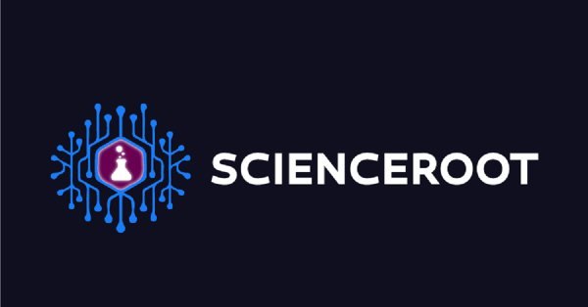
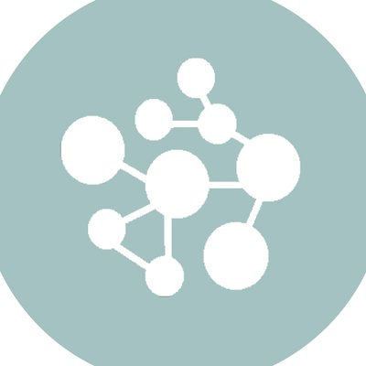
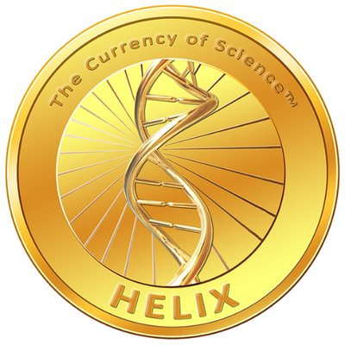
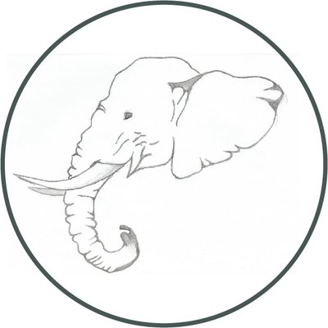
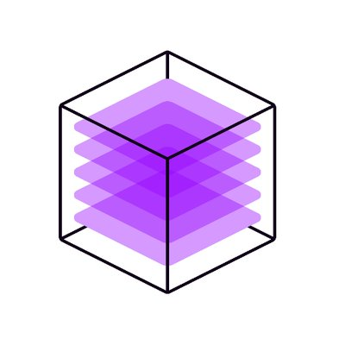
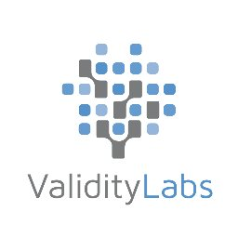
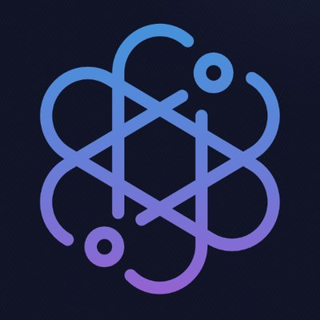
OPEN
And all the rest..
Collectively address the real issue of control and governance of public research.
@protohedgehog

Slide 35
The future
Slide courtesy of Rebecca Willen
@protohedgehog

