Slide 1
Children’s Health Exposure Analysis Resource (CHEAR)
Stakeholder Engagement in Metabolomics
Michael Conlon
Metabolomics Consortium Coordinating Center
University of Florida
November 2, 2018
1

Slide 2
Goals of the Consortium
The overall goal for Stage II of the Metabolomics Program is to realize the potential of metabolomics to inform basic, translational, and clinical research by:
Establishing an enduring national public repository for metabolomic data
Overcoming technical hurdles in analyzing and interpreting metabolomics data, including the ability to determine metabolite identities
Developing consensus for, and promoting adoption of, best practices and guidelines to promote accuracy, reproducibility, and re-analysis of metabolomics data in collaboration with the national and international communities
2

Slide 3
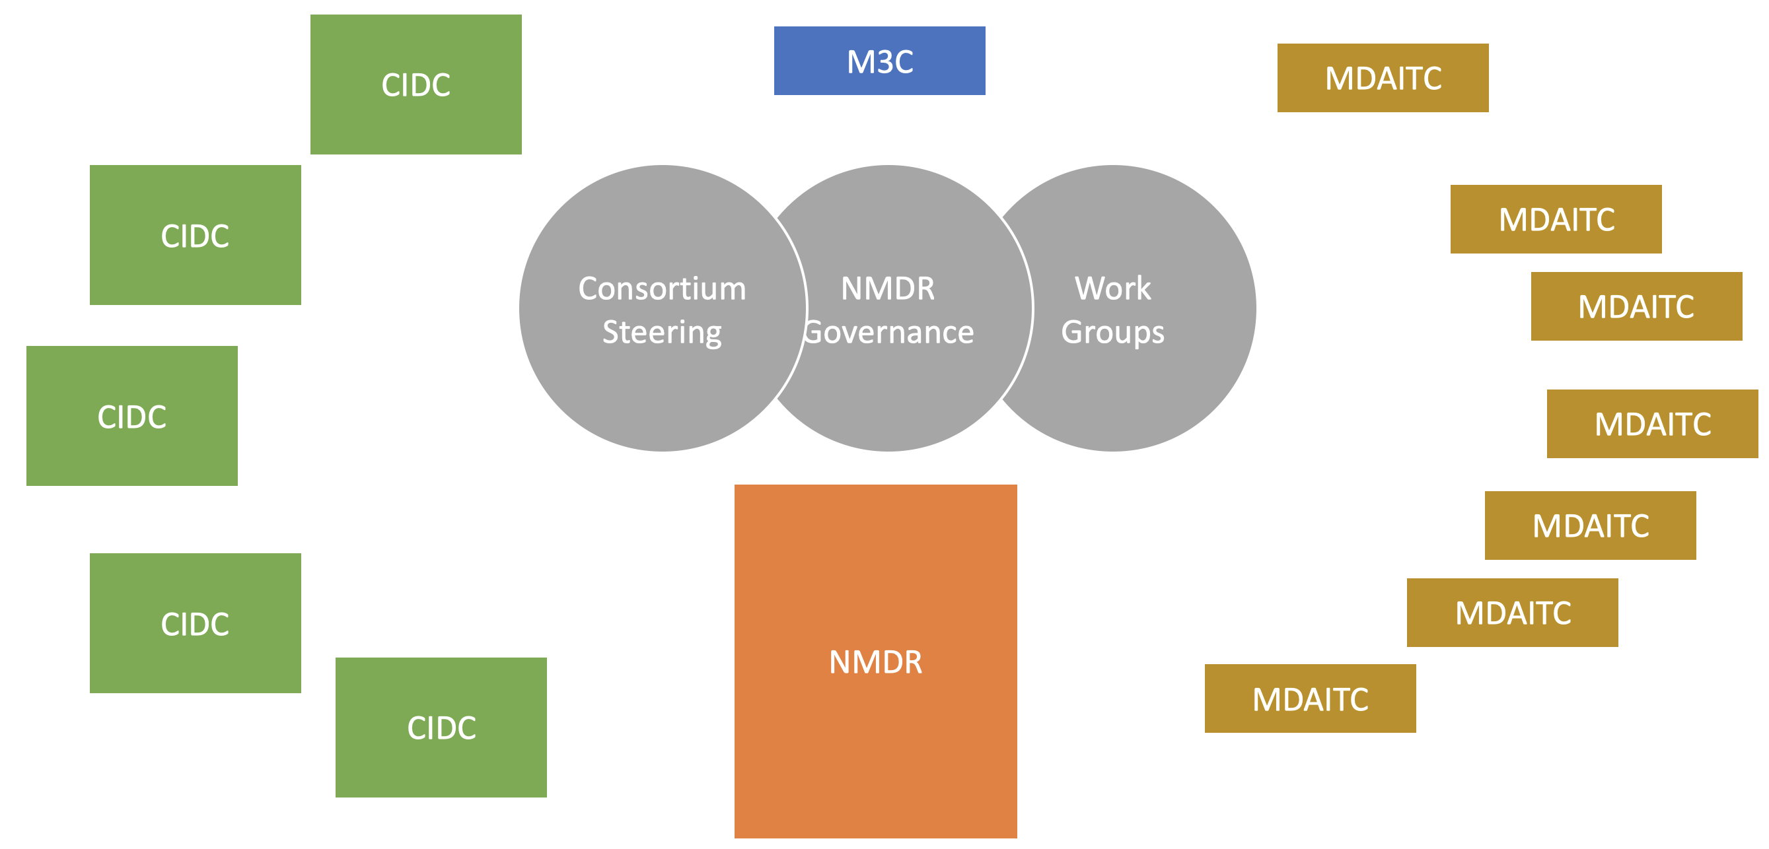
The Metabolomics Consortium
3

Slide 4
How The Consortium Works
Steering Committee
All Principal Investigators, NIH Work Group
Facilitated by M3C
Meets monthly, in-person twice a year
Workgroups
Time-limited, with stated deliverables
Facilitated by M3C
Proposed by investigators, approved by Steering
4

Slide 5
How The Consortium Works (Part 2)
NMDR Governance Board
Experts, thought leaders
Data Repositories, FAIR principles, usability, and reuse
Meets quarterly
External Scientific Consultants
Stakeholder experts
Advise NIH regarding consortium progress
Meet annually
5

Slide 6
My background
Biostatistics, clinical trials, biomedical informatics
UFHSC CIO
CTSI Co-director
SECIM P&O Core lead
VIVO Project Director
Retired 2015
Metabolomics Consortium Coordinating Center (M3C), co-PI with Rick Yost
6

Slide 7
Engagement at SECIM
Goal: Self-sustaining service center within 4 years
On-line. Web site, newsletter. UF Look.
Training. Events each year
P&F Program. Every year
Science teachers. Some cells video.
Collaboration. Scripps, UF CTSI, Phase 1 consortium
7

Slide 8
SECIM Results
Revenue. $14K YR1, $621K YR4
Data. 63 datasets deposited in the NMDR
Publications. 42
Workshops. 472 attendees in 4 years
Pilots. 47 pilots funded
Investigators. 164 serviced
8

Slide 9
Engagement Examples from the UF CTSI
Goal: Accelerate translation from bench to bedside
News. w/ VPR, VPPR
Training. Events each year
P&F Program. Every year
Services. Studios
Patients. HealthStreet, Personalized Medicine
Collaboration. College of Journalism and Communications
9

Slide 10
UF CTSI Results
Revenue. Grew to $18M/yr
Services. Grew to $5M/yr
Data Repository. Includes 16M Floridians
ROI. 11:1
Economic Impact. $1.2B
By 2015. 1K investigators (41% junior faculty), 2,354 publications, 652 IRB approvals, 1,401 grants, $359M grant funding, 2400+ trainees
10

Slide 11
Goals for Metabolomics Engagement
Advance the program goals
  Create a vibrant NMDR
  Overcome technical hurdles
  Best practices for metabolomics data/markers
Build participation
  Build awareness (brand)
  Build collaboration
11

Slide 12
Some Metabolomics Stakeholders
Clinical scientists
Translational scientists
Basic scientists
Data scientists
Trainees
NIH Common Fund
Journal editors
Industry
Public
Related consortia
Science Journalists
International collaborators
12

Slide 13
Some Metabolomics Stakeholders
Junior investigators
The FAIR Data Community
Publishers
Trainers
Funders
Consortium work group members
Related associations
Advocacy groups
And many more
13

Slide 14
Principles for Engagement
Open/Inclusive > Closed/Exclusive
  share, make it easy to participate
Their ideas > Your ideas
  listen, act on their ideas
Community members engage each other > You engage them
  encourage, step back
14

Slide 15
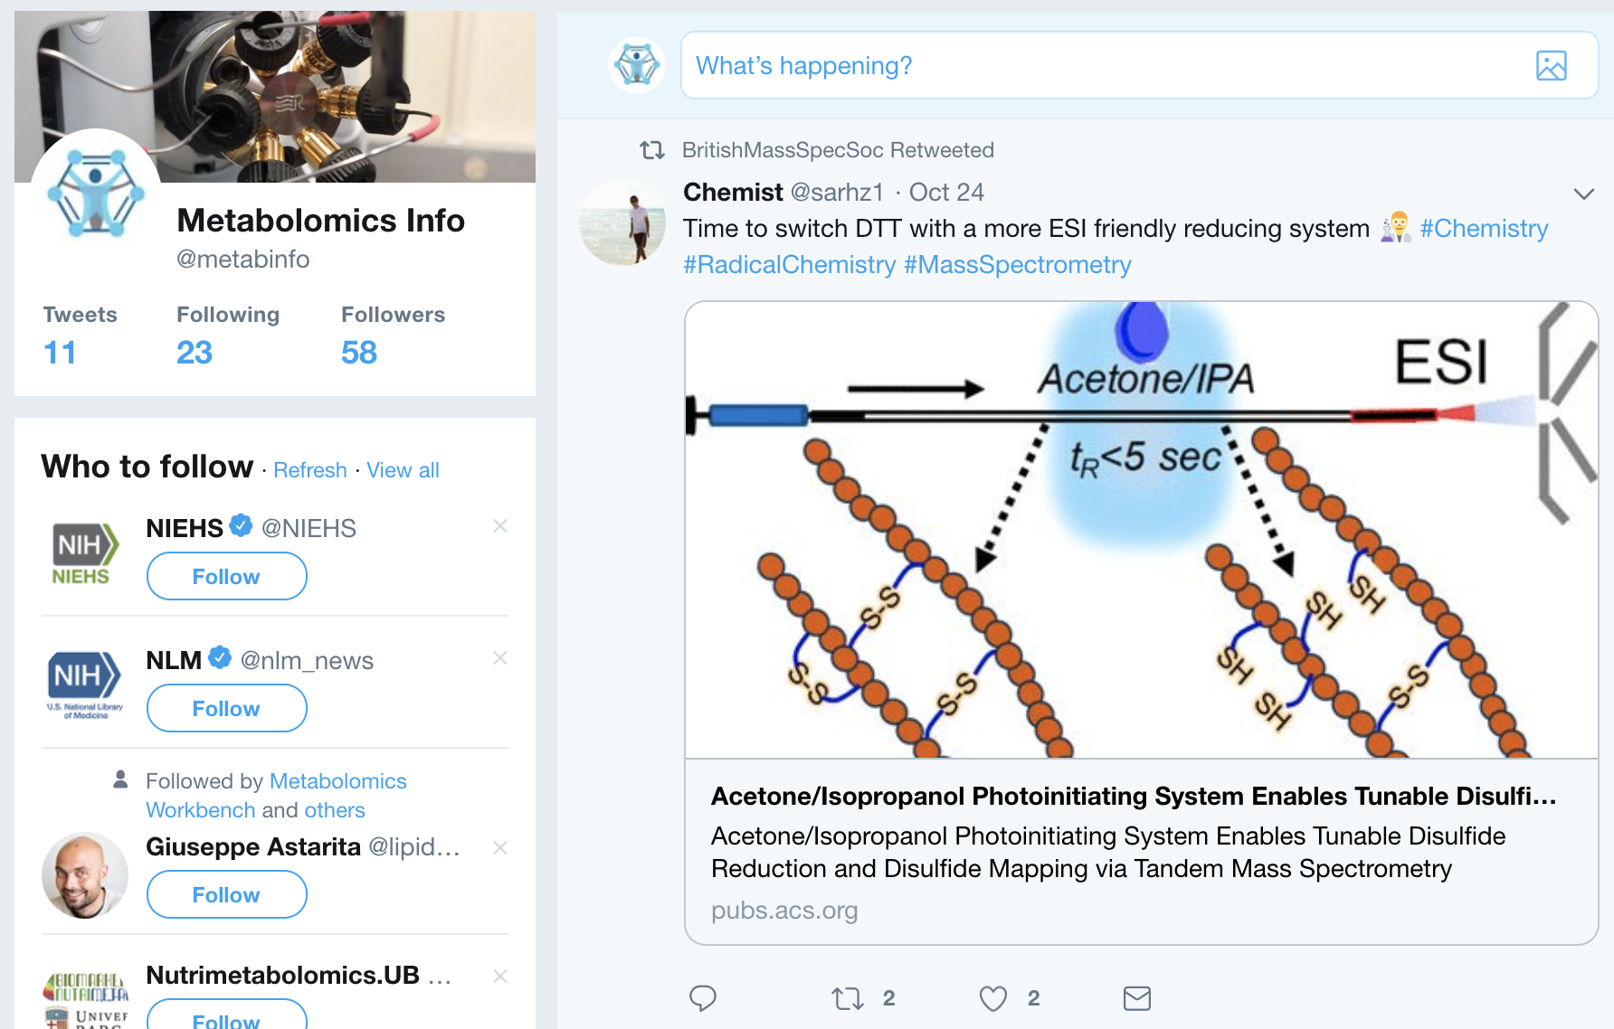
Modalities of Engagement
Twitter. @metabinfo
Pilot program. Encourage clinical and translational use
Existing networks. CHEAR, CTSA, EMBL-EBI, UDN, …
Presentations, posters, letters. Such as this one
Web site. News, events, links to data, pubs, protocols, guidelines
http://metabolomics.info
15

Slide 16
Modalities for Communities
Symposia for journal editors
Develop joint statement on data, protocols
Pilot awards for translational applications
Encourage new collaborations
Collaboration with the CTSA community
CD2H and other programs
16

Slide 17
Modalities for Communities (part 2)
Collaboration with GoFAIR
Possible Metabolomics Implementation Network
Presentations, posters, panels at related meetings
Build awareness of metabolomics, the consortium and related work
On-line presence
Build cross-community awareness
17

Slide 18
Summary
M3C and the Phase 2 Metabolomics Consortium is open for business
Web: http://metabolomics.info
Twitter: @metabinfo
Multi-modal Stakeholder Engagement across Communities
Identify communities, use principles and modalities to engage
18

