Slide 1
Open access through OER
NWU, Vanderbijlpark, 22 October 2018 by Tony Mays

Slide 2
Overview
Open access
OER
Open access through OER
Open access through OER, 22 October 2018

Slide 3
Opening the doors of learning (ANC, 1994; Christie, 2008)
“Open learning is an approach which combines the principles of learner-centredness, lifelong learning, flexibility of learning provision, the removal of barriers to access learning, the recognition of credit for prior learning experience, the provision of learner support, the construction of learning programmes in the expectation that learners can succeed, and the maintenance of rigorous quality assurance over the design of learning materials and support systems” (Department of Education, 1995; DHET, 2017 – emphasis added).
Open access through OER, 22 October 2018

Slide 4
New ways to open the doors of learning
The combination of digital technology, a more collaborative relationship between teachers and learners and the ability to disseminate information freely and quickly in support of change, have opened up new possibilities to open access to and to support deep lifelong learning in pursuit of SDG4 2030 (Adekola, Dale and Gardiner, 2017; Fullan & Langworthy, 2014; Khan, 2012, UNESCO, 2016).

Slide 5
Opening access through ICT #1
“The core philosophy informing all of the revised policies introduced in this White Paper is a move towards facilitating “openness” – open access, open Internet and open Government. (DTPS, 2016, p. 4)
“E-learning and innovative use of ICTs in the education sector can assist in addressing inequalities in education in schools across South Africa, and facilitate ongoing improvement of educator skills.” (DTPS, 2016, p. 8)
However, the cost of mobile data relative to annual salaries, while decreasing, remains high (Hülsmann, 2016)
Open access through OER, 22 October 2018

Slide 6
Opening access through ICT #2
87% of households had access to a cellular phone only, approximately 10% had access to both cellular and landline telephone but only 3,5% had access to neither in 2016. However, household internet access was somewhat lower at about 59,3% with Gauteng and the Western Cape at 72,2% and 68,5% respectively and Limpopo with the lowest level of access at 42,4%. The internet was accessed by 53,9% of households using mobile devices, while access through other means was considerably lower: at home (9,5%), at work (15,8%) or at internet café or educational institution (9,8%). However, smart phone subscriptions have grown dramatically from an estimated 24,340,341 in 2016 to 42,094,018 in 2017 and internet bandwidth grew correspondingly in this period with 99% of population areas now able to access 3G and 77% LTE/4G in 2017. (ICASA, 2018)
Access to what?
Open access through OER, 22 October 2018

Slide 7
Opening access through ICT #3
“Government will therefore explore measures aimed at introducing a creative commons licensing framework.” (DTPS, 2016, p. 145)
Open access through OER, 22 October 2018

Slide 8
OER
Open Educational Resources (OERs) are any type of educational materials that are in the public domain or introduced with an open license.
The nature of these open materials means that anyone can legally and freely copy, use, adapt and re-share them.
OERs range from textbooks to curricula, syllabi, lecture notes, assignments, tests, projects, audio, video and animation.
UNESCO 2017
Open access through OER, 22 October 2018

Slide 9
A resource
Notes:
Almost any kind of resource has potential educational value …

Slide 10
An educational resource
This is a cat.
How do we say “cat” in each official language?
How would you name this animal using South African Sign Language?
Notes:
… however we are most interested in resources which have been incorporated into some kind of learning activity … but can you just use it if you like it?

Slide 11
An OER
This is a cat.
How do we say “cat” in each official language?
How would you name this animal using South African Sign Language?
This work is licensed under a
Creative Commons Attribution 4.0 Citation: Tony Mays 2018
Notes:
The “openness” relates to the way in which the resource is licensed for re-use.

Slide 12
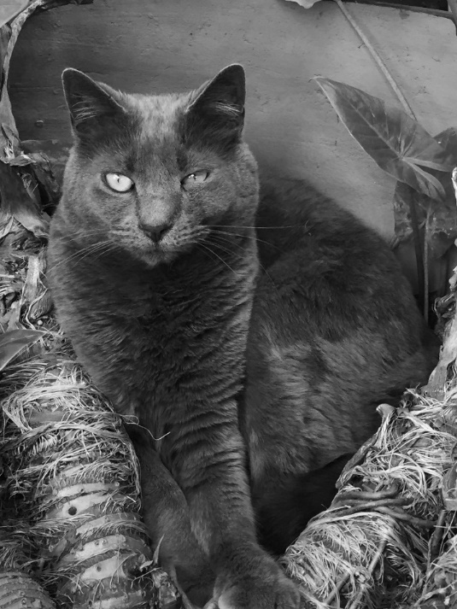
A Revised OER
Think of a story in which a cat is the main character.
Tell one another the story you have thought of.
Now discuss:
What human characteristics are associated with particular kinds of animals and with cats in particular?
Do different cultures associate different characteristics?
This work is licensed under a
Creative Commons Attribution 4.0 Citation: Jane Kamau 2018
Photo: Tony Mays 2018
Notes:
The least restrictive licenses allow the original resource to be adapted for a different audience or context.

Slide 13
Wiley’s 5Rs
Retain, Reuse, Revise, Remix, Redistribute
http://opencontent.org/definition/
Turning access into success: more students can actively learn by doing things with resources, including doing things that were not possible before such as:
Remixing/adapting resources
Recontextualising an open textbook
Responding to diverse needs – media, language, examples … (Wiley, 2016)

Slide 14
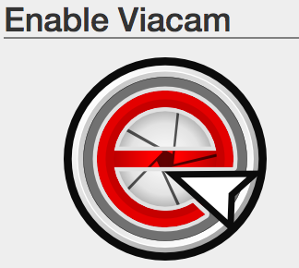
Open to people e.g. assistive technology (Mangiatordi, 2018)

Slide 15
Open to places https://notesmaster.com/

Slide 16
Open to ideas https://slidewiki.org/

Slide 17
Access through OER
Access to free sample course and self-assessment materials prior to enrolment #feesmustfall
Free access to multiple voices in multiple formats #decolonisingthecurriculum
Free access to supporting materials and applications at need #access4success

Slide 18
edX
Notes:
Possibilities for opening up access to just-in-time learning without all the traditional application and registration procedures … but you need to have high levels of self-discipline and intrinsic motivation and not all courses may lead to recognition for credit

Slide 19
OERu
Notes:
Offering free accredited university courses

Slide 20
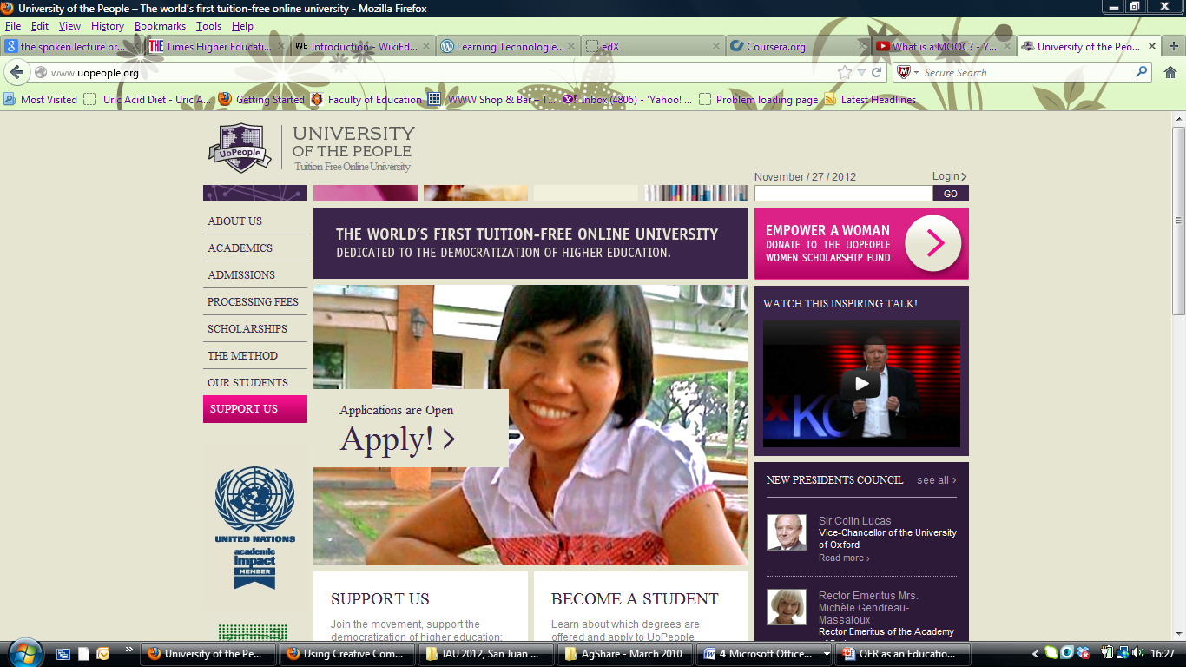
Notes:
Increasing the role of peer mentoring and support

Slide 21
Open-ecology model (Mays, 2017)
OER
OEP
Vision and mission
ODeL

Slide 22
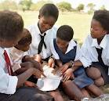
OER for Africa… and the world
OER Africa (www.oerafrica.org) show-cases African intellectual capital – allowing us our rightful participation as contributors to the global knowledge economy.
Notes:
Because OER allows flexibility in module and course design and in the long-term, cuts costs
No Royalties; Choose how to share; Freely available
Allows contextualisation of existing quality resources
Facilitates conversations about institutional and national policy necessary to support quality teaching, learning and research
OER is a tool that enables Africa to share with the rest of the world its wealth of knowledge!

Slide 23
References
Adekola, J., Dale, V.H.M. & Gardiner, K. (2017). Development of an institutional framework to guide transitions into enhanced blended learning in higher education. Research in Learning Technology. 25(1063519):1–17.
African National Congress. (1994). A Policy Framework for Education and Training. Johannesburg: ANC Education Desk
Christie, P. (2008). Changing schools in South Africa: Opening the doors of learning. Sandton: Heinemann Publishers.
Department of Education. (1995). White Paper on Education and Training, Notice 196 of 1996. Pretoria: DoE.
Department of Higher Education and Training. (2017). Open Learning Policy Framework for Post-School Education and Training. Pretoria: DHET
Department of Telecommunications and Postal Services (DTPS). (2016). National Integrated ICT Policy White Paper. Retrieved from Pretoria: https://www.gov.za/sites/default/files/40325_gon1212.pdf
Fullan, M., & Langworthy, M. (2014). A Rich Seam: How New Pedagogies Find Deep Learning. London: Pearson.
Hülsmann, T. (2016). The impact of ICT on the costs and economics of distance education: A review of the literature. Vancouver: Commonwealth of Learning.
Independent Communications Authority of South Africa (ICASA). (2018). 3rd Report on the state of the ICT sector in South Africa. Johannesburg: ICASA.
Khan, S. (2012). The One World School House: Education reimagined. London: Hodder & Stoughton.
Mangiatordi, A. (2018). Keynote address on opening access to learning for the disabled. Open Learning Conference, 2018, DEASA-Nadeosa, Unisa Muckleneuk Campus, 7 September, 2018.
Mays, T. J. (2017). Utilising Open Educational Resources in support of curriculum transformation at Africa Nazarene University: a participatory action research approach. Doctoral thesis. Pretoria: Unisa.
UNESCO. (2016). Incheon Declaration and Framework for Action for the implementation of Sustainable Development Goal 4. [Online], Accessed at http://unesdoc.unesco.org/images/0024/002456/245656E.pdf on 17 October, 2018.
UNESCO. (2017). What are Open Educational Resources (OERs)? Accessed from http://www.unesco.org/new/en/communication-and-information/access-to-knowledge/open-educational-resources/what-are-open-educational-resources-oers/ on 15 May 2017.
Wiley, D. (2016). Skype address to the OER Africa convening meeting in Nairobi on 17 May, 2016.
This work is licensed under a Creative Commons Attribution 4.0 License
Citation: Mays, T. (2018). Open access through OER. Pretoria: University of Pretoria.
Open access through OER, 22 October 2018

Slide 24
Open access through OER, 22 October 2018

