Slide 1
Research Data Management at UC San Diego reflections on a decade of work
David Minor Director, Research Data Curation Program UC San Diego Library

Slide 2
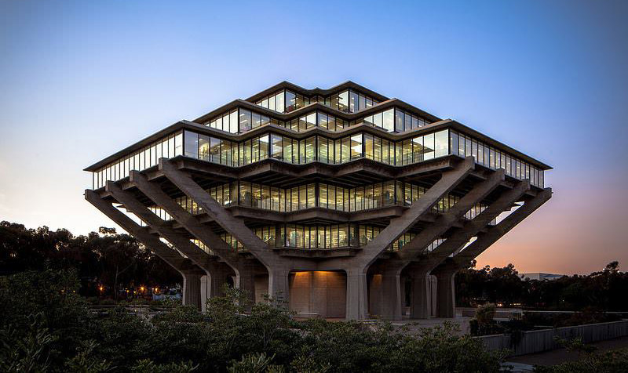
Today’s topics:
History of Research Data Management at UC San Diego
Current status
Some burning questions
Notes:
Data curation at UC San Diego started 15+ years ago with a series of planning exercises and surveys.
Work became concrete with the founding of the Research Data Curation Program ~5 years ago
We now have a multi-organizational thrust to work on data management issues

Slide 3
The briefest of histories...
Notes:
Data curation at UC San Diego started 15+ years ago with a series of planning exercises and surveys.
Work became concrete with the founding of the Research Data Curation Program ~5 years ago
We now have a multi-organizational thrust to work on data management issues

Slide 4
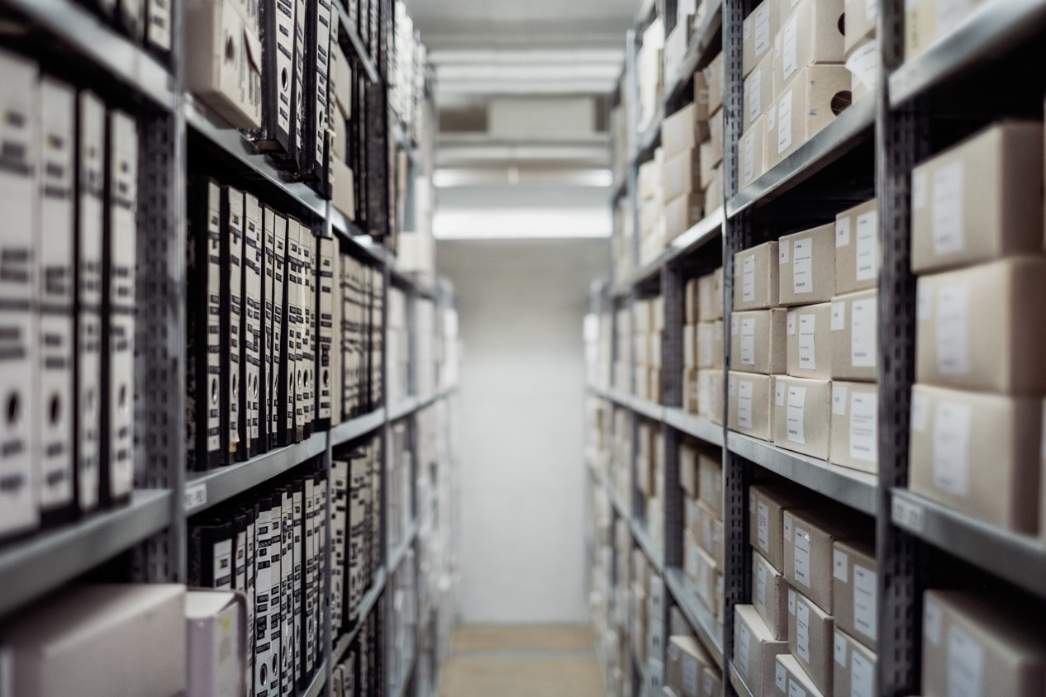
Repository work
Photo by Samuel Zeller on Unsplash

Slide 5
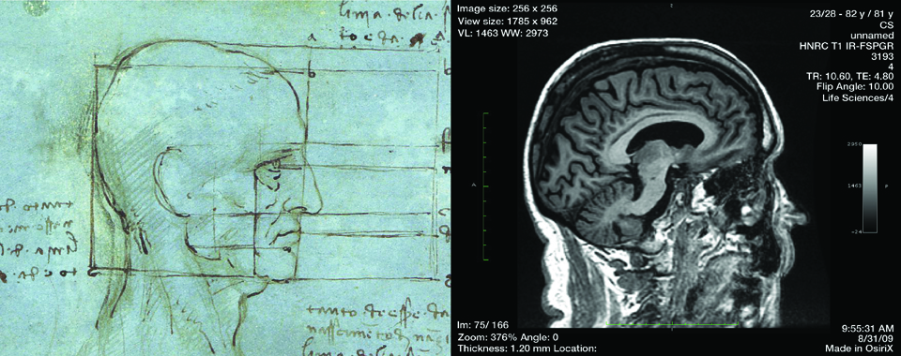
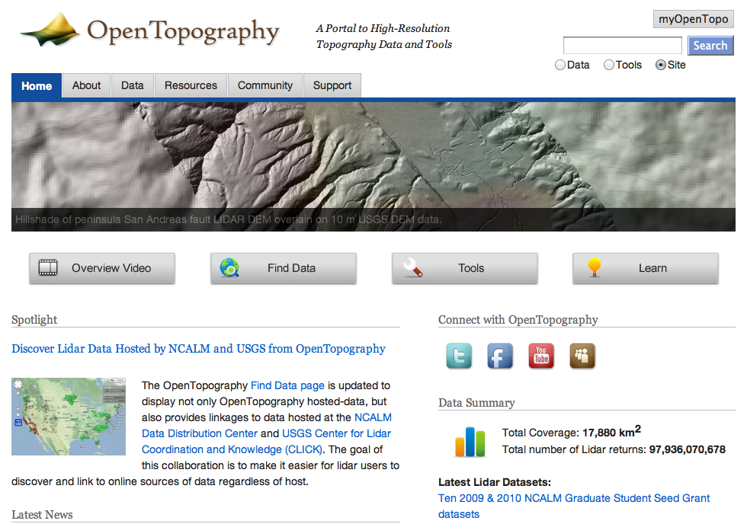
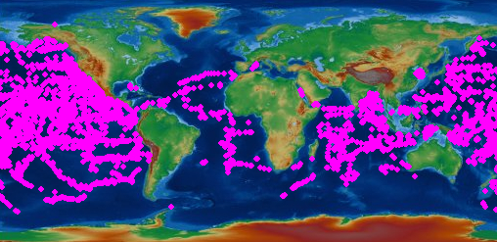
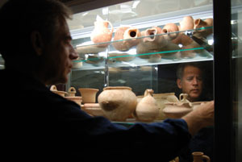
Notes:
We started with six pilots, chosen based on a campus-wide solicitation. They were selected to represent major research thrusts of our campus. We intentionally chose topics that had complexity, and that were not like each other. The metadata processes were completely dissimilar from each other.
At the same time, we investigated a number of repository platforms, including HubZero, the Smithsonian’s application, BitCurator, SharedShelf, and our own system. We chose our own system because it allowed us direct control over development and the ability to create complex data objects.
One of the guiding principles was that we wanted to created a mediated process, that allowed for the creation of rich, complex data objects. This was guided by two ideas: 1) that without this, discovery would be impossible; 2) we eventually wanted to end up with something that could be a “data paper” or “data publication.”

Slide 6
Gen 1 conclusions
The team looked at:
Metadata modeling – what do we want to say about stuff?
Data representations – how do we want to represent stuff?
Researcher requirements – what do they want us to do with their stuff?
Funder requirements – what are they required to do with their stuff?

Slide 7
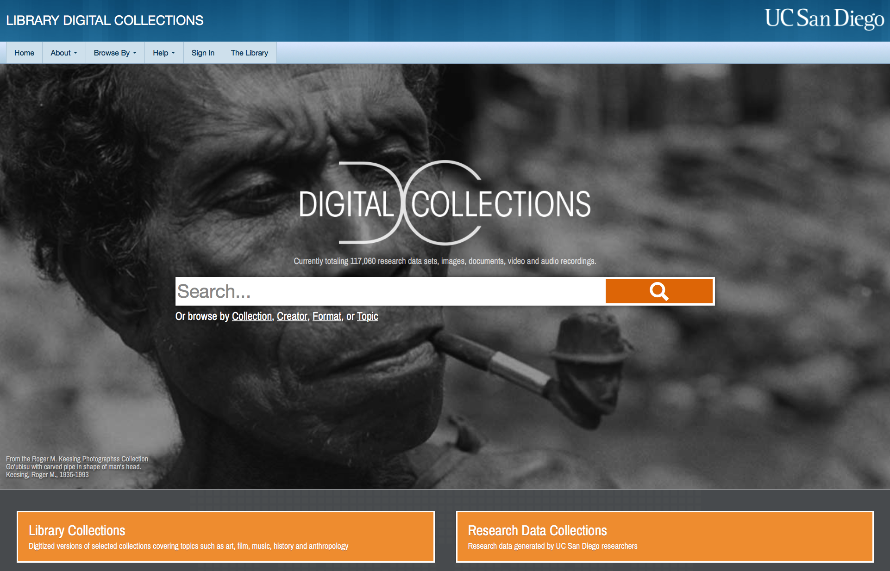
https://library.ucsd.edu/dc
Notes:
Based on what we learned from the pilots, we agreed to use our local repository as the core of our work. However, we required significant upgrades to the backend, frontend and metadata. All of these things together were a significant driver to new engagement with the hydra and fedora communities.
We also completely re-wrote our metadata specification, taking six months of closed-door work to come up with a single metadata model, to be used for all digital objects. (Much of this worked ended up forming the core of PCDM.) We also figured out how to filter out the key pieces of our existing metadata schema, which is huge and built for libraries, for research data in particular. We hired a technical analyst to lead our interactions with researchers, and we opened up our ingest spigot some, going from 5 collections over three years to about 1-2 collections per month.

Slide 8
https://library.ucsd.edu/dc
Notes:
Based on what we learned from the pilots, we agreed to use our local repository as the core of our work. However, we required significant upgrades to the backend, frontend and metadata. All of these things together were a significant driver to new engagement with the hydra and fedora communities.
We also completely re-wrote our metadata specification, taking six months of closed-door work to come up with a single metadata model, to be used for all digital objects. (Much of this worked ended up forming the core of PCDM.)
We hired a technical analyst to lead our interactions with researchers, and we opened up our ingest spigot some, going from 5 collections over three years to about 1-2 collections per month.

Slide 9
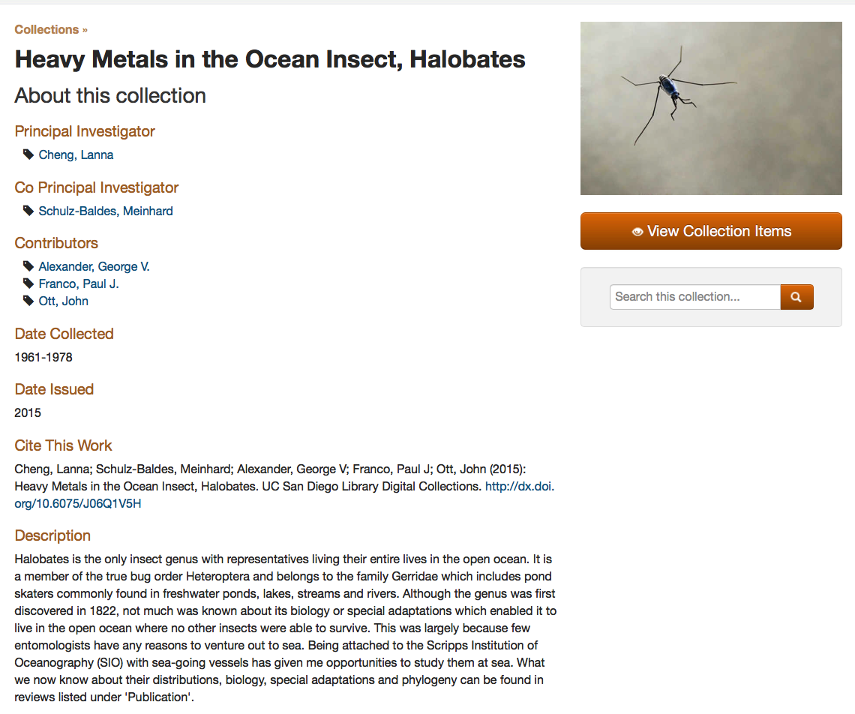
https://library.ucsd.edu/dc
Notes:
Based on what we learned from the pilots, we agreed to use our local repository as the core of our work. However, we required significant upgrades to the backend, frontend and metadata. All of these things together were a significant driver to new engagement with the hydra and fedora communities.
We also completely re-wrote our metadata specification, taking six months of closed-door work to come up with a single metadata model, to be used for all digital objects. (Much of this worked ended up forming the core of PCDM.)
We hired a technical analyst to lead our interactions with researchers, and we opened up our ingest spigot some, going from 5 collections over three years to about 1-2 collections per month.

Slide 10
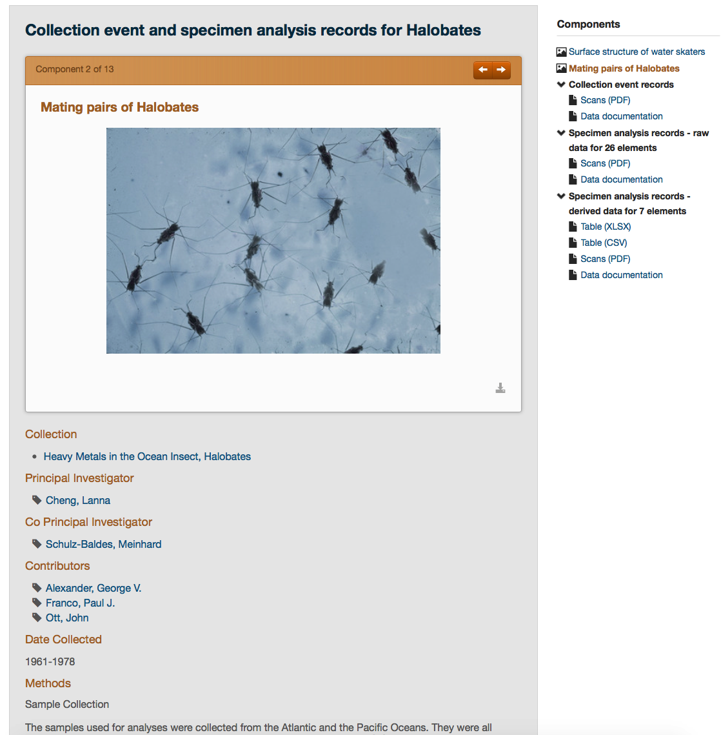
https://library.ucsd.edu/dc
Notes:
Based on what we learned from the pilots, we agreed to use our local repository as the core of our work. However, we required significant upgrades to the backend, frontend and metadata. All of these things together were a significant driver to new engagement with the hydra and fedora communities.
We also completely re-wrote our metadata specification, taking six months of closed-door work to come up with a single metadata model, to be used for all digital objects. (Much of this worked ended up forming the core of PCDM.)
We hired a technical analyst to lead our interactions with researchers, and we opened up our ingest spigot some, going from 5 collections over three years to about 1-2 collections per month.

Slide 11
What other ways do people want to access the content?
What other ways do people want to use the content?
Notes:
Based on what we learned from the pilots, we agreed to use our local repository as the core of our work. However, we required significant upgrades to the backend, frontend and metadata. All of these things together were a significant driver to new engagement with the hydra and fedora communities.
We also completely re-wrote our metadata specification, taking six months of closed-door work to come up with a single metadata model, to be used for all digital objects. (Much of this worked ended up forming the core of PCDM.)
We hired a technical analyst to lead our interactions with researchers, and we opened up our ingest spigot some, going from 5 collections over three years to about 1-2 collections per month.

Slide 12
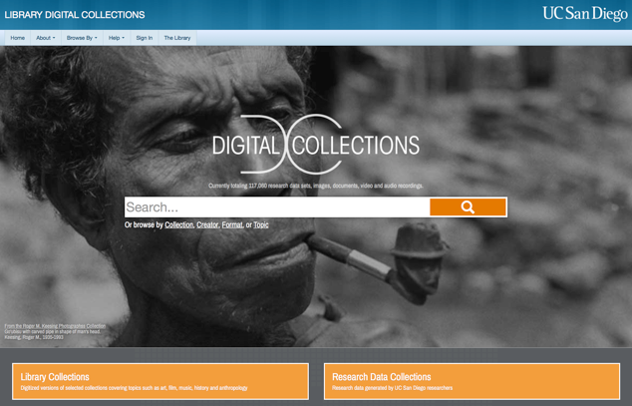
Gen 4
Notes:
How do we increase our ingest footprint while staying true to our core principles? Hire more staff (a challenge)? Hire students (a risk)? Or just keep the flow at the relatively slow rate?
Regardless, we are also embarking on a new direction - looking at new ways of expressing the content in our repository. We’ve signed a contract with figshare to do an 18 month pilot of Figshare for Institutions. We’re also looking at other tools, like Suave.

Slide 13
Gen 4 repository+
Gen 4
Notes:
How do we tie our repository to the larger campus ecosystem? How do we tie it to other applications and processes? We tested the waters with the SHARE database, creating TritonSHARE. And we’re early users of the DimensionsPlus application.
How do we tie it to other emerging networks - e.g. COAR, GO FAIR?

Slide 14
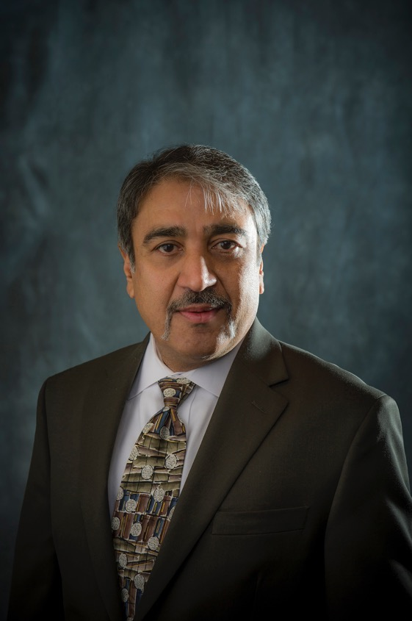
Chancellor
(Important person)
“Our university receives over $1 billion annually in research funding.
What are our research outputs??”

Slide 15
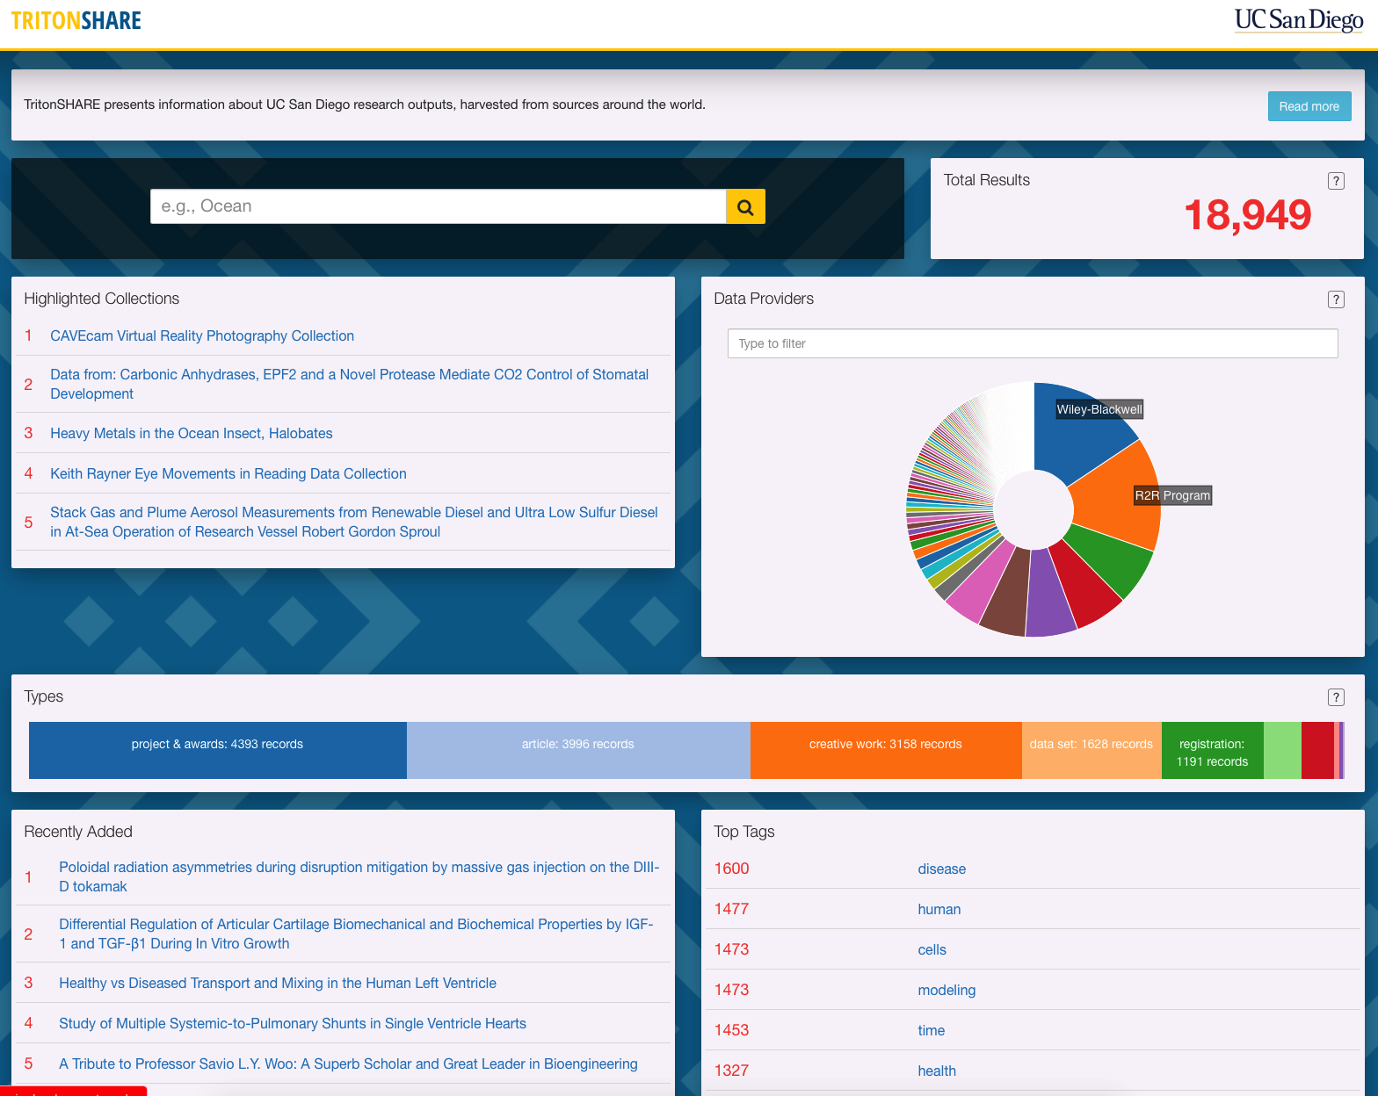
https://tritonshare.ucsd.edu
Notes:
Required but minimal metadata isn’t a good solution (UCSD naming example)
Humans not being in the loop is a challenge
People are really happy to dump and run

Slide 16
https://tritonshare.ucsd.edu
Notes:
Required but minimal metadata isn’t a good solution (UCSD naming example)
Humans not being in the loop is a challenge
People are really happy to dump and run

Slide 17
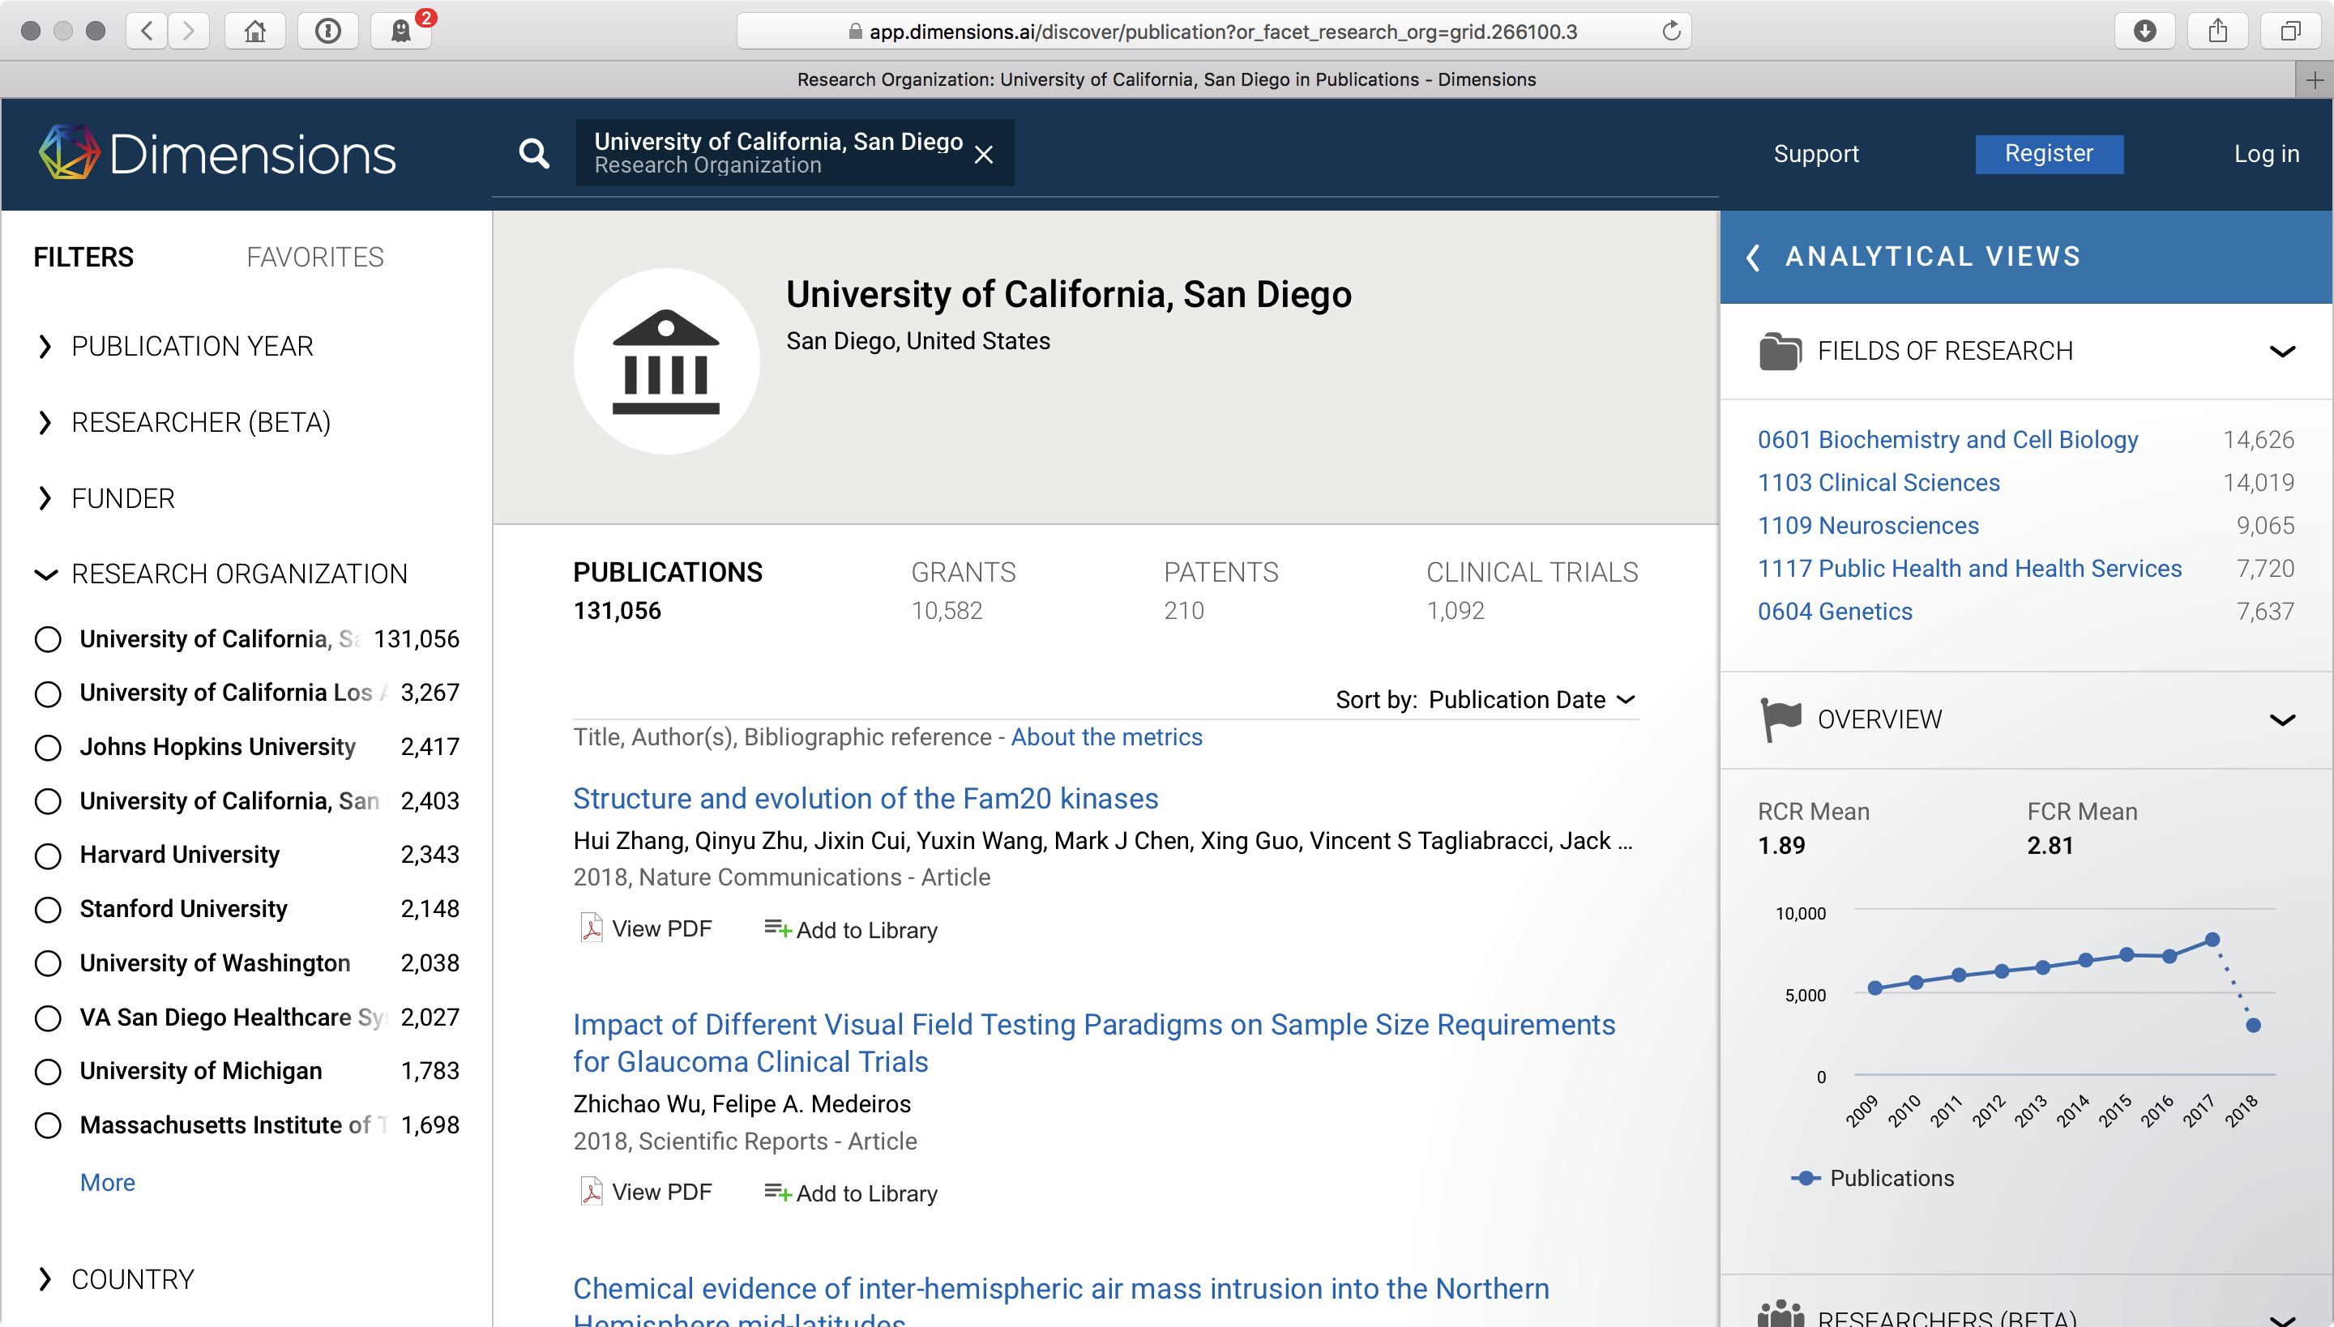
Gen 3 conclusions

Slide 18
Gen 4 repository+
Gen 4
Notes:
How do we tie our repository to the larger campus ecosystem? How do we tie it to other applications and processes? We tested the waters with the SHARE database, creating TritonSHARE. And we’re early users of the DimensionsPlus application.
How do we tie it to other emerging networks - e.g. COAR, GO FAIR?

Slide 19
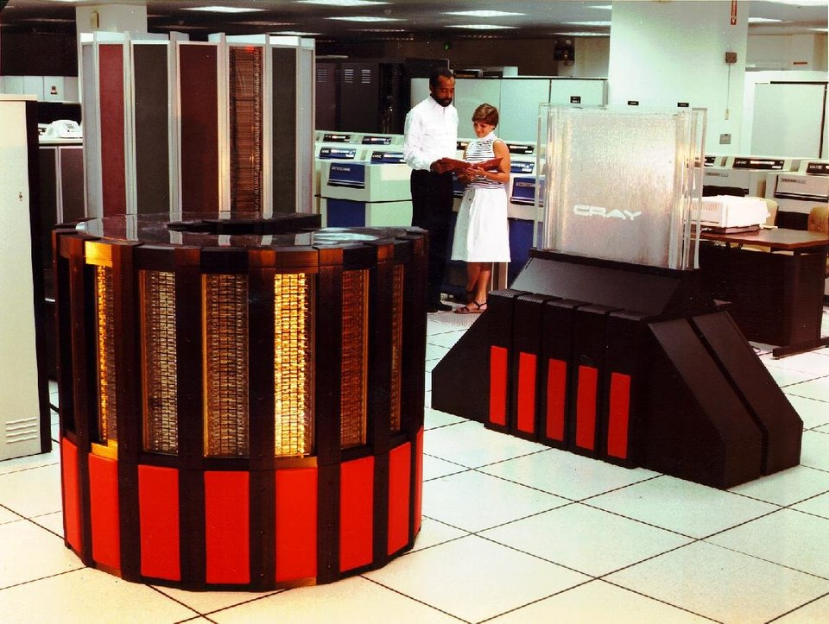
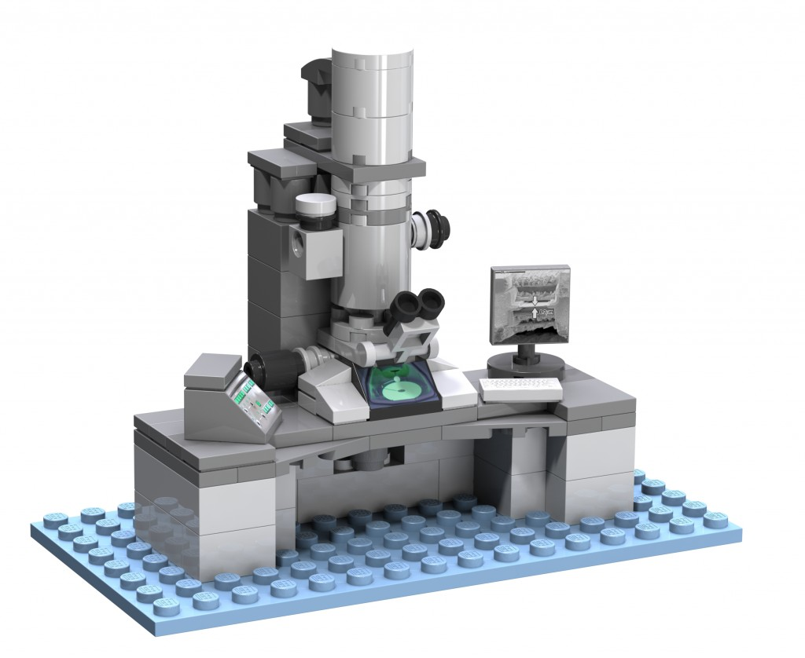
Gen 4 repository+
Gen 4
Notes:
How do we tie our repository to the larger campus ecosystem? How do we tie it to other applications and processes? We tested the waters with the SHARE database, creating TritonSHARE. And we’re early users of the DimensionsPlus application.
How do we tie it to other emerging networks - e.g. COAR, GO FAIR?

Slide 20
Gen 3 conclusions
So… where are we today?
We’ve built a successful curation program that meets the needs of a range of campus users.
Generally speaking the decisions we made at the beginning of the program have been validated, and we have a solid base to build on.

Slide 21
So… where are we today?
We have a small, well-oiled machine.
We are viewed positively on campus.
We’ve hit the upper limit of current staffing.
Our big challenge is meeting demand and looking at emerging needs.
The landscape and, thus the value proposition, is changing

Slide 22
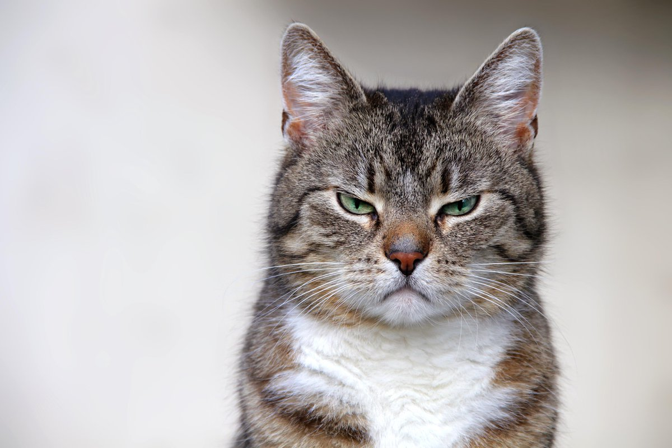
Some thoughts….
From: Black Metal Cats

Slide 23
What have we learned??
How are we going to tie together the growing network of disparate tools, on and off campus?
How do we define the emerging stakeholders?

Slide 24
What have we learned??
Our experience with TritonSHARE showed us that even when repositories have minimal metadata standards, if they aren’t vetted, it’s a mess. And saying “machine learning will fix it” is still talking about unicorns and fairies.

Slide 25
What have we learned??
We still have a tension between discoverability (for the end user) and ease of use (for the depositor).
What’s the point of saving anything if only the owner knows it exists? Or is that good enough? Most researchers seem to think so. If that’s the case, what is the role of a library/data management unit? Are we just getting in the way?

Slide 26
What have we learned??
What are the future needs?
We have to better understand how data is reused, and to what extent the library's mission is to generate reuse value vs to provide immediate training, storage, and sharing needs of researchers.

Slide 27
What have we learned??
How do we even begin to evaluate the effectiveness of the work we’ve done?

Slide 28
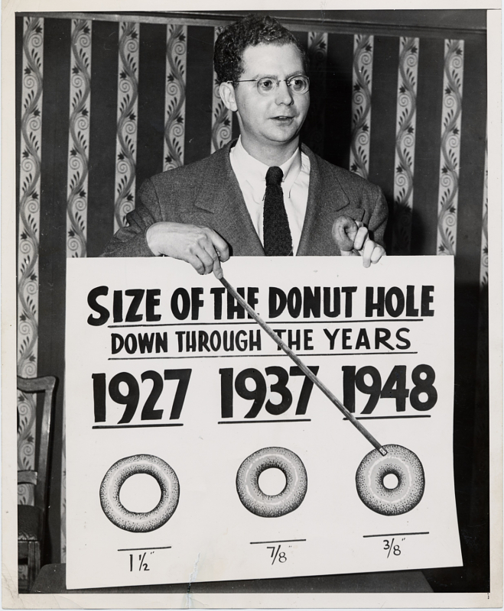
Thank you!
David Minor
dminor@ucsd.edu
From the Smithsonian’s Sally L. Steinberg Collection of Doughnut Ephemera

