Slide 1
Crafting true stories
Interpreting Australian journalists’ descriptions of their nonfiction book writing
Varunika Ruwanpura-The university of Adelaide

Slide 2
Scope of Study
Masters research project. My professional background is in journalism.
I wanted to study how and why Australian journalists write nonfiction books.
Case studies of four Australian journalists writing nonfiction were undertaken.
Interviewed each journalist twice over a two-year period in 2017/2018.
Read select nonfiction books authored by each journalist prior to interviews so that I could question them in detail about their nonfiction writing process.
Undertook wider contextual research on their journalism experience before interviews to identify connections between their journalism practice and their nonfiction writing practice.
Then did a narrative analysis of these interviews to interpret each journalists’ individual nonfiction writing style.

Slide 3
JourNalist Case studies
Two senior journalists:
Christopher Kremmer – academic and former ABC South Asia correspondent 1990-2000, Sydney Morning Herald and The Age. He has authored three nonfiction books, The Carpet Wars (2002) on Afghanistan, The Bamboo Palace (2003) on Laos & Inhaling the Mahatma (2006) on India.
Annabel Crabb – ABC’s chief online political reporter, ABC TV journalist and Sydney Morning Herald weekend columnist. She too has authored three nonfiction books, Losing It: The Inside Story of the Labor Party in Opposition (2005), Rise of the Ruddbot: Observations from the Gallery (2010) & The Wife Drought (2014).

Slide 4
JourNalist Case studies
Two younger journalists:
Ben Stubbs – academic, freelance journalist and travel writer for The Canberra Times, Sydney Morning Herald, Australian Geographic, The Guardian (Australia) & The New York Times (Australia). He has authored two nonfiction books, Ticket To Paradise (2012) & After Dark: A Nocturnal Exploration Of Madrid (2016) and is currently writing a third book on South Australia.
Shannon Harvey – independent investigative journalist and documentary filmmaker. Formerly a broadcast and radio journalist with the ABC and Fairfax. She has authored one nonfiction book, The Whole Health Life (2016) and is currently writing a second investigative book on the global wellness industry.

Slide 5
The Journalists

Slide 6
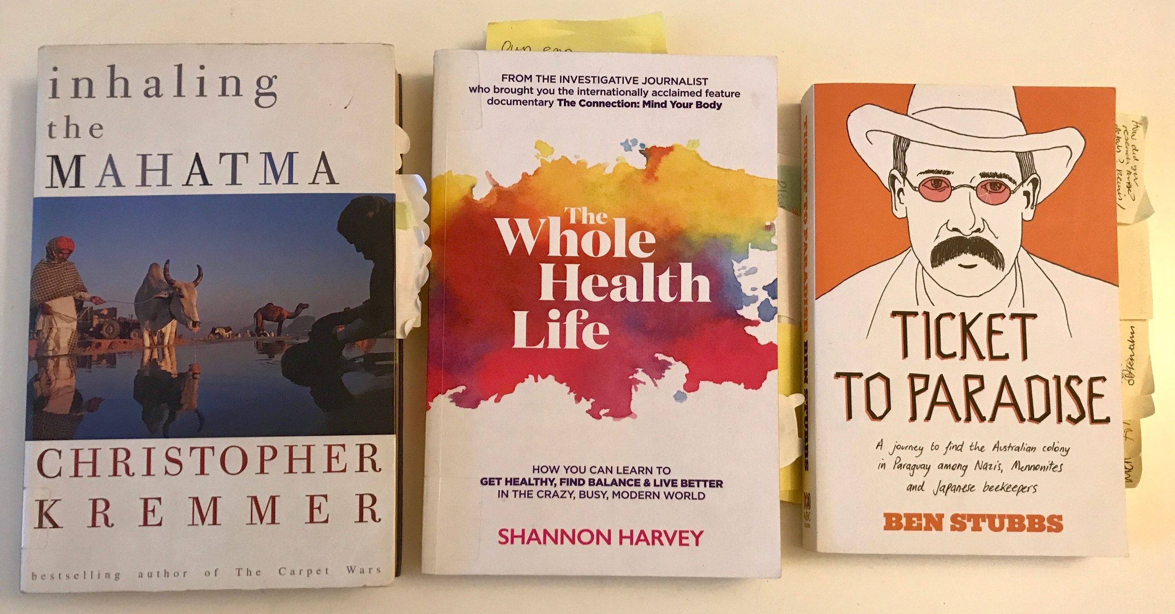
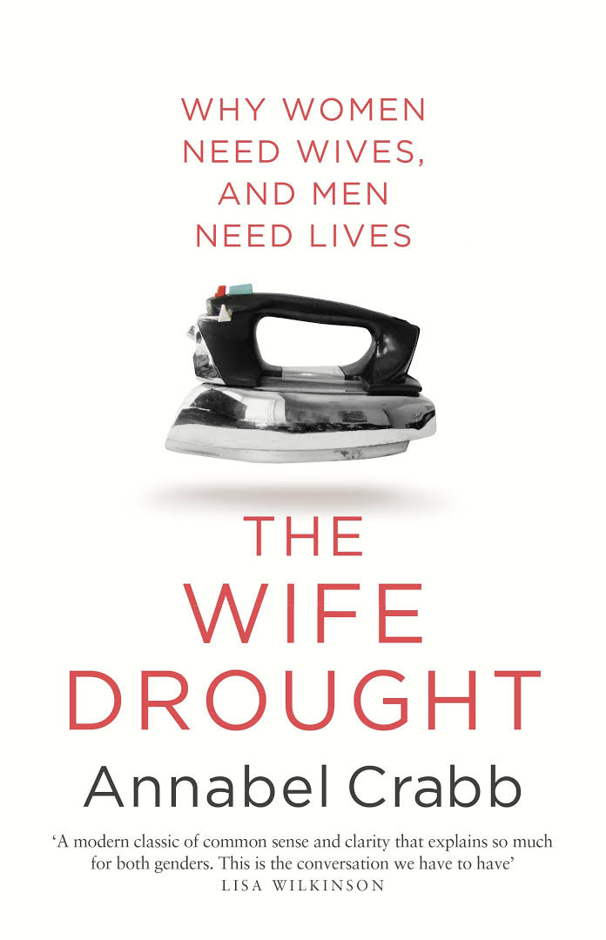
The Nonfiction books

Slide 7
Key Literature & Theories
Looked at studies on literary journalism and nonfiction writing from the United States, United Kingdom, Europe and Australia. The New Journalism movement of the 1960s & 1970s set a precedent for most of the book-length journalism that has followed.
Also looked at recent studies on slow journalism undertaken by Megan Le Masurier (Australia) and Eric Neveu (Europe).
Started with the one pre-structuralist theory on writing and literature and then incorporated three other specific theories from Journalism and Communication Studies that supported my research.
Sartre (1947) essays, What is Literature—“writing is a certain way of wanting freedom” where the author is solely responsible for texts they create. “One is not a writer for having chosen to say certain things but for having chosen to say them in a certain way.”
Geiber (1964)—creation of a news narrative is an intensely personal experience for reporters.
Sims (1984)—five characteristics of literary journalism as immersion, structure, accuracy, voice and [author] responsibility.
Eason (1984)—the two types of literary journalism as ethnographic realism and cultural phenomenology.
Notes:
Particularly looked at studies on literary journalism undertaken by Tom Wolfe, Chris Anderson, Barbara Lounsberry, Kevin Kerrane and Ben Yagoda, John Hartsock, Norman Sims, Richard Boynton and Mark Kramer in the U.S.A.
John Bak, Richard Keeble and John Tulloch in the U.K. and Europe.
Matthew Ricketson, Sue Joseph, Christopher Kremmer, and Carolyn Rickett in Australia.

Slide 8
Methods: Research qs.
A case study methodology concentrating on four journalist case studies. Focusing on interpreting a smaller number of case studies enables a richer analysis of each case (Yin 2018).
Method: a constructivist narrative analysis of eight interviews conducted with the selected journalists. Constructivist N.A. uses semi-structured interviews (open-ended interpretation) and recognises that power is shared between the researcher and the participant (Clandinin 2007).
The narrative being analysed is the journalists’ verbal descriptions of their nonfiction writing practice.
How does journalism experience and their reading interests influence the participants’ nonfiction writing?
Why do some journalists choose to write nonfiction books?
What story crafting techniques do they employ?
How does nonfiction writing enrich their mainstream work and contribute to Australian literary journalism?
Notes:
“If we find a particular individual an intriguing person worth investigating and writing about in depth, then case study methodology and compatible methods are likely the most suitable for the enterprise” (Saldana 2015).
A categorical-content narrative analysis (Lieblich et al 1998) of interview transcripts based on framed research questions.

Slide 9
Influence of journalism experience on their nonfiction writing
Christopher Kremmer | Annabel Crabb | Ben Stubbs | Shannon Harvey
Provided the base, access to sources and information for all his nonfiction books. | Provided the base, access to sources and information for all her nonfiction books. | Provided the base, access to sources and information for his first nonfiction book. | Provided the base, access to sources and information for her nonfiction books.
Thinks of stories verbally and artistically, “like fashioning a lump of clay”. | Thinks of stories both visually and verbally given her combined broadcast, print and online journalism experience. | Thinks of stories dramatically/climax-driven due to his screen writing experience. | Thinks of stories visually first as a documentary filmmaker.
Range of skills such as observational journalism, note taking and research skills. A tension between his hard news writing and literary writing. “A kind of firewall”. | Range of skills such as observational journalism, note taking and research skills. No tension between news writing and nonfiction writing as primarily an opinion news writer. | Range of skills such as observational journalism, note taking and research skills. No tension between news writing and nonfiction writing as he writes feature/travel news. | Range of skills such as observational journalism, note taking and research skills. No tension between news writing and nonfiction writing now. Writes health news features.
Notes:
Following are my current observations from my N.A of these interviews: firstly, I spoke to them about their journalism experience and how it relates to their nonfiction writing

Slide 10
Influence of Reading interests on their nonfiction writing
Christopher Kremmer | Annabel Crabb | Ben Stubbs | Shannon Harvey
Classics, new journalism and travel writers | Classics, contemporary long form journalism and fiction writers | Literary & Travel writers | Contemporary health, science and science fiction writers
Overall influencers: Russian greats such as Tolstoy and Chekov. Need to make a reader actively engage with a text. Inspired by Hunter S Thompson’s dedication to his writing craft. | Overall influencers: British political sketch writers like Matthew Parris & Caitlin Moran. David Marr from Australia. Also likes Russian classics and Virginia Woolf-feminism. | Overall influencers: Pico Iyer, William Dalrymple, Gabriel Garcia Marquez, & Graham Greene. | Overall influencers: Reads contemporary health, science and lifestyle nonfiction by authors like Johann Hari, Tim Parks and Michael Pollan.
Vikram Seth’s book From Heaven Lake was as catalyst for his first book. | Matthew Parris’ political sketch writing. | Garcia Marquez & Ted Conover for Ticket To Paradise. Dickens for After Dark. | U.K. writer Ruby Wax because she writes about her personal battles with mental health.
Notes:
Similar to Mark Kramer being inspired by reading George Orwell’s Down & Out in Paris (Sims 1984). Genre of books they choose to read sets a precedent for the kind of books they choose to write.

Slide 11
Reasons for writing nonfiction
Christopher Kremmer | Annabel Crabb | Ben Stubbs | Shannon Harvey
News writing was insufficient to convey all the nuances of his experiences in India, Laos & Afghanistan. | Book writing allows her to explore news themes that she wants to explore further in a narrative form. | Started writing nonfiction when he got bored with the restrictive format/word count limitations of news features. | Most personal motivation of all four journalists. Inspired to investigate & write the truth about health and wellbeing after suffering from lupus.
“…it was just this classic journalistic grim sort of portrait…there was nothing that really mattered” (Kremmer 2017) | “I wrote it because I’d been thinking and writing about and living a lot of the issues in the book.” (Crabb 2017) | “I’m drawn to nonfiction because I find true stories and real people’s lives so much more fascinating than fiction.” (Stubbs 2017) | “I love finding things out. If I was put on this Earth to ask one question, it would be why, why is it so?” (Harvey 2017)
His books adopt close personal narrative angles to humanise the story. He wrote all three books in close succession. | Got the idea for The Wife Drought from reader responses to a Sunday column she wrote for The Sydney Morning Herald in 2011. | His books often include historical anecdotes because he is interested in how much history shapes the stories people tell. | Continues to write nonfiction books investigating the science of health and wellbeing.

Slide 12
Story crafting techniques
Christopher Kremmer | Annabel Crabb | Ben Stubbs | Shannon Harvey
Immersion: Spent years in each of the countries he wrote about in close company with locals. | Immersion: Was immersed in politics, workplace legislation and women’s rights already. | Immersion: Spent months living in the New Australian colony in Paraguay. Libraries and archives. | Immersion: Referenced over 770 scientific papers and interviewed numerous scientists and medical experts for her book.
Structure: “…structures are like nightmares in these books. How do you tie it together in a narrative when it’s so disparate?” (Kremmer 2017) | Structure: Literally “sketched out the structure on a napkin” (Crabb 2017) in a café one day. | Structure: “That was the most challenging thing…I think it works well, how I’ve spliced my experience with the historical experience” (Stubbs 2017). | Structure: “You’ve got to have a cohesive structure but it doesn’t necessarily have to come to a climatic conclusion” (Harvey 2017).
Voice: Literary in style, often rhythmic and highly creative. | Voice: Sharp, witty, satirical, investigative. | Voice: Rich in historical context, literary in style. | Voice: Gentle, analytical and investigative.
Notes:
Examined their story crafting techniques against Sims’ five characteristics of literary journalism.

Slide 13
Story crafting techniques
Christopher Kremmer | Annabel Crabb | Ben Stubbs | Shannon Harvey
Accuracy: historical information on India, facts about Indian political system and society. | Accuracy: Australian workplace legislation, marriage laws, media law, and historical information. | Accuracy: historical information, facts about South America, Paraguay and Australia. | Accuracy: mostly scientific and medical information, and some historical facts.
Responsibility: to family and other sources in India. | Responsibility: to journalists, politicians and members of public used as sources. | Responsibility: to sources in the New Australian colony. | Responsibility: to sources of information and readers who may act on her advice.
Notes:
According to Sims’ five characteristics of literary journalism, all four books qualify as literary journalism but at different levels of creativity.

Slide 14
How nonfiction writing enriches their mainstream work and australian literary journalism
Christopher Kremmer | Annabel Crabb | Ben Stubbs | Shannon Harvey
Doesn’t directly influence his present work as an academic. But his nonfiction writing experience may influence how he now analyses others’ nonfiction. | Gets ideas for her news reporting from her book writing and vice versa. | A scholar of nonfiction writing as well as a nonfiction writer. So his writing practice and scholarship complement each other. | Gets ideas for her news reporting from her book writing and vice versa.
Travel nonfiction and current affairs. An Australian journalist’s literary narratives on South Asia. | Current affairs and politics. Contemporary Australian literary journalism which is closely tied to the national political and social landscape. | Travel nonfiction on Paraguay, Madrid and South Australia. Pushing the boundaries of literary journalism and travel writing further with each new book. | Health nonfiction is less explored as a genre of literary journalism. So this is a new kind of contribution.

Slide 15
Contemporary Relevance of journalists writing nonfiction
A pluralistic writing practice that extends public discourse on significant news topics to a longer narrative format.
Contributes to slow journalism and the growing body of Australian literary journalism.
Validates this conference’s theme of multiple realities in present-day media communication.
Still relevant because of nonfiction’s enduring narrative structures stemming from the historical journalistic sketch (Sims 2007) and the distinct narrative voice of each author.
Practically, journalists writing nonfiction gain enhanced credibility in the eyes of news organisations and new editors (Matt Cunningham, Sky News Darwin Bureau Chief).
Thank you to my supervisors: Kathryn Bowd, Kim Barbour & Jillian Schedneck.
Thank you for listening ☺.

