Slide 1
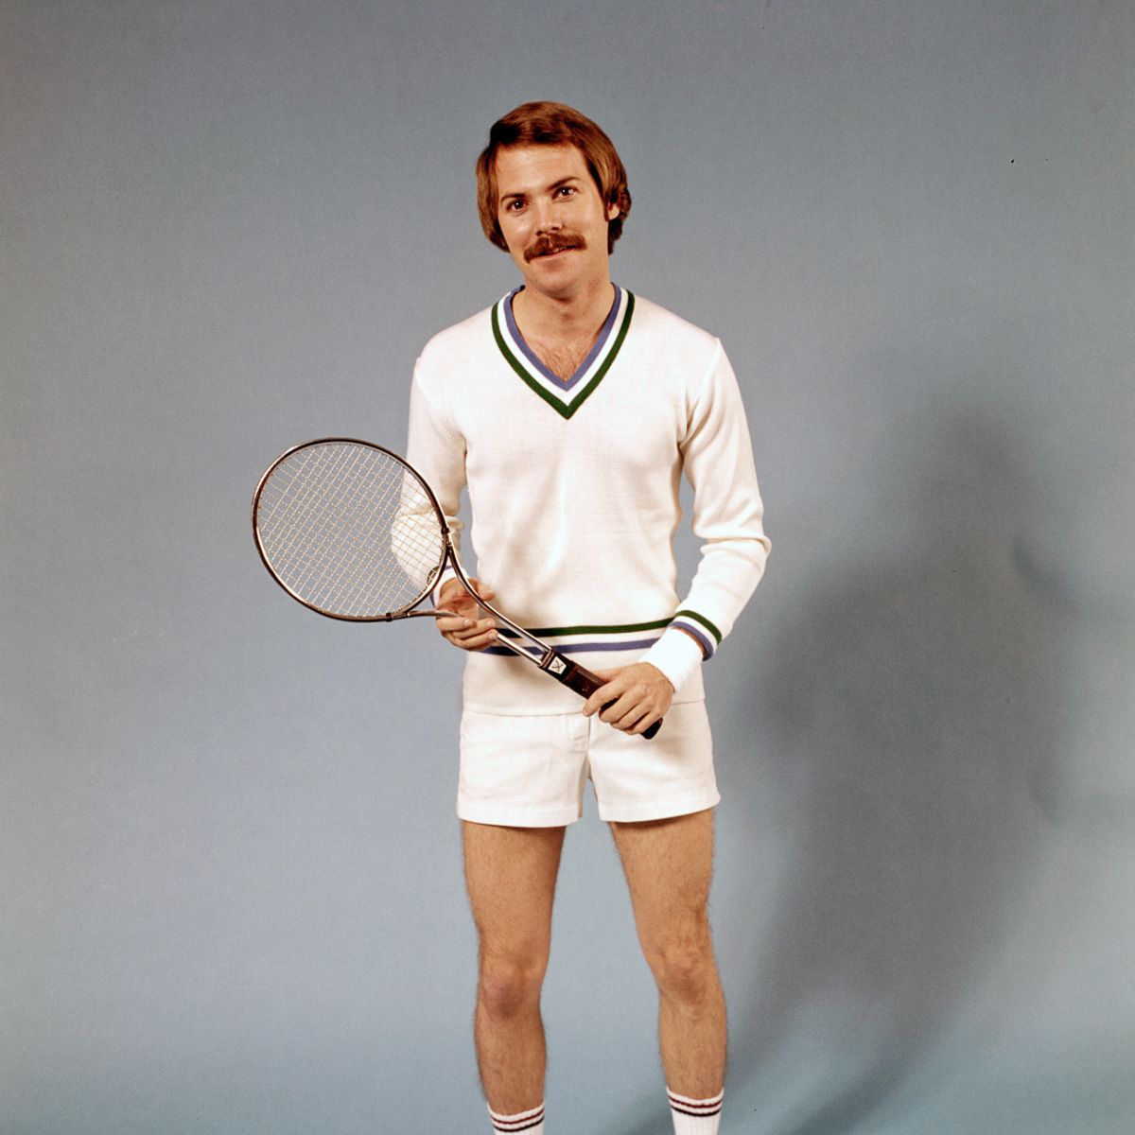
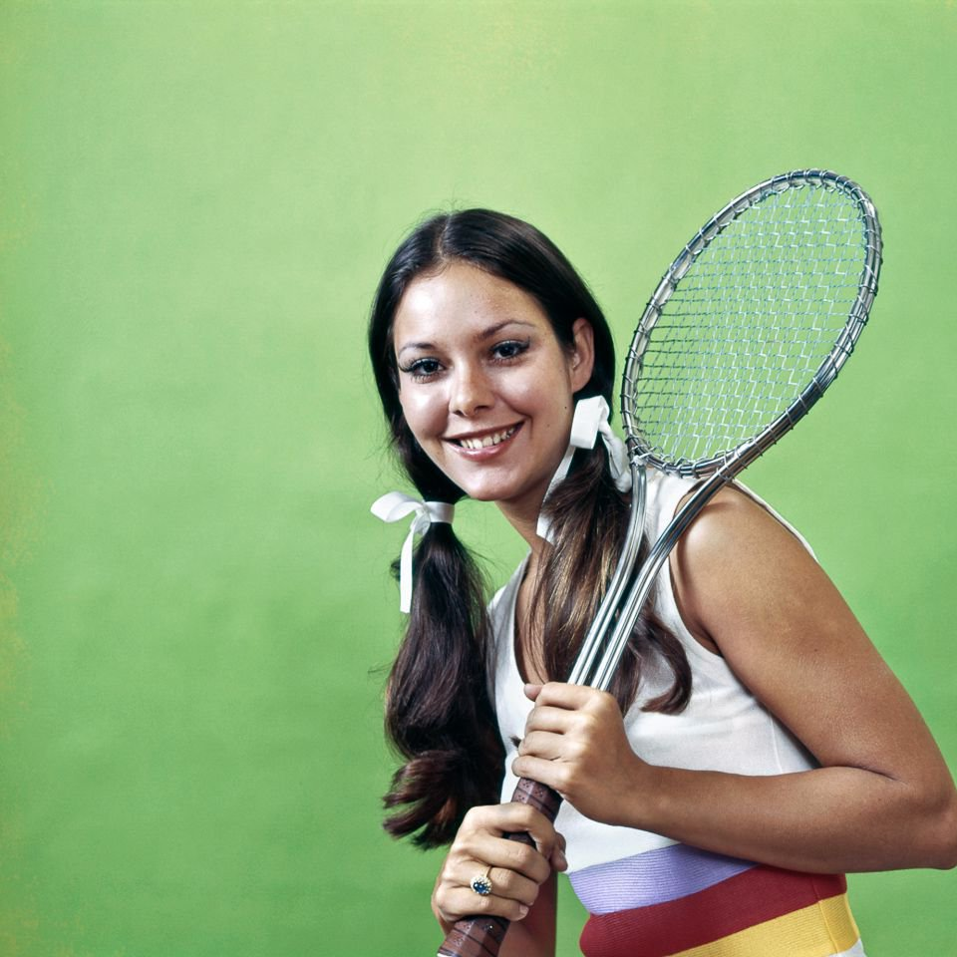
David Minor Director, Research Data Curation Program UC San Diego Library
David Minor Director, Research Data Curation Program UC San Diego Library
A figshare pilot
With the UC San Diego Library

Slide 2
Our repository

Slide 3
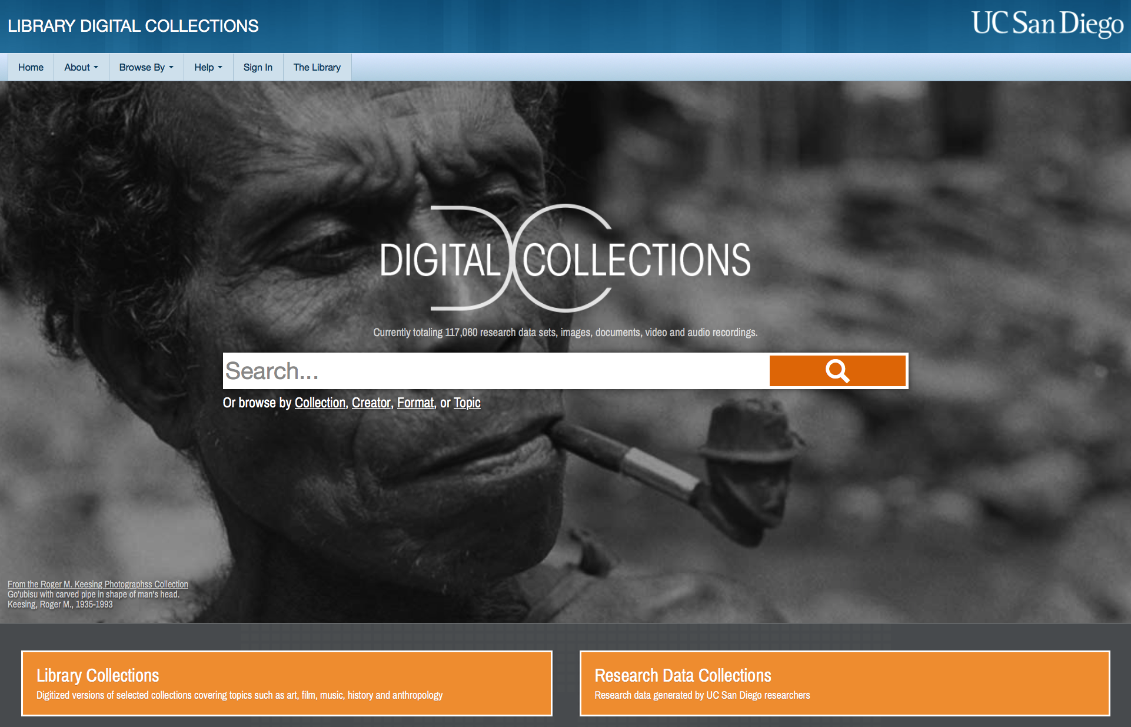
https://library.ucsd.edu/dc

Slide 4
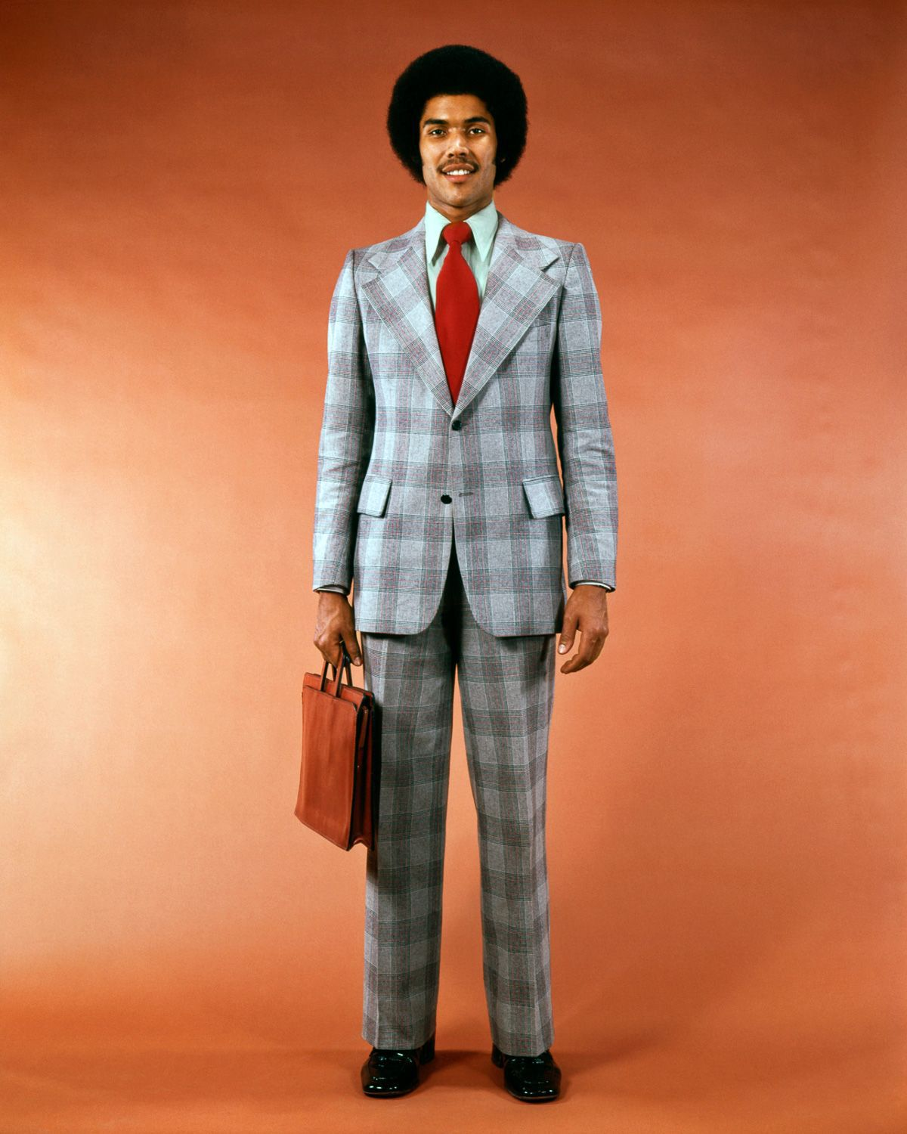
History: content

Slide 5
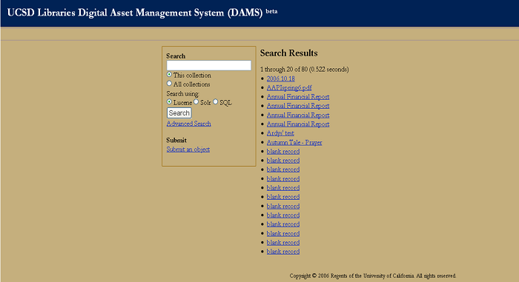
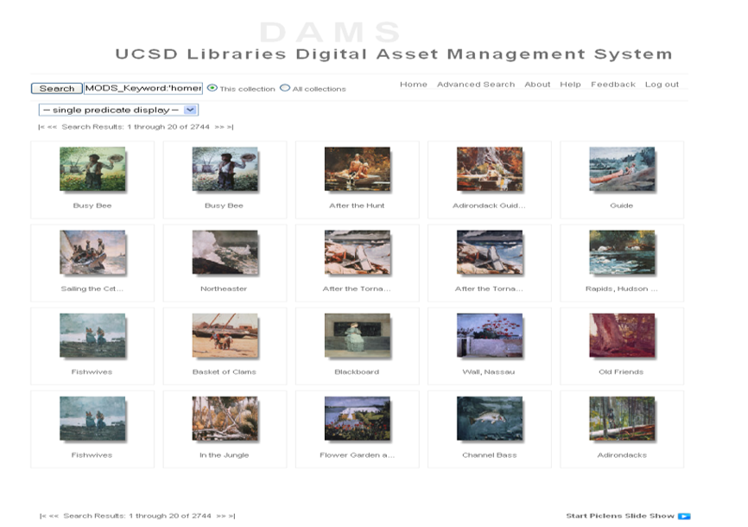
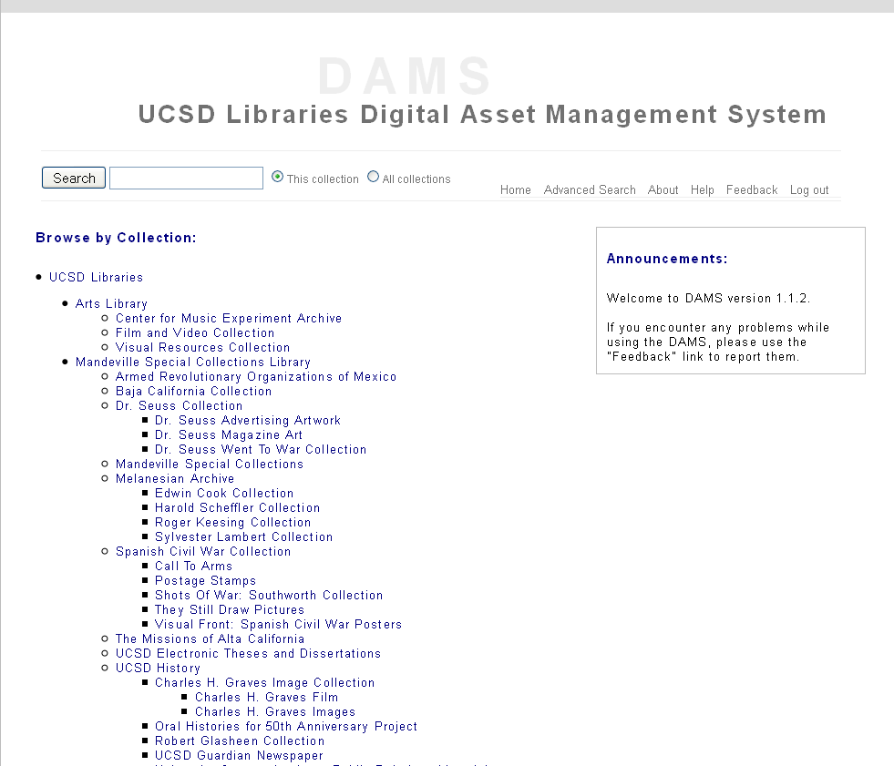
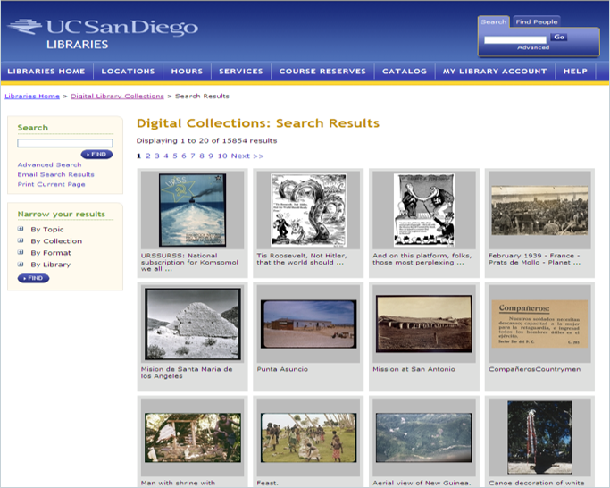
Notes:
Preservation environment
Working with ArtStor – detailed metadata
Special collections/archives focus

Slide 6
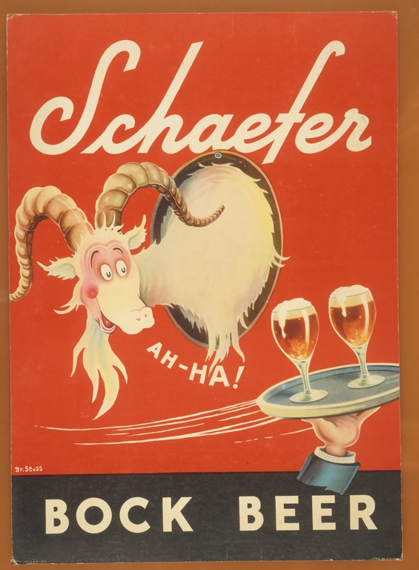
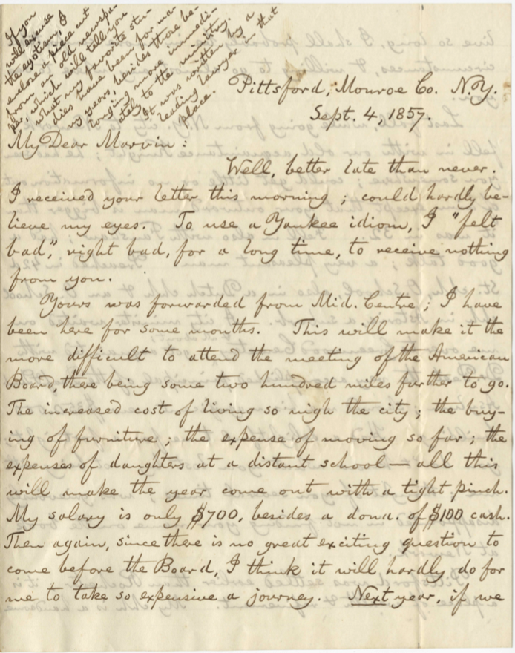
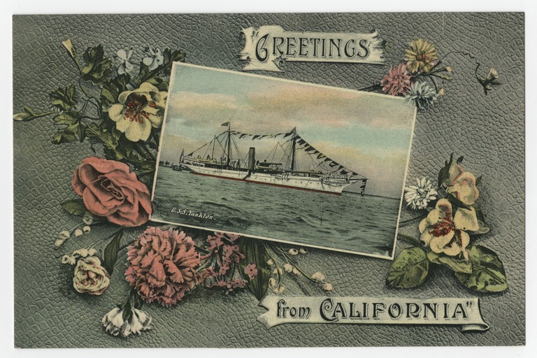
Notes:
Preservation environment
Working with ArtStor – detailed metadata
Special collections/archives focus

Slide 7
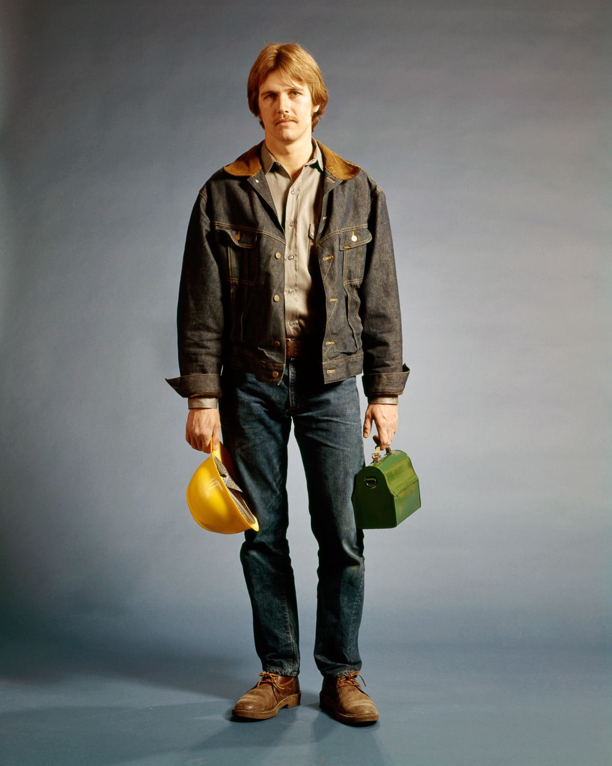
History: technology

Slide 8
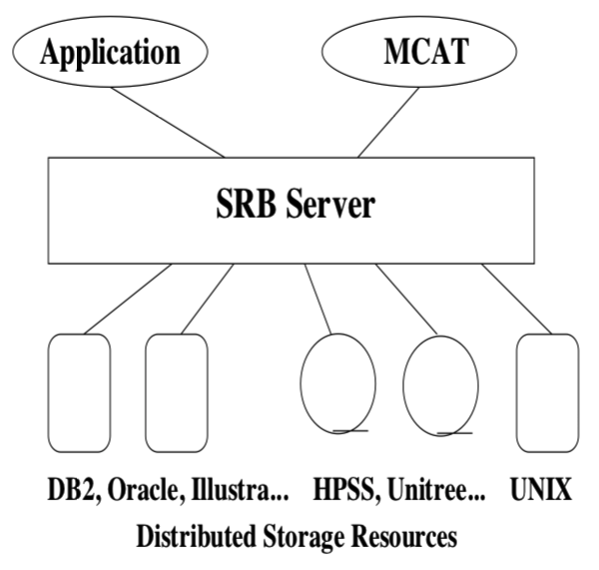
doi.org/10.1145/1925805.1925816

Slide 9
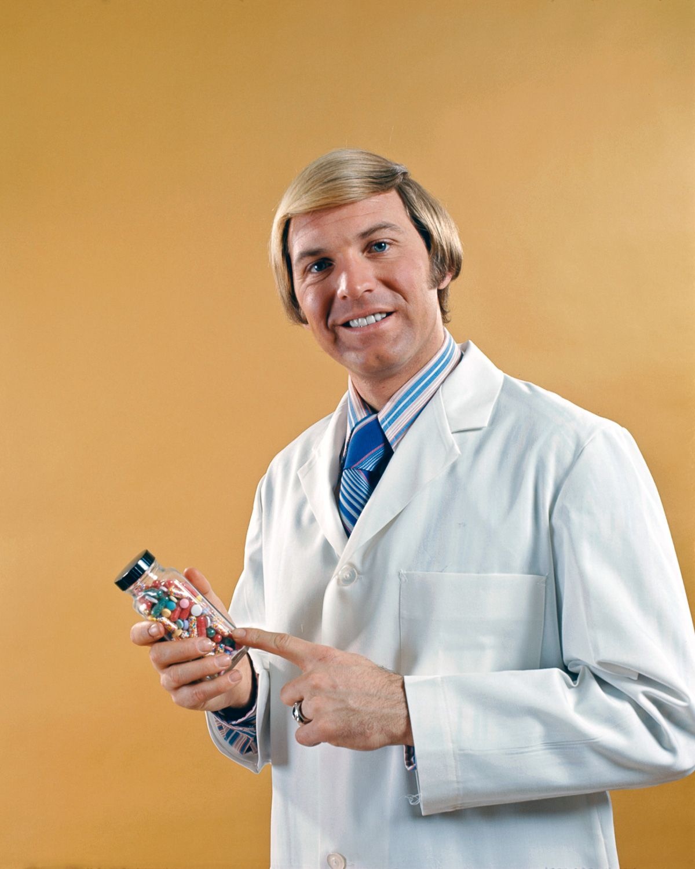
Research data

Slide 10
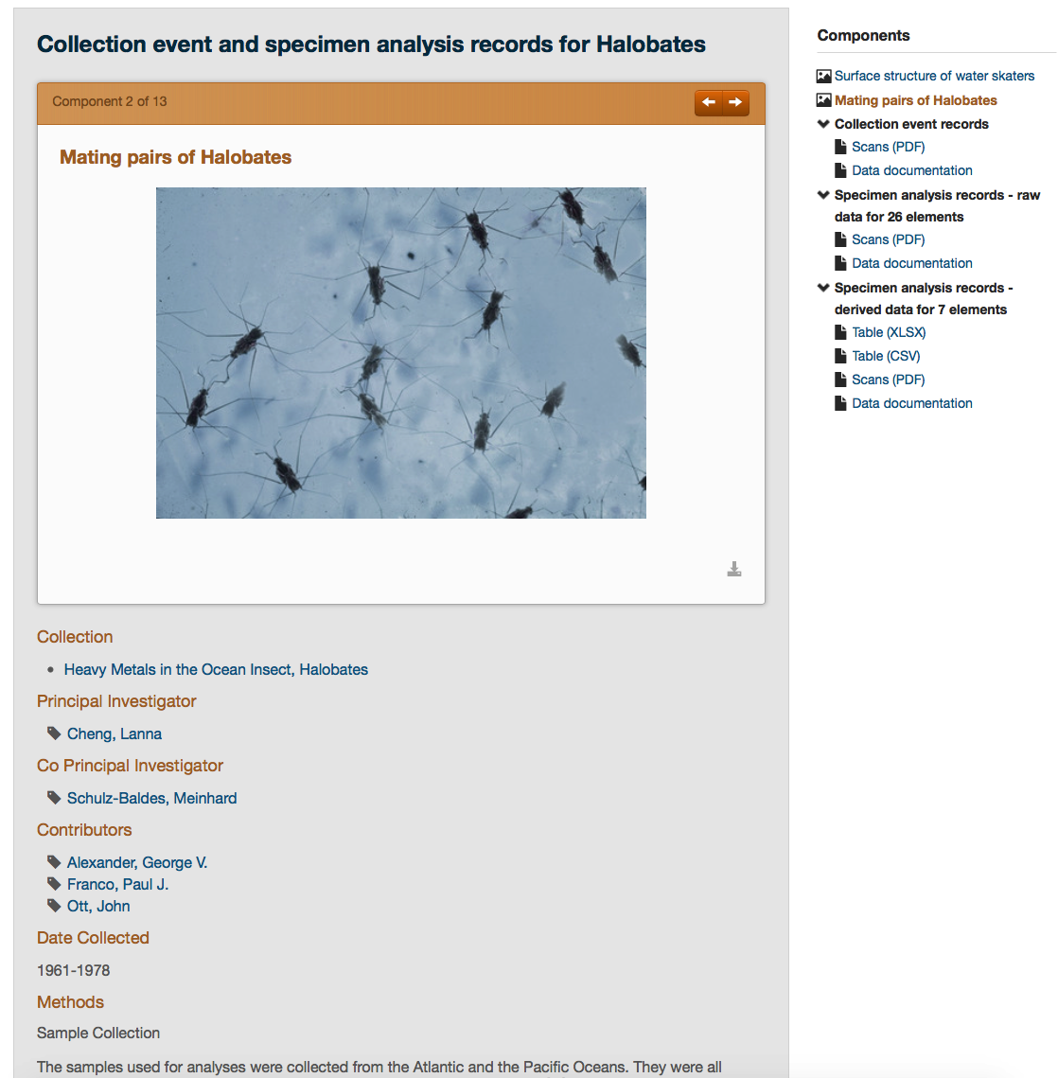
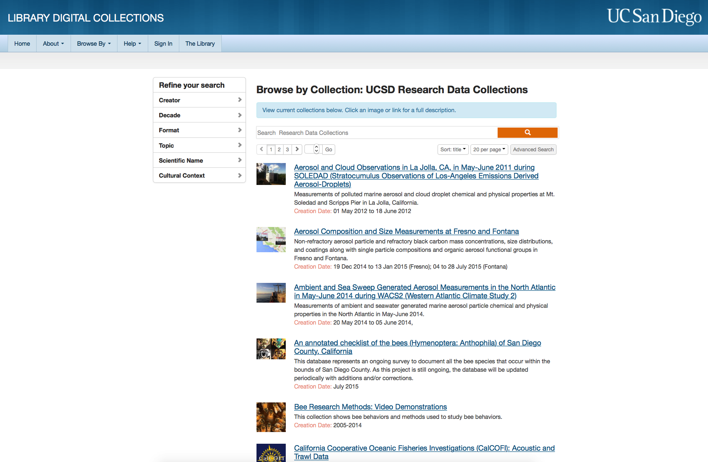
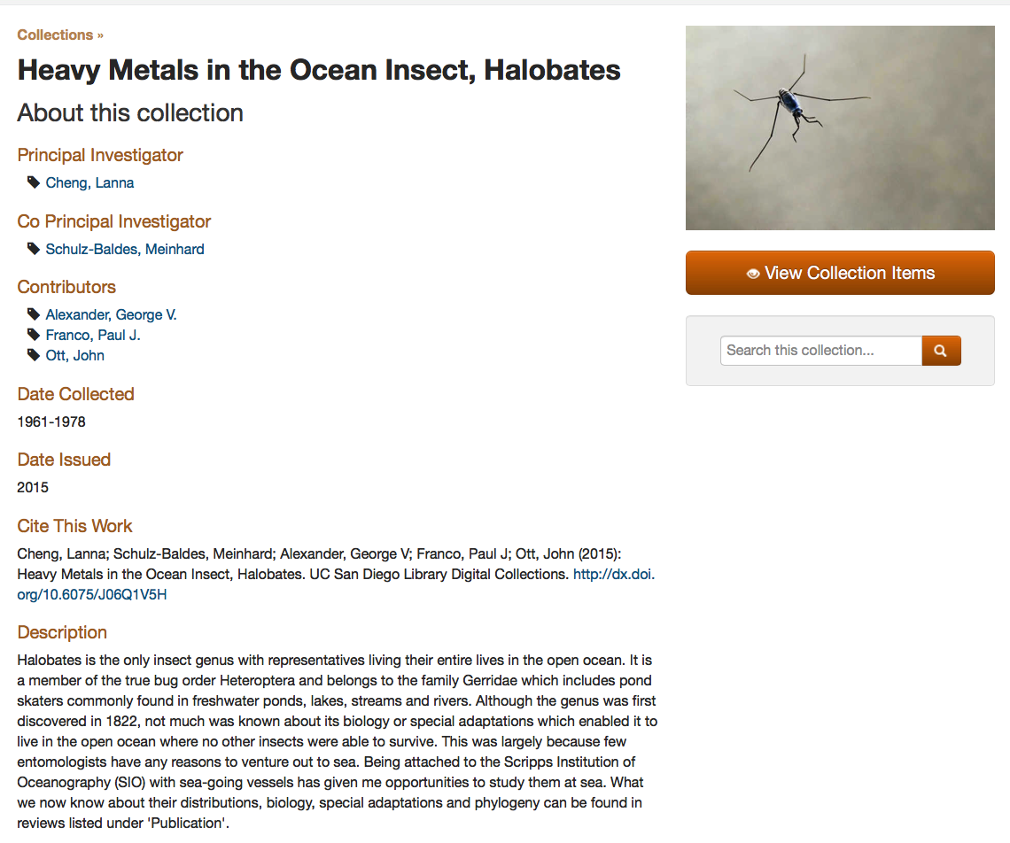

Slide 11
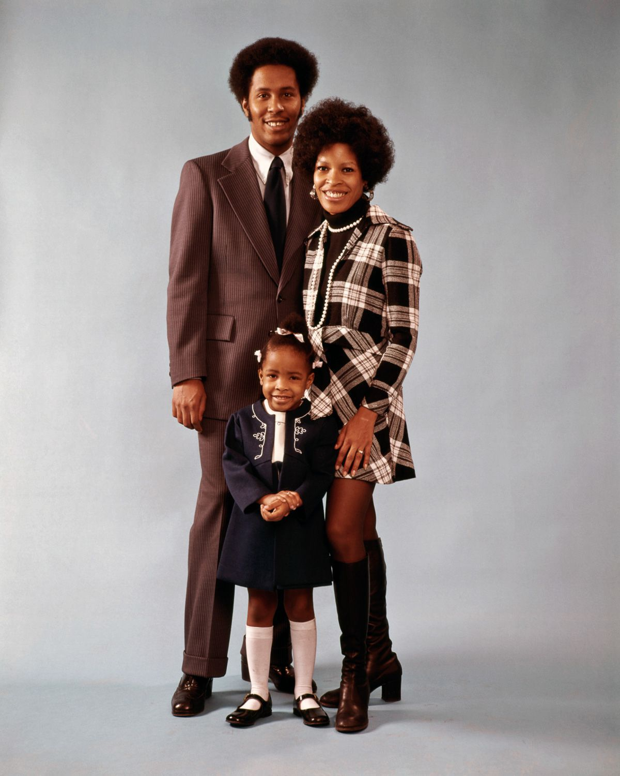
Current research data holdings

Slide 12
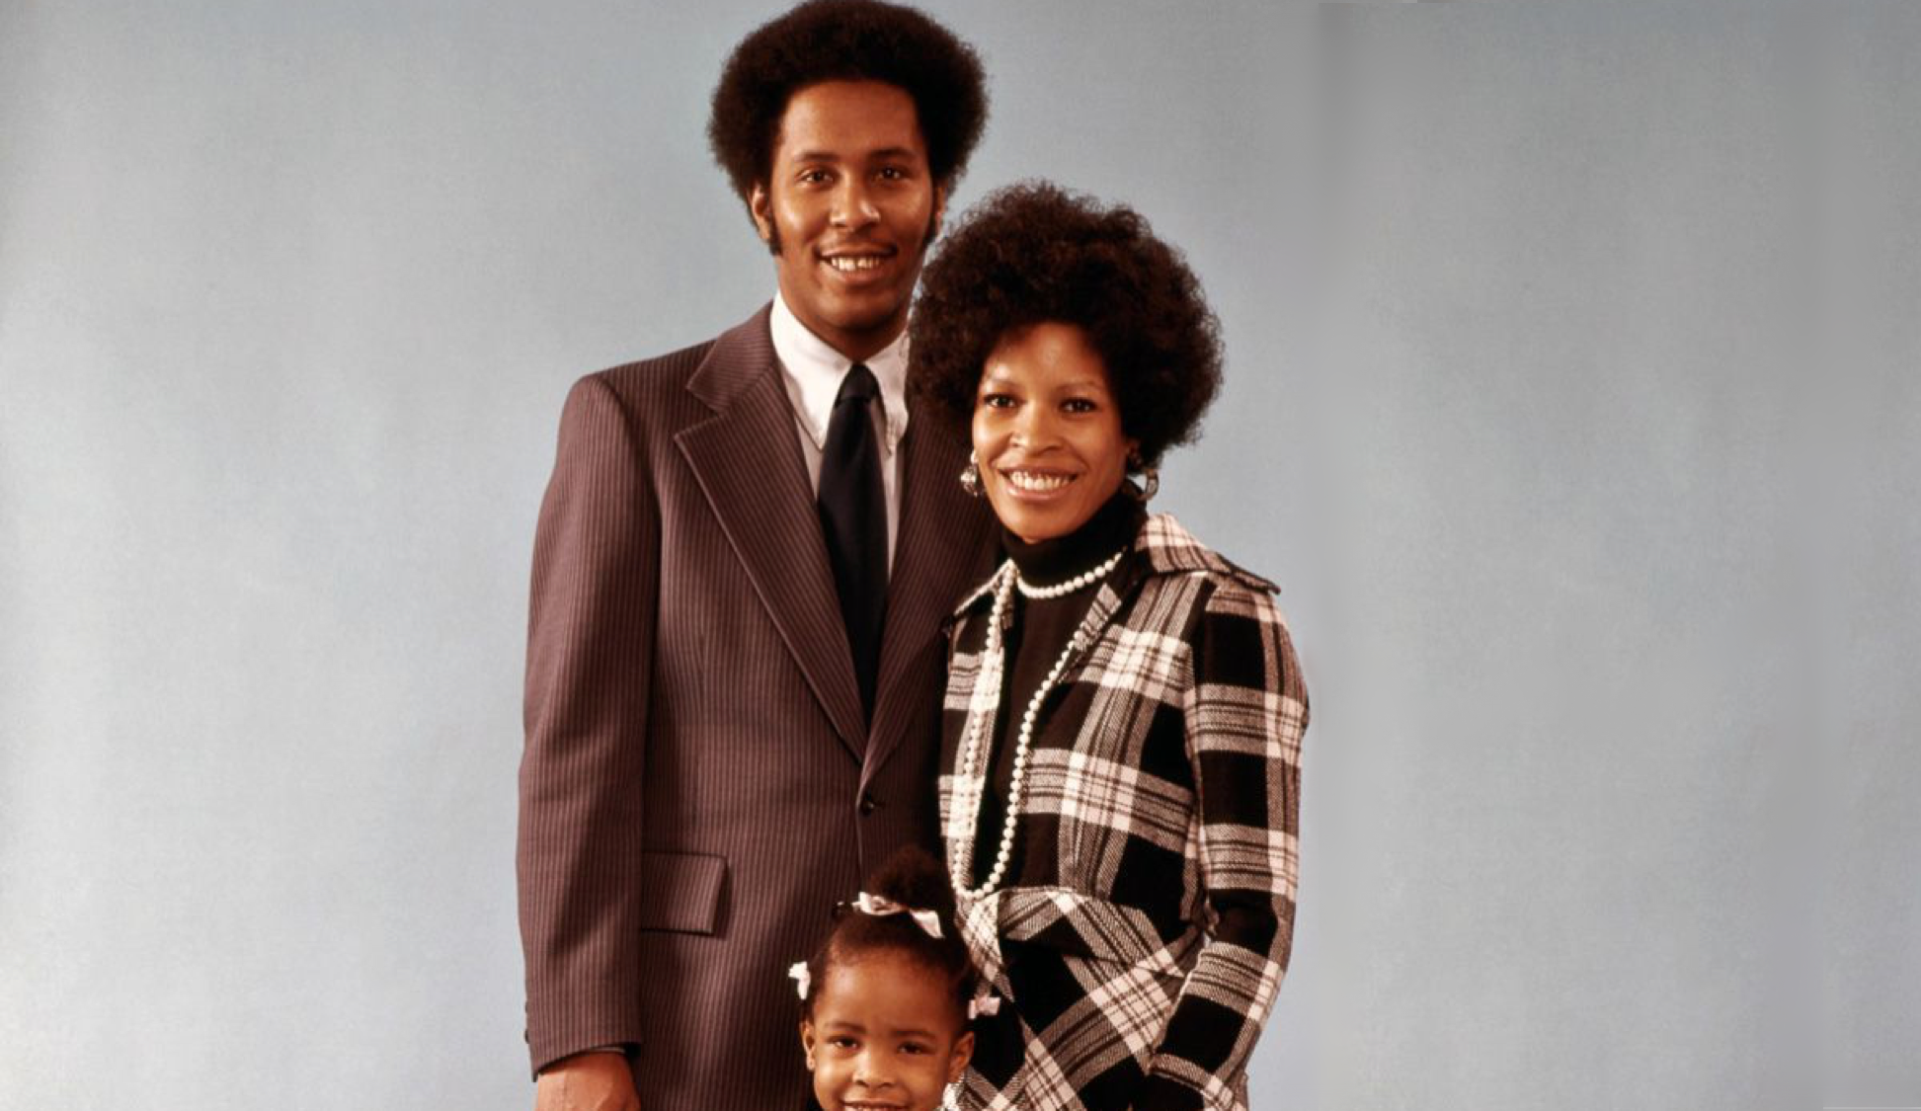
Over 30k files
9k objects
60 collections

Slide 13
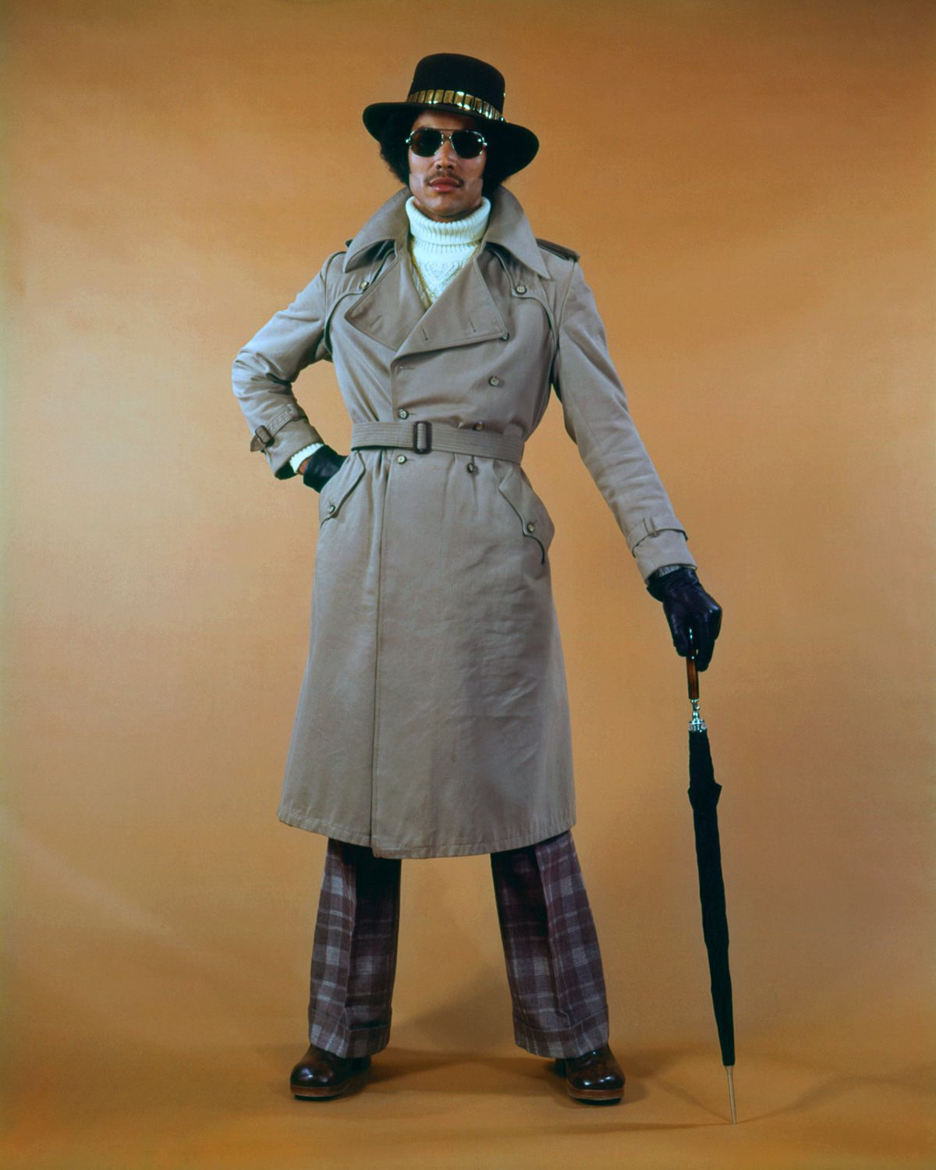
Interface

Slide 14
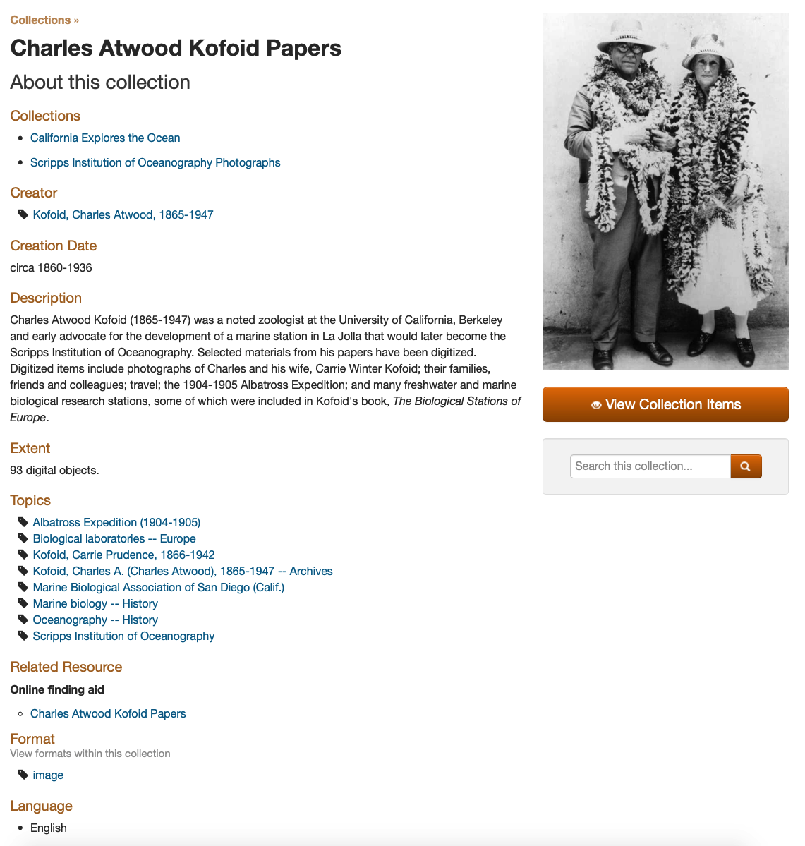
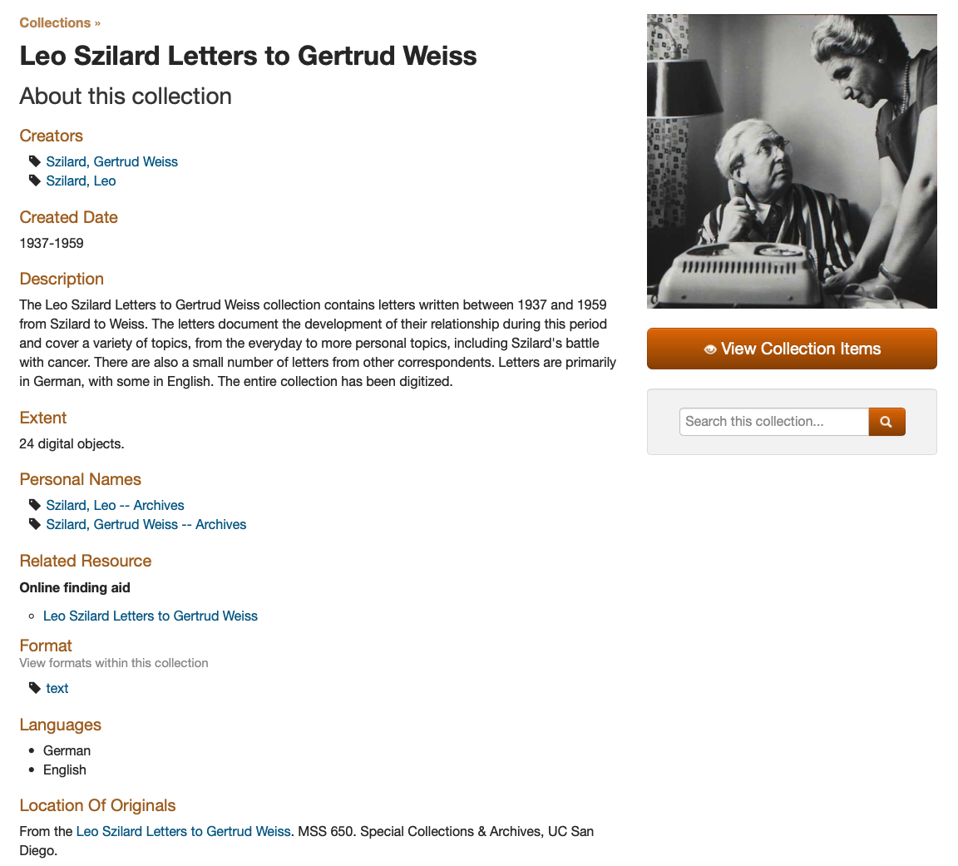
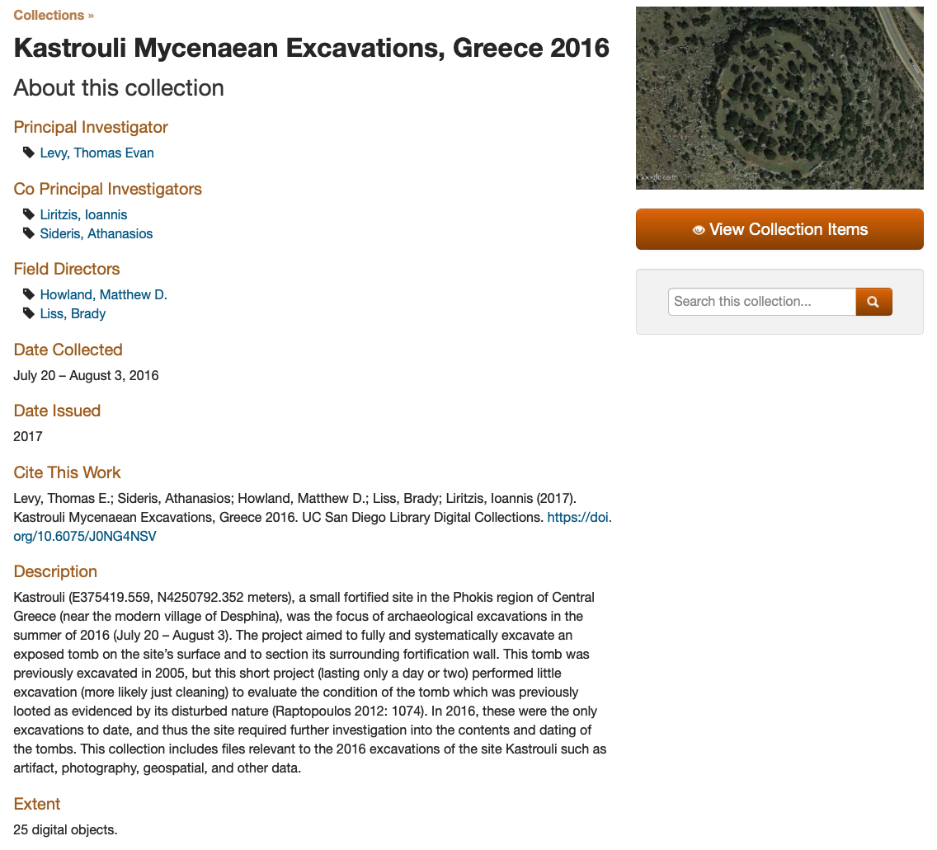
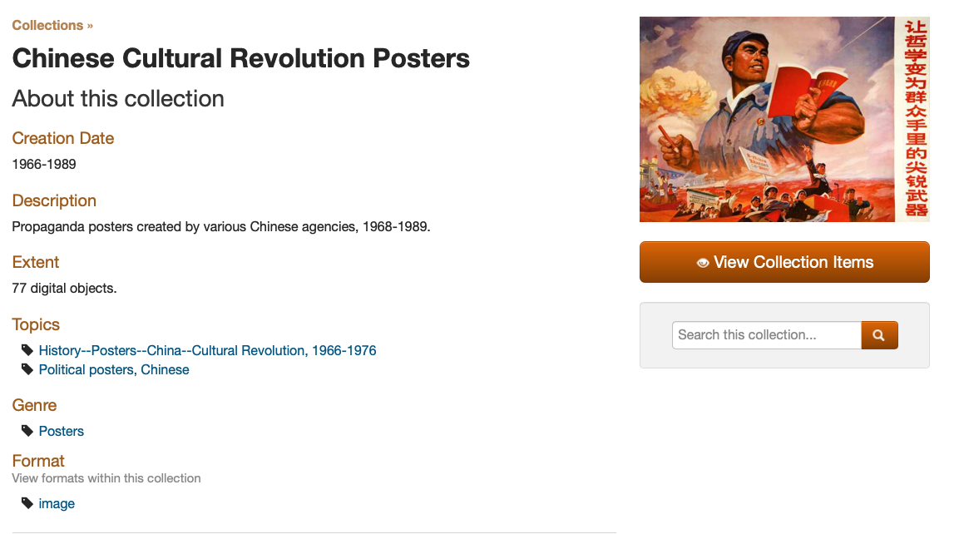
Notes:
We’ve intentionally strived for consistency across all content
Everything gets a collection landing page
Every collection gets a DOI
Metadata for collection pages and objects

Slide 15
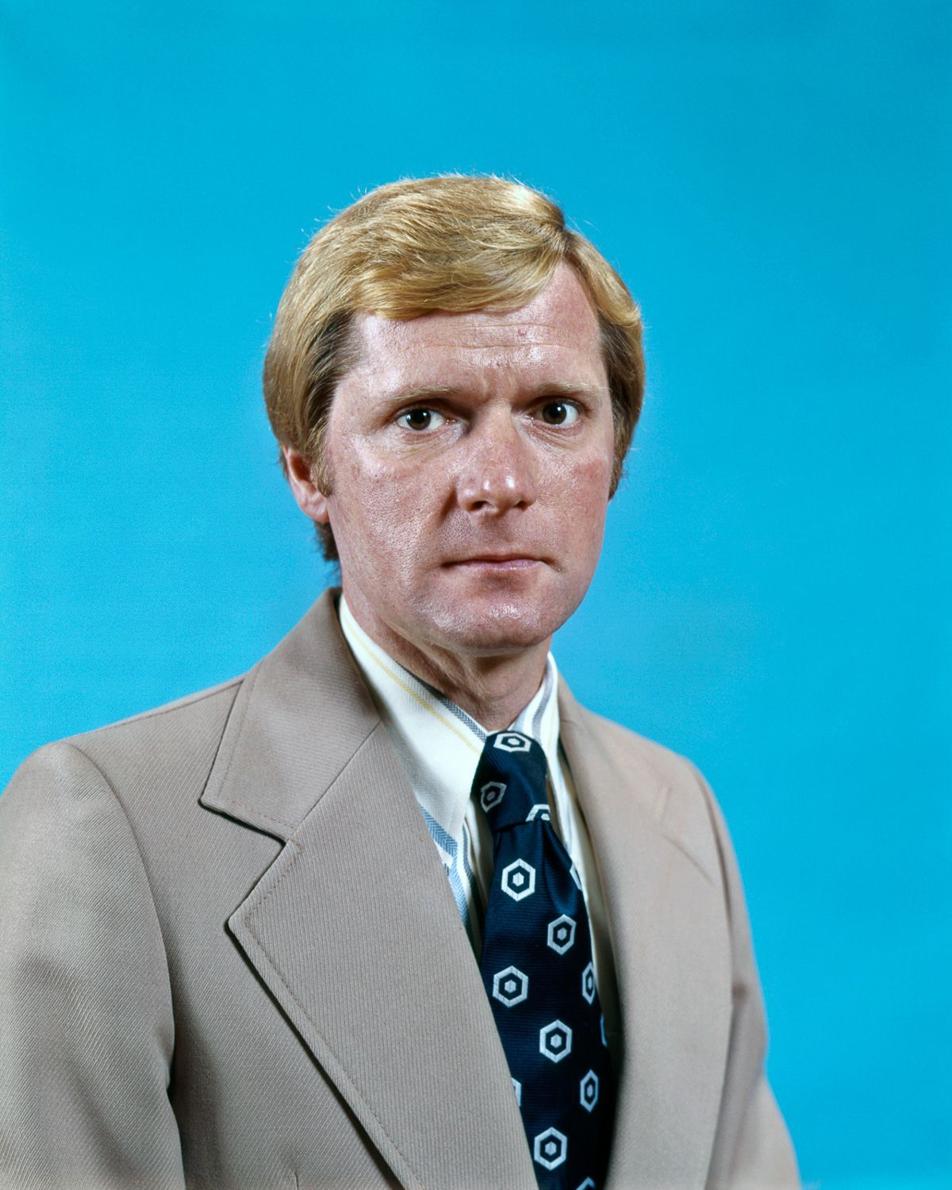
Current issues

Slide 16
We don’t tie to active data processes.
We can’t offer an array of visualization options.
We don’t have automatic ingests.
We don’t have consistent metrics.
We don’t offer easy API access.

Slide 17
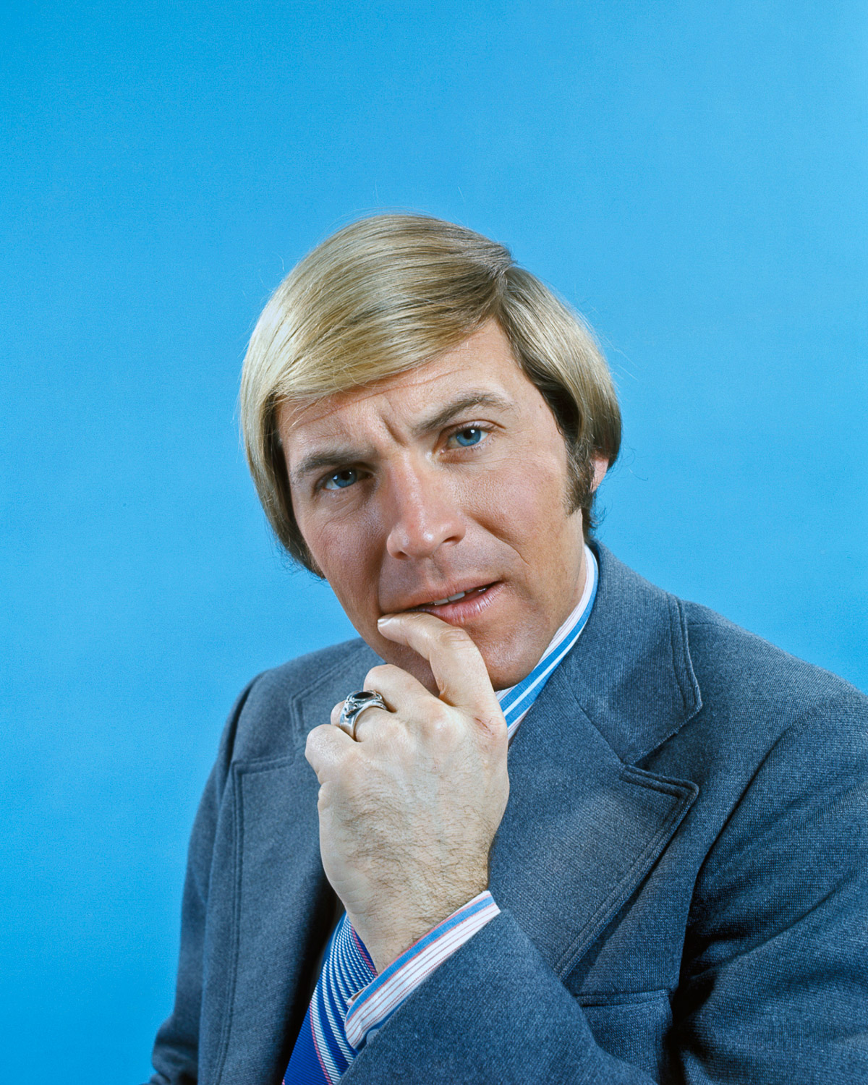
Greenfield thinking (What would it look like if we started from scratch?)

Slide 18
Tie to active data processes.
Offer an array of visualization options.
Offer automatic ingests.
(Metrics are still hard).
Offer easy API access.

Slide 19
Well, yeah, but we can’t do all those things by ourselves.

Slide 20
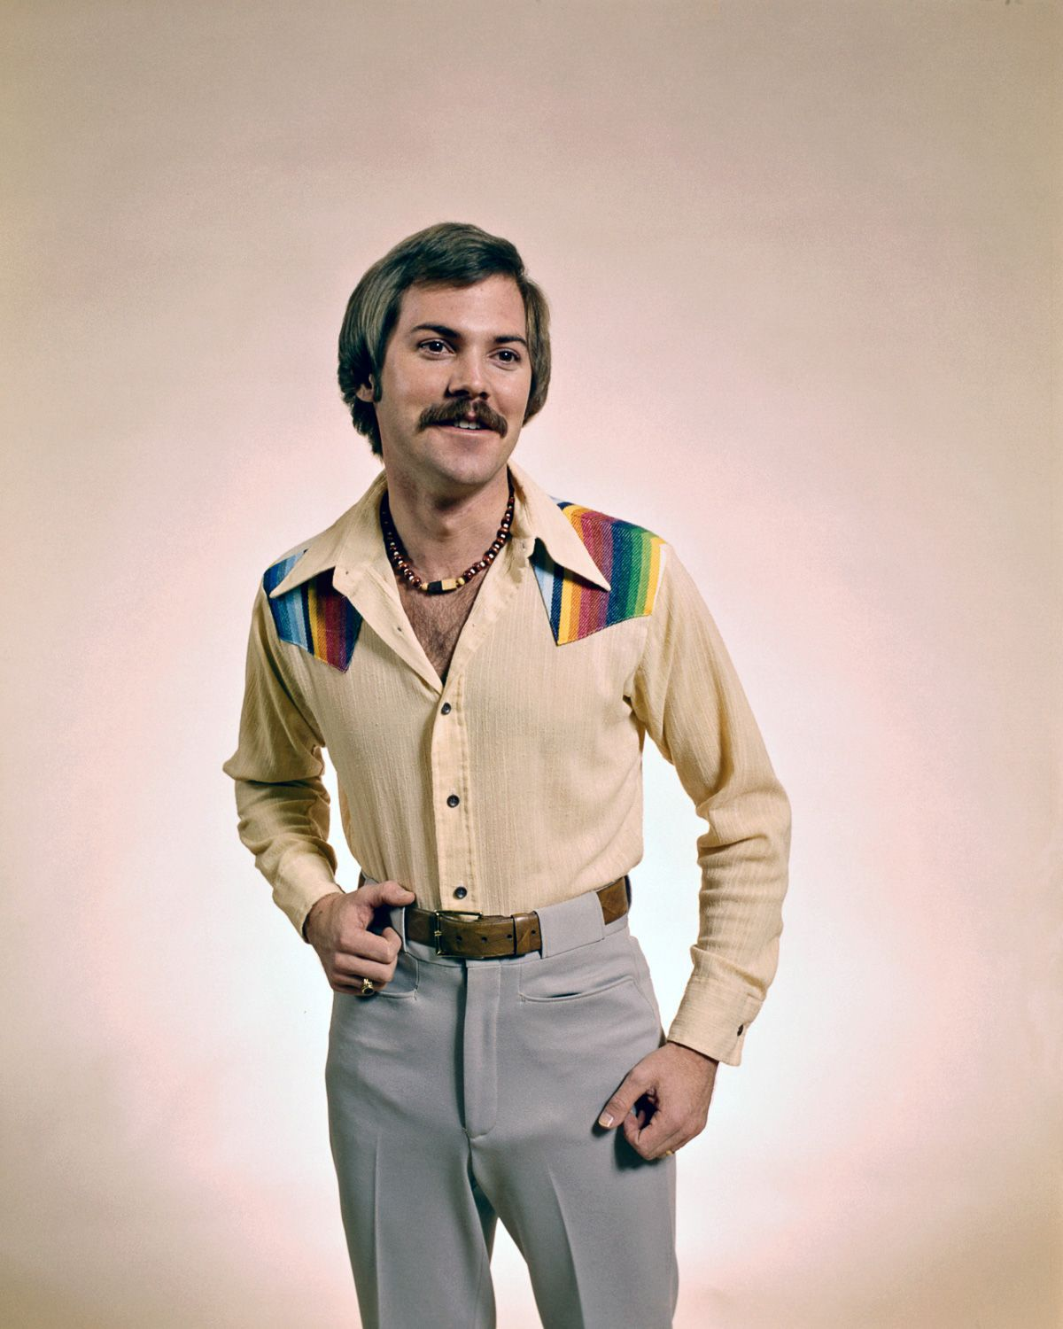
Cool things going on in this space

Slide 21
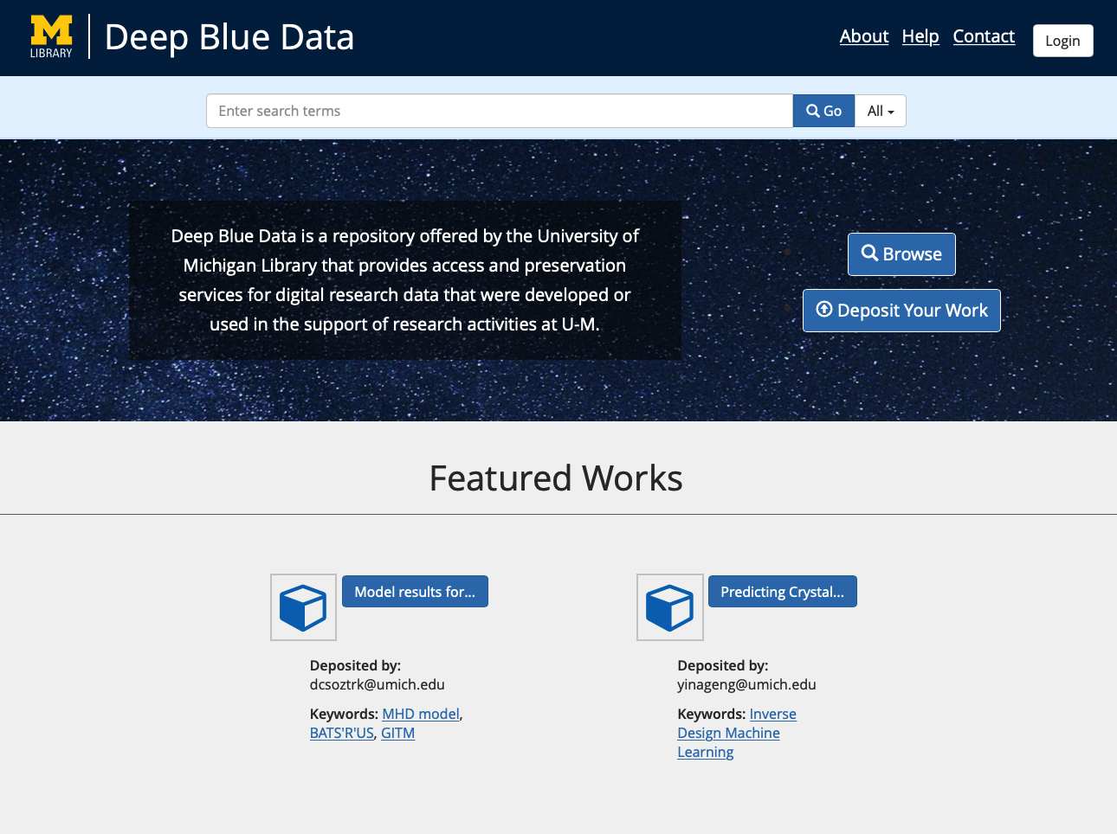
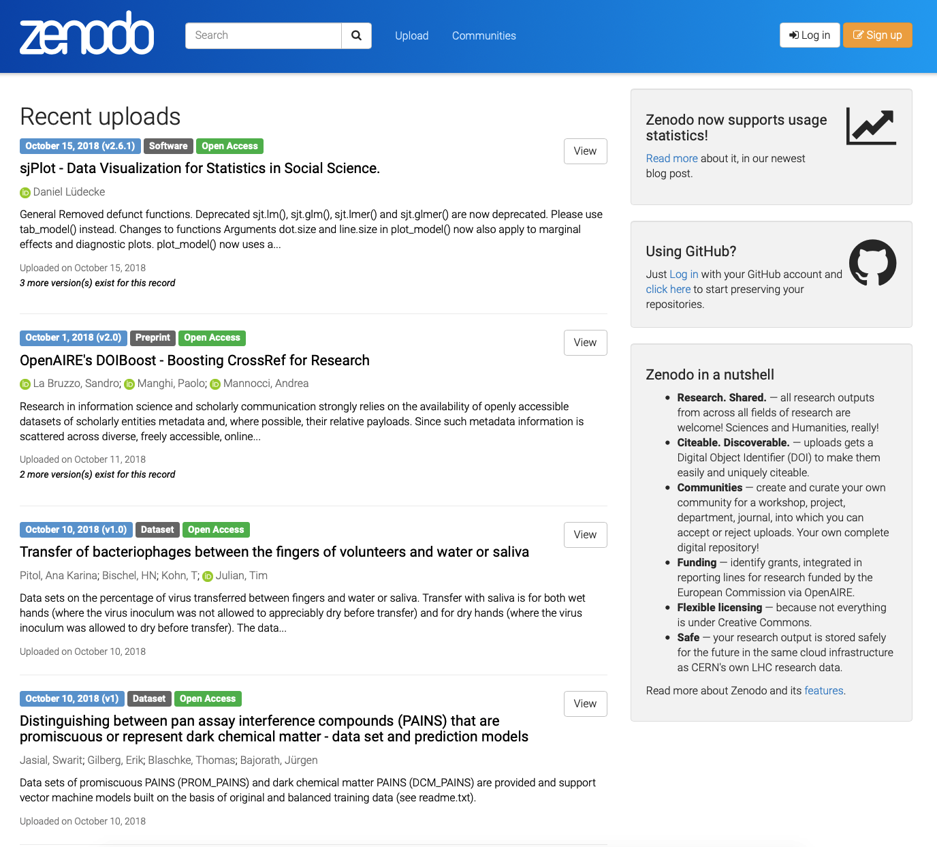
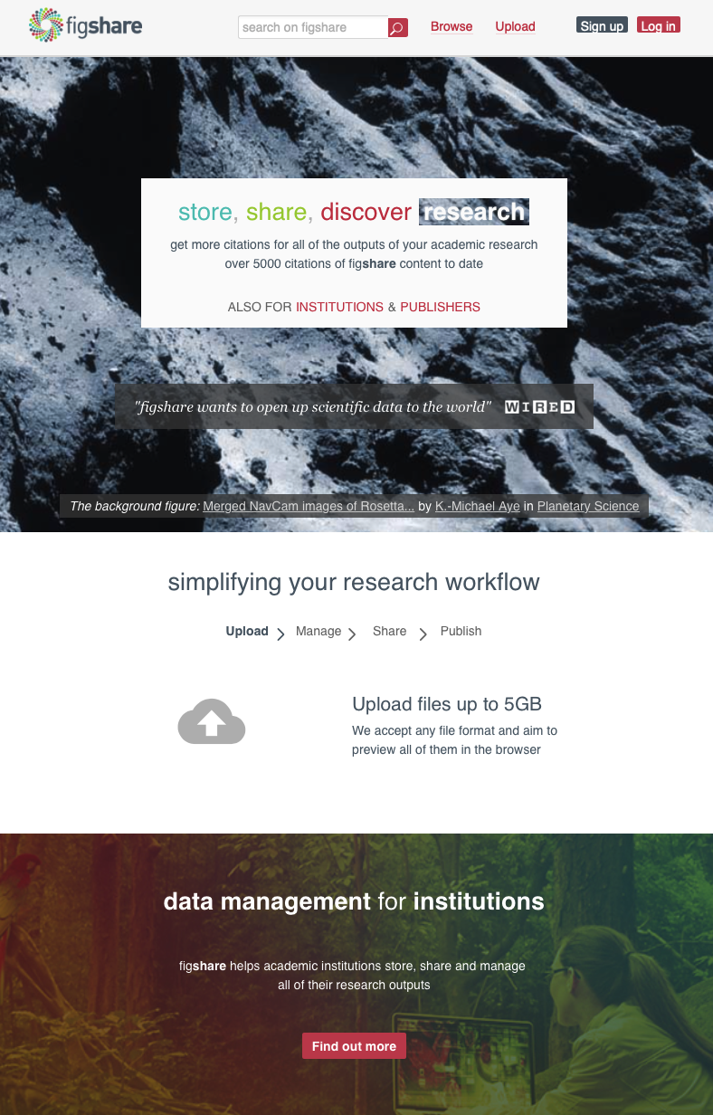
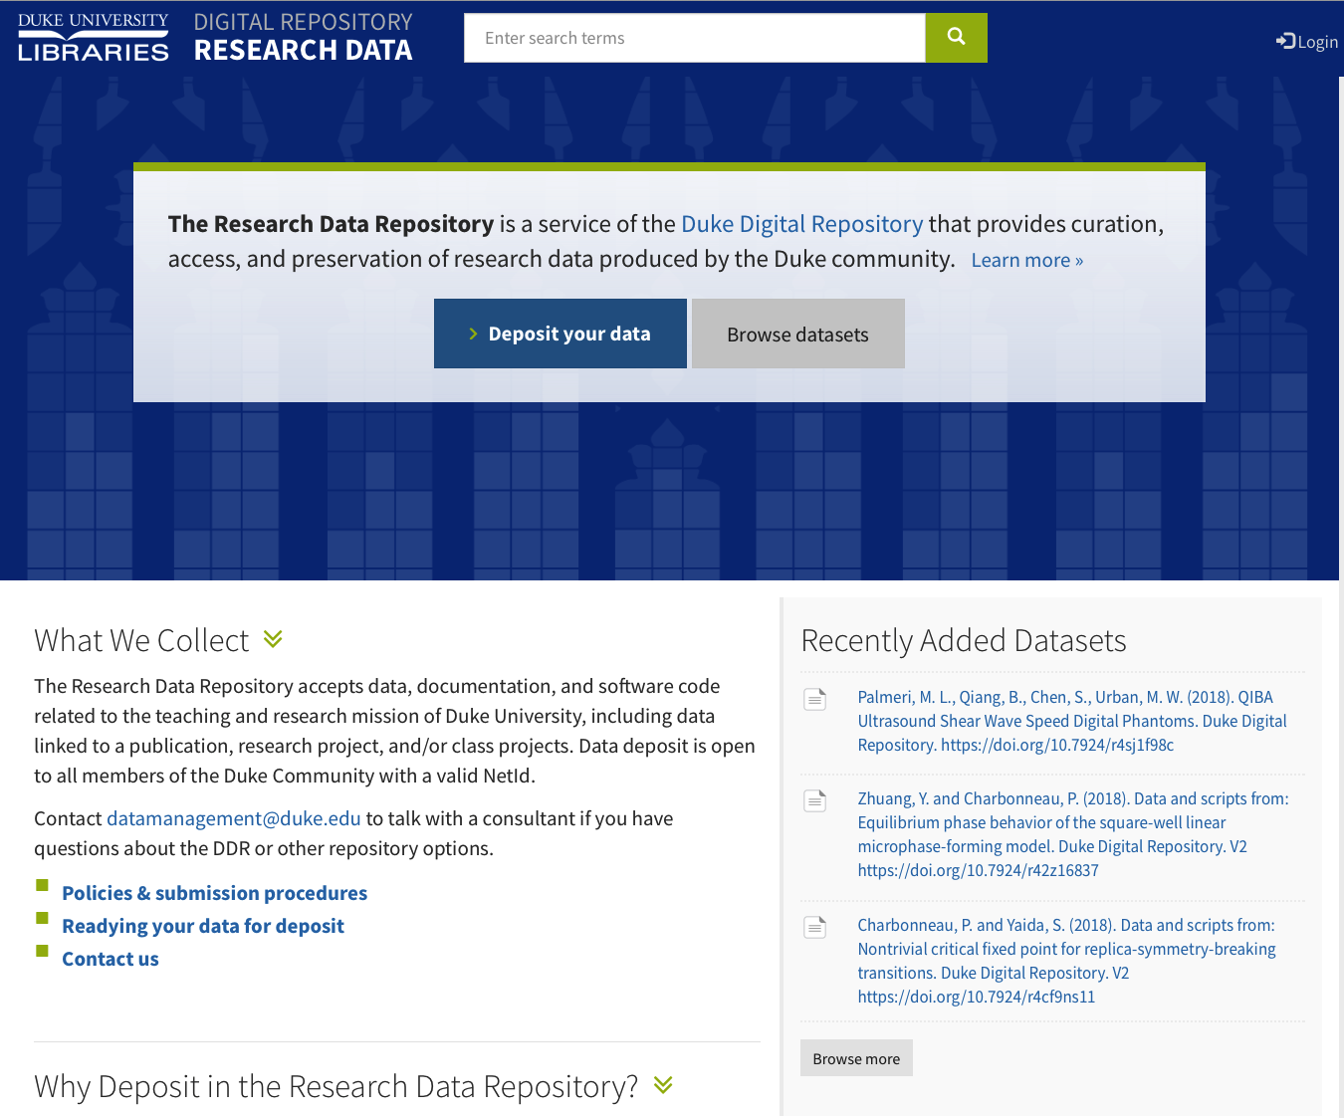
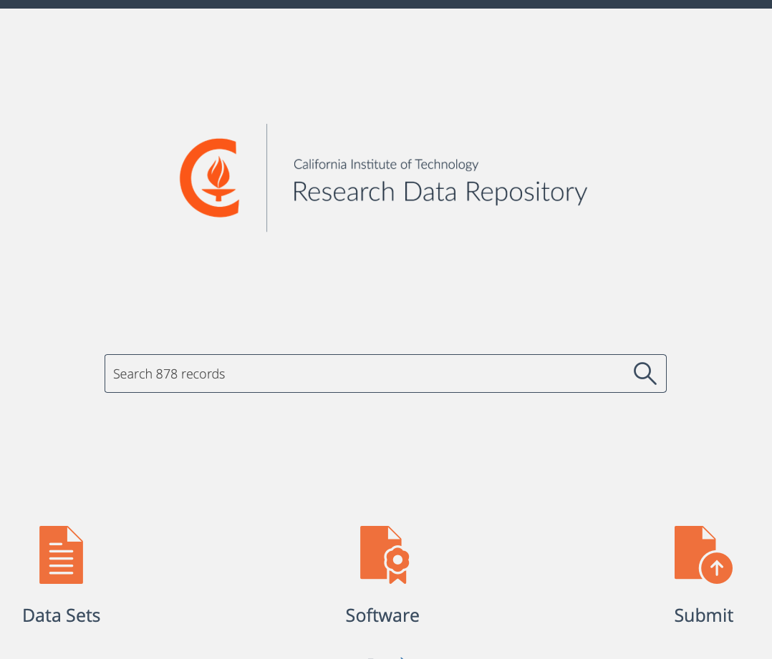

Slide 22
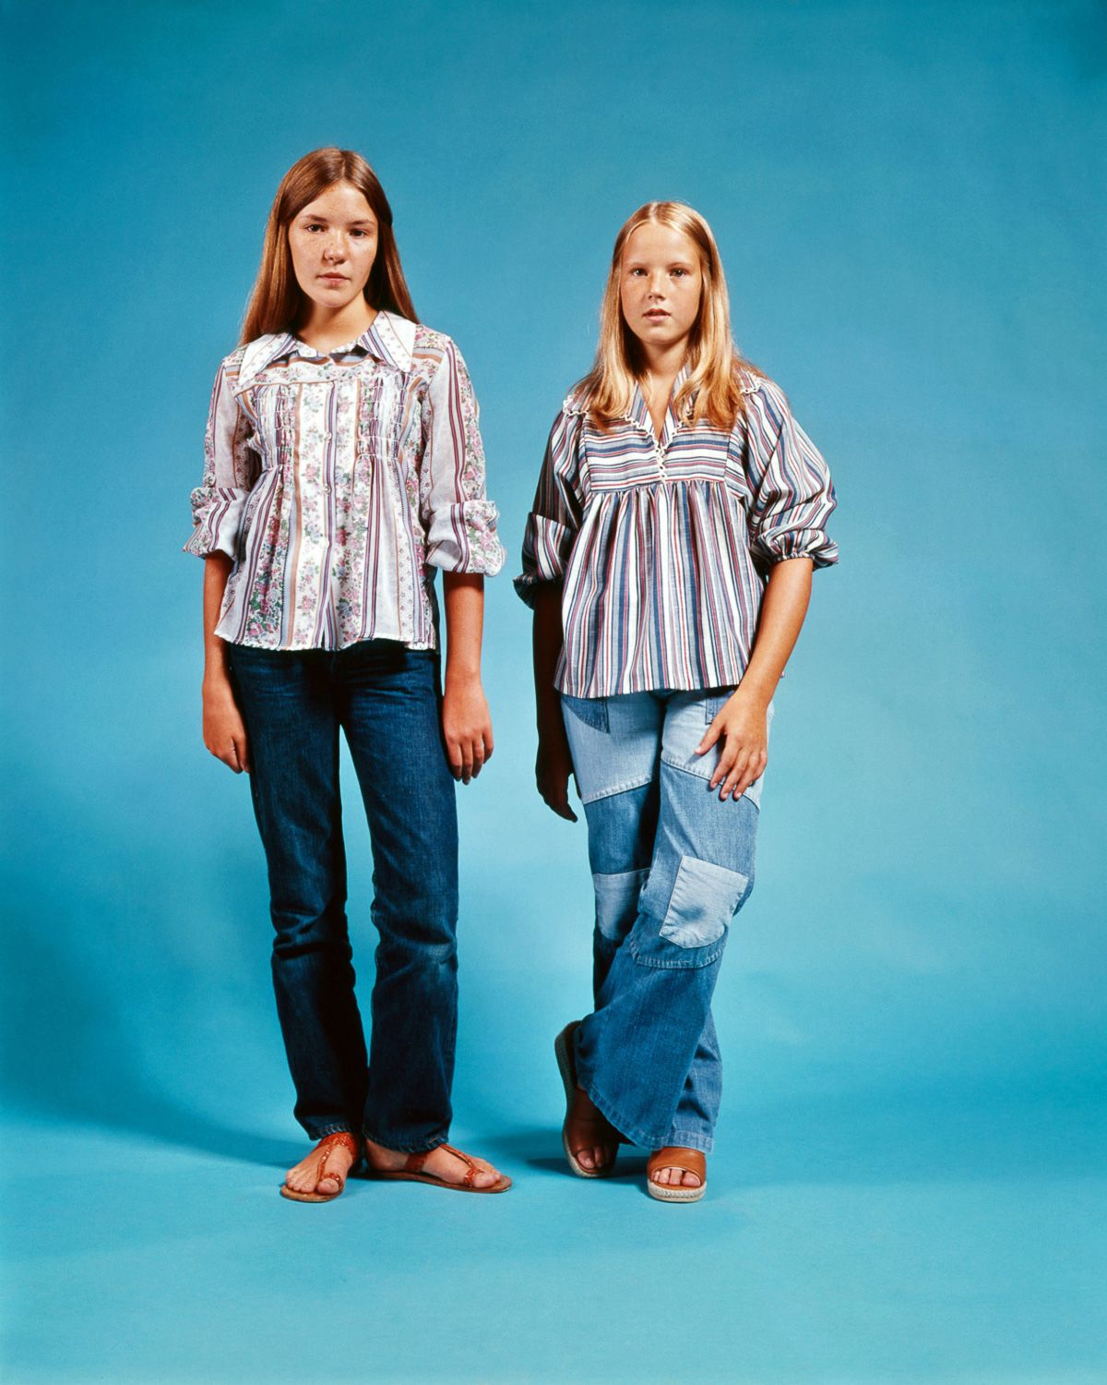
Our figshare project

Slide 23
Kick some tires…
and compare our processes.

Slide 24
Metadata mapping

Slide 25
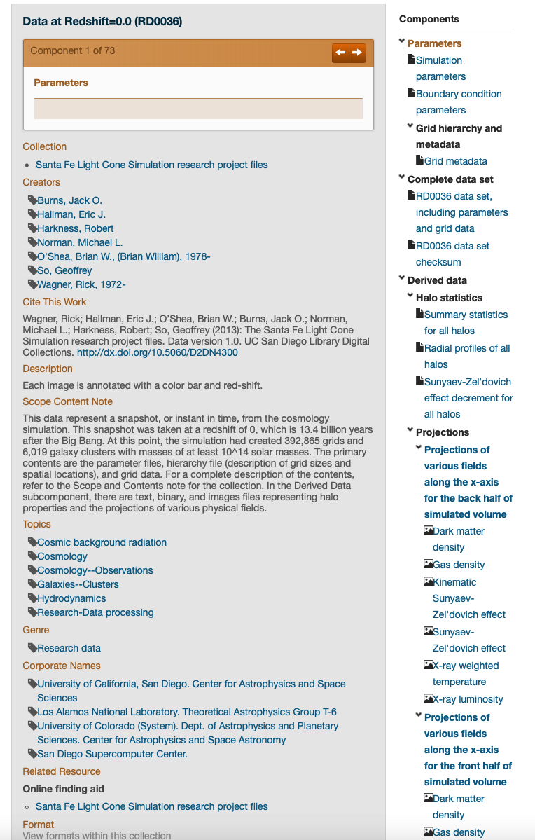
Notes:
Complex objects
Collections and objects (or not)
DOIs

Slide 26
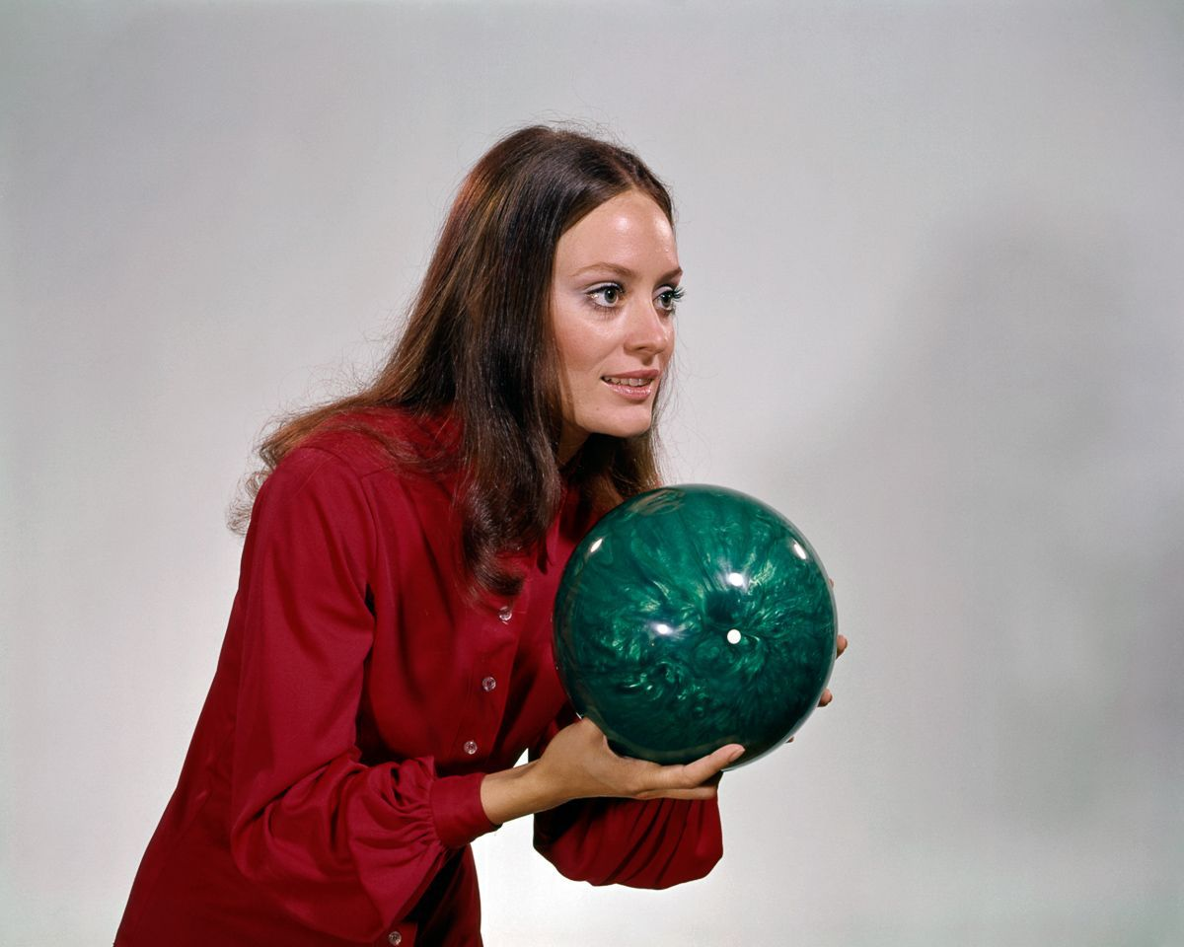
Ingest processes

Slide 27
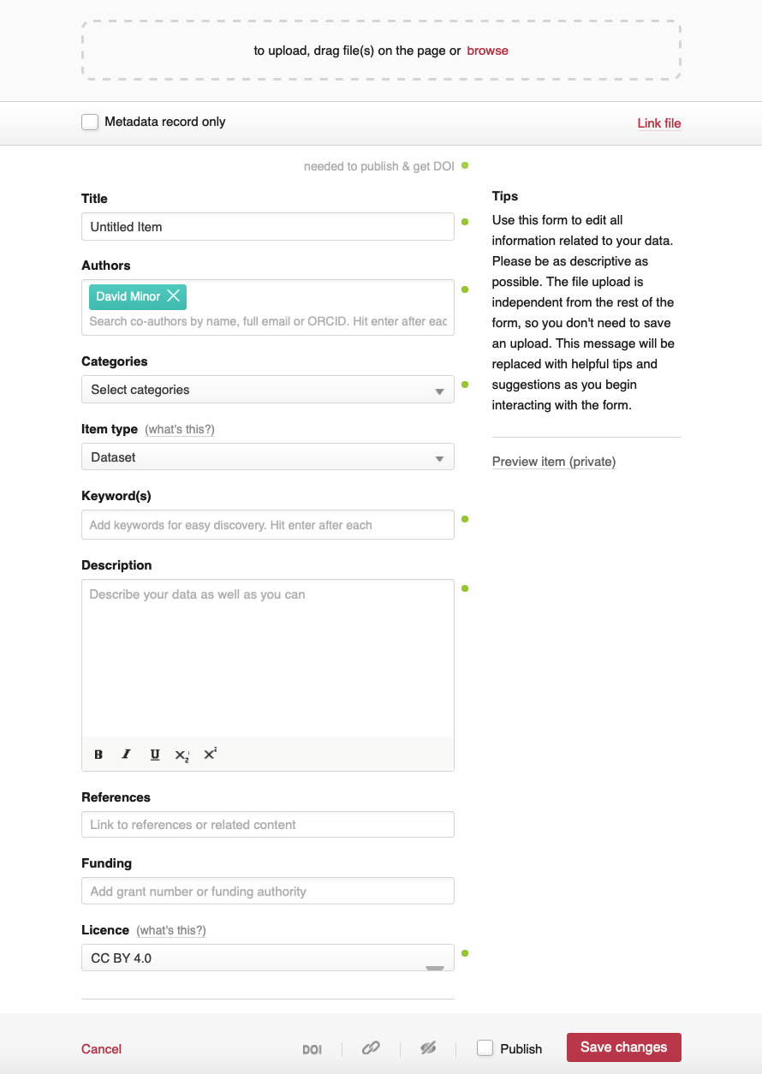
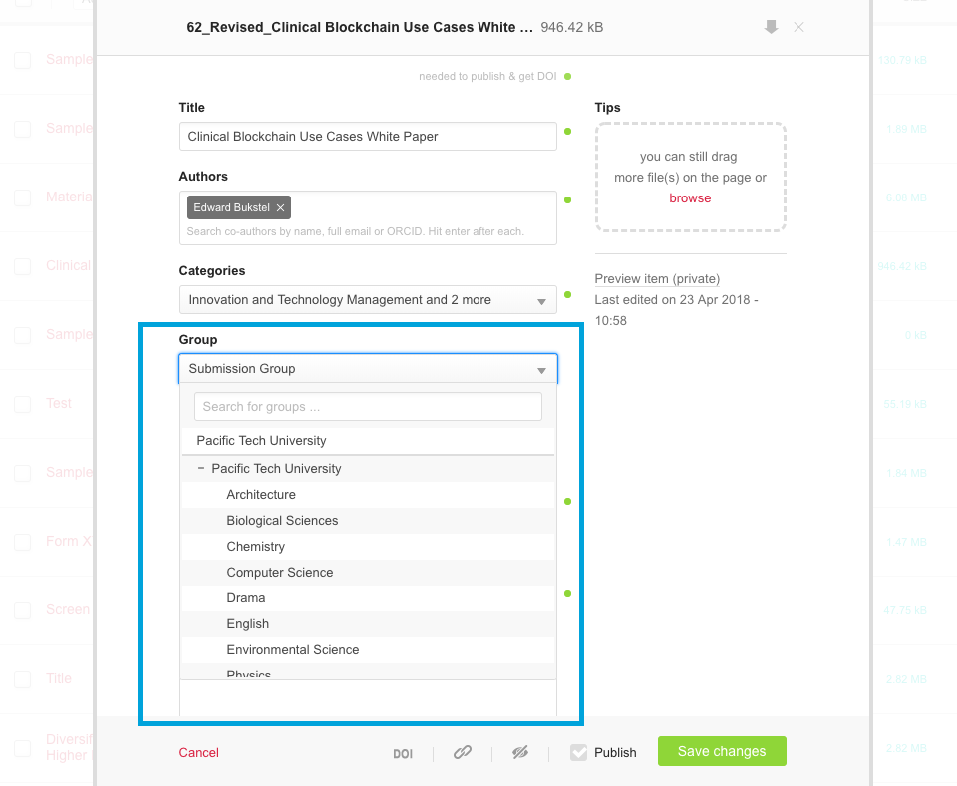
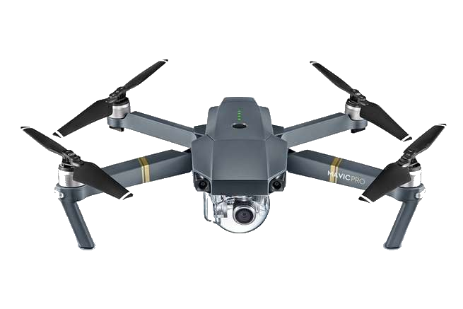
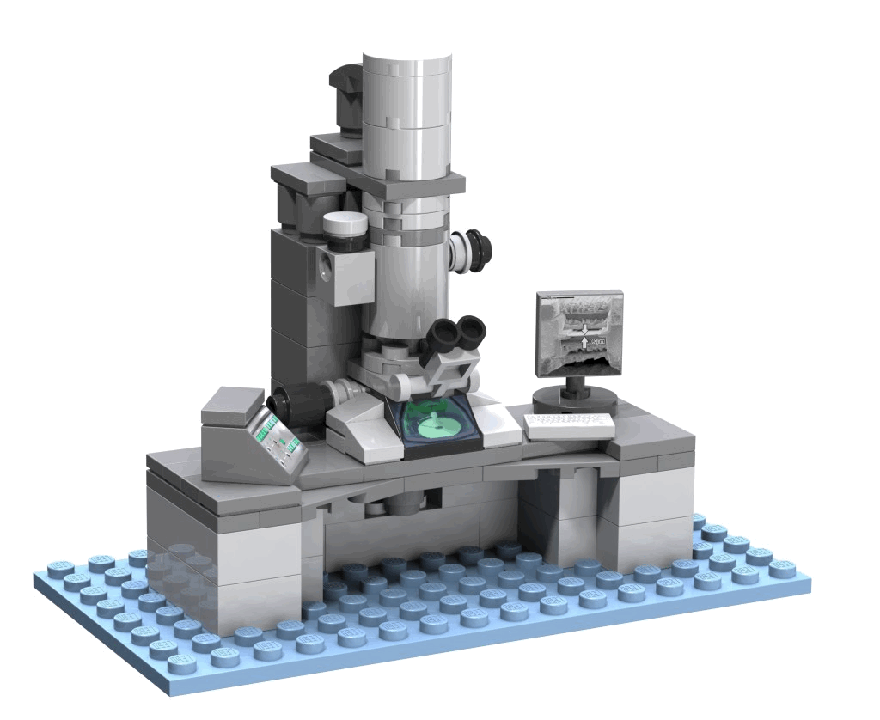
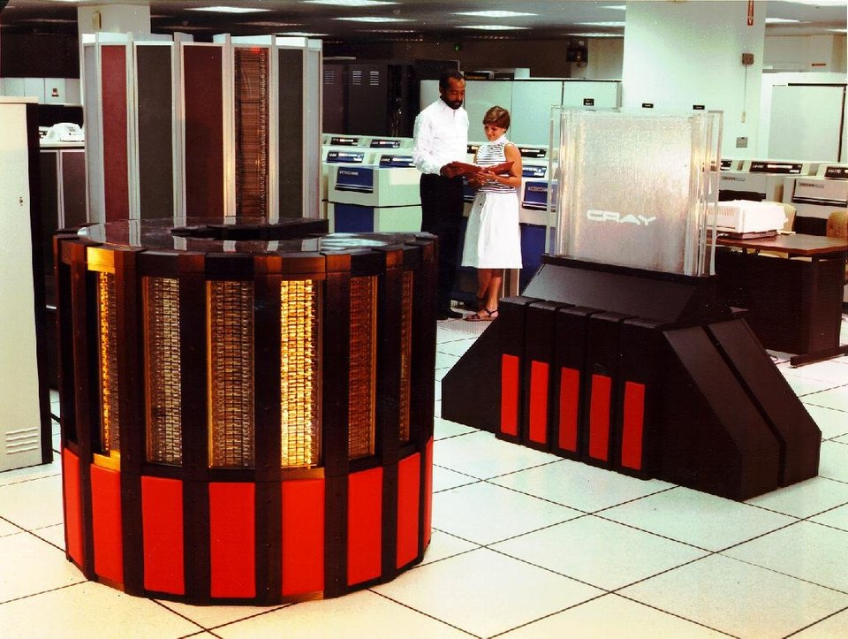

Slide 28
Display tools and visualizations

Slide 29
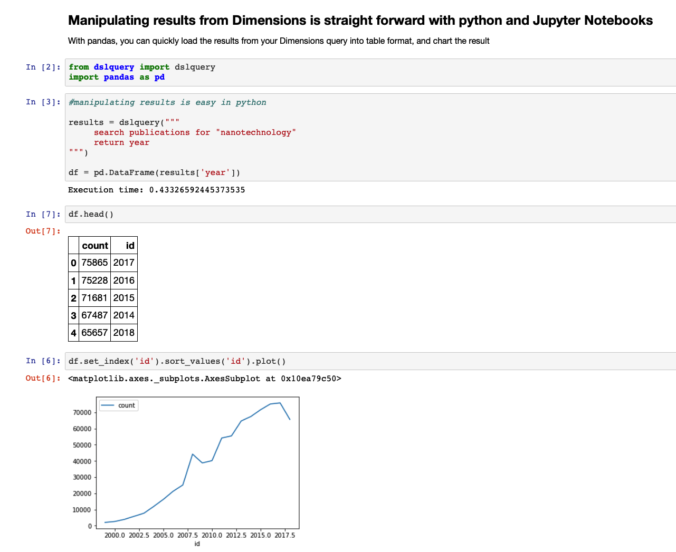
https://doi.org/10.6084/m9.figshare.7210565.v1
https://doi.org/10.6084/m9.figshare.c.4262975.v2
https://doi.org/10.3389/fmicb.2018.02441.s002

Slide 30
We’re about six months into an 18 month project
… so stay tuned!

Slide 31
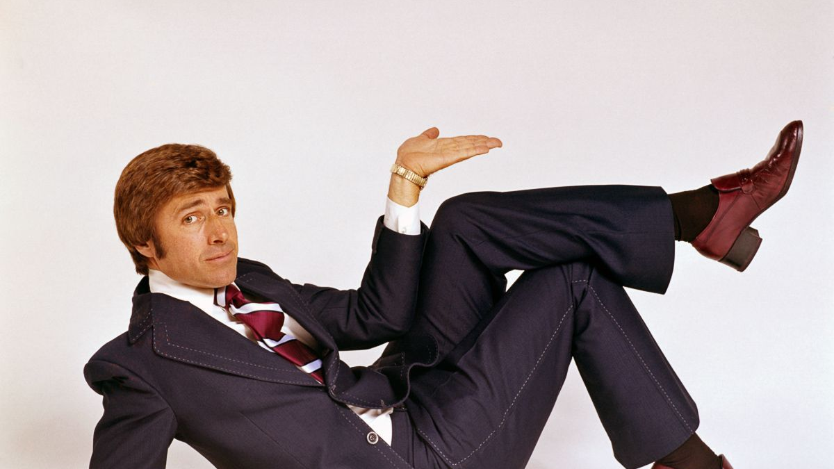
THANKS!
dminor@ucsd.edu
https://flashbak.com/fabulous-1970s-stock-photo-model-shots-38596
Copyright status unknown.

