Slide 1
Judith Ugbeh
Effects of Particulate Contamination and Jet Fuel Chemistry on the Nucleation of Water and Ice in Aircraft Fuel Systems
17th September 2018

Slide 2
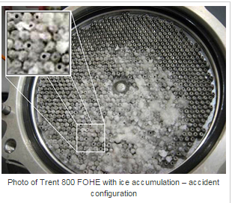
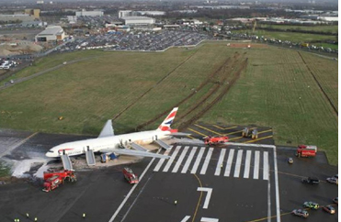
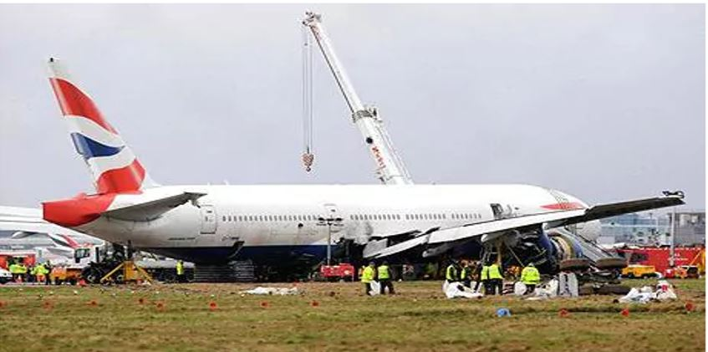
Effects of Particulate Contamination and Jet Fuel Chemistry on the Nucleation of Water and Ice in Aircraft Fuel Systems
Ice blocking the fuel oil heat exchanger--------------------------------------------------------------------------
PROJECT AIM
To examine the behaviour of water in jet fuel and introduction of a new jet fuel compositions.
Heathrow Accident: British Airways jet lost power as it came into land because ice had blocked the fuel supply
Behaviour of water in fuel
New jet fuel composition
THIS AREA OF YOUR SLIDE WILL BE COVERED BY A TIMER

