Slide 1









The modern well-founded laboratory: how has software changed the practice of research? https://doi.org/10.6084/m9.figshare.7233137
22nd October 2018, National Physical Laboratory
Neil Chue Hong (@npch), Software Sustainability Institute
ORCID: 0000-0002-8876-7606 | N.ChueHong@software.ac.uk
Supported by
Project funding
from
Slides licensed under
CC-BY where indicated:
Notes:
In this talk, I will discuss the Software Sustainability Institute’s work in understanding the role of software in contemporary research, the research infrastructure that is required to support modern research, and the practices that can be used to improve the quality and efficiency of research that makes use of specialist software in areas such as modelling and simulation, data capture and analysis, and experimental control. I will also describe some of the universal challenges facing us all, including the “reproducibility crisis”, software credit and careers, and software sustainability.

Slide 2
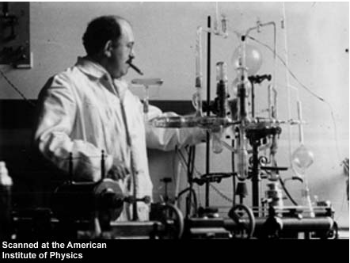
Picture of Otto Stern courtesy of
Emilio Segre Visual Archives
Notes:
From Wikipedia:
The Stern–Gerlach experiment demonstrated that the spatial orientation of angular momentumis quantized, and thus an atomic-scale system having intrinsically quantum properties. In the original experiment, silver atoms were sent through a spatially varying magnetic field, which deflected them before they struck a detector screen, such as a glass slide. Particles with non-zero magnetic moment are deflected, due to the magnetic field gradient, from a straight path. The screen reveals discrete points of accumulation, rather than a continuous distribution,^{[1]}owing to their quantized spin. Historically, this experiment was decisive in convincing physicists of the reality of angular-momentum quantization in all atomic-scale systems.
From “Stern and Gerlach: How a Bad Cigar Helped Reorient Atomic Physics”, Bretislav Friedrich and Dudley Herschbach, Physics Today, December 2003.
Happily, Stern found an eager recruit in Gerlach, who until then had not heard of space quantization.10
Despite Stern’s careful design and feasibility calcula- tions, the experiment took more than a year to accomplish. In the final form of the apparatus, a beam of silver atoms (produced by effusion of metallic vapor from an oven heated to 1000°C) was collimated by two narrow slits (0.03 mm wide) and traversed a deflecting magnet 3.5 cm long with field strength about 0.1 tesla and gradient 10 tesla/cm. The splitting of the silver beam achieved was only 0.2 mm. Accordingly, misalignments of collimating slits or the magnet by more than 0.01 mm were enough to spoil an experimental run. The attainable operating time was usually only a few hours between breakdowns of the apparatus. Thus, only a meager film of silver atoms, too thin to be visible to an unaided eye, was deposited on the collector plate. Stern described an early episode:
After venting to release the vacuum, Gerlach removed the detector flange. But he could see no trace of the silver atom beam and handed the flange to me. With Gerlach looking over my shoulder as I peered closely at the plate, we were surprised to see gradually emerge the trace of the beam. . . . Finally we realized what [had happened]. I was then the equiva- lent of an assistant professor. My salary was too low to afford good cigars, so I smoked bad cigars. These had a lot of sulfur in them, so my breath on the plate turned the silver into silver sulfide, which is jet black, so easily vis- ible. It was like devel- oping a photographic film.7
After that episode, Gerlach
and Stern began using a pho- tographic development process, although both continued puffing cigars in the lab. Still, recalcitrant difficulties per- sisted. As inconclusive efforts continued for months, Stern’s assessment of space quantization wavered between conviction and rejection. Gerlach also encountered doubt- ful colleagues, including Debye, who said, “But surely you don’t believe that the [spatial] orientation of atoms is something physically real; that is [only] a timetable for the
electrons.”10

Slide 3
A well-founded laboratory has the minimum level of equipment, at an acceptable quality and quantity available to support research.
A well-founded laboratory is a precondition to host research infrastructure for world-class science.

Slide 4

Raise standards for preclinical cancer research
Begley, Ellis. Nature, 483, 2012
doi:10.1038/483531a
47 out of 53
“landmark” publications
could not be replicated
Notes:
4
AMGEN study tried to recreate landmark papers from preclinical oncology studies.
Important because clinical trials rely on these studies, and clinical trials are expensive!

Slide 5
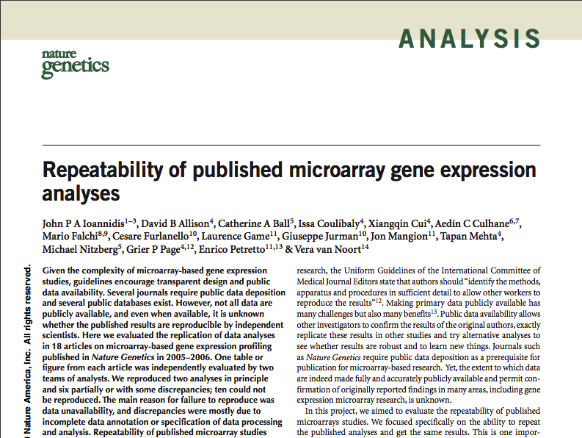
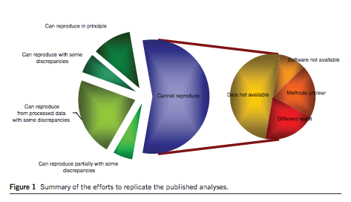
Repeatability of published microarray gene expression analyses
Ioannidis et al. Nature Genetics, 41, 2010
doi:10.1038/ng.295
56% of analyses could not be repeated,
of which 30% were because of software issues.
50% did not state software version, 39% did not provide raw data.
Only 11% could be reproduced satisfactorily.
Notes:
5
Science could be better at providing data and code

Slide 6
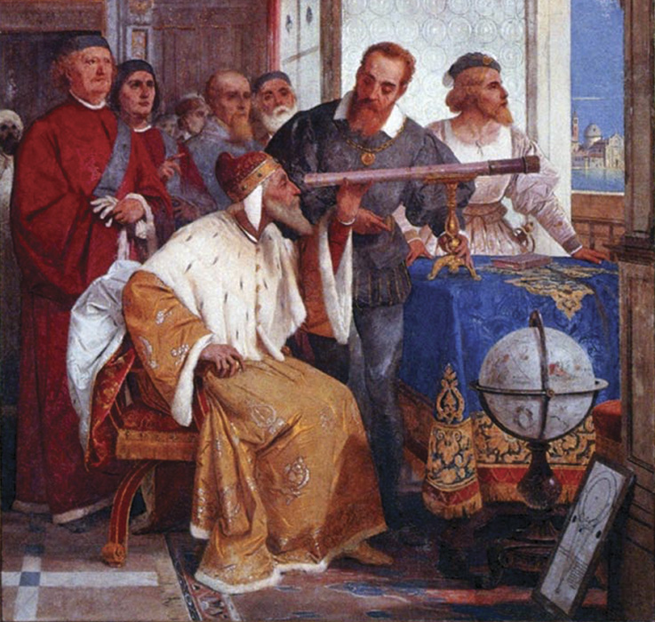
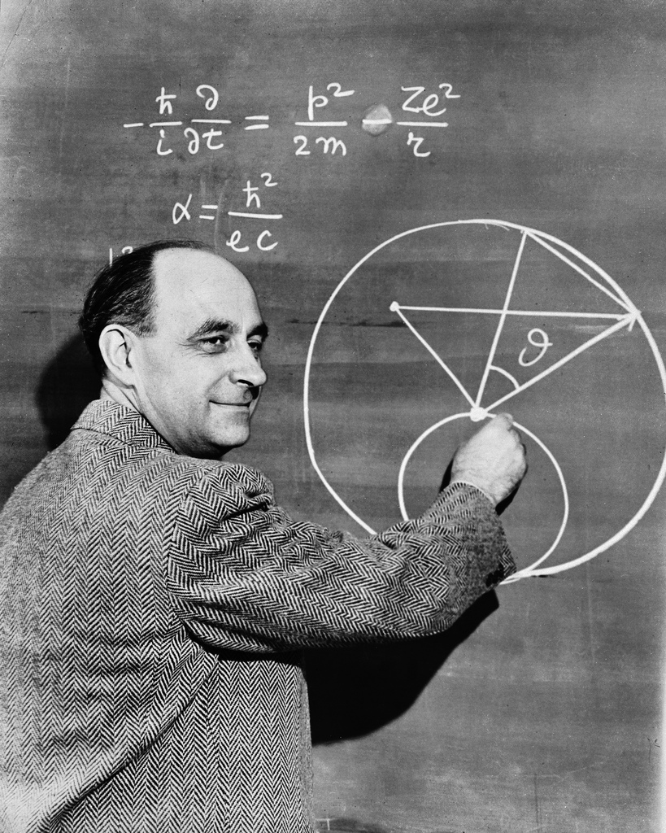
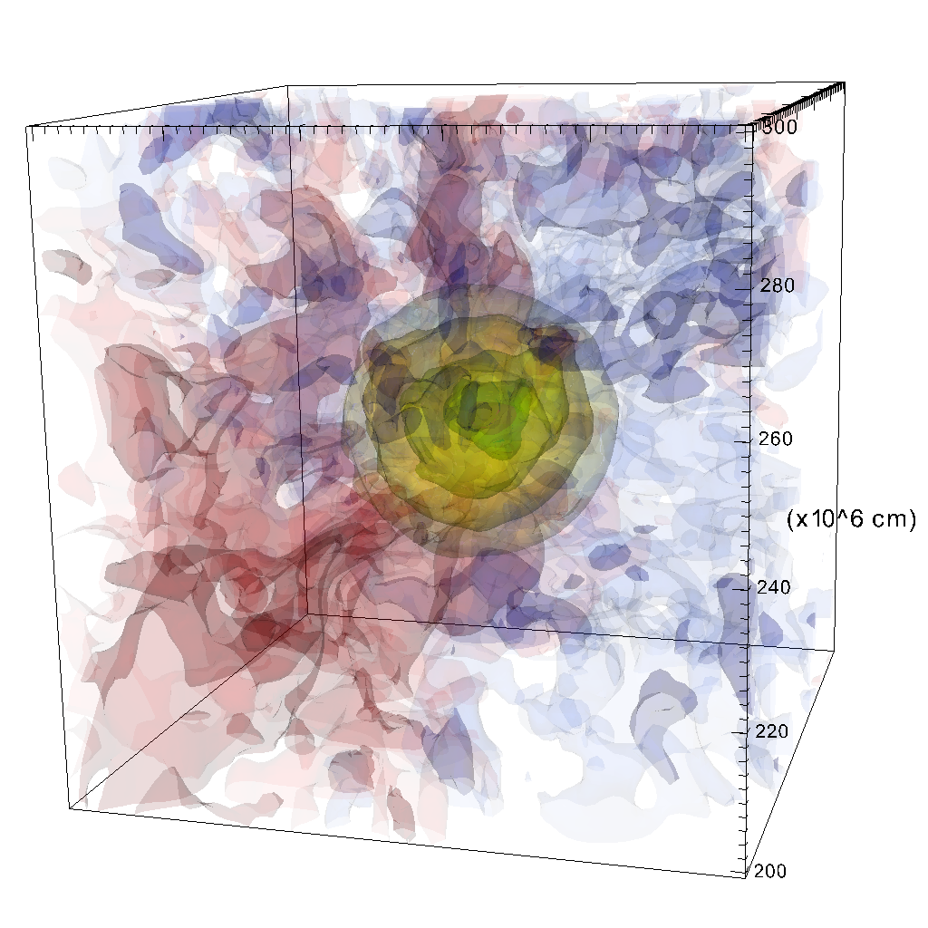
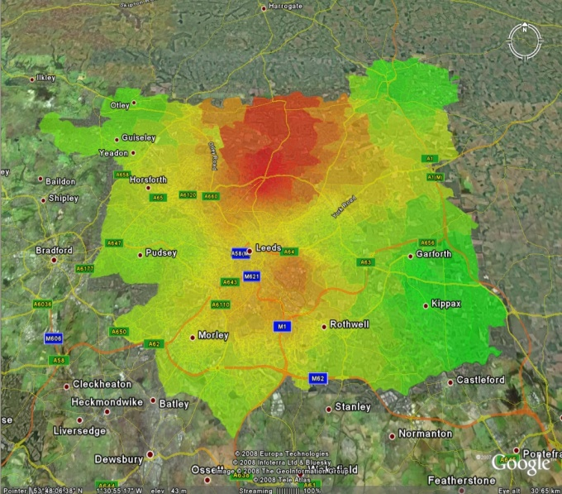
Four Paradigms of Research
Empirical
Theoretical
Computational
Data Exploration
Notes:
For thousands of years, research was empirical, using observation and experiment to describe natural phenomena
In the last few hundred years, theory developed using models and generalisations
In the last decades, computational simulation has made it possible to model complex phenomena
In the last few years, data exploration – digital research – has unified experimental data, theory, and computational simulation to analyse the vast amounts of collected and generated information

Slide 7
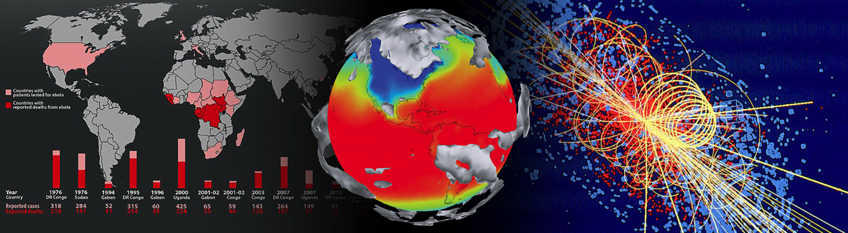
Modern research is impossible without software
From thrown-together scripts, through an abundance of complex spreadsheets, to the millions of lines of code behind large-scale infrastructure, there are few areas where software does not play a fundamental part in research

Slide 8
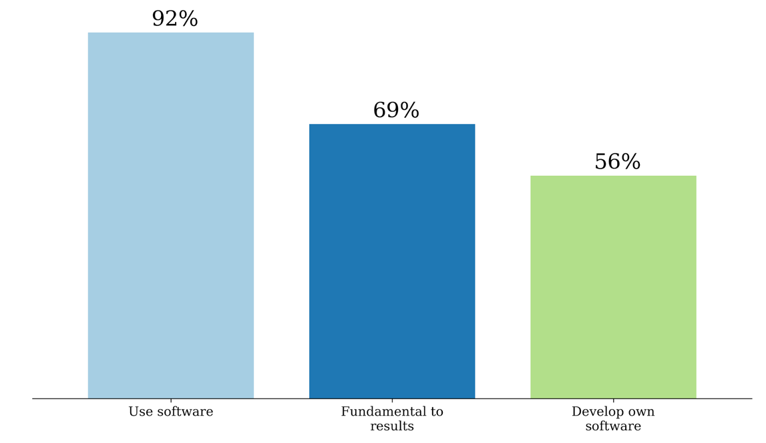
UK software survey 2014
S.J. Hettrick et al,
UK Research Software Survey 2014
​DOI:10.5281/zenodo.1183562.
Notes:
417 responses across 15 Russell Group universities. Can’t re-run the analysis because people did not like being cold-called.
https://www.software.ac.uk/blog/2016-09-12-its-impossible-conduct-research-without-software-say-7-out-10-uk-researchers
RCs invested around £4.7 billion a year, which means £3.2 billion (69%) is at risk.
https://www.gov.uk/government/uploads/system/uploads/attachment_data/file/505308/bis-16-160-allocation-science-research-funding-2016-17-2019-20.pdf
Industrial strategy aims to spend 2.4% of GDP on research and development (equivalent to £480 billion in 2017). 69% of that is £380 billion.

Slide 9
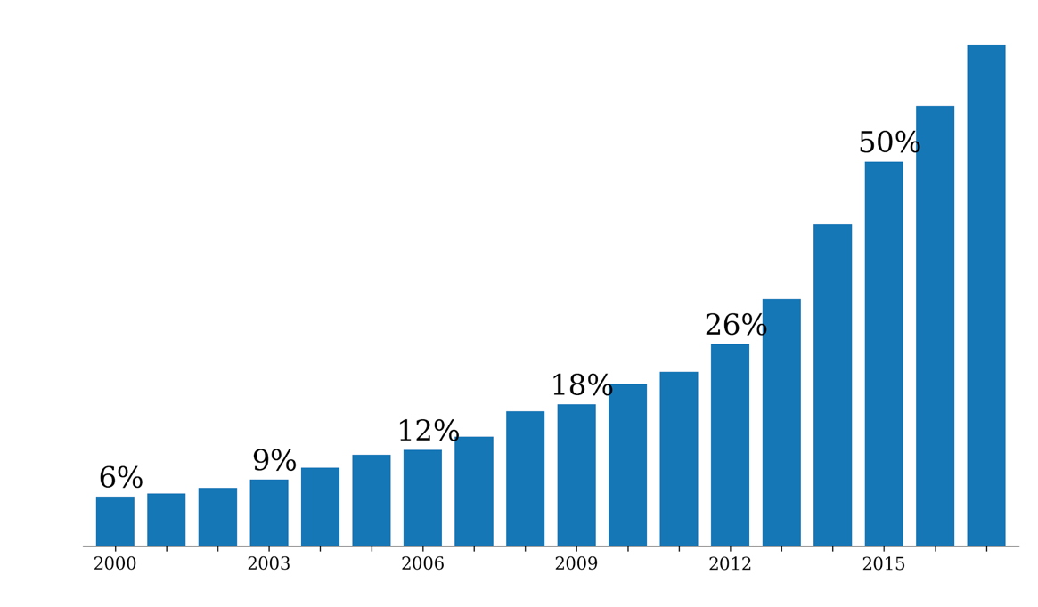
Software in research papers
65%
Searched Eprints repositories from 31 UK institutions ~ 600k papers
Displayed the percentage of papers found to have software-related terms against all papers in the repository.
2017
Notes:
It’s really difficult to assess an unbiased way of identifying the importance of software in research.
Eprints is a digital repository which many institutions are mandating their researchers to use.
We searched Eprints repositories from 31 UK institutions (~ 600k papers) for terms indicating that the results in the publication relied on the use of software at some stage of the research.
This graph displays the percentage of papers found to have software-related terms against all papers in the repository submitted in that year. Not only has the number of papers submitted been rising, but the percentage dependent on software has also been rising dramatically.

Slide 10
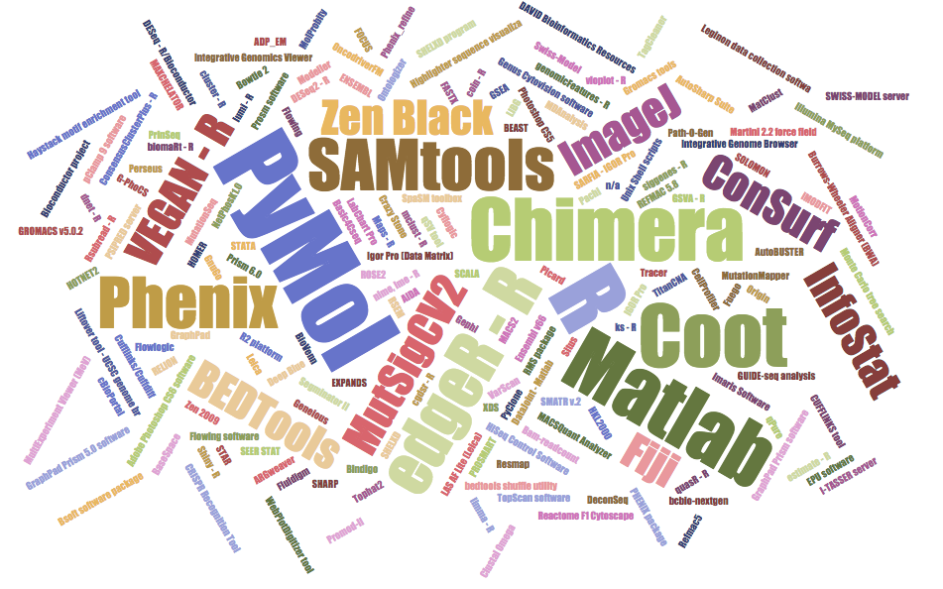
Software in nature
January – March 2016
173 pieces of software mentioned
32 of 40 papers mention software
  Nangia and Katz: 10.1109/eScience.2017.78
Notes:
Study by Nangia and Katz
https://arxiv.org/pdf/1706.06527.pdf
January – March 2016, 173 pieces of software mentioned
32 of 40 papers mention software
6 packages mentioned in 4 or more papers: Pymol, R, Chimera, Coot, Matlab, PHENIX
26 packages mentioned in 2 or more papers
Note that R packages feature heavily, along with visualisation tools

Slide 11
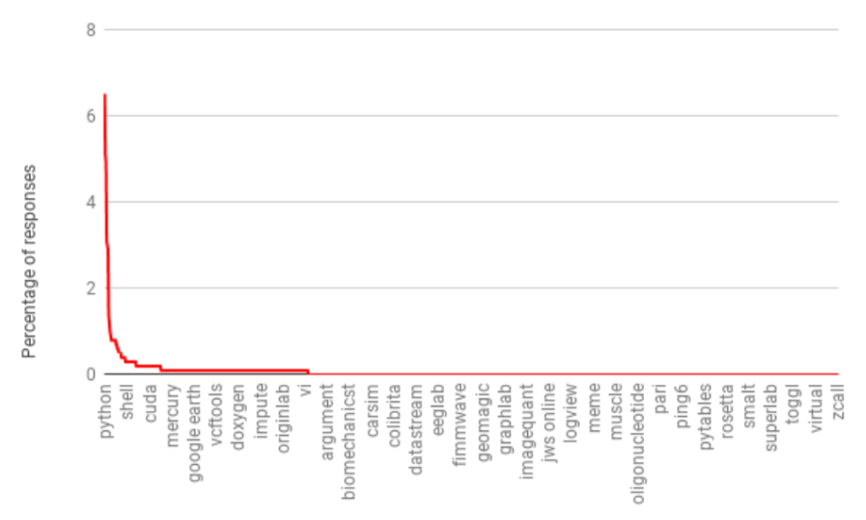
Long, long, long tail
“What software do you use in your research?”
2958 responses (2014–16, 1261 participants)
>10: 35 packages
>1: 304 packages
1: 2654 packages
Python, Matlab, R
SPSS, Excel top packages
http://doi.org/10.5281/zenodo.60276
Slide courtesy of Simon Hettrick

Slide 12




Software Sustainability Institute
A national facility for cultivating better, more sustainable, research software to enable
world-class research
Software reaches boundaries in its
development cycle that prevent
improvement, growth and adoption
Providing the expertise and services
needed to negotiate to the next stage
Developing the policy and tools to
support the community developing and
using research software
Supported by EPSRC Grant EP/H043160/1
+ EPSRC/ESRC/BBSRC grant EP/N006410/1
Notes:
The Software Sustainability Institute can help with: software reviews and refactoring, collaborations to develop your project, guidance and best practice
on software development, project management, community building, publicity and more…
Drawing on pool of specialists to drive the continued improvement and impact of research software developed by and for researchers
Providing services for research
software users and developers
Developing research community
interactions and capacity
Promoting research software
best practice and capability

Slide 13
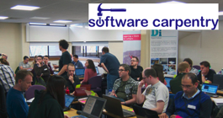

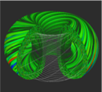
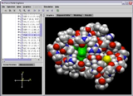
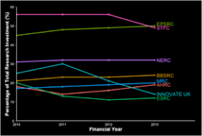
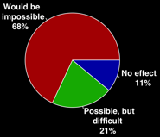


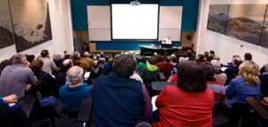


Software
Training
Helping the community to develop software that meets the needs of reliable, reproducible, and reusable research
Delivering essential software skills to researchers via CDTs, institutions & doctoral schools
Outreach
Exploiting our platform to enable engagement, delivery & uptake
Collecting evidence
on the community’s software use & sharing with stakeholders
Bringing together
the right people to understand and address topical issues
Policy
Community

Slide 14
Writing software is HARD
It’s not easy to understand how to produce good software
One size doesn’t always fit all
Best practice requires more than just one person “buying in” to become widely adopted
xkcd: Good Code by Randall Munroe
https://xkcd.com/844/

Slide 15
Growth in a time of debt
Can you spot
the mistake?
“All I can hope is that future historians note that one of the core empirical points providing the intellectual foundation for the global move to austerity in the early 2010s was based on someone accidentally not updating a row formula in Excel” – Mike Konczal
Reinhart, Carmen M.; Rogoff, Kenneth S. (2010). "Growth in a Time of Debt". American Economic Review. 100 (2): 573–78. doi:10.1257/aer.100.2.573
https://qz.com/75035/fixing-this-excel-error-transforms-high-debt-countries-from-recession-to-growth/
http://www.nytimes.com/2013/04/26/opinion/debt-growth-and-the-austerity-debate.html
https://www.bloomberg.com/news/articles/2013-04-18/faq-reinhart-rogoff-and-the-excel-error-that-changed-history

Slide 16
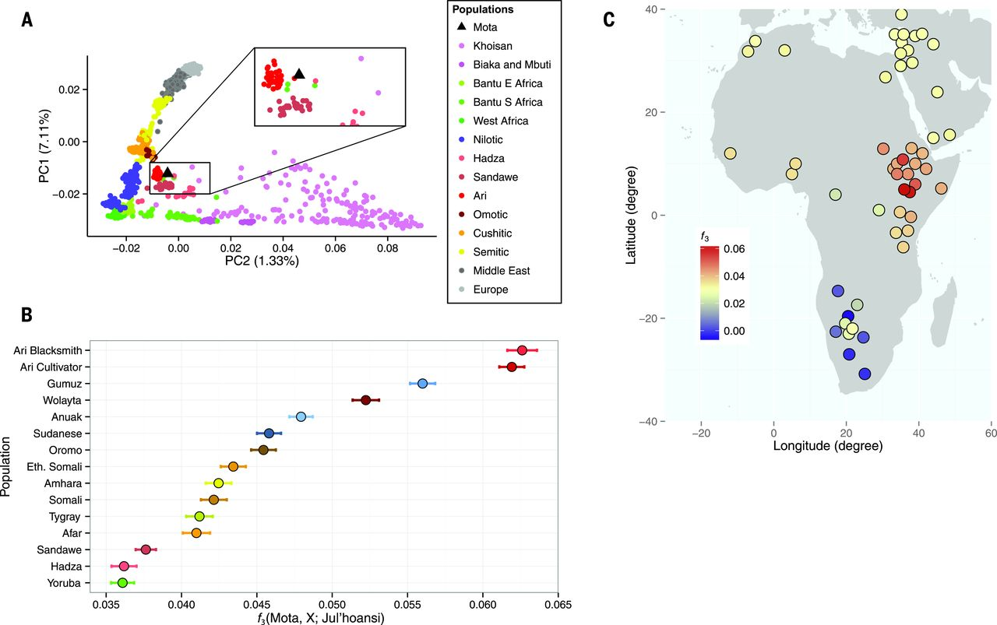
Llorente et al. Science, 350, 6262
doi:10.1126/science.aad2879
The results presented in the Report “Ancient Ethiopian genome reveals extensive Eurasian admixture throughout the African continent“ were affected by a bioinformatics error
https://www.nature.com/news/error-found-in-study-of-first-ancient-african-genome-1.19258
Notes:
One of the conclusions of a report published last year suggested a large migration of Eurasians back into Africa. However it turned out that this was due to an error in the bioinformatics pipeline wrongly discarding data.
In this case, this is a case of good science – the methodology was published, the data was available (http://africangenome.org/index.php/African_genome_ftp though not licensed) and the authors issued an erratum when the mistake was found.
The results presented in the Report “Ancient Ethiopian genome reveals extensive Eurasian admixture throughout the African continent“ were affected by a bioinformatics error. A script necessary to convert the input produced by samtools v0.1.19 to be compatible with PLINK was not run when merging the ancient genome, Mota, with the contemporary populations SNP panel, leading to homozygote positions to the human reference genome being dropped as missing data (the analysis of admixture with Neanderthals and Denisovans was not affected). When those positions were included, 255,922 SNP out of 256,540 from the contemporary reference panel could be called in Mota. The conclusion of a large migration into East Africa from Western Eurasia, and more precisely from a source genetically close to the early Neolithic farmers, is not affected. However, the geographic extent of the genetic impact of this migration was overestimated: the Western Eurasian backflow mostly affected East Africa and only a few Sub-Saharan populations; the Yoruba and Mbuti do not show higher levels of Western Eurasian ancestry compared to Mota.
We thank Pontus Skoglund and David Reich for letting us know about this problem.

Slide 17
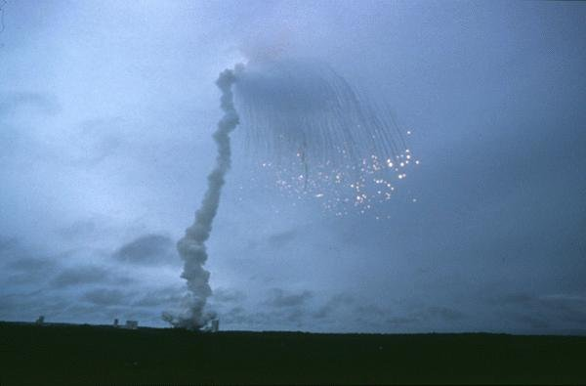
When things go wrong
64 bit floating point number
10101010
10101010
10101010
10101010
10101010
10101010
10101010
10101010
10101010
10101010
10101010
10101010
10101010
10101010
10101010
10101010
16 bit signed integer
11111111
00000000
00001111
11110000
00110011
11001100
00001111
11110000
“nozzle deflections were commanded by the ... software on the basis of data transmitted by the active Inertial Reference System (SRI 2) ... Part of these data ... did not contain proper flight data, but ... was interpreted as flight data.”
“SRI 2 did not send correct attitude data ... due to a software exception”
“software exception was caused during execution of a data conversion from 64-bit floating point to 16-bit signed integer value”
ARIANE 5 Flight 501 Failure, Report by the Inquiry Board, 19 July 1996
http://www.esa.int/For_Media/Press_Releases/Ariane_501_-_Presentation_of_Inquiry_Board_report
Cost of this bug: US$370 million
http://www.esa.int/spaceinimages/Images/2009/09/Explosion_of_first_Ariane_5_flight_June_4_1996

Slide 18
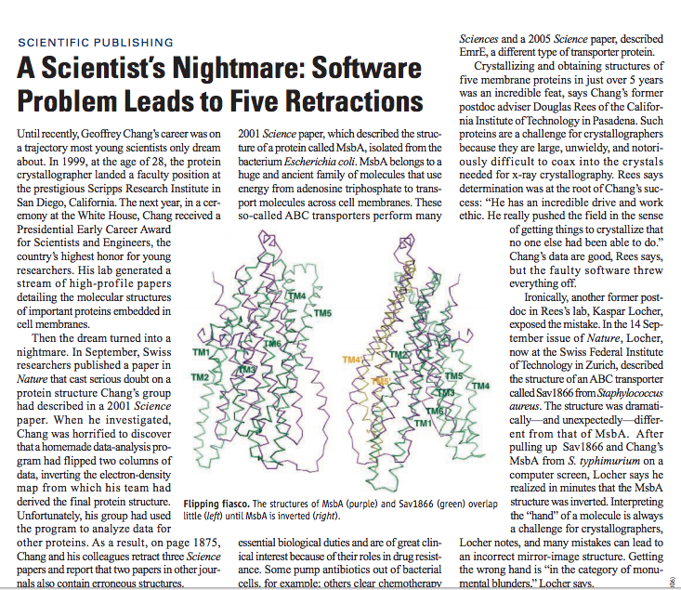
“Chang’s data are good…
but the faulty software
threw everything off”
http://science.sciencemag.org/
content/314/5807/1856.full
“a homemade data-analysis program had flipped two columns”
Notes:
http://science.sciencemag.org/content/314/5807/1856.full

Slide 19
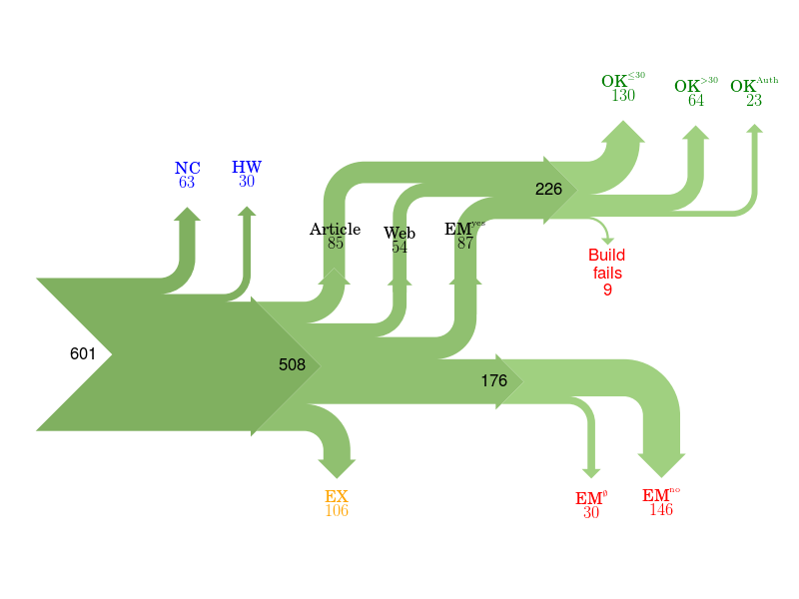
Of 601 papers in ACM Computer Science journals and proceedings,
only 85 provided a link to software.
For 176 the software could not be obtained.
Collberg, Proebsting, Warren, University of Arizona TR 14-04, 2015
http://reproducibility.cs.arizona.edu/v2/RepeatabilityTR.pdf
Notes:
NC Paper excluded due to results not being backed by code.
HW Paper excluded due to replication requiring special hardware.
EX Paper excluded due to overlapping author lists.
EMno Author responds that the code cannot be provided.
EMØ Author does not respond to email request within 2 months.
Article Code is found from link in the article itself.
Web Code is found from a web search.
EMyes Code is provided by author after email request.
OK≤30 We succeed in building the system in ≤30 minutes.
OK>30 We succeed in building the system in >30 minutes.
OK>Author We fail to build, but the author says the code builds with reasonable effort.
Fails We fail to build, and the author doesn't respond to survey or says code may have problems building.

Slide 20
Science is just a data pipeline
xkcd: Data Pipeline by Randall Munroe
https://xkcd.com/2054/

Slide 21
“Perceived” importance
“It has been said … that writing a large piece of software is akin to building infrastructure such as a telescope rather than a creditable scientific contribution…”
“software development [is] often discounted in the scientific community, and programming is treated as something to spend as little time on as possible”
“Serious scientists are not expected to carefully test code, let alone document it, in the same way they are trained to properly use other tools or document their experiments”
  Stodden, V., Bailey, D. H., Borwein, J., LeVeque, R.J., Rider, W., Stein, W. “Setting the Default to Reproducible Reproducibility in Computational and Experimental Mathematics”, ICERM 2013, February 2013.

Slide 22
Culture change is hard
In 2011 Science changed its editorial policies:
“We require that all computer code used for modeling and/or data analysis that is not commercially available be deposited in a publicly accessible repository upon publication.”
“After publication, all reasonable requests for data, code, or materials must be fulfilled.”
Stodden, Seiler, Ma. An empirical analysis of journal policy
effectiveness for computational reproducibility
https://doi.org/10.1073/pnas.1708290115
Notes:
https://doi.org/10.1073/pnas.1708290115
http://www.sciencemag.org/authors/science-journals-editorial-policies
Implemented February 11, 2011.

Slide 23
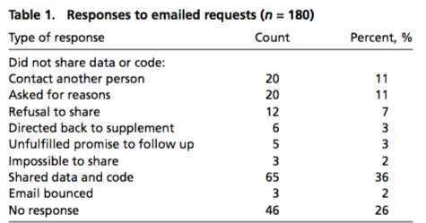
Culture change is hard
Stodden, Seiler, Ma. An empirical analysis of journal policy
effectiveness for computational reproducibility
https://doi.org/10.1073/pnas.1708290115
Notes:
https://doi.org/10.1073/pnas.1708290115
http://www.sciencemag.org/authors/science-journals-editorial-policies
Implemented February 11, 2011.

Slide 24
Culture change is hard
“There appeared to be some confusion among authors, some of whom seemed to be unaware of Science’s data and code sharing requirement. We can most easily demonstrate this with some anonymized author responses that highlight some of the barriers to sharing they perceived:”
Stodden, Seiler, Ma. An empirical analysis of journal policy
effectiveness for computational reproducibility
https://doi.org/10.1073/pnas.1708290115
Notes:
https://doi.org/10.1073/pnas.1708290115
http://www.sciencemag.org/authors/science-journals-editorial-policies
Implemented February 11, 2011.

Slide 25
Culture change is hard
“Normally we do not provide this kind of information to people we do not know. It might be that you want to check the data analysis, and that might be of some use to us, but only if you publish your findings while properly referring to us.”
“Thank you for your interest in our paper. For the [redacted] calculations I used my own code, and there is no public version of this code, which could be downloaded. Since this code is not very user-friendly and is under constant development I prefer not to share this code.”
“I have to say that this is a very unusual request without any explanation! Please ask your supervisor to send me an email with a detailed, and I mean detailed, explanation.”
“When you approach a PI for the source codes and raw data, you better explain who you are, whom you work for, why you need the data and what you are going to do with it.”
Stodden, Seiler, Ma. An empirical analysis of journal policy
effectiveness for computational reproducibility
https://doi.org/10.1073/pnas.1708290115
Notes:
https://doi.org/10.1073/pnas.1708290115
http://www.sciencemag.org/authors/science-journals-editorial-policies
Implemented February 11, 2011.

Slide 26
Foundations of Research
Re-usable
Re-producible
Re-search
Recognition / Reward
Skills and Capability
Careers
Software
Software
Software
Notes:
Some further resources:
http://www.software.ac.uk/blog/2012-11-09-craftsperson-and-scholar
http://software.ac.uk/blog/2012-08-16-what-research-software-community-and-why-should-you-care
http://www.software.ac.uk/blog/2011-05-02-publish-or-be-damned-alternative-impact-manifesto-research-software
http://www.software.ac.uk/software-evaluation-guide
http://www.software.ac.uk/software-carpentry
http://www.software.ac.uk/resources/guides
http://www.software.ac.uk/training

Slide 27
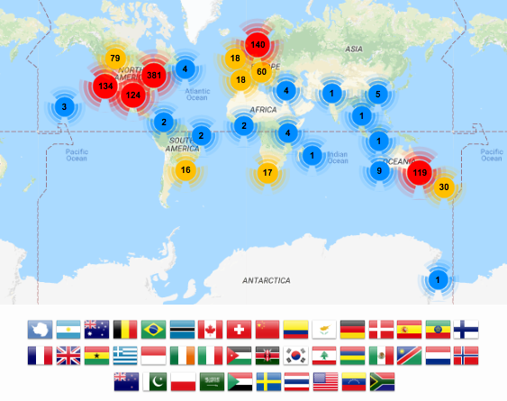


Foundational skills for researchers
Basic lab skills for scientific computing; researchers can do more in less time and with less pain.
Basic concepts, skills and tools for working more effectively with data.
Open source learning, “Train the trainers”

Slide 28
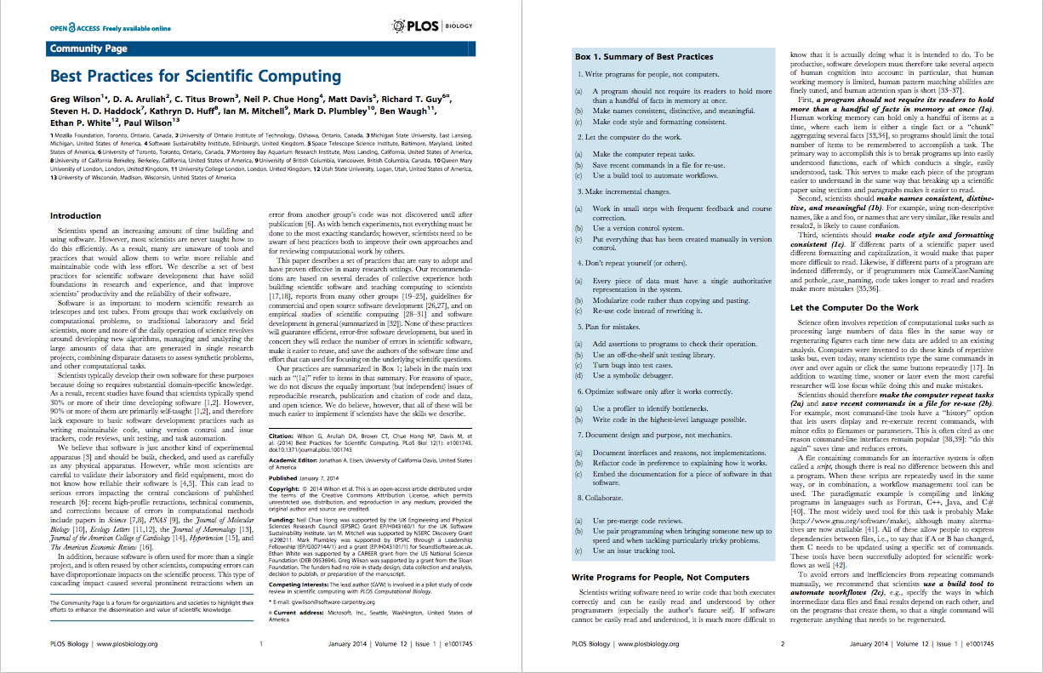
  Best Practices for Scientific Computing: https://doi.org/10.1371/journal.pbio.1001745

Slide 29
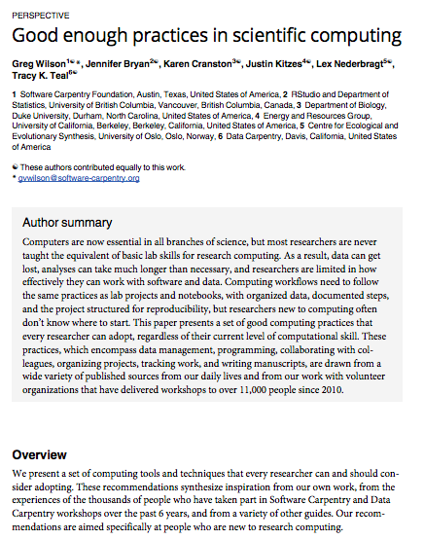
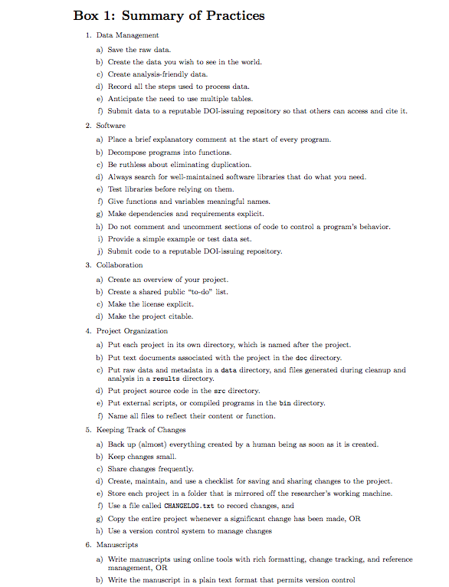
Good Enough Practices in Scientific Computing: https://doi.org/10.1371/journal.pcbi.1005510
Notes:
Good Enough Practices in Scientific Computing: https://doi.org/10.1371/journal.pcbi.1005510

Slide 30
The Research Cycle
Research
Outputs
Research is a continuous cycle.
When we publish we are contributing to the body of knowledge.
Interpret
Data
Test
Revise
Publish
Paper
Software
Create

Slide 31
Research/Reuse/Reward Cycle
Research
Reuse
Reuse is also a cycle. We build our research on the work of others.
Reward mechanisms should encourage reuse.
Interpret
Index
Test
Revise
Publish
Identify
Create
Reward
Cite
Notes:
Citation is the traditional mechanism

Slide 32
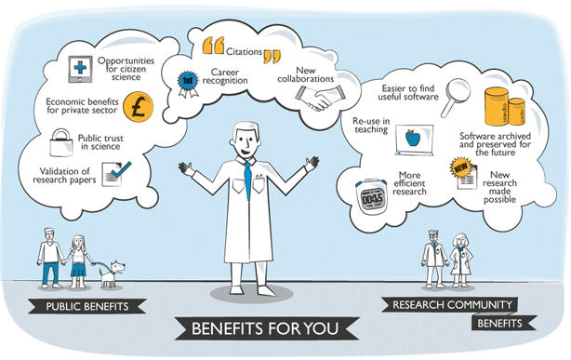
Software publications
http://openresearchsoftware.metajnl.com
http://dx.doi.org/10.6084/m9.figshare.942289
Notes:
A metajournal which encourages the publication of information that encourages the reuse of software.
A way of using the current tools and practices to make software better recognised.

Slide 33
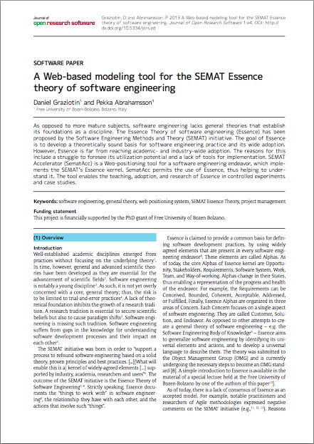
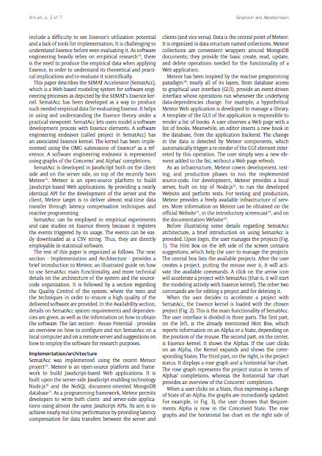
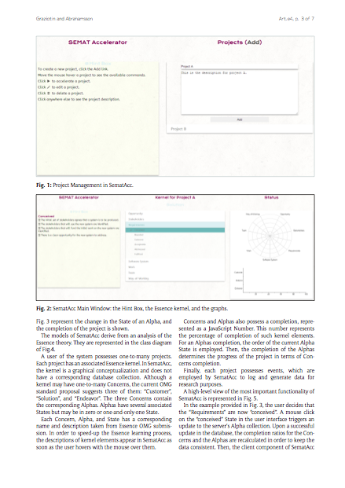
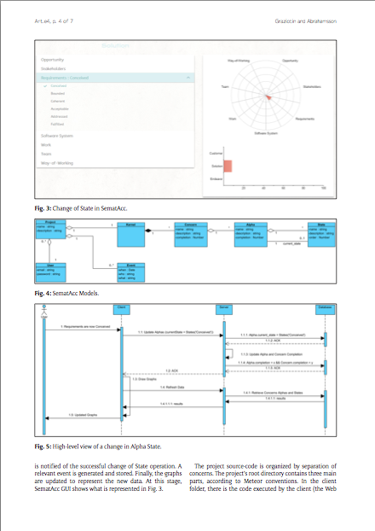
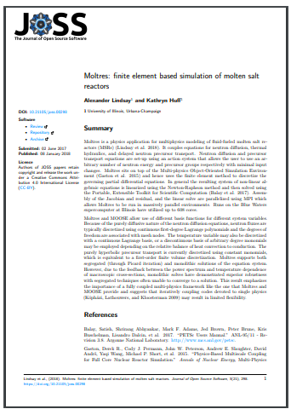
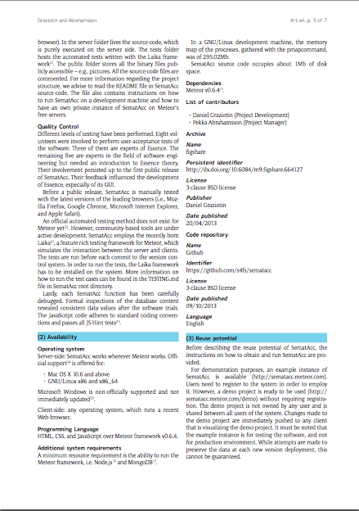
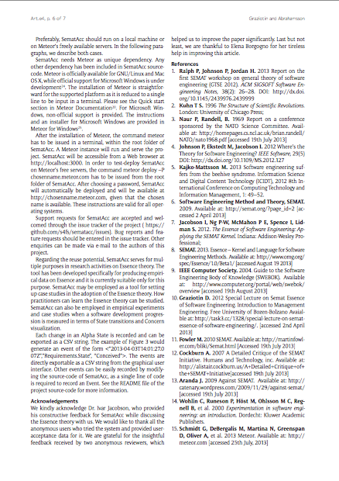
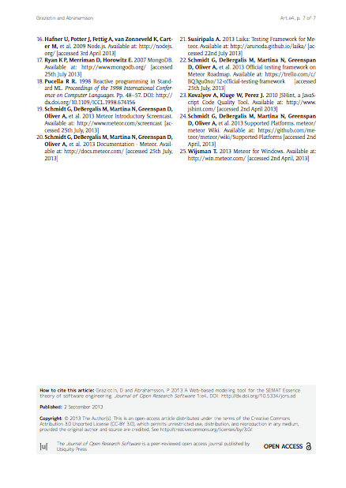
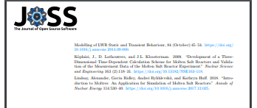
Introduction
Implementation + Usage
Screenshots
Metadata
Introduction
Usage and Reuse
References
Quality
Control
Metadata
References
Anatomy
of a software paper
(JORS & JOSS)
Reuse
Metadata

Slide 34
Smith, A. M., Katz, D. S., & Niemeyer, K. E. (2016). Software citation principles. PeerJ Computer Science, 2, e86.
https://doi.org/10.7717/peerj-cs.86

Slide 35
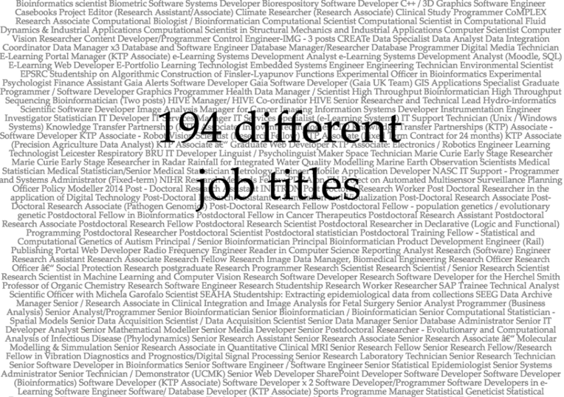
What about careers?
jobs.ac.uk
10,000 jobs assessed
~400 related to software development (4%)
Slide courtesy of Simon Hettrick

Slide 36
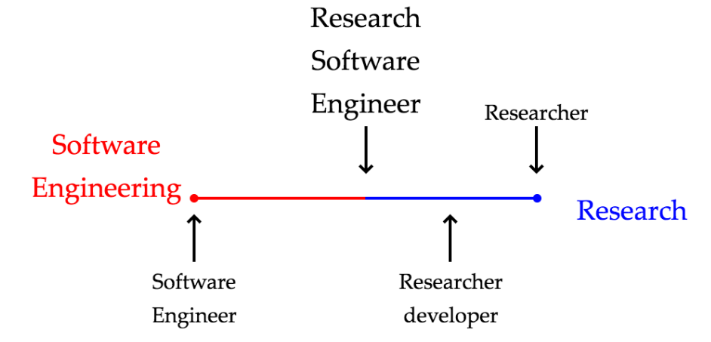
A new name is born
Slide courtesy of Simon Hettrick

Slide 37
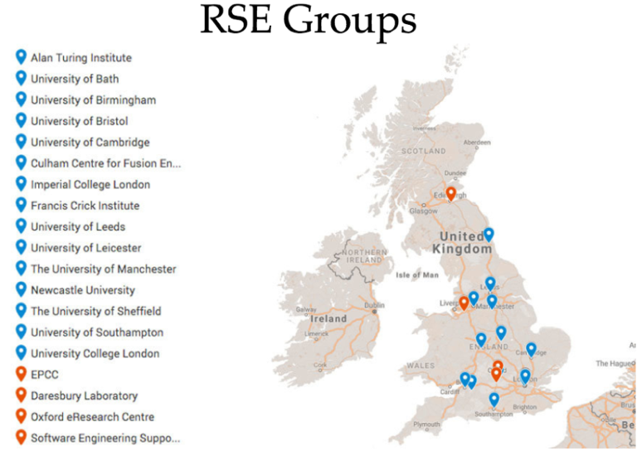

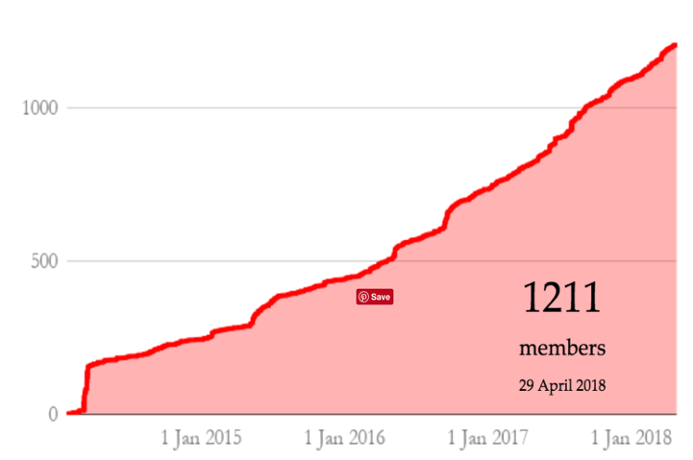
Growth of RSE Community
Slide courtesy of Simon Hettrick

Slide 38
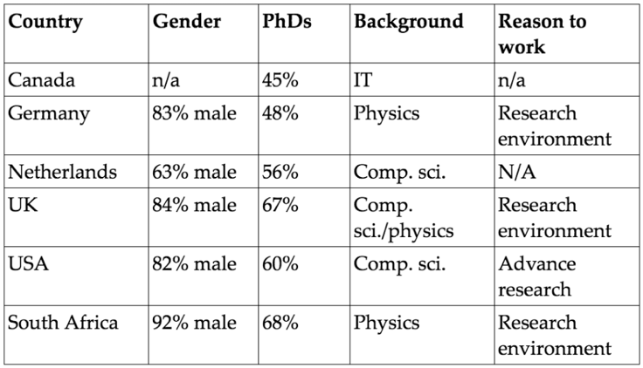
RSEs are worldwide
Wants to work in a research environment
Wants to advance research
Wants to develop software
github.com/softwaresaved/international-survey/tree/master/analysis
Slide courtesy of Simon Hettrick

Slide 39
Sharing is key to reproducibility
Improves transparency
Improves understanding
Elimination of errors
Encourages collaboration
Easier on-ramping
Improves trust
“Deep intellectual contributions now encoded only in software" – Stodden
“Scholarship is the full software environment, code and data, that produced the result” - Claerbout

Slide 40






Research Software Workflow
describe
develop ➔ share ➔ preserve
Developed and
versioned using
code repository
Published via
code repository
or website
Deposited in
digital repository
with paper /
for preservation

Slide 41










Free software infrastructure
Collaboration
Testing & CI
Deployment
Scientific Libraries
Impact
Visualisation?

Slide 42
LIGO Example
LIGO Paper:
  http://journals.aps.org/prl/abstract/10.1103/PhysRevLett.116.061102
LIGO Notebook:
  https://losc.ligo.org/s/events/GW150914/GW150914_tutorial.ipynb
Notes:
LIGO Paper:
http://journals.aps.org/prl/abstract/10.1103/PhysRevLett.116.061102
LIGO Notebook:
https://losc.ligo.org/s/events/GW150914/GW150914_tutorial.ipynb

Slide 43
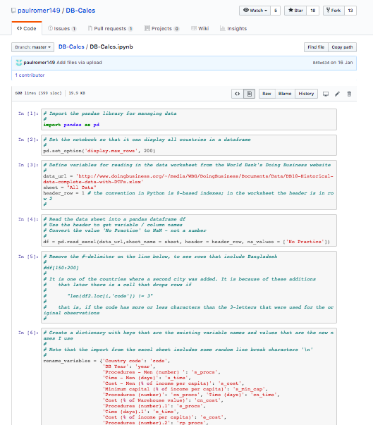
Doing Business example
https://paulromer.net/doing-business/
Notes:
And we’re back round to Economics – Paul Romer (who won the 2018 Nobel Prize for Economics) is a strong proponent of transparent research, and published a Jupyter Notebook to show how anyone could use the available data to calculate the rankings used in the Doing Business reports.

Slide 44
The modern well-founded laboratory has the minimum level of software training, people and infrastructure to support reproducible and reusable research at an acceptable quality and quantity.
Software is now an integral part of every world-class research infrastructure.

Slide 45
Summary
Software is ubiquitous and underpinning in modern research
Modern research needs a skilled workforce, incentives for reuse, and alternative career paths
The modern well-founded laboratory has to support good software practice
Slides: https://doi.org/10.6084/m9.figshare.7233137

Slide 46



Find out more about the SSI
Community Engagement (Lead: Shoaib Sufi)
  Fellowship Programme & Events and Workshops
Consultancy (Lead: Steve Crouch)
  Open Call for Projects / Collaborations
  Online Software Evaluation & Software Management Planning
Policy and Publicity (Lead: Simon Hettrick)
  Case Studies / Policy Campaigns
  Software and Research Blog
Training (Lead: Aleksandra Nenadic)
  Software Carpentry and Data Carpentry
  Guides and Top Tips
Journal of Open Research Software (Editor: Neil Chue Hong)
Collaboration between universities of Edinburgh, Manchester, Oxford and Southampton
Supported by EPSRC Grant EP/H043160/1 + EPSRC/ESRC/BBSRC grant EP/N006410/1

Slide 47



Acknowledgements
The SSI team/alumni:
Aleksandra Nenadic
Aleksandra Pawlik
Alexander Hay
Arno Proeme
Carole Goble
Claire Wyatt
Clem Hadfield
Dave De Roure
Devasena Prasad
Giacomo Peru
Graeme Smith
Iain Emsley
James Graham
John Robinson
Les Carr
Malcolm Atkinson
Malcolm Illingworth
Mario Antonioletti
Mark Parsons
Mike Jackson
Olivier Philippe
Priyanka Singh
Raniere Silva
Rob Baxter
Robin Wilson
Shoaib Sufi
Simon Hettrick
Stephen Crouch
Tim Parkinson
Toni Collis
Plus the SSI Fellows
and RSE community
Scientific software:
Dan Katz
Heather Piowowar
James Howison
Jeff Carver
Jennifer Schopf
Kaitlin Thaney
Martin Fenner
Victoria Stodden
WSSSPE community
Software/Data Carpentry
Greg Wilson
Jonah Duckles
Tracy Teal
Instructor Community
Supported by EPSRC Grant EP/H043160/1 +
EPSRC/ESRC/BBSRC grant EP/N006410/1

Slide 48
Software Sustainability Institute
A national facility for cultivating better, more sustainable, research software to enable
world-class research
Software reaches boundaries in its
development cycle that prevent
improvement, growth and adoption
Providing the expertise and services
needed to negotiate to the next stage
Developing the policy and tools to
support the community developing and
using research software
Supported by EPSRC Grant EP/H043160/1
+ EPSRC/ESRC/BBSRC grant EP/N006410/1
Notes:
The Software Sustainability Institute can help with: software reviews and refactoring, collaborations to develop your project, guidance and best practice
on software development, project management, community building, publicity and more…
Drawing on pool of specialists to drive the continued improvement and impact of research software developed by and for researchers
Providing services for research
software users and developers
Developing research community
interactions and capacity
Promoting research software
best practice and capability

Slide 49
Software
Training
Helping the community to develop software that meets the needs of reliable, reproducible, and reusable research
Delivering essential software skills to researchers via CDTs, institutions & doctoral schools
Outreach
Exploiting our platform to enable engagement, delivery & uptake
Collecting evidence
on the community’s software use & sharing with stakeholders
Bringing together
the right people to understand and address topical issues
Policy
Community

Slide 50

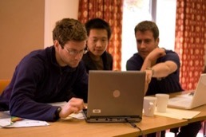
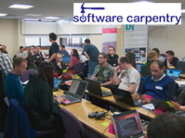
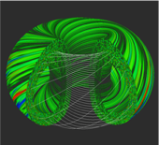
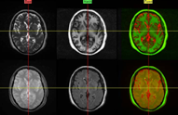


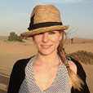
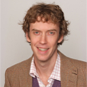
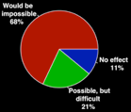







Software
Training
Advice
Courses
35+ UK SWC
workshops
1000+ learners
Consultancy
50+ projects
130+ evaluations
4 surgeries
Guides
Outreach
80+ guides
50,000 readers
Website & blog
150+ contributed articles
20,000 unique visitors per month
3,000 Twitter followers
Research
740 researchers
50,000 grants
analysed
Campaigns
Workshops
Fellowship
61 domain
ambassadors
300+ RSEs engaged
2100 signatures
13 issues highlighted
Policy
Community
20+ workshops organised

Slide 51

Guides are popular
Software Evaluation Guide (over 65k unique visits)
Choosing a repository for your software project (over 50k unique visits)
How to cite and describe software (over 25k unique visits)
Developing maintainable software (over 25k unique visits)
In which journals should I publish my software (over 22k unique visits)
But on their own, they don’t ensure
adoption of good practice

Slide 52

DLR Initiative
https://doi.org/10.6084/m9.figshare.5331703.v2
Carina Haupt and Tobias Schlauch

Slide 53

https://doi.org/10.6084/m9.figshare.5331703.v2
Carina Haupt and Tobias Schlauch

Slide 54

https://doi.org/10.6084/m9.figshare.5331703.v2
Carina Haupt and Tobias Schlauch

Slide 55
Community standards
ESIP (Earth Sciences):
https://esipfed.github.io/Software-Assessment-Guidelines/
CLARIAH (Arts and Humanities): https://github.com/CLARIAH/software-quality-guidelines
IPOL (Image Processing): https://tools.ipol.im/wiki/ref/software_guidelines/
ELIXIR (Life Sciences): https://www.ncbi.nlm.nih.gov/pmc/articles/PMC5490478/

Slide 56
Software Development Best Practices for Life Sciences
Goal:
  Define procedures to improve quality and sustainability of software development that could be adopted by ELIXIR and other biomedical Research Infrastructures
Series of workshops (lightning talks, facilitated sessions)
  Agree practices
  Build community
  Create policy
  Develop guidance
Outputs
  “Four simple recommendations” paper
  “Top 10 Metrics” paper
  Training course (in development)
  Endorsement by community
  Repo: https://github.com/SoftDev4Research/
1. Develop publicly accessible open source code from day one
2. Make software easy to discover by providing software metadata via a popular community registry
3. Adopt a license and comply with the licence of third-party dependencies
4. Have a clear and transparent contribution, governance and communication processes

Slide 57

Victoria Stodden, AMP 2011 http://www.stodden.net/AMP2011/,
Special Issue Reproducible Research Computing in Science and Engineering
July/August 2012, 14(4)
Howison and Herbsleb (2013) "Incentives and Integration In Scientific Software Production" CSCW 2013.
Notes:
Victoria Stodden, AMP 2011 http://www.stodden.net/AMP2011/,
Special Issue Reproducible Research Computing in Science and Engineering
July/August 2012, 14(4)
Howison and Herbsleb (2013) "Incentives and Integration In Scientific Software Production" CSCW 2013.

Slide 58
It’s still all about reputation
“This particular project was something I wrote a couple years ago to help me out with a workflow… I’d put it up on Github, so that others could potentially use it or use the code. So I went to see what people were saying about this project. It seemed liked I’d done something fundamentally wrong, so stupid that it flabbergasts someone... So of course I start sobbing. Then I see these people’s follower count, and I sob harder. I can’t help but think of potential future employers that are no longer potential.”
http://www.software.ac.uk/blog/2013-01-25-haters-gonna-
hate-why-you-shouldnt-be-ashamed-releasing-your-code

Slide 59
It’s impossible to do this on your own

Slide 60
Communities of Practice
Domain: A domain of knowledge creates common ground, inspires members to participate, guides their learning and gives meaning to their actions
Community: The notion of a community creates the social fabric for that learning. A strong community fosters interactions and encourages a willingness to share ideas.
Practice: While the domain provides the general area of interest for the community, the practice is the specific focus around which the community develops, shares and maintains its core of knowledge.
Wenger, Etienne; McDermott, Richard; Snyder, William M. (2002). Cultivating Communities of Practice (Hardcover).
Harvard Business Press; 1 edition. ISBN 978-1-57851-330-7.

Slide 61
Cultivating successful CoPs
Design the community to evolve naturally
Create opportunities for open dialog within and with outside perspectives
Welcome and allow different levels of participation
Develop both public and private community spaces
Focus on the value of the community
Combine familiarity and excitement
Find and nurture a regular rhythm for the community
Wenger, Etienne; McDermott, Richard; Snyder, William M. (2002). Cultivating Communities of Practice (Hardcover).
Harvard Business Press; 1 edition. ISBN 978-1-57851-330-7.

Slide 62





Examples of CoPs
https://cookbook.carpentries.org/
https://ourcodingclub.github.io/
Sheffield Astrophysics Code Review Club
https://www.software.ac.uk/index.php/blog/
2018-05-18-code-review-academia
http://melbourne.resbaz.edu.au/HackyHour
http://collections.plos.org/
ten-simple-rules

Slide 63

This is still going to be painful
Piled Higher and Deeper" by Jorge Cham
www.phdcomics.com
http://phdcomics.com/comics.php?f=1689

