Slide 1
Konstantinos Kentrotis
Water & Design

Slide 2
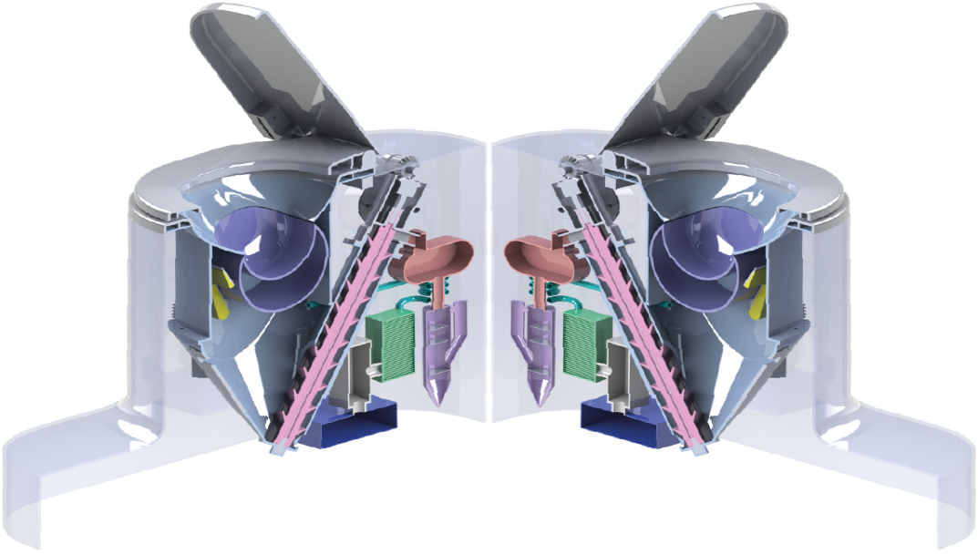
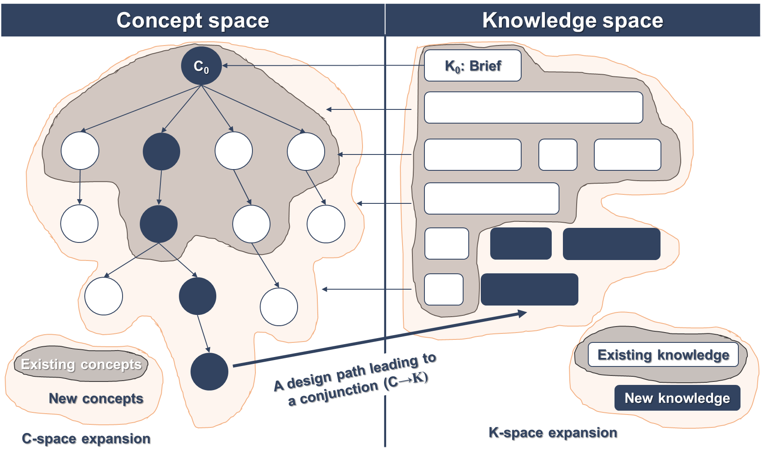
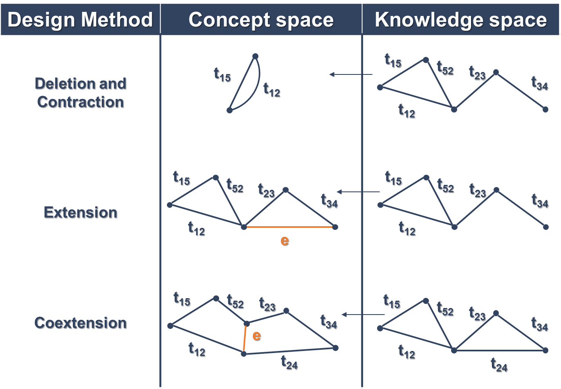
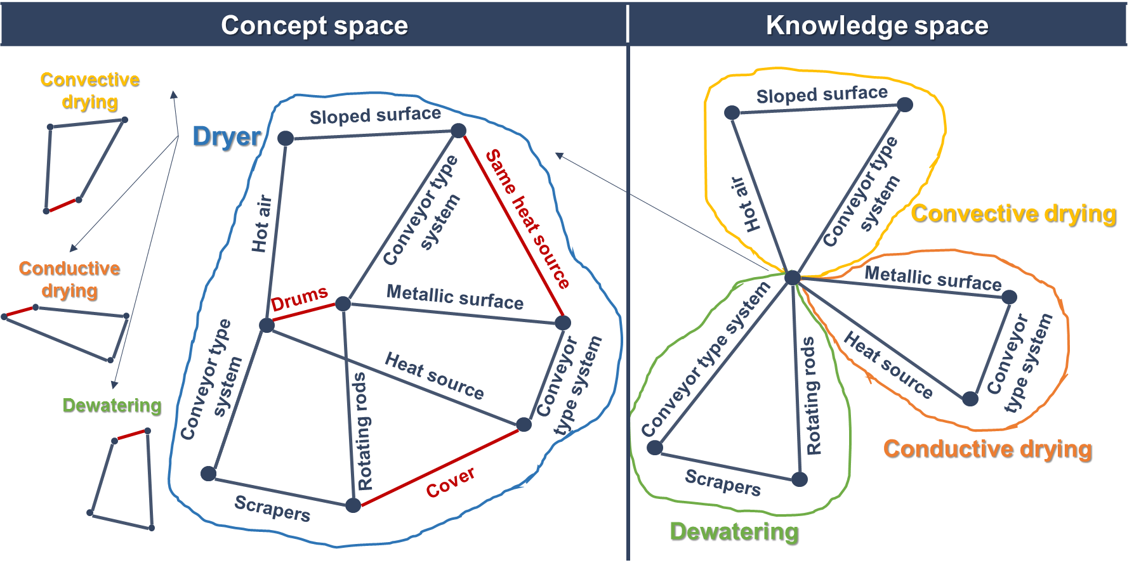
What makes us good inventors?
Dryer/Pelletizer
1
2
Real-world invention
Understanding the cognitive process
4
What makes us good inventors?
3
Linking with modern Design Theory
THIS AREA OF YOUR SLIDE WILL BE COVERED BY A TIMER

