Slide 1
Alban Echchelh
Sustainable reuse of oil wastewater for irrigation in drylands
Water and design

Slide 2
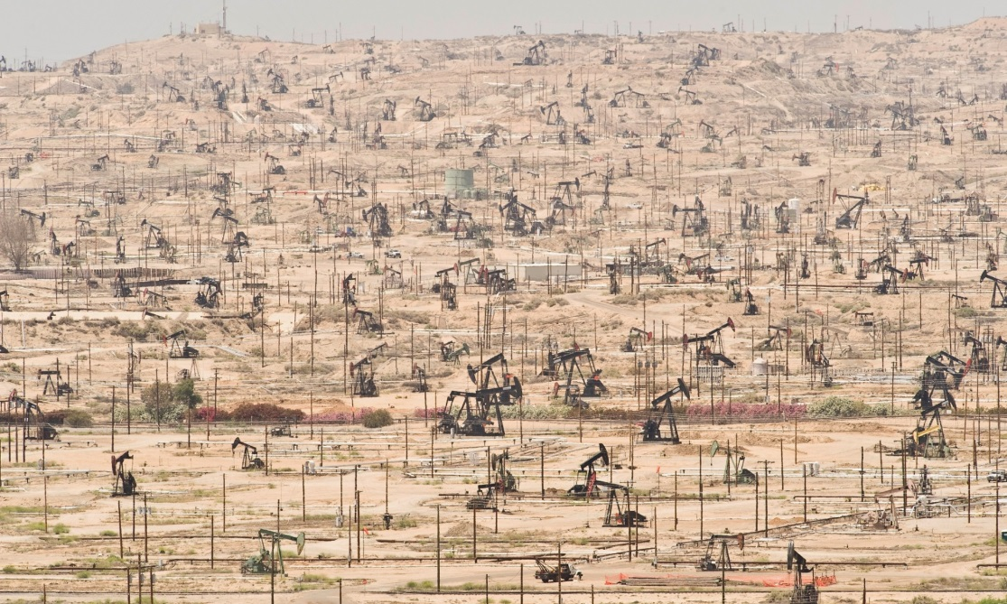
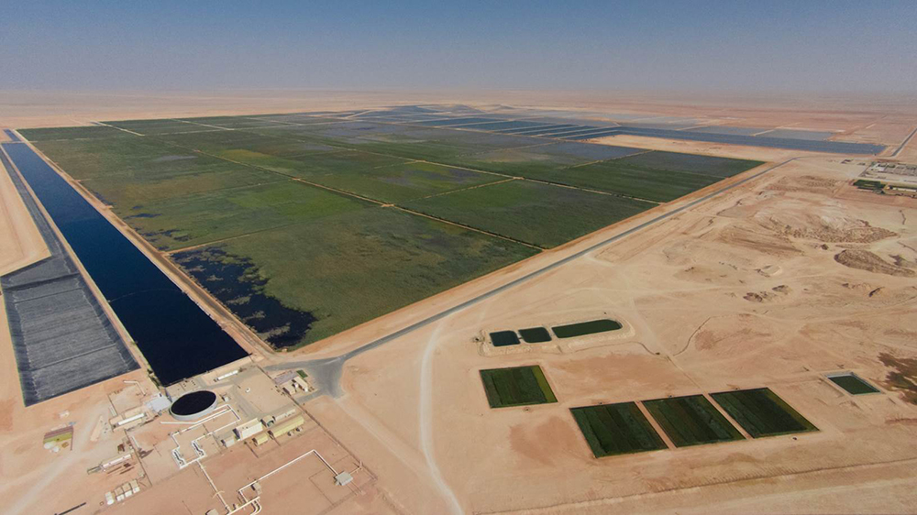
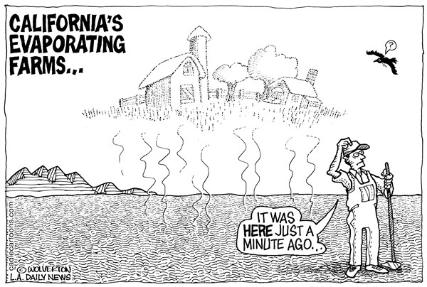
Water Reuse
Cost
Environmental impact
Sustainability ?
THIS AREA OF YOUR SLIDE WILL BE COVERED BY A TIMER

