Slide 1
Comparing Price and Performance of Three Cloud-Based Data-Storage Architectures To Optimize Use of S3 in AWS
James Gallagher, Aleksandar Jelenak, Nathan Potter,
David W Fulker and Ted Habermann
OPeNDAP, Inc. and THG, Inc.

Slide 2
Outline
Review a trade study on (NASA) data in the cloud
Evaluating architectures for storing data files in S3
Developing a cost model
(For more info, see report at www.opendap.org)
Report more recent work
Optimizing three specific aspects of S3 usage as above
Parallelism
Connection Reuse
Accessing S3 via HTTPS versus HTTP
Making better-informed architectural decisions about utilizing cloud-based web-object stores in data-as-service systems

Slide 3
Trade-Study Methodology
Analyzed NASA data-server logs to build 21 use cases
Selected/uploaded (into AWS S3) three NASA data collections
MERRA-2 product – 231 GB as 7,466 netCDF4 files, ~31 MB each
AIRS-STD3.006 product – 122 GB as 365 HDF5 files, ~334 MB each
Other representative HDF5 files – 125 MB as 96 files of varying sizes
Designed three specific architectures (see subsequent slides)
Implemented all three (as adaptations of OPeNDAP’s Hyrax)
Running in AWS & utilizing S3 (in 3 distinct ways)
Using an enhanced HDF5 library (which offers extended data-storage info)
Evaluated all three architectures against the 21 uses cases!

Slide 4
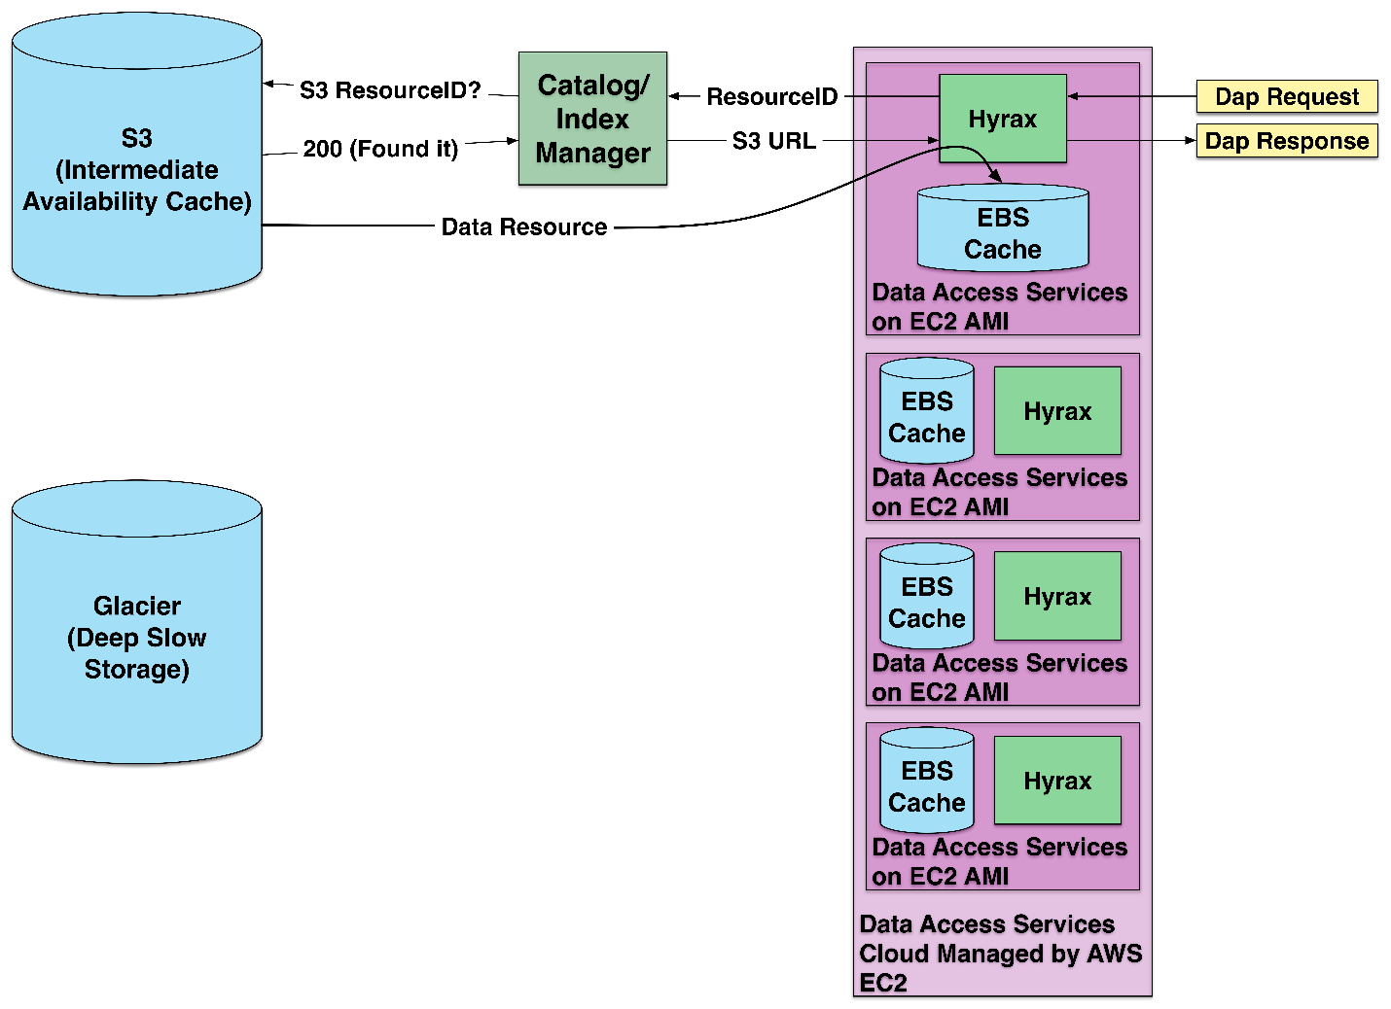
Arch 1: Baseline
Access using whole files retrieved from S3
Notes:
AS: Added from trade study report, rev 1

Slide 5
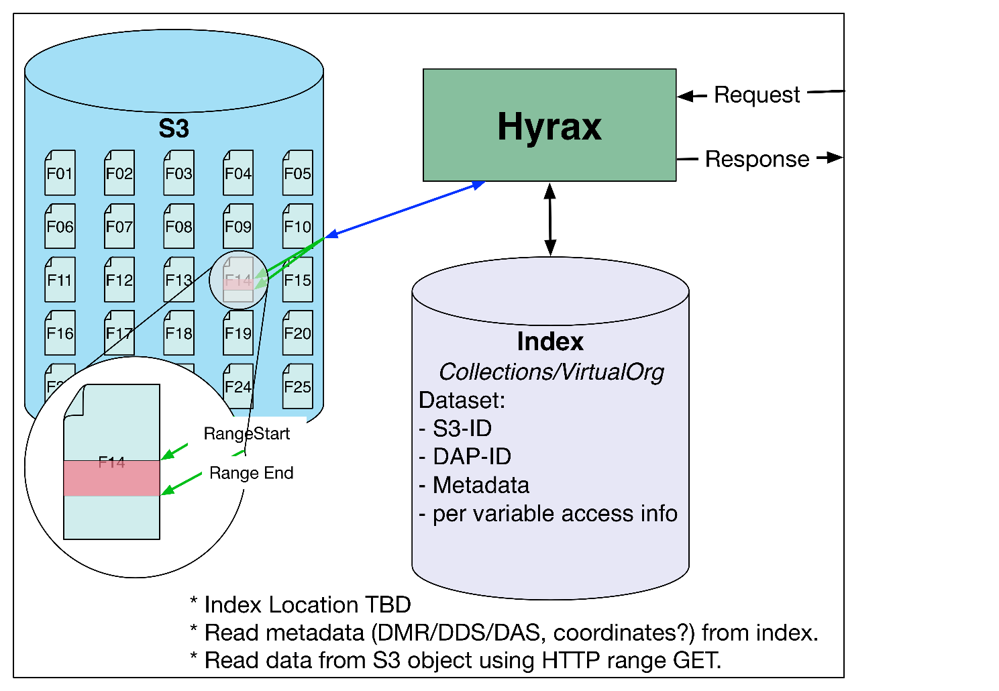
Arch 2: Files with HTTP Range GETs
HTTP Range-Get access to whole files in S3
Notes:
AS: Added from trade study report, rev 1

Slide 6
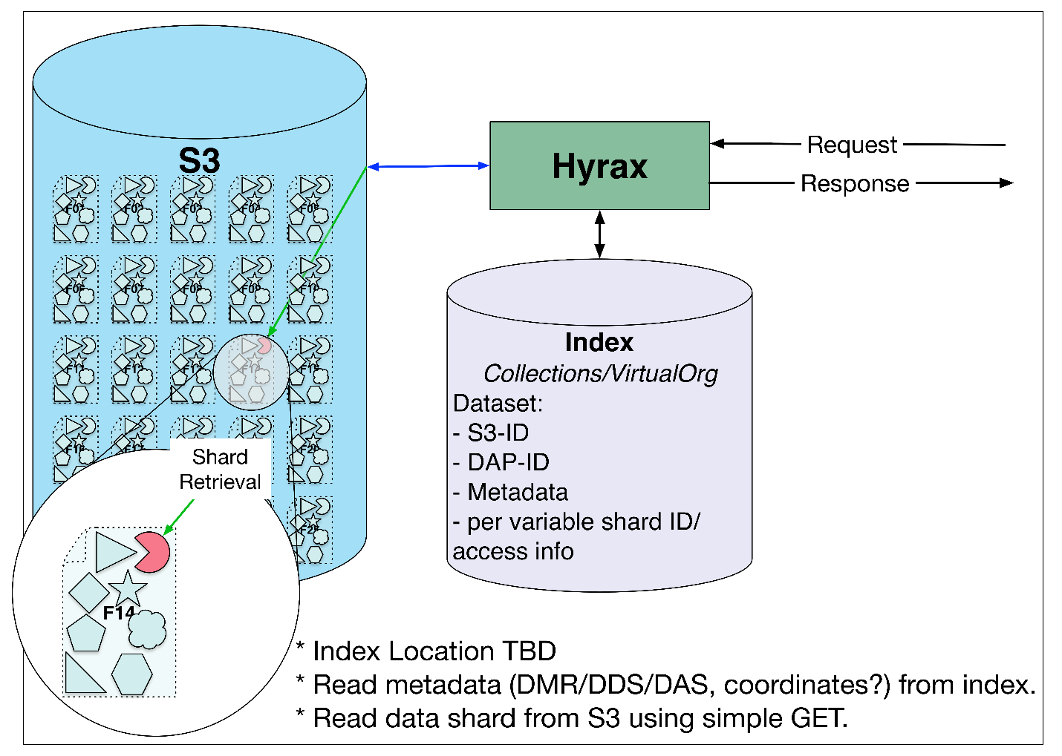
Arch 3: Shredded HDF5 Files
HTTP Get access to parts of HDF5 files as objects in S3
Notes:
AS: Added from trade study report, rev 1

Slide 7
Findings on Reducing Costs & Latencies
Costs | Cost-Reducing Strategies
Storage | Minimize duplication
In-Cloud Data Transfers | Relatively insignificant
Web-Service Transfers | Minimize volume of data transferred out of the cloud
In-Cloud Processing | Minimize waiting (primarily for access-startup)
Latencies | Latency-Reducing Strategies
In-Cloud Data Transfers | Minimize accesses & volumes (though accesses often dominate)
Web-Service Transfers | Minimize accesses & volumes (though volumes often dominate)
In-Cloud Processing | Minimize waiting (primarily for access-startup)

Slide 8
Optimization for reducing S3 Access Time
Ways to reduce access time:
Parallel transfers
HTTP/S connection reuse
HTTP instead of HTTPS
Notes:
JG: Replaced “Architectures that make fewer connections to S3 were faster for data requests that touched a small number of chunks” with “Architectures that make fewer connections to S3 for a single data request are generally faster.” (bullet 2)
And added “… and S3 access latency.” to bullet 2.3

Slide 9
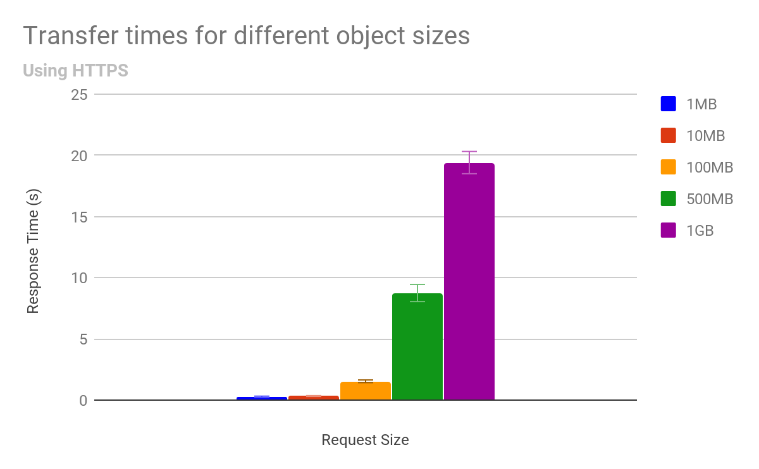
Baseline Data
Smaller objects' transfer times are dominated by S3 overhead
Objects 100MB and greater show linear relationship between size and time
We used HTTP 1.1 to access S3, but we'll come back to this later...
For parallel access we used HTTP Range-Get to create virtual shards from whole objects

Slide 10
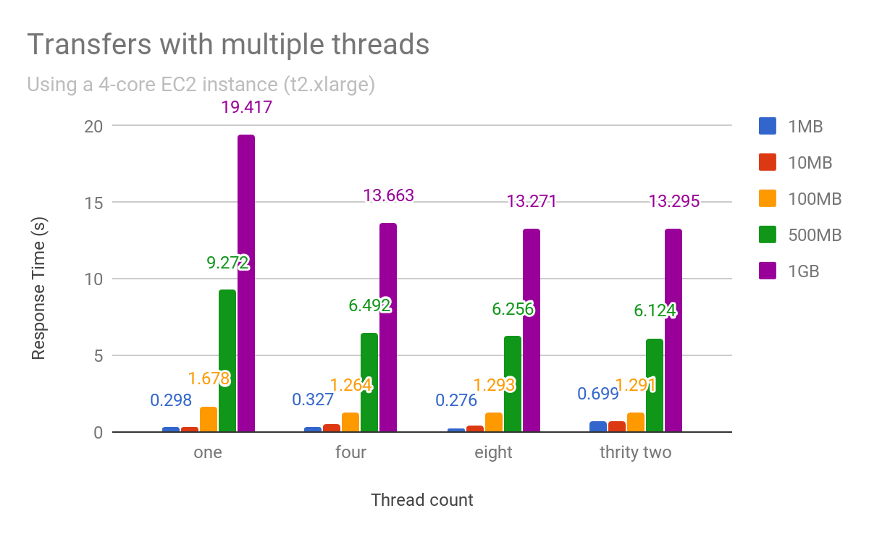
Parallel access to shards decreases response time
Splitting larger objects into shards and getting those in parallel improves response time
But, it does not improve response time for small objects
And, performance improvements level out at four parallel accesses
Note: For these tests the number of shards is the same as the number of threads

Slide 11
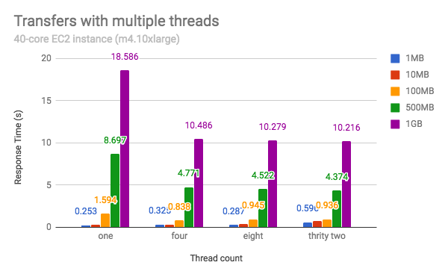
Do bigger EC2 instances alter this?
Increasing the number of cores does not radically alter the shape of the response curve
(note that the somewhat faster m4 machine achieves better performance over all)

Slide 12
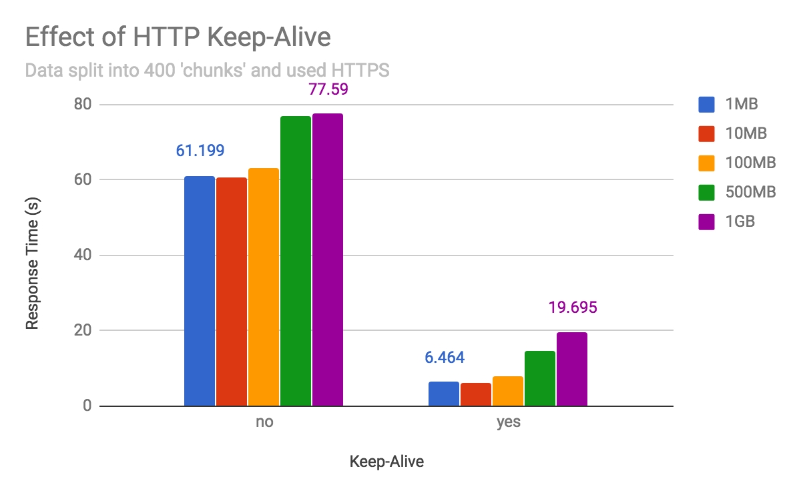
HTTP connection reuse is important when using sharding
Here we broke each object into 400 shards and accessed them with and without connection reuse (aka HTTP 1.1 Keep-ALive)
Note that for the small responses there is a significant penalty in performance even with connection reuse while for the large responses there is negligible cost
And, note that HTTP 2, which S3 supported as of Sept 2016, includes connection reuse by default*
Notes:
https://tools.ietf.org/html/rfc7540#page-66

Slide 13
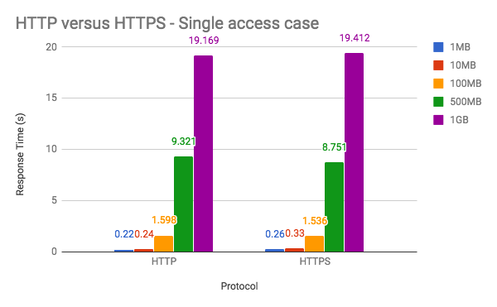
HTTP versus HTTPS?
The Single access case
Using HTTP instead of HTTPS makes no difference for large objects and negligible difference for small ones
Note: HTTPS adds TLS encryption to HTTP. Transport Layer Security (TLS) adds data encryption and origin server verification to TCP (Transfer Control Protocol) connections.

Slide 14
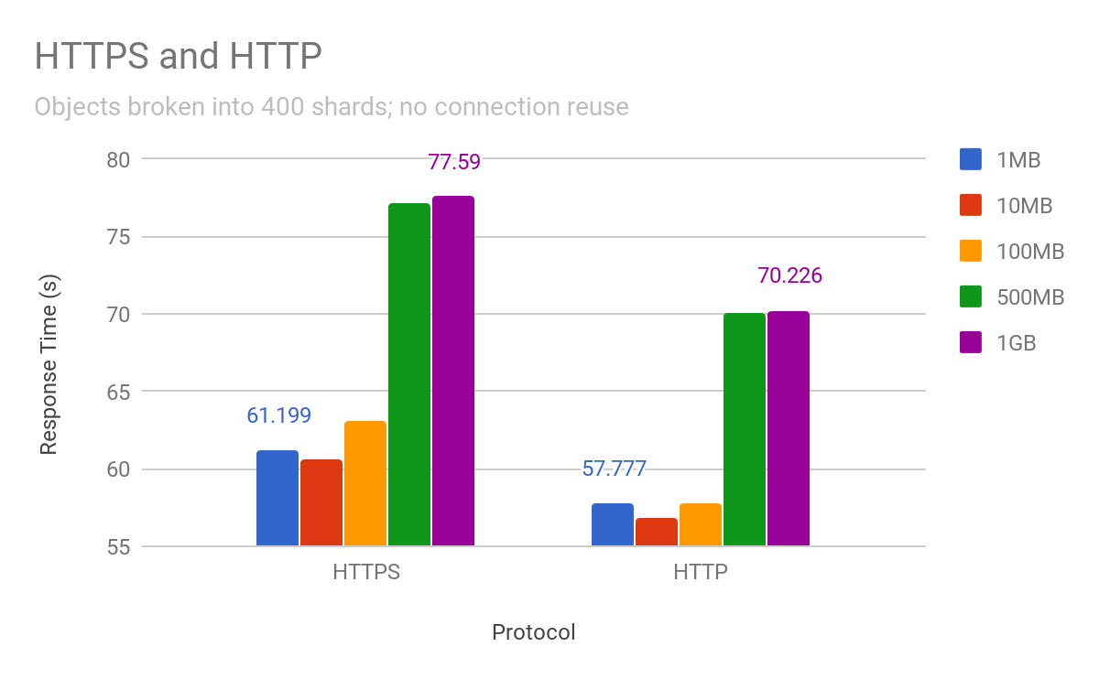
HTTP versus HTTPS
But with shards...
When data are broken up into a large number of shards (e.g., 400), the cost of the HTTPS over HTTP does become noticeable.
Where is the cost? It is primarily the cost of establishing the secure connection.
Recall from two slides ago, that accessing data broken into 400 shards with connection reuse was essentially the same as accessing the same data with a single request.

Slide 15
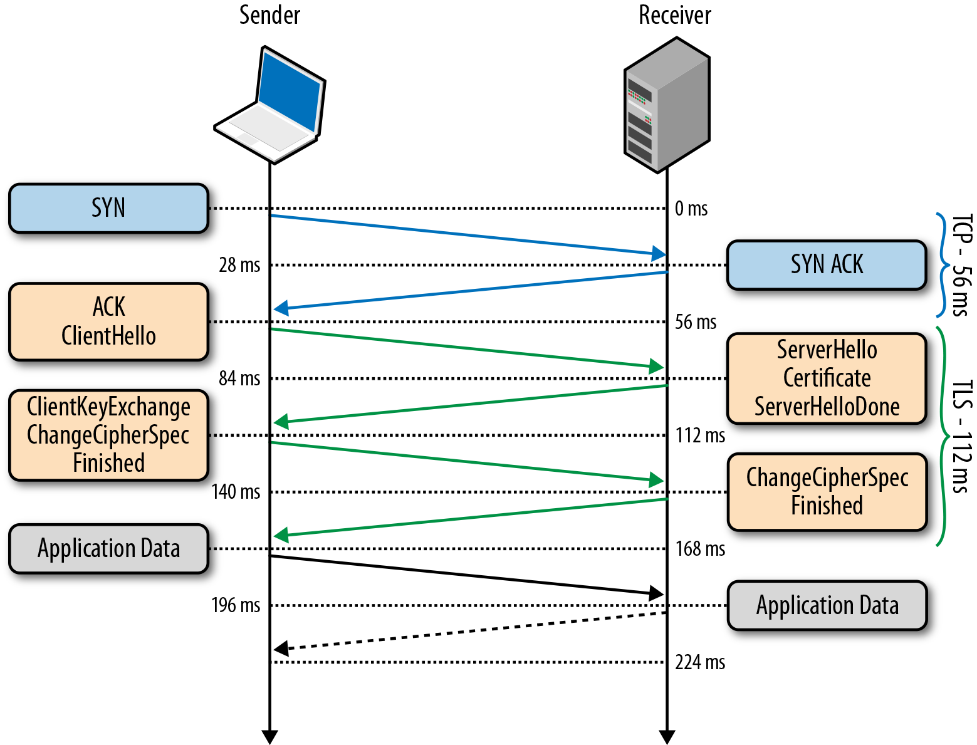
Why HTTPS has longer startup latency
HTTPS uses TLS in addition to TCP - setting that up takes extra time.
A common belief is that HTTPS 'takes longer' because all Application Data must be encrypted.
Our results indicate that for S3, extra time spent establishing the connection is much more costly than time spent encrypting data.
Image source: https://hpbn.co/transport-layer-security-tls/

Slide 16
Optimizing S3
Breaking an Object into (virtual) pieces is a strategy use by two of our architectures
Optimizing access to these shards/objects may involve:
Parallel transfers
Four to Eight parallel transfers provides a performance boost
Reusing 'HTTP connections' (e.g., HTTP Keep-Alive)
Connection reuse can almost eliminate the time penalty of sharding
Using HTTP instead of HTTPS
Limited benefit given connection reuse or minimal sharding

Slide 17
The Architectures and Optimizations
The range-get architecture has the advantage that the whole object can be accessed.
It also can be broken into ‘virtual’ shards using range-get
It allows for changing the shard size/number based on access patterns

Slide 18
Acknowledgements
NASA funded the original trade study as part of contract number NNG15HZ39C; Raytheon managed the trade study work.
OPeNDAP and THG carried out the additional work on S3 optimization.
Special thanks to Joe Lee and Kent Yang of THG for help with HDF5 and Nathan Potter of OPeNDAP for S3 access measurements
Any opinions, findings, conclusions, or recommendations expressed in this material are those of the authors and do not necessarily reflect the views of NASA, Raytheon, OPeNDAP Inc., or The HDF Group, Inc.

