Slide 1
ORCID implementation at Leiden University
Peter Verhaar

Slide 2
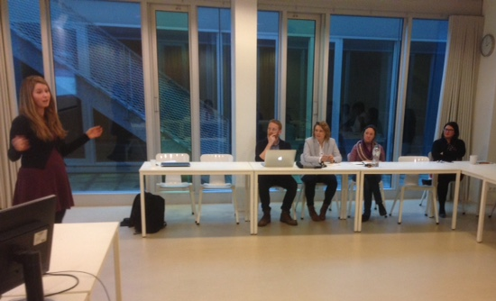
Raising awareness
Institution-wide project begun in 2017
Spreading the message
Personalised mails and news items on university webpage
Personal visists from project members
Information sessions
Collaboratons with academic directors

Slide 3
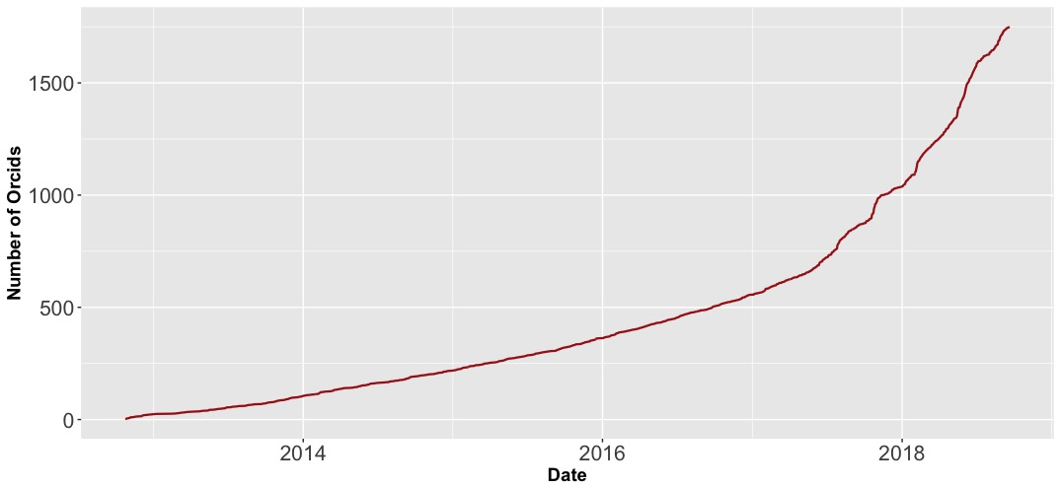
ORCID uptake
1885 ORCID iDs for 2733 researchers (68,9 % coverage)

Slide 4
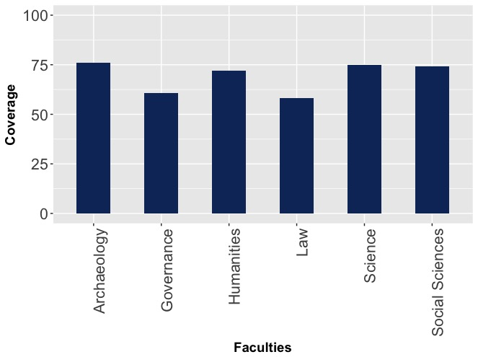

Slide 5
Mandatory for new staff

Slide 6
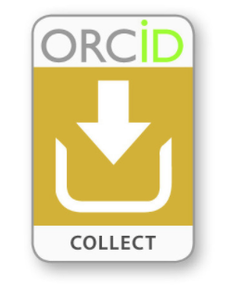
Collecting iDs
ORCID iDs are collected by making use of name search API and by cross-referencing the HR system
The link between Converis and LUCRIS is unstable
At the moment, Converis cannot push affiliation data to researchers records

Slide 7
Affiliation
Out of the current 1885 records, 132 are fully private
Affiliation captured in different ways
Universiteit Leiden | 4496
Leiden University | grid.5132.5
Universiteit Leiden
Leiden University
Leiden University Centre for Linguistics | 394592
Universiteit Leiden Faculteit der Wiskunde en Natuurwetenschappen | 98812
Leiden Law School
Universiteit Leiden Instituut-Lorentz | 220725
Leiden Amsterdam Centre for Drug Research | 195335
Universiteit Leiden Leiden University College The Hague
Leiden University | 4496
University of Leiden | 4496
Leiden University Institute for History
Leiden University, Institute of Psychology
Universiteit Leiden Leiden University College The Hague | 423297
Universiteit Leiden Instituut Psychologie | 192236
Leiden Academic Centre for Drug Research | 195335
Universiteit Leiden Faculteit der Rechtsgeleerdheid | 90043
Universiteit Leiden Centre for Terrorism and Counterterrorism | 194981

Slide 8
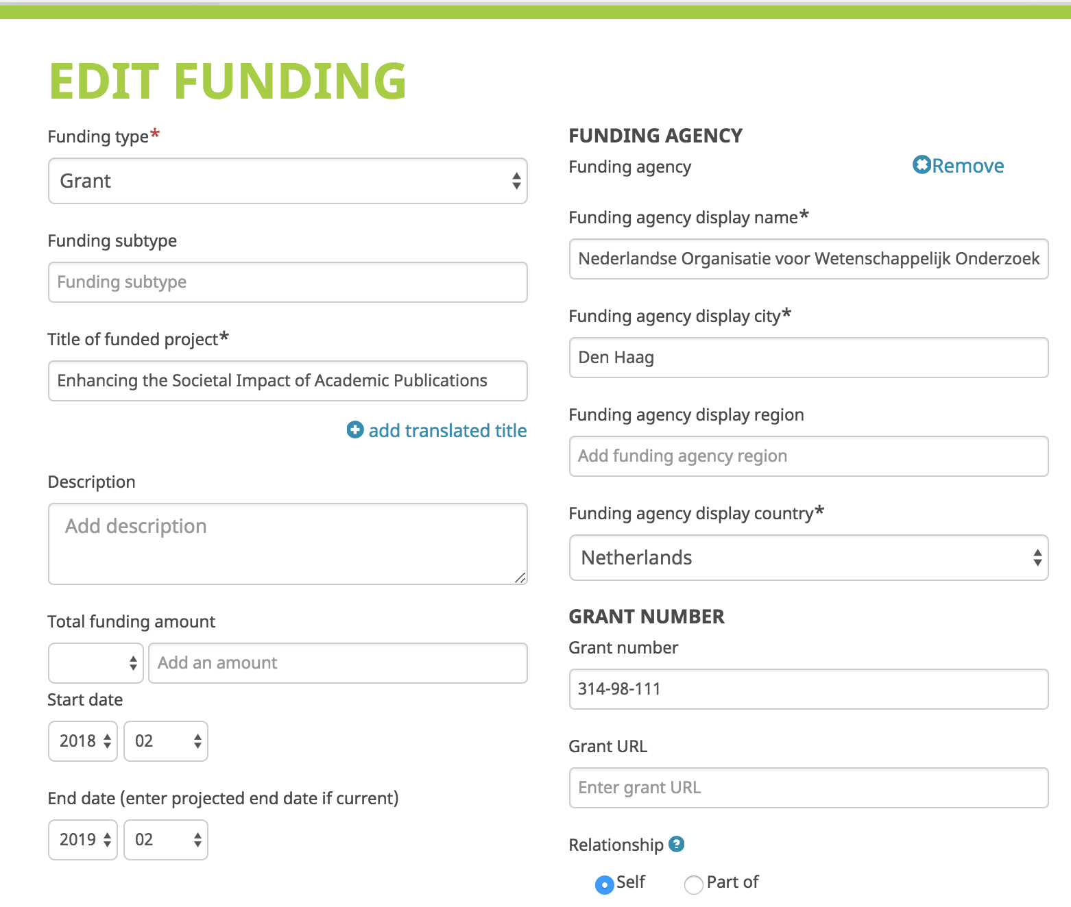
Funding Agencies

Slide 9
Forcing researchers to create an ORCID account may run counter to ORCID’s central philosophy

