Slide 1
A
B
IB Total MAPT
IB Tau1
SQSTM1 KO
penta KO
WT
OPTN KO
ATG5 KO
mMapt KO, HsMAPT
mMapt KO, HsMAPT
SQSTM1
MMapt KO
mMapt KO
50 kDa
WT
WT
OPTN
75 kDa
75 kDa
75 kDa
Short exposure
NBR1
150 kDa
50 kDa
50 kDa
TAX1BP1
100 kDa
Long exposure
CALCOCO2
50 kDa
TUBG
50 kDa
ATG5
50 kDa
TUBG
50 kDa
C
D
WT
SQSTM1 KO
OPTN KO
penta KO
ATG5 KO
MAPT ladder
Tau1
50 kDa
50 kDa
TUBG
WT
OPTN KO
ATG5 KO
SQSTM1 KO
penta KO
E
F
WT
penta KO
CMV
CMV
SQSTM1
OPTN
Tau1
50 kDa
TUBG
50 kDa
G
WT
OPTN KO
H
CMV
CMV
OPTN
Tau1
50 kDa
TUBG
50 kDa
OPTN KO

Slide 2
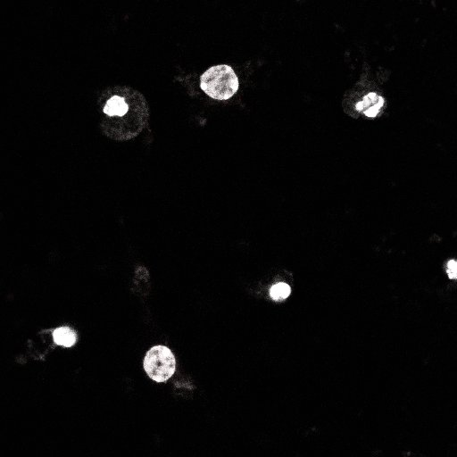
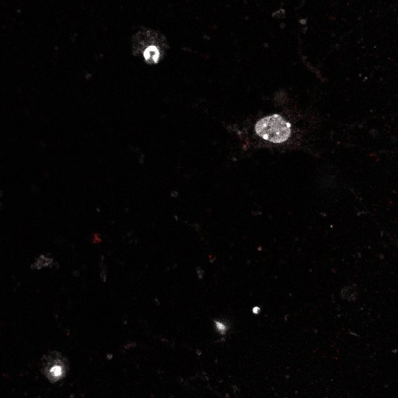
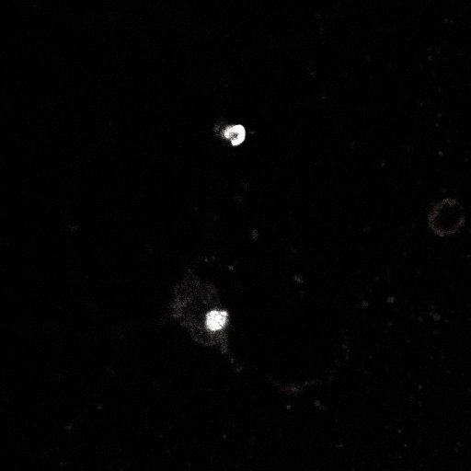
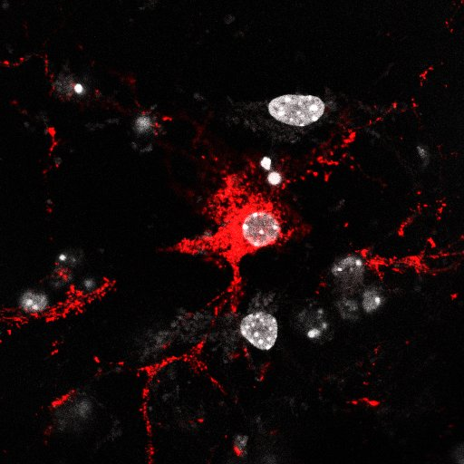
A
IP IgG
IP V5
Input IgG
Input V5
B
DAPI/MC1 after 1% Triton X-100 extraction
Seeded
Seeded
Seeded
Seeded
Ctrl lysate
rTg4510 lysate
Ctrl
Ctrl
Ctrl
Ctrl
SQSTM1
50 kDa
MAPT-PL-V5
50 kDa
WT neurons
TUBG
50 kDa
rTg4510 neurons

Slide 3
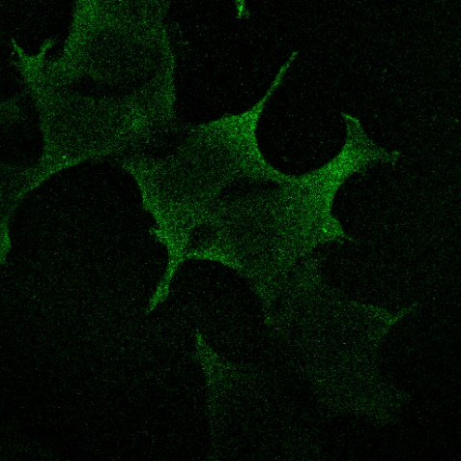
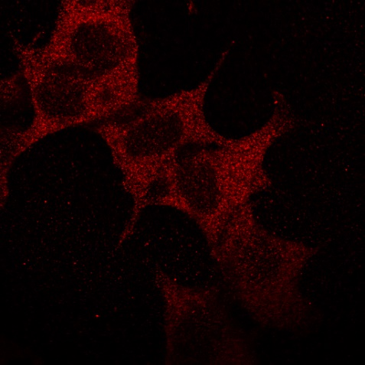
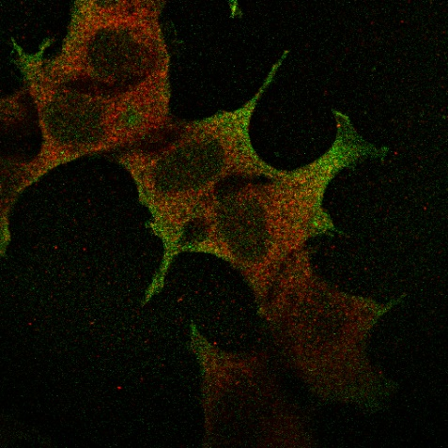
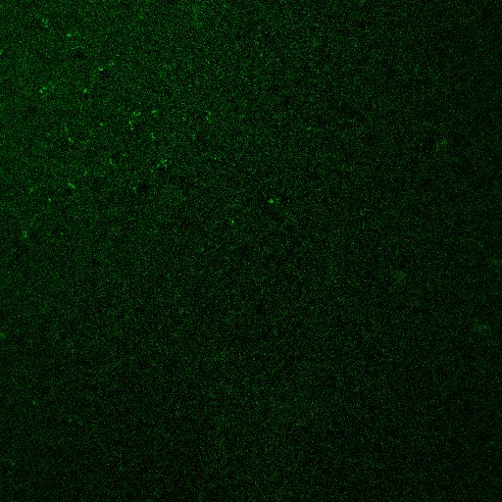

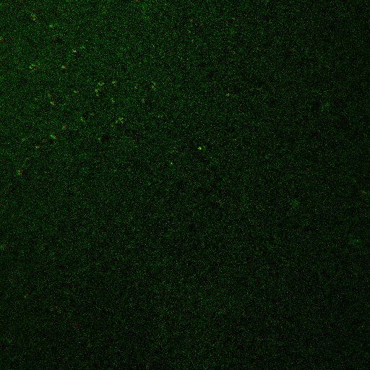
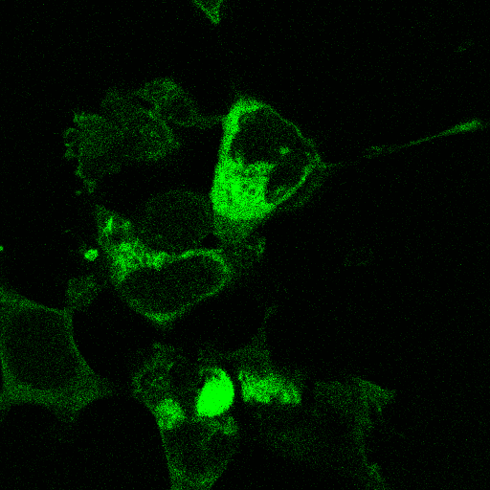
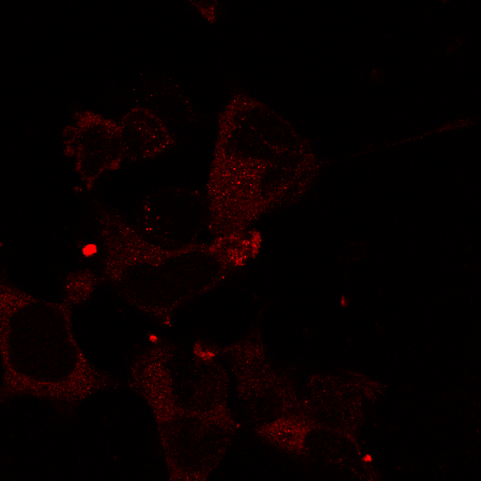
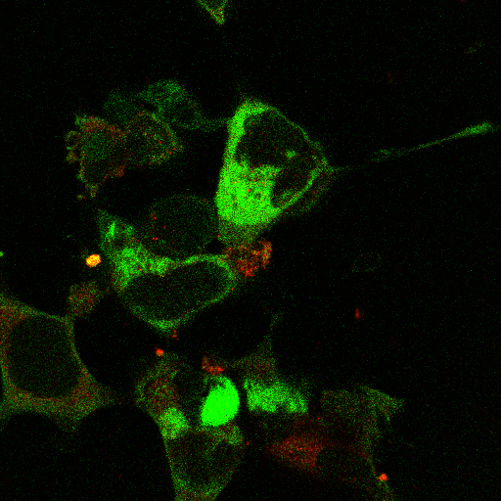
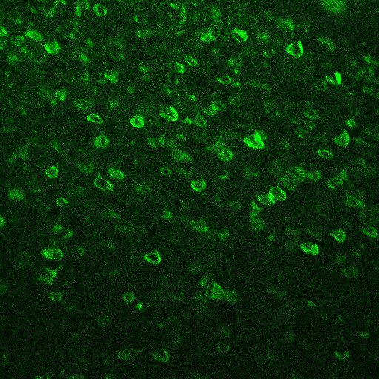

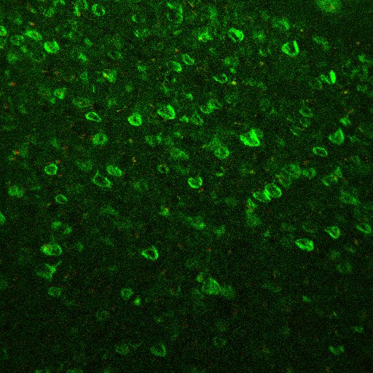
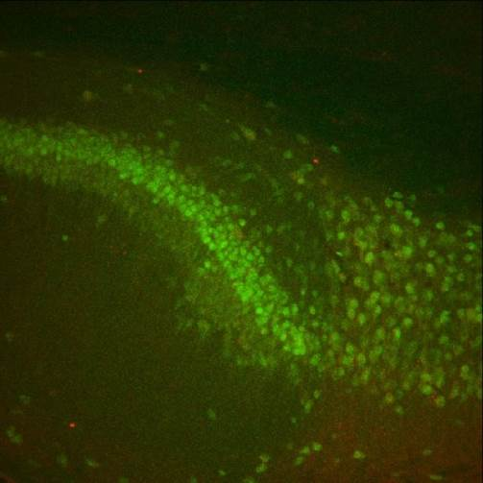
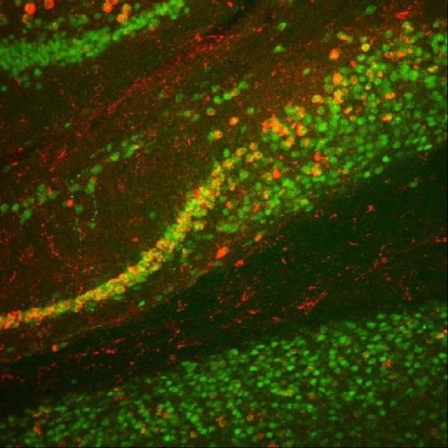
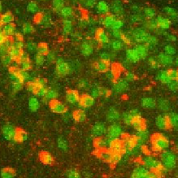
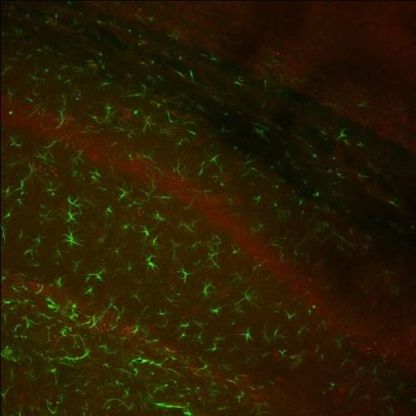
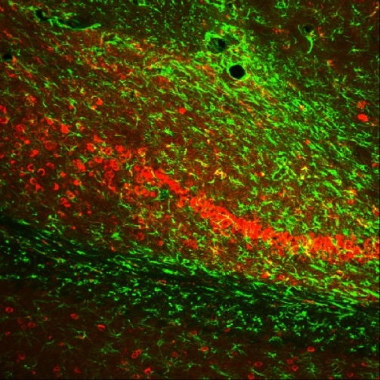
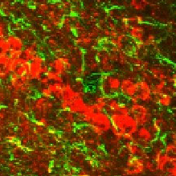
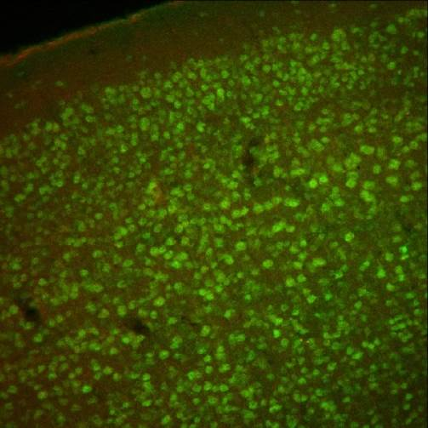
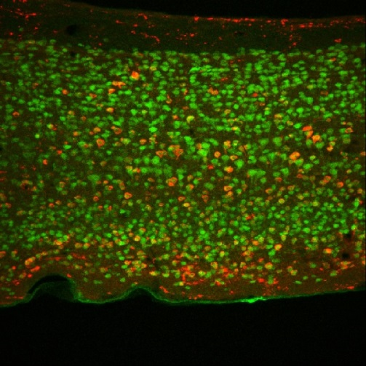
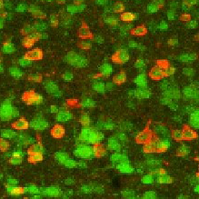
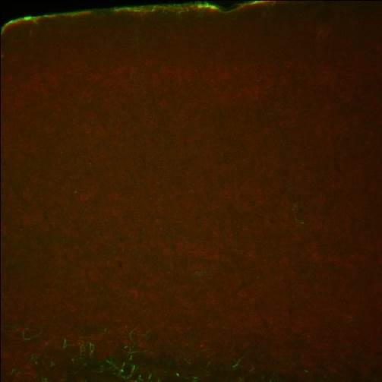
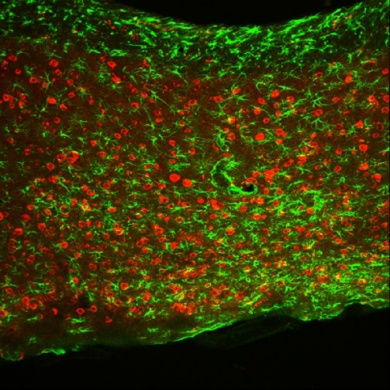
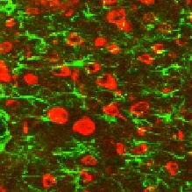
A
ThioS
OPTN
Merge
B
ThioS
OPTN
Merge
Ctrl lysate
Ctrl
rTg4510 lysate
rTg4510
C
RBFOX3/SQSTM1
GFAP/SQSTM1
Ctrl
rTg4510
Zoom in
Ctrl
rTg4510
Zoom in
Hippocampus
Cortex
Notes:
Bar 20um in cell
Bar 100um in vivo

Slide 4
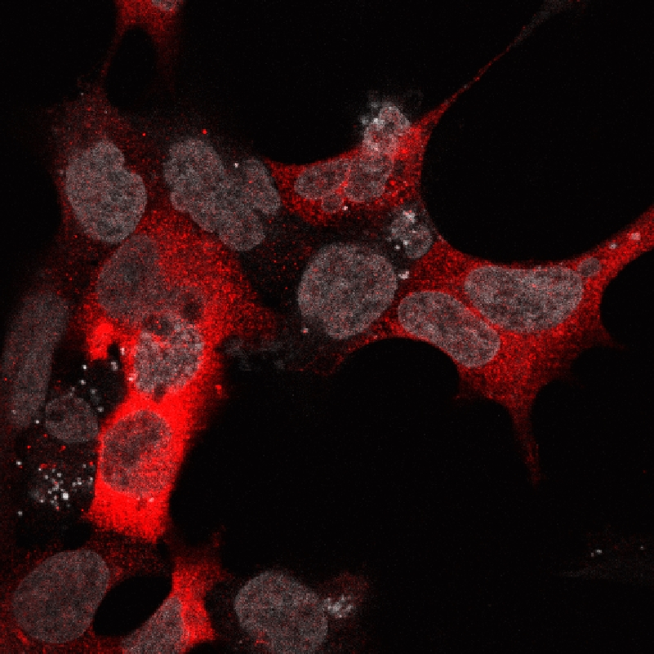
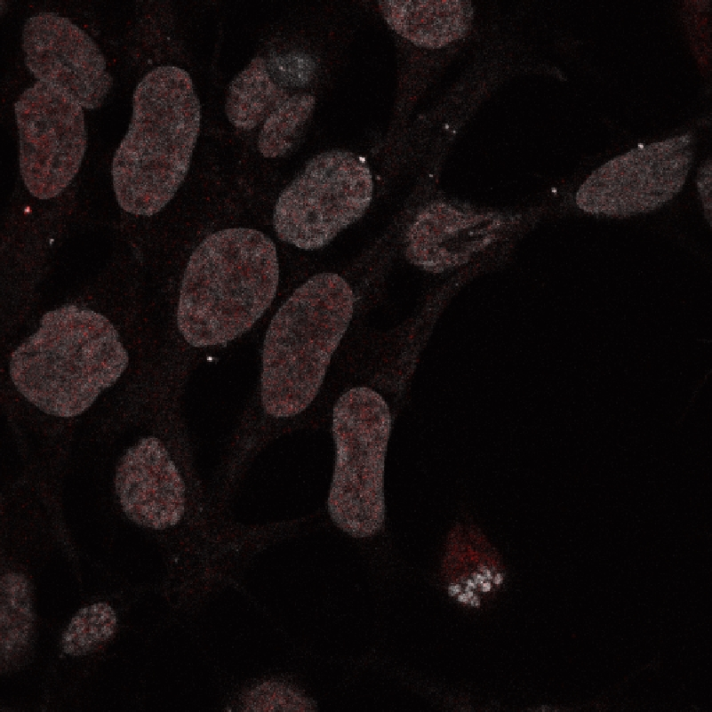
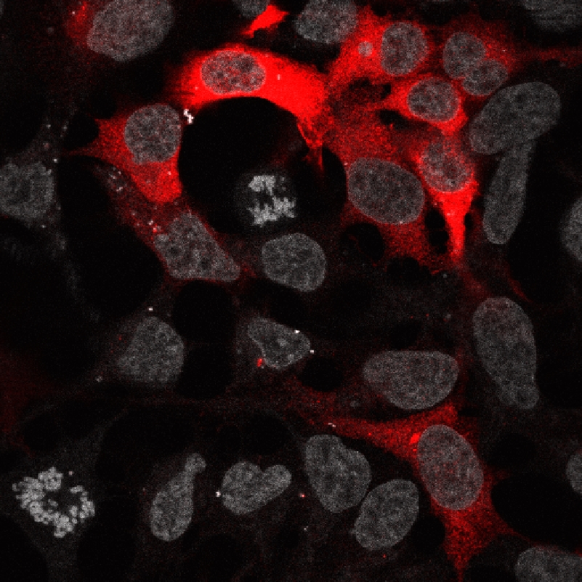
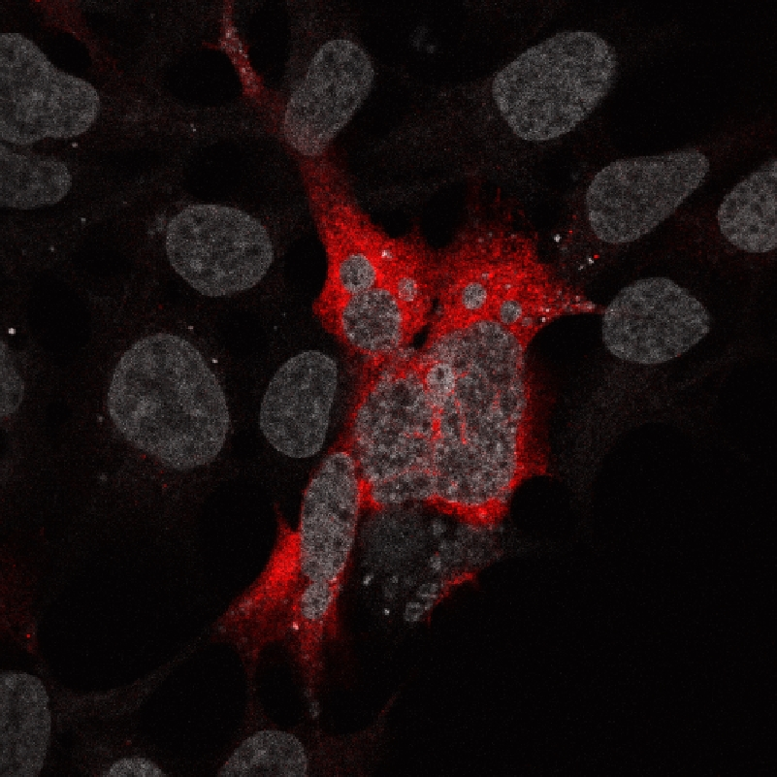
ULK1-WT
ULK1-4AS
p-ULK1 (Ser555)
Staining
ULK1

Slide 5
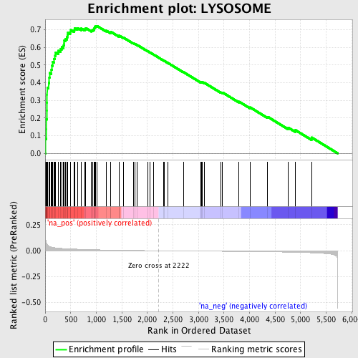
A
B
Notes:
Bar 200um

Slide 6
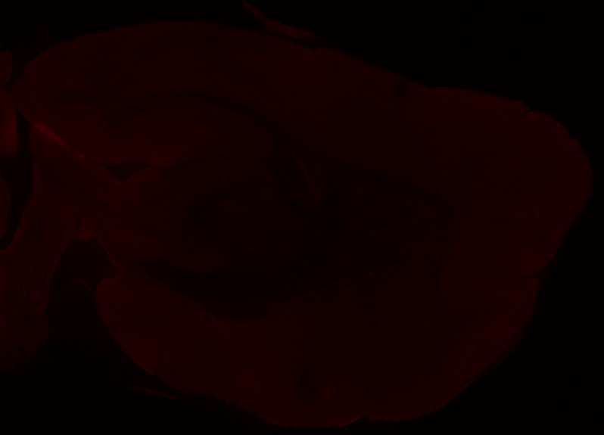
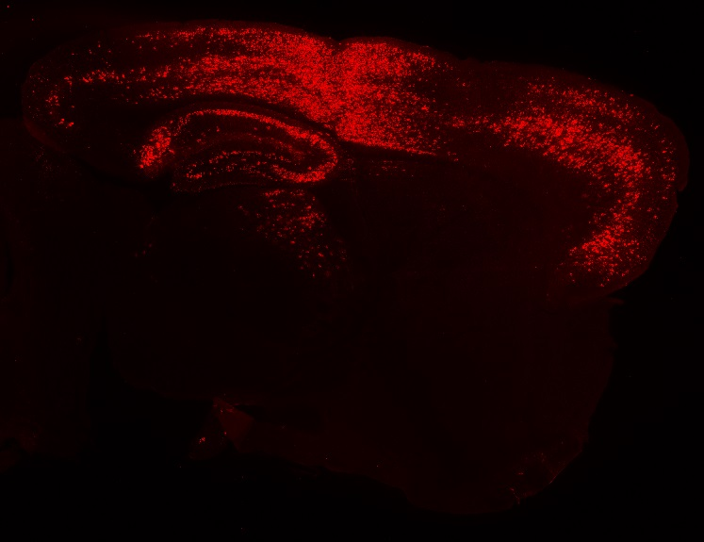
A
AAV-GFP
AAV-SQSTM1
SQSTM1 staining
B
C
GFP
SQSTM1
MC1 staining
SQSTM1
AAV-GFP
AAV-SQSTM1
50 kDa
GFP
25 kDa
TUBG
50 kDa
Cortex
Hippocampus
Notes:
2mm

Slide 7
AT8 staining
Ipsilateral
Contralateral
AAV-GFP
AAV-SQSTM1

