Slide 1
Soudabeh Bolourian
School Of Management

Slide 2
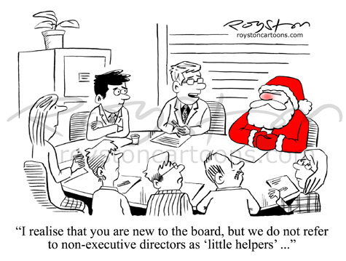
Analysing the Impact of Corporate Governance on
Corporate Sustainability at Board-level
THIS AREA OF YOUR SLIDE WILL BE COVERED BY A TIMER

