Slide 1
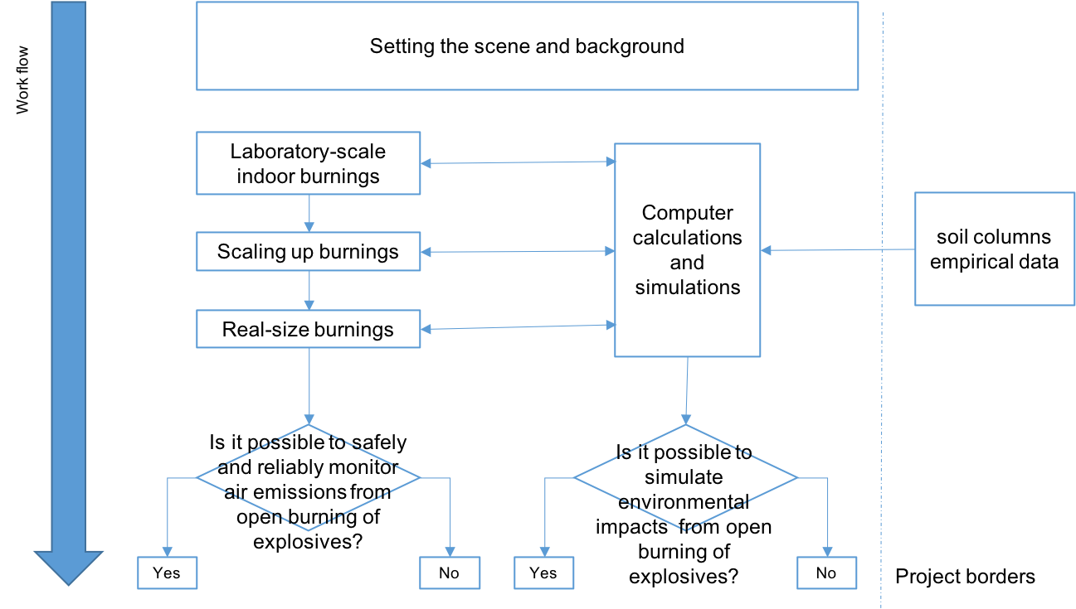
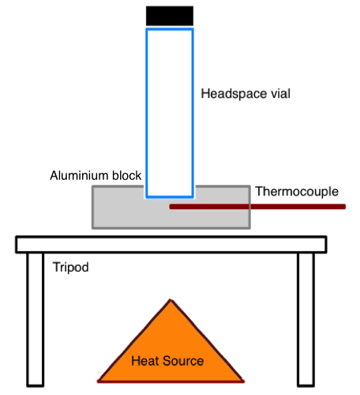
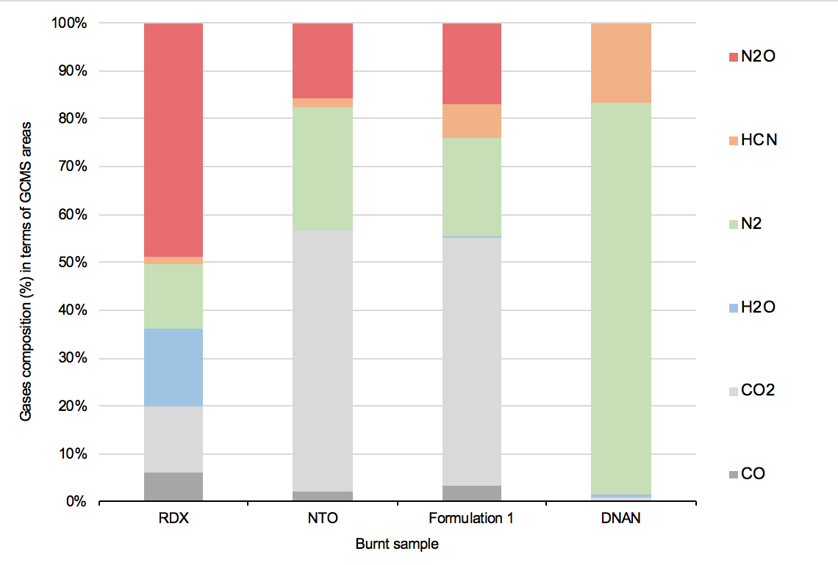
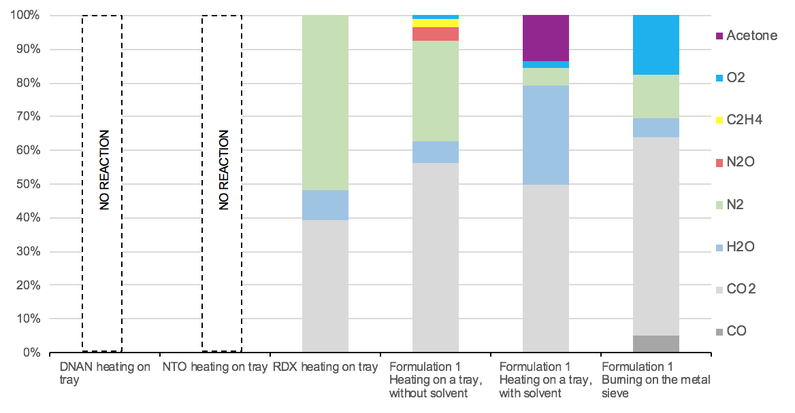
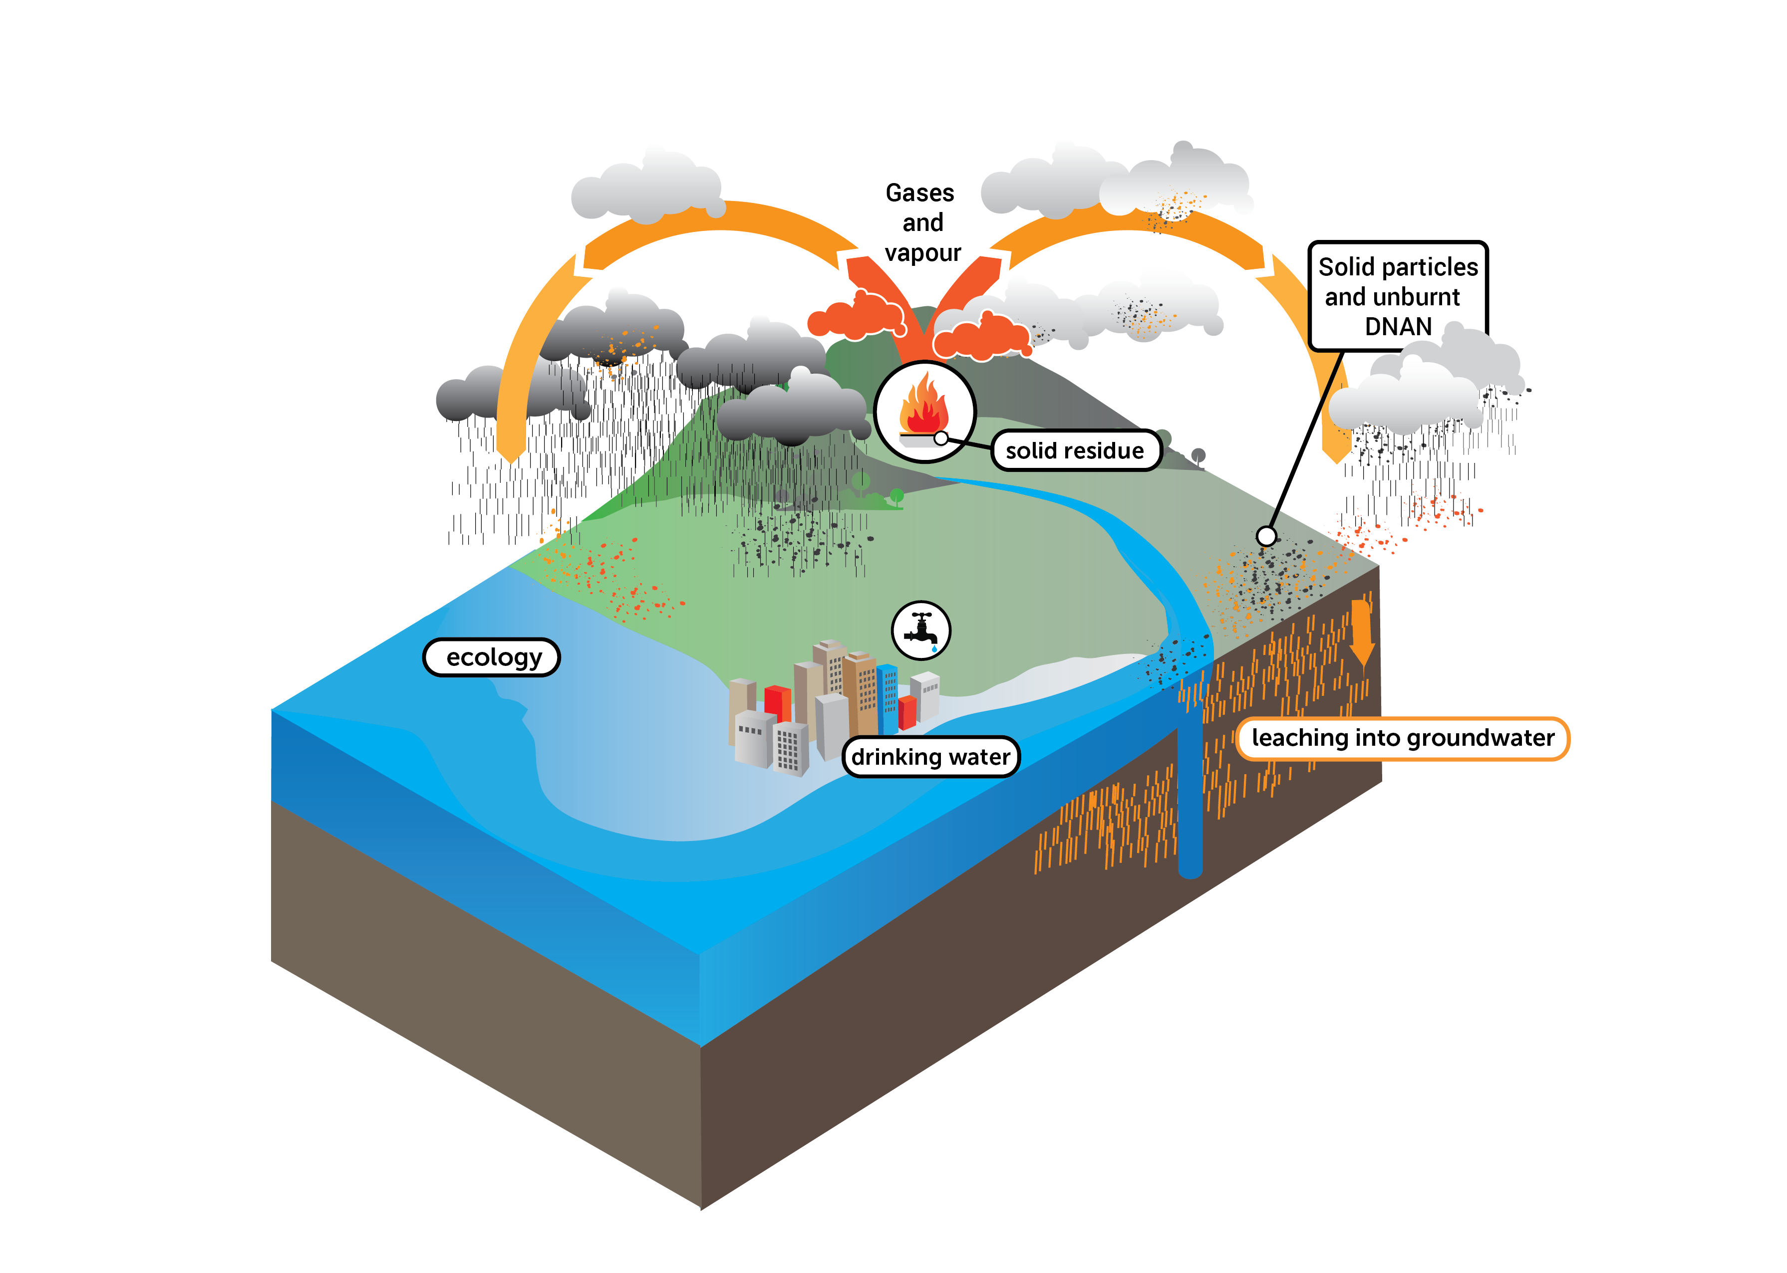
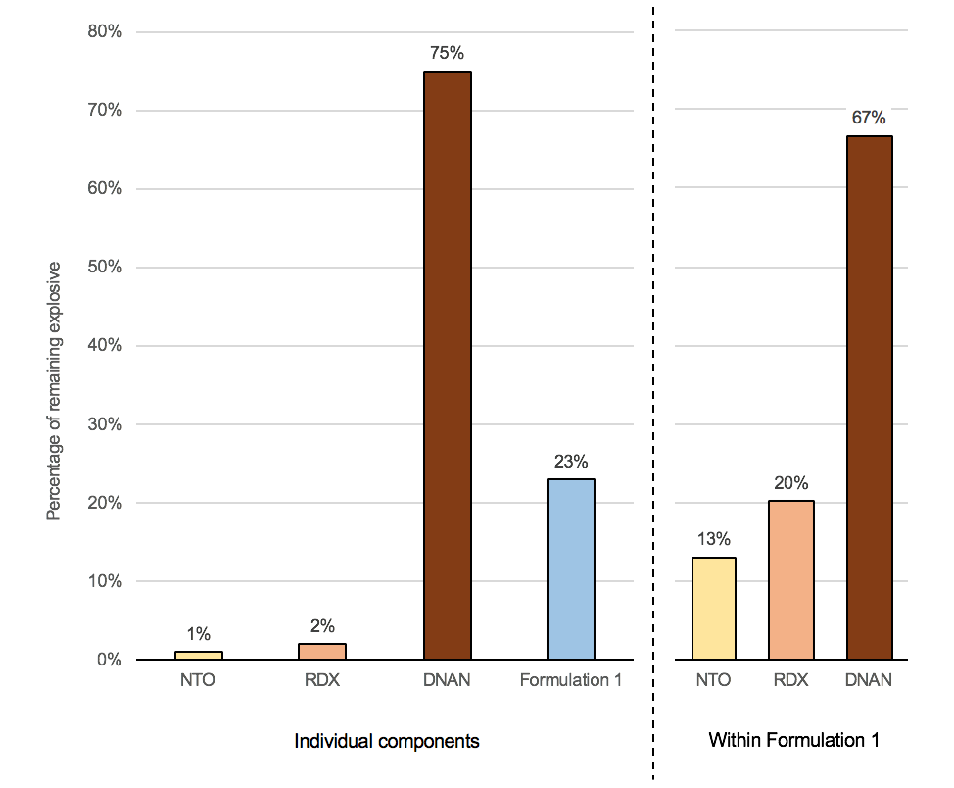
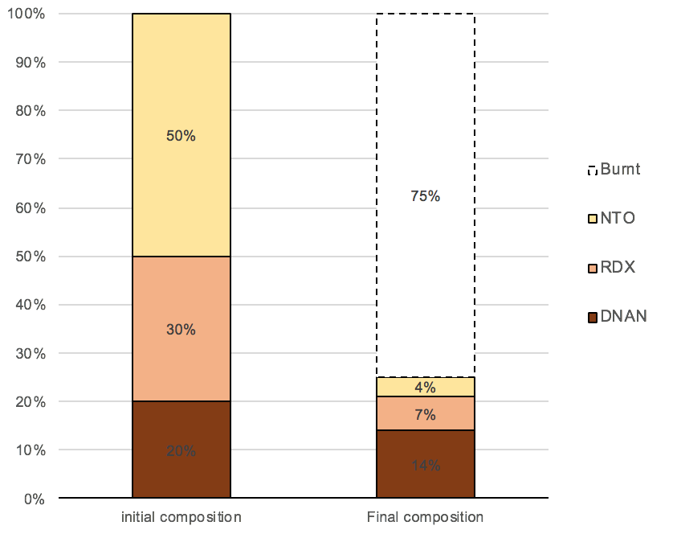
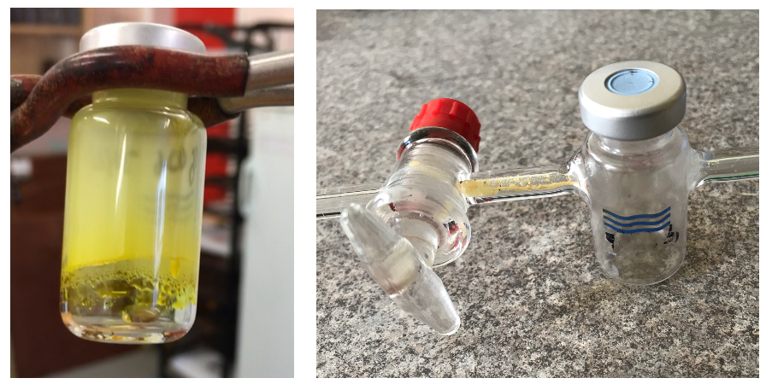
Environmental Impact of open burning of DNAN-based Insensitive High explosive
Abstract
Overall Methodology
Experimental Setup
New safety requirements are pressuring military organizations to replace TNT with insensitive high explosives (IHEs) containing DNAN, NTO and RDX but little is known about the behaviour IHE components and formulations in the environment. The environmental impact of ordnance during the in-service phase has been studied, but most reports concern TNT-based legacy explosives and their impact on soil rather than other environmental compartments. To address this knowledge gap, IHE samples ranging from milligrams in a closed system to grams and kilograms in an open system were tested in the laboratory and field, yielding environmental impact data that helps to determine the behaviour of the materials during open burning. The thermodynamic properties of DNAN make it more likely to melt, boil and sublimate during open burning, leaving ~70 % behind as unreacted residues. DNAN also inhibits the burning of RDX and NTO, such the near zero residual mass when these are burned as pure compounds increases to ~20 % of the initial mass when the formulation is burned. Overall, the experiments showed that DNAN-based IHEs behave in a similar manner to TNT based legacy explosives regarding emission of greenhouse gases, but worse in terms of solid residues. Ultimately, the body of work reported through this thesis has shown that traditional open burning of DNAN-based IHE could leave as much as 12 % (w/w) of unburnt explosive on the soil. We have therefore concluded that the open burning methodology adopted for TNT-legacy munitions should be avoided for disposing of IHE explosives
Small-scale closed burning | Small-scale and Medium-scale open burning setups | Large-scale open burning
Results
Conclusions
 | Close system burning | Open system burning
Gases analysis
Solid residues
Overall, the results indicate that the gaseous products generated by the open burning of IHEs are not a significant environmental issue because they are similar to emissions from other solid waste. The main concern is therefore the solid residues left on the burning area as well as unreacted explosives, which can be carried by smoke and hot gases, thus spreading to surrounding areas.
Based the data shown in Table 1, the first interesting point is that the massive difference in the residual mass of DNAN between the two experimental setups is due to its sublimation: when tested in the closed system, DNAN sublimated but remained confined (solidification at the top of the vial) (Figure 1) and was recovered in the solvent, whereas in the open experiment it sublimated and moved away from the metal tray (and was recovered in the modified headspace vial) (Figure 1), which is consistent with the sublimation observed.
The overall conclusion is that DNAN-based rounds are very resistant to open burning. The tendency of DNAN to undergo sublimation must always be considered, since this work showed that 70%of DNAN remains unreacted, as well as it increases the solid residues from NTO and RDX to 10–20 % of the initial mass.
Ultimately, this work has demonstrated that disposal process for newer IHE rounds needs to be reviewed to avoid and minimize critical environmental issues.
Table 1. Summary of the residual explosive masses after each experiment
 | Tested individually (w/w %) |  |  |  |  | Remaining masses within IHE (F1) (w/w %)
 | NTO | RDX | DNAN | IHE |  | NTO | RDX | DNAN
Percentage of unburnt explosives remaining after combustion by closed-system small-scale burning | 1 | 2 | 75 | 23 |  | 13 | 20 | 67
Percentage of unburnt explosives remaining on the metal tray after the heating cycle in the small-scale experiment without accelerants | 67 | 35 | 0 | 12 |  | 8 | 22 | 70
Figure 1. Recovered DNAN in the closed-system experiment (left) and open‑system experiment (right)
Maj Erick Galante, Dr Nathalie Mai, Dr Melissa Ladyman, Mrs Tracey Temple, Dr Phill Gill
t.temple@cranfield.ac.uk

