Slide 1
Blockchain for Open Science
FORCE 11, 2018
Blockchain4openscience.org

Slide 2
What do you have in your scholarly wallet?
...hard earned reputation with assets everywhere...
Notes:
similar to a physical wallet where you have assets from different sources, e.g. visa from BoA, a gift card from amazon, a debit card from citi bank, a gold lucky coin, etc. our scholarly wallet makes it posssible for us to hold all our assets in one place and also to do transactions over them

Slide 3
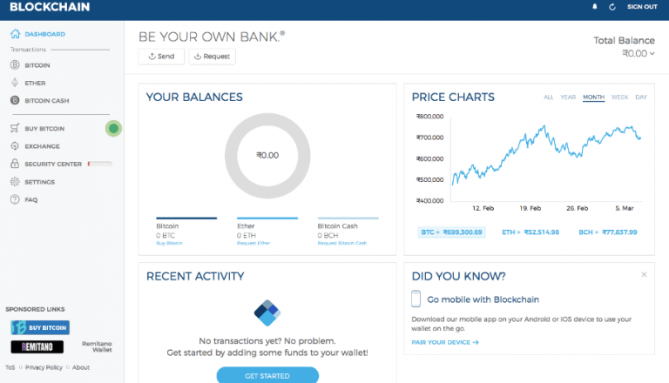
A crypto wallet
holds the private keys you use to prove you own specific assets,
allows you to send and receive assets; you send assets by registering payments in the blockchain, which is the public ledger containing all transactions since the beginning of asset.
Notes:
the nature of the wallet remains the same no matter what the manifestation may be. the one u hold in your pocket is the same as the one living in the web or in a USB drive. the wallet holds assets and facilitates operations over them.

Slide 4
So why not a wallet for our scholarly assets?
Why not?
Notes:
the assets we produce and transact upon live in many places, git, figshare, dryad, etc but… there is little difference with the assets we have in the wallet living in our pockets. assets remain assets and transactions remain transactions.

Slide 5
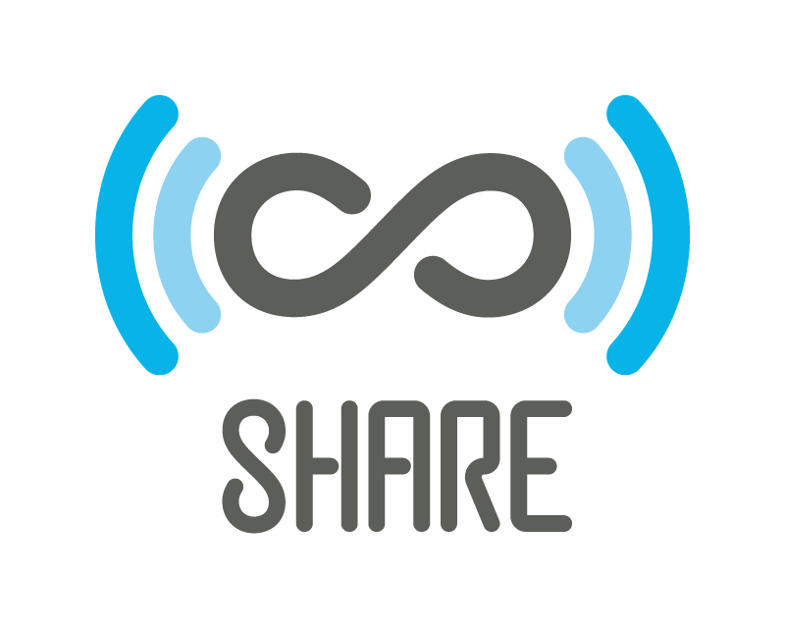
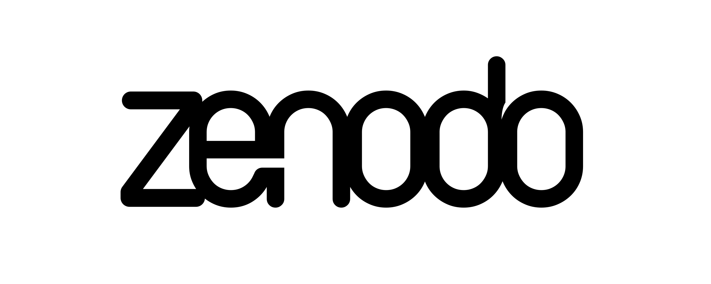
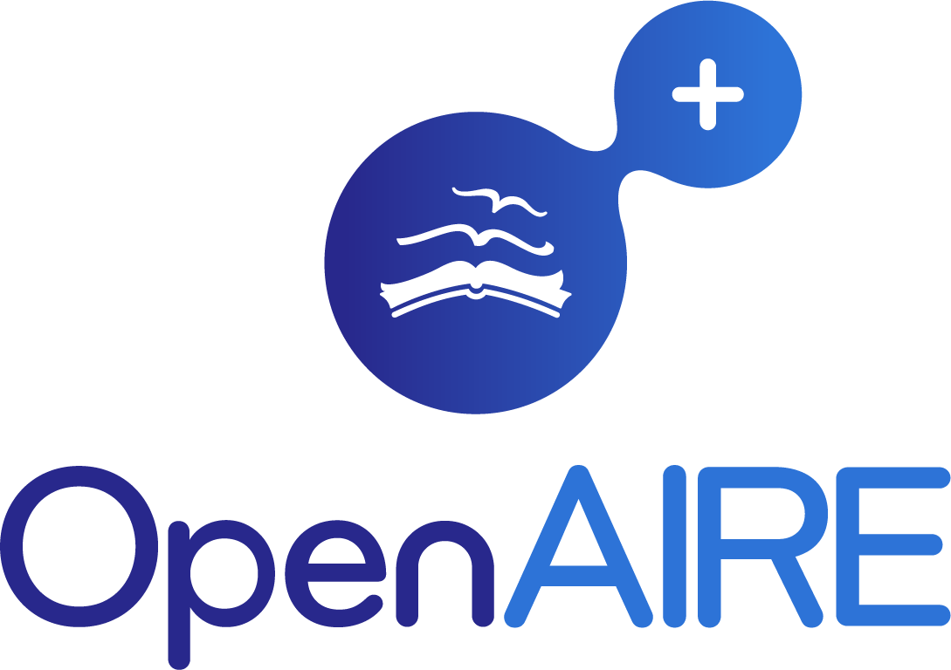
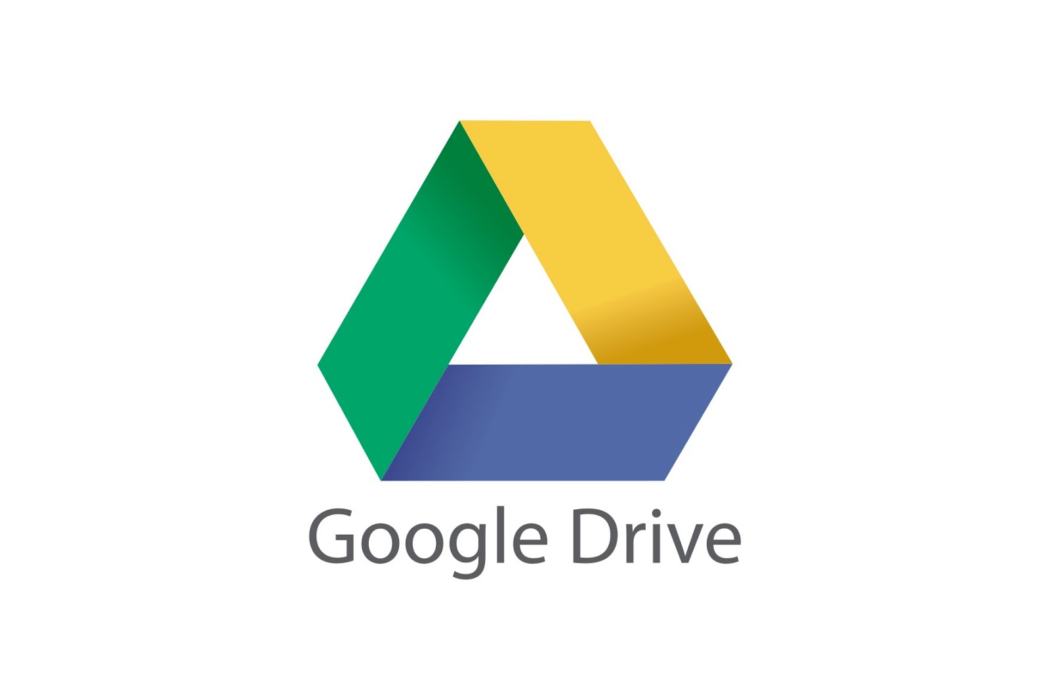
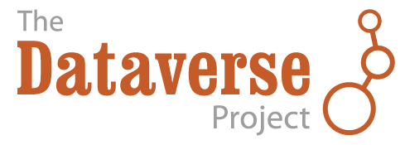
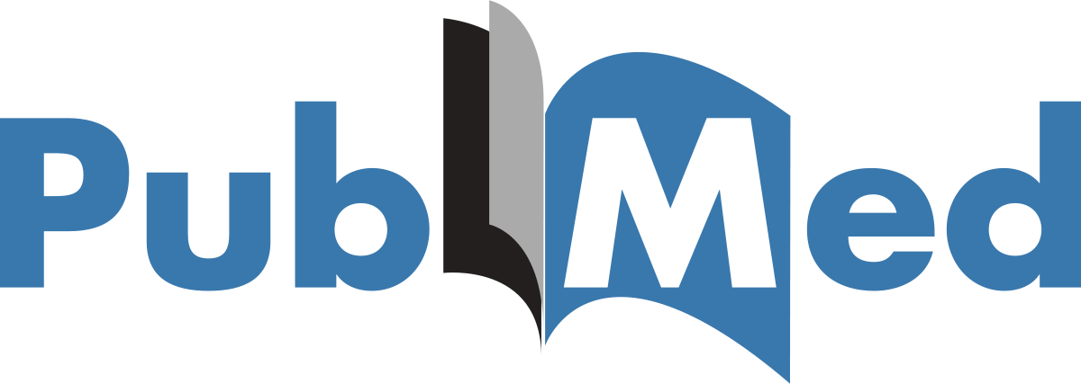
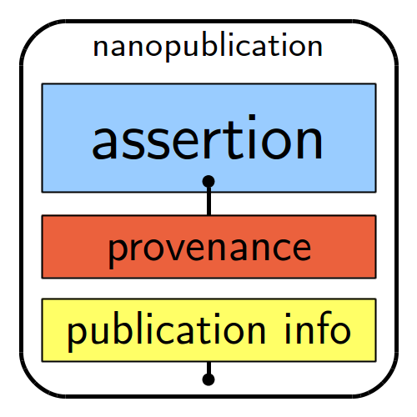
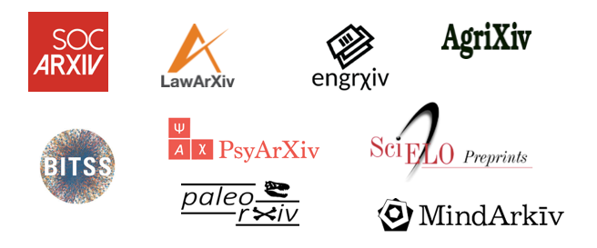
Why not store all the value in a blockchain? In this way the value produced through the research life cycle could be accounted for and thus become part of the reward mechanism from researchers, moving from a paper centric ecosystem to a research object environment.
OSF
one single point of value
nanopublication
Notes:
Currently, all the value is currently stored in one single object: the published paper. This is the only traceable asset; rewards for researchers are paper centric. Funding also depends on the publication record. The paper is the one single point of value.
But there are many ways researchers create value, using many apps, often use for different research outcomes, e.g. code, datasets, images, presentations, social activity, vents, performances, peer review, conference organizing, leadership, etc. These values should be just as attributable as published papers; moreover, transactions (assertions) over these assets should be recorded and managed.
All scholarly work has value. We need to gather our value as assertions in our scholarly wallet on an open blockchain for science.

Slide 6
The wallet is an aggregator
Let's keep it simple and start with the wallet
as the window to the ledger as well as the data entry point for the generation of reward mechanisms
Notes:
the wallet makes it possible for researchers to add value to their assets by improving metadata. it is an agregator, it also makes it possible for researcher to state that they own something, or have participated in something or have a stake in something.

Slide 7
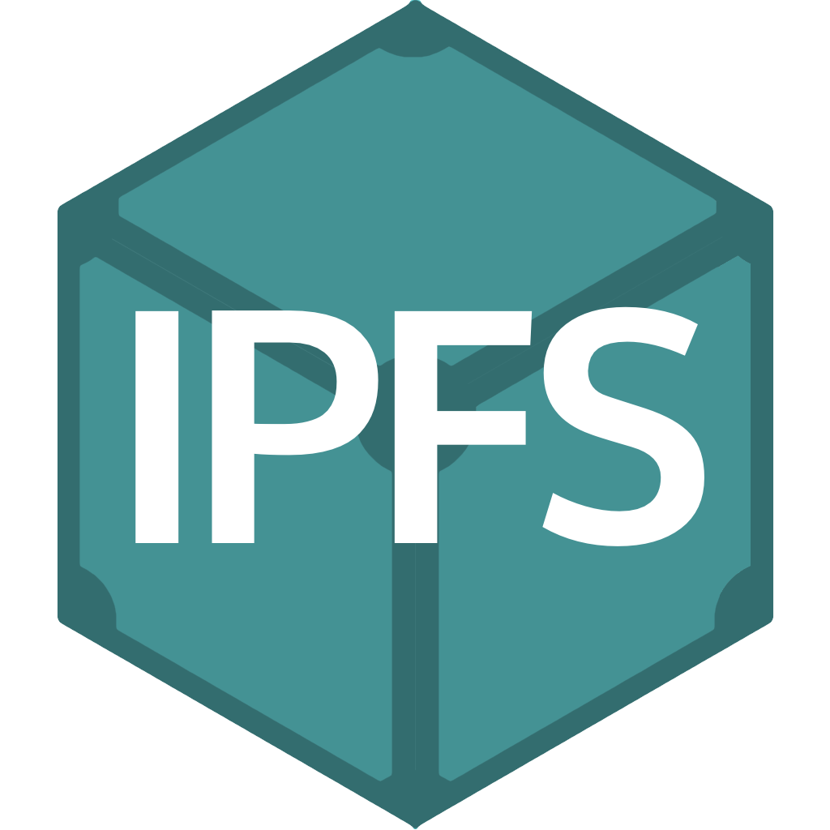
Our approach
P2P layer
File management
Addressable content
nanopublication
Claimed Objects
Asset management
Reward mechanisms
Asset management
OSF
Assets
Transactions
Exchanges
Participants
Claim
Claim
Smart Contracts
Reward tokens
Claim
All research outputs are accounted for independently from the web application used to manage or store them.
Notes:
We propose to develop a blockchain for open science that stores ledgers of assets and transactions on assets amongst researchers. It makes it possible for researchers to continue using their tools of choice (see Figure), secure, distribute, and preserve the ledger, while providing a common means for accessing ledger contents.

Slide 8
Incentives
the wallet makes it possible for researchers to gain by behaving, e.g. by providing good metadata for their research objects
Notes:
But also the simple fact that they can aggregate their work in one single place that is also a proof of their contribution statements (research objects) which generates tokens as an incentive

Slide 9
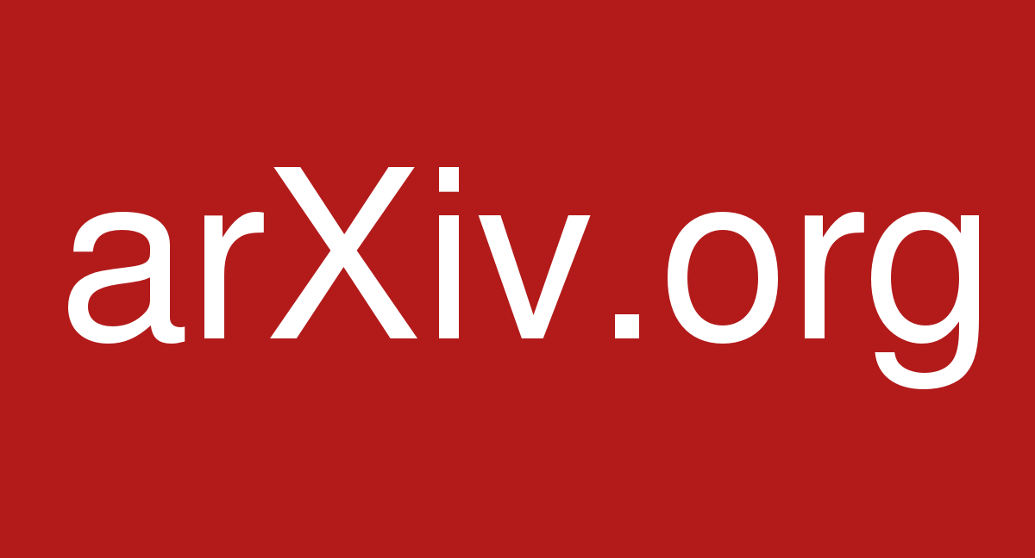
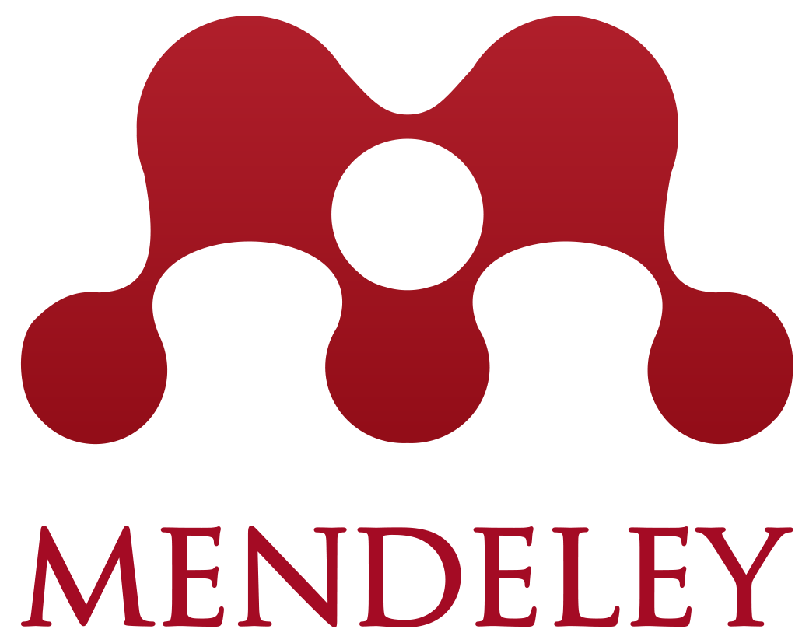
This token results from aggregating claimed contributions across different applications. It also aggregates metadata enrichments, transactions and exchanges. The aggregation can be unassembled; making it possible to see “who” has done “what”, “when”, “how” and “where”. Keeping the ledger for open science
File management
Addressable content
Asset management
Reward mechanisms
nanopublication
RMap DiSCO
(Distributed Scholarly Compound Object)
Claimed assets
P2P layer Assets Transactions Exchanges Participants
RMap Smart Contract
RMap
Asset
Token Reward
Claiming
Assets into P2P layer
Metadata enrichment, e.g. creating RMaps
Notes:
Rmap DiSCO (Distributed Scholarly Compound object) is simply a set of pointers to assets. Researchers can construct research objects as sets of other assets.

Slide 10
The token is built upon the definitions for assets, transactions, participants and smart contracts. This means that communities can define their own features and still interact with all other nodes in the ledger/IPFS space.
File management
Addressable content
Asset management
Reward mechanisms
Has presentations
Has FAIR
FAIR declaration
RMap
CODE
Has dataset
Claimed asset
Metadata enrichment FAIR declaration
Has preprint
Claimed assets and RMap creation and FAIR declaration
Claimed asset
Claimed asset
Has bib-Refs
Claimed asset
Claimed asset
nanopublication
Claimed asset
Claimed asset
nanopublication
P2P layer Assets Transactions Exchanges Participants
RMap Smart Contract
Metadata enrichment,
e.g. creating RMaps FAIR declarations
RMap
Asset
Token Reward
Claiming
Assets into P2P layer

Slide 11
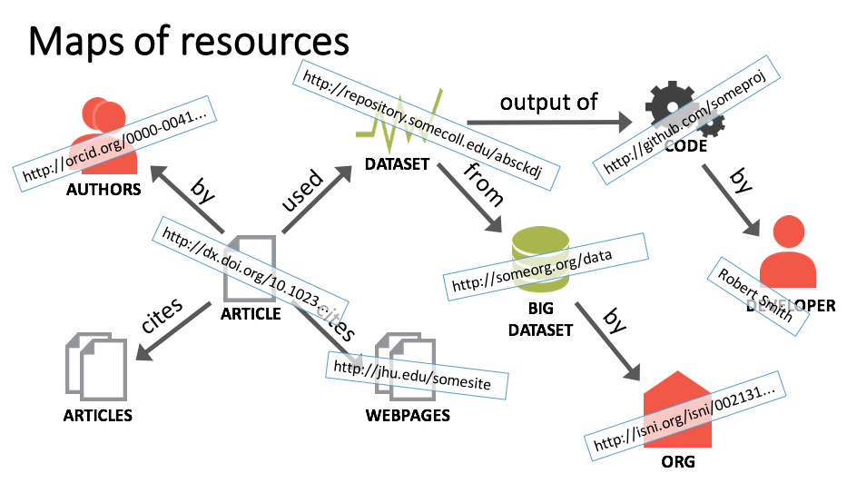
Notes:
This simple case is just resuing DISCO (Distributed Scholarly Compound Object) technology and moving it to the blockchain. By creating resource maps, researchers earn tokens. incentives are highy idioscincratical, the ledger allows communities to specify their own incentives as well as asset management practices.

Slide 12
The Journal for Open Source Software JOSS
clear assets, built on GIT technology, easy to track contributions from all parties, open platform, a good starting point
Notes:
JOSS offers a good starting point for this technology as used by publishers. JOSS is entirely built upon GIT tech, it has a clear and well defined type of papers, the assets are well defined (software), it is easy to track down everyone’s contributions, (author, reviewer, editor, etc)

Slide 13
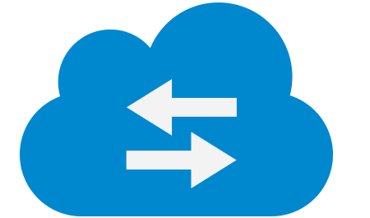
File management
Addressable content
Asset management
Reward mechanisms
Manuscript, Code, Data submitted
Authors
Process Management
Editor
PrePrint
Authors
Authors
The Journal of Open Source Software
API
Reviewers
JOSS
submission
Metadata enrichment, e.g. RMaps and FAIR declarations. Authors
Publication
Review Process
Reviewers
Editors
P2P layer Assets Transactions Exchanges Participants
Identifiable rewards:
“who” has done “what”, “when”, “how” and “where”
Notes:
In this case the blockchain becomes the permanent and immutable record of everything that happens during the publication process. it makes it possible to identify everyone’s contributions and generates tokens for those contributions.

Slide 14
Advantages of Blockchain
Less/No Traceability of transaction
Lack of visibility to all peers
Capability to track down transactions
Complete audit trail: Who does What When
Any changes will reflect in shared ledger
Visible to all peers
Provenance
Data or transactions are editable/ changeable
Immutability
Once a block is committed with data / transaction, No one. not even administrator can modify without approval from all peers
Centralized systems managed by single party
Guarantees that all transactions in the system go through a peer verification process before being approved
Reduces the scope for manipulation by a single peer
Valuables provenance
Multiple places to save data
Reconciliation process required to prepare final data
Consensus
One Single Source of truth: Shared Ledger
All updates are available to all peers
Finality
Notes:
For the scholarly aset management blockchain offers multiple advantages.

Slide 15
Where are we?
Basic infrastructure has been created
Open Authentication and multiple APIs “talk” to hyperledger
currently talking to hyperledger
Git, Figshare, LinkedIn (slideshare), VIVO
Simple rewards based on tokens
Public asset board
as assets come in to the ledger these are presented over a public asset board that is another entry point for manipulating the assets
Basic digital rights management in the form of smart contracts
this facilitates sharing data because it makes it possible to share data based on a smart contract
Everything is open, https://github.com/Blockchain4openscience

Slide 16
Video
Notes:
here simply fast forward the video explaining that the user logs in with an ORCID, there is a multiple authentication mechanism that allows to manage multiple sites currently being used to manage our scholarly assets from one single entry point, the wallet, and from this interface the user claims and does metadata management thus generating tokens (earning rewards). the wallet presents the tokens and dereferences them meaning that at any given point in time one can always understand why such token was generated.

Slide 17
Our ecosystem is a Decentralized Autonomous Organization
Not so simple
and much more interesting than those DAOs in the crypto world
Notes:
our DAO ecosystem is one where institutions facilitating the creation of assets, e.g. funders, universities, research institutes, have to manage the assets in a completely decentralized and very often anarchical manner. Researchers produce assets that in principle belong to the duet university-funder but researchers, with the silent ok from the duet university-funder, deposit their assets in third party applications. thus, adding value (actually creating value) for those third parties, e.g. figshare, git, dryad, etc. in the meantime, relations across assets is lost, metadata is poor, universities-funders cant really track what happen to those assets, very often they don’t even know what assets they own. our solution addresses this problem by simply formalizing the DAO with blockchain technology. It is not just the wallet, it is the formalization of the DAO.

Slide 18
Similar to VIVO, a Decentralized Autonomous Organization
Institutions are responsible for their institutional profiles
VIVO
VIVO is a DAO
One standard,
Interoperability across nodes
Multiple publishers
Institutions should be equally responsible for the assets they produce
At least in part
Notes:
Network of universities being responsible for accounting for their own production at the very least as metadata. Each university is a node in the network, the curation or research objects as well as the accounting for research objects is decentralized, traceable, immutable, and verifiable from the institution that produces the ro. The researcher may choose to also have the RO elsewhere simply declaring where and specifying the relation to wherever it is also living. Relations across ROs are curated by the community. Institutions are at the very least responsible for the metadata of the assets being produced by their researchers.

Slide 19
Similar to VIVO
A full scholarly DAO is simply a group of organizations that agree on asset management processes
This includes assets, transactions and smart contracts
The ledger becomes a part of universities infrastructure,
stewards for the assets
By relative weight this forces every third party, including publishers to behave
VIVO is a DAO where nodes have agreed on some standards to publish data
Relative weight forces everyone to behave

Slide 20
Work to be done...
user experience, integration with VIVO, implementing a reward for software runs … that's our minimal viable product
Notes:
The user experience for interacting with the assets needs a lot of work, we also need to integrate the wallet with VIVO assets and make it easier for users to clean duplicated assets. also, there is a problem with assets being fraudulently claimed, what is the resolution process?
We are also working on a use case that generates traceable rewards for runs of software. the scenario is as follows
PETER created a software YY for sequence alignment, the software runs in server XX that is not under PETERS jurisdiction. PETER distributed his software with the scicre-ware software that makes it possible to do the accounting where ever the software is installed. JOHN, the sys admin for the server XX installs PETER’S software at XX. Then there is a user KK who runs PETERs software YY over the server XX. as this person KK runs the software then the tokens or credits are created and associated to the ID of the software creator (in this case PETER) and passed over to the wallet.
Our MVP makes it possible to have assets in the ledger and do some basic management over them but the real work related to the scholarly DAO remains to be done. A wallet is just a starting point, the DAO should be the end goal.

