Slide 1
Building ties across countries: International collaboration, field specialization, and global leadership
Zaida Chinchilla-Rodríguez, Vincent Larivière, Nicolás Robinson-García, Rodrigo Costas and Cassidy R. Sugimoto
STI 2018, 12-14 September, Leiden, The Netherlands

Slide 2
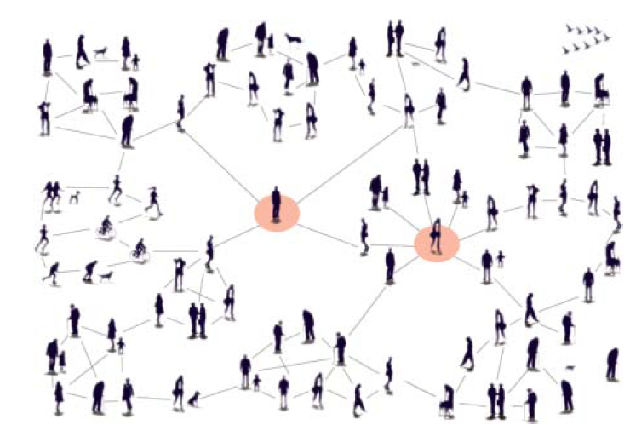
Dimensions of analysis
International collaboration
Leadership Specialization

Slide 3
International collaboration
International collaboration plays an important role in fostering high-quality knowledge production

Slide 4
Leadership
Leader is someone who has followers

Slide 5
Leadership in science
Leaders as brilliant iconoclasts whose ideas were disruptive and innovative, those who shook up the way we think about the world
What has changed over time is that bold creative thinkers are increasingly less likely to be able to “go it alone”

Slide 6
Changing landscape in science
Changes in the nature of the practice of science and technology
New players/leaders appear in global collaboration network

Slide 7
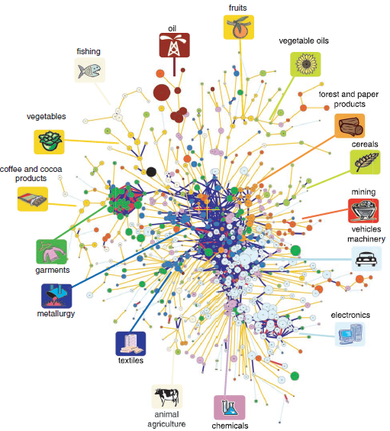
National publication profiles/economic sectors

Slide 8
The idea
Analyzing these dimensions could improve the understanding of the global scientific system and identify opportunities for and risks of scientific collaboration and specialization

Slide 9
Our Goal
To discern preferences of domestic and international outputs in determining the disciplinary structure in scientific relationships
How leadership in publications affects relationships and performance

Slide 10
Establish a terminology

Slide 11
The many faces of leadership

Slide 12
Who/what do we think of as “leader”?
People?
Institutions?
Countries?

Slide 13
Leadership in an activity measure
Who produces the most publications?
Who receives the most citations?
Who builds most on the most recently published literature?
Klavans, R., & Boyack, K. W. (2008). Thought leadership: A new indicator for national and institutional comparison. Scientometrics, 75(2), 239–250.
Klavans, R., & Boyack, K. W. (2010). Toward an objective, reliable and accurate method for measuring research leadership. Scientometrics, 82(3), 539–553.

Slide 14
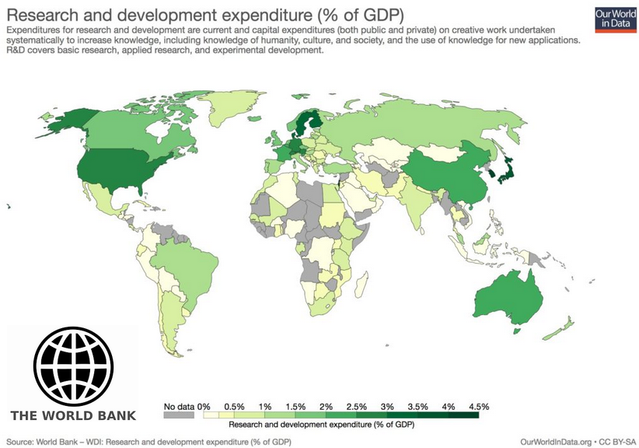
Leadership in expenditure
Who spends the most money?

Slide 15
Leadership in contribution
Who contributes the most to international publications?
Authorship could indicate leadership
First
Last
Corresponding
(ICMJE 2012 ; Moya-Anegón et al. 2013; Larivière et al.2016; Costas & Iribarren, 2007; Van Leeuwen 2009; Chinchilla et al, 2016).

Slide 16
Types of production

Slide 17
Domestic output
+3

Slide 18
International collaboration (with or whitout domestic collaboration)
+3
+1

Slide 19
Operationalizing leadership IN CONTRIBUTIONS: Corresponding AUTHOR

Slide 20
Scientific size Total number of publications
20 papers in total
8 international collaboration
Leading publications (corresponding author)
2 leading by the country

Slide 21
Objectives
Does domestic and international leadership affect the thematic specialization of countries?
To what extent does collaborating with leading partners improve specialization and citation impact?

Slide 22
Data

Slide 23
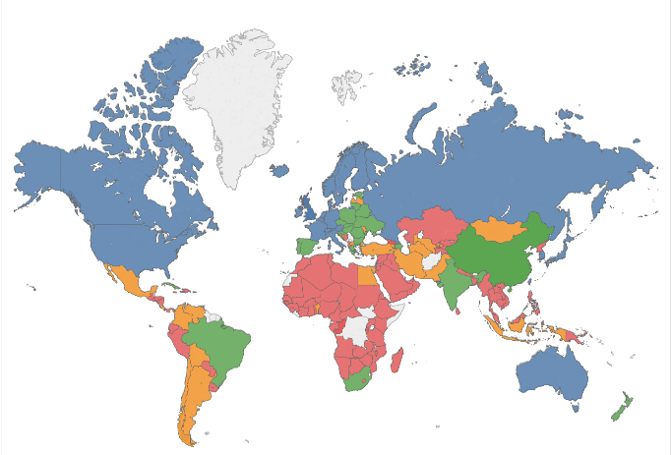
Web of Science
Period: 2000 – 2016
Document type: papers, reviews and conferences
World: 19,460,980
94 Countries
Biomedical Research: 5,474,143

Slide 25
Methods

Slide 26
Bibliometric analysis (indicators)
Scientific size: number of papers (total and leading papers)
International collaboration: more than one country
Research performance: mean normalized citation score (MNCS)
Benefit rate of collaboration in research performance:
$\frac{(MNCS_NL−MNCS_L)}{MNCS_N}$
- Relative Specialization Index: relative effort a country devotes to a given disciplinary domain

Slide 27
RESULTS

Slide 28
Relative Specialization Index

Slide 29
Relative Specialization Index

Slide 30
Normalized citation (MNCS)

Slide 31
Authorship and expenditures in R&D
Colors refers to the R&D as percentage of GDP (green ≥ 2%; blue ≥ 1%; orange: ≥ 0.5%; red: ≤ 0.5%)

Slide 32
Authorship and expenditures in R&D
The largest differences in research performance are located in countries with the lowest R&D investment when they publish domestically or leading international papers.
Countries with larger research investment are more likely to act as leaders and garner higher specialization and visibility in domestic and leading production

Slide 33
Authorship and expenditures in R&D
Non-leading publications in general, have the highest impact and specialization
That demonstrates the strong importance of collaboration for countries with the lowest R&D expenditures.

Slide 34
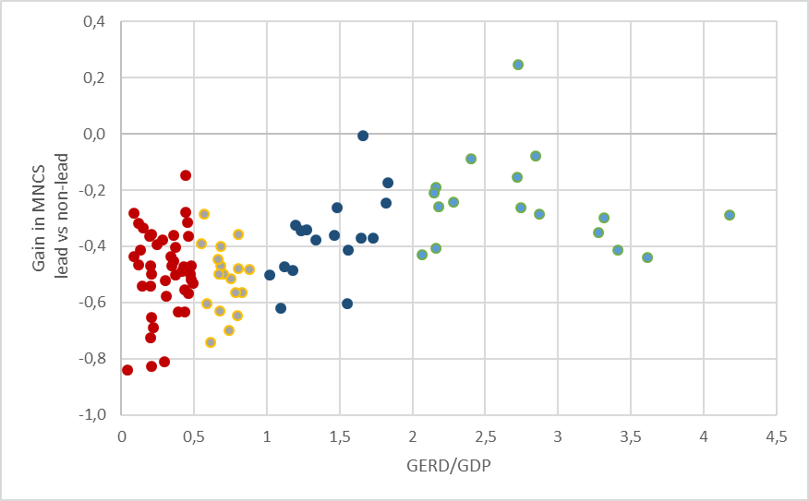
Autonomy vs dependency
Autonomy
Dependency
Gain in MNCS when leading in comparison when non-leading internationally as a function of the GERD/GDP by country. Colors refers to the R&D as percentage of GDP (green ≥ 2%; blue ≥ 1%; orange: ≥ 0.5%; red: ≤ 0.5%)

Slide 35
Summary

Slide 36
Different types of authorship translate in different results in terms of specialization and citation

Slide 37
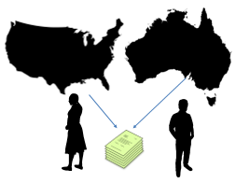
Genuine capacities – Strategic partners
Some countries show higher level of specialization in domestic and leading papers than in non-leading papers

Slide 38
Collaboration enhances specialization
The disciplinary specialization in some countries is due to their international production more than their domestic one.

Slide 39
Collaboration and leadership
International collaboration almost always has benefits to citations
But leading on publications not always offers much more benefit

Slide 40
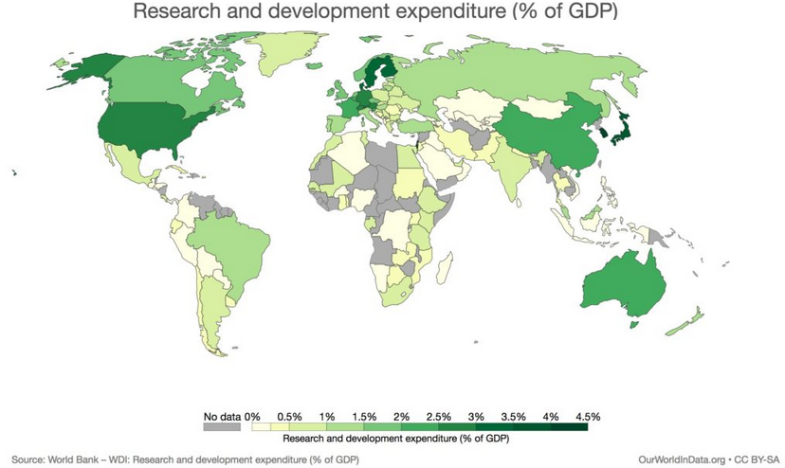
Money matters
More funding facilitates access to more resources and scientific personal within the country
More resources allow countries to be more autonomus while the opposite is more dependency of collaborators

Slide 41
Collaboration facilitates visibility, but it comes at a cost
Strategies for international collaboration do not equally benefit all countries
There is no citation benefit to lead research, but there is for collaborating

Slide 42
Absorptive capacity
Collaboration may help in increasing the absorptive capacity of countries, even when they do not generate new world frontier knowledge (highly cited papers)
It can raise their influence in science without diminishing their attention to topics of national priority

Slide 43
The approach
This approach could contribute to an understanding of how the system of research fields of each country functions and could help to fortifying some of the areas that prove competitive at the national and international level.

Slide 44
Limitations and Future Work

Slide 45
Hetereogenity
We should consider specific disciplines, instead of a large thematic area

Slide 46
Large-scale analysis
Include more countries in the analysis not only those with R&D expenditure’s data available
Limit R&D data for the specific field (if possible)

Slide 47
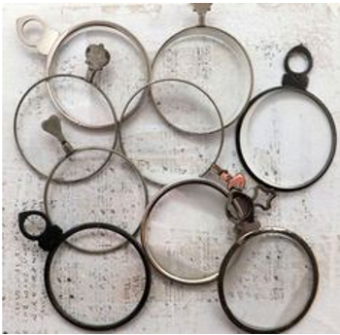
Many perspectives needed
Evaluative frameworks of countries must consider a variety of indicators and other approaches
All limitations and assumptions typical of bibliometric analyses

Slide 48
Building ties across countries: International collaboration, field specialization, and global leadership
Thanks for your attention!
Questions?
zaida.chinchilla@csic.es; vincent.lariviere@umontreal.ca; rcostas@cwts.leidenuniv.nl; elrobinster@gmail.com; sugimoto@indiana.edu
STI 2018, 12-14 September, Leiden, The Netherlands

