Slide 1
Future work and applications RDF Validation tutorial
Jose Emilio Labra Gayo
WESO Research group
University of Oviedo, Spain
Eric Prud'hommeaux
World Wide Web Consortium
MIT, Cambridge, MA, USA
Iovka Boneva
LINKS, INRIA & CNRS
University of Lille, France
Harold Solbrig
Mayo Clinic, USA

Slide 2
Contents
Some applications
ShEx
WebIndex: A linked data portal using ShEx
FHIR
SHACL
Future work

Slide 3
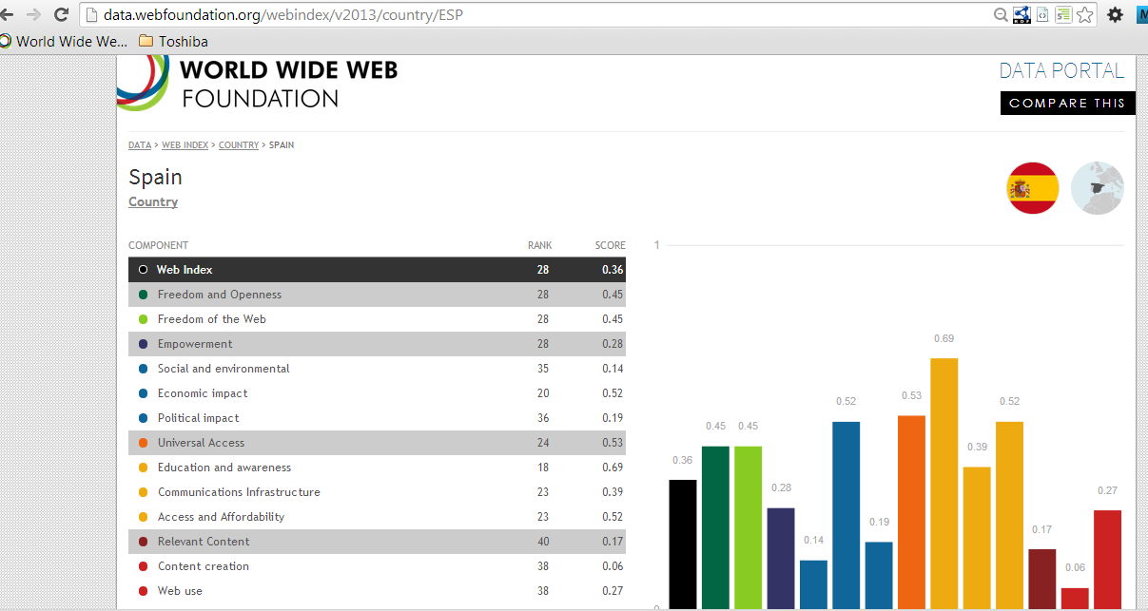
Web Index
Measure WWW's contribution to development and human rights by country
Developed by the Web Foundation
81 countries, 116 indicators, 5 years (2007-12)
Linked data portal
http://data.webfoundation.org/webindex/2013

Slide 4
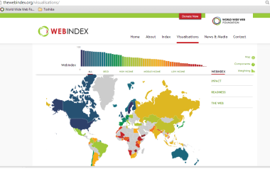
Webindex workflow
Conversion
Excel → RDF
Enrichment
Data
(Excel)
RDF
Datastore
Visualizations
Linked data portal

Slide 5
WebIndex data model
Model based on RDF Data Cube
Main entity = Observation
Observations have values by years
Observations refer to indicators and countries
Observation
Indicator
% Broadband subscribers
Years
Countries
ITU_B | 2011 | 2012 | 2013 | ...
Germany | 20.34 | 35.46 | 37.12 | ...
Spain | 19.12 | 23.78 | 25.45 | ...
France | 20.12 | 21.34 | 28.34 | ...
... | ... | ... | ... | ...
ITU_B | 2011 | 2012 | 2013 | ...
Germany | 20.34 | 35.46 | 37.12 | ...
Spain | 19.12 | 23.78 | 25.45 | ...
France | 20.12 | 21.34 | 28.34 | ...
... | ... | ... | ... | ...
ITU_B | 2010 | 2011 | 2012 | ...
Germany | 20.34 | 35.46 | 37.12 | ...
Spain | 19.12 | 23.78 | 25.45 | ...
France | 20.12 | 21.34 | 28.34 | ...
... | ... | ... | ... | ...
DataSets are published by Organizations
Datasets contain several slices
Slices group observations
Indicators are provided by Organizations
Examples
ITU = International Telecommunication Union
UN = United Nations
WB = World bank
...
DataSet
Slice

Slide 6
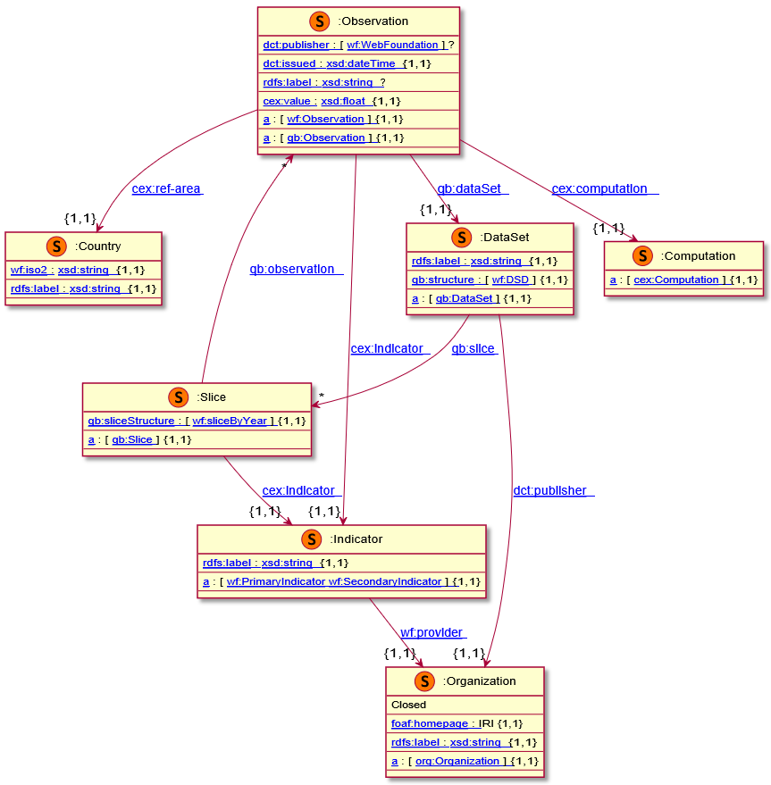
Main webIndex data model (in ShEx)

Slide 7
Use of shape expressions in WebIndex
Documentation of linked data portal
Human-readable
Machine processable
Team communication
Communicate the developers which shapes they had to generate
Validation
For example: check if a value of type qb:Observation has shape <Observation>
http://weso.github.io/wiDoc

Slide 8
WebIndex as a benchmarking
We have created a tool to generate synthetic RDF data that conforms (or not) to the WebIndex data model
The tool can be used to benchmark ShEx and SHACL
See: http://labra.github.io/wiGen/

Slide 9
HL7 FHIR
ShEx is currently being used to develop FHIR/RDF
validate examples (in documentation)
exchange site-specific restrictions
enable consumer and producer validation
See: https://www.w3.org/2016/FHIR-tutorial/Constellations

Slide 10
SHACL applications
TopBraid Composer includes support for SHACL
See: http://www.topquadrant.com/technology/shacl/tutorial/
RDFUnit is also planning to include SHACL support
See: https://github.com/AKSW/RDFUnit
OpenPublicData: prototype to list, filter and present open data
See: http://www.openpublicdata.com/
Schema.org converted to SHACL
See:http://datashapes.org/schema

Slide 11
Some ideas for future work
ShEx ⇔ SHACL
Recursion & negation (see Semantics and validation of recursive SHACL at ISWC)
http://iswc2018.semanticweb.org/sessions/semantics-and-validation-of-recursive-shacl/
Inference of shapes from knowledge graphs (see SheXer poster at ISWC)
Visualization & authoring tools
Usability of processors (better information for debugging)
Rules and shapes (SHACL rules)
RDF Stream validation

Slide 12
Future work
SHACL Community group
ShEx Community group

