Slide 1
A Web of Research Data: Connecting Local, National and International Infrastructures
Danish eInfrastructure Cooperation Conference
October 2018
Alastair Dunning, @alastairdunning
Head of 4TU.ResearchData, and Research Data Services, TU Delft

Slide 2
A Web of Research Data: Connecting Local, National and International Infrastructures
Danish eInfrastructure Cooperation Conference
October 2018
Alastair Dunning, @alastairdunning
Head of 4TU.ResearchData, and Research Data Services, TU Delft

Slide 3
Changing Cultures of Research Data Management
Danish eInfrastructure Cooperation Conference
October 2018
Alastair Dunning, @alastairdunning
Head of 4TU.ResearchData, and Research Data Services, TU Delft

Slide 4
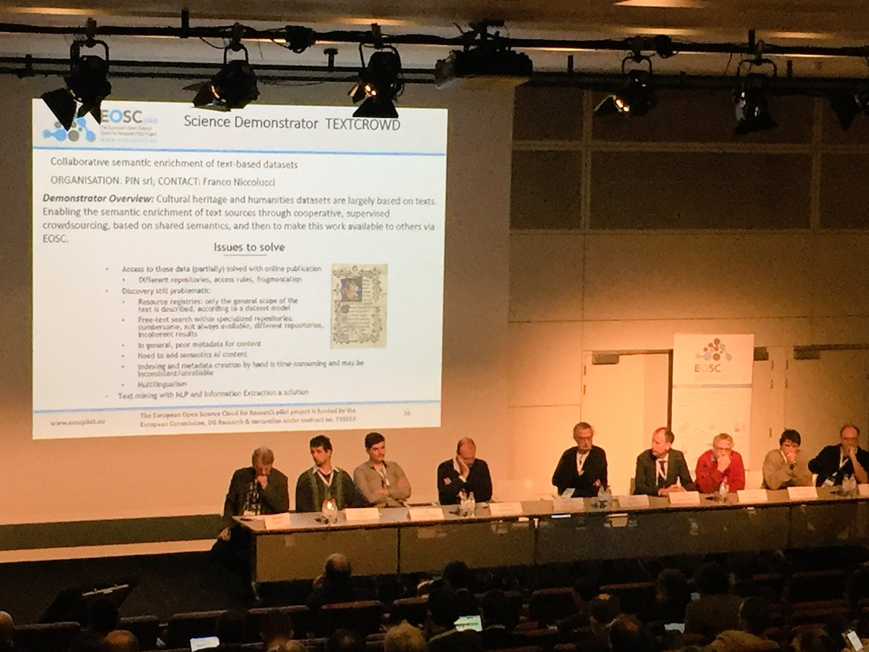
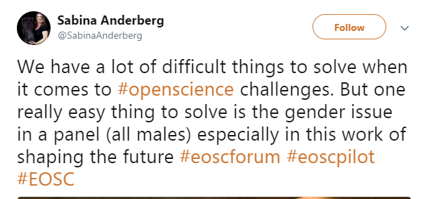
Image taken at EOSCpilot 1st stakeholder engagement event 28-29 Nov 2017 – Brussels

Slide 5
IRONY ALERT !

Slide 6
Often in RDM, discussions of the subject seems to end up at the big infrastructure questions
Notes:
Insert quotes from tweets

Slide 8
But where should the focus lie? My argument is that a focus on big data infrastructure blinds us to what’s needed in RDM
Notes:
Insert quotes from tweets

Slide 9
Let’s look at the drivers and challenges of RDM
Notes:
Insert quotes from tweets

Slide 10
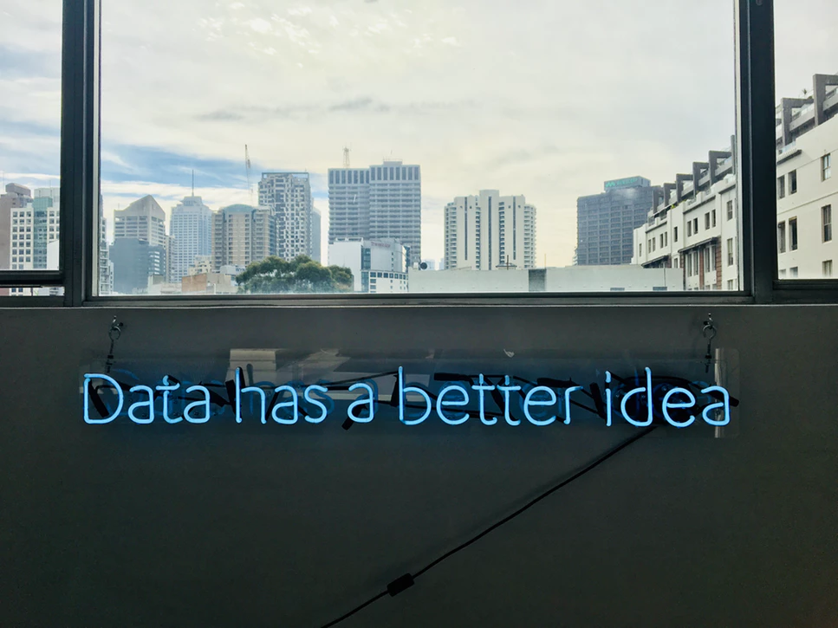
1. More Data + More Questions = More Answers

Slide 11
Let me clarify: well funded and powerful infrastructure is necessary for all kinds of research. Development is continuously needed.
Notes:
Insert quotes from tweets

Slide 12
But so many other issues are not technological
Notes:
Insert quotes from tweets

Slide 13
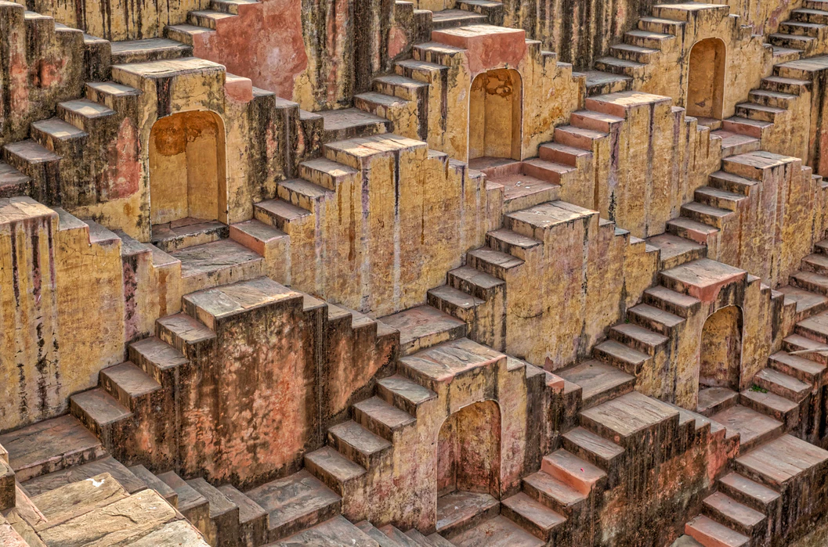
2. The Reproducibility Crisis
Notes:
Maybe that's a big jump for audience who might not be familiar with reproducibility crisis. Perhaps would be good to say first what do you mean by reproducibility crisis and how more transaprency (data sharing, data available for validation) could help making research more reproducible

Slide 14
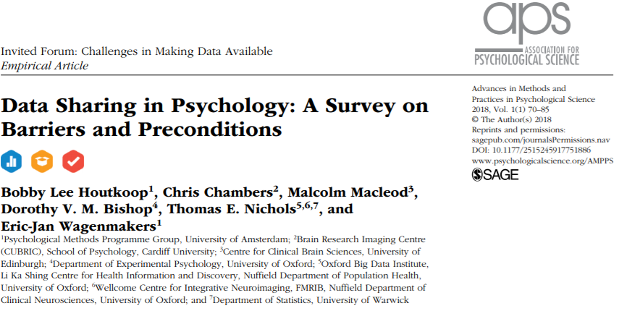
https://doi.org/10.1177/2515245917751886

Slide 15
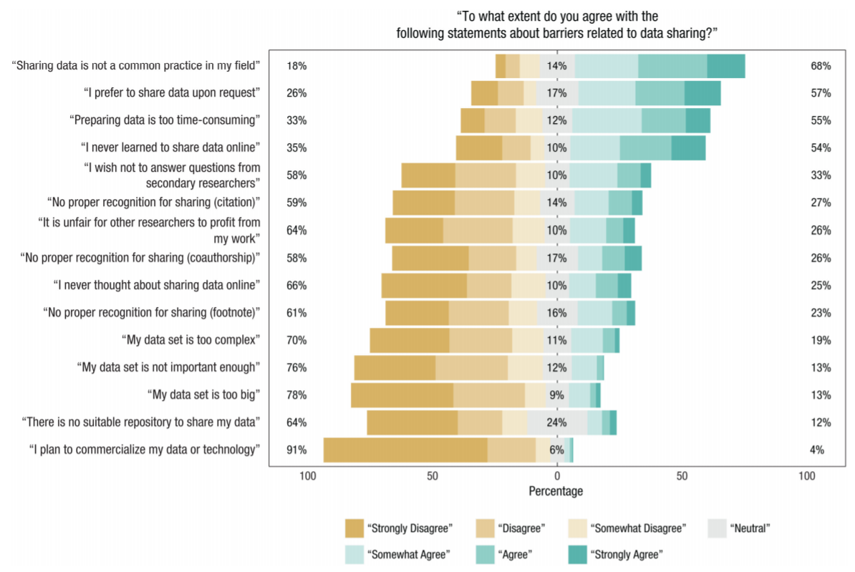
To what extent do you agree with the following statements about barriers related to data sharing?
https://doi.org/10.1177/2515245917751886

Slide 16
To what extent do you agree with the following statements about barriers related to data sharing?
Only two reasons close to the bottom are technological
https://doi.org/10.1177/2515245917751886

Slide 17
Similar findings in other reports (from other disciplines), e.g.
Life sciences, social sciences and humanities:
Van den Eynden et al. (2016)
https://doi.org/10.6084/m9.figshare.4055448.v1
All disciplines:
Johnson et al. (2016)
http://doi.org/10.5281/zenodo.177856

Slide 18
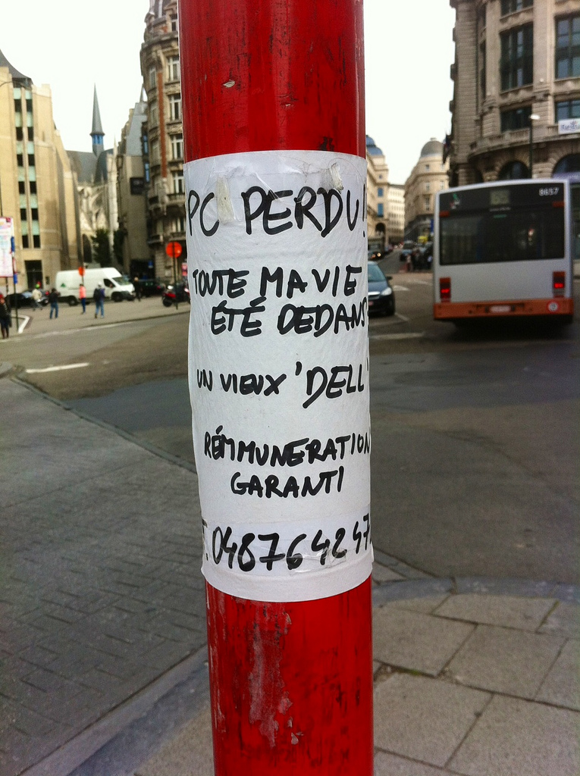
3. Back up, storage and sharing

Slide 19
The means and services for backup, storage and sharing nearly always exist. The problem is the communication about them
Notes:
Insert quotes from tweets

Slide 20
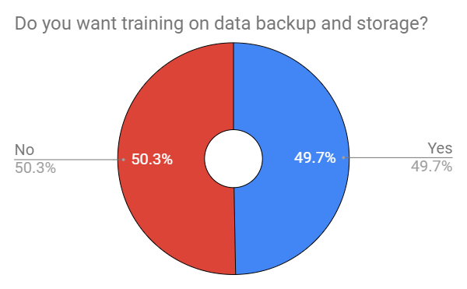
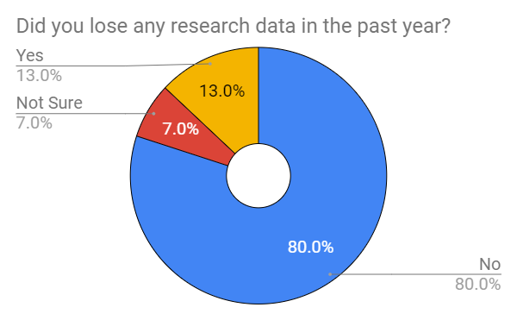
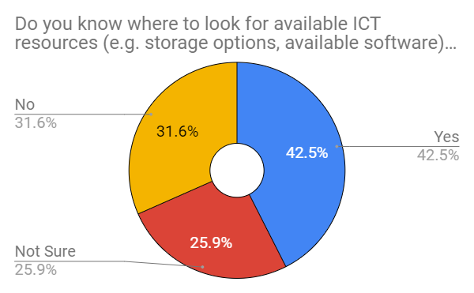
RDM Survey at TU Delft (2017-18, 680 respondents)
https://openworking.wordpress.com/2018/02/07/do-as-you-preach-results-of-2017-data-management-survey-now-published/

Slide 21
4. Data Protection and that damned GDPR

Slide 22
GDPR is not so new. There are technical challenges but they are dwarfed by the challenges in communicating roles and responsibilities.
Notes:
Look at your own university?

Slide 23
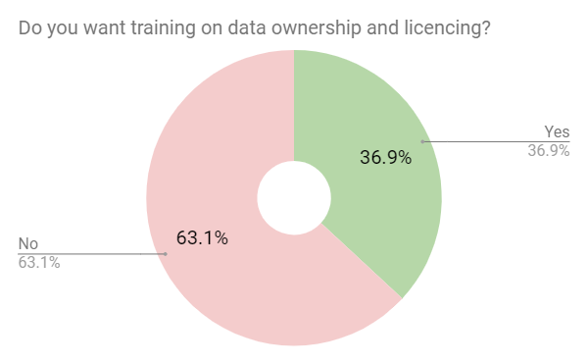
RDM Survey at TU Delft (2017-18, 680 respondents)
https://openworking.wordpress.com/2018/02/07/do-as-you-preach-results-of-2017-data-management-survey-now-published/

Slide 24
So what are we doing about this in the Netherlands?

Slide 25
Mix of infrastructure and support but messy …..
National Plan for Open Science
FAIR Data Action Plan for NL
National Coordination Point for Research Data Management
Notes:
Insert quotes from tweets

Slide 26
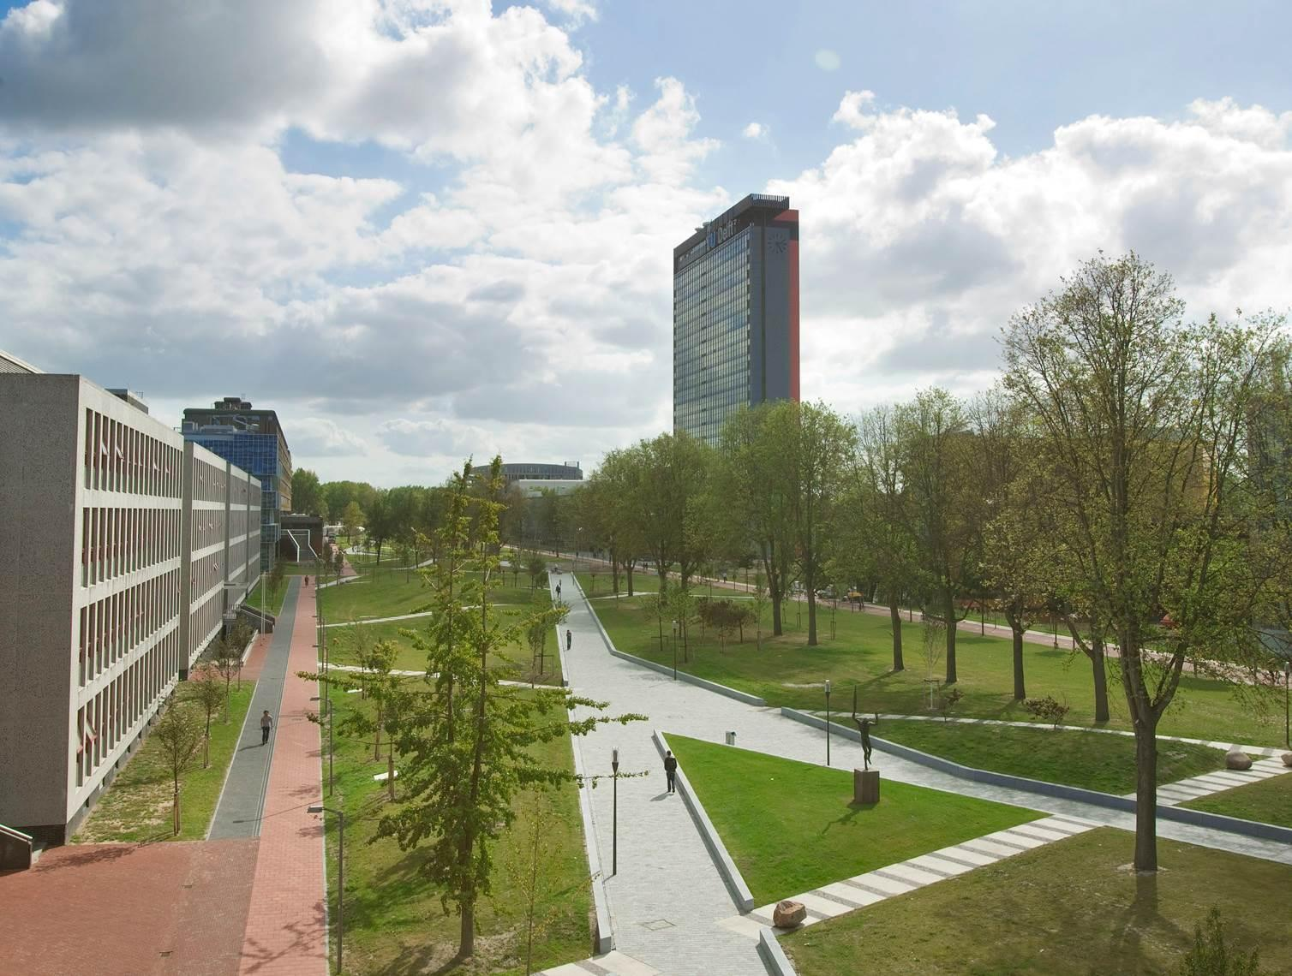
So what are we doing about this at TU Delft?

Slide 27
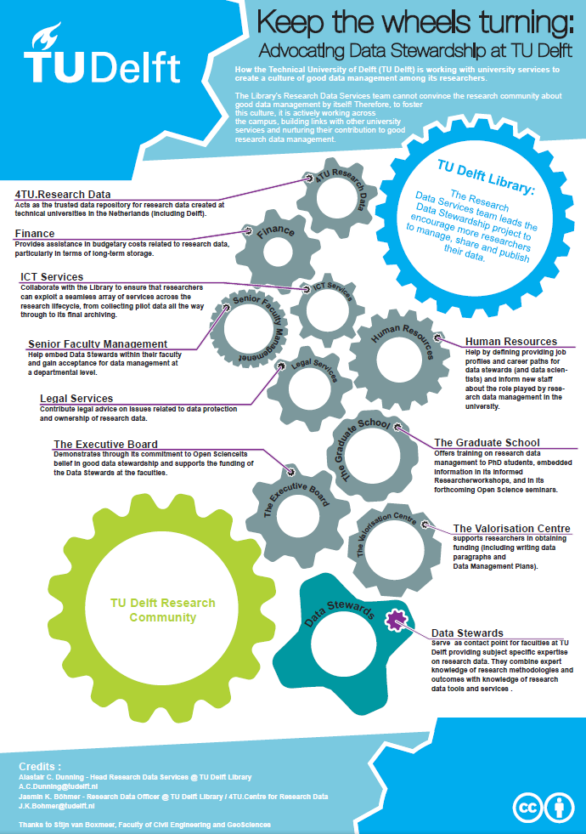
Embedding Data Stewards in each of our eight faculties
http://bit.ly/DataStewardship

Slide 28
Ensuring Data Stewards are articulate, networked, who can communicate at research and policy level

Slide 29
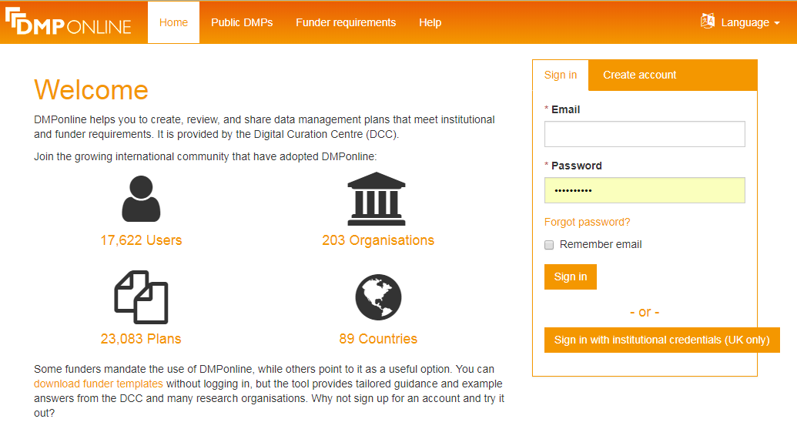
Articulate, Networked Communicators
Cross working between IT, Library, and Ethics Committee
Will use DMP (Data Management Plan) Online for
data management
managing use of storage
ensuring ethical compliance

Slide 30
Library based staff run our data archive, and link to national and international networks
Notes:
RDA

Slide 31
4TU.ResearchData
Connections with other data archives in the Netherlands (DANS, SURF Trusted Repository) via Research Data Netherlands (RDNL)
- RDA
- National Platform for Open Science
- National Coordination Point
- FAIRSharing
- Member of Carpentries
http://data.4tu.nl

Slide 32
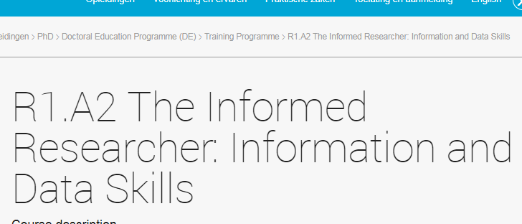
Training at local, national and international level

Slide 33
Our philosophy is that the key change is cultural not technological.

Slide 34
Not, “do we have the right infrastructure”, but “do we have the right people?”

Slide 35
Changing Cultures of Research Data Management
Danish eInfrastructure Cooperation Conference
October 2018
Alastair Dunning
Head of 4TU.ResearchData, and Research Data Services, TU Delft

Slide 36
Credits
Cube House Photo by Boudewijn Huysmans on Unsplash
Data Loss - https://www.flickr.com/photos/alastair-dunning/8042902341
Data Photo by Franki Chamaki on Unsplash
Net- Photo by Ben Hershey on Unsplash

