Slide 1
ORCID integration at
a small(ish) publisher Maarten Fröhlich Stephanie Delbecque
28 September 2018
iospress.com
Notes:
ORCID integration at a smallish publisher, AN IOS PRESS USE CASE

Slide 2
Outline
- Background - Done so far - What’s next
iospress.com

Slide 3
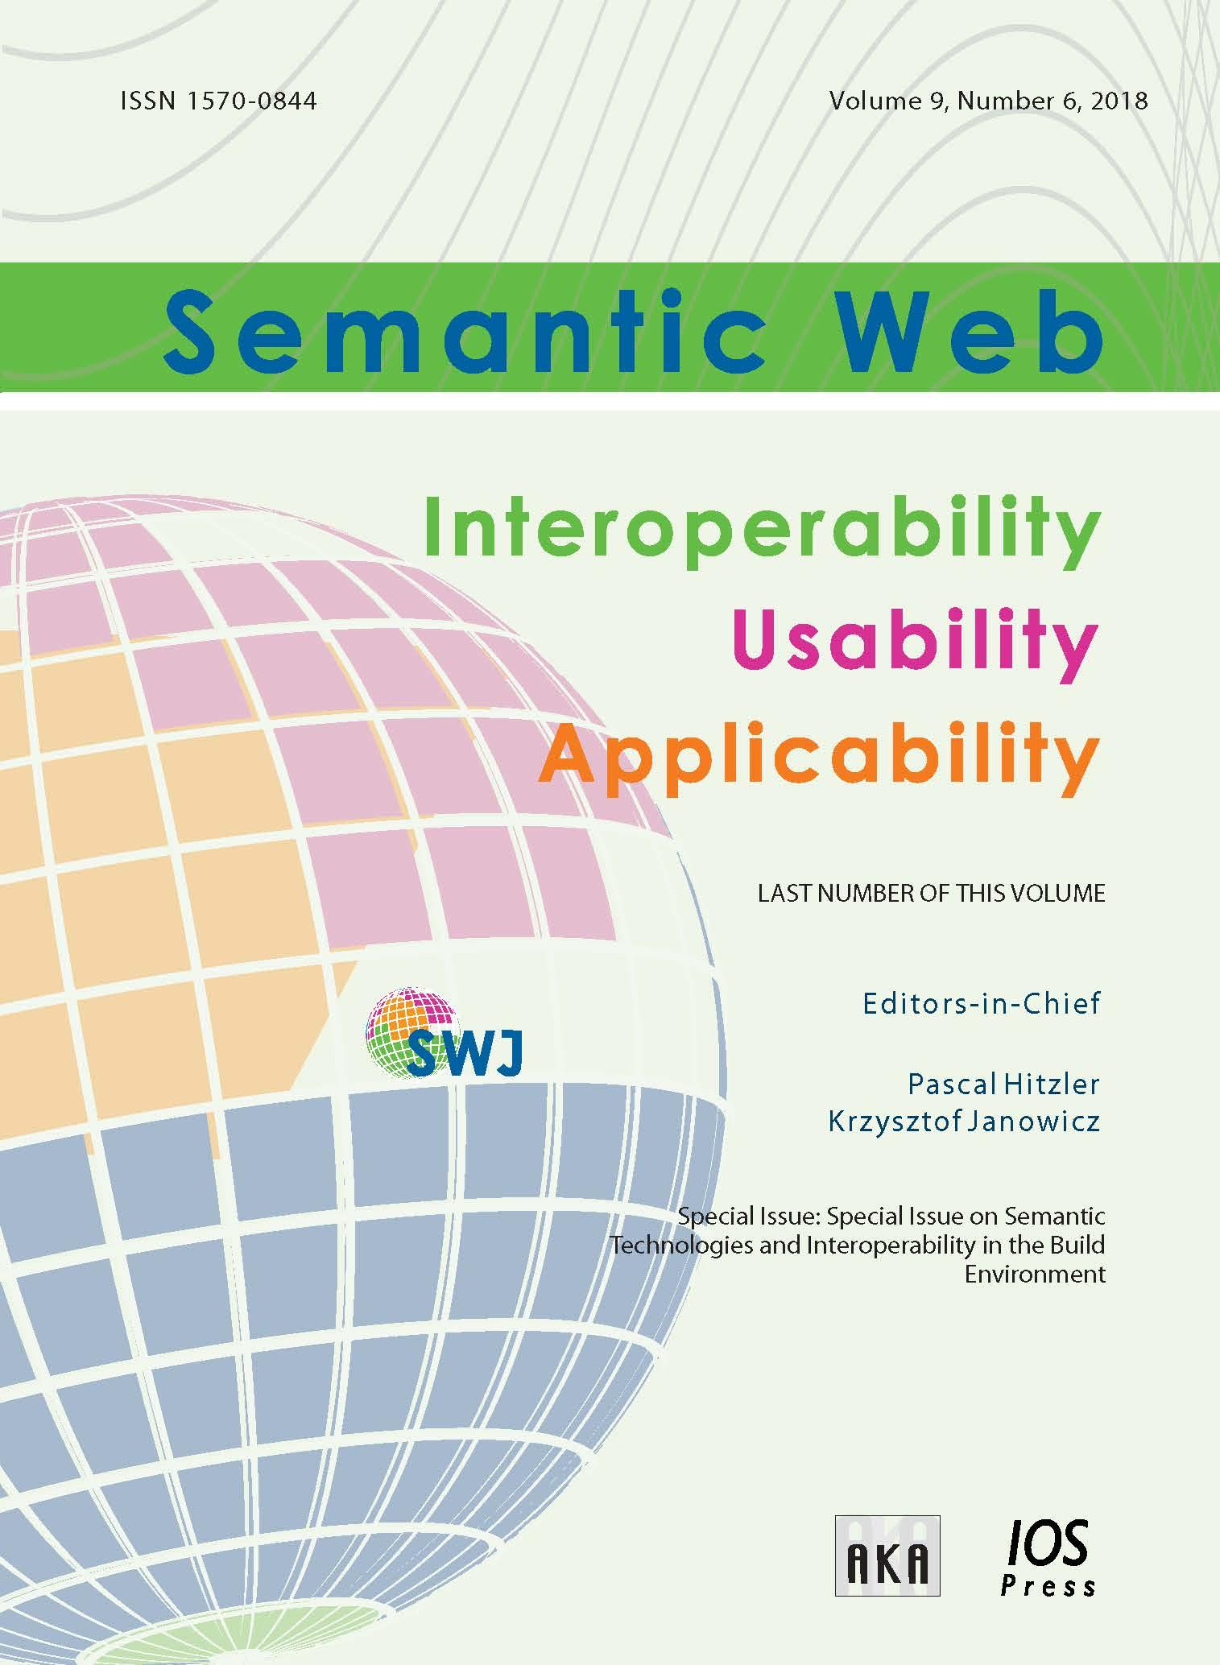
iospress.com

Slide 4
Open and transparent
- pre print @ journal website - all reviews are public - assigned editors and reviewers are known by name - everybody (first authors, co-authors, editors, reviewers) requires ORCID
iospress.com

Slide 5
iospress.com

Slide 6
iospress.com
Notes:
We had to Create custom Drupal 7 modules, there were no pre-existing modules for example for single sign on. The ones that were there didn’t work, were no longer supported.

Slide 7
Submission workflow incl ORCID
ORCID SSO, auto-complete fields
Notification to all co-authors to confirm ORCID
When all ORCIDs are in (optional) invite handling editor
Invite reviewers
Automatic login, ORCID SSO, submit review
ORCID iD in metadata of accepted paper
iospress.com
Notes:
Advantage of own system, guidig and explaining ORCID each step in the submission, intuitive, flexibility of integration. Disadvantage or challenges: lot of time and costs (Drupal module)

Slide 8
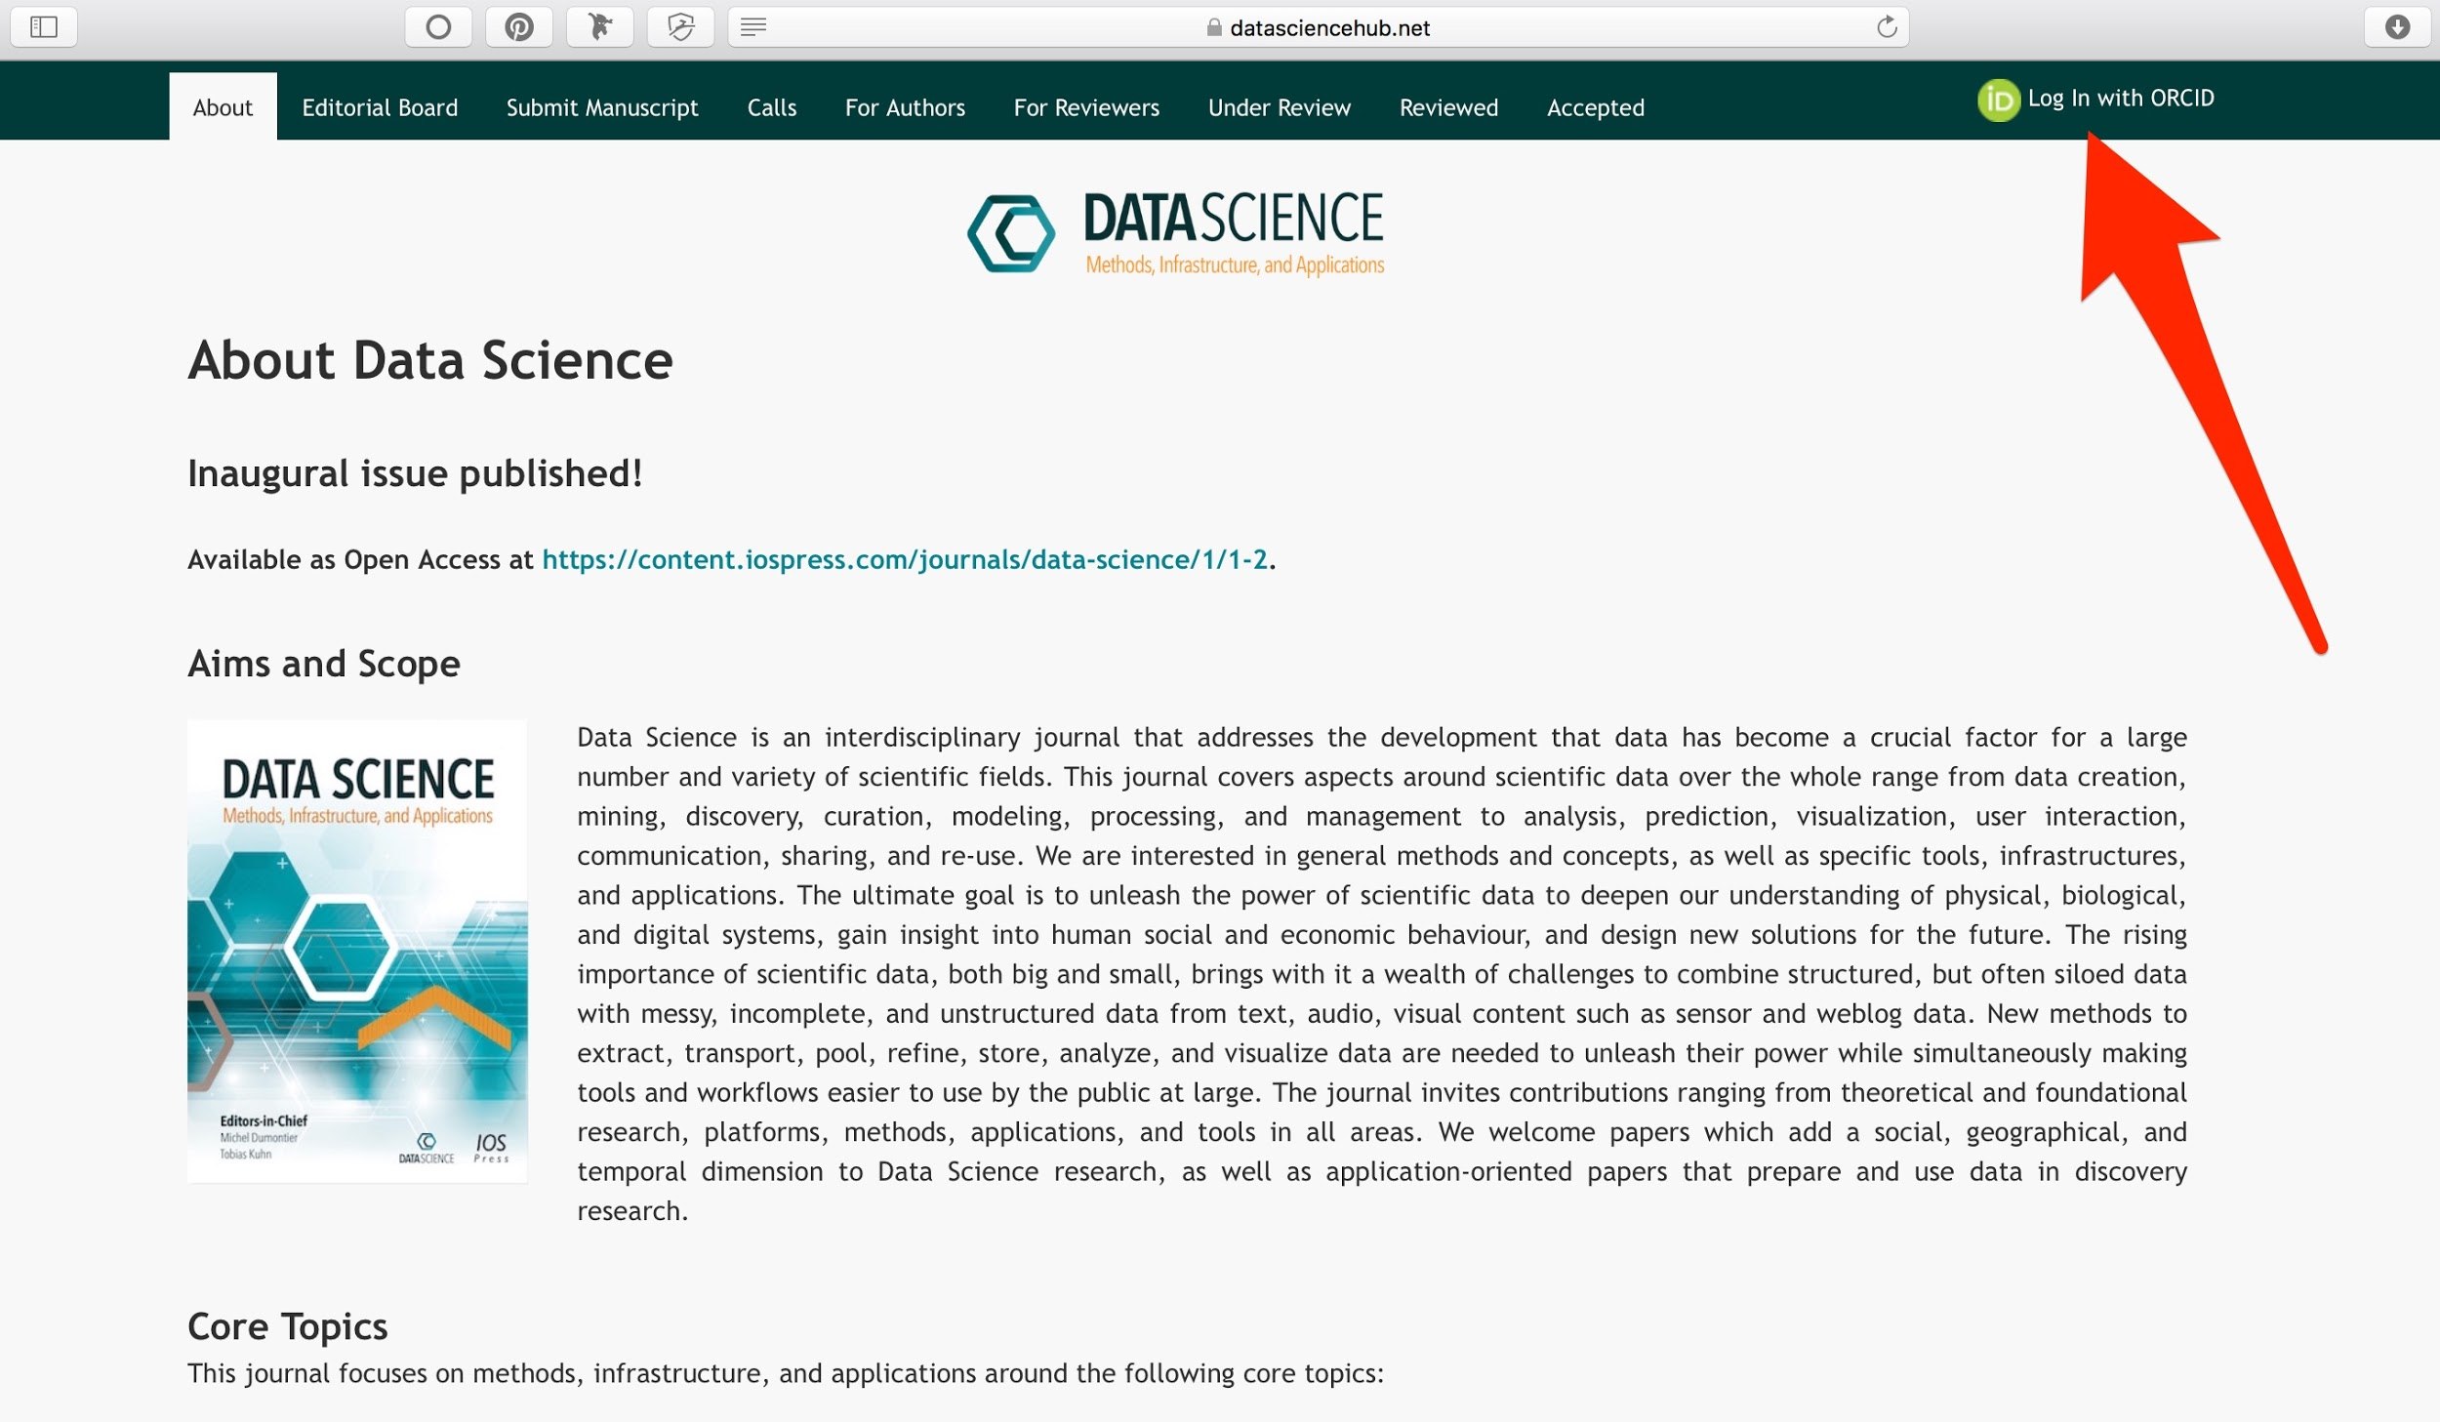
iospress.com
Notes:
We integrated single sign on. User can log in on homepage or through Submit Manuscript. Link to authentication page, where user logs in with or creates an ORCID account.

Slide 9
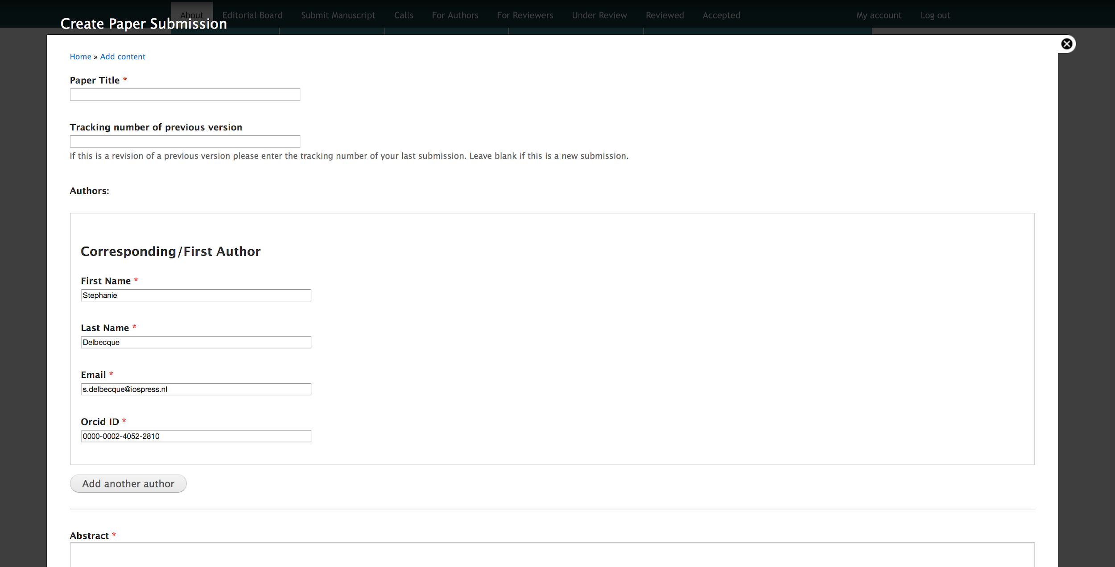
iospress.com
Notes:
Author field is auto-completed.

Slide 10
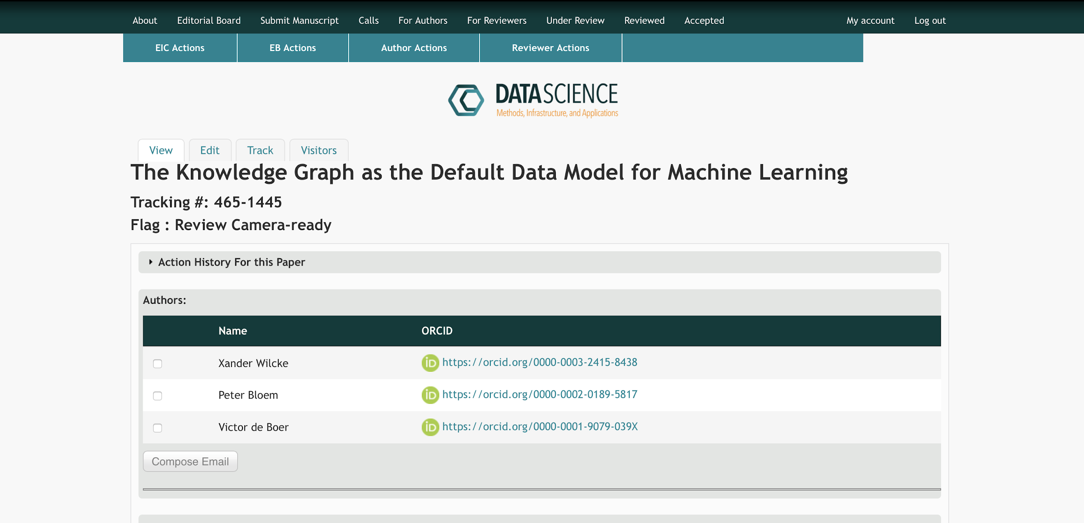
iospress.com
Notes:
When submission is done, a notification is sent to all co-authors to confirm their ORCID iDs and by that validates their co-authorship. When all co-author’s ORCID iDs are added, the EiC can invite a responsible editor.

Slide 11
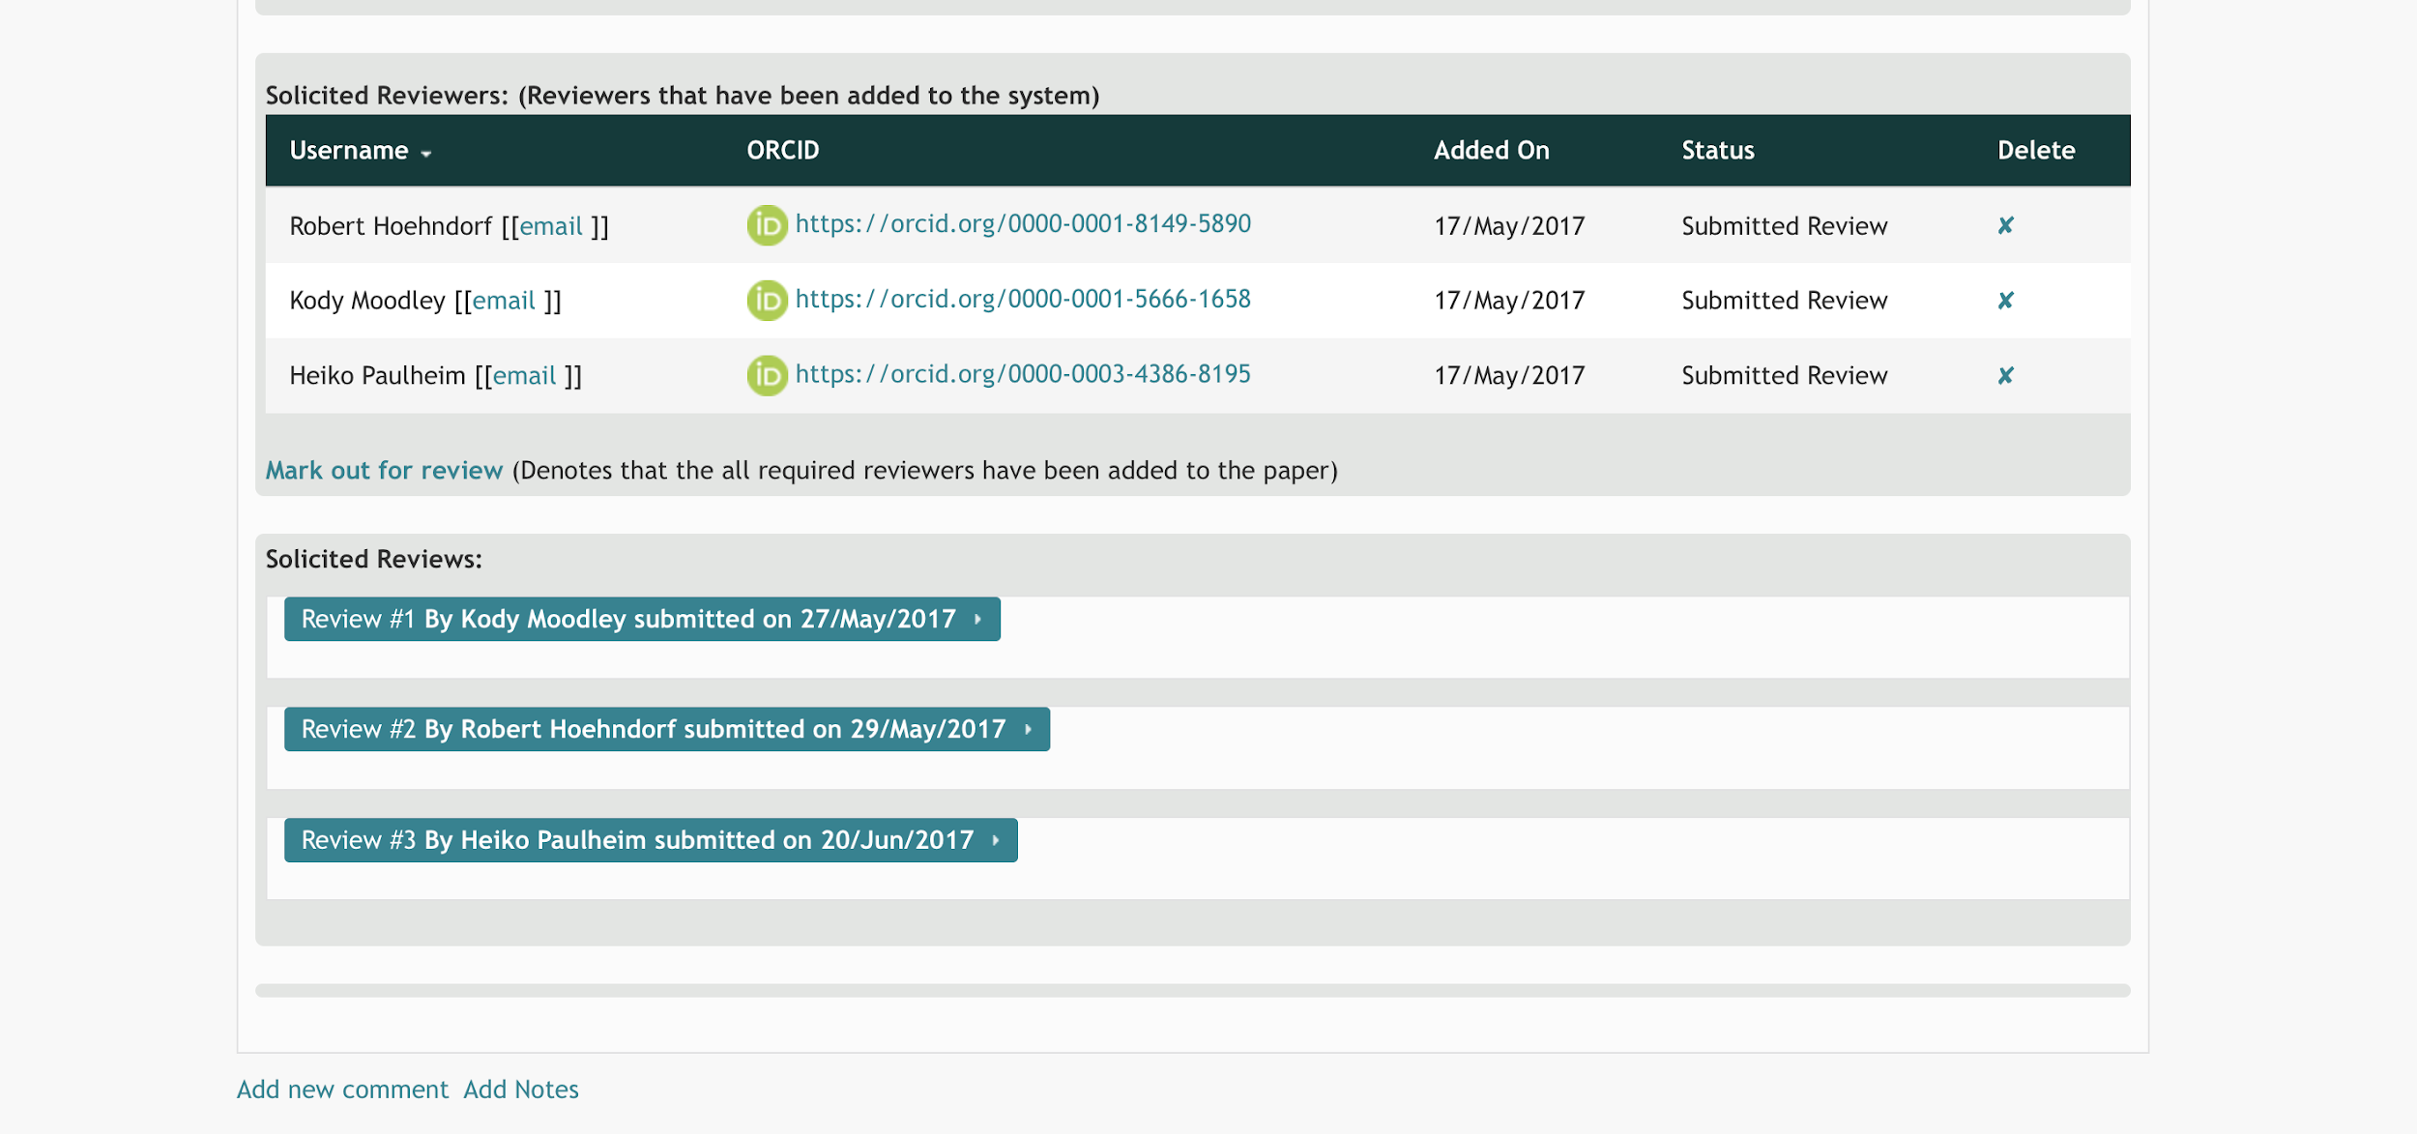
iospress.com
Notes:
Who invites reviewers through the same workflow: they receive an review invitation through mail where they can accept/decline and log in through ORCID to submit their review. The ORCID iDs of the reviewers are shown.

Slide 12
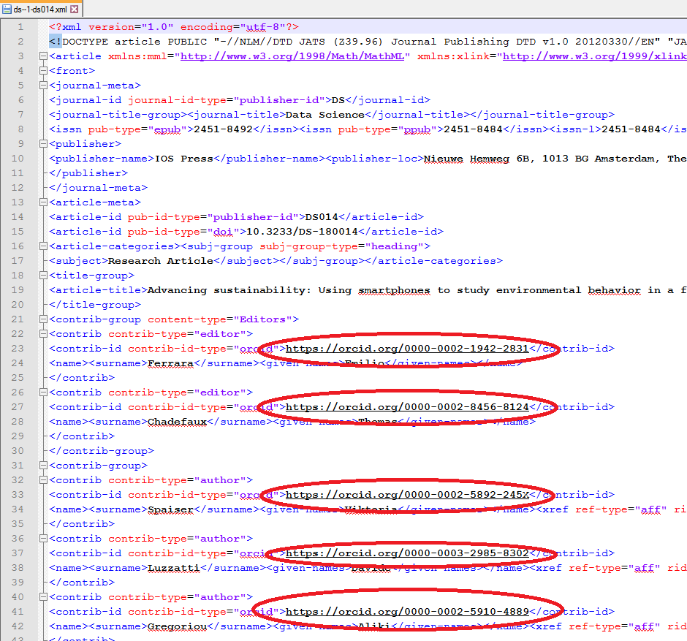
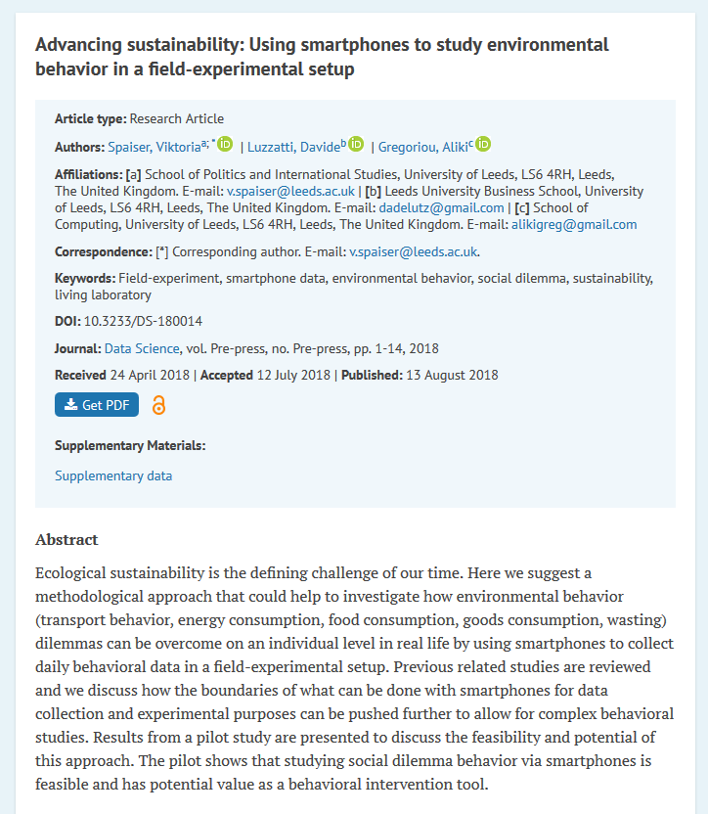
iospress.com
Notes:
Once a paper is accepted, the ORCID iDs are added to the metadata and displayed on the IOS Press Content platform

Slide 13
What’s next
Auto-update ORCID profiles
upon paper acceptance
review activity (open, closed)
other research contributions (eg comments, blog, editor)?
Expand to other journals
Single sign on for Drupal 8
Journal sites, research activities
Add ORCID iDs to LD Connect
Identity management in layer below?
iospress.com
Notes:
Challenges: other systems? Journal sites (data accurate enough? Diff in affiliation as Peter said etc)

Slide 14
Gonna catch ‘em all!
iospress.com

Slide 15
Thank you!
Maarten Fröhlich m.frohlich@iospress.nl
Stephanie Delbecque s.delbecque@iospress.nl
iospress.com

