Slide 1
Peer review uncertainty at the institutional level
V.A. Traag¹, M. Malgarini², T. Cicero², S. Sarlo², L. Waltman¹
¹Centre for Science and Technology Studies (CWTS), Leiden University, the Netherlands
²ANVUR, Rome, Italy

Slide 2
Comparing peer review with metrics
Post-publication research evaluation
Context: performance based research funding
How well do metrics agree with peer review?
Relevant aggregation level
Institutional level
Article level
Consider peer review uncertainty

Slide 3
Third Italian Research Evaluation Exercise (VQR 2011-2014)
VQR launched in June 2015, covering the period 2011—2014.
VQR covered
114 431 publications by
60 455 researchers working in
96 Universities,
12 Public Research Organizations (PRO) , and
27 other research Institutes (participating on a voluntary basis).
in 16 research areas (GEVs)
of which 11 bibliometric GEVs.
VQR executed by the Italian National Agency for the evaluation of Universities and Research Institutes (ANVUR, ENQA Affiliate from September 2013).

Slide 4
VQR research outputs evaluation method
Research Outputs to be evaluated
GEV assigns each output to two GEV members
GEV members may choose evaluation method on the basis of:
GEV rules (stated into GEV criteria documents)
Output characteristics
Ineligible
Informed peer-review method
Peer-review method
GEV final approval
Final Result
Excellent
Limited
Good
Acceptable
Fair

Slide 5
Sample journal articles
Random sample of 10% of all output of bibliometric GEV.
The sample has been stratified on the basis of GEV.
Selected articles were submitted for peer review using the same process as in the VQR exercise.
The number of articles effectively peer reviewed covers 9.3% of all articles submitted to bibliometric evaluation.
No substantial selection biases (language, number of pages, bibliometric evaluation) emerged from a post stratification analysis.
The final sample includes 7164 publications.

Slide 6
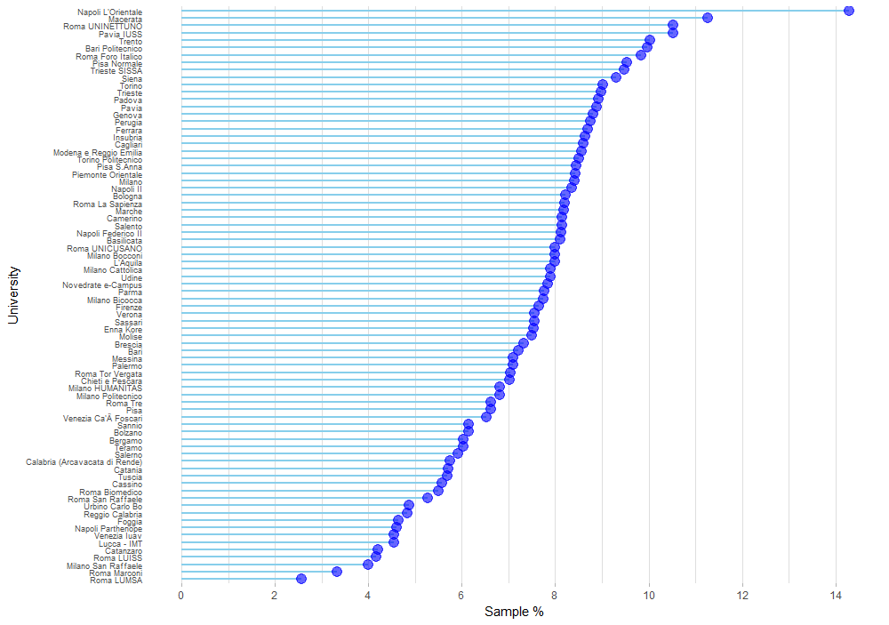
Sample shares at the institutional level

Slide 7
Bibliometric Methodology
Sampling 7164 papers, matched 5183 to WoS.
4560 from 78 Italian universities, almost 8%.
Two peer reviews of same article
Randomly designated reviewer 1 and reviewer 2
Score between 3 – 30 (covering originality, rigour and impact)
Institutional scores
Average of peer review scores
Average of normalised WoS citations
Average of normalised WoS journal impact
Average of VQR citation percentile (various data sources)
Average of VQR journal percentile (various data sources)

Slide 8
Metrics and peer review uncertainty
Peer review uncertainty
Compare institutional score of reviewer 2 to reviewer 1.
Metrics
Compare institutional metric score to reviewer 1.

Slide 9
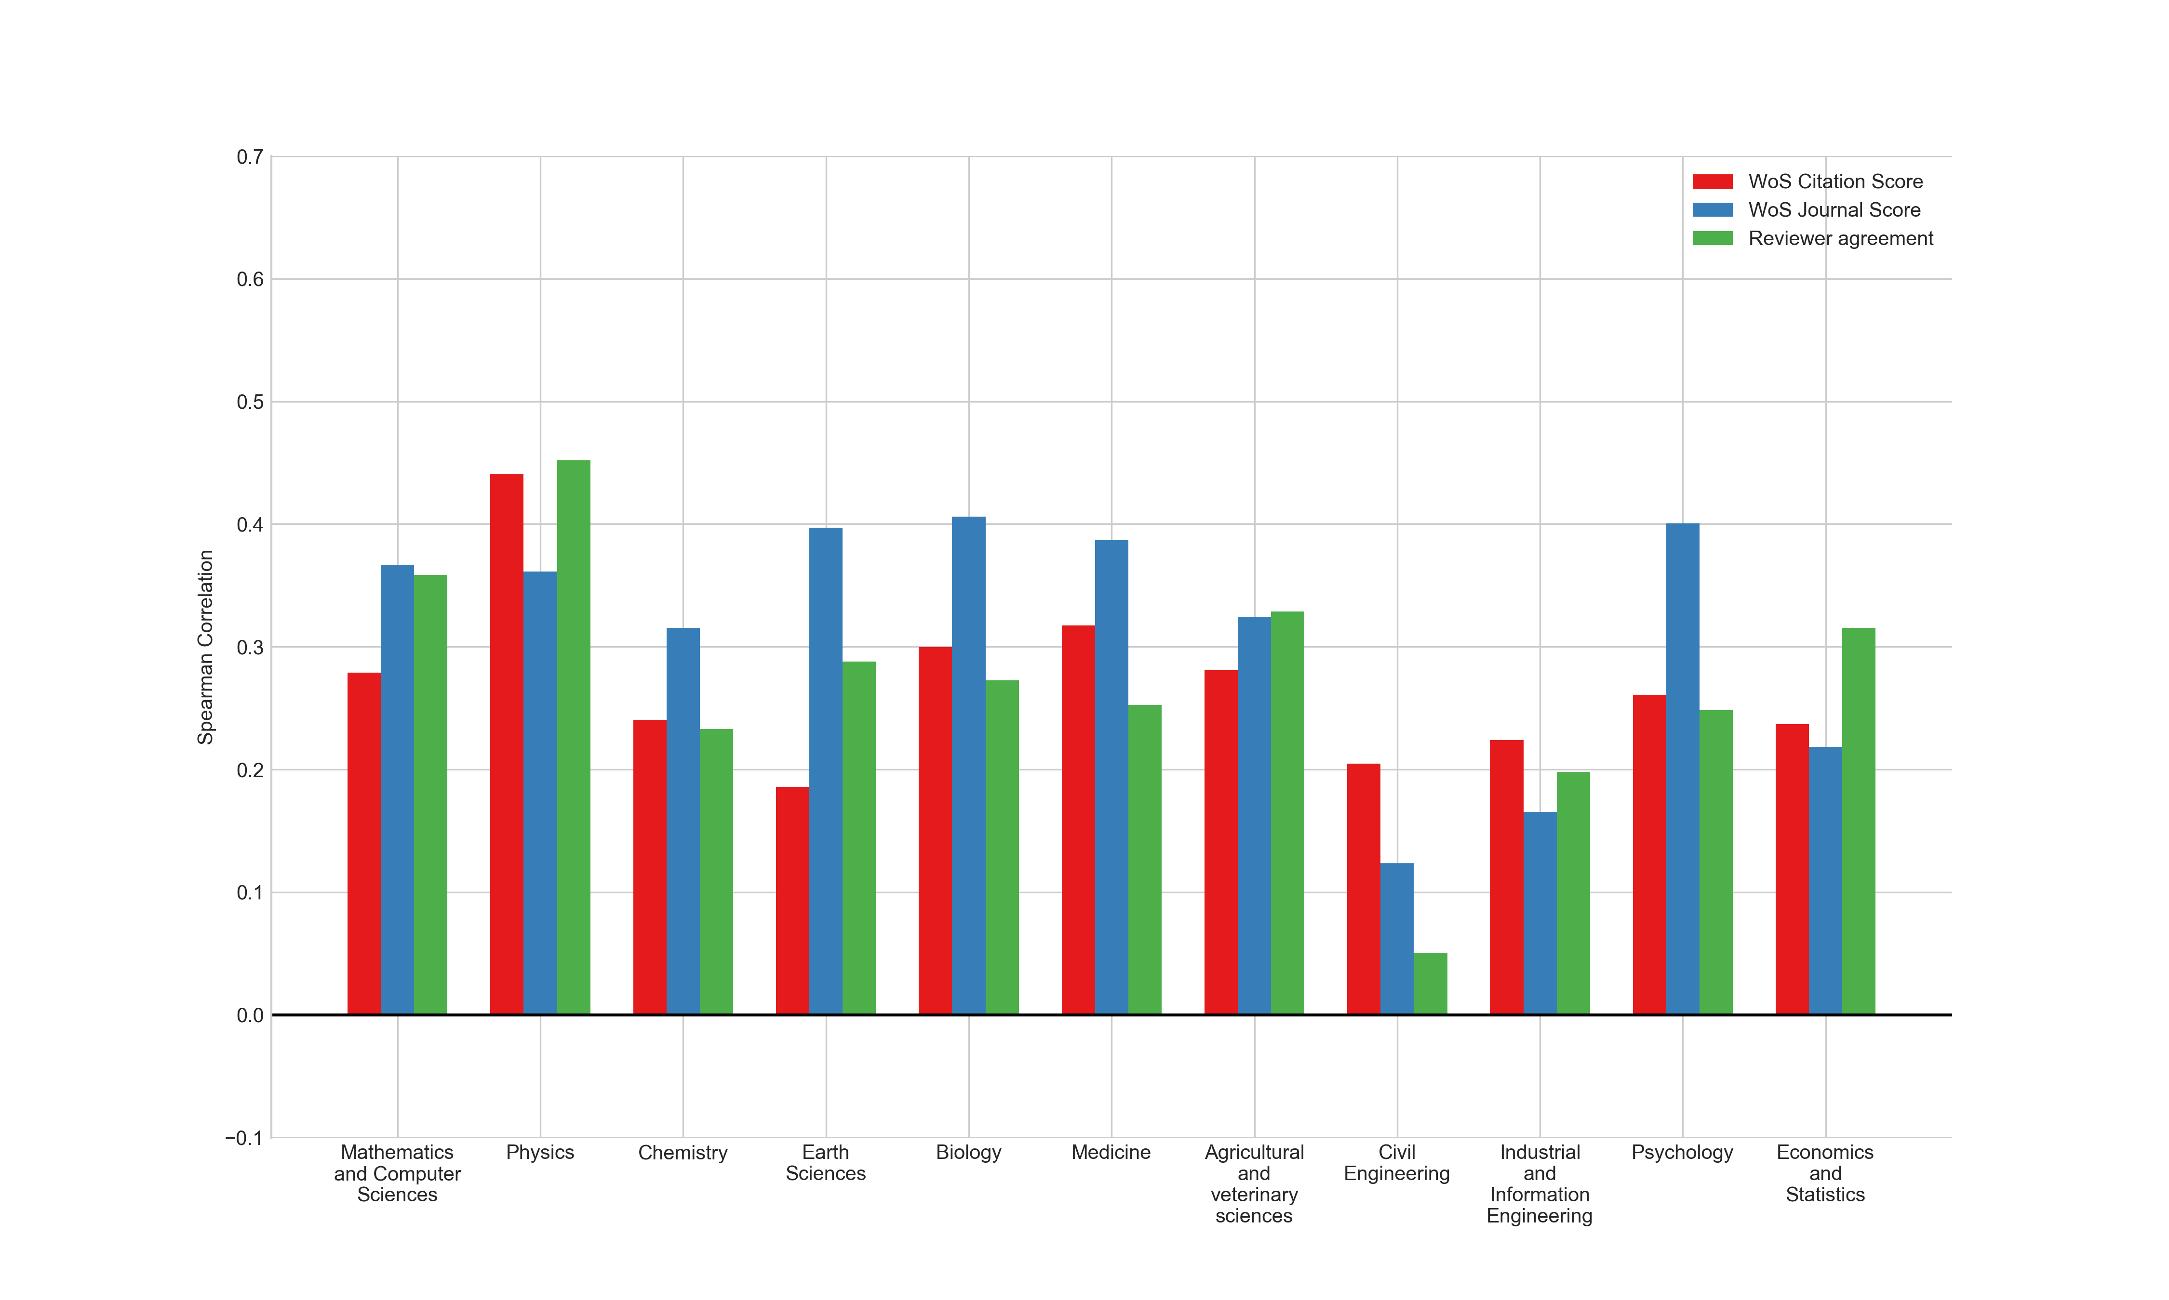
Article Spearman correlations (WoS)

Slide 10
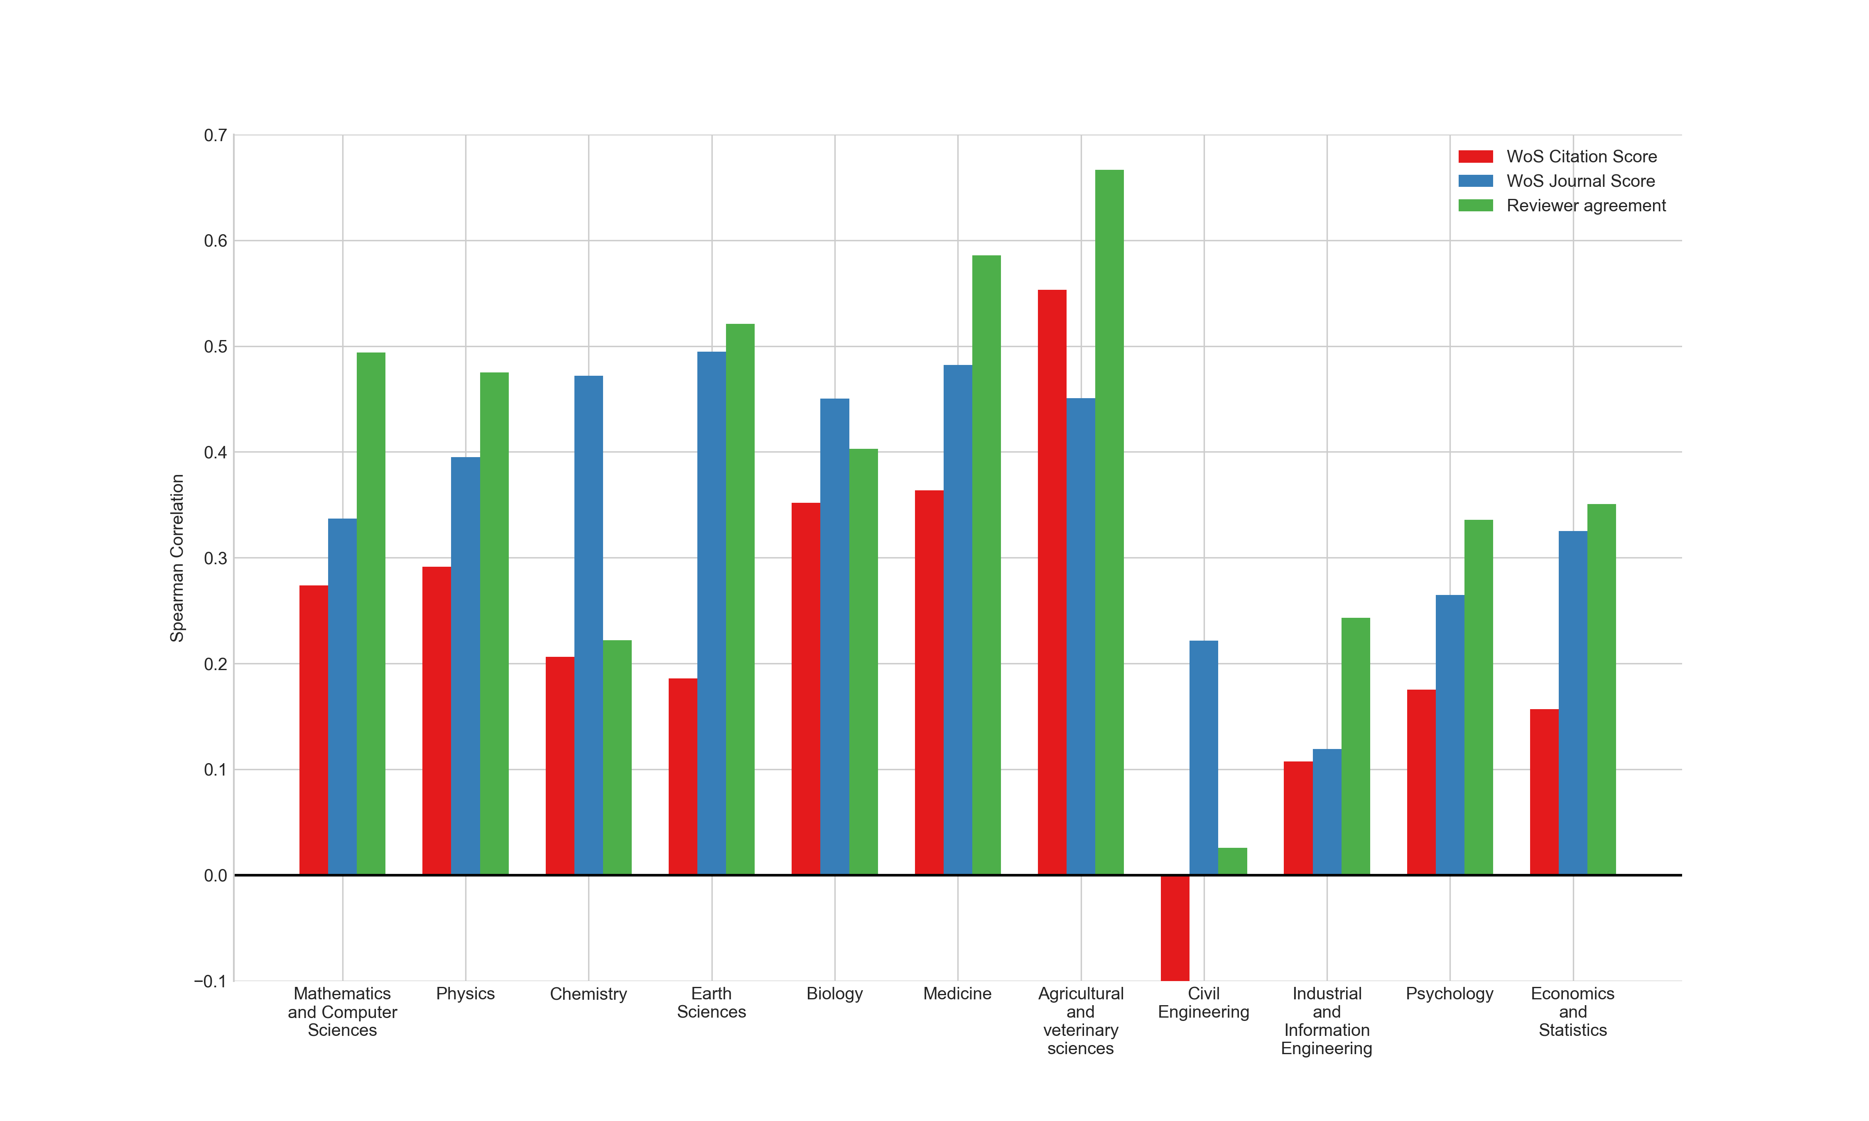
Institutional Spearman correlations (WoS)

Slide 11
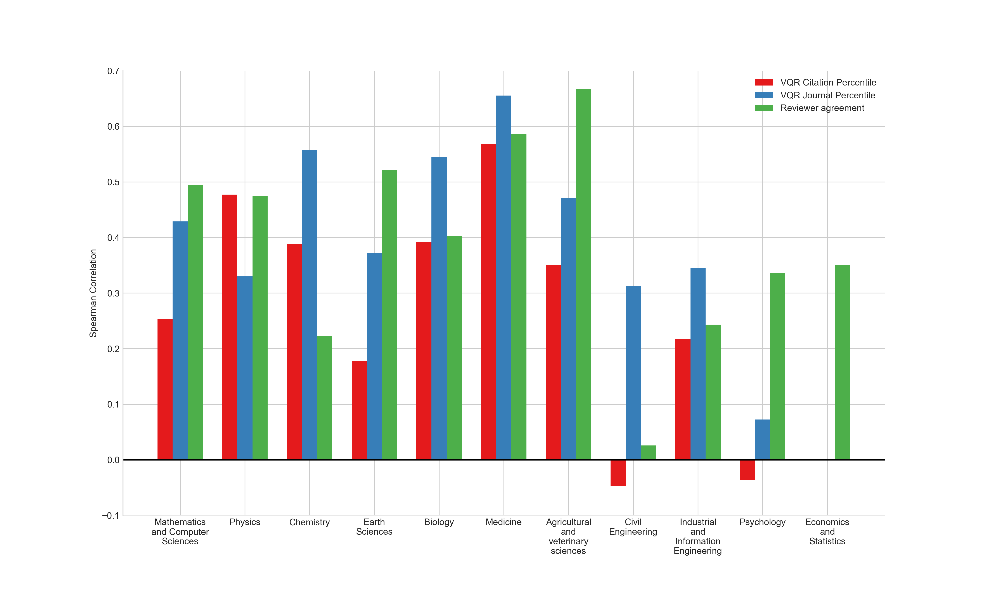
Institutional Spearman correlations (VQR)

Slide 12
Conclusions
Institutional level agreement higher than article level agreement.
Agreement with peer review is higher for journal indicators than for citation indicators.
Internal peer review agreement comparable to journal indicator agreement.
Do reviewers base evaluation largely on journal?

