Slide 1
Contributing to BIDS (especially BEP001)
Kirstie Whitaker
ISMRM Joint Study Group Virtual Meeting: Reproducible Research & White Matter Study Groups
4 October 2018

Slide 2
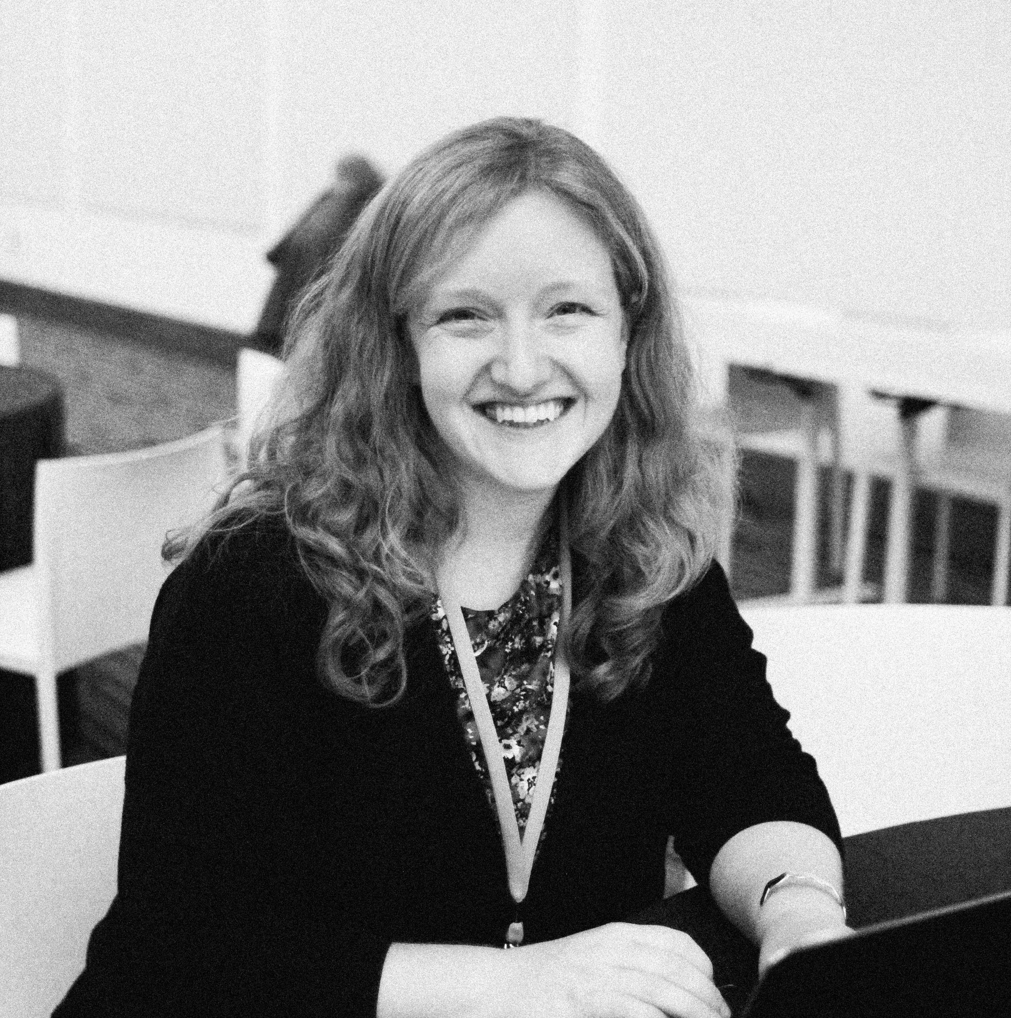
Research fellow at the Alan Turing Institute – the UK’s national institute for Data Science and Artificial Intelligence.
Senior research associate in the Department of Psychiatry at the University of Cambridge.
Passionate about making it easy for people to share evidence of the work they did
Published papers without data or code are just nice stories!

Slide 3
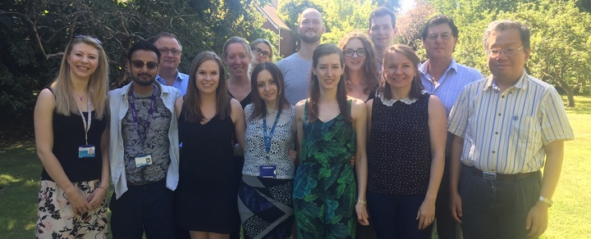
www.nspn.org.uk

Slide 4
R1 (1/T1)
Longitudinal relaxation time
Magnetisation Transfer
(MT)
R2* (1/T2*) Transverse relaxation time
Proton Density
(A)
Weiskopf et al, NeuroImage, 2011; Callaghan et al, Neurobiology of Aging, 2014; Lutti et al, NeuroImage, 2014

Slide 5
Whitaker*, Vertes* et al, PNAS, 2016
Rosas et al, Neurology, 2002

Slide 6
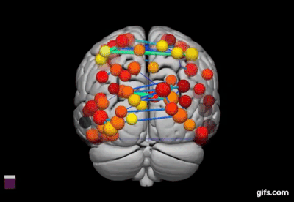
Whitaker*, Vertes* et al, PNAS, 2016

Slide 7
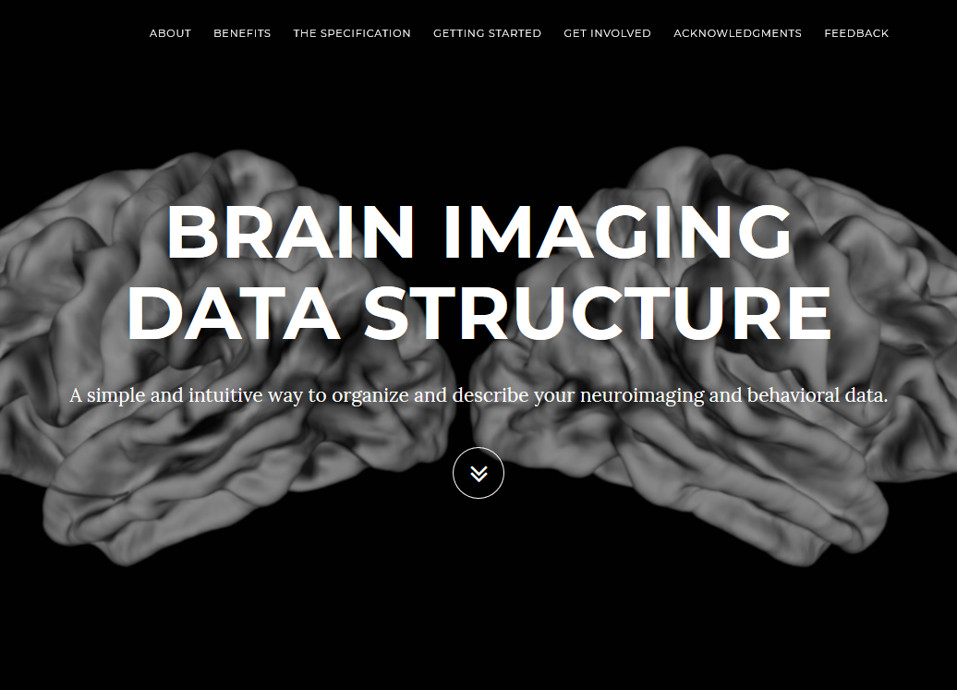
http://bids.neuroimaging.io

Slide 8
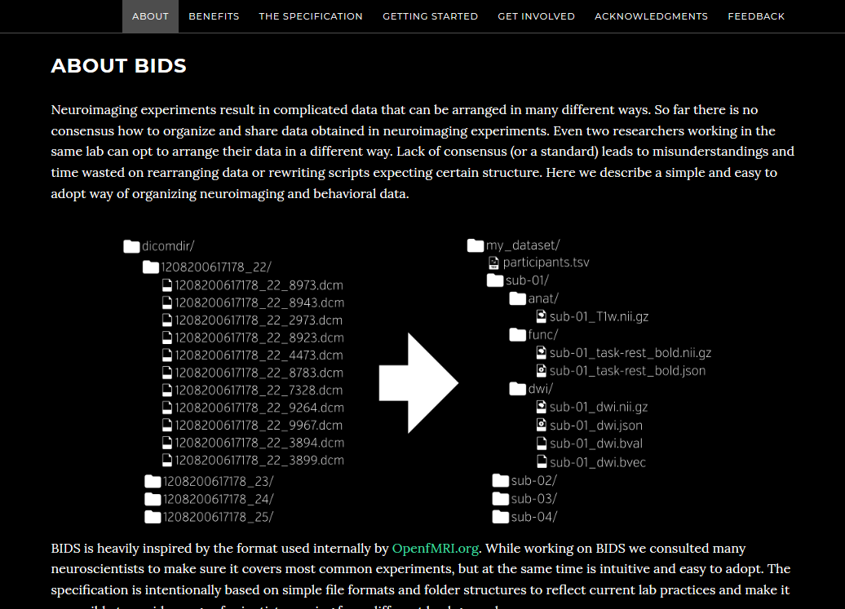
http://bids.neuroimaging.io

Slide 9
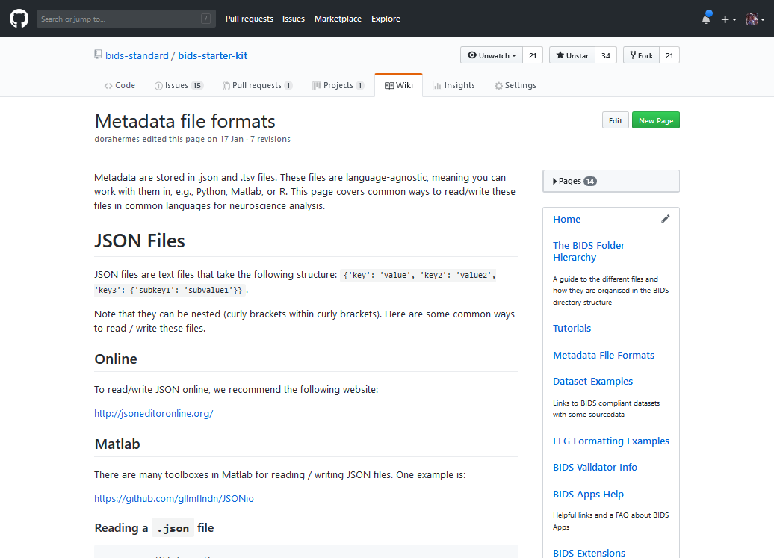
https://github.com/bids-standard/bids-starter-kit/wiki/Metadata-file-formats

Slide 10
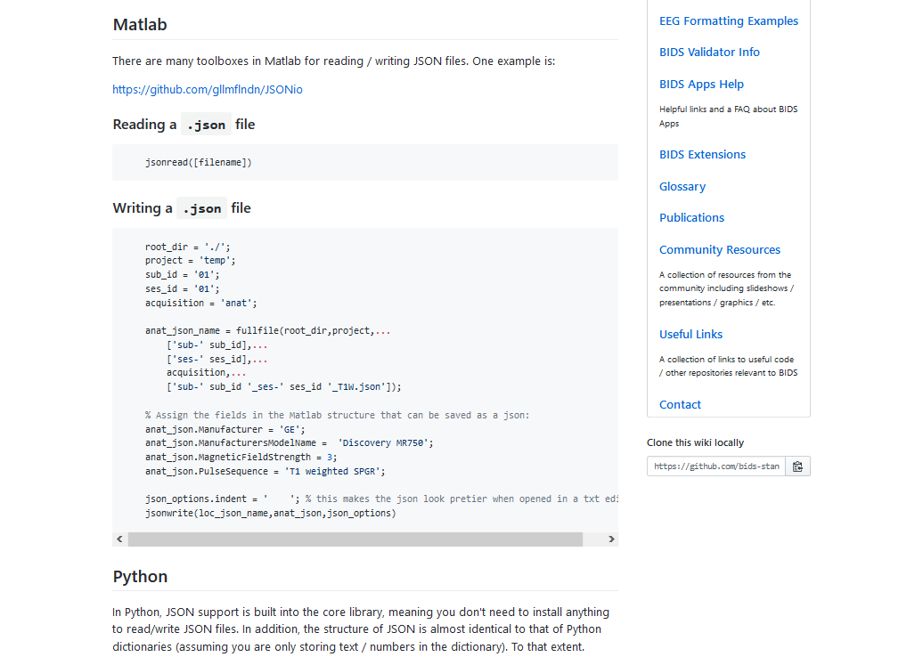
https://github.com/bids-standard/bids-starter-kit/wiki/Metadata-file-formats

Slide 11
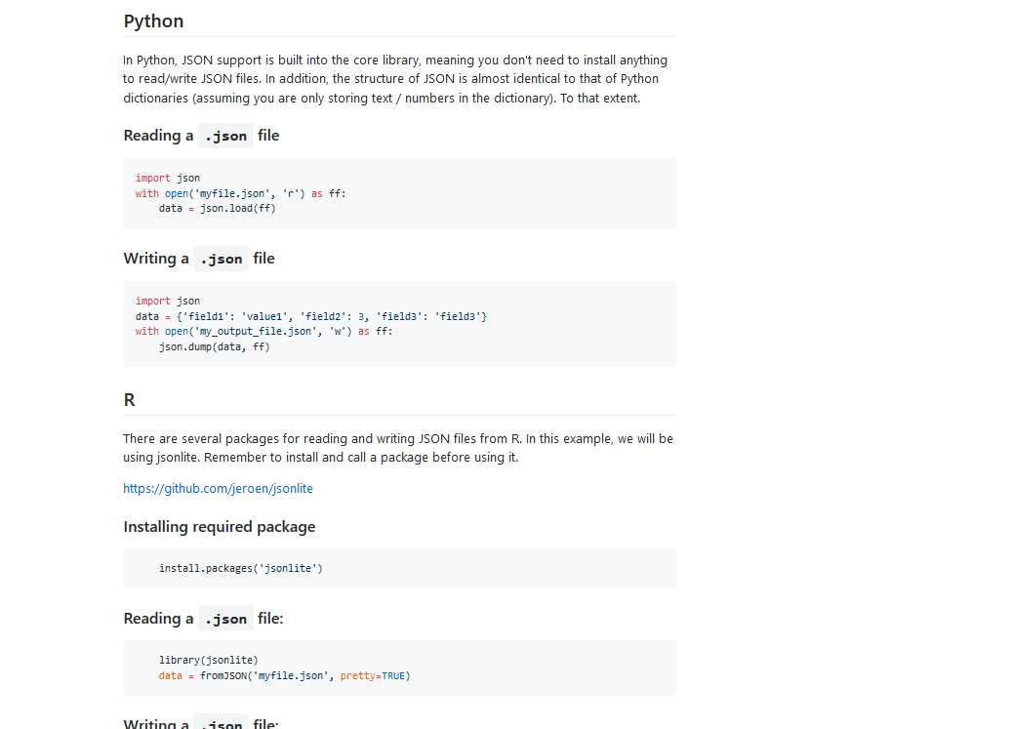
https://github.com/bids-standard/bids-starter-kit/wiki/Metadata-file-formats

Slide 12
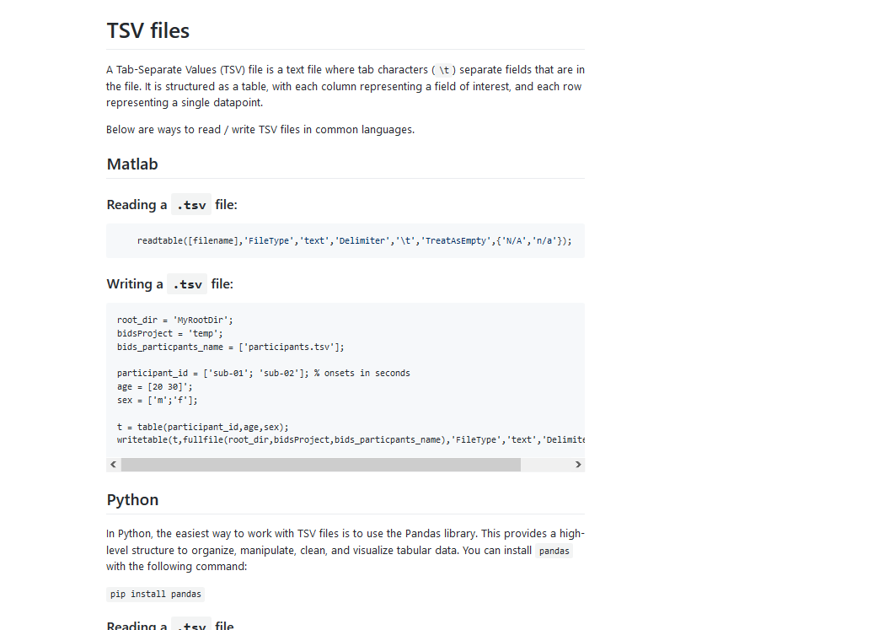
https://github.com/bids-standard/bids-starter-kit/wiki/Metadata-file-formats

Slide 13
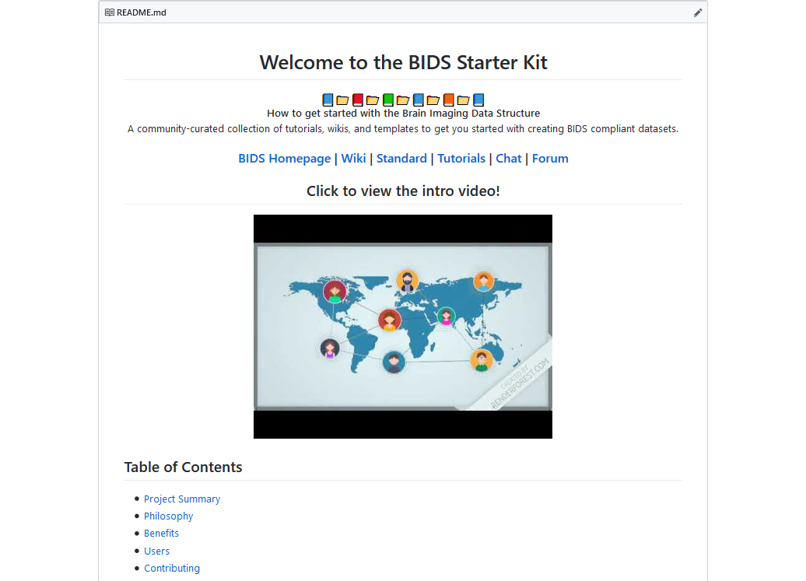
https://github.com/bids-standard/bids-starter-kit

Slide 14
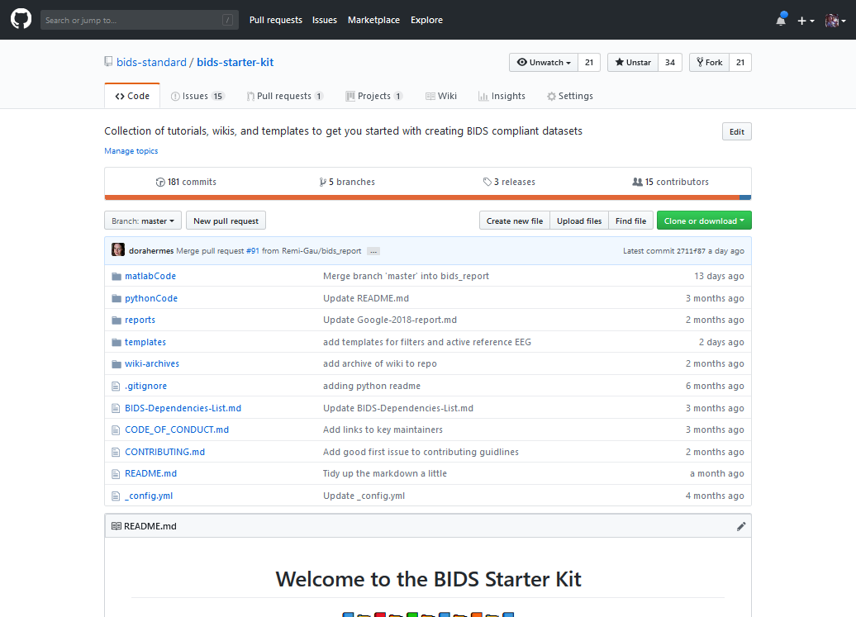
https://github.com/bids-standard/bids-starter-kit

Slide 15
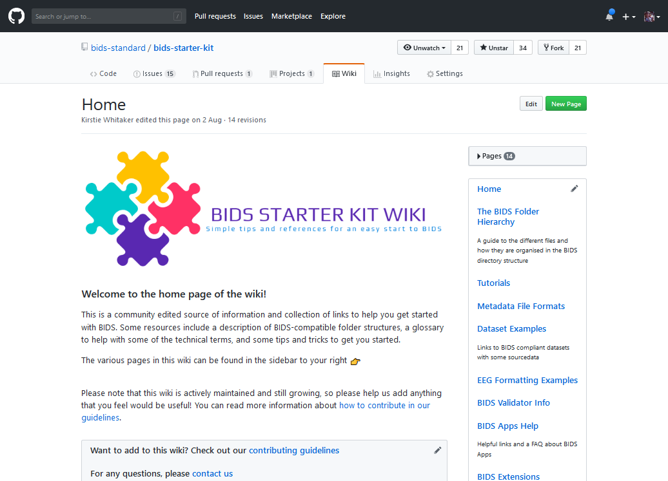
https://github.com/bids-standard/bids-starter-kit/wiki

Slide 16
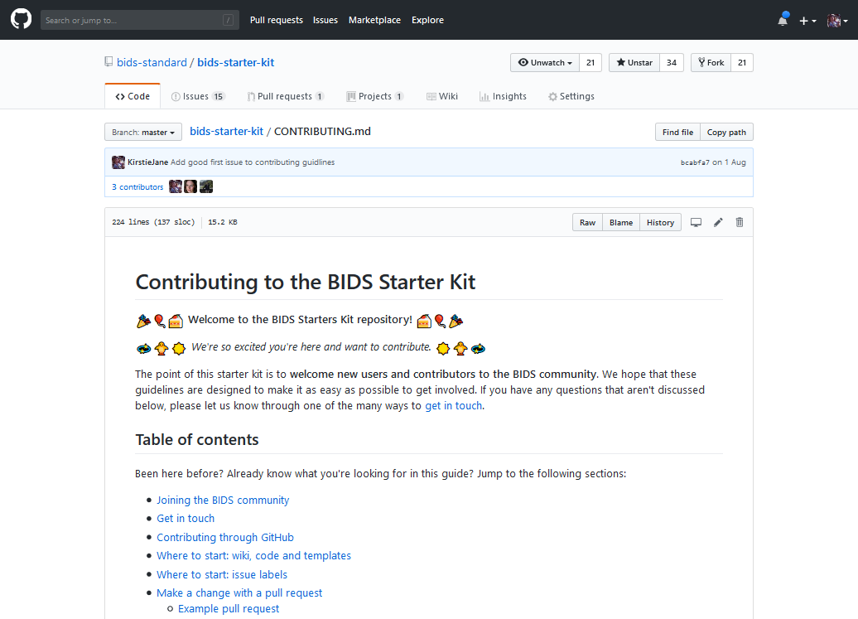
https://github.com/bids-standard/bids-starter-kit/blob/master/CONTRIBUTING.md

Slide 17
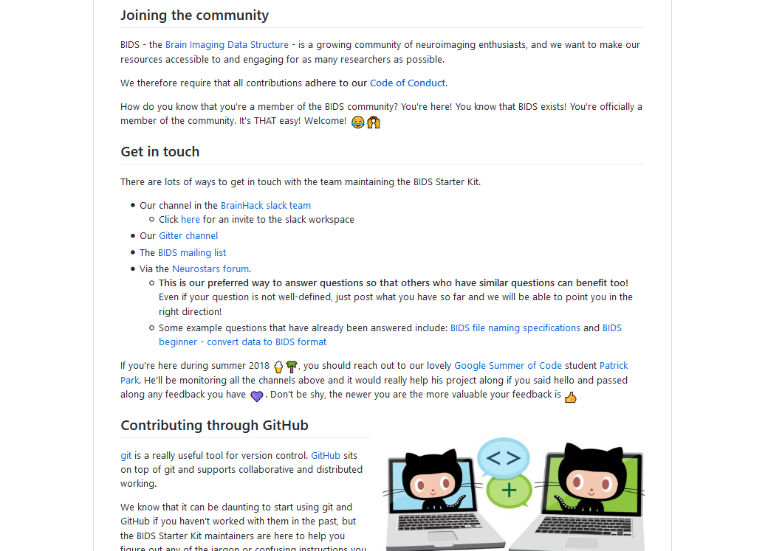
https://github.com/bids-standard/bids-starter-kit/blob/master/CONTRIBUTING.md

Slide 18
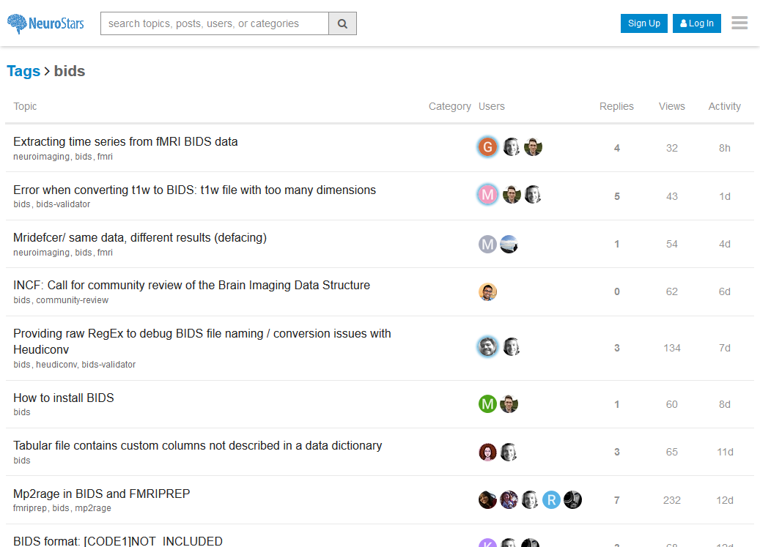
https://neurostars.org/tags/bids

Slide 19
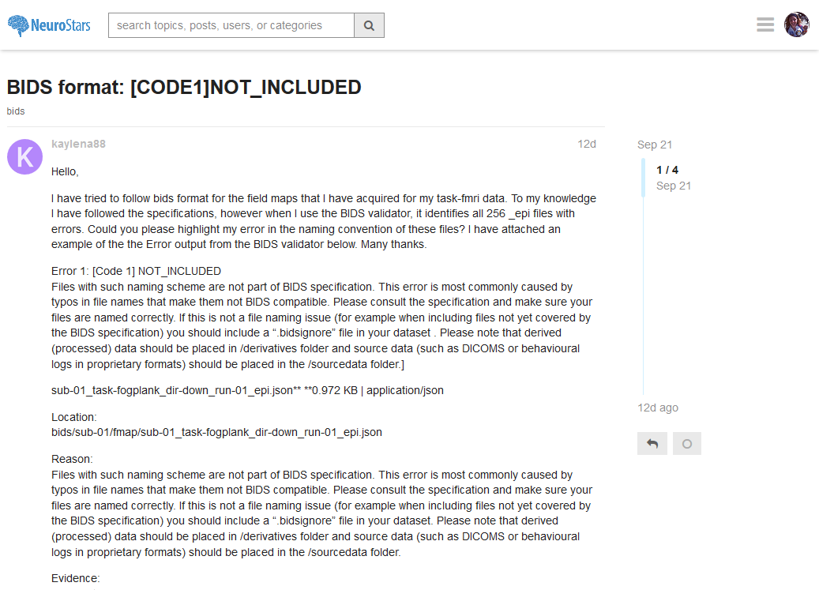
https://neurostars.org/tags/bids

Slide 20
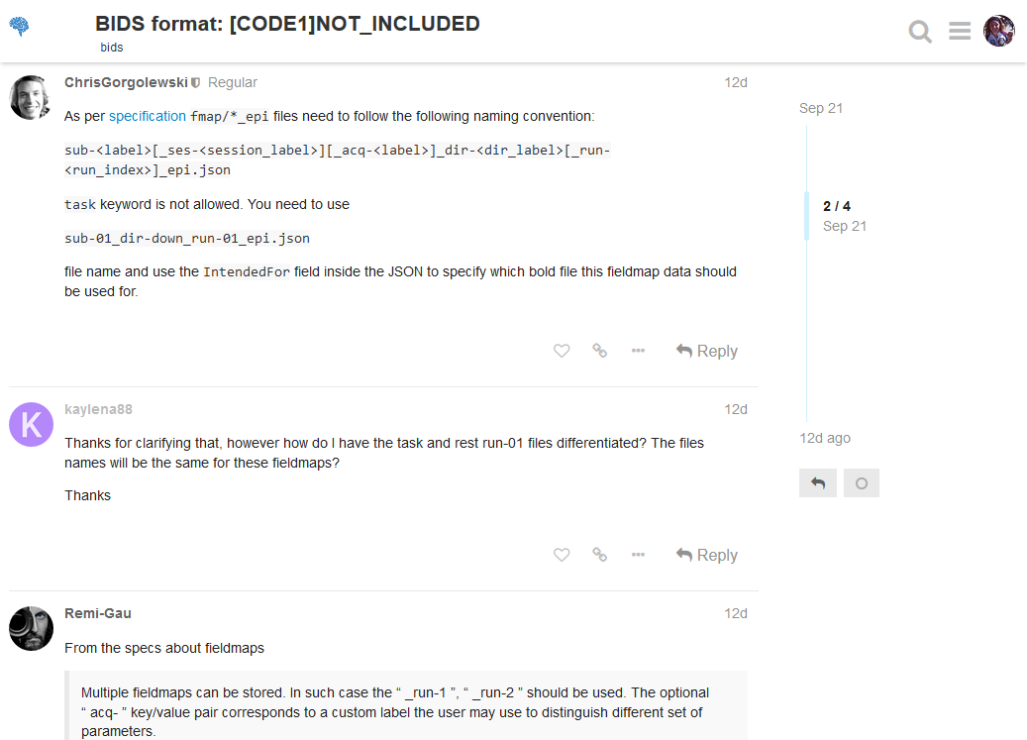
https://neurostars.org/tags/bids

Slide 21
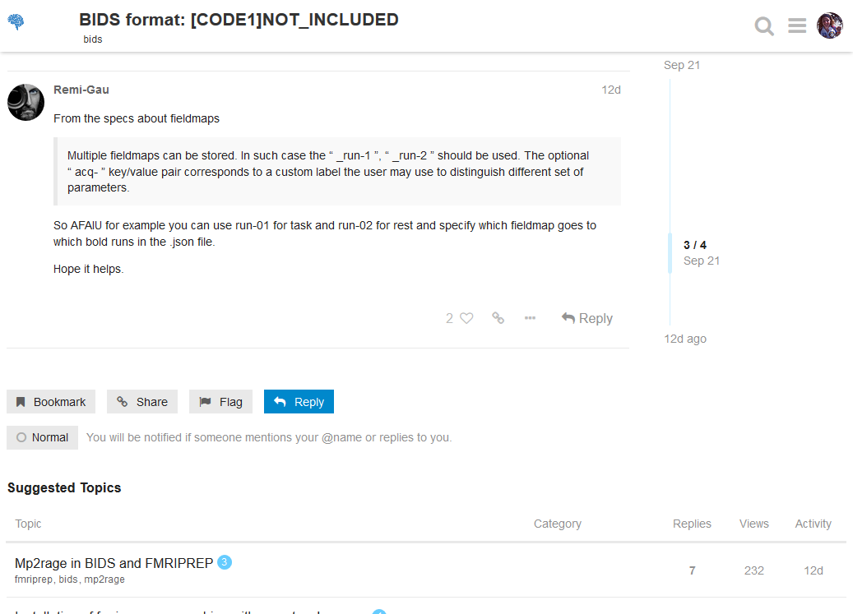
https://neurostars.org/tags/bids

Slide 22
https://github.com/bids-standard/bids-starter-kit/blob/master/CONTRIBUTING.md

Slide 23
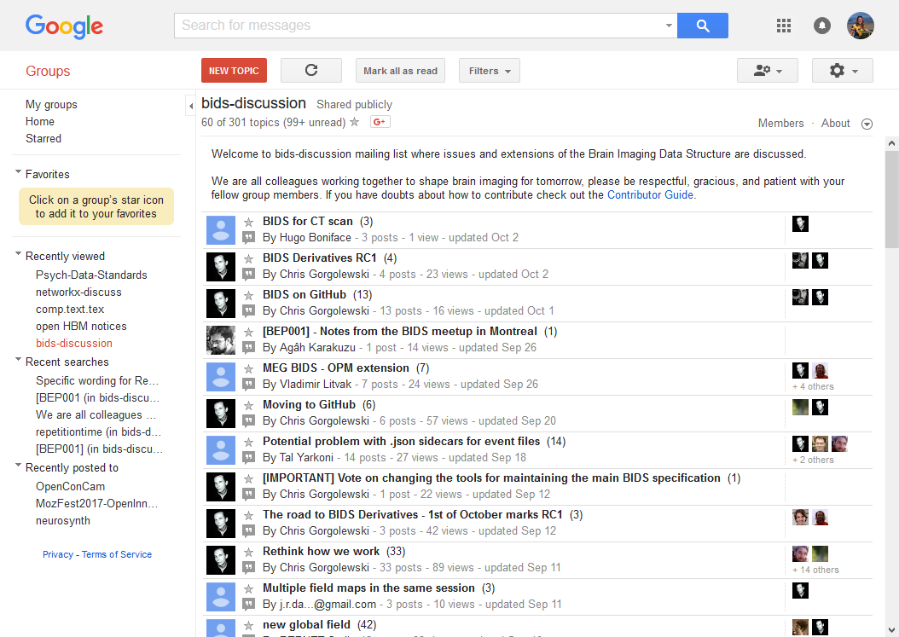
https://groups.google.com/forum/#!forum/bids-discussion

Slide 24
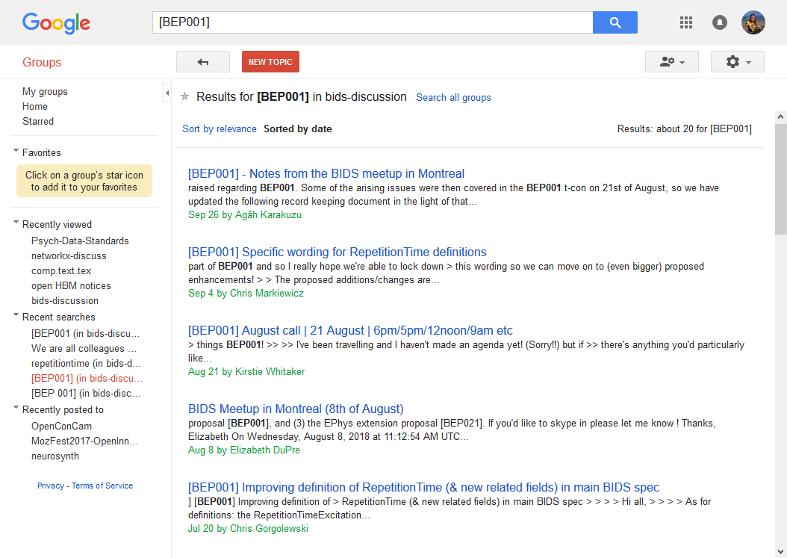
https://groups.google.com/forum/#!searchin/bids-discussion/%5BBEP001%5D%7Csort:date/bids-discussion/UXXOOEQ4t0M/JbyE99giBQAJ

Slide 25
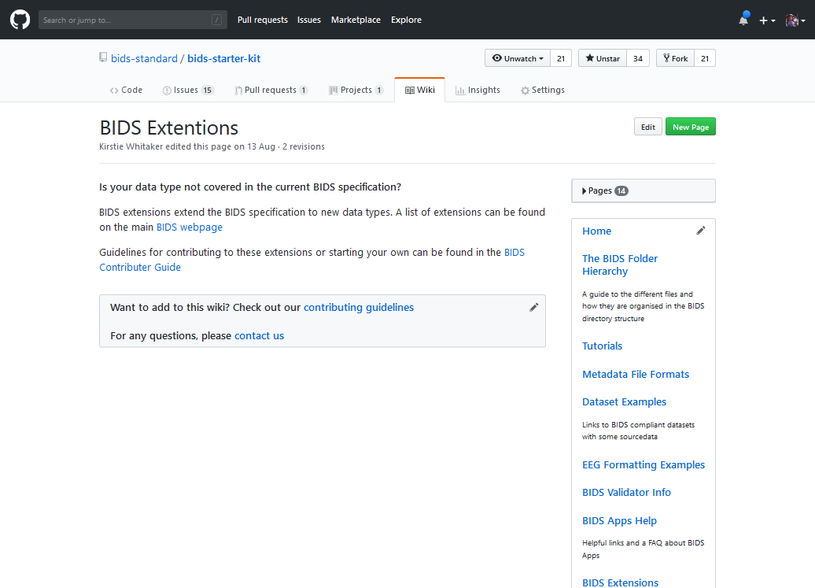
https://github.com/bids-standard/bids-starter-kit/wiki/BIDS-Extentions

Slide 26
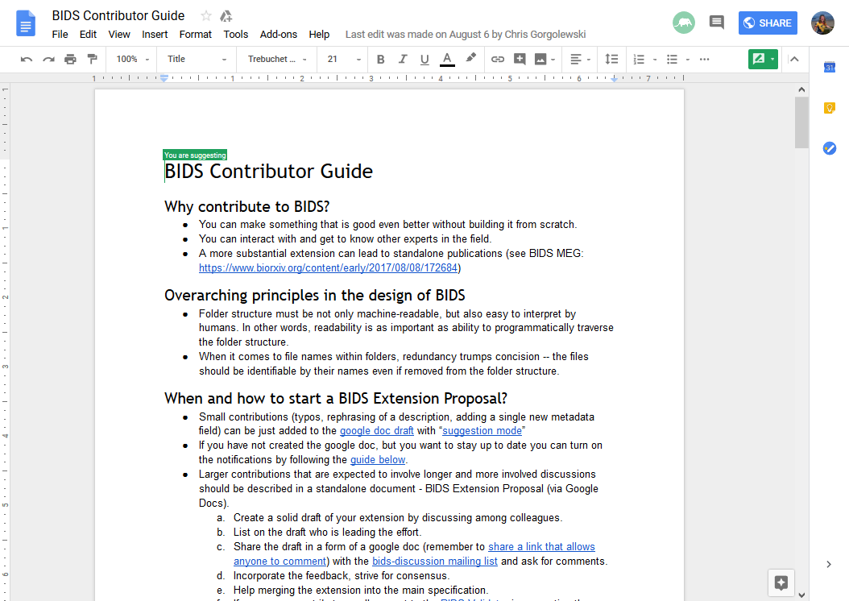
https://docs.google.com/document/d/1pWmEEY-1-WuwBPNy5tDAxVJYQ9Een4hZJM06tQZg8X4/edit

Slide 27
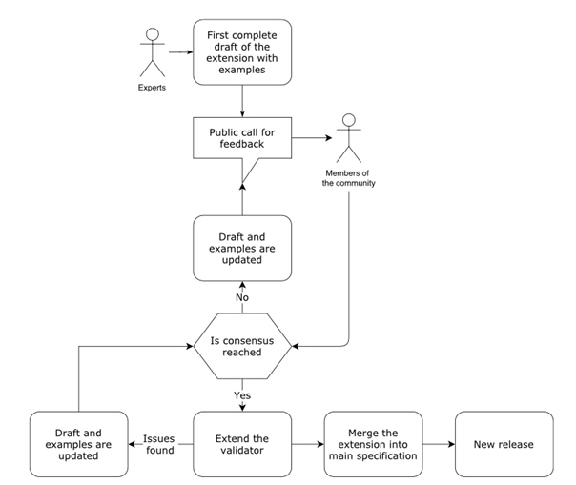
https://docs.google.com/document/d/1pWmEEY-1-WuwBPNy5tDAxVJYQ9Een4hZJM06tQZg8X4/edit

Slide 28
https://docs.google.com/document/d/1pWmEEY-1-WuwBPNy5tDAxVJYQ9Een4hZJM06tQZg8X4/edit

Slide 29
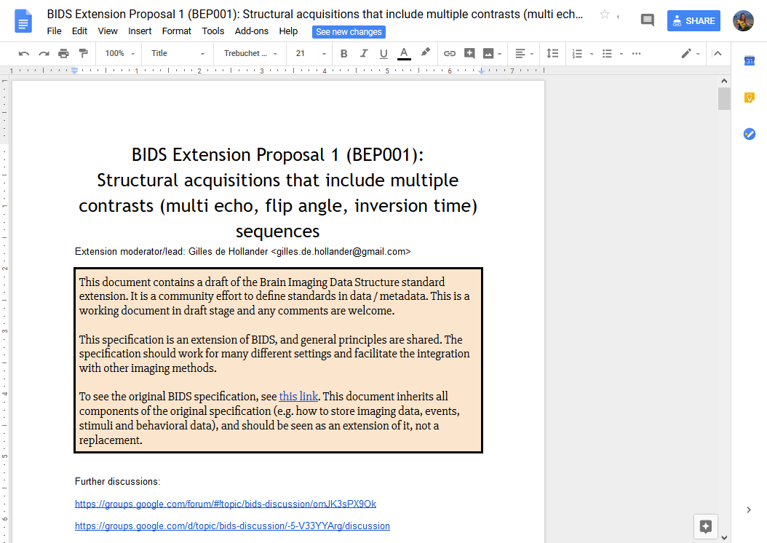
https://docs.google.com/document/d/1QwfHyBzOyFWOLO4u_kkojLpUhW0-4_M7Ubafu9Gf4Gg/edit

Slide 30
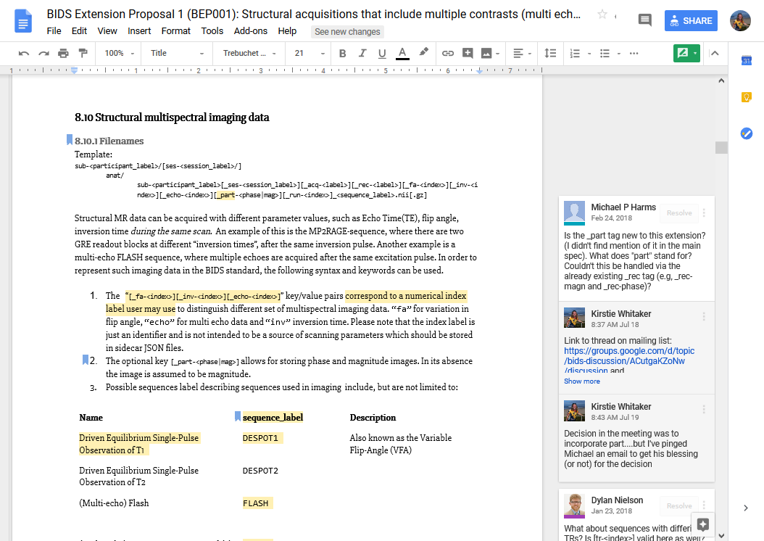
https://docs.google.com/document/d/1QwfHyBzOyFWOLO4u_kkojLpUhW0-4_M7Ubafu9Gf4Gg/edit

Slide 31
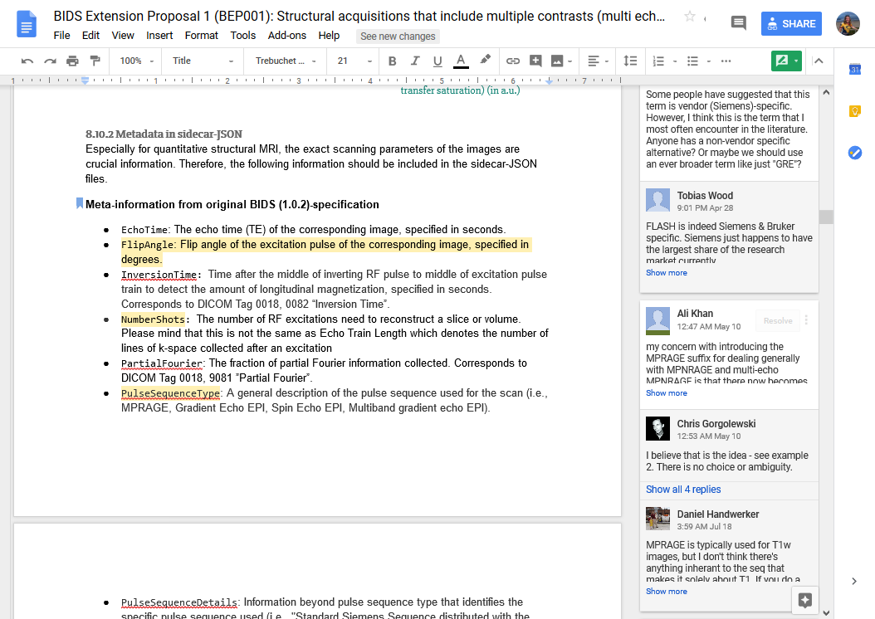
https://docs.google.com/document/d/1QwfHyBzOyFWOLO4u_kkojLpUhW0-4_M7Ubafu9Gf4Gg/edit

Slide 32
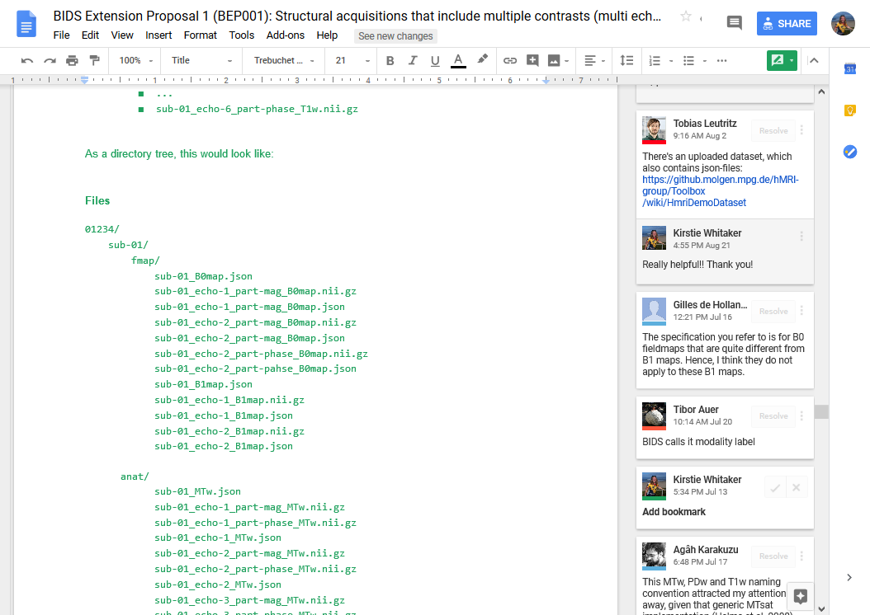
https://docs.google.com/document/d/1QwfHyBzOyFWOLO4u_kkojLpUhW0-4_M7Ubafu9Gf4Gg/edit

Slide 33
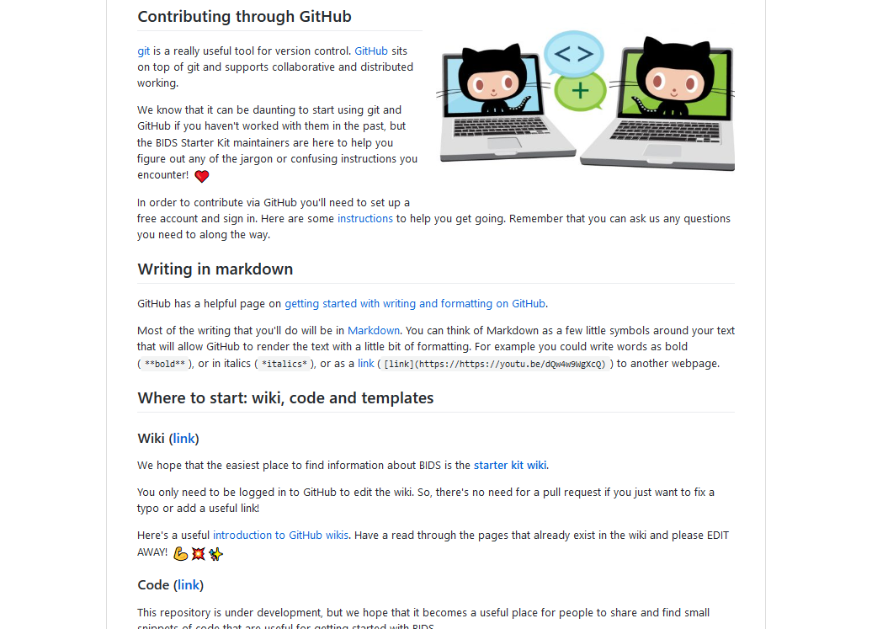
https://github.com/bids-standard/bids-starter-kit/blob/master/CONTRIBUTING.md

Slide 34
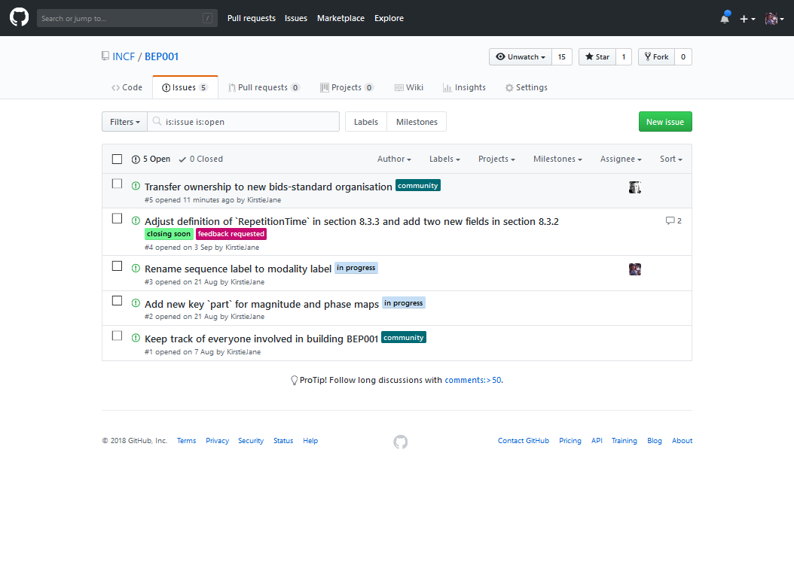
https://github.com/INCF/BEP001/issues

Slide 35
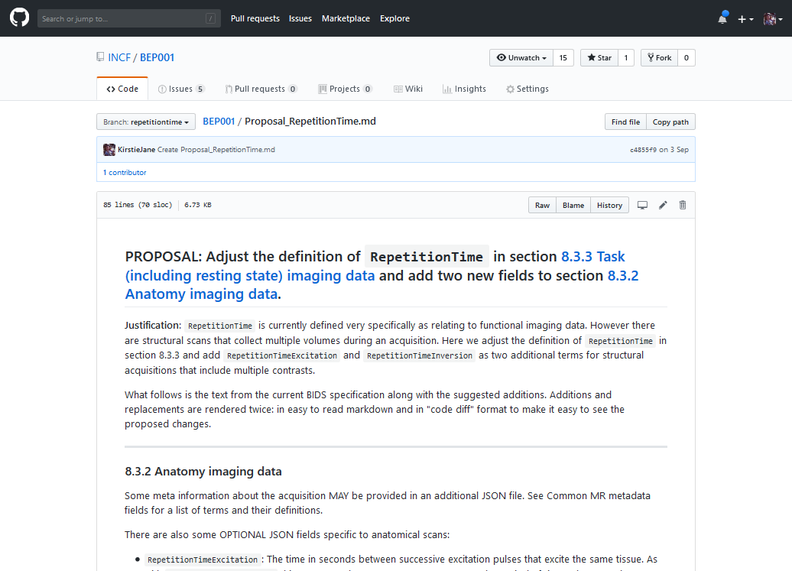
https://github.com/INCF/BEP001/blob/repetitiontime/Proposal_RepetitionTime.md

Slide 36
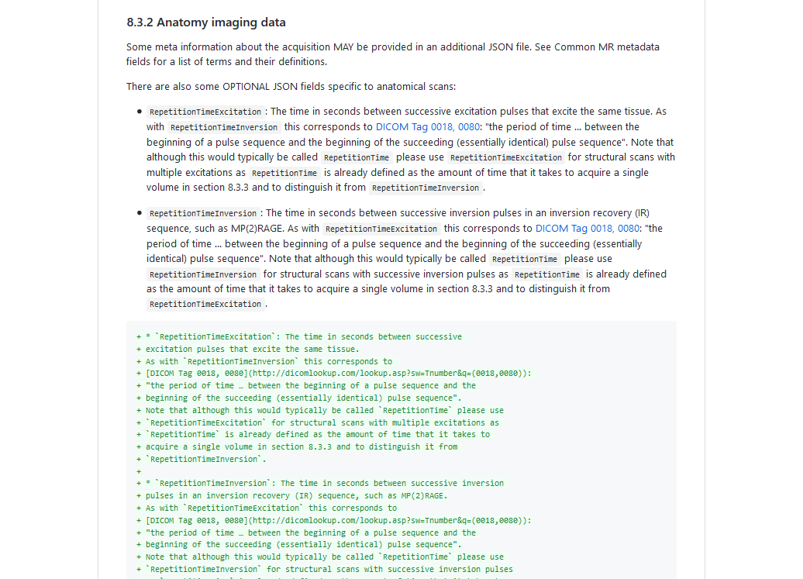
https://github.com/INCF/BEP001/blob/repetitiontime/Proposal_RepetitionTime.md

Slide 37
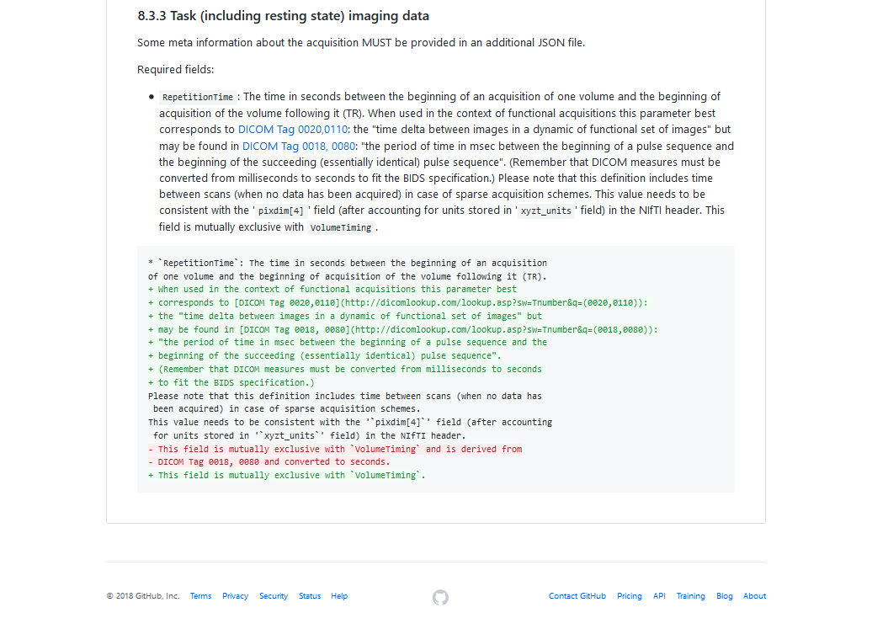
https://github.com/INCF/BEP001/blob/repetitiontime/Proposal_RepetitionTime.md

Slide 38
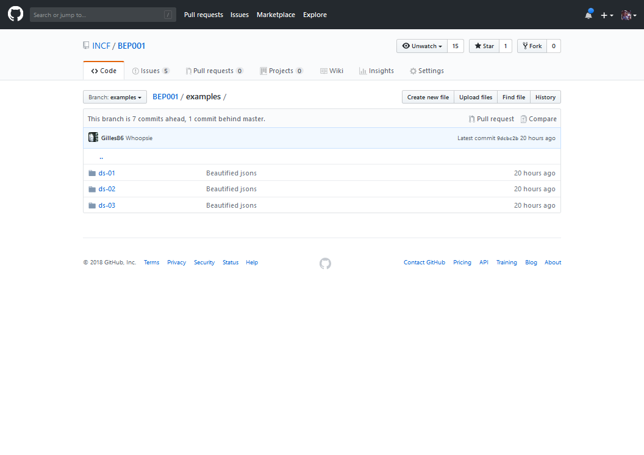
https://github.com/INCF/BEP001/tree/examples/examples

Slide 39
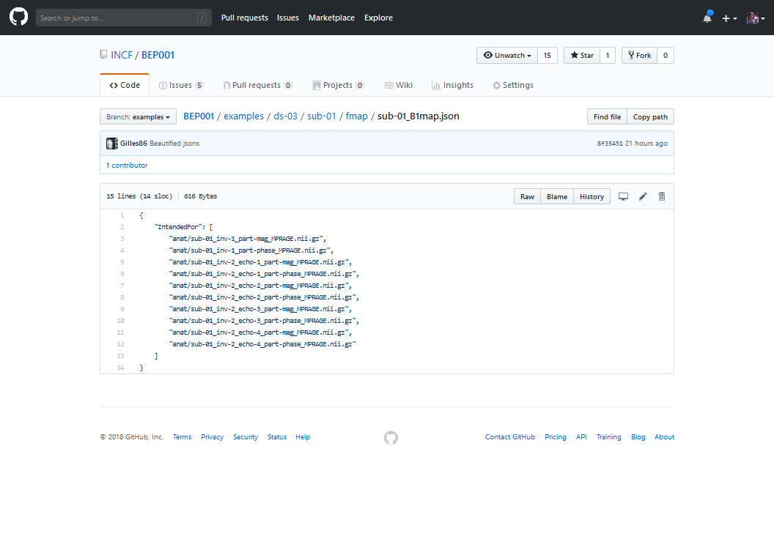
https://github.com/INCF/BEP001/blob/examples/examples/ds-03/sub-01/fmap/sub-01_B1map.json

Slide 40
To conclude
Please come and tell us what you think!

Slide 41
To conclude
Please come and tell us what you think!
Constructive suggestions are much easier to work with than NOPES

Slide 42
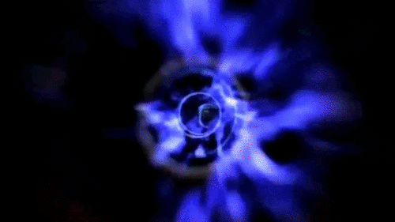
To conclude
Please come and tell us what you think!
Constructive suggestions are much easier to work with than NOPES.
We can’t go back in time – see BIDS 2.0 for breaking suggestions
https://docs.google.com/document/d/1LEgsMiisGDe1Gv-hBp1EcLmoz7AlKj6VYULUgDD3Zdw/edit#heading=h.u2m4n7lj0m6g

Slide 43
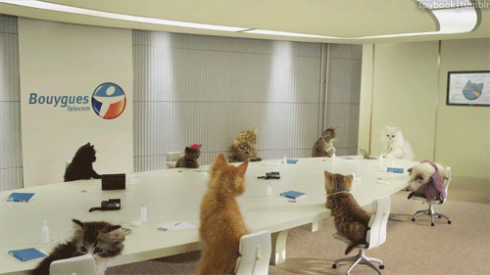
To conclude
Please come and tell us what you think!
Constructive suggestions are much easier to work with than NOPES.
We can’t go back in time – see BIDS 2.0 for breaking suggestions
https://docs.google.com/document/d/1LEgsMiisGDe1Gv-hBp1EcLmoz7AlKj6VYULUgDD3Zdw/edit#heading=h.u2m4n7lj0m6g
Keep an eye on the mailing list for [BEP001] announcements and calls

Slide 44
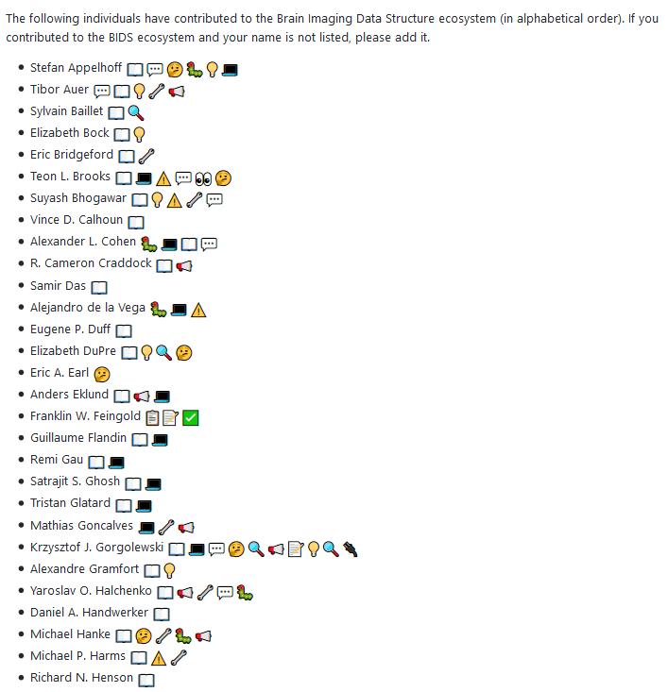
Thank you!
Email: kw401@cam.ac.uk
BIDS website: http://bids.neuroimaging.io
BEP001 github repository: https://github.com/INCF/BEP001

