Slide 1
ORCID US Community: Making the Most of your ORCID Membership
Sheila Rabun, ORCID US Community Specialist
https://orcid.org/0000-0002-1196-6279
October 2, 2018

Slide 2
Agenda
Intro to the ORCID US Community
Brief Review of ORCID Basics
Getting Started with ORCID:
Stakeholder Support
Technical Integration
Outreach & Education
Discussion & Questions

Slide 3
ORCID Across the Globe

Slide 4
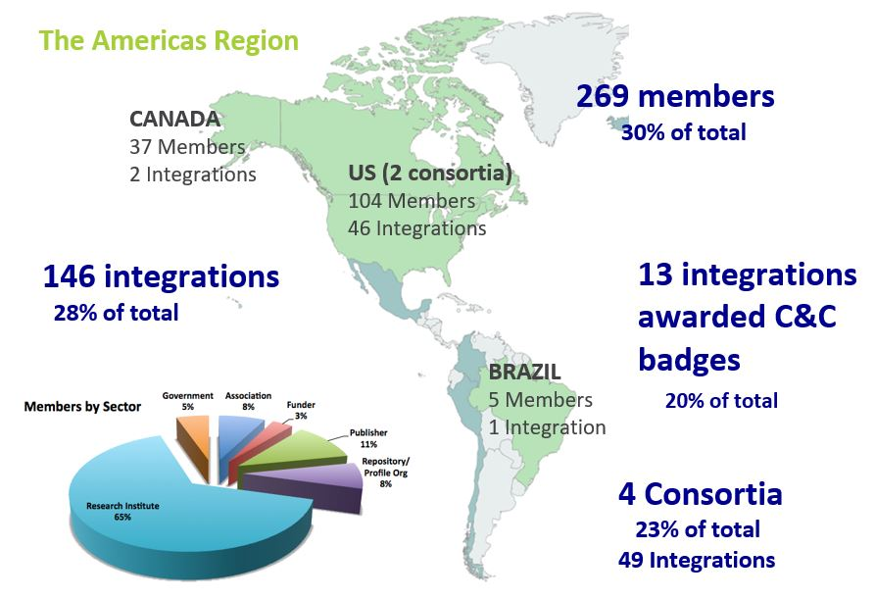
ORCID Americas Region

Slide 5
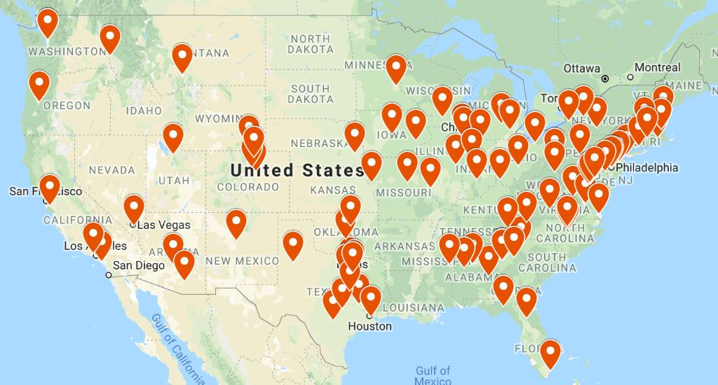
ORCID US Community
103 institutional members!
http://orcid-us.org

Slide 6
ORCID US Membership Benefits
Discounted fee for joining as a large group ($4,300/ calendar year)
Dedicated Technical & Community Support
5 API credentials for ORCID integration with 5 systems
Monthly Member Newsletter
Monthly statistics report

Slide 7
ORCID US Community Resources
ORCID US website: http://orcid-us.org

Slide 8
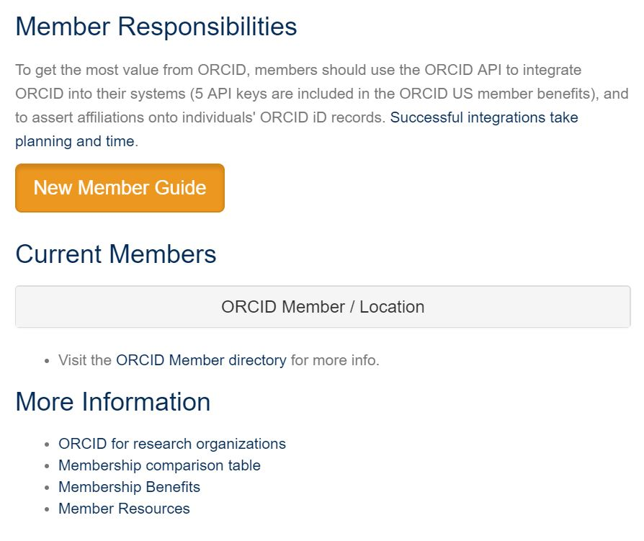
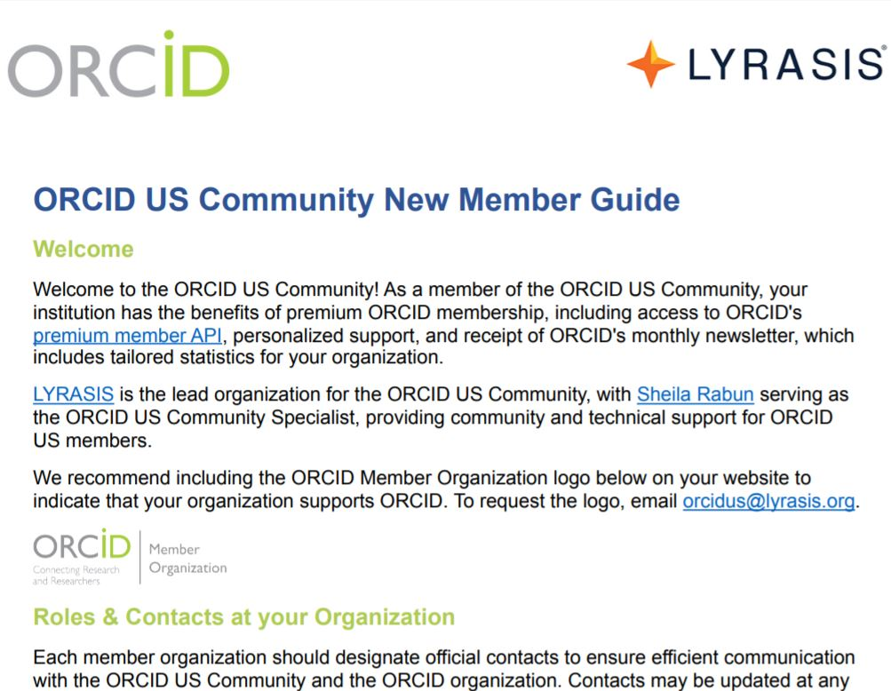
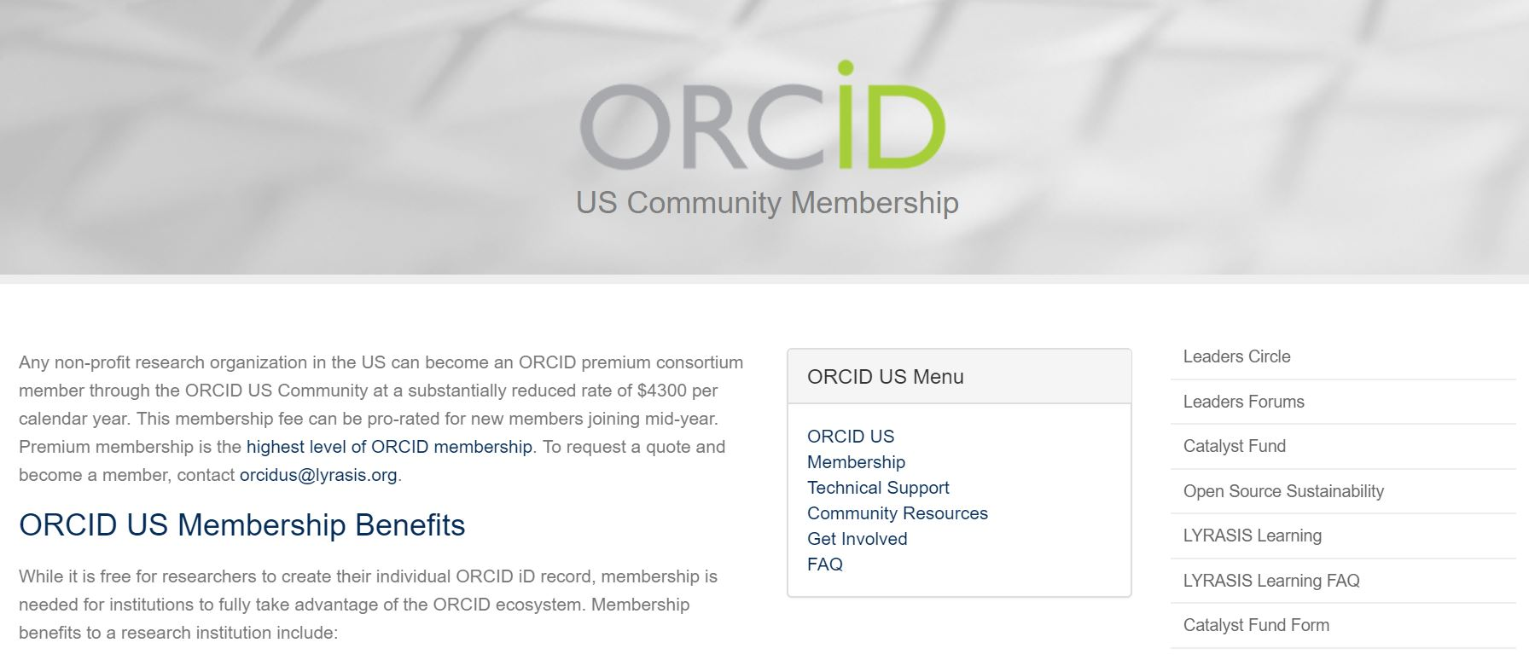
ORCID US Community Resources
New Members Guide

Slide 9
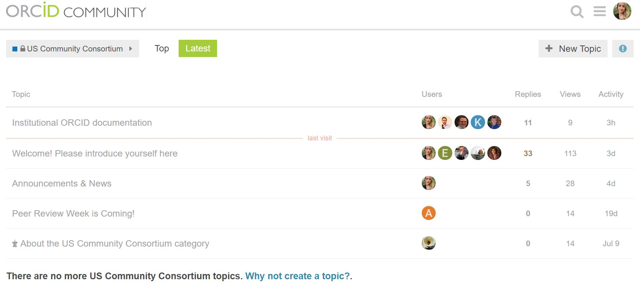
ORCID US Community Wisdom
Members-Only Discussion Forum: Utilize the collective knowledge of the community
Set up a consultation: orcidus@lyrasis.org
Members’ Discussion Forum:

Slide 10
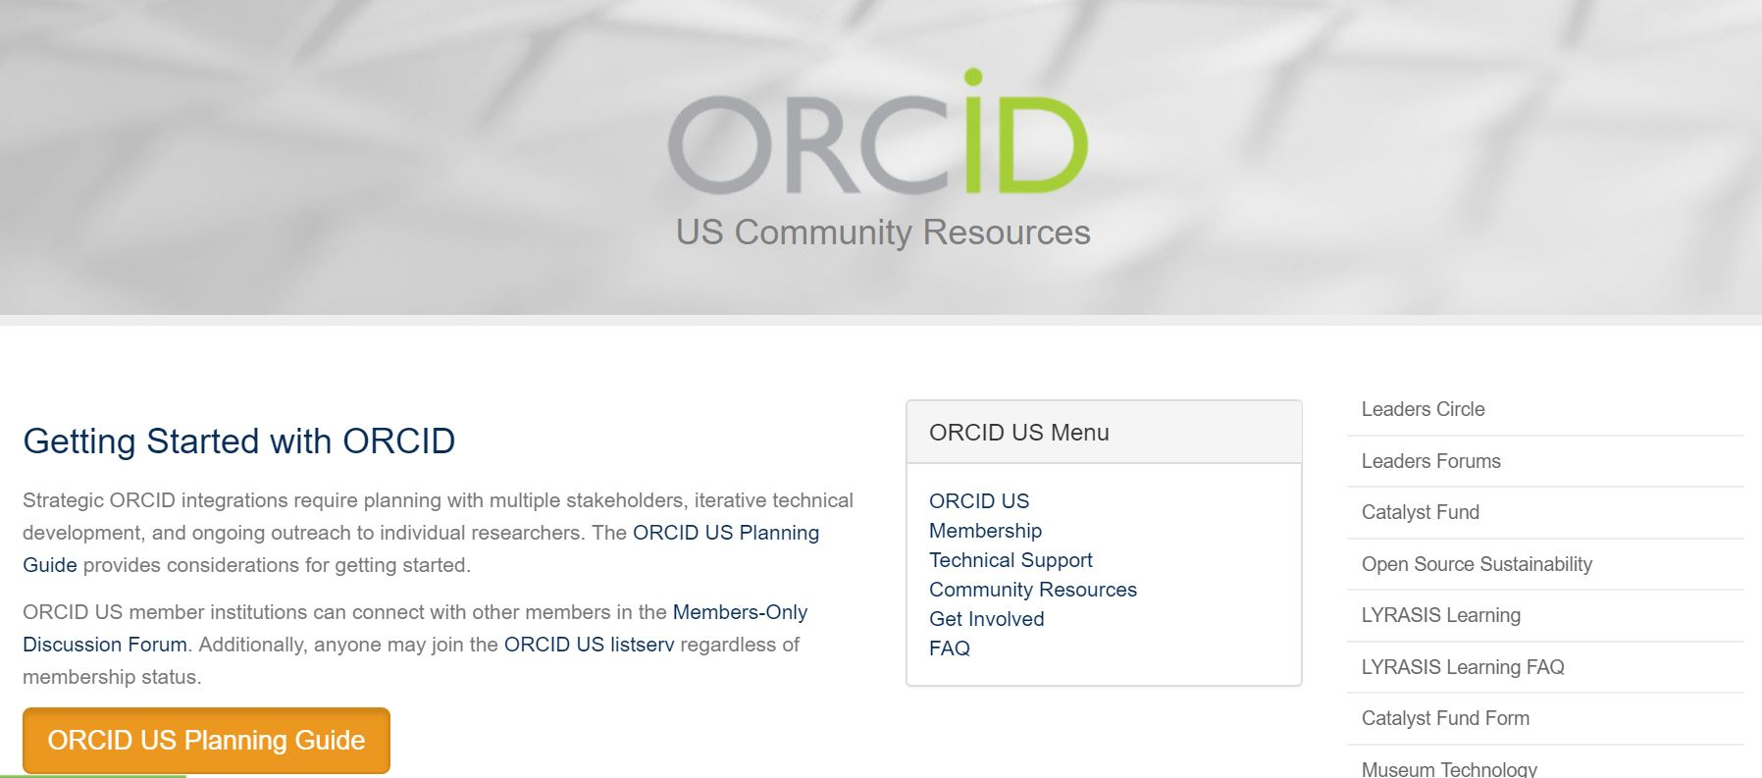
ORCID US Community Resources
Planning Guide for Research Institutions

Slide 11
Brief Review: ORCID Vision

Slide 12
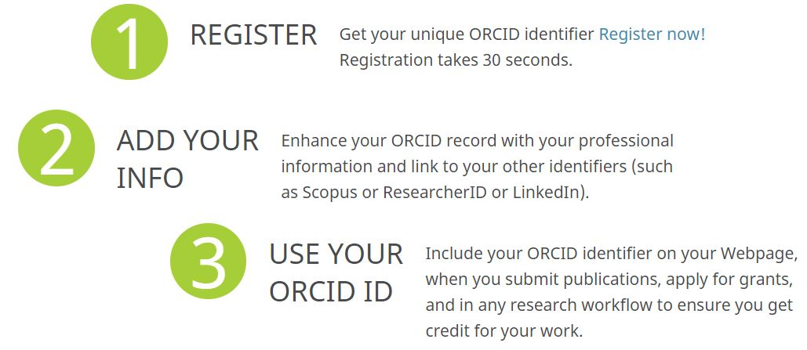
Brief Review: ORCID iD
Open Researcher and Contributor ID
Name disambiguation: Unique 16-digit number
0000-0002-1196-6279
Formatted as URI: https://orcid.org/0000-0002-1196-6279
FREE to Register

Slide 13
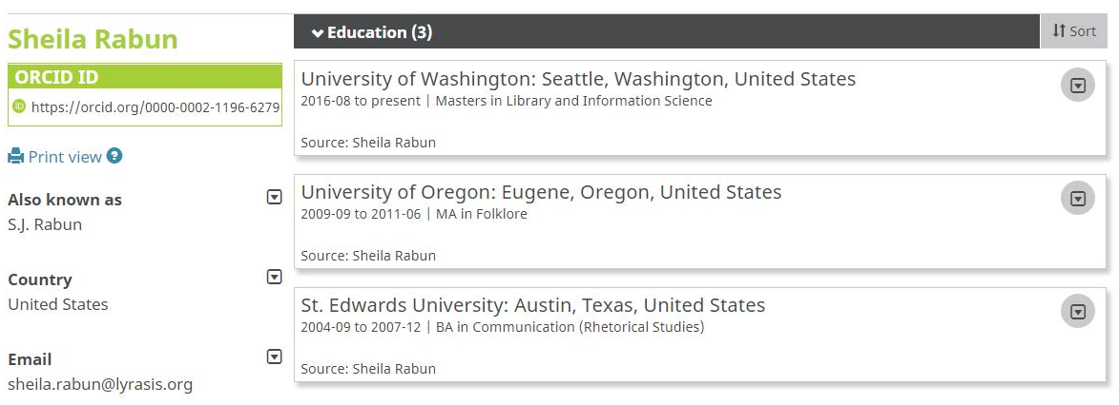
ORCID iD Record
Name
Keywords
Other IDs
Websites

Slide 14
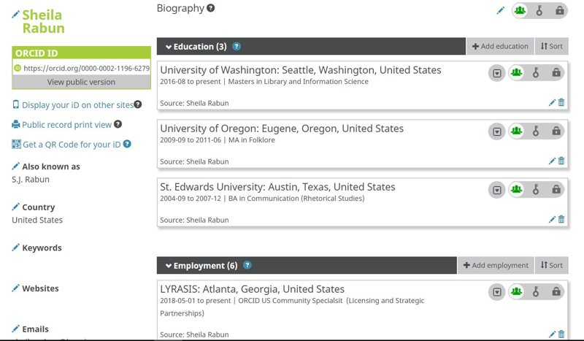
ORCID iD Record Visibility Settings & Source

Slide 15
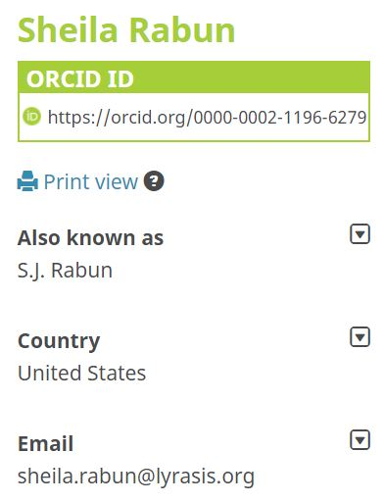
ORCID iD Records

Slide 16
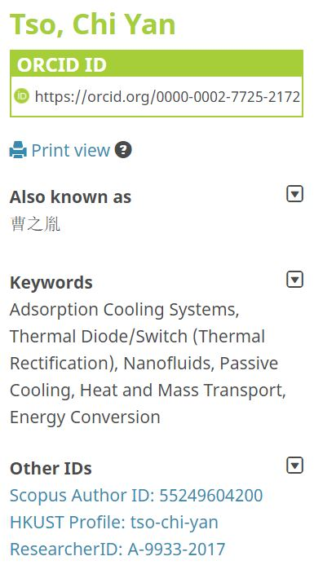
ORCID iD Records

Slide 17
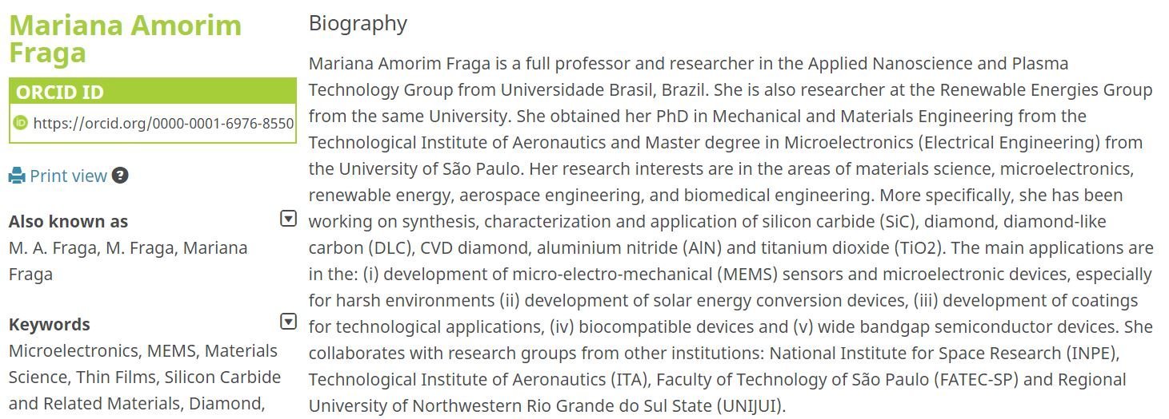
ORCID iD Records

Slide 18
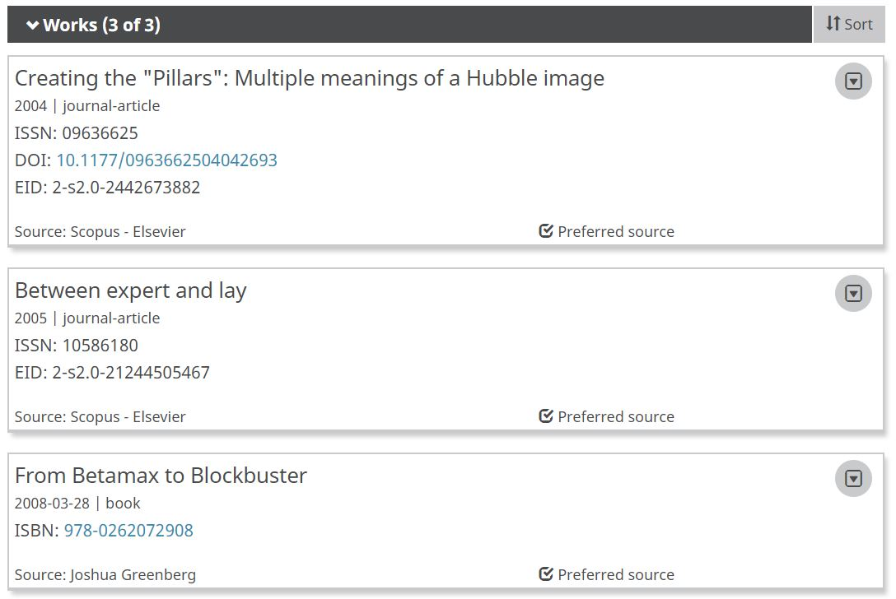
ORCID iD Records

Slide 19
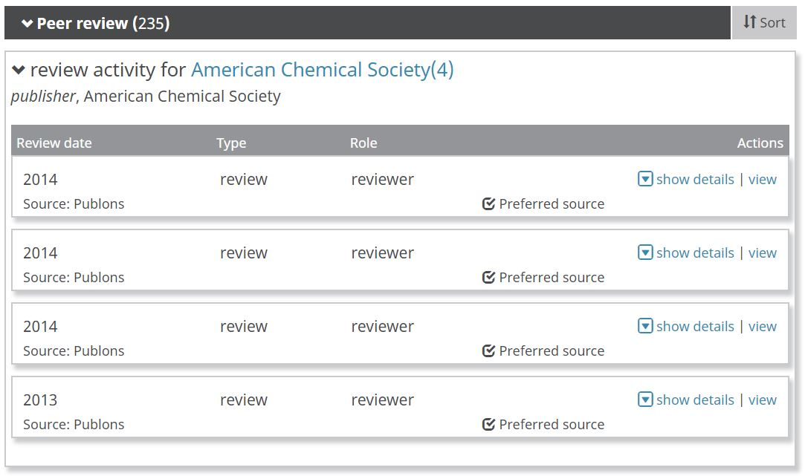
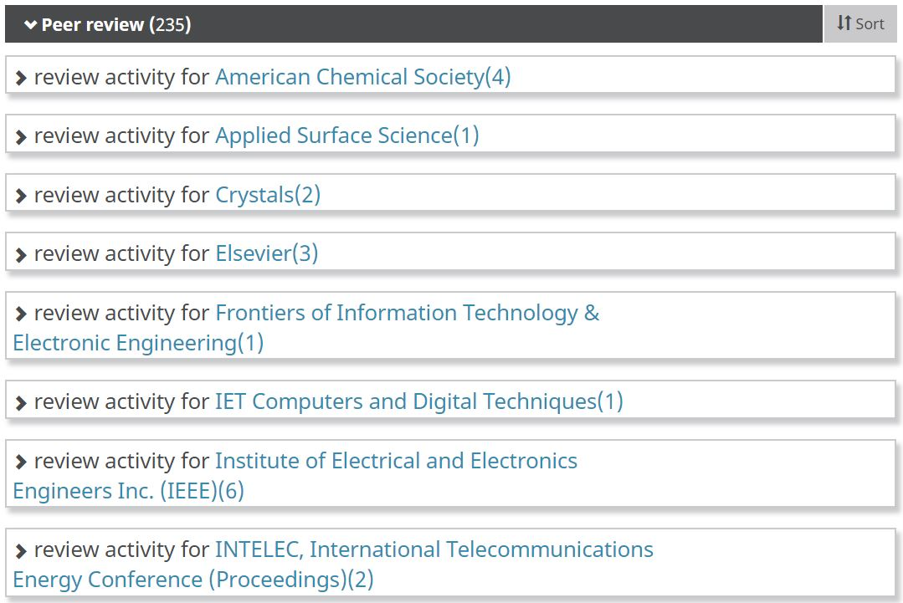
ORCID iD Records

Slide 20
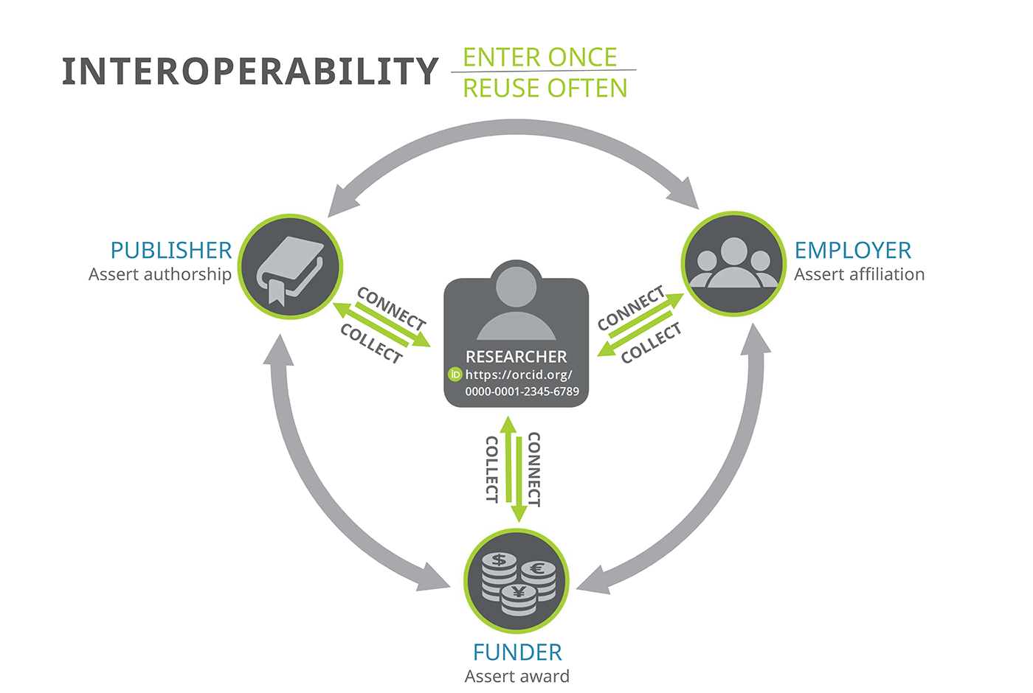
ORCID Ecosystem & Interoperability
Employment & Education Affiliations
Names(s) & Biographical Information
Research Published, Presentations, etc.
Peer Review Activity
Grant Funding Received

Slide 21
ORCID Benefits for Individuals
What does ORCID help individuals to do?
Distinguish themselves from others​
Ensure trustworthy record of contributions & affiliations
Save time & reduce administrative burden​

Slide 22
ORCID Benefits for Research Institutions
What does ORCID help research institutions to do?
Mitigate confusion caused by name ambiguity
Ensure trustworthy & accurate affiliations
Assess impact
Save time & reduce administrative burden​
Support individual researchers

Slide 23
1. Stakeholder Support
2. Technical Integration
3. Outreach & Education
That’s great! Now, how do we get started?

Slide 24
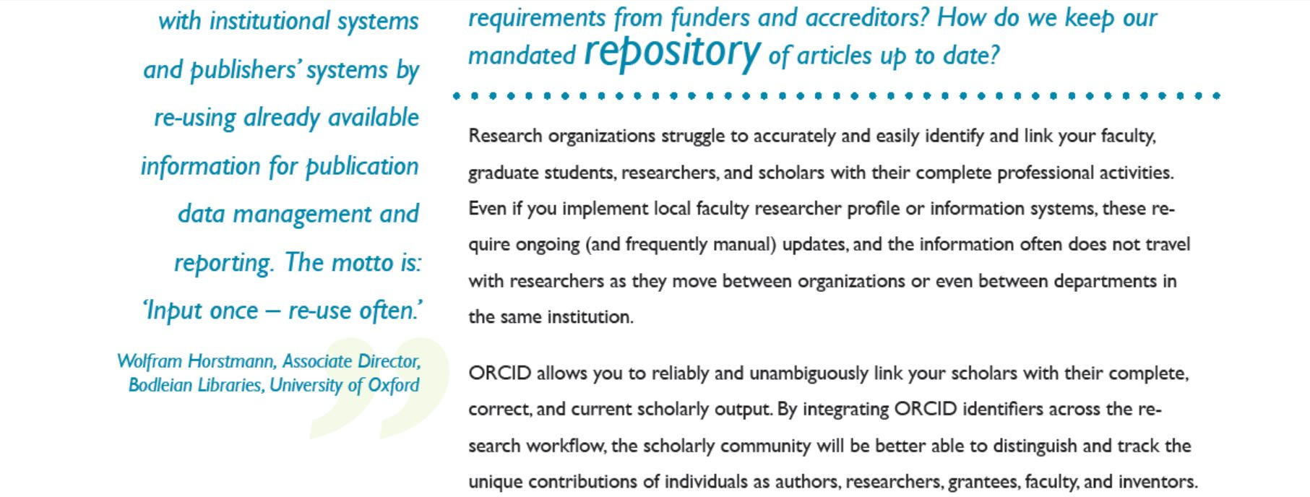
Stakeholder Support - Build a Business Case
Flier available at: http://members.orcid.org/outreach-resources/flier-researchorgs

Slide 25
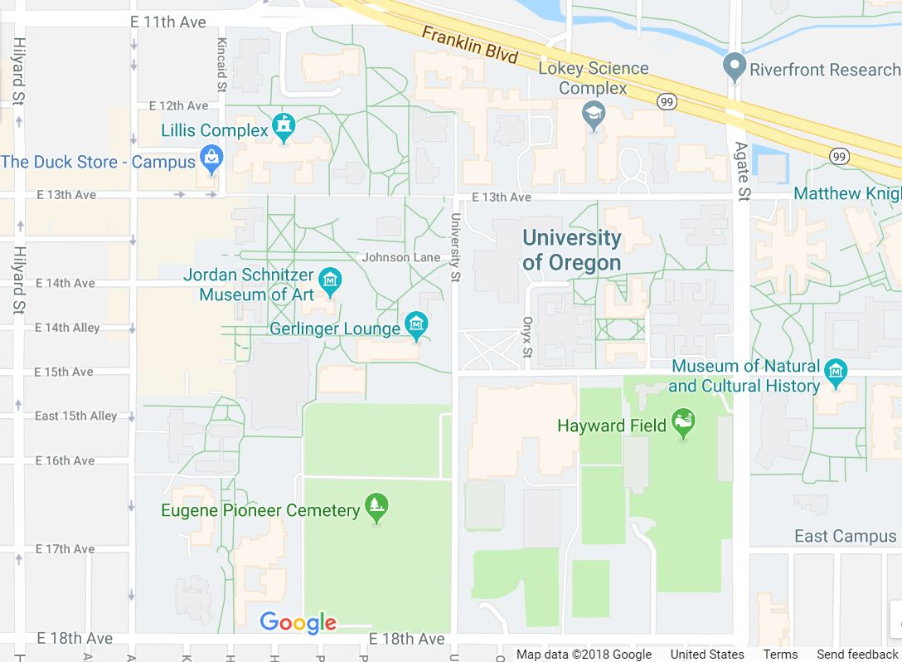
Stakeholder Support
Central IT
Research Office
Human Resources
Academic Units
Graduate School
Provost
Library/Libraries
Grants Office
Form a cross-institutional ORCID group to fully leverage ORCID benefits

Slide 26
Planning with Stakeholders
Example: Florida State University ORCID Implementation Committee
Office of Faculty Development & Advancement
Office of Research
University Libraries
Office of Institutional Research
National Magnet Lab
Graduate School
College of Medicine
What do you want to do with ORCID?
Read information from ORCID records?
Write information to ORCID records?
What kind of information are you interested in?

Slide 27
Common Systems
Institutional ID and Profile Systems
Current Research Information Systems (CRIS)
Grant Management
Human Resources
Institutional Repositories
Publishing Platforms
Peer Review
Data Management Platform
https://members.orcid.org/api/workflow

Slide 28
Technical Integration Planning
Inventory campus systems
Which systems might integrate with ORCID?
How will information flow between systems?
Image from Czech Technical University in Prague, 2016: https://dspace.cvut.cz/bitstream/handle/10467/67742/or2016_slides_ctu_comments.pdf?sequence=1&isAllowed=y

Slide 29
Vendor Systems
And more...
More info: http://members.orcid.org/api/orcid-enabled-systems

Slide 30
Vendor Systems
Example from Digital Measures (CRIS) https://www.digitalmeasures.com/activity-insight/docs/orcid.html

Slide 31
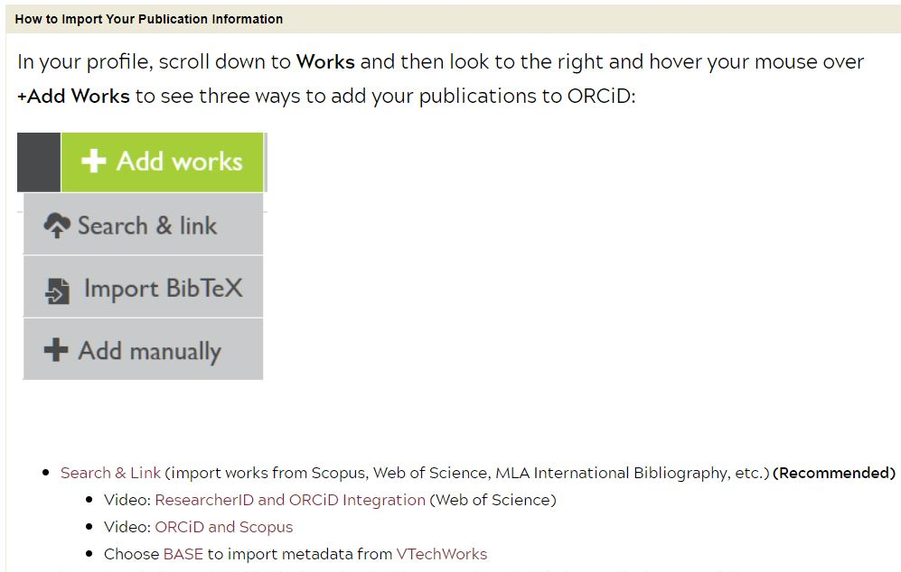
Training for Faculty Example
Image credit: Virginia Tech, https://guides.lib.vt.edu/orcid

Slide 32
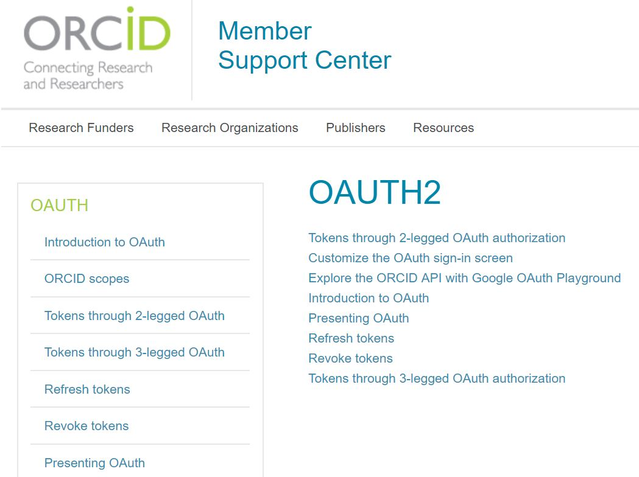
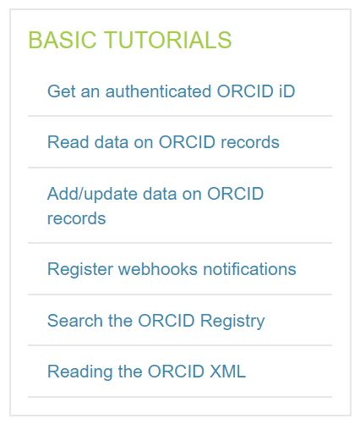
Technical Integration - Local Systems
Step 1 = Register for Sandbox credentials
http://members.orcid.org/api/getting-started

Slide 33
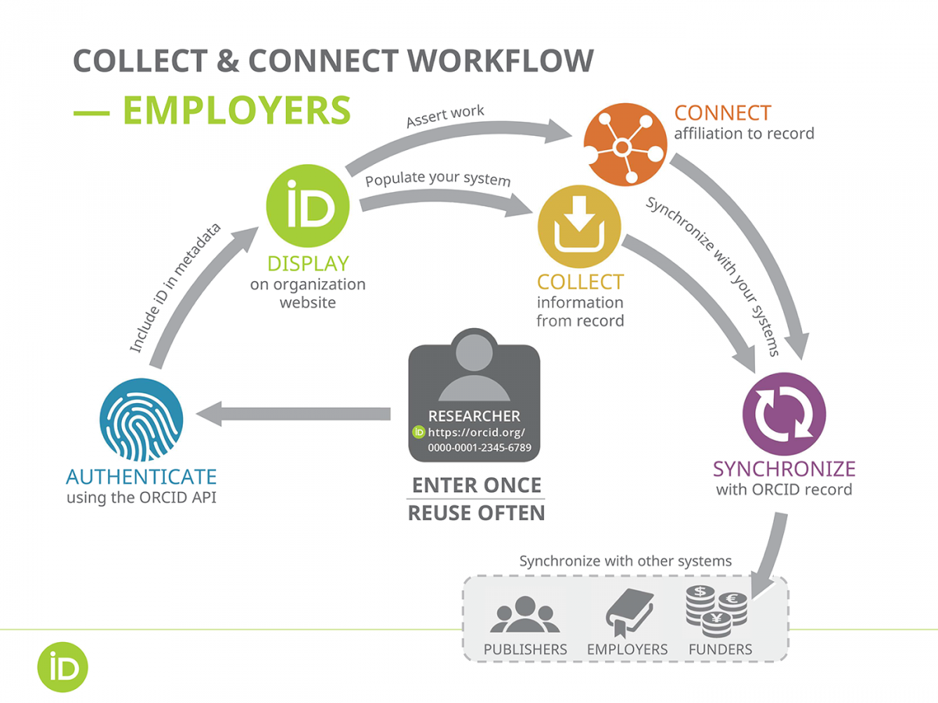
Iterative Integration Best Practices
2
3,4
1
5
https://orcid.org/content/best-practices-research-organizations

Slide 34
Get Authenticated ORCID iD Data
Configure a system to gather authenticated ORCID data, using the ORCID API (application programming interface)
Manual Entry of ORCID iDs is not authenticated
ORCID iD:
(Manual Entry)

Slide 35
“Create or Connect” - Presenting OAuth to Users
Get an ORCID iD!
Click the button below to get an ORCID iD and Connect to XYZ Institutional System.
Create a new ORCID iD
Already have an ORCID iD? Connect your existing ORCID iD

Slide 36
“Create or Connect” - Presenting OAuth to Users
Get an ORCID iD!
Click the button below to get an ORCID iD and Connect to XYZ Institutional System.
Create a new ORCID iD
Already have an ORCID iD? Connect your existing ORCID iD

Slide 37
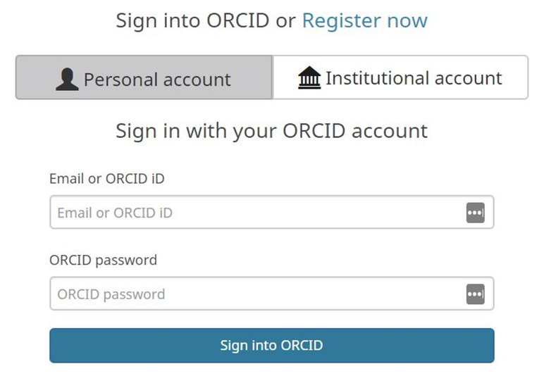
Log In Screen

Slide 38
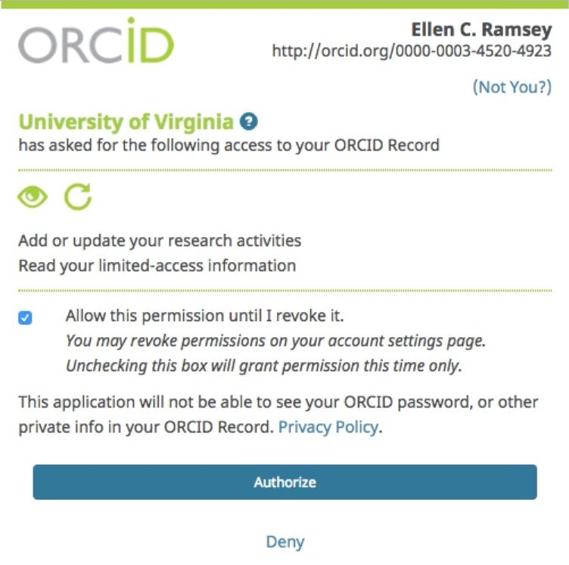
Authorization Screen
Individual’s Name
http://orcig.org/0000-0000-0000-0000
XYZ Institution Name

Slide 39
Storing Authenticated Data
Upon authentication, your system will receive the user’s name, ORCID iD, and access token that will allow you to connect with their ORCID record
Permissions last for 20 years unless otherwise revoked

Slide 40
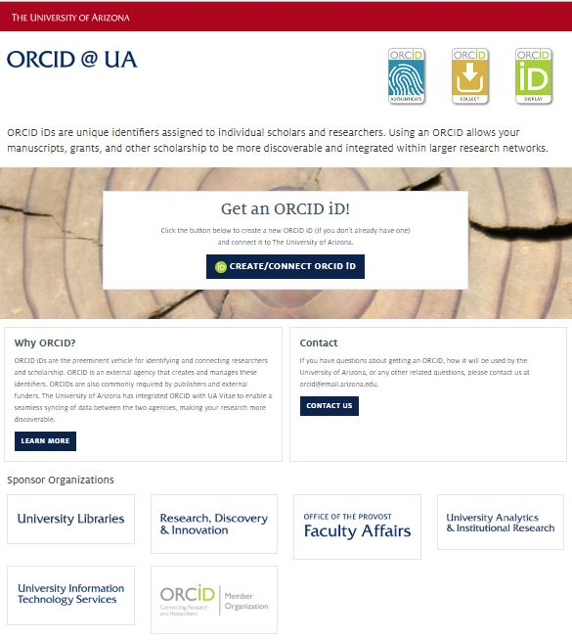
Create & Connect Example
https://orcid.arizona.edu/

Slide 41
Outreach & Education
It’s never too early to start educating researchers about ORCID!
The more people and systems using ORCID, the better for everyone!
Start using the logo:
https://orcid.org/trademark-and-id-display-guidelines

Slide 42
Outreach & Education Considerations
Do you want to start with a target pilot population?
New faculty
New students
Specific academic unit
Who will be leading outreach efforts?
Who will answer researchers’ questions about ORCID?
What outreach materials and formats would be most likely to reach your audience?
Image credit: UNC University Libraries

Slide 43
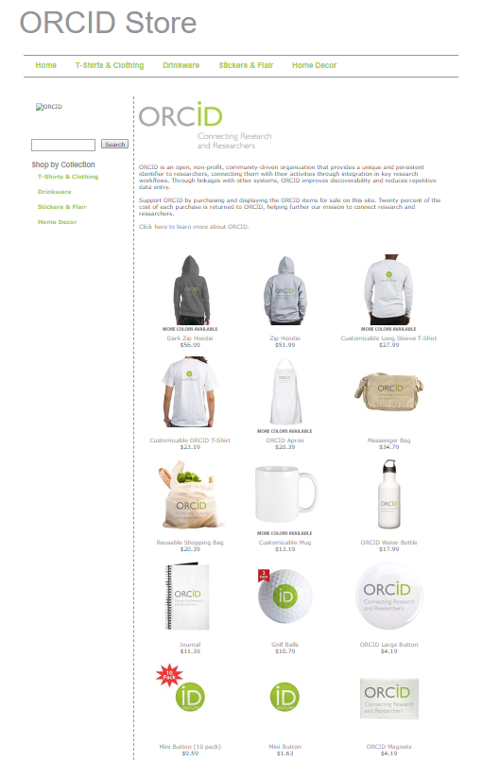
ORCID Swag
ORCID Store https://www.cafepress.com/orcid
Create your own https://orcid.org/trademark-and-id-display-guidelines
Print ORCID materials https://members.orcid.org/outreach-resources

Slide 44
ORCID Outreach Resources
https://members.orcid.org/outreach-resources

Slide 45
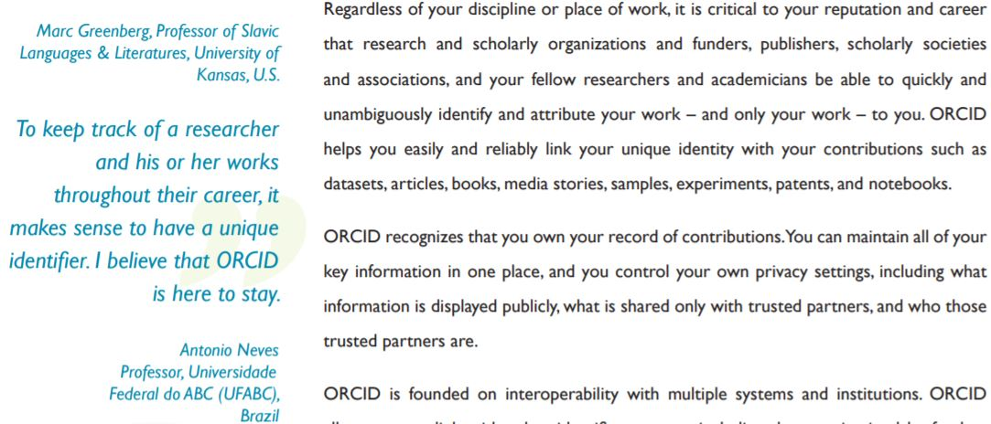
ORCID 3-Phase Communications Toolkit
Step 1 -
Build Anticipation: What is ORCID?
https://members.orcid.org/outreach-resources

Slide 46
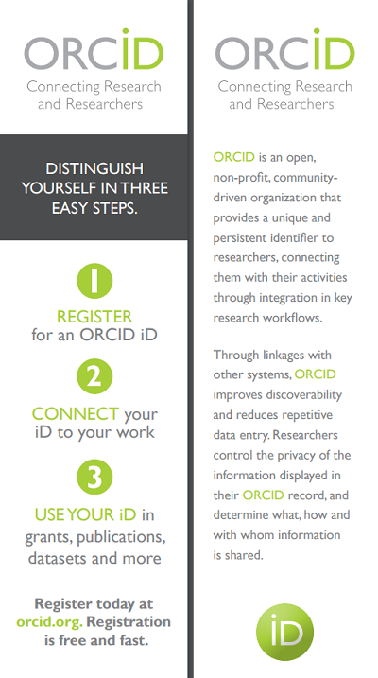
ORCID 3-Phase Communications Toolkit
https://members.orcid.org/outreach-resources
Step 1 -
Build Anticipation: What is ORCID?

Slide 47
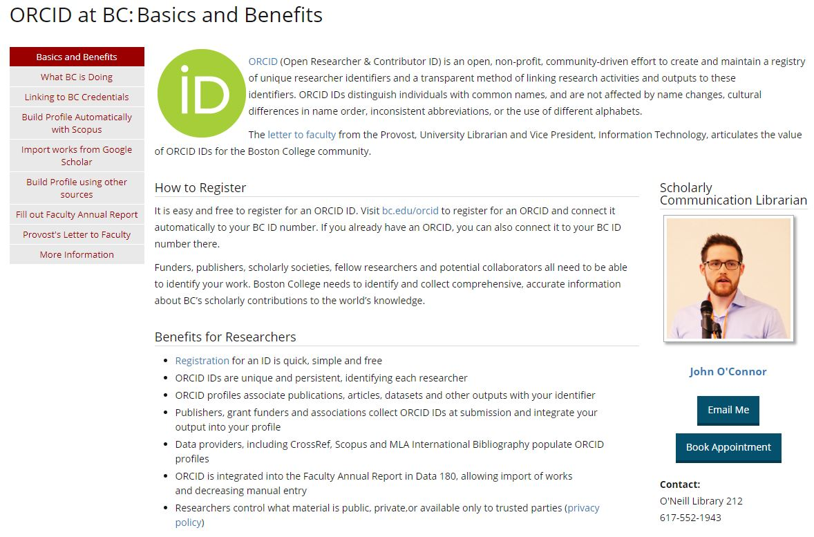
Outreach & Education Example
https://libguides.bc.edu/orcid

Slide 48
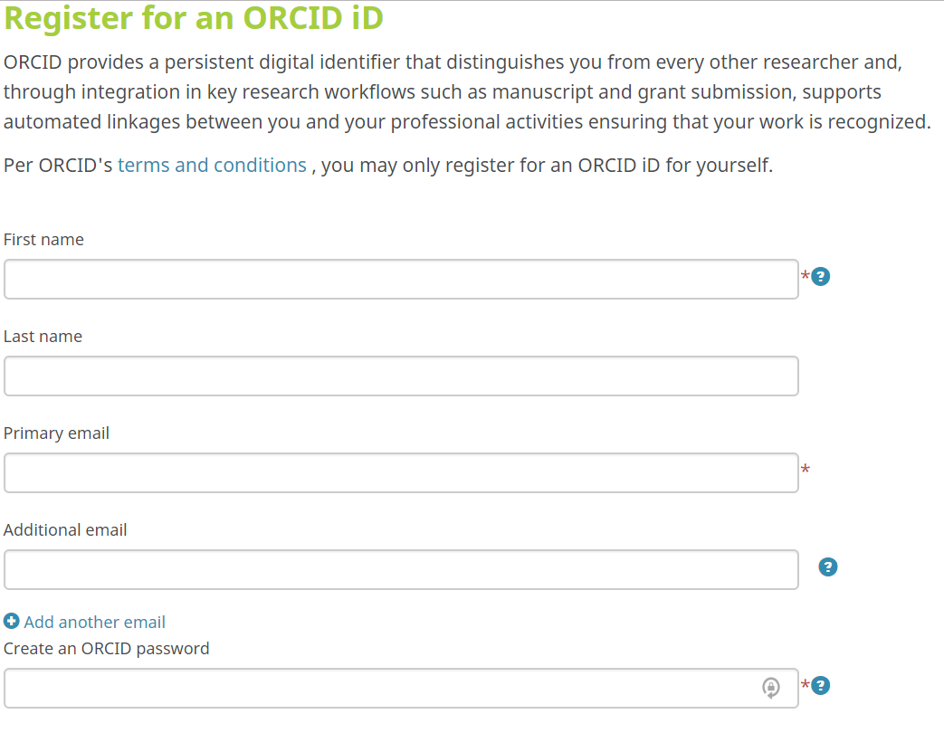
ORCID 3-Phase Communications Toolkit
Step 2 - Promote Action: Register for ORCID iD

Slide 49
ORCID 3-Phase Communications Toolkit
Step 2 - Promote Action: Create and Connect ORCID iD
Get an ORCID iD!
Click the button below to get an ORCID iD and Connect to XYZ Institutional System.
Create a new ORCID iD
Already have an ORCID iD? Connect your existing ORCID iD

Slide 50
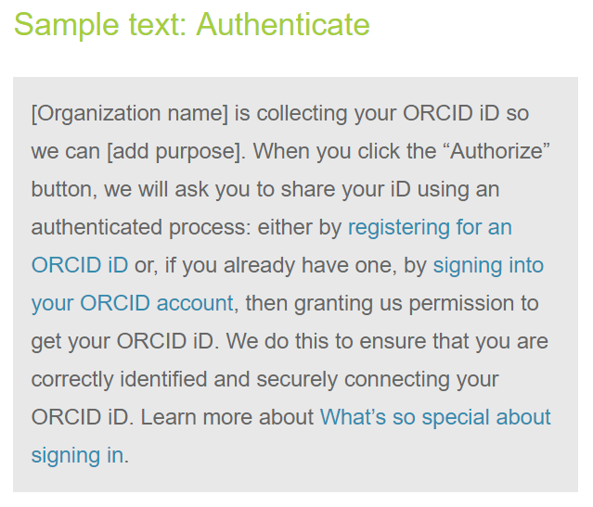
ORCID 3-Phase Communications Toolkit
Step 2 - Promote Action: Create and Connect ORCID iD
https://members.orcid.org/api/resources/graphics

Slide 51
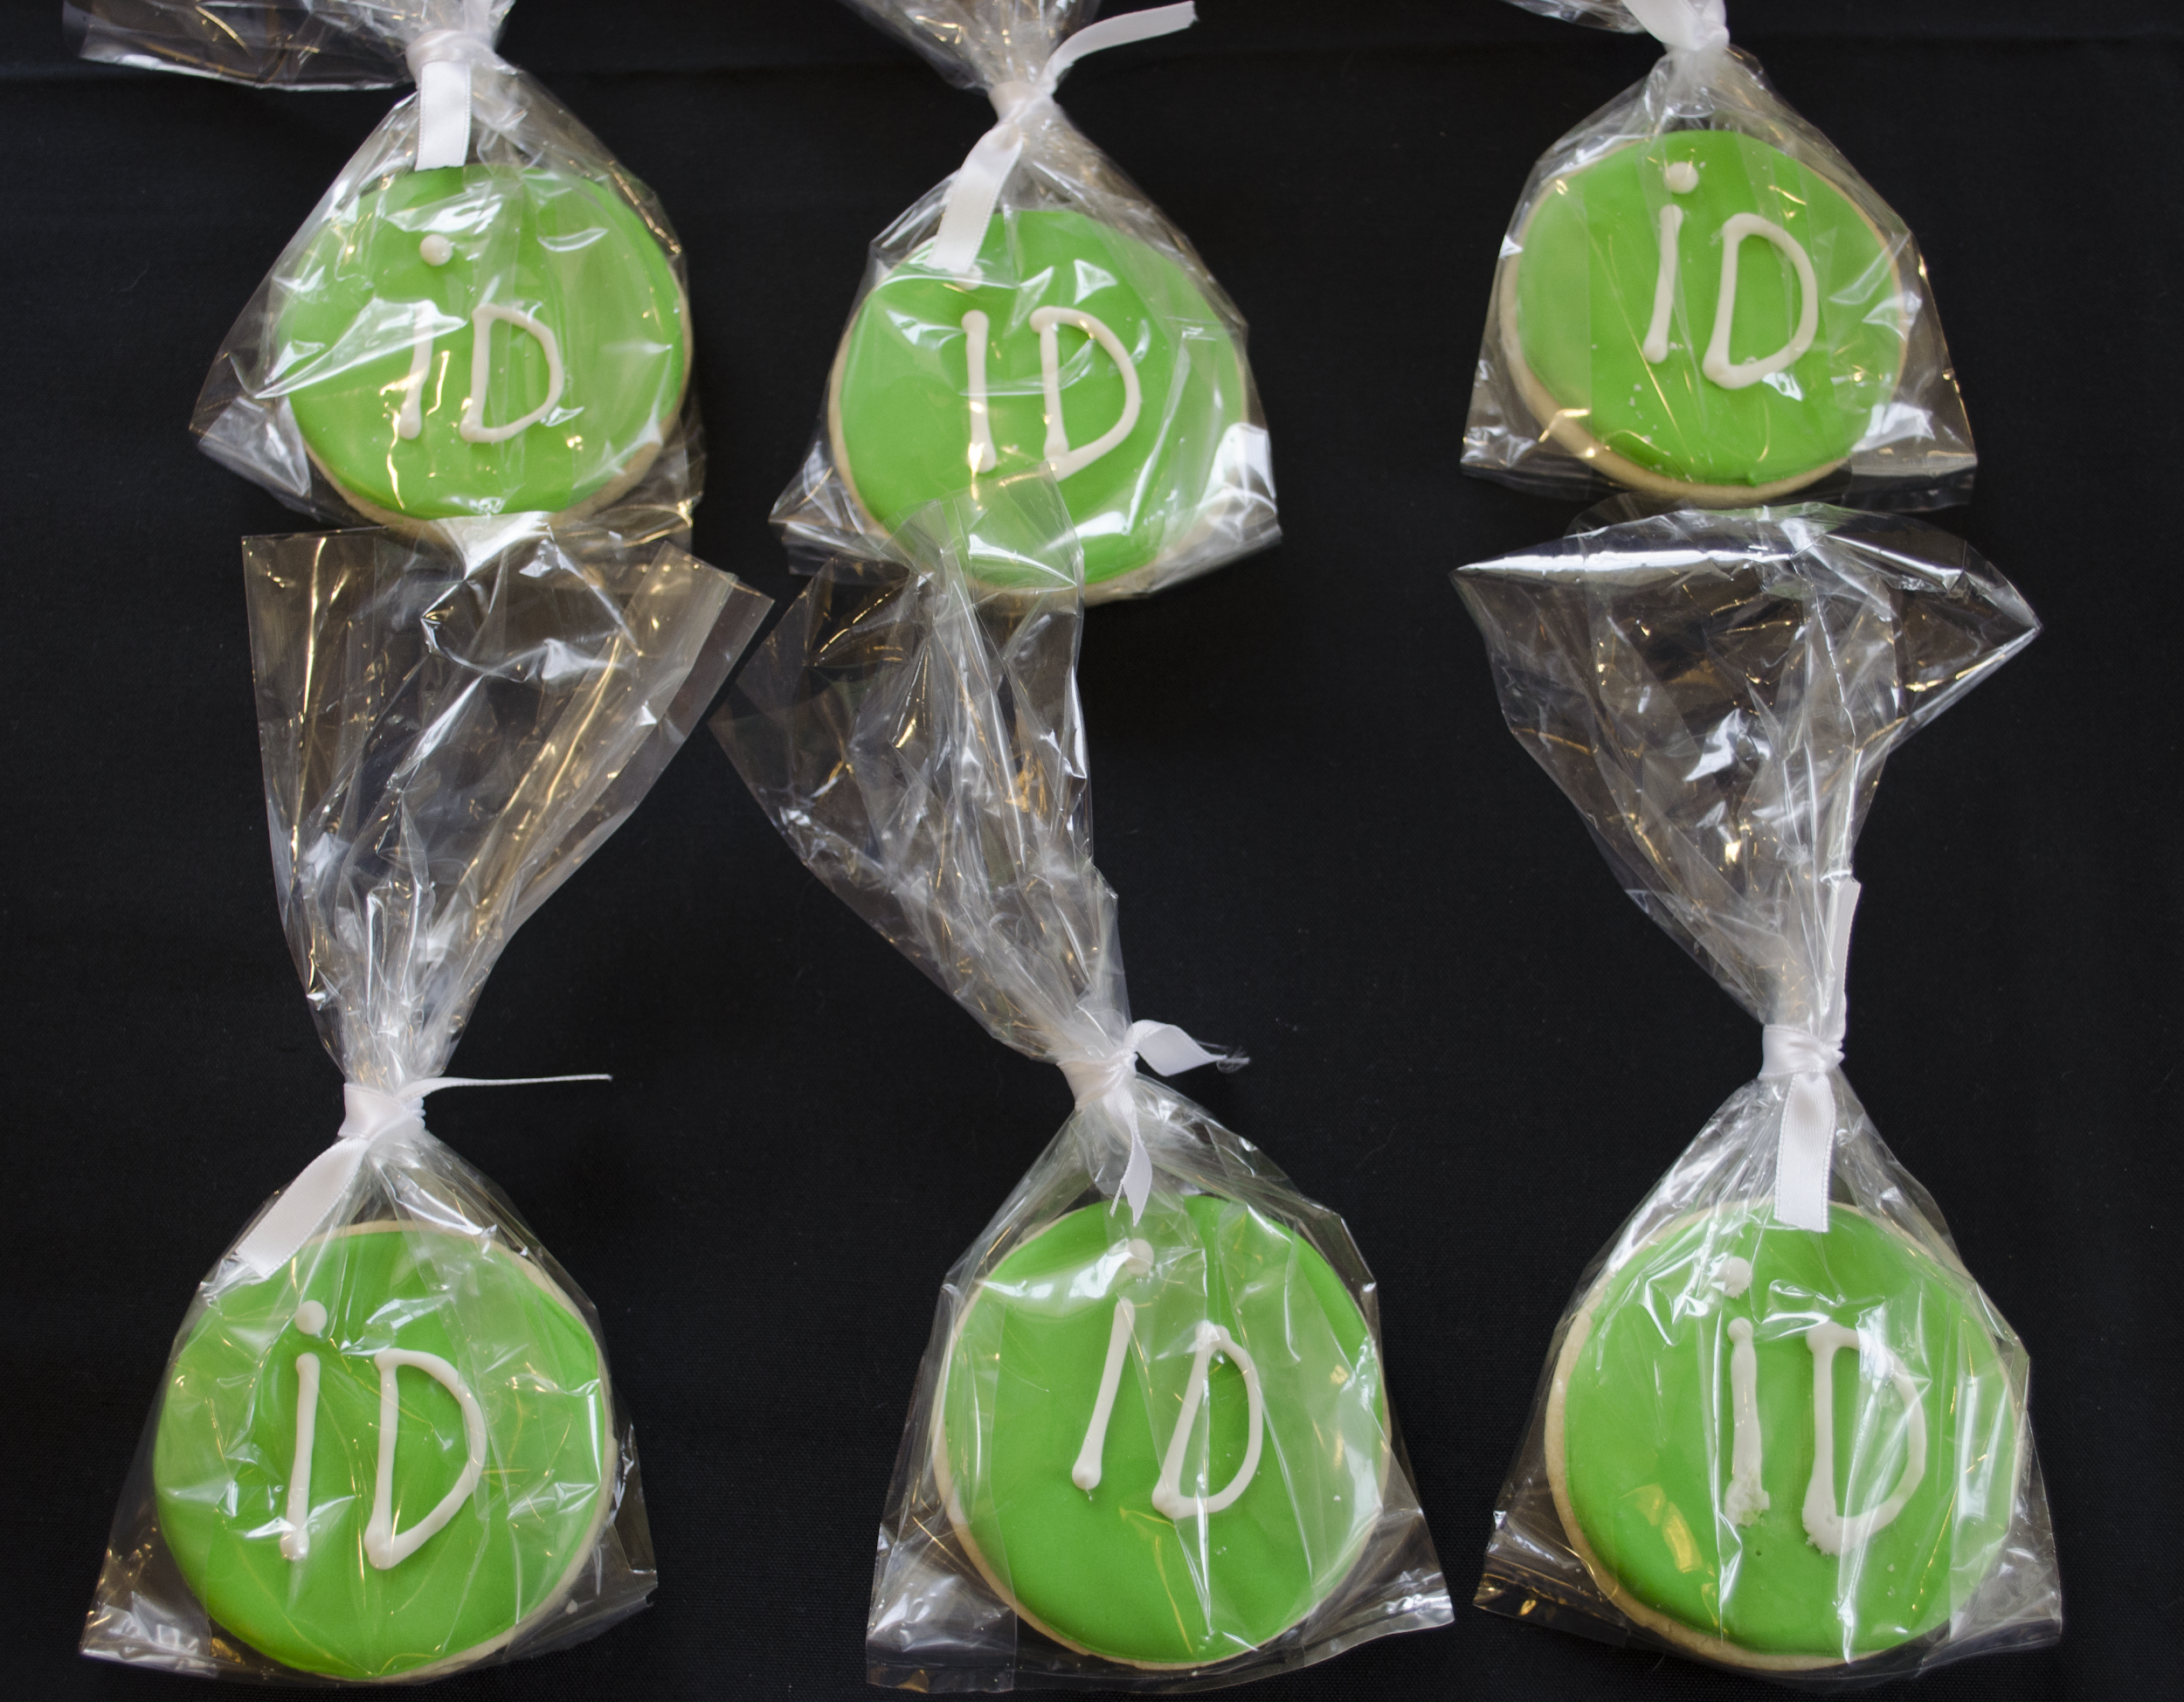
ORCID 3-Phase Communications Toolkit
Step 2 - Promote Action: Create and Connect ORCID iD
Cookie image courtesy of Baylor University Libraries

Slide 52
ORCID 3-Phase Communications Toolkit
Step 2 - Promote Action: Create and Connect ORCID iD
https://figshare.com/articles/ORCID_iD_3D_printed_cookie_cutter_template/5684449/1

Slide 53
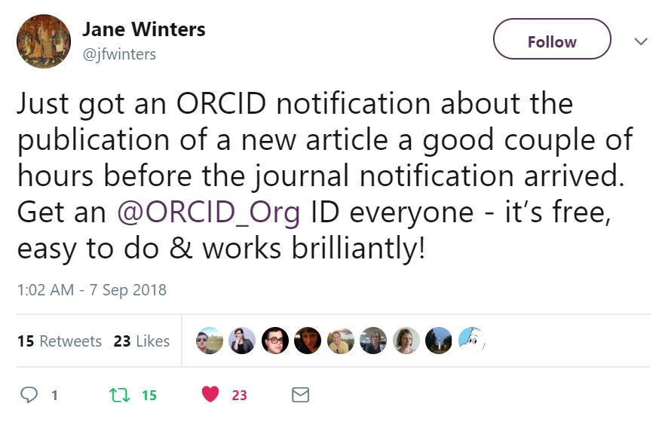
ORCID 3-Phase Communications Toolkit
Step 3 - Ongoing awareness: Use ORCID
https://twitter.com/jfwinters/status/1037974383090966528

Slide 54
ORCID 3-Phase Communications Toolkit
Step 3 - Ongoing awareness: Use ORCID
https://members.orcid.org/outreach-resources
https://libraries.ou.edu/impactchallenge

Slide 55
Thoughts? Questions?
Web orcid-us.org
Email orcidus@lyrasis.org
Thank you!

