Slide 1
IMPACT, The DISCIPLINES, AND VIVO
Michael Conlon, PhD
Emeritus Faculty Member
University of Florida

Slide 2
The Purpose of a University
“. . . it means a wish for less misery among the poor, less ignorance in schools, less bigotry in the temple, less suffering in the hospital, less fraud in business, less folly in politics.”
Daniel Coit Gilman, first president of Johns Hopkins University, 1876
https://www.jhu.edu/about/history/gilman-address/

Slide 3
The notion of impact
‘Pathways to impact’ statements required by the Research Councils include: “Academic impact: The demonstrable contribution that excellent research makes to academic advances, across and within disciplines, including significant advances in understanding, methods, theory and application” and “Economic and societal impacts: The demonstrable contribution that excellent research makes to society and the economy. Economic and societal impacts embrace all the extremely diverse ways in which research-related knowledge and skills benefit individuals, organisations and nations…”
http://www.rcuk.ac.uk/innovation/impacts/

Slide 4
The Becker Model Washington University at St. Louis, Becker Medic al Library
Advancement of Knowledge
Clinical Implementation
Community Benefit
Legislation and Policy
Economic Benefit
https://becker.wustl.edu/impact-assessment/model

Slide 5
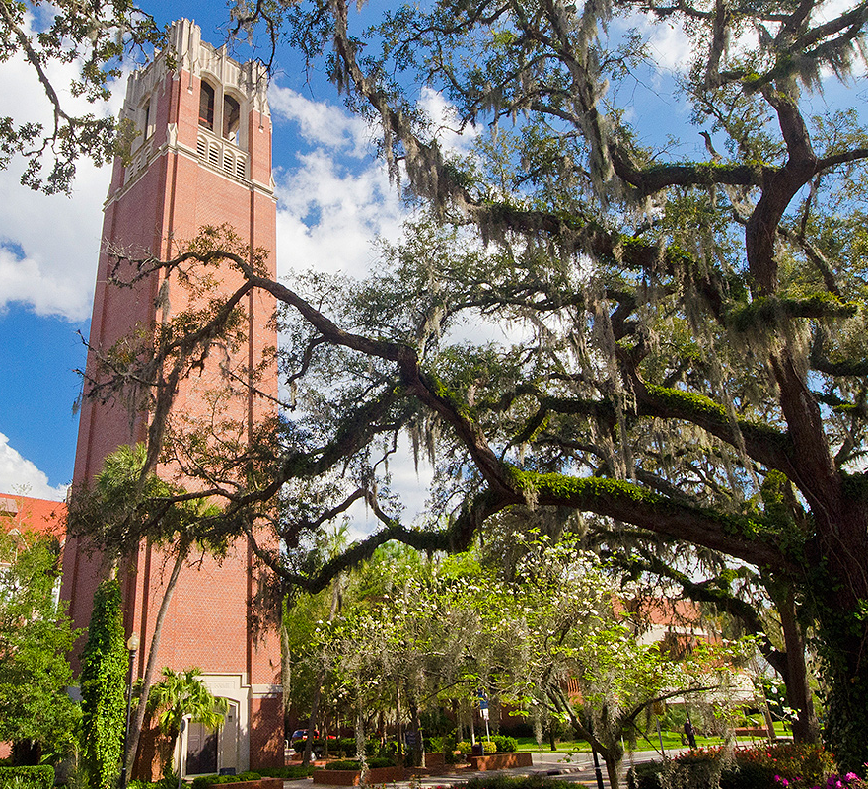
My University
University of Florida (UF), Gainesville, Florida, USA
Public, state-supported, grant funded
Free tuition for Florida students with high marks
Annual budget $6B
52,000 students, 6,000 faculty, 16 colleges, 2200 acres, 7,000 research papers per year. Nine hospitals, 67 agricultural offices, 25 research centers across the state

Slide 6
The STATED purpose of my University
The university welcomes the full exploration of its intellectual boundaries and supports its faculty and students in the creation of new knowledge and the pursuit of new ideas.
Teaching is a fundamental purpose of this university at both the undergraduate and graduate levels.
Research and scholarship are integral to the educational process and to the expansion of our understanding of the natural world, the intellect and the senses.
Service reflects the university's obligation to share the benefits of its research and knowledge for the public good. The university serves the nation's and the state's critical needs by contributing to a well-qualified and broadly diverse citizenry, leadership and workforce.

Slide 7
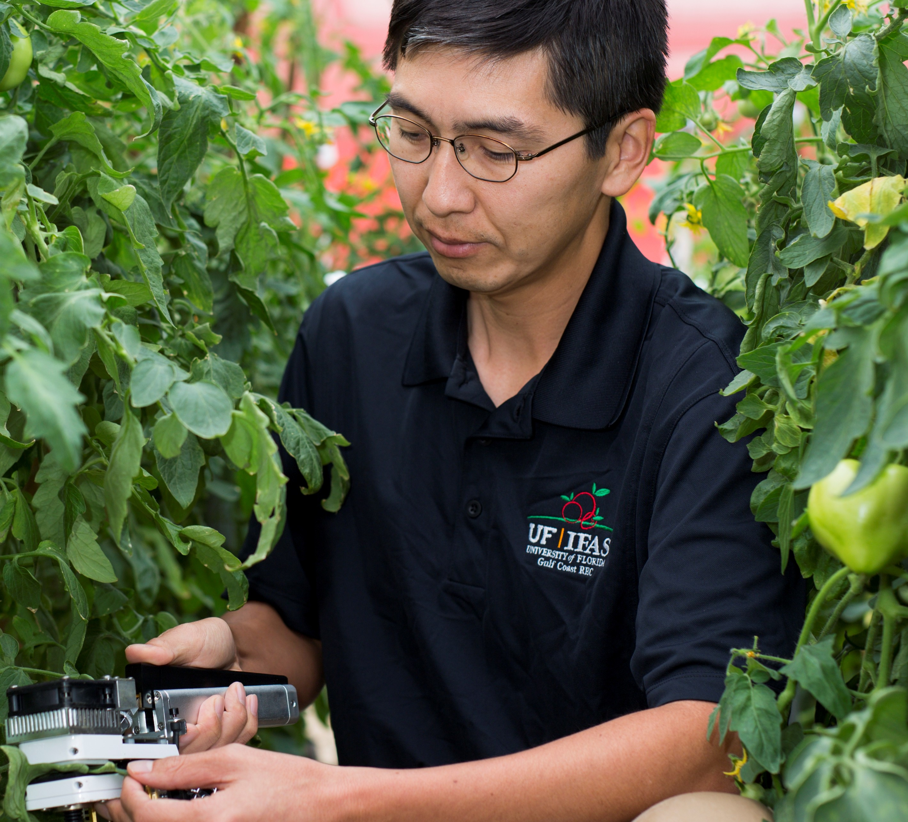
Agriculture
The Morrill Act (1862) set aside a land-grant for founding an agricultural and mechanical university in each state
Florida Department of Agriculture and Consumer Services (1870)
Florida Agricultural College (1884) renamed University of Florida (1905)
Smith-Lever Act (1914) establishes agricultural extension connected to land-grant universities
In the US, an extension agent is a university employee who develops and delivers educational programs to assist people in economic and community development, leadership, family issues, agriculture and environment.
Agriculture is the second largest industry in Florida, after tourism.

Slide 8
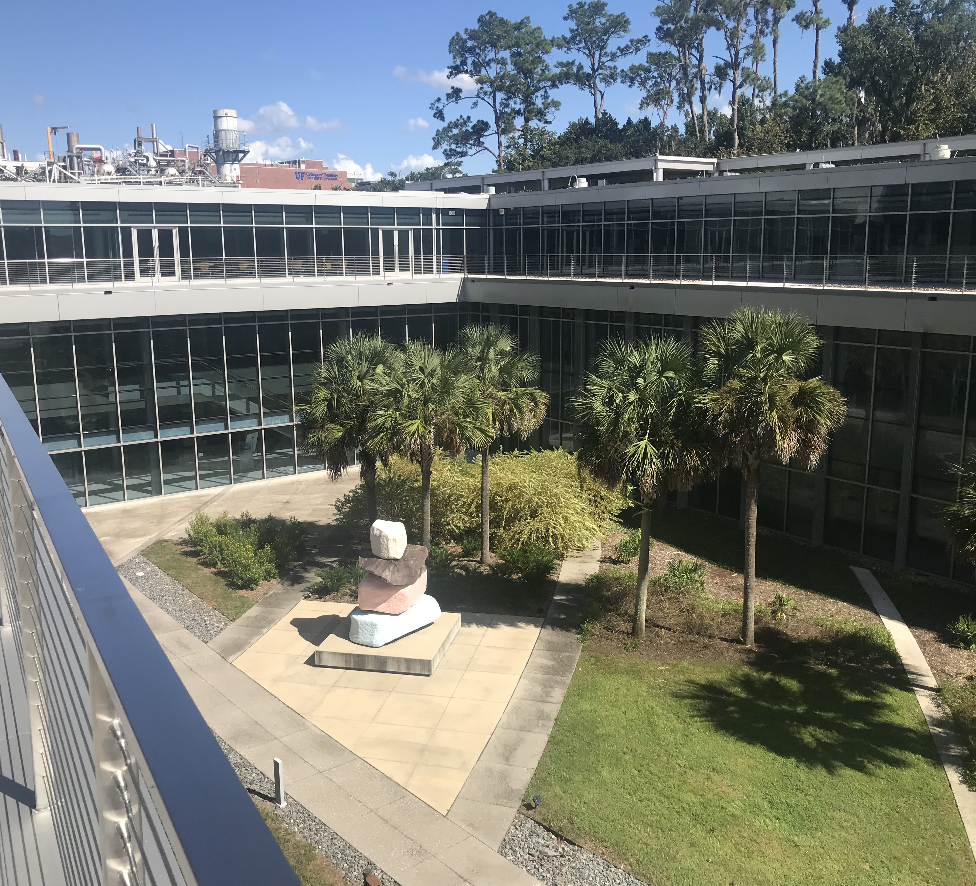
The MEDICAL PROFESSIONS
Dentistry, Medicine, Nursing, Occupational Therapy, Pharmacy, Physical Therapy, Physician’s Assistant, Veterinary Medicine
NIH (2006) established the Clinical and Translational Science Award program to accelerate the translation of basic science to the improvement of human health. 65 universities, including UF, have such awards.

Slide 9
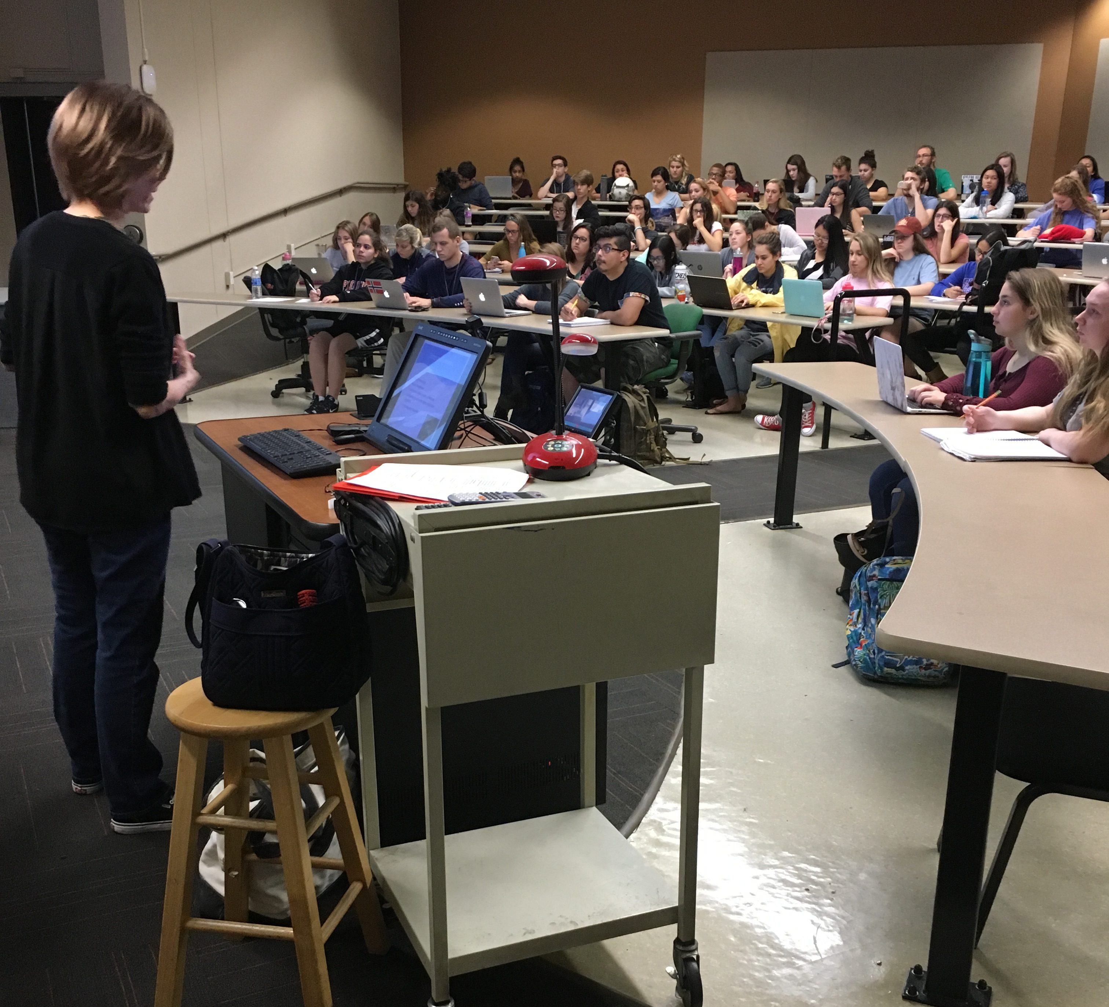
The Social Sciences
Strong student interest – psychology, political science, anthropology, economics, linguistics
Research collaborations in network science, medicine, policy, engineering, law, business, education
Translation to government and corporate activity

Slide 10
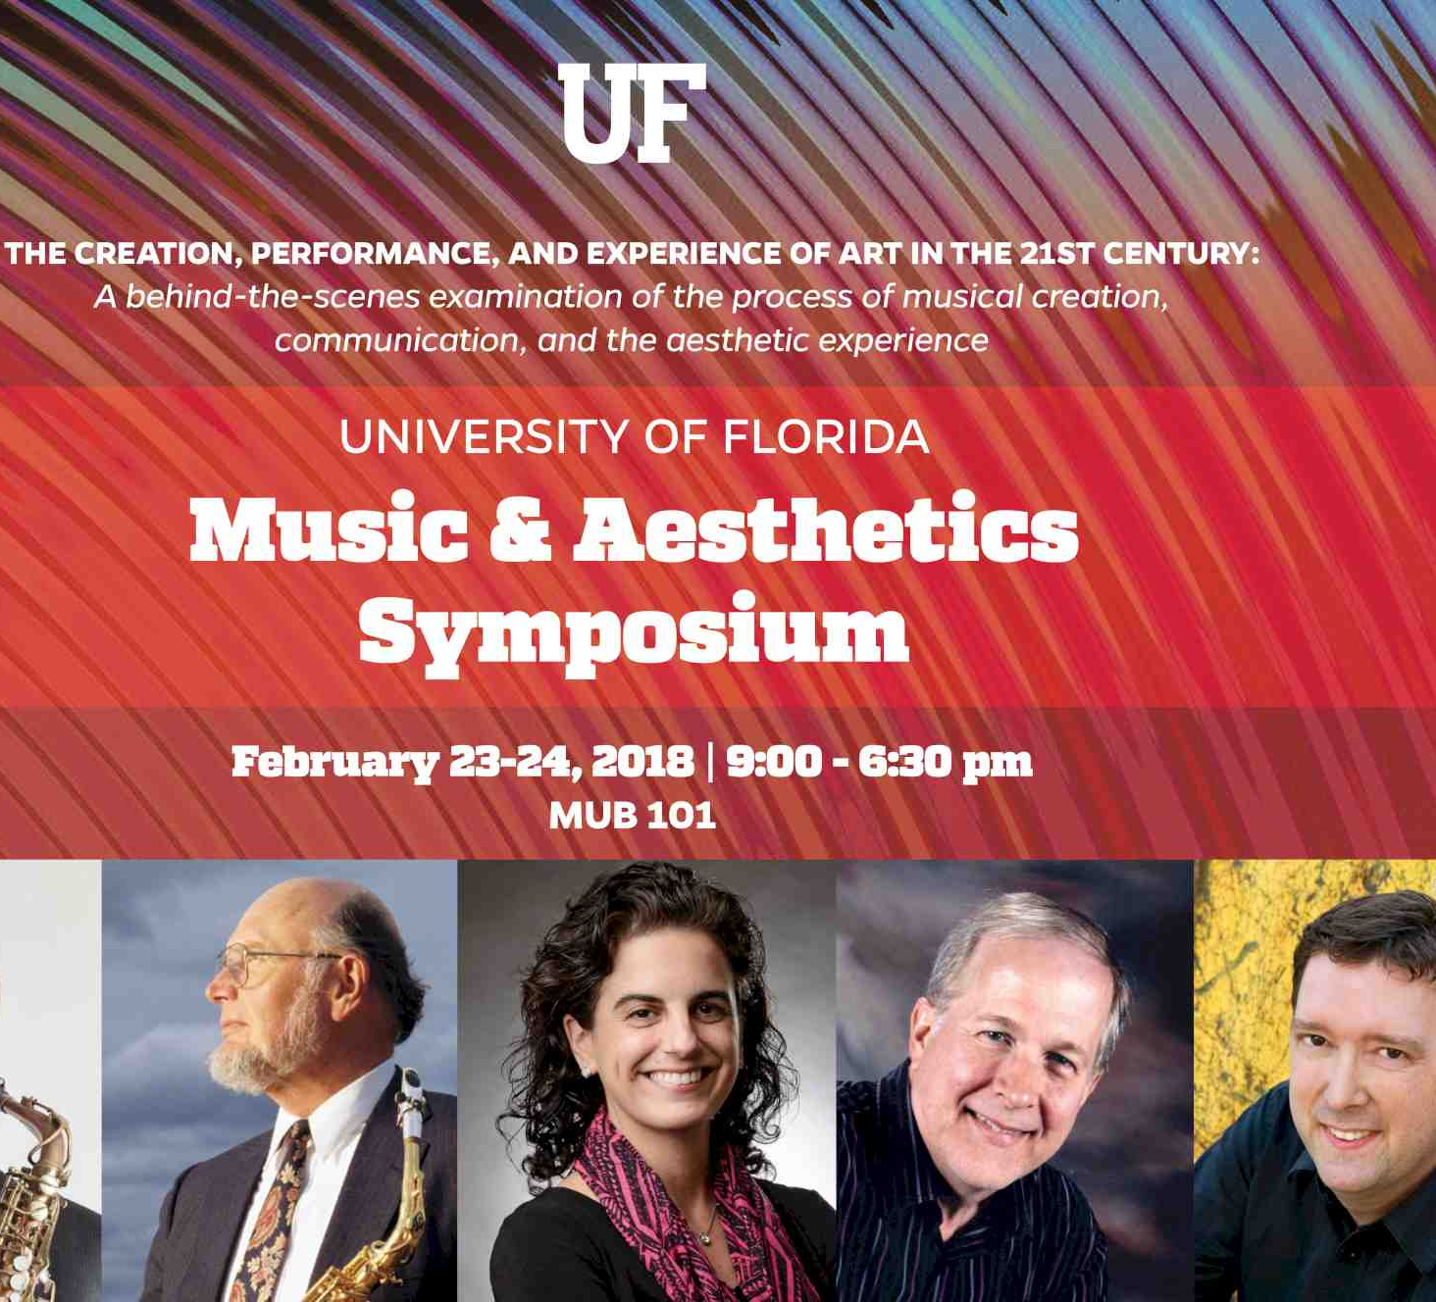
the humanities
Perhaps at the nadir
Proposal to eliminate the NEH
Very few opportunities for external funding
Little programmatic effort in partnership with governments
Translation to the public through performances, exhibitions, recordings, libraries, galleries

Slide 12
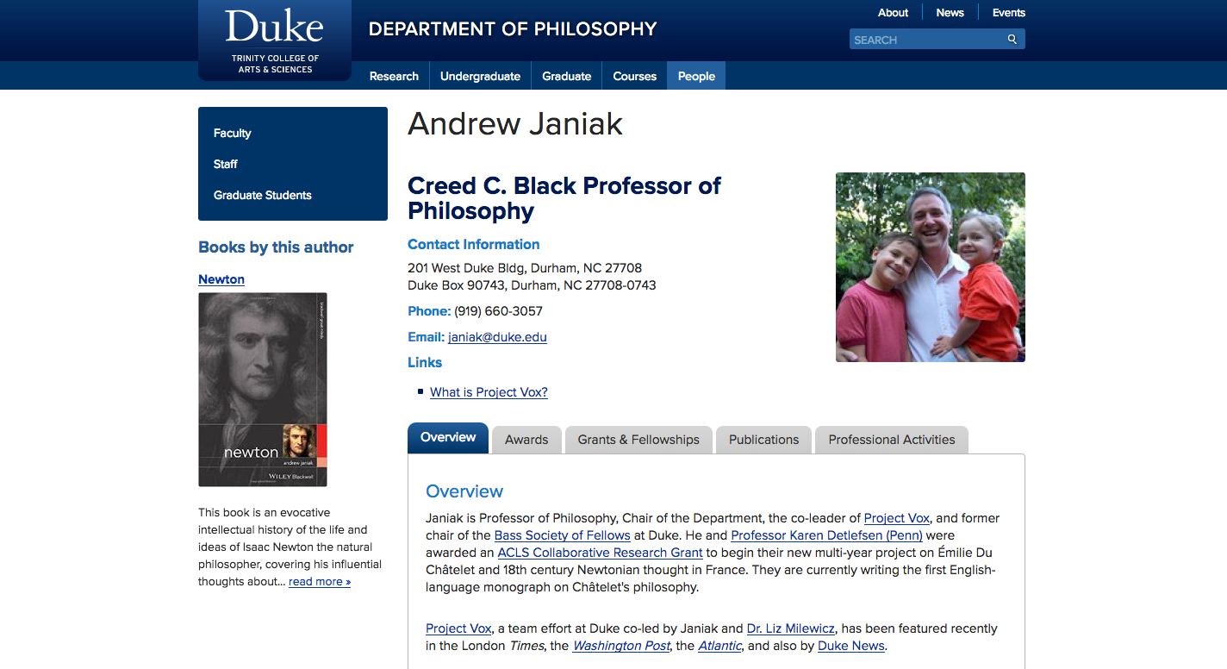
Assessment of near-term impact using VIVO
VIVO [Pronunciation: vee-voh] is member-supported, open source software and an ontology for representing scholarship. VIVO supports recording, editing, searching, browsing and visualizing scholarly activity. VIVO encourages research discovery, expert finding, network analysis and assessment of research impact. VIVO is easily extended to support additional domains of scholarly activity.

Slide 13
VIVO integrates and reuses institutional data
Reports
Expert
Finding
Organization
People
Projects
VIVO
Curricula
Vitae
Network
Analysis
Papers, Books Datasets, Software
Performances, exhibits
Web
Profiles
Teaching
Adhoc
Queries
Service
Visualizations

Slide 14
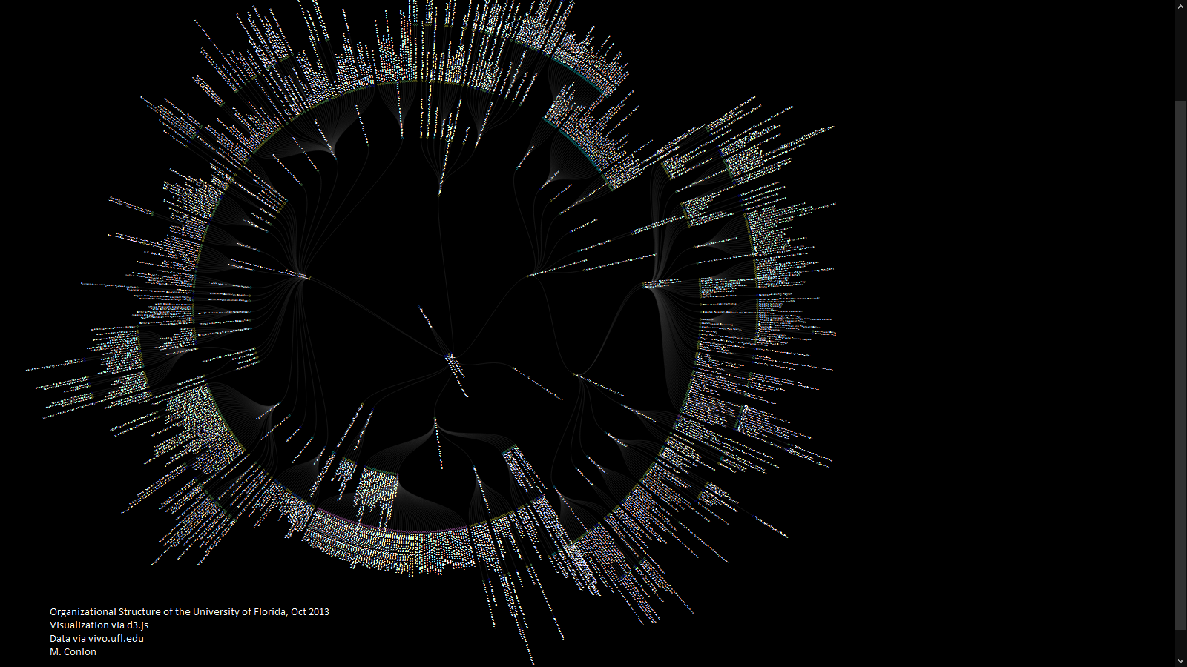

Slide 15
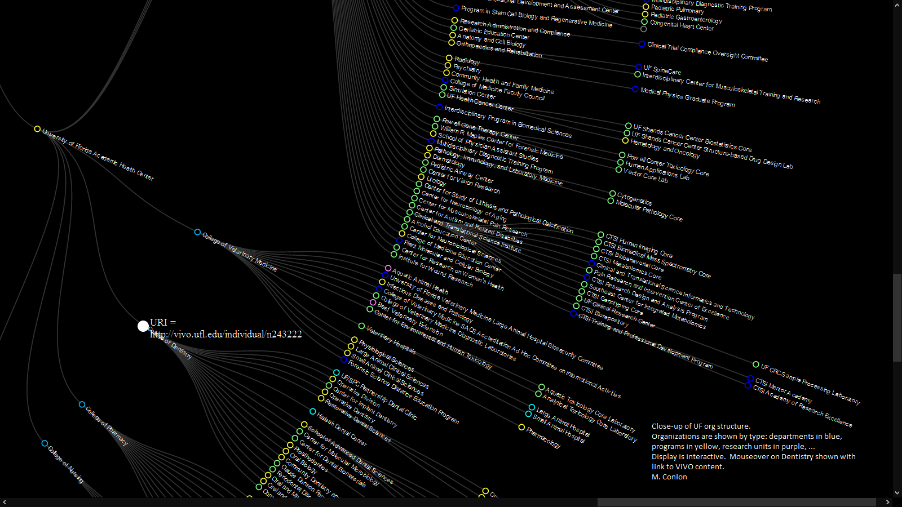
visualization via d3.js data via vivo.ufl.edu

Slide 16
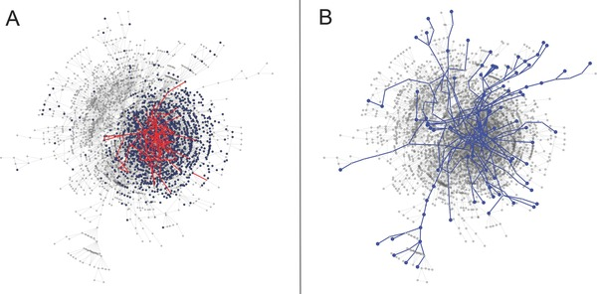
Vacca, R, McCarty, C, Conlon, M, and Nelson, D. Designing a CTSA‐Based Social Network Intervention to Foster Cross‐Disciplinary Team Science Clin Transl Sci. 2015 Aug; 8(4): 281–289. Published online 2015 Mar 19. doi: 10.1111/cts.12267
Using VIVO to Improve university Function
Co-author network of the University of Florida, 2013
A) shows new connections via induction. Health Center Faculty in blue. Pilot awardees and new connections in red
B) shows new connections via alteration

Slide 17
BUT IMPACT IS GENERATIONAL …
A university graduate goes on to become an international leader
A basic science discovery becomes a cancer-curing drug
An economic theory becomes influential
Scholarship in the arts, music, religion, culture, history improves our understanding of each other
Application of social science research leads to improved policy

Slide 18
... CANNOT BE ASSESSED IN THE MOMENT, …
A university graduate goes on to become an international leader for world peace
A basic science discovery becomes a cancer-curing drug
An economic theory becomes influential
Scholarship in the arts, music, religion, culture, history improves our understanding of each other
Application of social science research leads to improved policy

Slide 19
... AND OCCURS IN TRANSLATIONS
The education obtained at the university inspires the future world leader
A company develops the cancer-curing drug
The economic theory is discussed, taught, refined, and adopted by practitioners
Cultural heritage organizations insure access to important scholarly works
Policy makers use social science research findings

Slide 20
Thank You
VIVO Conference, September 4-6, 2019. Podgorica, Montenegro.
http://vivoconference.org
VIVO
http://vivoweb.org
@vivocollab
Michael Conlon
https://orcid.org/0000-0002-1304-8447
mconlon@ufl.edu
@mconlon17

