Slide 1
Linked Open Data for Scholarship: The VIVO Experience
Michael Conlon, PhD
VIVO Project Director
Emeritus Faculty Member
University of Florida

Slide 2
Improve Research
By representing, collecting and analyzing data about research, we seek to understand and improve research

Slide 3
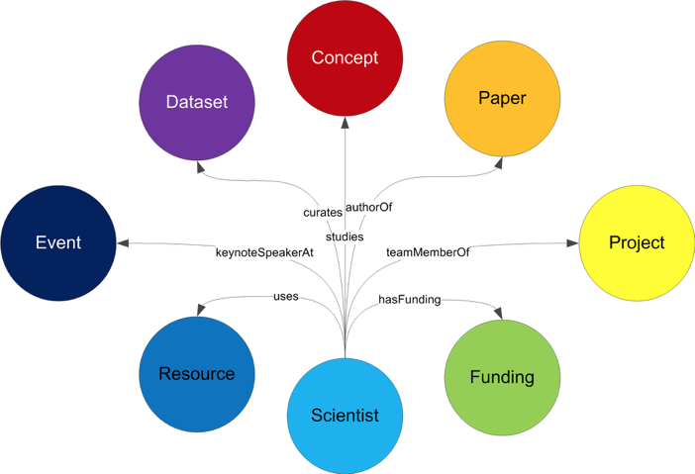
Conceptual

Slide 4
Understanding, Improving
Time – how is research changing over time (month, year, decade)
Geography – how are patterns different in space (local, national, world)
Network – how are things (people, projects, organizations) connected
Research topics/categories/concepts – how are works, people aggregated by common interests
Metrics – How do metrics (counts, impact factors) vary over time, topic, geography

Slide 5
What is VIVO
VIVO is an open source, semantic web application for representing, showcasing, and studying scholarship
VIVO uses a collection of ontologies to represent scholarship
VIVO produces linked data that is readily shared, combined, and analyzed
VIVO is member-supported project
VIVO is in use at over 150 institutions in 28 countries, representing more than 200,000 scholars and 2 million works.

Slide 6
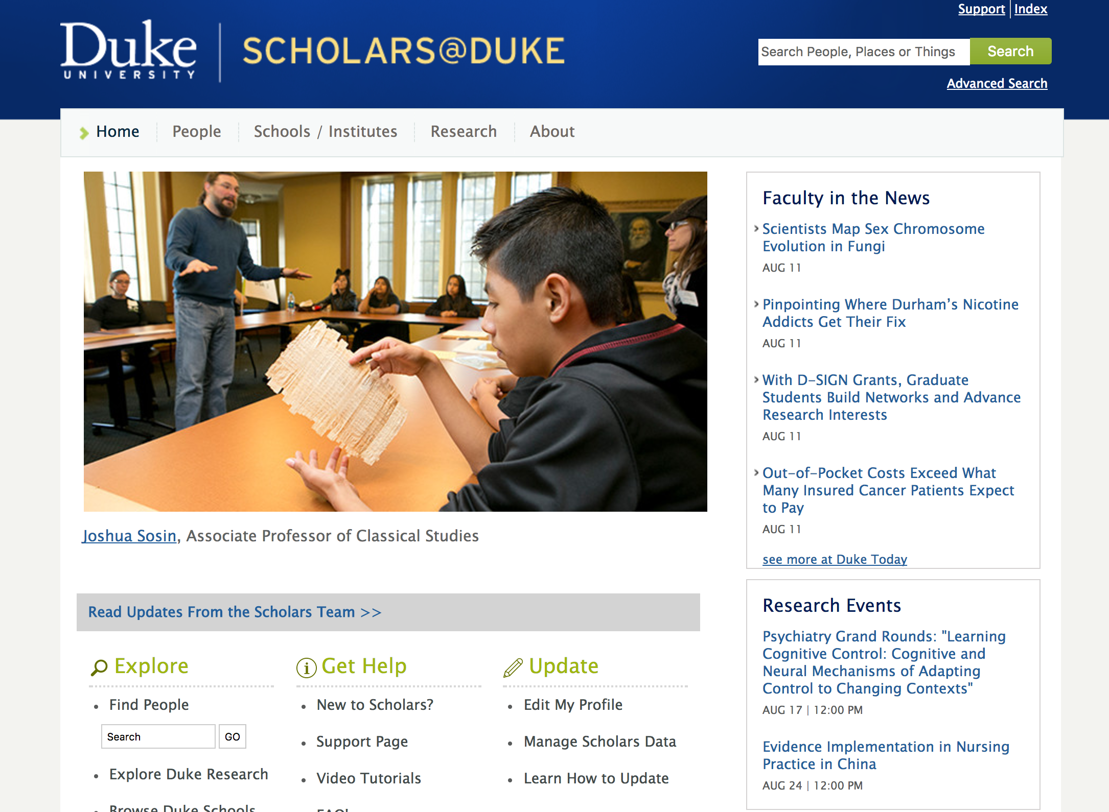

Slide 7
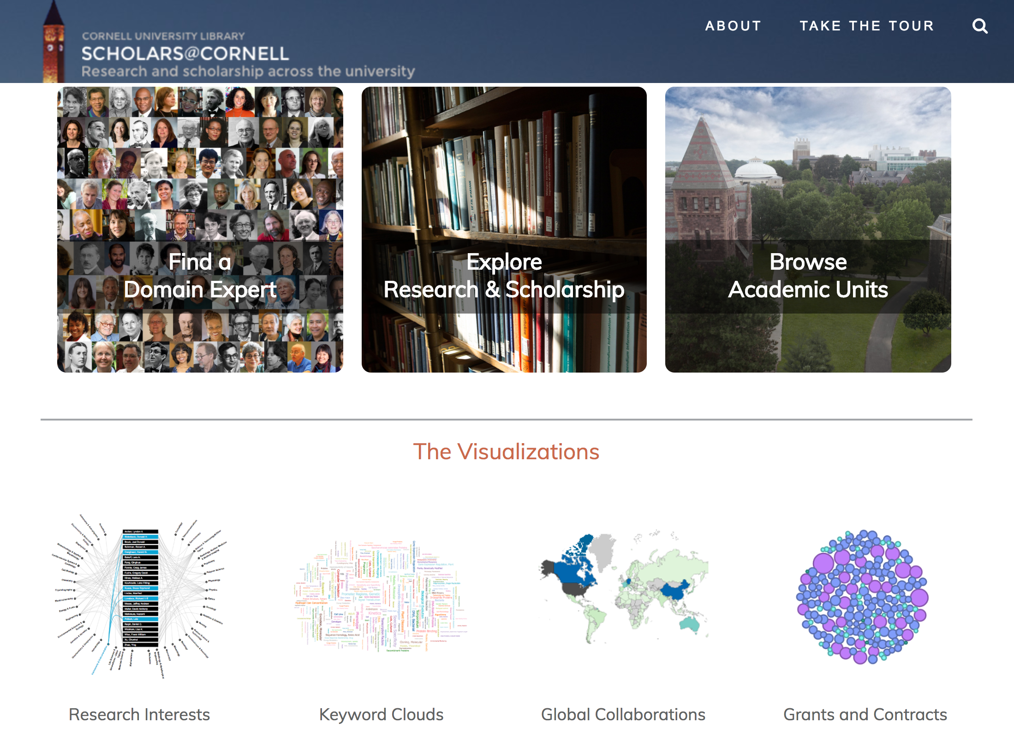

Slide 8
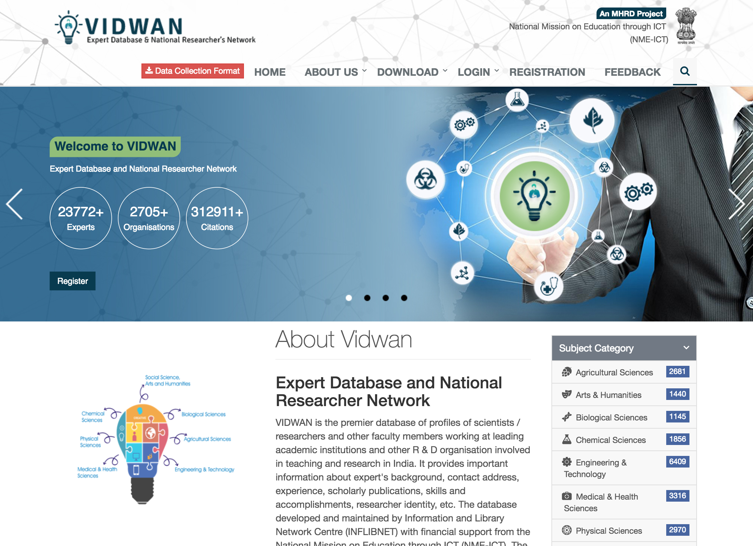

Slide 9
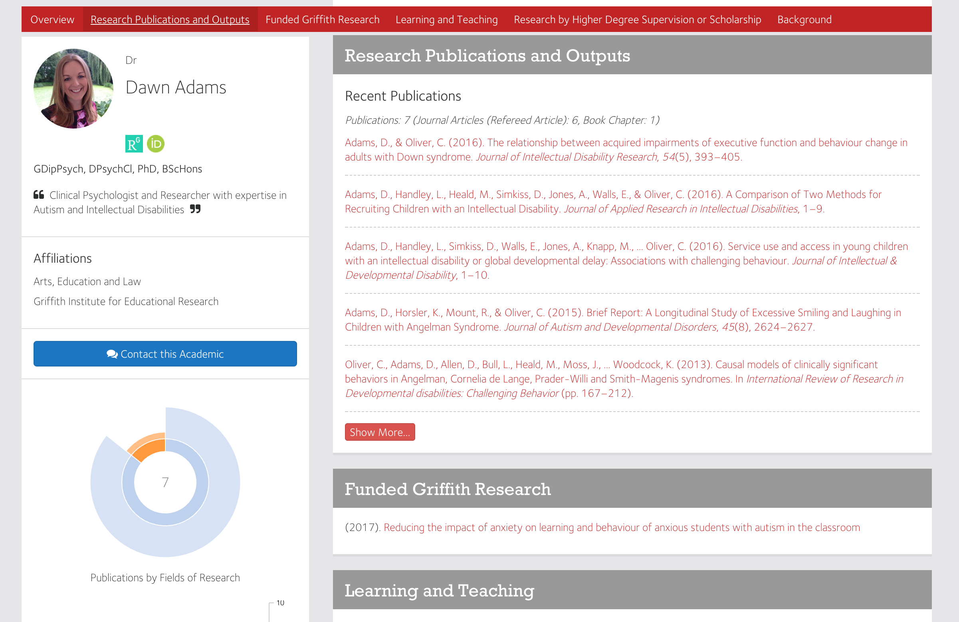

Slide 10
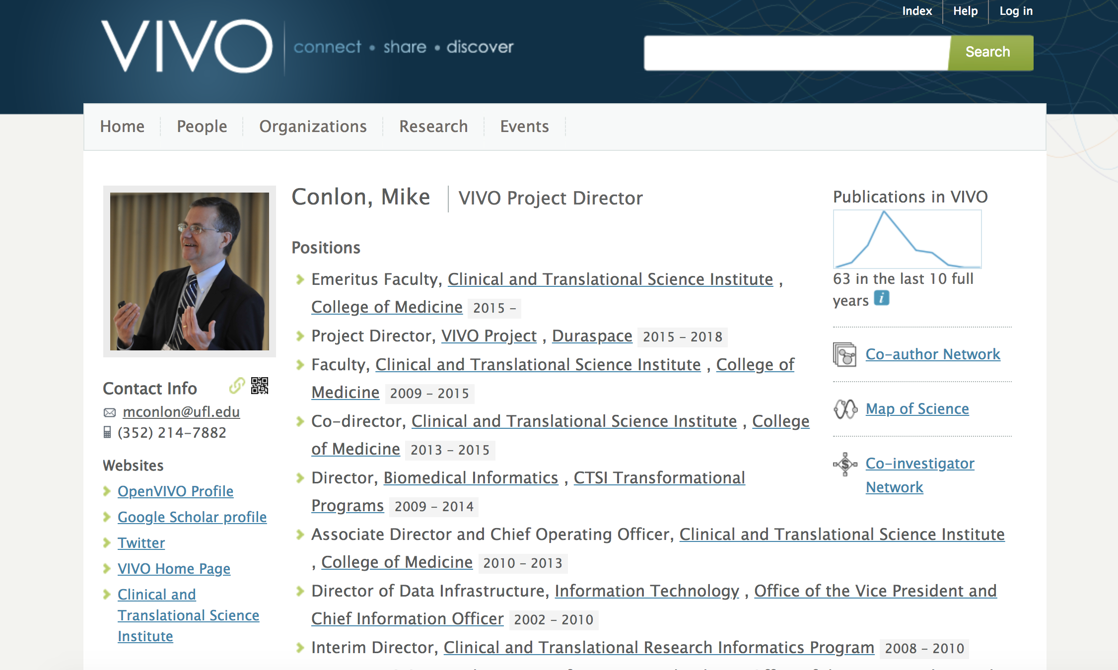

Slide 11
VIVO integrates and reuses institutional data
Reports
Expert
Finding
Organization
People
Projects
VIVO
Curricula
Vitae
Network
Analysis
Papers, Books Datasets, Software
Performances, exhibits
Web
Profiles
Teaching
Adhoc
Queries
Service
Visualizations

Slide 12
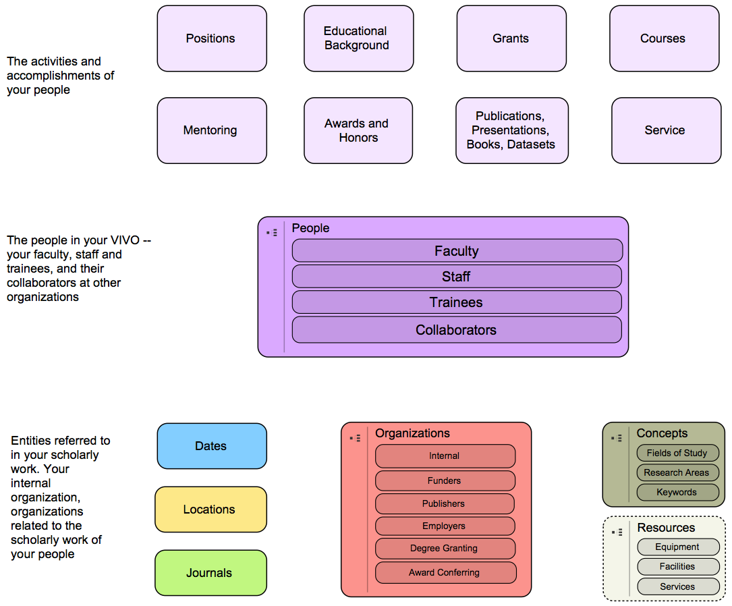
Domains of Representation

Slide 13
Issue: The Middle Ground
Above VIVO (more abstract) is the Basic Formal Ontology
Below VIVO (more specific) are domain specific ontologies and vocabularies (clinical trials, agriculture, humanities, cultural heritage, …)
Most ontologies “below” VIVO introduce their own “middle concepts” — person, paper, project — these must be “reconciled” with VIVO. This is fundamental collaborative work across projects

Slide 14
Issue: Missing Ontologies
To represent scholarship, VIVO must represent detail that is best defined by authoritative sources
Example: Academic Degrees
VIVO supports its own vocabulary of 173 academic degrees (because the world doesn’t have one)
Example: Research Areas
Many vocabularies exist for expressing research areas of faculty members. What might be “useful” for faculty to find people working in related areas? OpenVIVO uses FAST (Faceted Application of Subject Terminology) from OCLC (Online Computer Library Center).
Example: Contribution Ontology
The contribution ontology developed by the Force11 Attribution Work Group, VIVO Project, and OpenRIF is new. It will need to be refined based on experience and further analysis

Slide 15
Issue: Managing Ontological Change
Many institutions and projects use VIVO (150) and the VIVO ontology (another 250)
VIVO needs a process for updating ontologies it uses, and updating its data and interfaces to use updated ontologies
But many sites depend on the ontology to retrieve data from VIVO and other systems to web sites, software, and reports
What changes have minimal to no impact? Which do not? How to propose change? Govern change? Implement change?

Slide 16
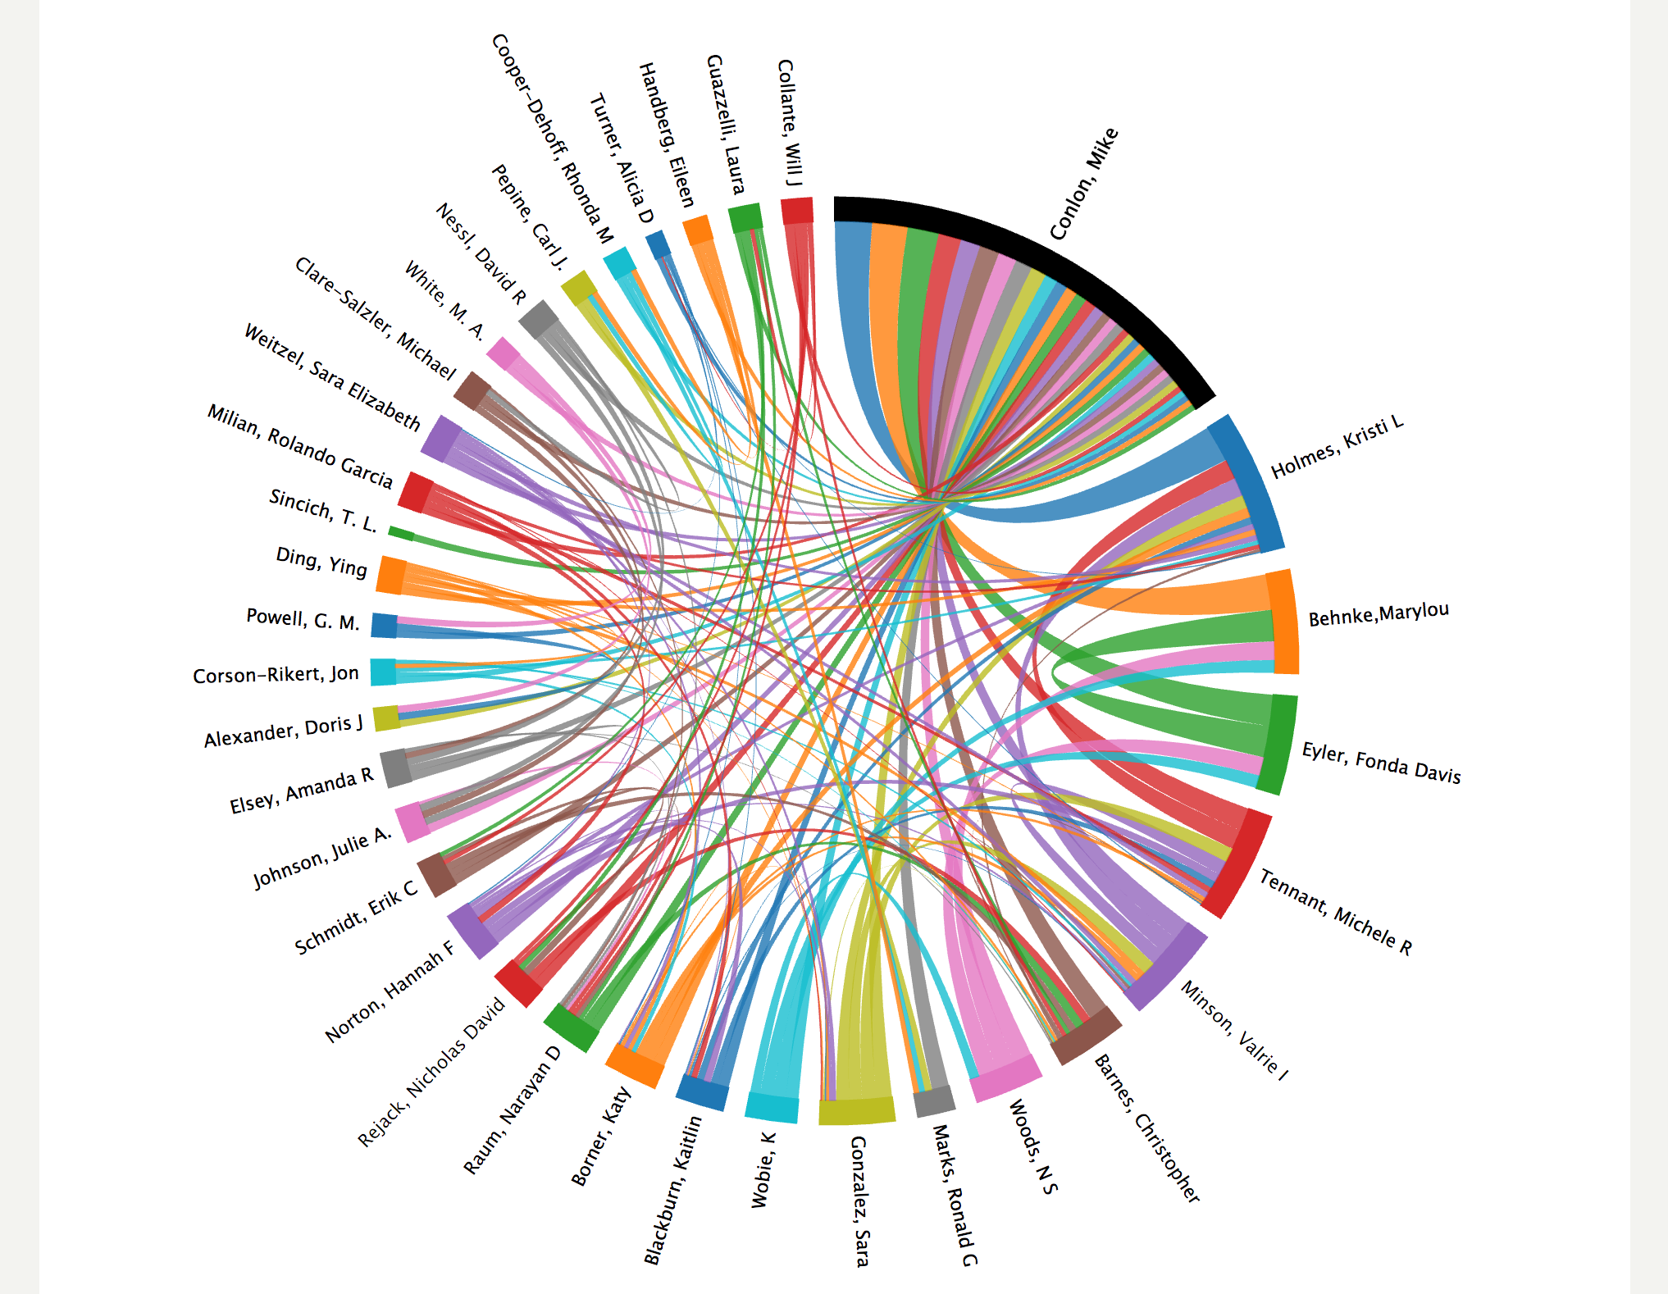

Slide 18
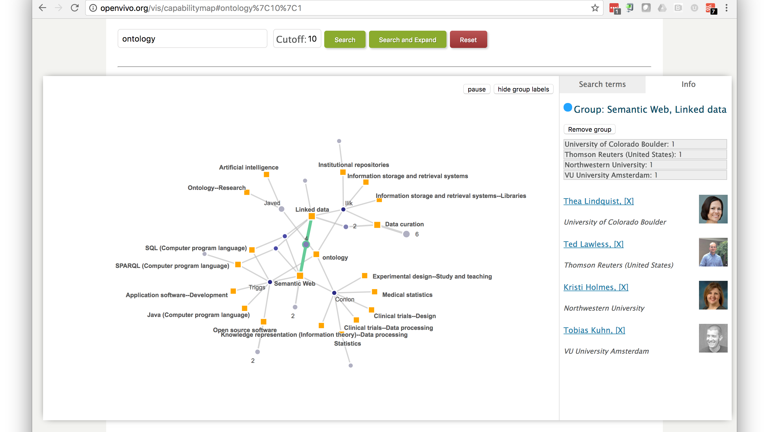

Slide 19
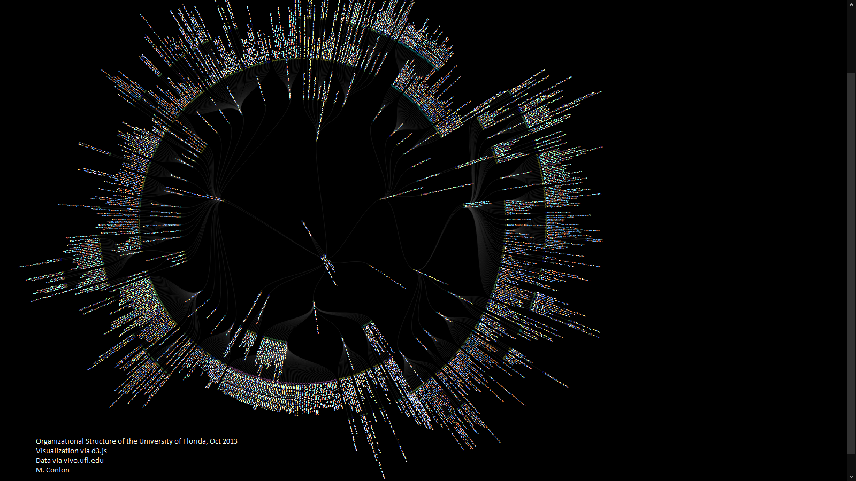
data visualization

Slide 20
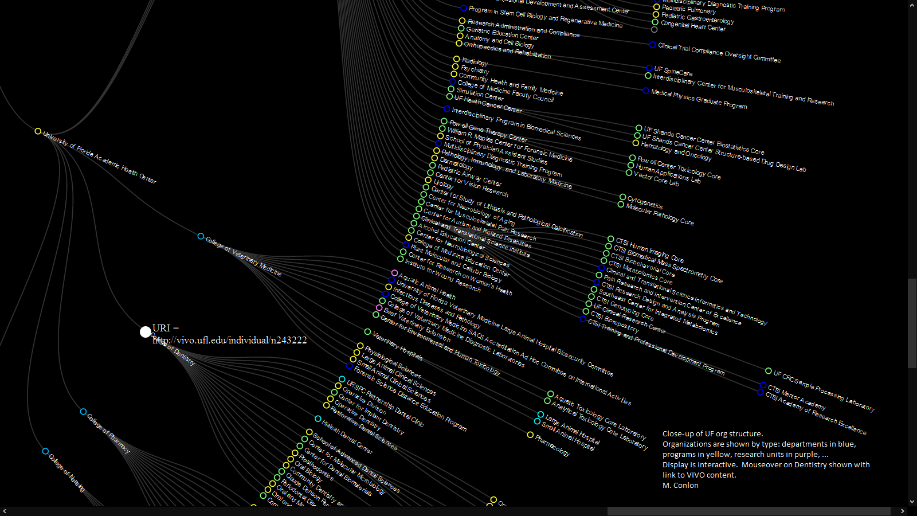
visualization via d3.js data via vivo.ufl.edu

Slide 21
Notes:
Towards an Intellectual Atlas of Scholars@Duke Jim Moody
faculty in Sociology & director of Duke Network Analysis group
research landscape where collaborations are depicted as a topography. darker areas (hills) represent clusters of papers of similar topic, ridges represent papers that link topics together, valleys represent gaps in knowledge, and islands represent widely different topics disconnected from the mainland. “Islands” show isolated areas of collaboration.

Slide 22
Towards an Intellectual Atlas of Scholars@Duke
James Moody (1,2), Peter Mucha (1,3,4); 1: Department of Sociology, Duke University, 2: Duke Network Analysis Center, Duke University, 3: Department of Mathematics, University of North Carolina, 4: DNAC Lab, Duke University
Notes:
Overlaid same research landscape by department, gender distribution, and collaboration clusters

Slide 23
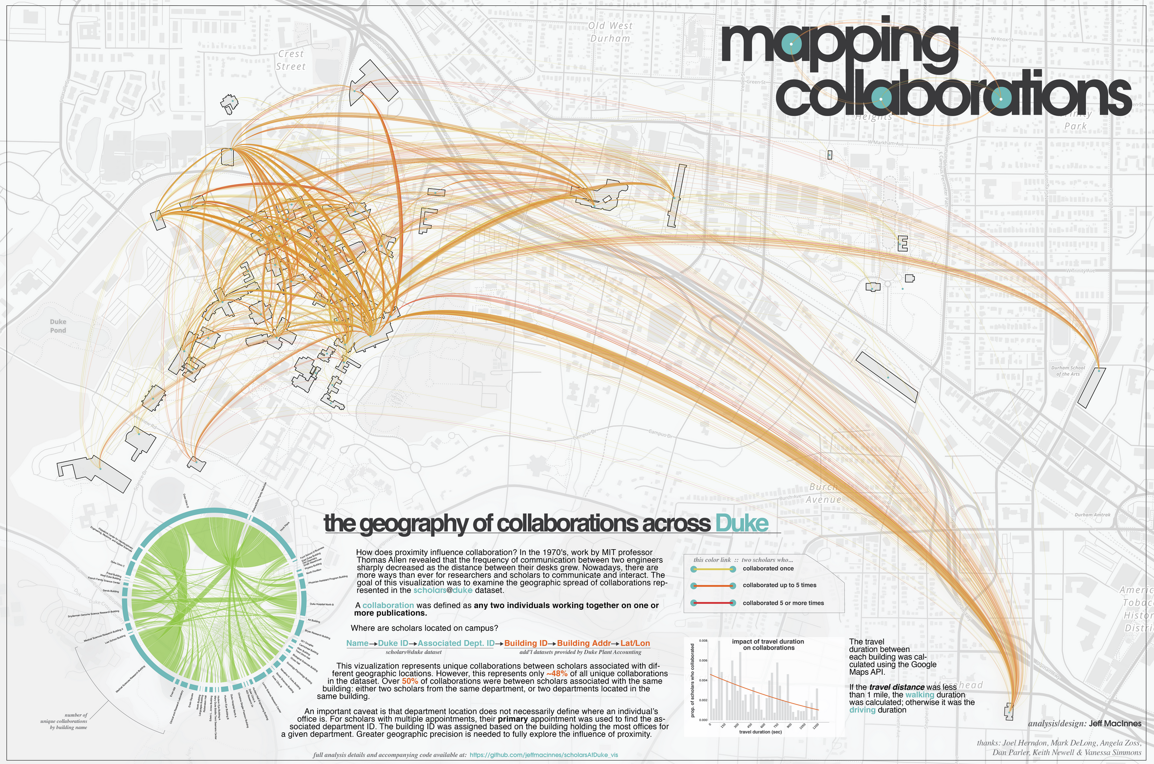
http://jeffmacinnes.com/visualization/collabMap/collabMap.php
Mapping the geographic spread of collaborations across Duke University
Jeff MacInnes, Duke Institute for Brain Sciences, Duke University
Notes:
Winner. cross-department collaborations and the interdisciplinary nature at Duke.

Slide 24
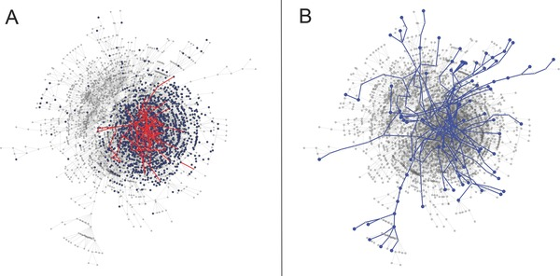
Vacca, R, McCarty, C, Conlon, M, and Nelson, D. Designing a CTSA‐Based Social Network Intervention to Foster Cross‐Disciplinary Team Science Clin Transl Sci. 2015 Aug; 8(4): 281–289. Published online 2015 Mar 19. doi: 10.1111/cts.12267
Using VIVO to Improve University Research
Co-author network of the University of Florida, 2013
A) shows new connections via induction. Health Center Faculty in blue. Pilot awardees and new connections in red
B) shows new connections via alteration

Slide 25
Visualization Issues
Research categories are an open issue
Push-button analytics v. question-driven custom analytics
Drill-down/hover, and extensive filtering is the expectation
VIVO is developing a plug-in architecture for visualization sharing

Slide 26
VIVO Data Issues
Semantic web approach is new for many universities
Locating, identifying, and disambiguating researchers and their works can be difficult
Shortcomings in the data may lead to unwillingness to make data available
Operational data may not be ready for display

Slide 27
Current VIVO Efforts
Internationalization – German, Spanish, Mandarin, French, English
New presentation layer – simplified tech, accessible
Combine – collect and disambiguate world and local data for VIVO
Search – use TPF for distributed semantic search
VIVO and Blockchain – using an open blockchain to store VIVO assertions
RIALTO – Stanford University research information
Decoupling architecture – plug-ins, swappable components
Research Graph – data augmentation
Research Management Information ontology for VIVO
CERIF to VIVO – convert CRIS data to VIVO
CD2H – expand person roles in scholarship
Metabolomics – domain coordinating center and repository
Ontology Improvement – clean-up, identifiers, languages, humanities

Slide 28
VIVO
Member
Organizations

Slide 29
VIVO Community
VIVO GitHub https://github.com/vivo-project
vivo-community@googlegroups.com
VIVO Conference http://vivoconference.org, Podgorica, Montenegro, September 4-6, 2019
mconlon@ufl.edu

