Slide 1
1. k-exact high-order finite volume linear advection 2. Forward propagation of uncertainties with stochastic Galerkin polynomial chaos methods
Slides available: doi.org/ct8n
Contact me: js102@zepler.net or @hertzsprrrung

Slide 2
k-exact high-order finite volume linear advection

Slide 3
k-exact high-order finite volume linear advection
Suitable for arbitrary polygonal meshes

Slide 4
k-exact high-order finite volume linear advection
Suitable for arbitrary polygonal meshes
Method-of-lines

Slide 5
k-exact high-order finite volume linear advection
Suitable for arbitrary polygonal meshes
Method-of-lines
Dimensionally unsplit

Slide 6
k-exact high-order finite volume linear advection
Suitable for arbitrary polygonal meshes
Method-of-lines
Dimensionally unsplit
Very cheap to compute (dot product of two vectors per face per time-stage)

Slide 7
k-exact high-order finite volume linear advection
Suitable for arbitrary polygonal meshes
Method-of-lines
Dimensionally unsplit
Very cheap to compute (dot product of two vectors per face per time-stage)
Non-monotonic, non shock-capturing

Slide 8
k-exact high-order finite volume linear advection
Suitable for arbitrary polygonal meshes
Method-of-lines
Dimensionally unsplit
Very cheap to compute (dot product of two vectors per face per time-stage)
Non-monotonic, non shock-capturing
(see p36/43 onwards in Toro’s course notes)

Slide 9
k-exact linear advection formulation

Slide 10
k-exact linear advection formulation
Finite volume method on a polygon
(Toro’s notes: equation 74, p38/43)

Slide 11
k-exact linear advection formulation
Finite volume method on a polygon
(Toro’s notes: equation 74, p38/43)
Polynomial reconstruction

Slide 12
k-exact linear advection formulation
Finite volume method on a polygon
(Toro’s notes: equation 74, p38/43)
Polynomial reconstruction
Face flux involves unknown coefficients a_{p}

Slide 13
k-exact linear advection formulation
Finite volume method on a polygon
(Toro’s notes: equation 74, p38/43)
Polynomial reconstruction
Face flux involves unknown coefficients a_{p}
Equate volume averages

Slide 14
k-exact linear advection formulation
Finite volume method on a polygon
(Toro’s notes: equation 74, p38/43)
Polynomial reconstruction
Face flux involves unknown coefficients a_{p}
Equate volume averages
Substitute polynomial reconstruction into LHS

Slide 15
k-exact linear advection formulation
Finite volume method on a polygon
(Toro’s notes: equation 74, p38/43)
Polynomial reconstruction
Face flux involves unknown coefficients a_{p}
Equate volume averages
Substitute polynomial reconstruction into LHS

Slide 16
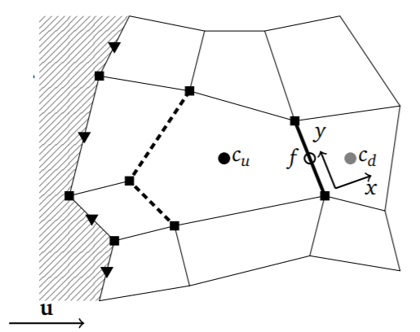
k-exact linear advection formulation
Upwind-biased spatial stencil
Use least squares to calculate unknown coefficients a_{p}

Slide 17
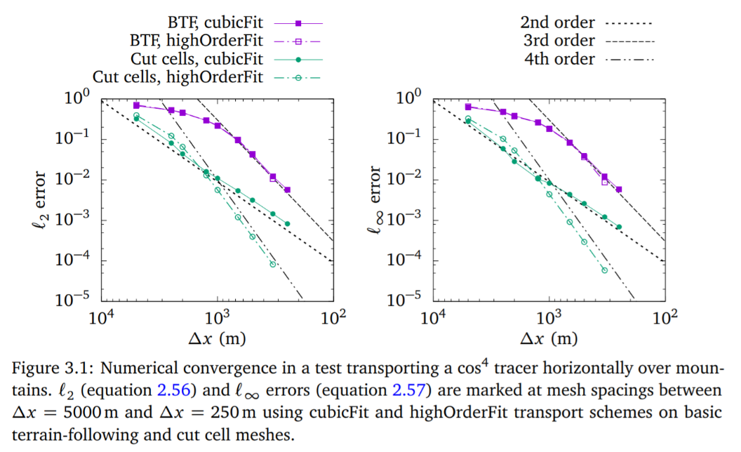
Order of convergence
datumedge.co.uk/publications/phd-thesis.pdf

Slide 18
Forward propagation of uncertainties with stochastic Galerkin polynomial chaos methods

Slide 19
Forward propagation of uncertainties with stochastic Galerkin polynomial chaos methods
Specify uncertainties on ICs, BCs, source terms (topography, friction)

Slide 20
Forward propagation of uncertainties with stochastic Galerkin polynomial chaos methods
Specify uncertainties on ICs, BCs, source terms (topography, friction)
Stochastic Galerkin method:
Deterministic (no random number generators)
Single integration to obtain a forecast with uncertainties
Faster than Monte Carlo

Slide 21
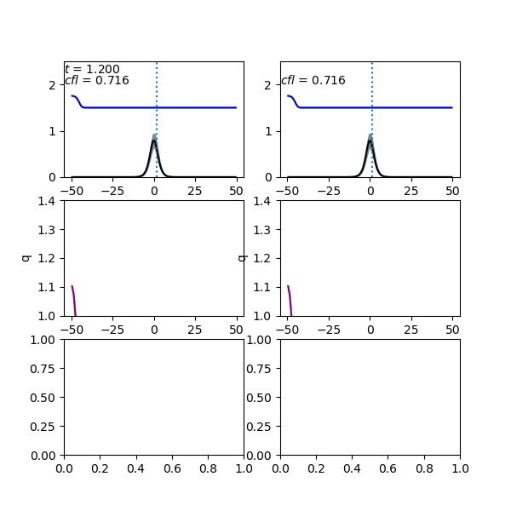
Flow over an uncertain hump
Monte Carlo
(“exact” solution)
Stochastic
Galerkin
Water elevation h
Topography b
Discharge q=hu
Monte Carlo kernel density estimate
Stochastic Galerkin probability density function
Slides available: doi.org/ct8n Contact me: js102@zepler.net or @hertzsprrrung

