Slide 1
Swedish student perceptions of achievement practices: The role of intelligence
Gavin T L Brown
The University of Auckland & Umeå Universitet, Sweden
Hanna Eklöf
Umeå Universitet, Sweden

Slide 2
Intelligence
The ability to flourish and succeed within the environment
Multi-componential & multiple models
Spearman
Performance across subjects is correlated ➔ ‘g’ general intelligence
Cattell
Sub-components depending on structure of process
Crystallised and structured capabilities ➔ ‘G_{c}’ crystallised intelligence ability to use learned knowledge and experience
Fluid or dynamic capabilities ➔ ‘G_{f}’ fluid intelligence: ability to solve new problems, use logic in new situations, and identify patterns

Slide 3
Achievement demands of school
Tests, Homework, Questions in class, failing-success,
Creates pressure on students from
Themselves
Teachers
Parents
Coping with demands is important
Self-regulation, self-efficacy contribute to greater success
Parental concerns rub off on students

Slide 4
Student attitudes matter
Positive views about assessment are associated with >test scores; Negative views about assessment <test scores
IQ contributes to >school achievement
Twin / triplet studies show that
IQ contributes to >coping, self-efficacy
Question
IQ lead to positive beliefs about achievement in normal populations of parents and students?

Slide 5
Conceptual model
IQ as predictor of beliefs (Model 1)
IQ as dependent on beliefs (Model 2)

Slide 6
Secondary Data: Swedish Evaluation Through Follow-up (ETF)
large cohort-sequential longitudinal database,
9 cohorts with individuals born between 1948 and 1998.
Each cohort about 9000 pupils, sampled to be nationally representative.
Cognitive tests and questionnaire with items about their experience of selected aspects of schooling.
parents of each student completed a questionnaire.
Students sampled through a multi-stage sampling design
Municipalities, schools, classes
http://ips.gu.se/english/research/research_projects/ETF

Slide 7
1998 birth cohort
Cohort 9 in Grade 6 survey = 2011 testing
N=9671 children, who were nominally 13 years old in early 2011 during the 2nd semester of their 6th year of schooling.
96.5% born in calendar year 1998,
born in 1997 (n=84) and 1999 (n=81).
Cases with >10% missing questionnaire responses deleted, those without matching parent data deleted
Effective sample n=4749
Sex: 51.8% boys, 48.2% girls

Slide 8
School clustering
School was available only for n=2918 (61% of retained sample)
Schools with ≥20 students n=1056; just 11%
Thus multilevel problematically non-generalizable?
ICCs ranged from 0.02 to 0.175 (M=0.05, SD=0.03)
only 1 value>0.10 (i.e., QS611-How often do you do tests?).
This item should show a significant school variance component since the frequency of testing is determined at the school level
The larger message is that the school contribution to variance in the model was relatively trivial
So a one-level model is defensible.

Slide 9
Modeling
CFA for student, parent, and IQ item sets
SEM for relationship of student-parent-IQ factors
Missing data with EM imputation
MLR estimation
Fit imputed not reject if: RMSEA <0.08; SRMR ≲ 0.06; CFI & gamma hat >0.90; χ2/df ratio has p > .05
MPlus used
Models compared for selection
ΔAIC>10➔smaller value preferred

Slide 10
A comment on missing values
Rubin & Little 2002
Imputation valid if missing is small (<5%)
Imputation techniques work if missing is large (<50%)
EM and MI maximise the input values of M, SD, matrices (covariance/correlation)
But meaningful in terms of the truth?
We deleted 4251 because >10% missing but FIML with 8650 found results almost identical, so proof that imputation maximises start values…which should you use if they are the same?

Slide 11
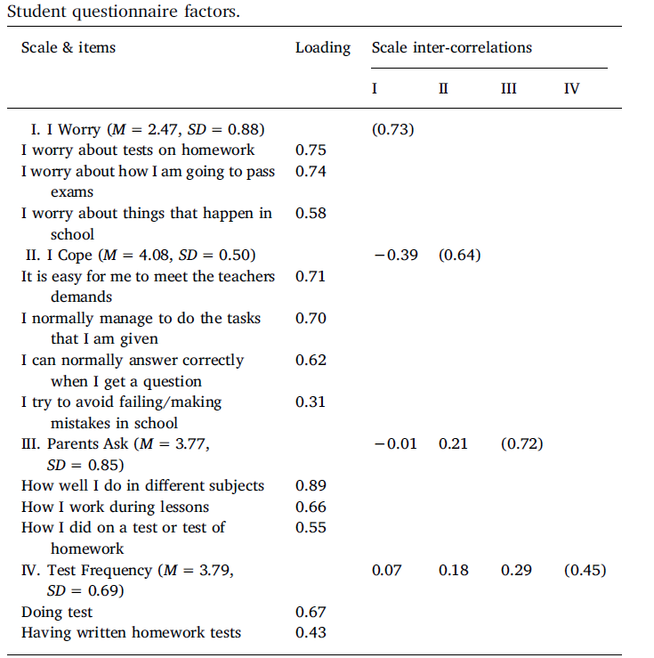
Student result
Fit
χ2=312.24; df=48; χ2/df=6.05, p=.01; CFI=0.97; gamma hat=0.99; RMSEA=0.03; SRMR=0.03
Students
strongly endorsed I cope with demands
moderately agreed that parents enquired about performance
reasonably high frequency of testing and homework
Overall, rejected being worried about tests, exams, and school happenings

Slide 12
Parent result
Fit: χ2=197.53; df=32; χ2/df=6.17, p=.01; CFI=0.98; gamma hat=0.99; RMSEA=0.03; SRMR=0.03
Parents want grades, but with more grade points than the then current 3-point scale.
Moderate level of demand from homework, pace of study, and responsibility.
Generally rejected the idea that school work and testing was too much pressure on their child.

Slide 13
IQ Result
IQ model
Crystallised: antonyms & synonyms
Fluid: metal folding & number series
Fit:
χ2=7.23; df=1; χ2/df=7.23, p < .01; CFI=0.99; gamma hat=0.99; RMSEA=0.04; SRMR=0.01
NB: synonyms & antonyms correlated r=.48

Slide 14
SEM results
Fit:
χ2=1815.43; df=278; χ2/df=6.53, p=.01; CFI=0.95; gamma hat=0.97; RMSEA=0.034; SRMR=0.041; AIC=334,565.416
ΔAIC=317.516, this model smaller so preferred
Fit:
χ2=2113.77; df=284; χ2/df=7.44, p< .01; CFI=0.94; gamma hat=0.97; RMSEA=0.037; SRMR=0.047; AIC=334,882.932
Model 1: IQ predictor
Model 2: IQ dependent

Slide 15
SEM result
Greater coping with school and reduced parental concern present among intellectually more able children
Parents beliefs do influence student coping
Cognitive tests are moderately strong predictors of student beliefs about achievement

Slide 16
Significance
Large, representative sample of the population with little (if any) shared genetic environments.
Thus is generalizable to the full population in schooling.
Unlike twin/triplet studies
Increasing IQ will help students cope
Can we stimulate during the neuro-plastic phases of schooling to greater intelligence? Surely yes!

Slide 17
Further research
Need to prove that changing IQ has the impact we want on self-regulation
IQ➔Self-regulating Beliefs➔Academic Achievement
Longitudinal or experimental studies
ETF
Add more tests for G_{f} and G_{c}, so correlated residuals not required
Add school achievement measures
Add attitudes about the IQ tests themselves
Follow cohort to university entrance for final year grades or SweSAT scores

Slide 18
Further reading
Brown, G. T. L., & Eklöf, H. (2018). Swedish student perceptions of achievement practices: The role of intelligence. Intelligence, 69, 94-103. doi:10.1016/j.intell.2018.05.006
Contact
Gavin Brown: gt.brown@auckland.ac.nz
Hanna Eklöf: hanna.eklof@umu.se

