Slide 1
The current crisis of psychology research in the Philippines:
Reproducibility or producibility?
James Montilla Doble, Christie P. Sio, Jose Antonio R. Clemente UNIVERSITY OF THE PHILIPPINES DILIMAN
http://osf.io/ybgsu
#PAP2018 #ReproducibilityPH
cmdoble@up.edu.ph

Slide 2
How do you feel about the current state of psychology?
Notes:
DEFINITIONS

Slide 3
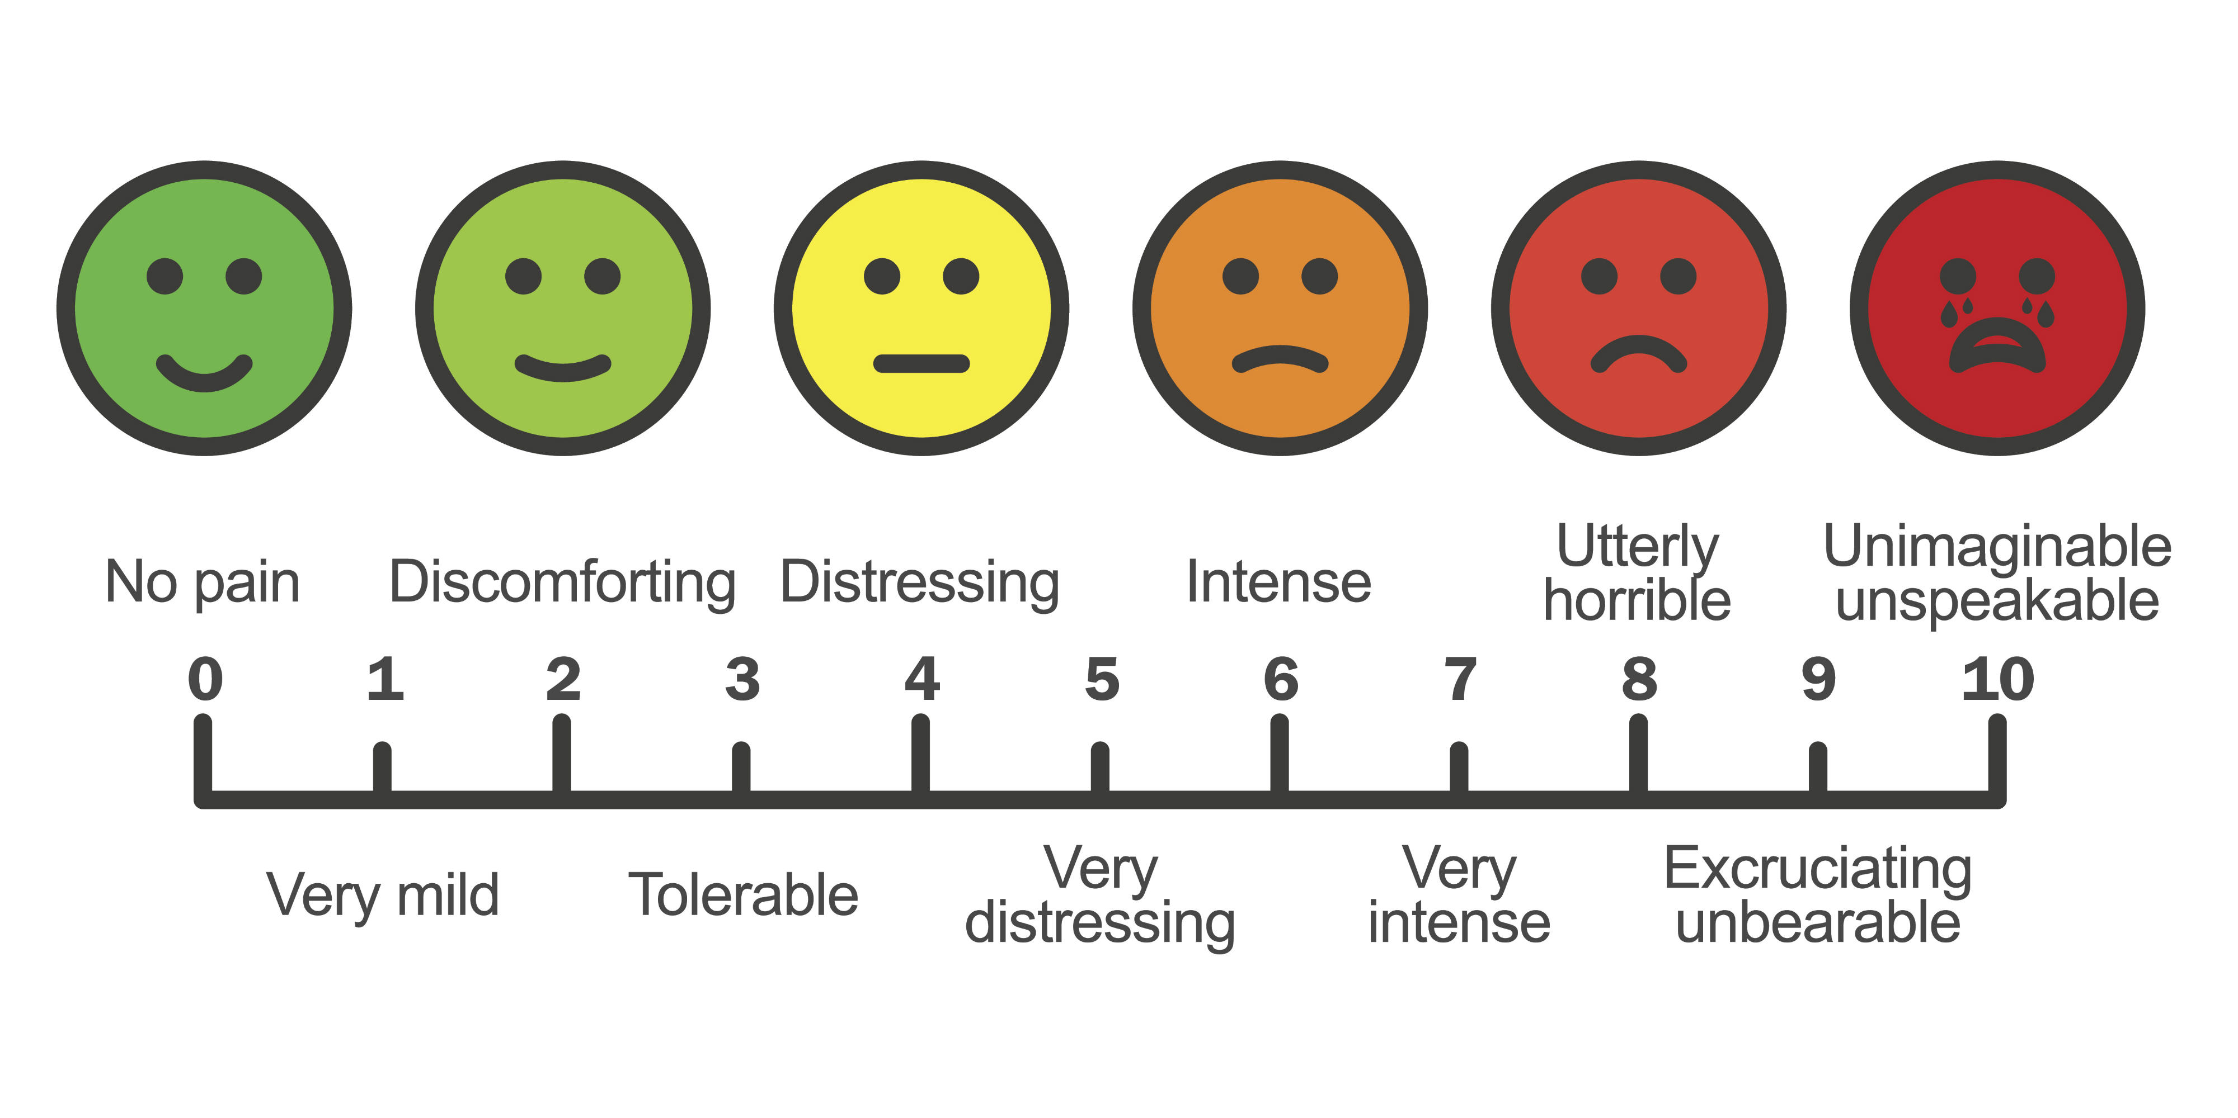
How do you feel about the current state of psychology?
Notes:
DEFINITIONS

Slide 4
As psychologists, what is your favorite psychology concept?
Notes:
DEFINITIONS

Slide 5
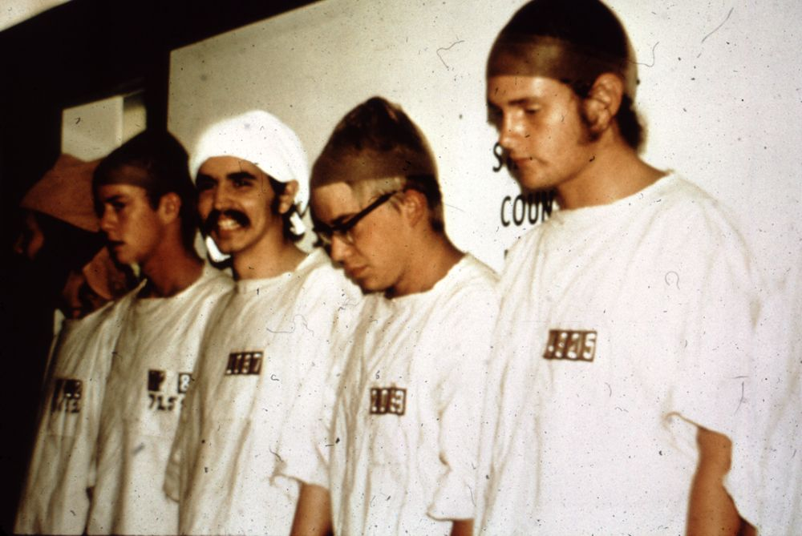
Stanford Prison Experiment (Haney et al., 1973)
The social roles that people enact can shape their attitudes and behavior.

Slide 6
Session outline
Consuming research The reproducibility crisis in psychology
Producing research The current crisis of psychology research in the Philippines
Teaching research Solutions to the (re)producibility crisis
Open forum
* Questions will be entertained during the open forum, but if you have urgent questions, they can be entertained in between segments.

Slide 7
The reproducibility crisis in psychology

Slide 8
Reproducibility
The ability of a researcher to repeat their own work or the work of another researcher (replication)

Slide 9
The state of psychology research
in other countries
Reproducibility crisis: One-third of psychology research is not replicable (Open Science Collaboration, 2015)
Publish-or-perish culture, publication bias (Baker, 2016. Bakker et al., 2012; Fanelli, 2010, van Dalen et al., 2012)
Questionable research practices, researcher degrees of freedom (John et al., 2012; Simmons et al., 2011)
Statistical inadequacies and misinterpretations (Haller & Kraus, 2012; Hoekstra et al., 2014; Maxwell, 2004)

Slide 10
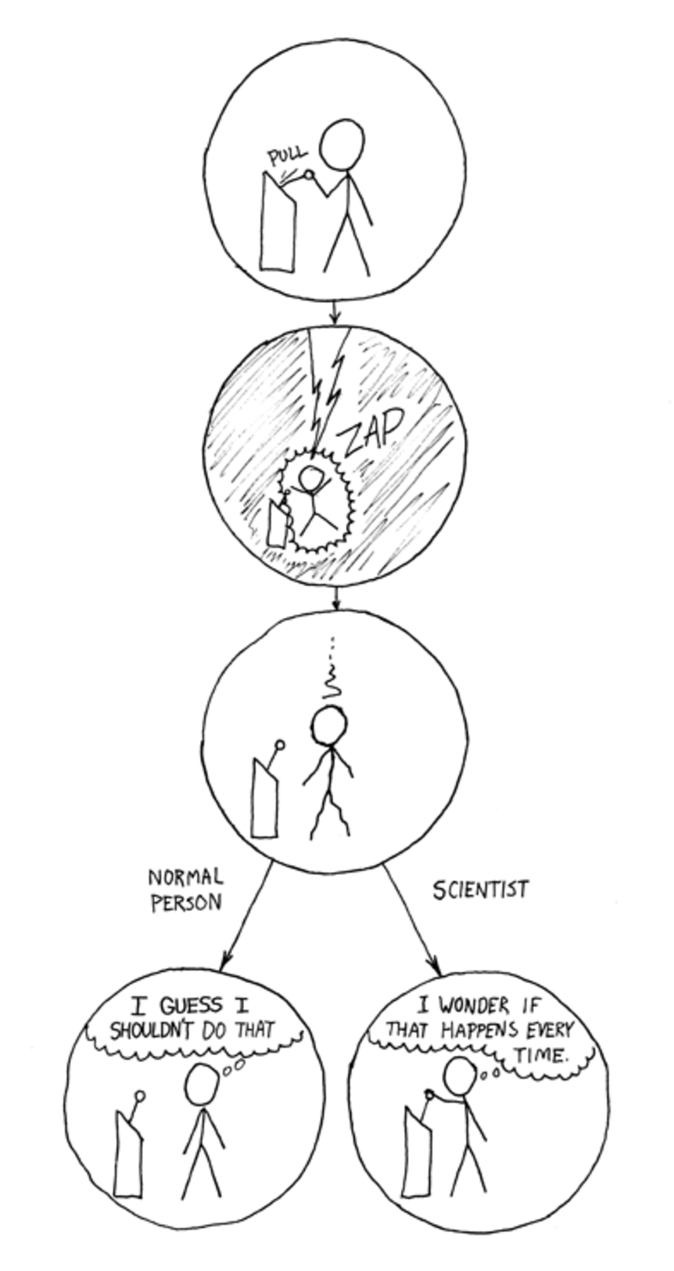

Slide 11
Generate and specify hypothesis
Design study
Conduct study and collect data
Analyze data and test hypothesis
Publish and/or conduct next experiment
Integrate results
The scientific method
(Munafo et al., 2017)

Slide 12
Generate and specify hypothesis
Design study
Conduct study and collect data
Analyze data and test hypothesis
Publish and/or conduct next experiment
Integrate results
Bias
Only publishing studies with “significant” results (publication bias)
Small sample sizes
Changing hypotheses to match results (HARK-ing)
Threats to the scientific method
Poor quality control
Collecting and analyzing data until results are “significant”
(Munafo et al., 2017)
Notes:
Unpack
Choose terms

Slide 13
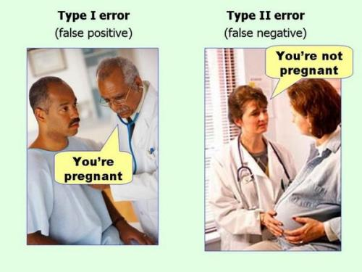
(Simmons et al., 2011)

Slide 14
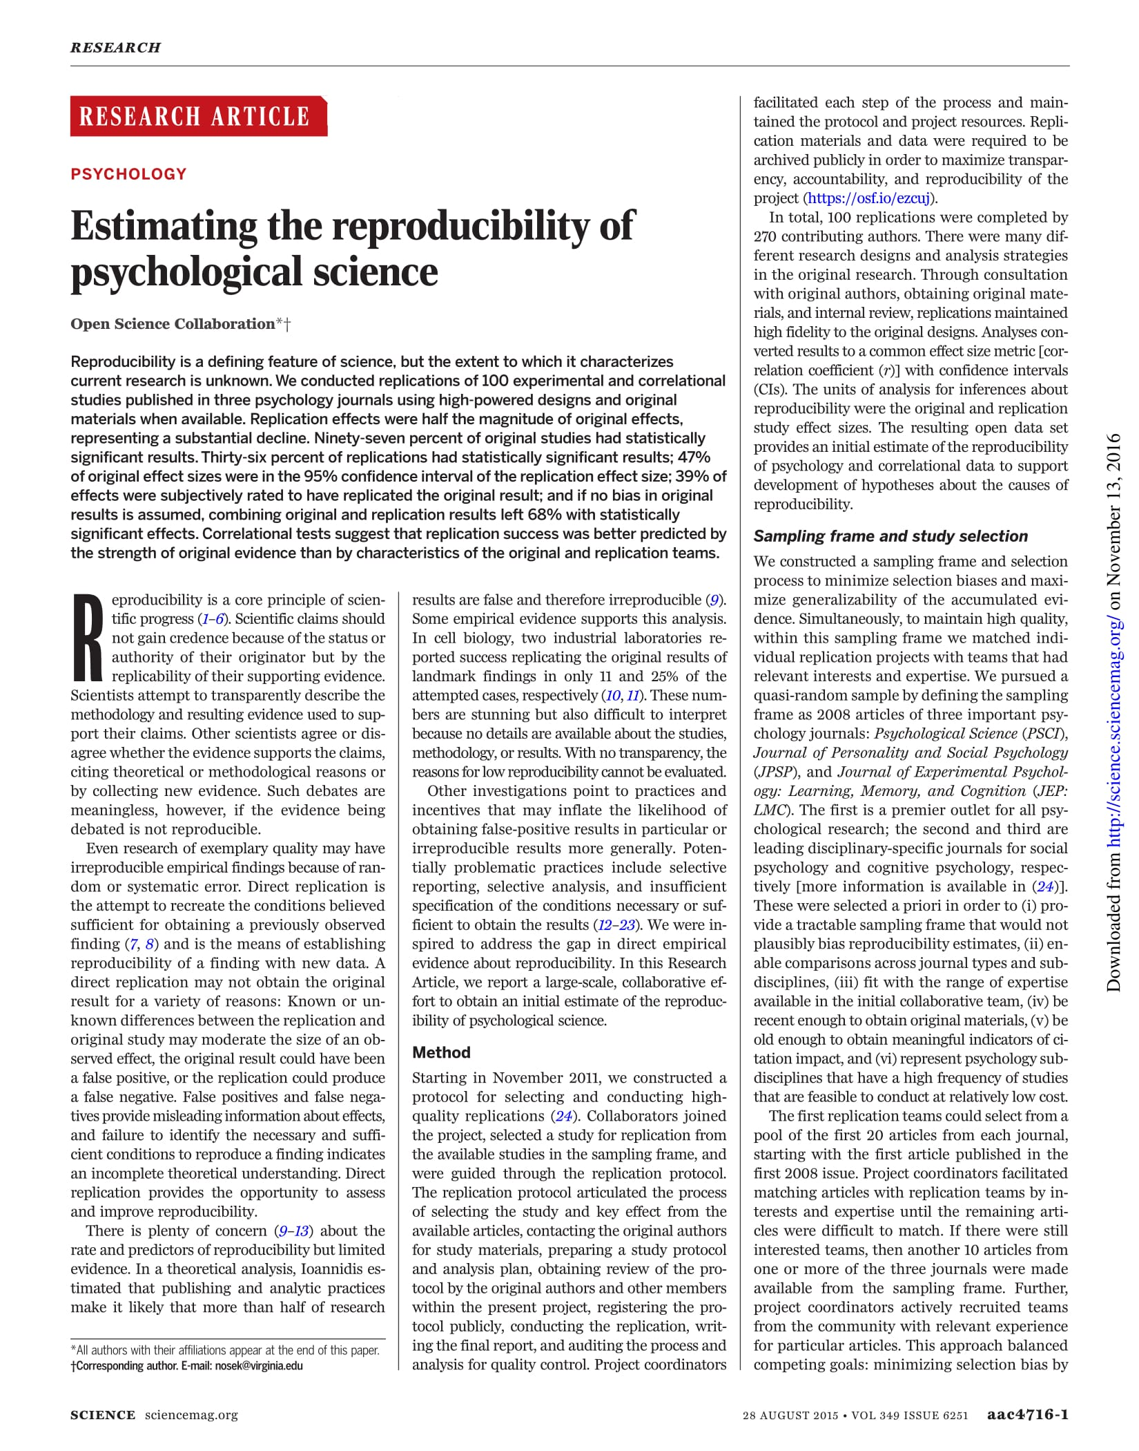
(OSC, 2015)

Slide 15
Notes:
Ask audience

Slide 16
Notes:
Ask audience

Slide 17
What happened? (Baker, 2016)
Publish-or-perish culture
Only reporting or publishing studies with “significant” results (file drawer effect, publication bias)
Poor research design
Insufficient oversight (mentoring, peer review)
Unavailable data and materials used for data collection and analysis (closed science)
Fraud
Notes:
Narrow down

Slide 18
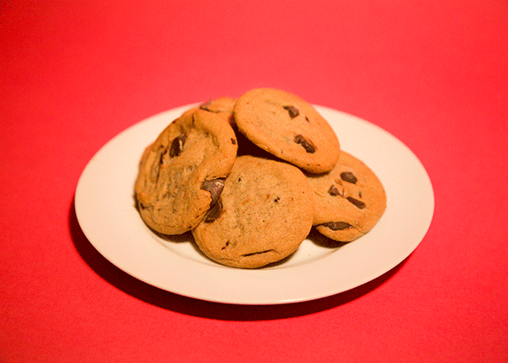
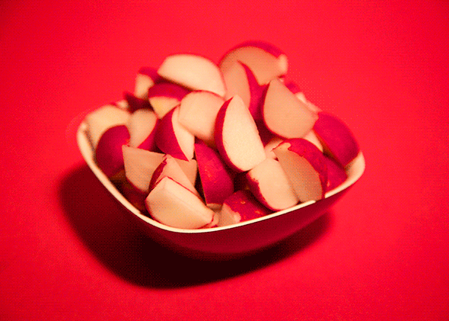
Ego depletion (Baumeister et al., 1998)
Self-control is a limited resource.
Notes:
Add study + citation

Slide 19
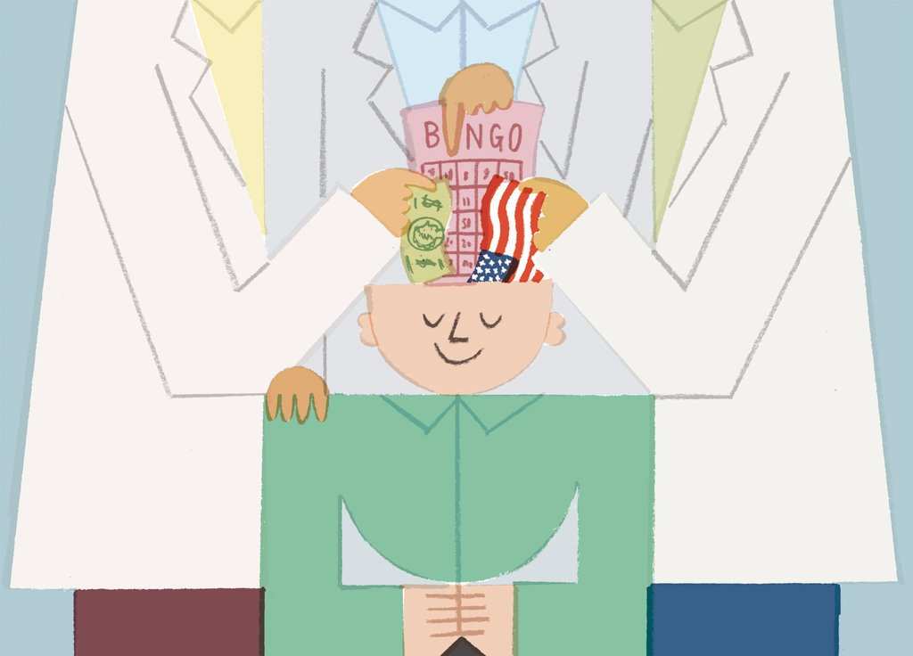
Social priming (Bargh et al., 1996; Dijksterhuis & van Knippenberg, 1998)
People can be primed to think, to feel, or to act a certain way.

Slide 20
Facial feedback hypothesis (Strack et al., 1988)
Facial expressions can cause people to feel the emotion being expressed
and to feel it more intensely.

Slide 21
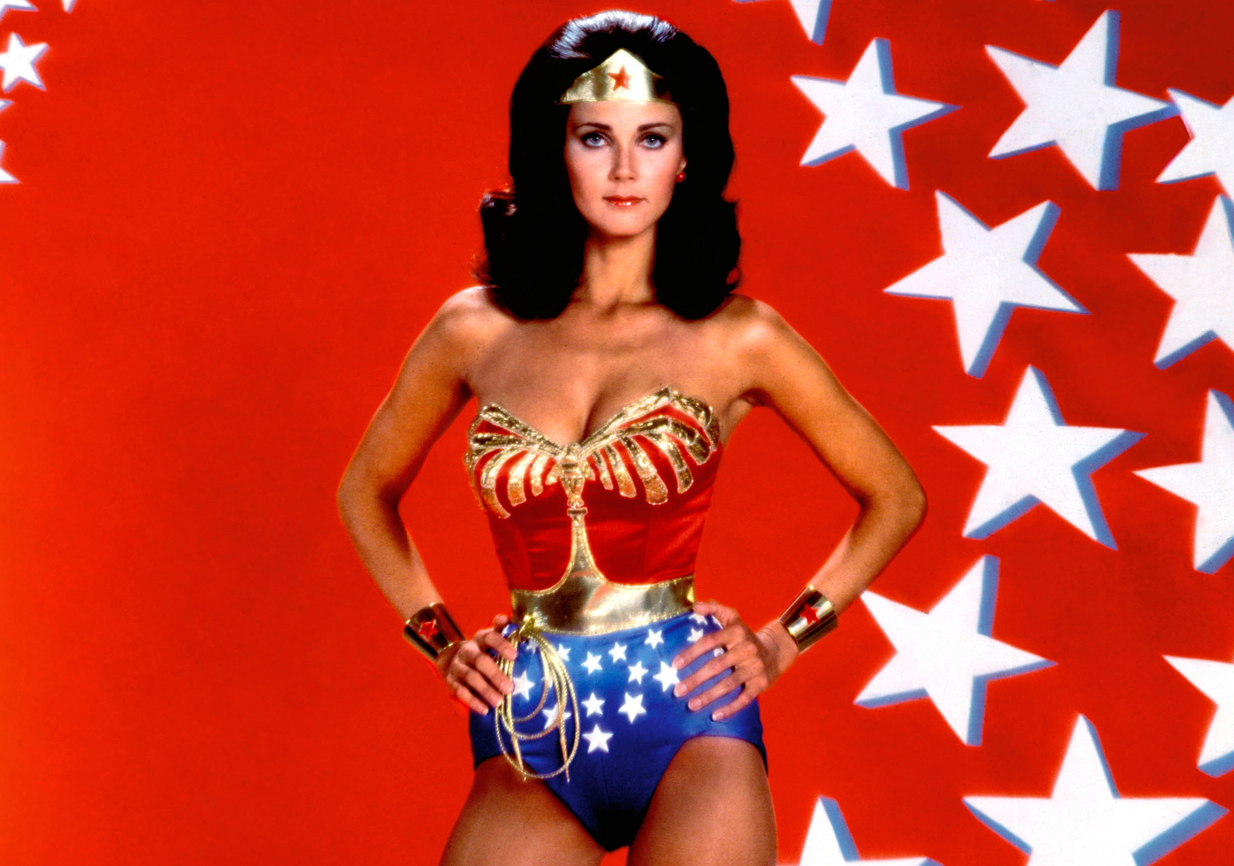
Power posing (Carney et al., 2010; Amy Cuddy TED Talk)
Holding a “power pose” for a few seconds can cause people to feel more powerful.

Slide 22
Published in 2005 at PLoS Medicine

Slide 23
Published in 2016 at Slate

Slide 24
Published in 2016 at The Atlantic

Slide 25
Generate and specify hypothesis
Design study
Conduct study and collect data
Analyze data and test hypothesis
Publish and/or conduct next experiment
Integrate results
Bias
Only publishing studies with “significant” results (publication bias)
Small sample sizes
Changing hypotheses to match results (HARK-ing)
Threats to the scientific method
Poor quality control
Collecting and analyzing data until results are “significant”
(Munafo et al., 2017)

Slide 26
Blinding, registering the study/analysis before data collection (pre-registration)
Generate and specify hypothesis
Design study
Conduct study and collect data
Analyze data and test hypothesis
Publish and/or conduct next experiment
Integrate results
Pre-prints, two-stage peer review (Registered reports)
Training and continuing education
Pre-registration
Initiatives / possible solutions for reproducible science
Pre-registration, reporting and protocol checklists
Team and open science
Pre-registration
(Munafo et al., 2017)
Notes:
Link

Slide 27
Published in 2017 at The Psychologist (British Psychological Society)

Slide 28
Published in 2016 at Vox

Slide 29
Published in 2016 at Five Thirty Eight

Slide 30
The current crisis of psychology research in the Philippines:
Reproducibility or producibility?

Slide 31
Producibility
The ability of a researcher to conduct their own research
Reproducibility
The ability of a researcher to repeat their own work or the work of another researcher (replication)

Slide 32
The state of psychology research
in other countries
Reproducibility crisis: One-third of psychology research is not replicable (Open Science Collaboration, 2015)
Publish-or-perish culture, publication bias (Baker, 2016. Bakker et al., 2012; Fanelli, 2010, van Dalen et al., 2012)
Questionable research practices, researcher degrees of freedom (John et al., 2012; Simmons et al., 2011)
Statistical inadequacies and misinterpretations (Haller & Kraus, 2012; Hoekstra et al., 2014; Maxwell, 2004)

Slide 33
The state of psychology research
in the Philippines
Most psychology research publications are descriptive (Bernardo, 1997)
“Absence of a research culture”
Lack of resources
Attitudes towards research
Extends to Philippine higher education institutions (Salazar-Clemeña & Almonte-Acosta, 2007)

Slide 34
Research questions
Is there a reproducibility crisis in psychology research in the Philippines?
What are the issues in conducting psychological research that psychological researchers find most pressing?
What are the strengths and weaknesses in psychological research methods curricula?
What are possible solutions that ensure reproducibility in local psychological research?

Slide 35
Methodology
Survey questionnaire
Pen-and-paper
Online
What are the most pressing issues in conducting psychological research?
What are the most pressing issues in conducting reproducible psychological research?

Slide 36
Participants
Psychologists and psychology graduate students
ADMU, DLSU, UP, UST
Other universities with graduate programs in psychology
Notes:
Demog

Slide 37
Questionable research conduct
Low research competence and efficacy
Negative attitudes towards research
Lack of resources
Low research producibility
Misconceptions about science and research

Slide 38
Funding
Time
Information
Lack of resources
Measures (local and foreign)
Literature (local and foreign)
Manpower

Slide 39
Hypothesis
What topics to study
How to publish research
Publication
Design
Which methods, statistical tests to use
Low research competence and efficacy
How to write up statistical results
Data reporting
Data collection
How to get participants
How to interpret statistical test results
Data analysis

Slide 40
Hypothesis
Bias, HARK-ing
Publication
Design
Multiple measures
Publication bias
Questionable research conduct
Only reporting “significant” results, HARK-ing
Data reporting
Data collection
Collecting data until results are “significant”
Multiple data analysis methods, p-hacking
Data analysis

Slide 41
Research = statistics
Preference for qualitative designs over quantitative
“Students [see research as irrelevant] to their future career, [which] is usually not in research”
“Research is not prioritized”
Negative attitudes towards research
“Exclusivity … of research”
“Perception of lack of capacity among researchers”
Research as irrelevant or unimportant
Research as exclusive and inaccessible
“Research is [only after] publication, affecting its quality”
Research as a means to an end

Slide 42
“Trivial”
“Limits the results of the study [and] new information from being generated”
“Not as useful”
Reproducibility as inessential to science
Misconceptions about research and science
“How can [replications] contribute to the advancement of knowledge?”
“[Less] important than original research”
“Waste of time and effort”
Research, practice, and science as separable
Research should be innovative, novel; replications as unoriginal
“Limited application”
“Utility”

Slide 43
Questionable research conduct
Low research competence and efficacy
Negative attitudes towards research
Lack of resources
Low research producibility
Misconceptions about science and research

Slide 44
Improve overall producibility to stimulate the growth of psychology research in the Philippines

Slide 45
How should we consume, produce, and teach research?

Slide 46
How to be better consumers of research (Chopik et al., 2018)
Is the study pre-registered? (cos.io/prereg)
Take note of sample sizes, p-values, and effect sizes
Has the effect demonstrated in the study been replicated? (curatescience.org)

Slide 47
How to be better producers of research (Baker, 2016)
More robust design
Better understanding and teaching of statistics
Better mentoring
More within- and external-lab validation
Incentives for better practice and formal reproduction
Journals enforcing standards (cos.io/our-services/top-guidelines)

Slide 48
How to be better teachers of research
Increase psychology students’ research competence and efficacy
Research design and methods curricula
Mentoring opportunities
Continuing education
Instill and enforce
Ethical research conduct
Positive attitudes towards research
Better understanding of research and science

Slide 49
Suggestions to improve overall producibility
Share pre-prints
Communicate research findings
Collaborate with researchers
Engage in other open science practices

Slide 50
Questionable research conduct
Low research competence and efficacy
Negative attitudes towards research
Lack of resources
Low research producibility
Misconceptions about science and research

Slide 51
Questionable research conduct
Ethical research conduct
Low research competence and efficacy
High research competence and efficacy
Negative attitudes towards research
Positive attitudes towards research
Lack of resources
Open science practices
Misconceptions about science and research
Low research producibility
Better understanding of research and science
High research producibility
Download: http://osf.io/ybgsu

Slide 52
The current crisis of psychology research in the Philippines:
Reproducibility or producibility?
James Montilla Doble, Christie P. Sio, Jose Antonio R. Clemente UNIVERSITY OF THE PHILIPPINES DILIMAN
http://osf.io/ybgsu
#PAP2018 #ReproducibilityPH
cmdoble@up.edu.ph

