Slide 1
Moodle-Aspire Integration @ Monash University
Rachelle Anne Orodio Applications Administrator
18th February 2015

Slide 2
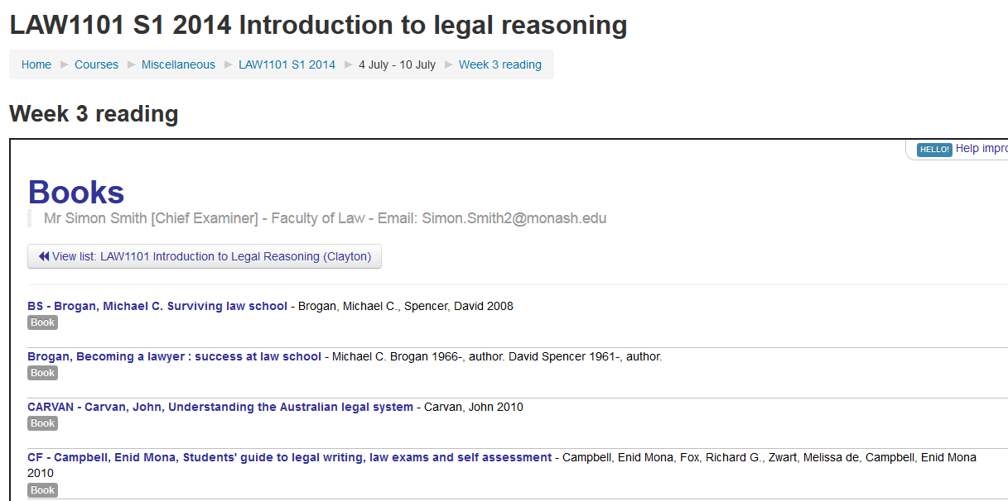
What kind of Integration ?
Highlight Weekly Readings
Automatic matching of Unit codes
Search Reading List directly within Moodle
Moodle-Aspire Integration
18th February 2015

Slide 3
Why Monash is doing this work?
Current culture at Monash is that the Library staff create reading lists sent to them by Academic staff.
We have been thinking of giving Academic staff their own role in creating their own list.
Setting up this functionality promotes the reading lists to Academic staff.
This will be the 1st LTI Integration in our Moodle environment.
The Education Faculty and Monash College will pilot this integration for selected units.

Slide 4
2 Types of Moodle integration
1. Activity Resource Plugin (https://github.com/talis/aspire-moodle-integration/releases/tag/v0.7)
Netspot to install code.
Takes longer to set-up, as Netspot needs to review the plugin code (4-6wks) before it is installed. This process can incur costs too.
If the code is already in Netspot’s reviewed plugins then it can be quicker.
Broadminster University Example: (https://www.youtube.com/watch?v=x0KD-o5UY-4)
2. Moodle config-only approach (http://knowledge.talis.com/articles/tarl-lti/)
Enable LTI using the shared secret, no installation required
Easy to set-up and no cost (except staff time)

Slide 5
What to consider as part of the work
Who will do the initial configuration/testing (Proof of concept)?
Naming conventions of your unit codes vs reading list unit codes
Who will add the activity/resource links? Academics or Faculty admins
Who manages Moodle and what services are enabled
Is LTI available?
How easy is it to install plugins?
Operational support
LTI/Moodle issues handled by Moodle Application Admins
Reading List handled by Library
Test instructions for Moodle Application admins during restarts or upgrades
Allow Talis access to a test environment for easy troubleshooting

Slide 6
DEMO
http://ias-lv-app-05.ocio.monash.edu/library/login/index.php
Moodle-Aspire Integration
18th February 2015

Slide 7
What would you do differently
Better scoping
Who will be involved in the pilot test
Decide on what approach to use, identify the pros and cons
Better planning and project timeline projections

