Slide 1
ANZREG Seminar
Rachelle Anne Orodio
Monash University
7th February 2014

Slide 2
Using the:
loan information
web services
Alma API

Slide 3
Loans information in Alma
Integration of Alma with our portal and mobile apps

Slide 4
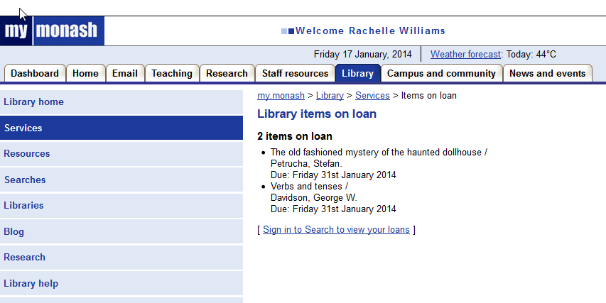
Loans info via Monash Portal
Something to take note of:
API call takes about 4 seconds to generate results
One call has a maximum of 20 items per API call
If a user has borrowed 60 items that means 3 API calls at approximately 12 seconds in total.

Slide 5
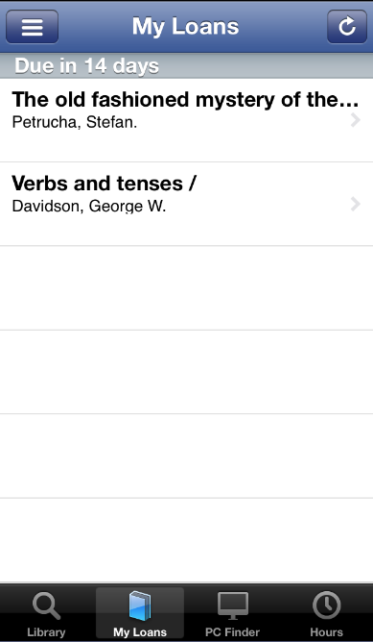
Loans info via Monash mobile app
Resources that are loaned
Earliest an item is due

Slide 6
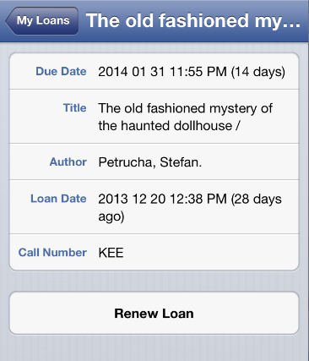
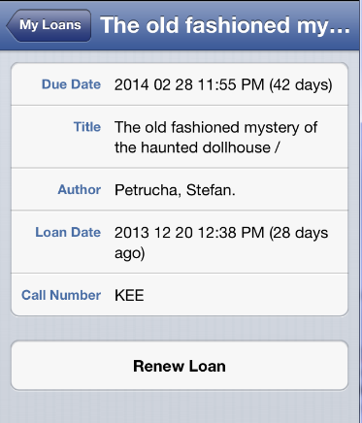
Renewing an item
Loan Renewed

Slide 7
What you need to know
SOAP/XML messages
Used to pass input parameters and read results
WSDL (Web Services Description Language) definition
XML based interface describing the functionality offered. Shows what parameters are expected and returned.
https://ap01.alma.exlibrisgroup.com/almaws/LoanWebServices?wsdl
XSDs input/output of the operations (Refer to Alma Developers Page)
XML Schema Definitions available in the Help file
Roles & Privileges
API User Information Read & Write Roles
Authentication:
Username: AlmaSDK-[username]-institutionCode-[inst_code]
ex. AlmaSDK-userone-intitutionCode-MYINST
END

Slide 8
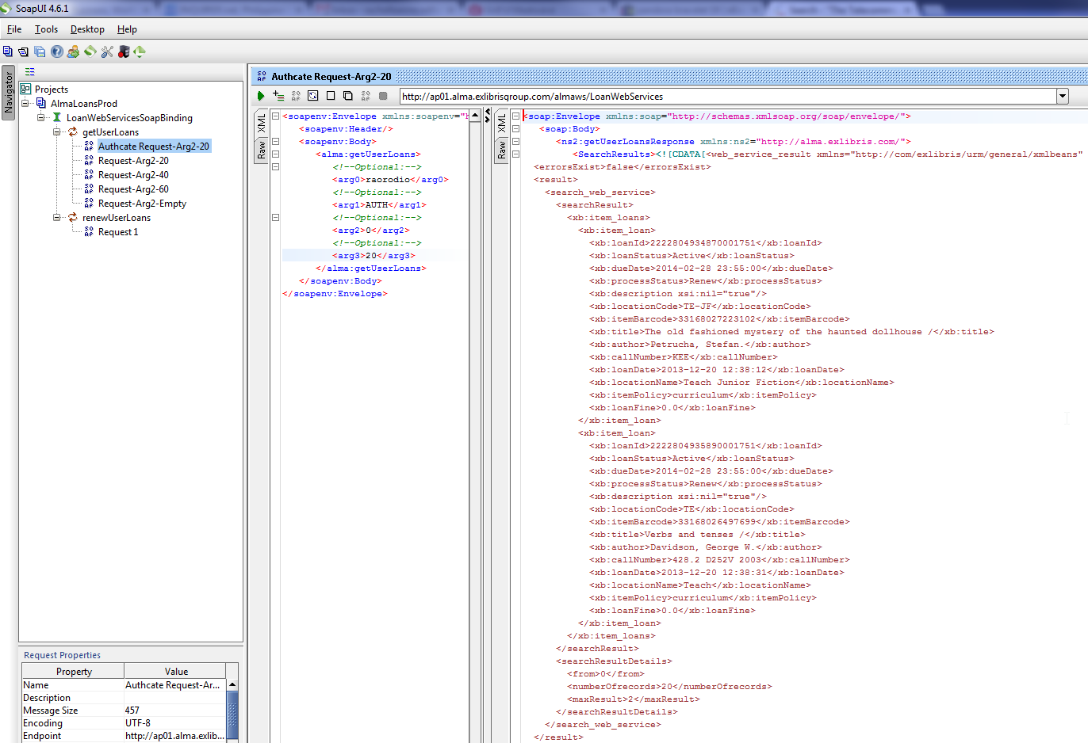
SOAP/XML example
BACK

Slide 9
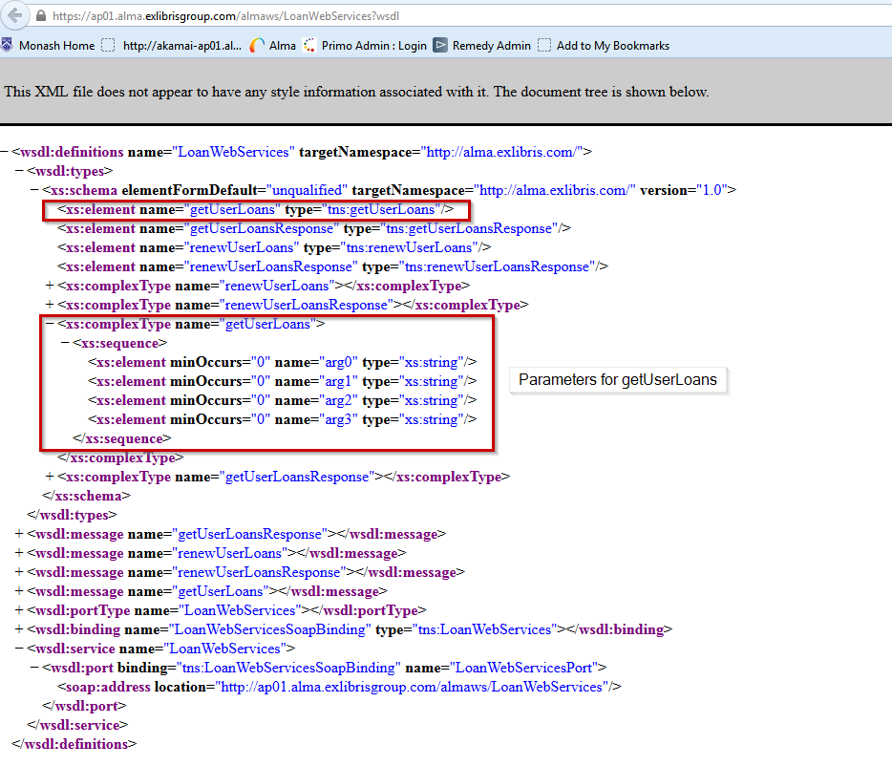
WSDL Example
BACK

Slide 10
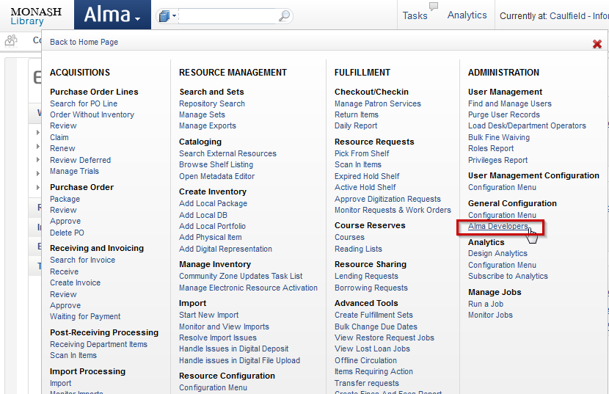
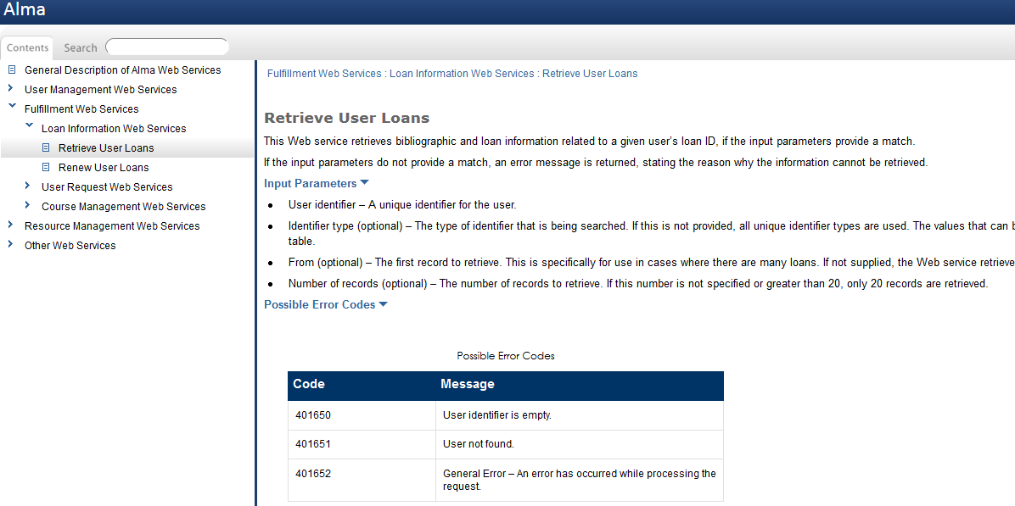
Alma Developers Page
BACK

Slide 11
Thank you! Email: Rachelle.Orodio@monash.edu

