Slide 1
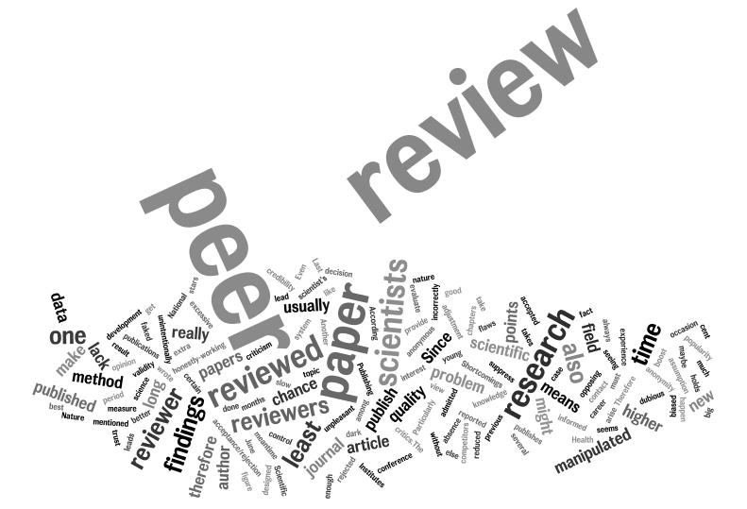
Christopher Jackson¹
Ian Kane²
¹
²

Slide 2
http://data-mining.philippe-fournier-viger.com/wp-content/uploads/2014/01/reviewer.png

Slide 3
Is Peer Review Important?
Yes. Very.
Peer review is one of the most critical means by which journal editors and scientists safeguard the integrity of the scientific literature
“Peer-review is a necessary component of quality control in science, but is no guarantee of quality” (Steven Novella)
It’s an important skill; e.g. it can help improve your research approach (e.g. develop skills allowing you to be critical, but constructive) and paper writing skills
It is a critical service to the scientific community
It is a privilege to be asked to peer-review!
https://cdn.vox-cdn.com/thumbor/OjS5NNIM4-M7dafOj1fRFPo7HiI=/0x0:4000x2800/1200x800/filters:focal(1680x1080:2320x1720)/cdn.vox-cdn.com/uploads/chorus_image/image/52044073/shutterstock_207481936.0.jpeg

Slide 4
Peer review is easy compared to writing, right?
Wrong!
Learning how to rigorously, constructively and efficiently review scientific literature is difficult
Writing a good review requires:
(i) relevant knowledge in the topic covered in the paper;
(ii) a solid understanding of research methods typically deployed to address the matter at hand;
(iii) a critical eye;
(iv) the ability to give fair and constructive feedback, whilst being sensitive to the feelings of authors and the requirements of the Editor/journal
http://www.academicevolution.com/peer-review/

Slide 5
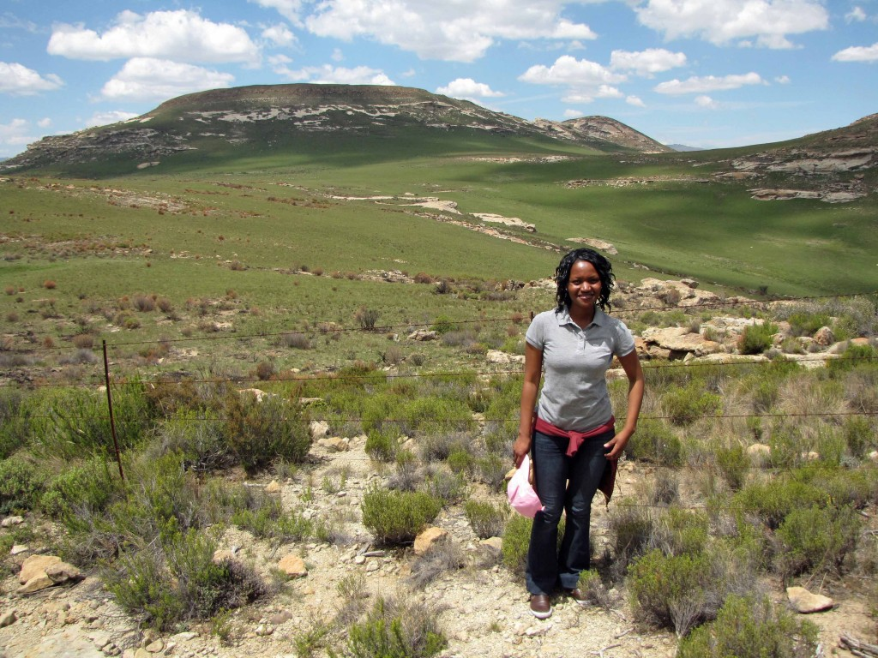
When and How Do I Get Into Peer-Review?
As you develop your expertise and profile; you do not need a PhD to undertake peer-review!
Ask supervisors to recommend you for peer-review duties
Ask Editors to consider you for peer-review duties
Engage on social media
Ensure you have a completed ORCID profile

Slide 6
Should I Peer Review?
Do you feel sufficiently knowledgeable about the topic to offer an intelligent assessment of the quality, value, novelty, etc of the paper?
Do you find the topic how interesting?
Is there a conflict of interest that may inhibit an unbiased (+ve/-ve) assessment?
Do I have the time?
Do I require and can I get some support and advice from, for example, supervisors, more experience co-workers?
https://ih0.redbubble.net/image.217113223.9179/flat,800x800,075,f.jpg

Slide 7
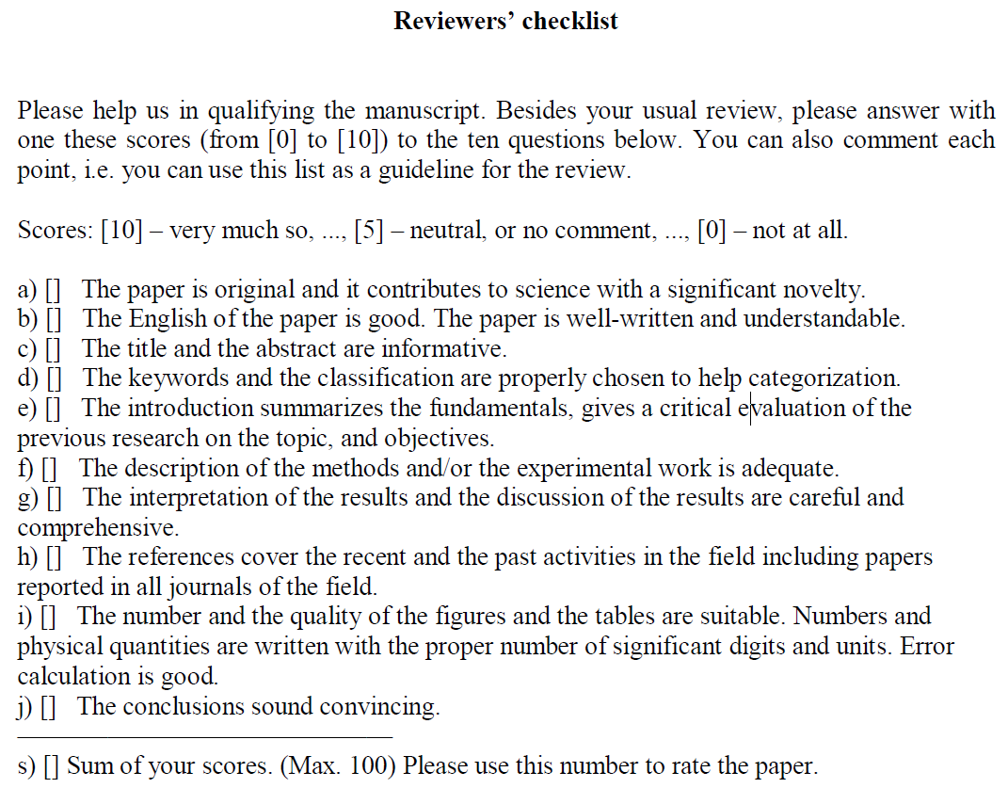
https://www.google.co.uk/url?sa=t&rct=j&q=&esrc=s&source=web&cd=1&ved=0ahUKEwiL8c6Fh4fYAhWDshQKHQDrAnIQFggpMAA&url=http%3A%2F%2Fwww.springer.com%2Fcda%2Fcontent%2Fdocument%2Fcda_downloaddocument%2FReviewersChecklist_JRNC.pdf%3FSGWID%3D0-0-45-1448042-p35708232&usg=AOvVaw20lM-YGGbg73HYIDN1fyKO
I’ve Said “Yes!”. Now What…?
Peer-review approaches come in many shapes and sizes;
Logistics
softcopy vs. hardcopy
word-by-word/detailed notes vs. initial overview/‘broad-brush’ assessment
formalised checklist (see here, here, and here) vs. no formalised checklist
Review
Is the study rationale/motivation clear and is the appropriate literature cited?
Are the methods appropriate to achieve the study aims and meet the objectives?
Are the results clearly presented (e.g. descriptions and interpretation separated) and differentiated from previous works?
Does the Discussion place the findings in a wider context and relate to key questions outlined in the Introduction? Does the discussion achieve a balance between useful speculation and tedious waffling?
Is the paper well-structured? For example, do the sections follow logically from one another, building the story as they go?

Slide 8
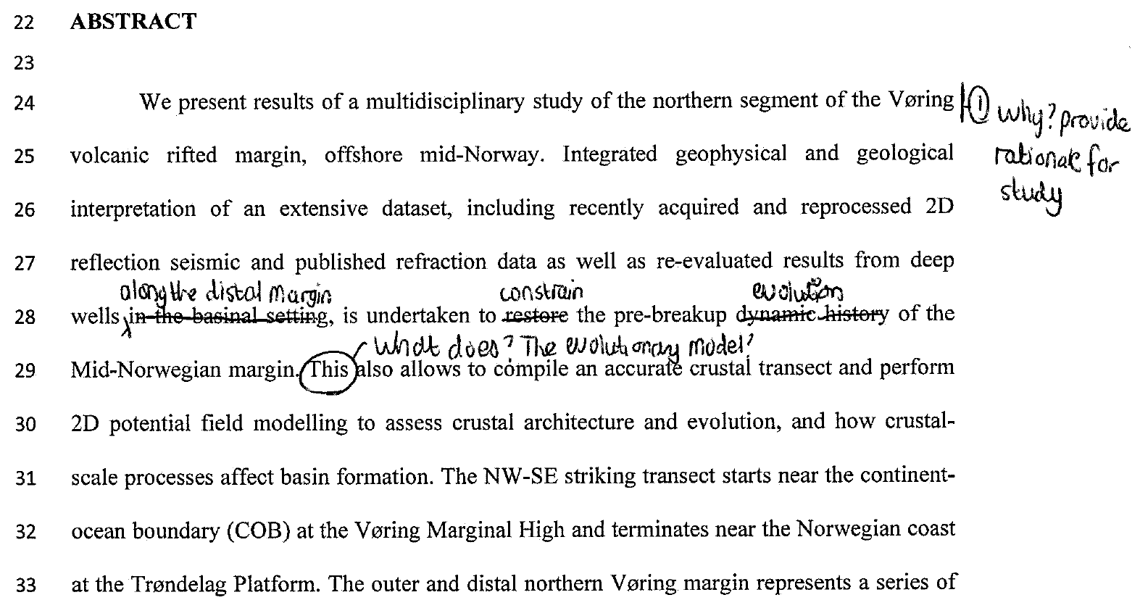
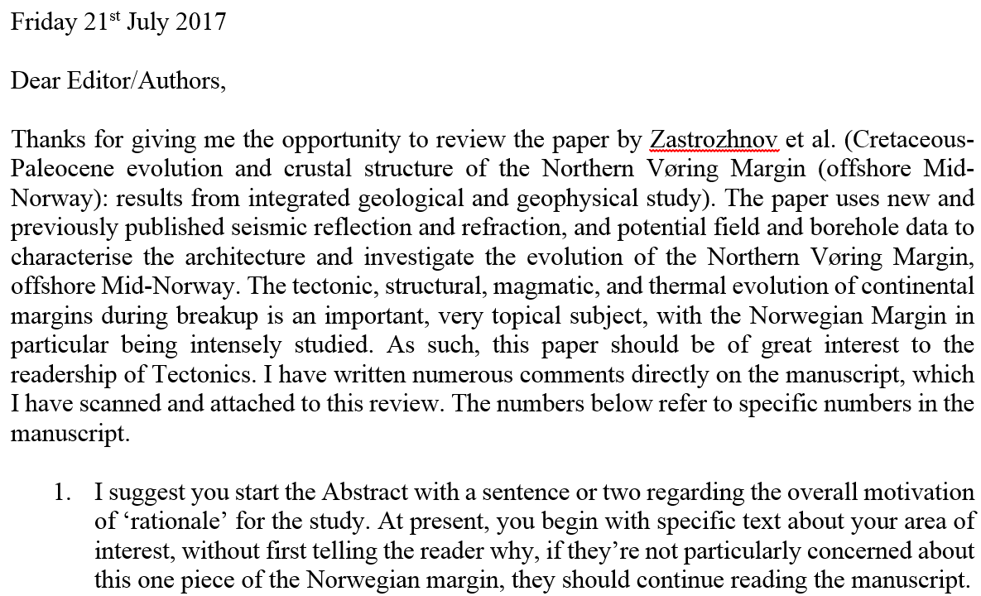
How Do I Write My Review?
LOGISTICS (N.B. the physical review can take MANY forms!):
Annotated PDF (+/- cover letter summarising main points)
Annotated hardcopy (scanned to PDF) with lengthy cover letter
Cover letter-only with call-outs to specific line numbers
STRUCTURE:
Begin the review with a general statement of your understanding of the paper and what it claims, followed by a paragraph offering an overall assessment
Specific comments on each section, listing the major questions or concerns

Slide 9
How Do I Write My Review?
Let the review experience sink in for a day or so; this may help you distinguish between major and minor issues
Be as constructive as possible; peer-review is not an opportunity to shame anyone or to show-off
Peer-review serves two purposes: (i) to help the authors improve their manuscript; and (ii) to help the Editor make a decision on whether to further consider the paper for publication
You role is to provide a neutral and balanced review of the manuscript’s strengths and weaknesses and how to potentially improve it
Language used is critical, thus write as though you are talking to the scientists in person or engaging in a post-talk Q&A; avoid rude or disparaging remarks and never use value judgments or value-laden adjectives (e.g. “lousy”, “stupid,” “incompetent”)
However, be thorough; i.e. you do the author(s) a disservice if you do not point out some part of the analysis might be “incomplete”, or that there is a “contradiction in their results”, or that “the method employed might not be optimal to achieve their aims”

Slide 10
Does It Matter How I Write My Review
Yes. Massively.
Exhibit A:

Slide 11
Should I Sign My Review?
This is highly contentious…
PROS
Promotes self-awareness: “Since obtaining tenure, I always sign my reviews. I believe it improves the transparency of the review process, and it also helps me police the quality of my own assessments by making me personally accountable.” Professor Chris Chambers, Cardiff University (in: http://www.sciencemag.org/careers/2016/09/how-review-paper)
Helps encourage positive interactions and build collaborative links:
Signed reviews may be more impactful on the authors (e.g. from someone respected in the field)
Challenges the underlying problems discussed on the following slide...
“If we don’t promote the proper actions,
we succumb to the improper ones”
(David Fernandez-Blanco)

Slide 12
Should I Sign My Review?
CONS
Unfair post-review criticism, grant/paper rejection, etc: “One academic I know – a prominent professor at a prominent university – holds absurd, petty grudges against people who have slighted him (or who he imagines have slighted him). He sometimes expresses his grudges in grossly unethical ways (e.g. by denying access to resources in the stewardship of which he’s mistakenly been entrusted with a role). When asked to review a manuscript by him, I’d refuse and tell the editor something about why.” Anon
May interfere with how a review is received: “Anonymous reviewing lets the review stand by itself. I review manuscripts written by close friends/colleagues as well as by people that don’t like me. I write fair and honest reviews; my hope is that, by being anonymous, the authors recognise this and don’t worry whether I went easy on them or was unfairly harsh.” Anon NSF postdoctoral fellow
“Avoids the authors not taking the reviews seriously because they come from a “junior” scientist (i.e. Msc/PhD/postdoc). Yet, junior scientists are often the ones giving the most detailed and careful reviews”. Anon

Slide 13
References
Peer review (Wikepedia): https://en.wikipedia.org/wiki/Peer_review
Peer review in 3 minutes: https://youtu.be/rOCQZ7QnoN0
How to review a paper: http://www.sciencemag.org/careers/2016/09/how-review-paper
Why we don’t sign peer reviews: http://www.molecularecologist.com/2014/04/why-we-dont-sign/
Why we sign peer reviews: http://www.molecularecologist.com/2014/04/why-we-sign/
Scientific peer review ca. 1945: https://www.youtube.com/watch?v=-VRBWLpYCPY

Slide 14
Author
http://www.boulderbookstore.net/event/local-author-open-house

