Slide 1
Outcomes from the PDC sessions at the Second Pan-GASS meeting
3rd Workshop on Physics Dynamics Coupling (PDC18)
12th July 2018

Slide 2
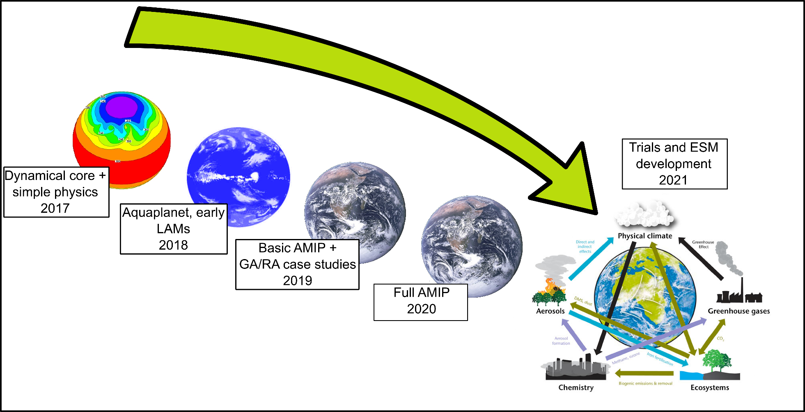
GASS
DCMIP

Slide 3
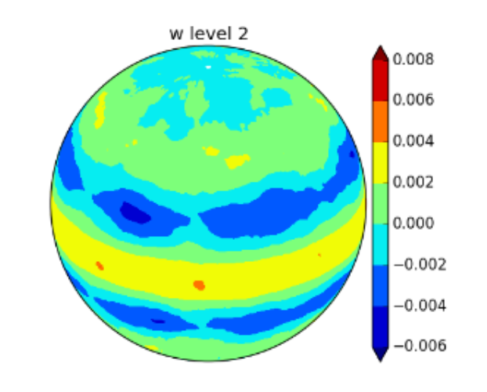
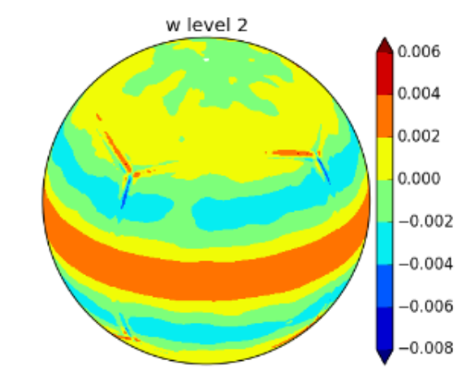

Slide 4
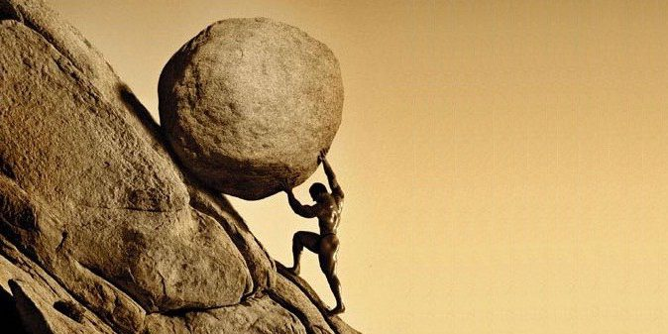
Model development is HARD
Unified Model development is REALLY HARD
Unified Earth System Model development is …

Slide 5
2001
GABLS
Global Atmospheric Boundary Layer Studies
2010
GASS
Global Atmospheric System Studies
1993
GCSS
Global Cloud System Studies
Radiation
2006
Microphysics
80s-00s
CIRC
Continuous Intercomparison of Radiation Codes
Clouds
ICRCCM
Intercomparison of Radiation Codes in Climate Models)
Boundary layer
Convection

Slide 6
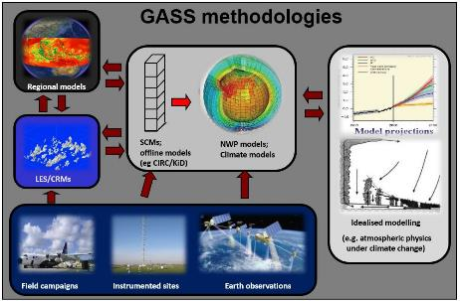
GASS provides leadership for the scientific community involved in improving the representation of atmosphere processes in weather and climate models.
through the coordination of scientific projects that bring together experts in process-modelling, observations, and the development of atmospheric parameterizations.
(All projects to date involve model comparisons)
New Chairs (2018)

Slide 7
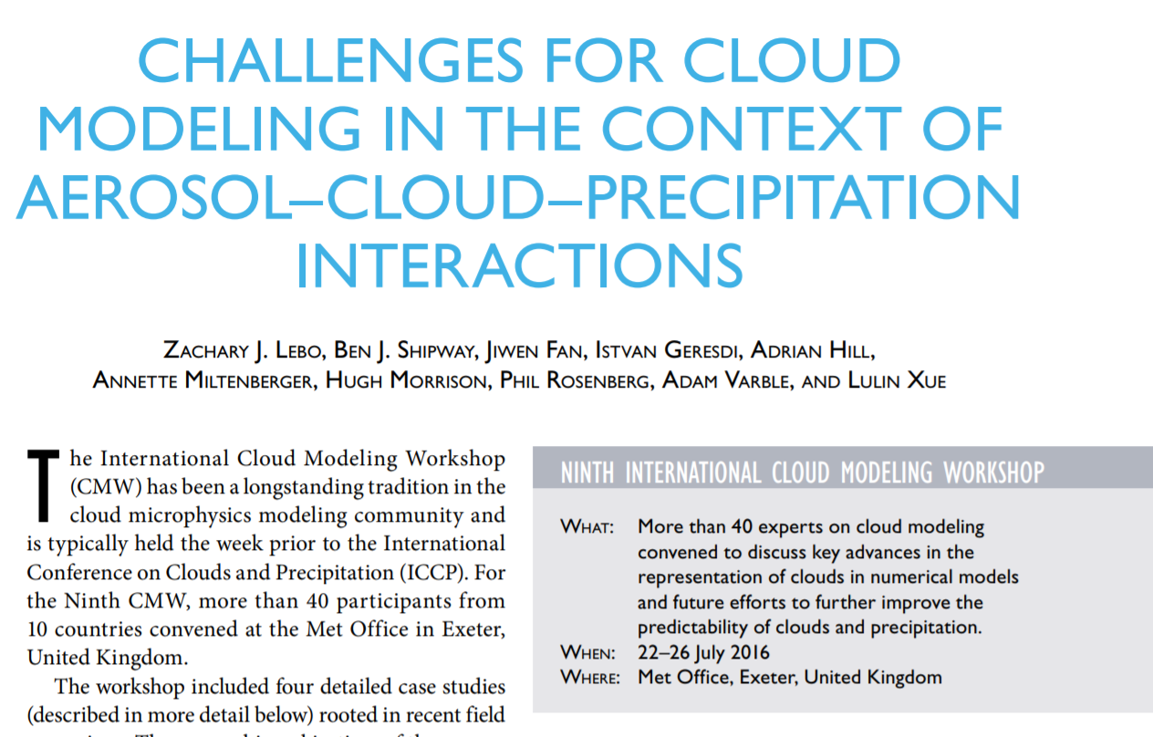
GASS projects are often collaborative with other efforts

Slide 8
Improved representation
Truncation error
Missing processes
Model Error
P-D coupling
Time

Slide 9
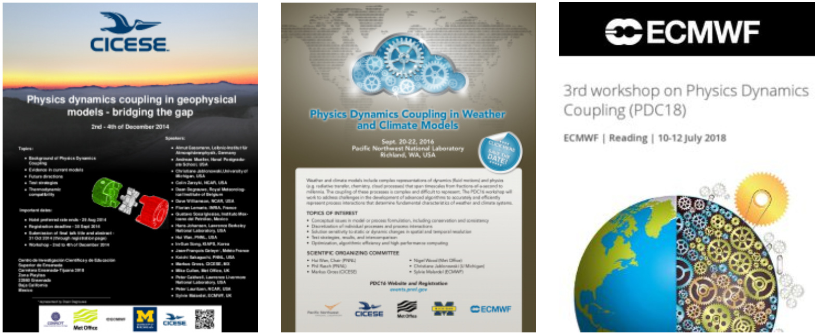

Slide 10
GASS
Physics-Dynamics Coupling
DCMIP

Slide 11
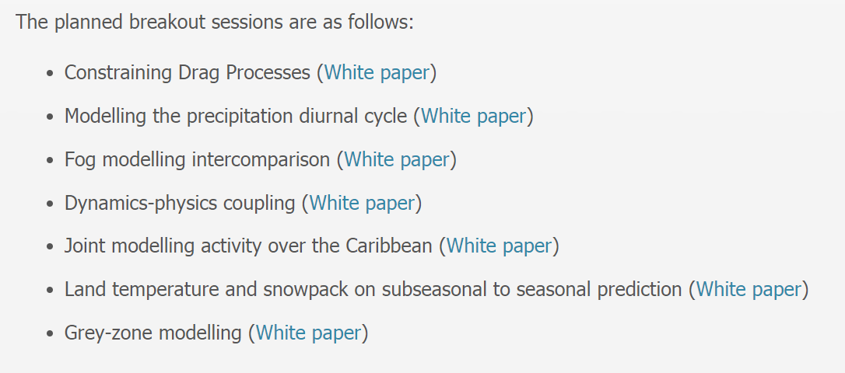
https://journals.ametsoc.org/doi/abs/10.1175/BAMS-D-18-0139.1

Slide 13
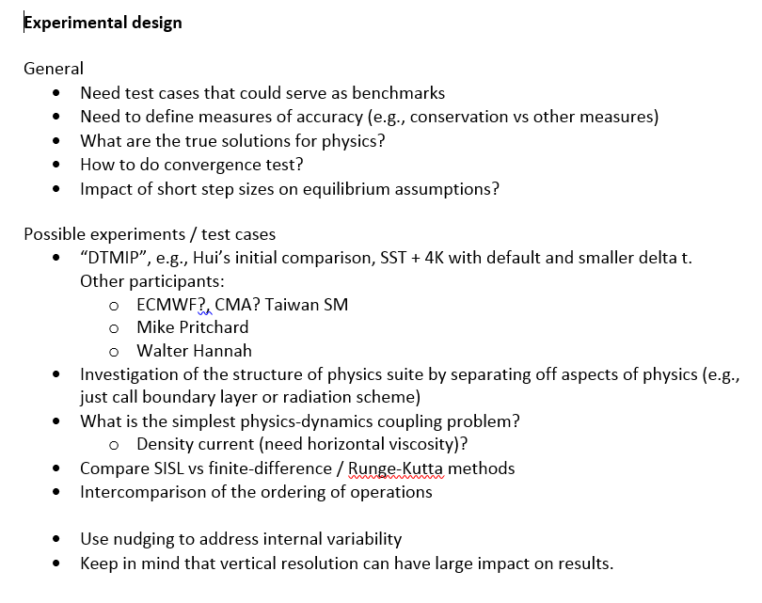
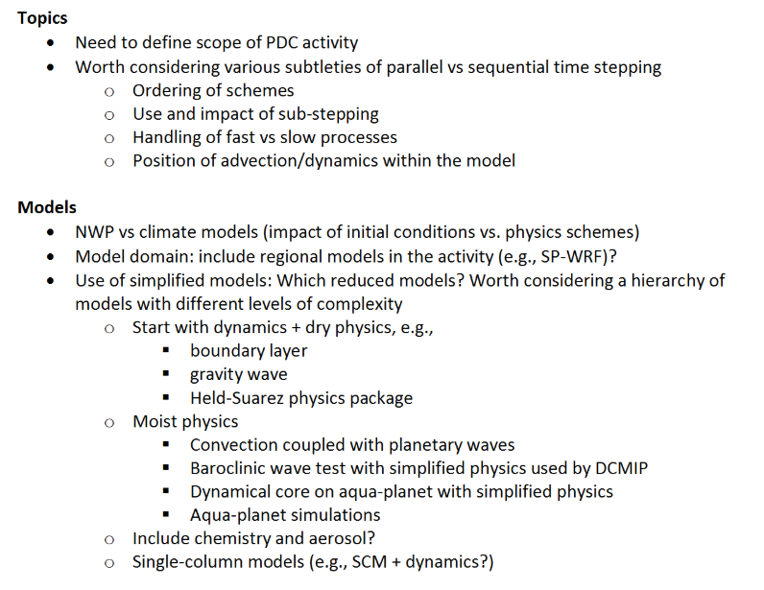
Phil’s breakout notes

Slide 14
Proposal for intercomparison work
Timeline
Confirmed participants of the first climate change simulations…exchange results at end 2018.
A survey to gauge interest in additional experimental design and analysis foci will be distributed in summer 2018
Further planning of the intercomparison will be organized at the AGU Fall meeting in 2018 and EGU General Assembly in spring 2019.
Key aims:
Design experimental and analysis methods to identify coupling issues
Promote/facilitate the evaluation of coupling methods developed by individual groups/researchers in multiple models.
Initial experimental setup
+4K climate simulations
Timestep sensitivity
Following Hui and Phil’s previous work

Slide 15
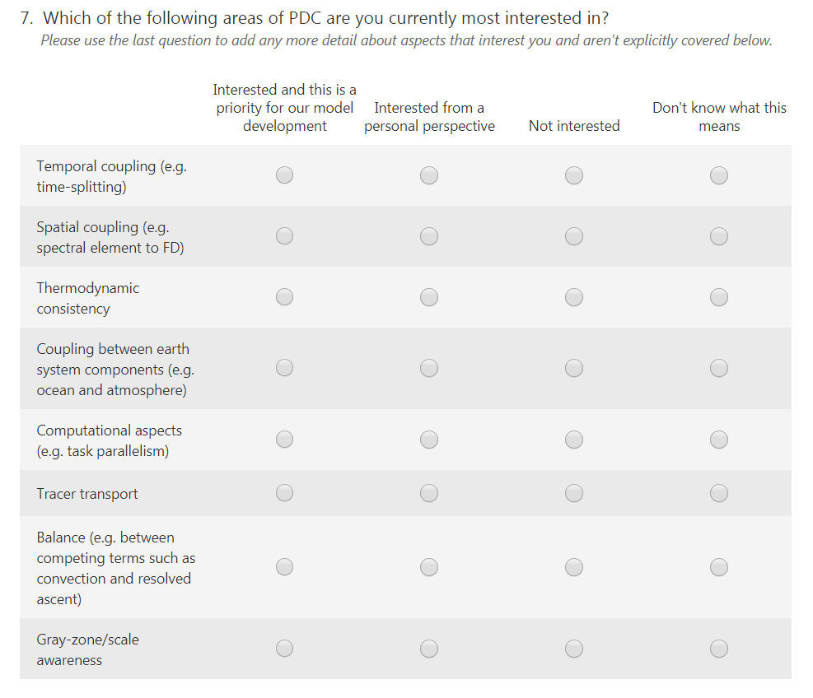
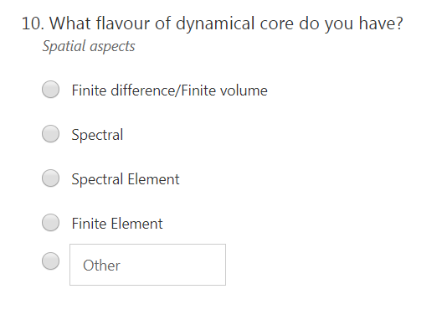
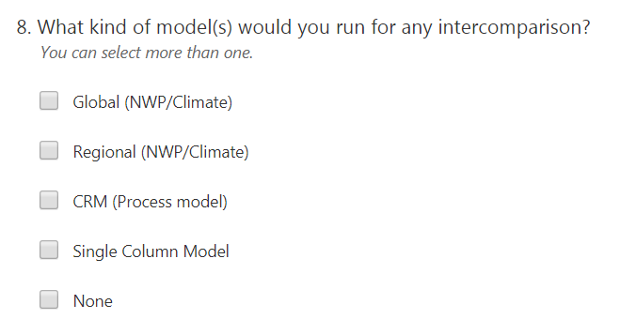
...further gathering of community requirements needed?

Slide 16
Summary
Summer 2018 (NOW): Would like to identify participants of an initial model intercomparison for +4K climate sensitivities
Summer 2018 (NOW): Gauge broader interest and start to plan follow on activities and experimental design
Meetings of opportunity: Possibly AGU (end 2018) and EGU (spring 2019)
Contact me (Ben Shipway) or Hui Wan. Sign up to GASS mailing list: https://www.gewex.org/panels/global-atmospheric-system-studies-panel/

Slide 17
Irina…

Slide 18
Constraining Orographic Drag Effects (COORDE)
New GASS/WGNE intercomparison
Run high resolution (4-9km) simulations with high resolution orography
Run high resolution simulations with low resolution orography (150/125km)
Run low resolution global simulations with parametrized orographic drag
Run low resolution global simulations without parametrized orographic drag
Difference gives the impact of resolved orography
Difference gives the impact of parametrized orographic drag
(Global or regional)
A.van Niekerk, I. Sandu and
S. Vosper
Notes:
Another impressive and in my view ground breaking piece of work is also work I’ve been doing with annelize van Niekerk and simon vosper from the metoffice – in which we used again the um lam to simulate the Himalayas at 4km resolution at which most of the effects are resolved, and we came up with the a method allowing to assess the impact on the winds (as a proxy for impact on the circulation) induced by explicitely simulating the mountain, or by using a coarse resolution mountain plus a parametrization – what you see on the left is an acceleration/respectively a deceleration of the zonal wind south/north flanks of the Himalayas when we explicitely resolve the mountain by doing the 4km simulation , and on the right the impact of using a coarse mountain like this one and a parametrization – if the parametrization would work well the middle and righ figures will look like the left one. What we find is that, while there are some similarities, they are quite different at low levels, where low-level deceleration from orography occurs. We also see some indication of gravity wave drag deceleration in the upper atmosphere but the drag from the SSO appears to be too small in the upper atmosphere. – and we showed this is has to do as much with the parametrization itself as with the coupling between the physics and dynamics. And the same stands for other resolutions used for ensemble, monthly or seasonal simulations.
This setup is now proposed as an intercomparison exercise in the framework of the gass and wgne working groups and already aroused lots of interest with participation confirmed from ….
18

Slide 19
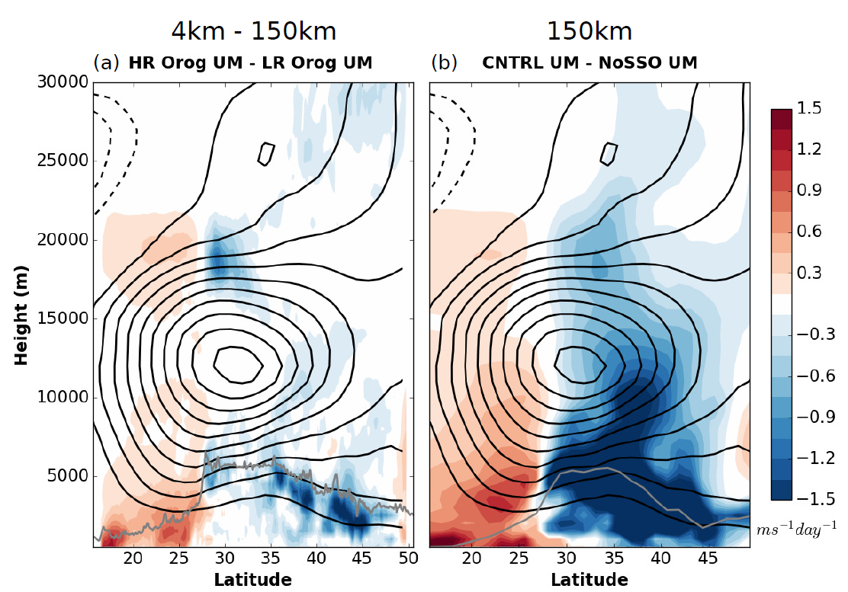
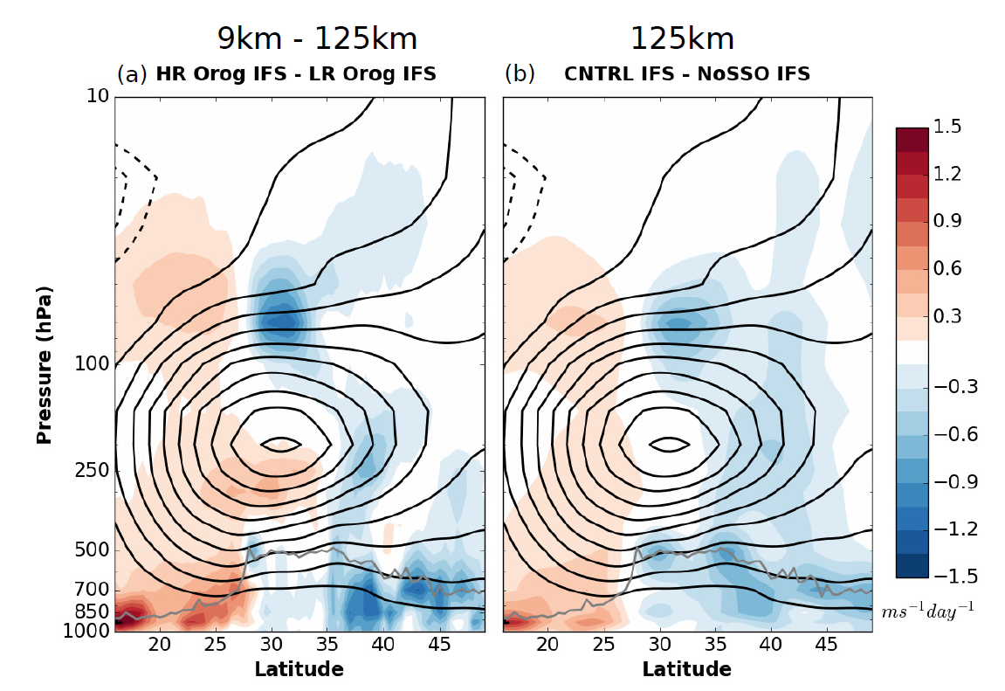
Constraining Orographic Drag Effects (COORDE)
New GASS/WGNE intercomparison
Change in winds after 24 hours due to :
explicit orography
parametrized orography
UM
IFS
A.van Niekerk, I. Sandu and
S. Vosper
Notes:
Another impressive and in my view ground breaking piece of work is also work I’ve been doing with annelize van Niekerk and simon vosper from the metoffice – in which we used again the um lam to simulate the Himalayas at 4km resolution at which most of the effects are resolved, and we came up with the a method allowing to assess the impact on the winds (as a proxy for impact on the circulation) induced by explicitely simulating the mountain, or by using a coarse resolution mountain plus a parametrization – what you see on the left is an acceleration/respectively a deceleration of the zonal wind south/north flanks of the Himalayas when we explicitely resolve the mountain by doing the 4km simulation , and on the right the impact of using a coarse mountain like this one and a parametrization – if the parametrization would work well the middle and righ figures will look like the left one. What we find is that, while there are some similarities, they are quite different at low levels, where low-level deceleration from orography occurs. We also see some indication of gravity wave drag deceleration in the upper atmosphere but the drag from the SSO appears to be too small in the upper atmosphere. – and we showed this is has to do as much with the parametrization itself as with the coupling between the physics and dynamics. And the same stands for other resolutions used for ensemble, monthly or seasonal simulations.
This setup is now proposed as an intercomparison exercise in the framework of the gass and wgne working groups and already aroused lots of interest with participation confirmed from ….
19

Slide 20
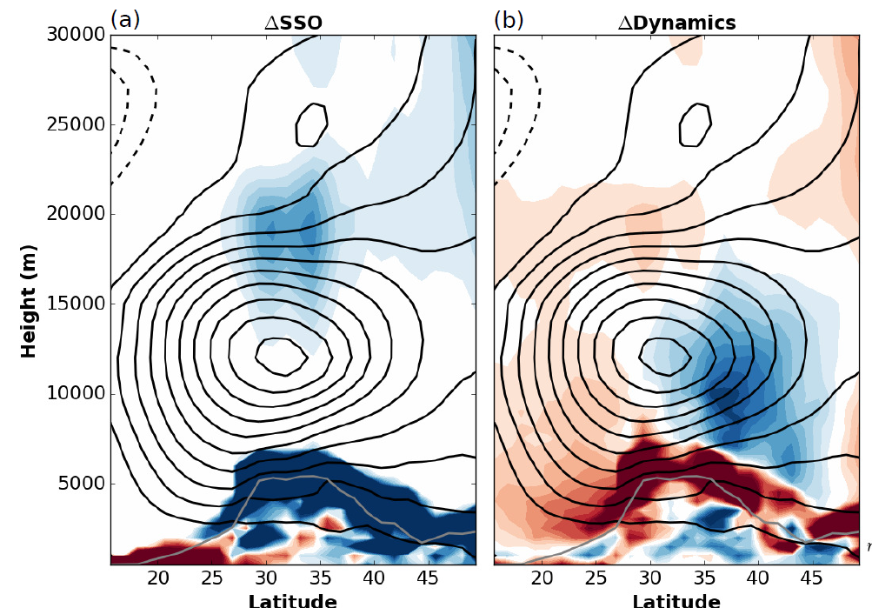
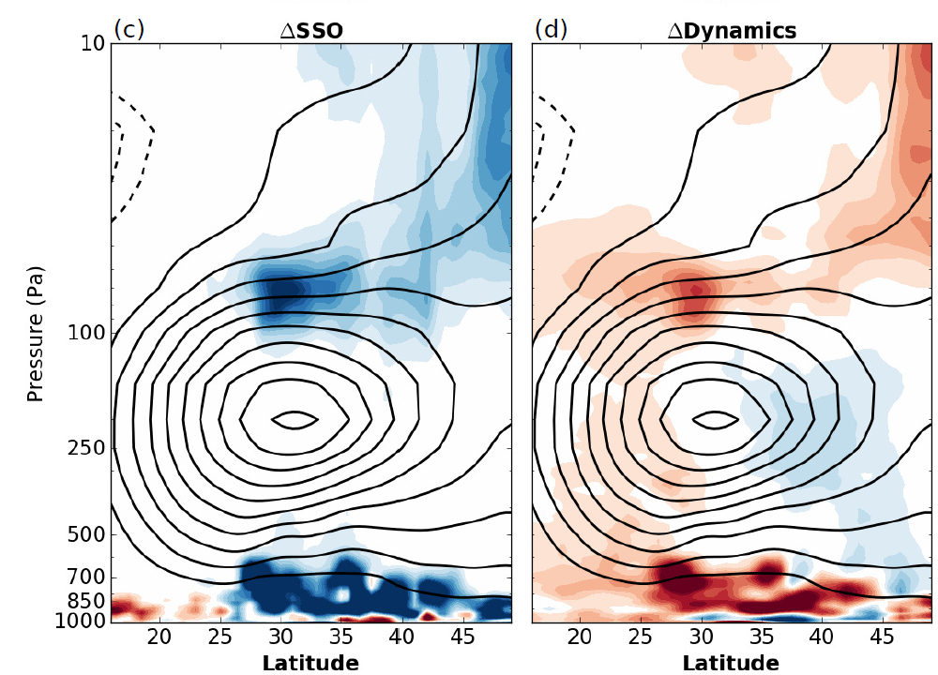
Constraining Orographic Drag Effects (COORDE)
New GASS/WGNE intercomparison
Change in winds after 24 hours due to :
Impact due to
parametrized orography
=
phys + dyn tendency
explicit orography
parametrized orography
UM
As much a parametrization problem as a physics-dynamics problem
IFS
A.van Niekerk, I. Sandu and
S. Vosper
Notes:
Another impressive and in my view ground breaking piece of work is also work I’ve been doing with annelize van Niekerk and simon vosper from the metoffice – in which we used again the um lam to simulate the Himalayas at 4km resolution at which most of the effects are resolved, and we came up with the a method allowing to assess the impact on the winds (as a proxy for impact on the circulation) induced by explicitely simulating the mountain, or by using a coarse resolution mountain plus a parametrization – what you see on the left is an acceleration/respectively a deceleration of the zonal wind south/north flanks of the Himalayas when we explicitely resolve the mountain by doing the 4km simulation , and on the right the impact of using a coarse mountain like this one and a parametrization – if the parametrization would work well the middle and righ figures will look like the left one. What we find is that, while there are some similarities, they are quite different at low levels, where low-level deceleration from orography occurs. We also see some indication of gravity wave drag deceleration in the upper atmosphere but the drag from the SSO appears to be too small in the upper atmosphere. – and we showed this is has to do as much with the parametrization itself as with the coupling between the physics and dynamics. And the same stands for other resolutions used for ensemble, monthly or seasonal simulations.
This setup is now proposed as an intercomparison exercise in the framework of the gass and wgne working groups and already aroused lots of interest with participation confirmed from ….
20

Slide 21
Constraining Orographic Drag Effects (COORDE)
New GASS/WGNE intercomparison
Change in winds after 24 hours due to :
Impact due to
parametrized orography
=
phys + dyn tendency
explicit orography
parametrized orography
As much a parametrization problem as a physics-dynamics problem
New GASS/WGNE intercomparison
Confirmed participation: DWD, Meteo-France, CMC, KIAPS, NOAA/NCEP, JMA
Contact: annelize.vanniekerk@metoffice.gov.uk & irina.sandu@ecmwf.int
A.van Niekerk, I. Sandu and
S. Vosper
Notes:
Another impressive and in my view ground breaking piece of work is also work I’ve been doing with annelize van Niekerk and simon vosper from the metoffice – in which we used again the um lam to simulate the Himalayas at 4km resolution at which most of the effects are resolved, and we came up with the a method allowing to assess the impact on the winds (as a proxy for impact on the circulation) induced by explicitely simulating the mountain, or by using a coarse resolution mountain plus a parametrization – what you see on the left is an acceleration/respectively a deceleration of the zonal wind south/north flanks of the Himalayas when we explicitely resolve the mountain by doing the 4km simulation , and on the right the impact of using a coarse mountain like this one and a parametrization – if the parametrization would work well the middle and righ figures will look like the left one. What we find is that, while there are some similarities, they are quite different at low levels, where low-level deceleration from orography occurs. We also see some indication of gravity wave drag deceleration in the upper atmosphere but the drag from the SSO appears to be too small in the upper atmosphere. – and we showed this is has to do as much with the parametrization itself as with the coupling between the physics and dynamics. And the same stands for other resolutions used for ensemble, monthly or seasonal simulations.
This setup is now proposed as an intercomparison exercise in the framework of the gass and wgne working groups and already aroused lots of interest with participation confirmed from ….
21

