Slide 1
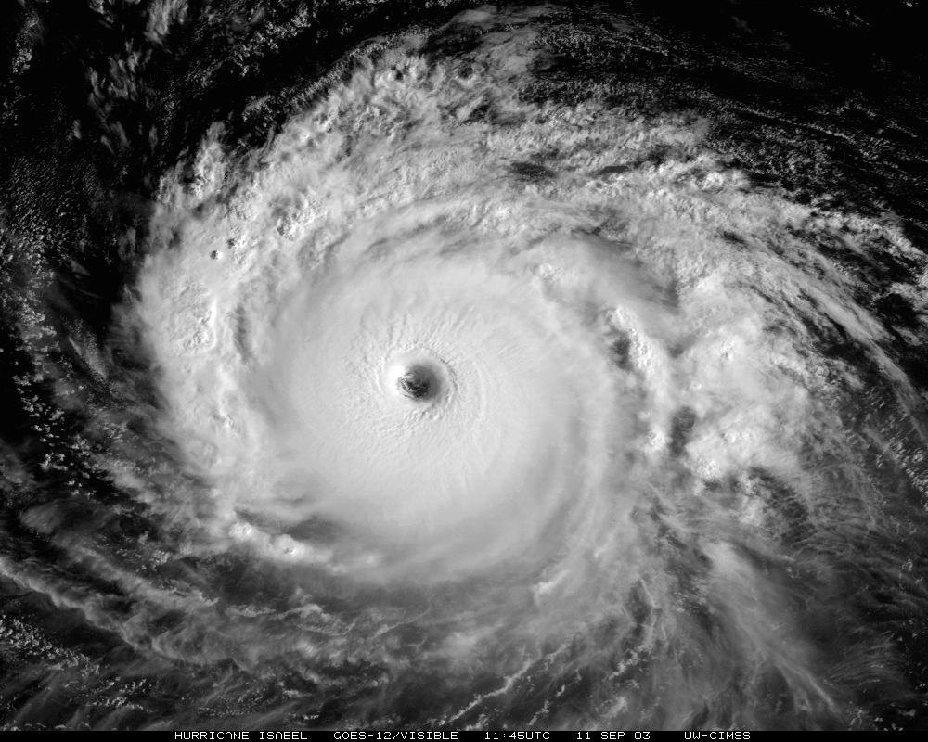
Reduced Complexity Frameworks for Exploring Physics Dynamics Coupling Sensitivities
Kevin A. Reed & Adam R. Herrington
School of Marine and Atmospheric Sciences
Stony Brook University, Stony Brook, New York, USA

Slide 2
Outline
Motivation: Extreme Weather and Climate
Resolution ⬆, better representation of:
Extreme weather events
Land-surface processes
Topography
Atm/ocn/ice/lnd interfaces
Chemical emission/transport/reactions/removal
OLR (W/m²)
4000 km
Courtesy of Colin Zarzycki (NCAR)

Slide 3
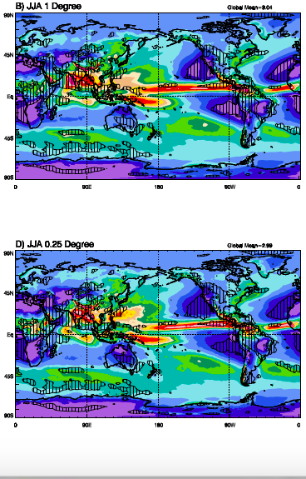
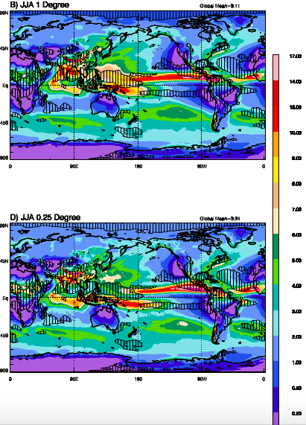
Outline
Motivation: Resolution Sensitivity in CAM
1 deg.
(100 km)
CAM4
CAM5
0.25 deg.
(25 km)
[Bacmeister et al. 2014, J. Climate]

Slide 4
Outline
Motivation: Resolution Sensitivity in CAM4
Change in
convective
precipitation
Change in stratiform
(large-scale) precipitation
[Herrington & Reed 2017, J. Climate]

Slide 5
Outline
How are GCMs evaluated? Physics-Dynamics Coupling?
Utilize a test hierarchy
Increasing Complexity
3D
Dry Dynamical Core
Test Cases
2D
Shallow Water
Test Cases
3D
Aqua-Planet
Experiment
3D
AMIP
Deterministic tests
Tests of the
statistical behavior
(model ‘climate’)
[Reed & Jablonowski 2012, JAMES]
Notes:
Simplified boundary conditions

Slide 6
Outline
Scale sensitivity in CAM5 Aqua-Planet
Temperature tendency from the physical parameterizations (black), vertical pressure velocity from the dynamical core (colors)
Magnitude of vertical velocities increase with resolution
Horizontal scale of the physics forcing decreases with resolution
[Herrington & Reed 2018, JAMES]

Slide 7
Outline
How are GCMs evaluated? Physics-Dynamics Coupling?
Utilize a test hierarchy
Increasing Complexity
3D
Aqua-Planet
+
Simplified Boundary Conditions
3D
Dry Dynamical Core
Test Cases
2D
Shallow Water
Test Cases
3D
Aqua-Planet
Experiment
3D
AMIP
Deterministic
Tests
Additional
Complexities
Tests of
Statistical Behavior
[Updated from Reed & Jablonowski 2012, JAMES]
Notes:
Simplified boundary conditions

Slide 8
Outline
Design of RCE Experiments
NCAR’s Community Atmosphere Model version 5 (CAM 5).
The SE dynamical core with 30 vertical levels is used at the horizontal resolutions of:
  ne=30 (~100 km) => with reduced Earth radius
  ne=120 (~25 km)
Full physics in Aquaplanet mode is used, with a simplified ocean covered Earth and constant SST of 29º C.
No rotation effects (i.e., 10 deg. N).
Diurnally varying, spatially uniform insolation (~340 W/m²).
No direct and indirect effects of aerosols.
  Tuning parameters are set to ne=30 configuration for all simulations.
  Such a setup mimics similar simulations with limited-area or cloud-resolving models, but at a relatively lower resolution.

Slide 9
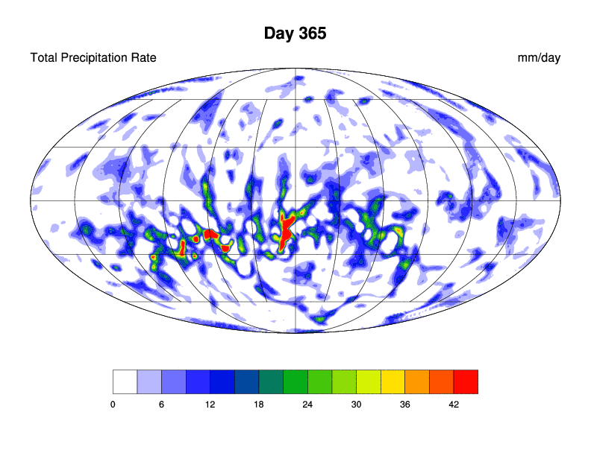
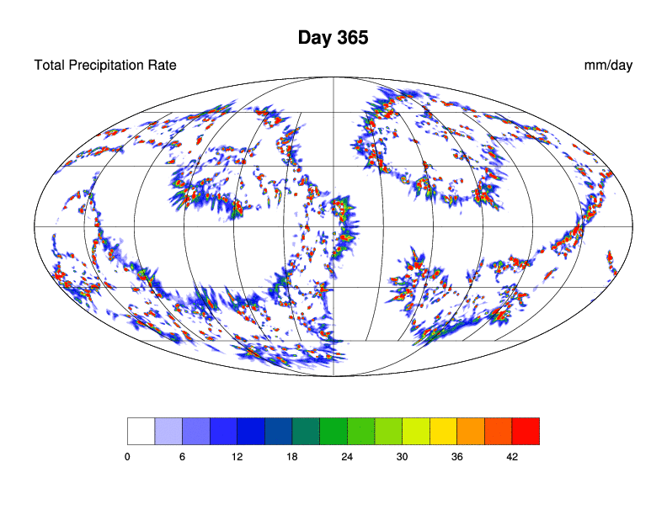
Outline
RCE: Resolution Comparison
6-hr Avg. Precipitation (mm/day)
ne30 (~100 km)
ne120 (~25 km)
[Reed et al. 2015, JAS]

Slide 10
Outline
Reduced Planet RCE: Resolution Dependence – Scale Awareness
[Reed and Medeiros 2016, GRL]

Slide 11
Outline
Reduced Planet RCE: Resolution Dependence – Scale Awareness
Ascending
Descending
[Reed and Medeiros 2016, GRL]

Slide 12
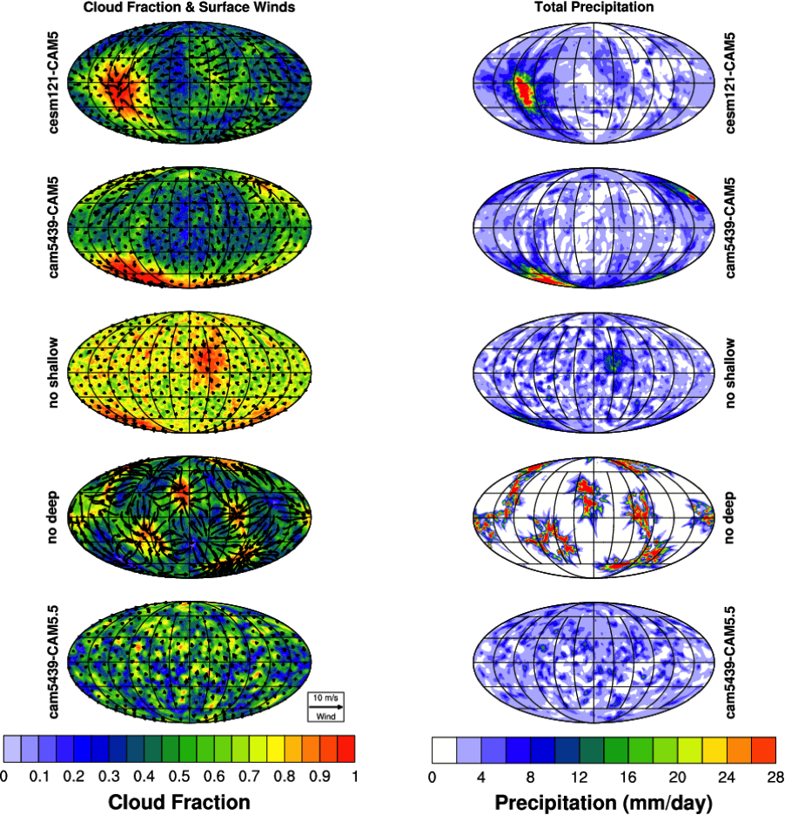
Outline
Investigate Convection Parameterizations Choices
CAM5
CAM5
No Deep
CAM6
[Courtesy of Adam Herrington]

Slide 13
Outline
How Do we evaluate GCMs?
Physics-Dynamics Coupling?
Utilize a test hierarchy
Increasing Complexity
3D
Dynamical Core
+ Moist
Simplified-Physics
Test Cases
3D
Aqua-Planet
+
Simplified Boundary Conditions
3D
Dry Dynamical Core
Test Cases
2D
Shallow Water
Test Cases
3D
Aqua-Planet
Experiment
3D
AMIP
Deterministic
Tests
Additional
Complexities
Tests of
Statistical Behavior
[Updated from Reed & Jablonowski 2012, JAMES]
Notes:
Simplified boundary conditions

Slide 14
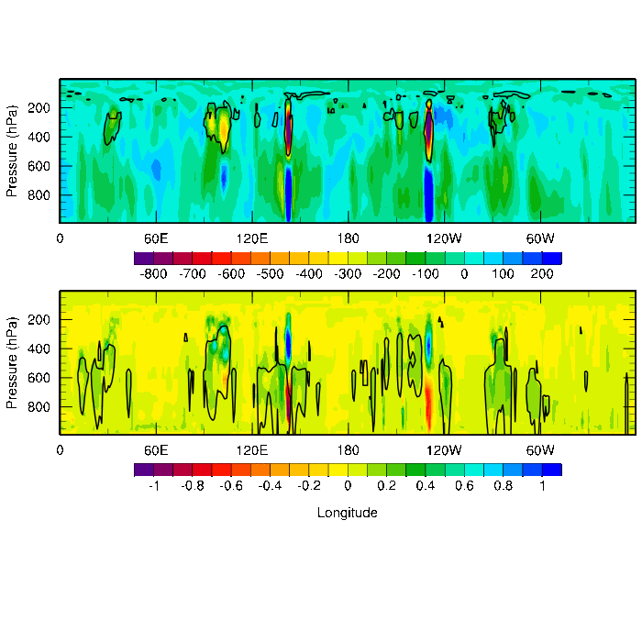
Outline
Think Back to the CAM5 Aqua-Planet
Resolved vertical pressure velocity (colors)
Potential Temperature perturbation from parameterizations (color) with Deep convective mass fluxes (black contour)
[Herrington & Reed 2018, JAMES]

Slide 15
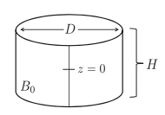

Outline
The thought....
Hypothesize D proportional to Δx in aqua-planets & and that their equilibrated solutions are described by the scaling:
W ~ 1/Δx
[modified after Jeevanjee and Romps 2015]

Slide 16
Outline
The thought....
Aqua-planet solutions
This scaling over-``predicts” the vertical velocity response to horizontal resolution on aqua-planets...
Scaled to high-res
[Herrington & Reed 2017, J. Climate]

Slide 17
Outline
Design of Idealized Bubble Experiments
NCAR’s Community Atmosphere Model version 5 (CAM 5).
The SE dynamical core with 30 vertical levels is used at the horizontal resolution of ne=30 (~100 km).
The radius of the Earth is then decreased to mimic increase resolution.
Select physics (i.e., none (dry), simple condensation, or stratiform precip only) in is used, with a simplified ocean covered Earth and constant SST of 29º C.
No rotation effects.
  Any tuning parameters are set to ne=30 configuration for all simulations.
  Such a setup mimics similar to previous work with bubble experiments, but to include moisture!
[Herrington & Reed 2018, JAMES]

Slide 18
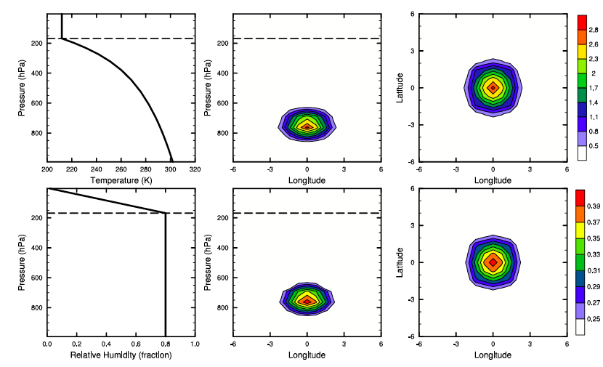
Outline
Design of Idealized Bubble Experiments
[Herrington & Reed 2018, JAMES]

Slide 19
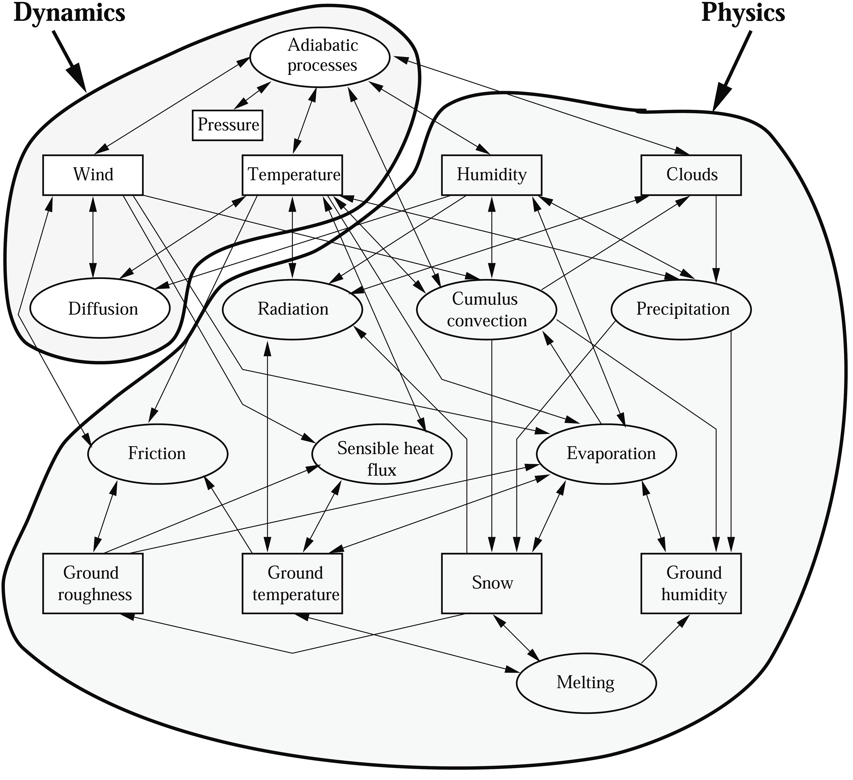
Outline
Reduced Complexity
Dynamical Core
Physics
Process
Variable
Interaction

Slide 20
Outline
Scaling with Bubble Test:
Dry and Simple Physics
RED: Consider the dry SE dynamical core only
BLUE: Couple with a large-scale condensation routine from Reed and Jablonowski 2011.
(Model the environment/bubble after aqua-planets)
The scaling works, even with moisture!!
[Herrington & Reed 2018, JAMES]

Slide 21
Outline
Test the Scaling: Choice of Physics Time-Step
Conventionally, physics packages only update the state periodically
Incrementally increase the physics time-step (dycore Δt = 75 s)
[Herrington & Reed 2018, JAMES]

Slide 22
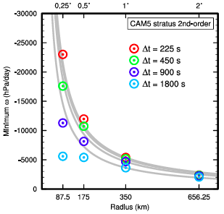
Outline
Test the Scaling: Choice of Dynamical Core
Is this sensitive to the choice of dynamical core and therefore potentially physics-dynamics coupling decisions?
Results are similar with CAM-FV core!
[Herrington & Reed 2018, JAMES]

Slide 23
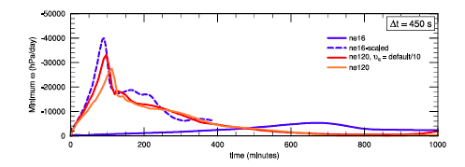
Outline
Test the Scaling: Choice of Hyperviscosity Coeficient
Recover the scaling by reducing the horizontal hyper-viscosity coefficients (for specific humidity, only).
[Herrington & Reed 2018, JAMES]
Notes:
When the ratio of the physics time-step to the dynamical core time-step is too large, numerical filters have more time to smooth specific humidity perturbations prior to passing to the condensation routine, destroying the length scale D.

Slide 24
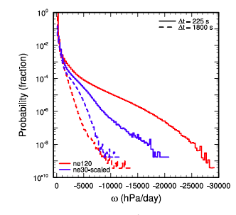
Outline
Relate back to Aqua-planet?
What if we rescale the more complex Aqua-planet simulations?
Need to build up additional complexity!
[Herrington & Reed 2018, JAMES]
Notes:
When the ratio of the physics time-step to the dynamical core time-step is too large, numerical filters have more time to smooth specific humidity perturbations prior to passing to the condensation routine, destroying the length scale D.

Slide 25
Outline
How Do we evaluate GCMs?
Physics-Dynamics Coupling?
Utilize a test hierarchy
Increasing Complexity
3D
Dynamical Core
+ Moist
Simplified-Physics
Test Cases
3D
Aqua-Planet
+
Simplified Boundary Conditions
3D
Dry Dynamical Core
Test Cases
2D
Shallow Water
Test Cases
3D
Aqua-Planet
Experiment
3D
AMIP
Deterministic
Tests
Additional
Complexities
Tests of
Statistical Behavior
[Updated from Reed & Jablonowski 2012, JAMES]
Notes:
Simplified boundary conditions

Slide 26
Outline
Simple-Physics
Dynamical Core
Physics
Process
Variable
Interaction

Slide 27
Outline
Simple-Physics Dynamical Core Comparison – Coupling Role?
Wind Speed (m/s)
At Day 10
Differing strengths and shapes:
FV & SE
at 0.25º
(≈ 28 km)
EUL & SLD
at T340
(≈ 39 km)
[Reed & Jablonowski 2012, JAMES]

Slide 28
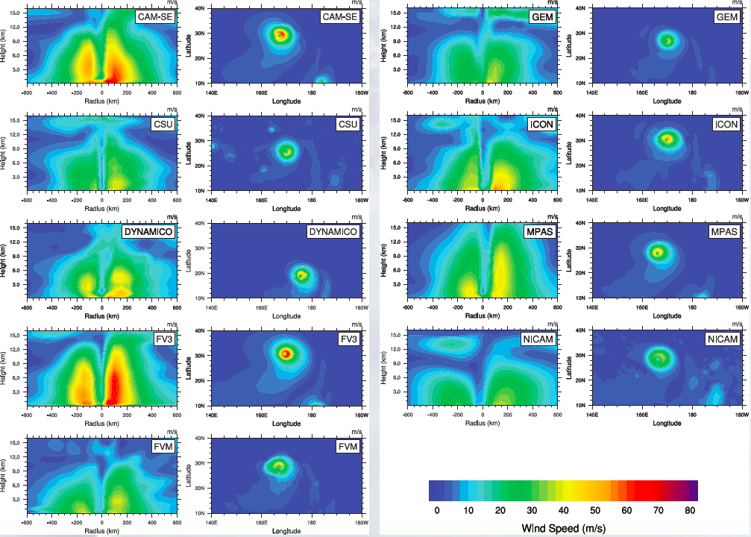
Outline
DCMIP-2016: Dynamical Core Intercomparison Project
Wind Speed (m/s)
At Day 10
Differing strengths and shapes:
Various Models
from around the world at 0.5º
(≈ 56 km)
[Reed et al. 2018, in prep. ]

Slide 29
Outline
Final Thoughts
Standard and reduced complexity CAM simulations show a sensitivity to horizontal resolution. The magnitude of this sensitivity is not expected from simple scaling arguments
Isolating interactions between a dynamical core and moisture processes using simplified physics packages can reveal aspects of the physics-dynamics coupling that impact this resolution sensitivity (i.e., coupling frequency!).
Reduced complexity testbeds are a useful tool (with quick turn around times) to test/understand physics-dynamics coupling, since they can be analyzed more easily than traditional climate modeling approaches.
kevin.a.reed@stonybrook.edu

Slide 30
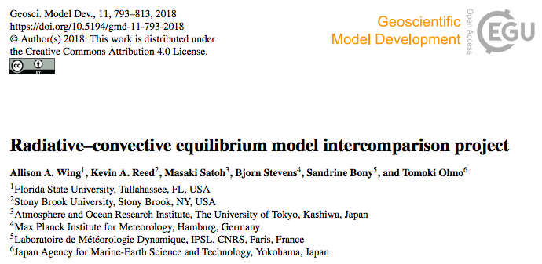

Outline
Advertisement: RCEMIP
[http://myweb.fsu.edu/awing/rcemip.html]

