Slide 1
Assessing and Improving the Numerical Solution of Atmospheric Physics in an Earth System Model
Funding for the studies presented here was provided by US DOE ‘s Office of Biological and Environmental Research and Office of Advanced Scientific Computing Research
Phil Rasch
on behalf of a SciDAC project team:
Hui Wan¹, Carol Woodward², David Gardner², Huan Lei¹, Vince Larson³, Phil Rasch¹, Balwinder Singh¹, Jeremy Sousa³, Panos Stinis¹, Nicolas Strike³, Chris Vogl², Xubin Zeng⁴, and Shixuan Zhang¹
¹Pacific Northwest National Laboratory
²Lawrence Livermore National Laboratory
³University of Wisconsin—Milwaukee
⁴University of Arizona

Slide 2
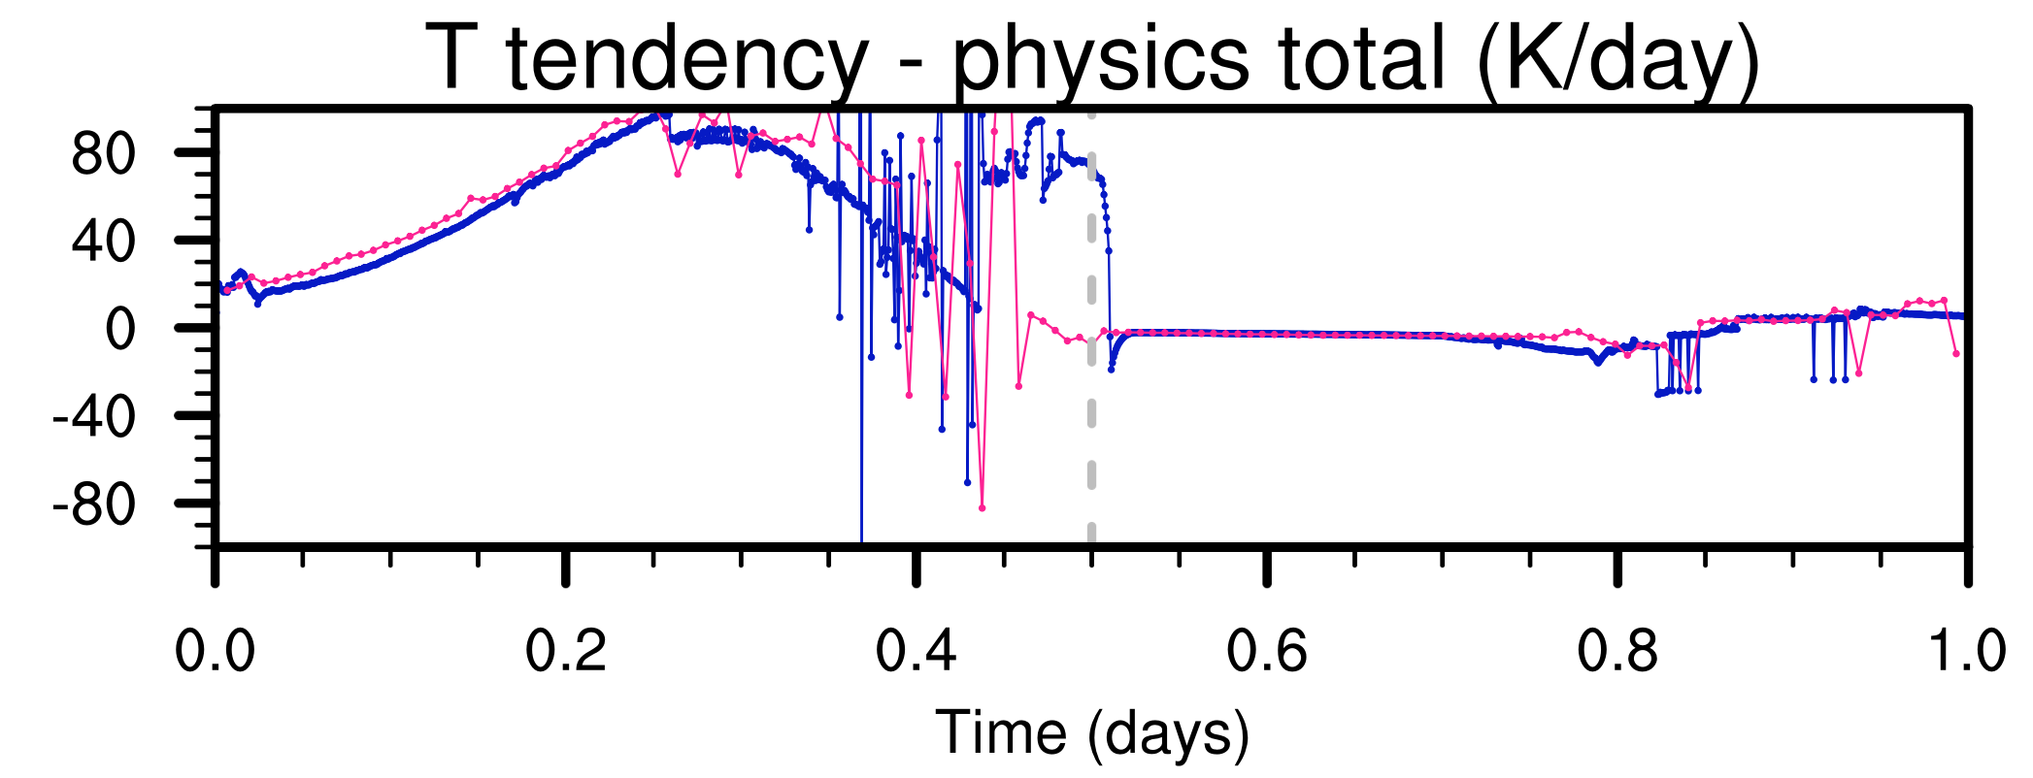




Parameterizations in AGCMs
Traditional focus on conceptualization of understanding + handling of spatial scales
Practical motivation to use longest possible time step
Ubiquitous use of clipping, limiters etc.
1-day time series of T tendency (K/day) at 700 hPa from E3SM v0 physics
∆t = 10 minutes
∆t = 1 minute
Physics parameterizations
  are known to be noisy in time (i.e., varying fast compare to dynamics)
  can be very sensitive to perturbation
Are these expected for deterministic PDE systems?

Slide 3
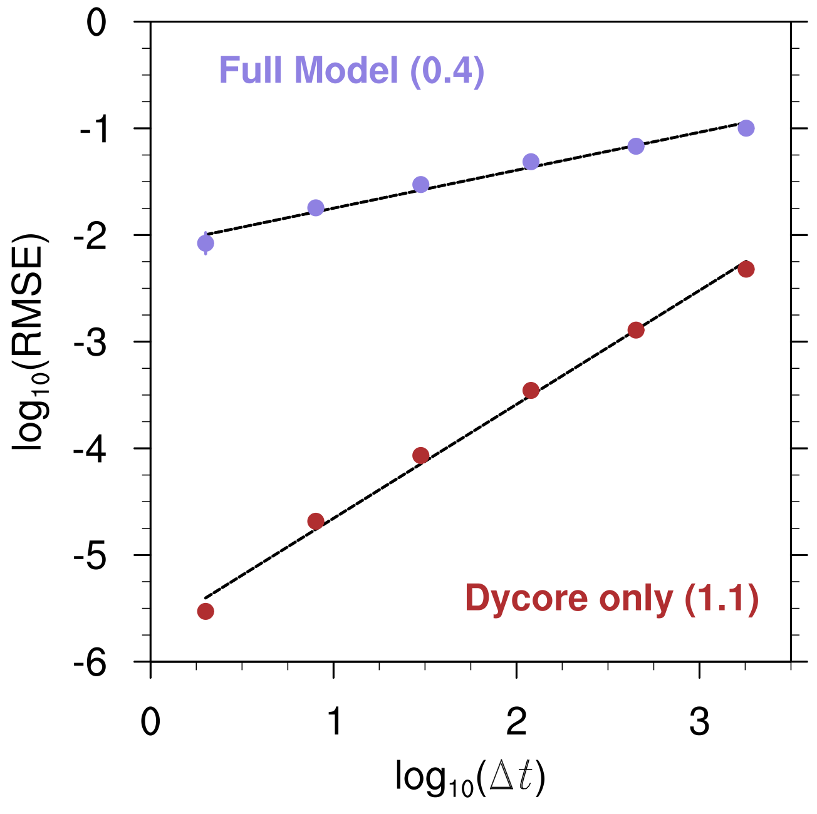
The Time-step Convergence Puzzle
Experimental design
  Very short (1-hour) simulations
  A wide range of time step sizes
  Solution with shortest step size as reference (i.e. self-convergence)
  Ensemble runs to take into account possible flow-dependency
Time Stepping Error and Convergence Rate in CAM5
Convergence rate of the full model
  Expected: 1.0
  Diagnosed: 0.4
Contrast between dynamical-core-only and full-model results
Slower convergence is associated with larger time stepping error

Slide 4
Value of Convergence Testing
For a full-fledged model with complex physics, does it make sense to talk about time-step convergence at all?
Our opinion: For very short simulations, if the solutions do not converge or converge to an unexpected state, then the equations, the discretization, and the coding need to be revisited
The next slides demonstrate that convergence testing can help identify issues in
  Model’s continuous formulation
  Physics-dynamics coupling (splitting)
  Time stepping in physics

Slide 5
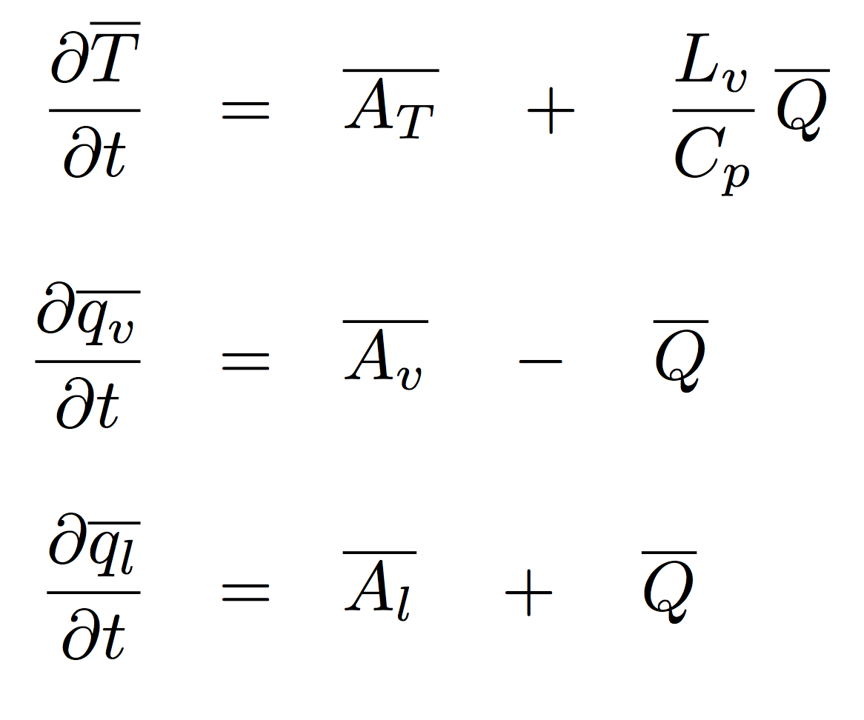
A Test Problem
E3SM’s dynamical core + a very simple parameterization
Equations directly affected by parameterizations are:
Temperature:
Physics: bare-bone version of the large-scale condensation scheme in CAM2-CAM4
(Zhang et al., 2003; Rasch and Kristjansson,1998; Sundqvist,1978)
Water vapor:
Cloud liquid:
Dynamics (advection): Spectral-element dynamical core on cubed sphere,1-degree, 30 layers

Slide 6
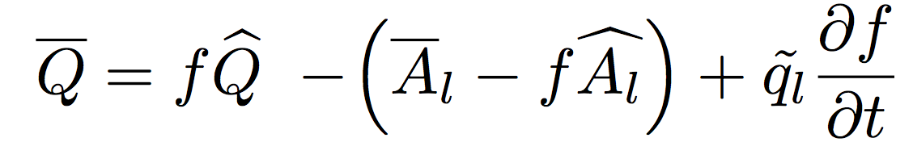
Large-scale Condensation Scheme
Basic assumptions
  Instantaneous condensation
  Fractional cloudiness
Grid-box mean condensation rate
In-cloud condensation
Clear-sky evaporation
Phase change associated with cloud fraction change
Closure assumption:
“When the cloud is growing (df/dt > 0), the new cloud water increases to match that within the cloudy part of the grid box. Conversely, when the cloud is eroding (df/dt < 0), the cloud water goes to zero in that region.”
— Rasch and Kristjansson (1998); Zhang et al. (2003)

Slide 7
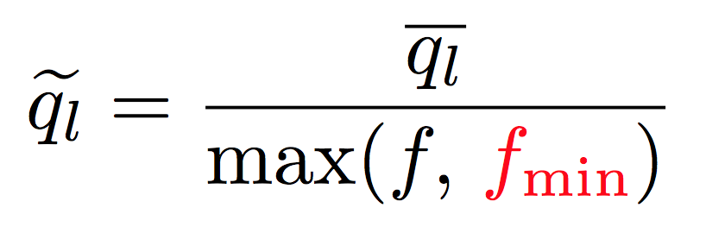
Singularity
Closure assumption
If ql > 0 but f ~ 0, we get “infinitely dense cloud” (singularity)
The use of a ”safeguard parameter” is a common remedy
… but it can hide problems
(will show ona later slide)
Does such singularity actually occur in the simulations?
Unfortunately, yes, and it affects convergence

Slide 8
Impact of Physics-Dynamics Coupling (Splitting)

Slide 9
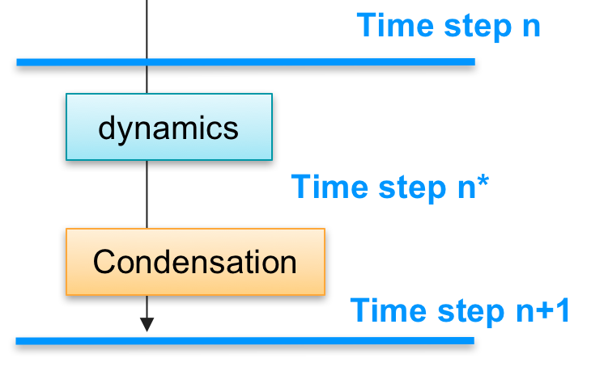
Splitting in CAM4
Physics and dynamics are sequentially split
At the intermediate step n*
  Model state is out of saturation equilibrium
  Condensation scheme is expected to bring the state back to equilibrium
  This is totally legitimate (i.e., this is how the parameterization was designed to work)
But consider this scenario:
  Advection brings liquid to a very dry cell
  Condensation scheme evaporates liquid and brings cell back to cloud-free at step n+1
  The intermediate step n* has ql > 0 and f = 0!

Slide 10
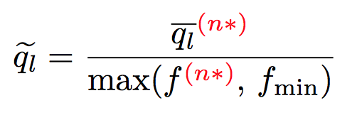
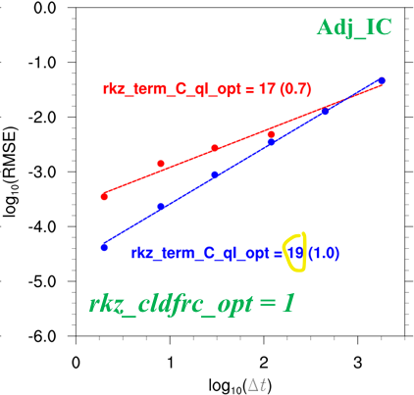
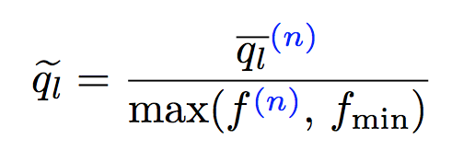
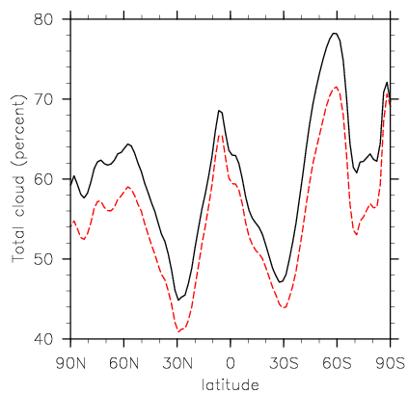
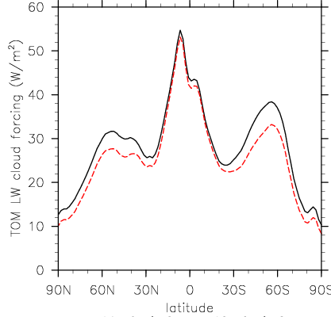
Revised Splitting for the Closure
Original implementation in e.g., CAM4:
Convergence rate in test problem
Original splitting: 0.7
Revision: use step n (in equilibrium)
Revised splitting: 1.0
Helps restore convergence in test problem
Mean climate in full-model simulations with CAM4 physics
Total cloud cover
Longwave cloud forcing
Revised splitting
Original splitting
Also has a substantial impact on model climate in CAM4!
Revised splitting
Original splitting

Slide 11

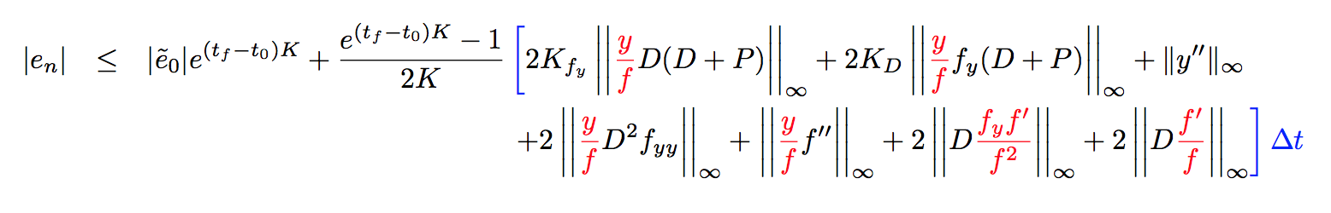
Formal Error Analysis
Impact of singularity: f = 0 can lead to unbounded solution error, hence loss of convergence

Slide 12
Impact of Model’s Continuous Formulation

Slide 13
Cause of Singularity
Disconnect between ql and f in basic model setup
  Cloud fraction based purely on RH (Slingo-type)
  Liquid concentration predicted by a separate equation
Closure assumption
Revised splitting helps, but convergence can still be lost
  Within 1 hour -- if initial condition contains singularity
  In longer simulations -- because singularity can be generated even when it does not occur in the initial conditions
Ultimate solution of convergence problem requires revision of model formulation

Slide 14
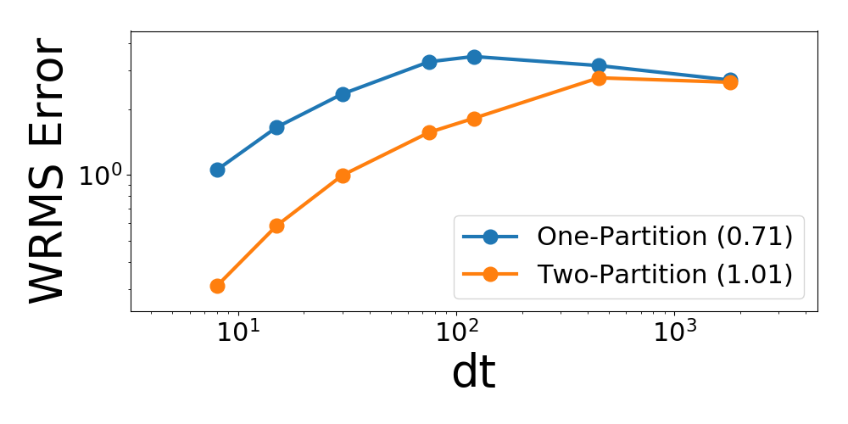
A Revised Formulation
Keeps the basic setup and assumptions
Replaced the closure assumption
Binary cloudiness (0 or 1)
Fractional cloudiness
Preliminary results:
Closure without assumption of continuity shows better convergence
Another possibility: change the basic setup, choose different prognostic variables (we are interested in exploring this option, too)

Slide 15
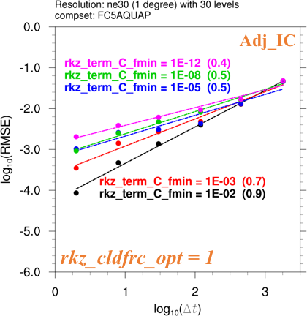
Why Is This Important?
What we encountered was essentially a “division by zero” problem, commonly encountered in, e.g.
  In-cloud hydrometeor concentrations
  In-cloud aerosol concentrations
  Skewness of sub-grid PDFs in CLUBB
Original closure assumption and splitting, poor convergence masked by large fmin
The use of the “safeguard parameter” seems to simplify life
… but it can hide problems
The revised splitting avoids sensitivity to the artificial parameter
The revised formulation does not need the parameter at all.

Slide 16
Impact of Time Stepping in Physics

Slide 17
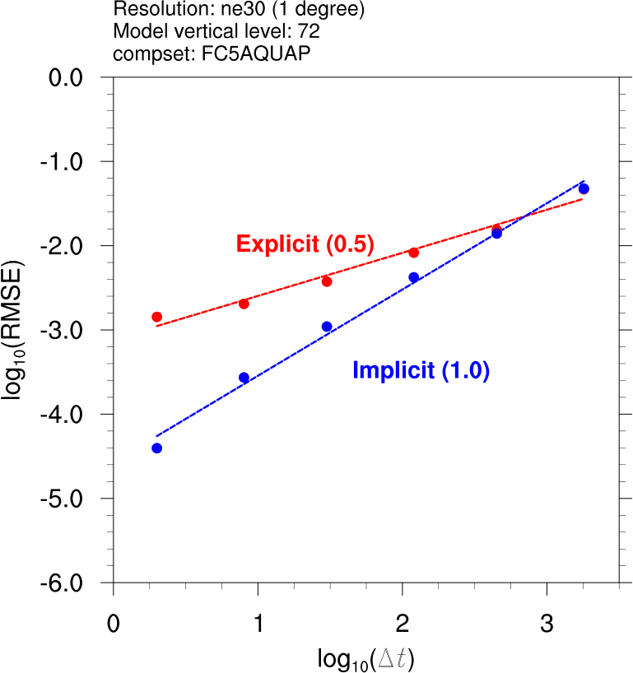
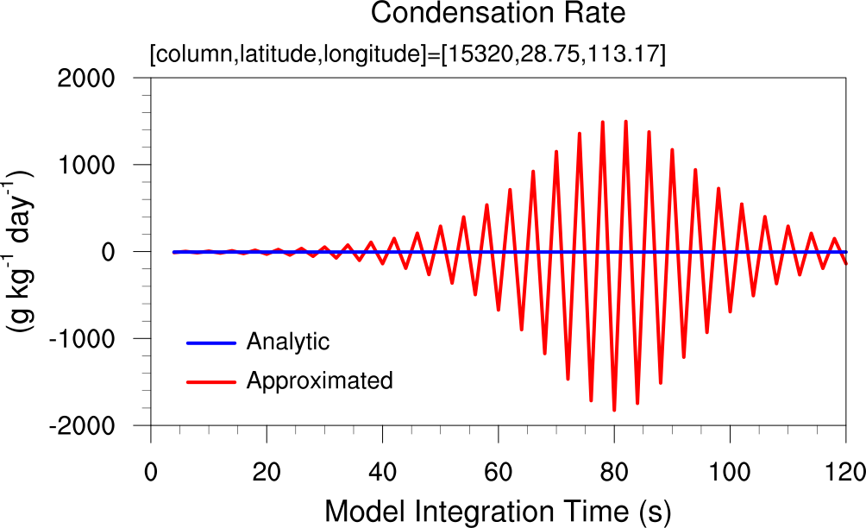
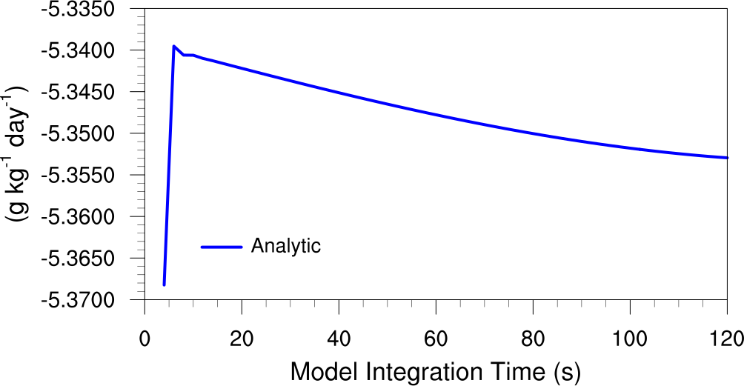
Cloud Fraction Change
Time Stepping Error and Convergence Rate
Two options based on a semi-analytic method (Zhang et al. 2003): explicit and implicit
Explicit method converges poorly and produces unphysically large oscillations
Time Series of Condensation Rate
Fast and strongly coupled processes need to be handled with care
Implicit
Explicit

Slide 18


Summary
E3SM model developers have teamed up with applied mathematicians to address the time-step convergence puzzle in the atmosphere model
First results from a simplified model demonstrate that poor convergence in short-tem simulations can be understood and improved
Poorly converging and properly converging models can produce different climate
Insights from convergence testing can help improve not only time integration but also the continuous formulation of a parameterization.
We are now working on more complex and realistic equations
(i.e., parameterizations in E3SM: CLUBB, cloud microphysics, etc.)

Slide 19
Careers at PNNL
Build your career at PNNL, one of the world’s leading institutions for atmospheric, climate, and global change research!
We’re searching for creative, ambitious, and collaboration-oriented scientists to join the Atmospheric Sciences and Global Change Division at Pacific Northwest National Laboratory. PNNL leads and contributes to a wide range of projects supported by the U.S. Department of Energy as well as other federal agencies. This includes, for example, ARM, E3SM, GCAM, and many other cutting-edge observational and modeling activities.
We are in immediate need of 10+ researchers at all career stages to build, lead, and contribute to projects spanning the atmospheric, climate, and Earth system sciences. Positions are currently available for work in a wide range of research
areas, including:
Convection and cloud physics
Aerosol observations and modeling
Aerosol-cloud interactions
Global cloud resolving modeling
Hydrology and land surface processes
Land-atmosphere interactions
Cloud observations and remote sensing
Climate dynamics and atmospheric feedbacks
Terrestrial biogeochemistry
Arctic amplification and high-latitude processes
Integrated assessment and multi-sector modeling
Software engineering to support multi-sector modeling
Contact Gary.Worrell@pnnl.gov or visit https://www.pnnl.gov/atmospheric/jobs.asp.

Slide 20
Backup slides

Slide 21
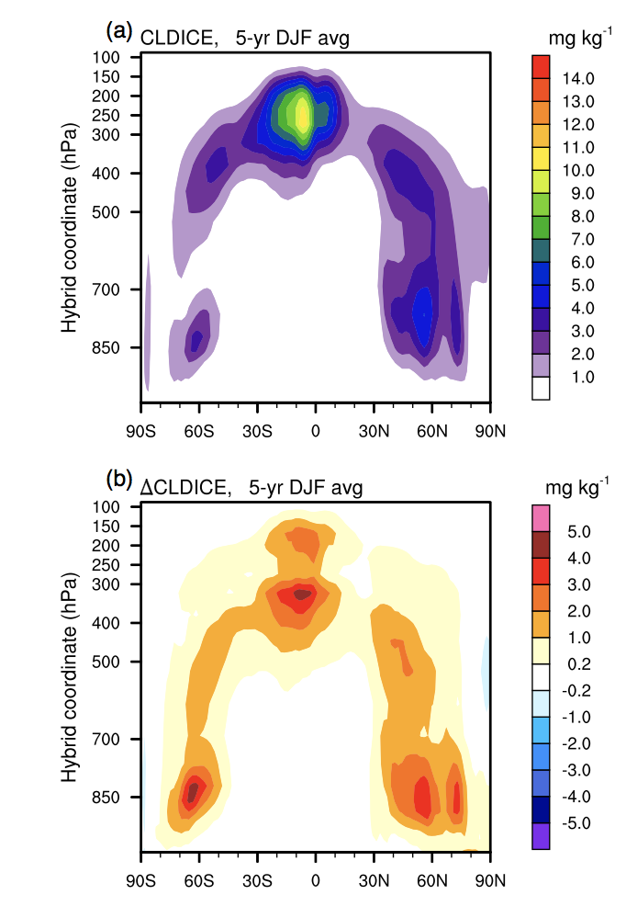
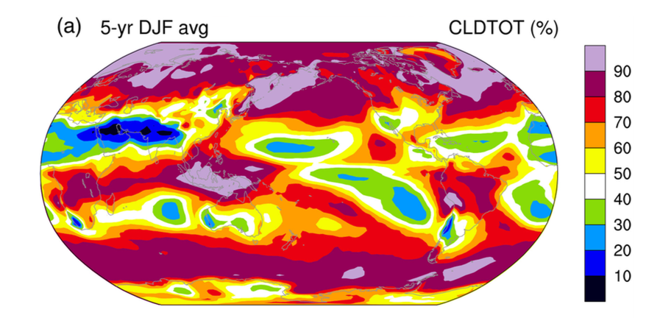
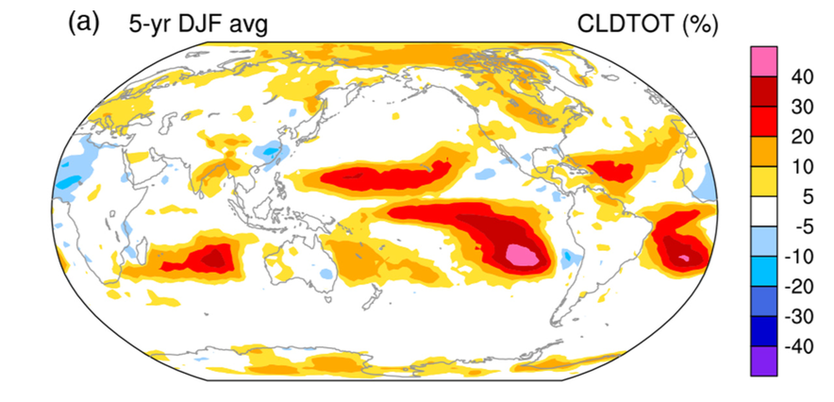
Strong Time-step Sensitivity in E3SM and Its Predecessors
Present-day climate simulated with CAM5
Cloud Ice Mass Concentration
Total Cloud Cover
Default model
(2-degree FV,
30-min step size)
∆
Difference due to reduction of step size to 4 min
Wan, Rasch et al. (2014, GMD)
E3SM v0 uses a different dynamical core but shows very similar results, indicating the issues are in the physics package

Slide 22
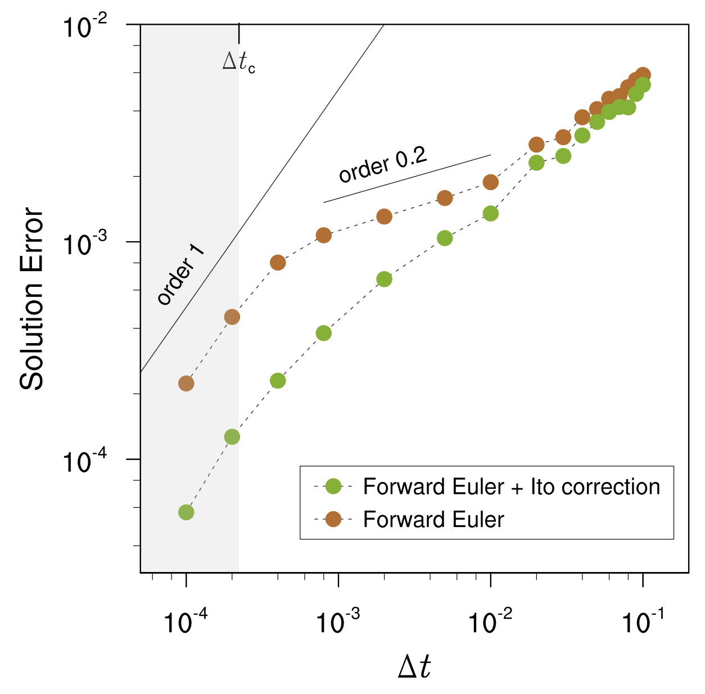
Noisy Physics
Our strategy for addressing this challenge
  Identify and remove pathological noisiness
  Apply deterministic and stochastic PDE theories to handle physical noisiness
Initial investigations into prototype problems show promising results
Time-stepping error in advection-diffusion model with colored spectrum of fast forcing
SDE work inspired by Hodyss et al. (2013, MWR)
Our first test problem:
  1D advection-diffusion equation with a wide spectrum of fast forcing
  Generalized Ito correction
  Improved accuracy and convergence

